Slide 1
Linkage Disequilibrium

Slide 2
Outline
Linkage disequilibrium (LD)
Definition of linkage disequilibrium
Importance of disequilibrium
Measures of disequilibrium
SNP selection
Public resources
Tag SNP selection programs
Imputation

Slide 3
Definitions
SNP1: rs3822050 and SNP2: rs10517002
Allele
Different versions of DNA sequence at a given location
Genotype
The two alleles in an individual at a given locus
Haplotype
A series of alleles along a single chromosome
Diplotype
a set of haplotype pairs in an individual
SNP1: C and T
SNP2: C and A
SNP1: C/C, C/T or T/T
SNP2: C/C, C/A or A/A
SNP1 SNP2 SNP1 SNP2
C C C A
T C T A
C C C A
C C C C
T C T A
C C T C

Slide 4
What is Linkage Disequilibrium?
Linkage Disequilibrium: Two loci that are in linkage disequilibrium are inherited together more often than would be expected by chance.
Zondervan & Cardon, 2004
Systematic studies of common genetic variants are facilitated by the fact that individuals who carry a particular SNP allele at one site often predictably carry specific alleles at other nearby variant sites. This correlation is known as linkage disequilibrium
The international HapMap consortium, 2005
Linkage Disequilibrium refers to the nonindependence of alleles at different sites.
Pritchard and Przeworski 2001

Slide 5
Linkage Equilibrium
SNP1 SNP2 SNP1 SNP2
SNP1: C/T
SNP2: C/A
C A C C
T C T A
haplotype frequencies in population match what is expected based on allele frequencies
Example: frequency of C-A haplotype equals frequency of C allele at SNP 1 * frequency of A allele at SNP 2
Linkage Disequilibrium
SNP1 SNP2 SNP1 SNP2
SNP1: C/T
SNP2: C/A
C A C C
T C T A
haplotype frequencies in population differ from what is expected based on allele frequencies

Slide 6
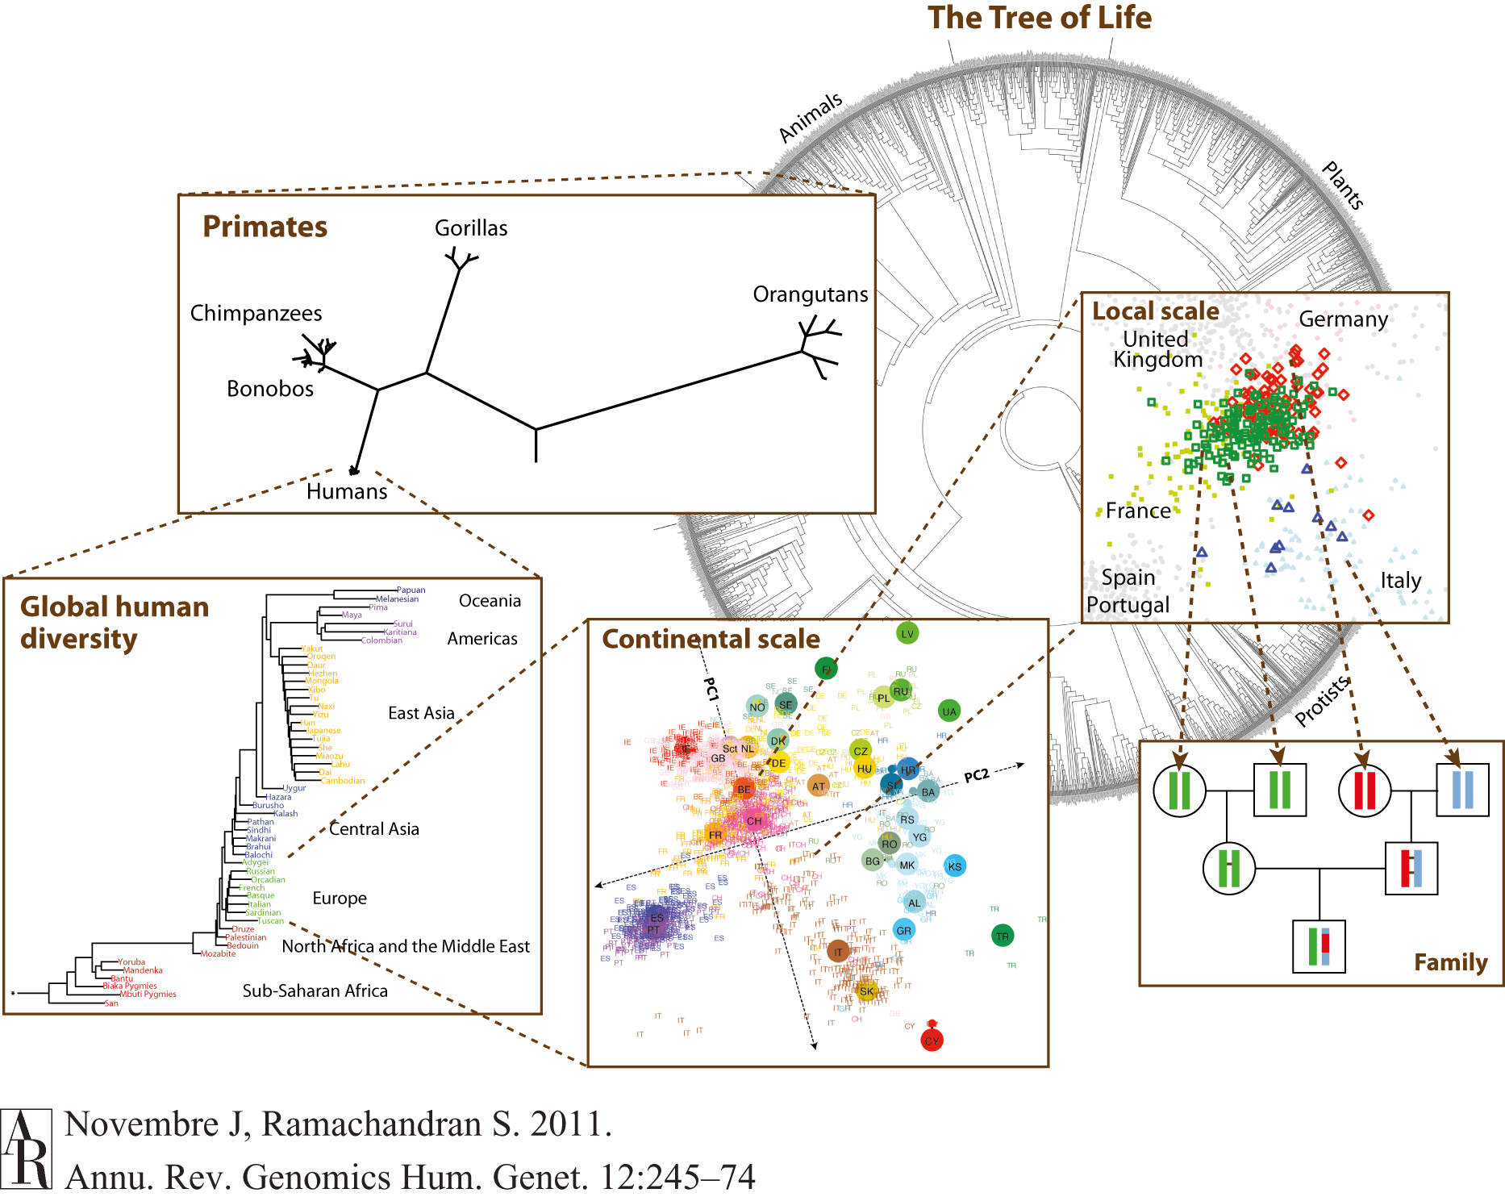
It is a Matter of Scale
"Nothing in biology makes sense except in the light of evolution”
-Theodosius Dobzhansky, 1973
Notes:
ADD EVOLUTION QUOTE

Slide 7
Current Haplotypes Arose from Ancient Mutation Events
Ancestral state has no variation at either SNP position.
Mutation leads to first SNP
Asecond mutation leads to second SNP
Recombination or recurrent mutation needed for all four haplotypes
C A
C A
T A
C A
T A
T C
T A
C A
C A
T A
T C
T C
C C

Slide 8
Haplotypes
The International HapMap Consortium. Nature | Vol 437 | 27October2005
Notes:
Luckily, because of what we mentioned earlier, chunks of chromosomes tend to stick together:
For instance, this region of chromosome 2 includes 36 SNPs:
if they were all assorting independently, there would be 2^36 possible combinations
But out of 120 chromosomes, only 7 combinations were observed
Due to the shared ancestry of contemporary chromosomes, only need to genotype 7 SNPs to study all of the variation in this region

Slide 9
Focus on Pairwise LD
A a
B p_{AB} p_{aB} p_{B}
b p_{Ab} p_{ab} p_{b}
p_{A} p_{a}
A
B
A
b
a
B
a
b
If loci are independent, then we expect
p_{AB}= p_{A}* p_{B}
p_{Ab}= p_{A}* p_{b}
p_{AB}= p_{A}* p_{B}
p_{AB}= p_{A}* p_{B}

Slide 10
Measuring LD for pairs of sites- D
A a
B p_{AB} p_{aB} p_{B}
b p_{Ab} p_{ab} p_{b}
p_{A} p_{a}
A
B
A
b
a
B
a
b
One important measure of LD is
D_{AB} = p_{AB} – p_{A}p_{B}
Notice that D=0 if and only the two sites are independent
A disadvantage of D is that the range of possible values depends greatly on the marginal allele frequencies.

Slide 11
Measuring LD for pairs of sites- D’
A a
B p_{AB} p_{aB} p_{B}
b p_{Ab} p_{ab} p_{b}
p_{A} p_{a}
Lewontin (1964) proposed an adjusted
statistic that has range [-1, 1]:
D’ = D/max(D), where max(D) is dependent on the marginal allele frequencies
If D_{AB}>0: D’_{AB} = D_{AB}/(min(P_{a}P_{B}, P_{A}P_{b}))
If D_{AB}<0: D’_{AB} = D_{AB}/(min(P_{A}P_{B},P_{a}P_{b}))

Slide 12
Properties of D’
D’ favored in medical genetics
D’=0 implies independence
|D’|<1 implies that there has been recombination between the two sites in the history of the sample (or recurrent mutation)
|D’=1| implies “complete LD”
No historic recombination
Neither site has experienced recurrent mutation or gene conversion
Genotypes not perfectly correlated (unequal allele frequency)
D’ inflated in smaller samples

Slide 13
Measuring LD for pairs of sites- r²
A a
B p_{AB} p_{aB} p_{B}
b p_{Ab} p_{ab} p_{b}
p_{A} p_{a}
Along with D’, the other most widely
used statistic is r²:
r² = D_{AB}² / (p_{A}*p_{B}*p_{a}*p_{b})
r² has range [0,1]. Its value is 1 if
just 2 of the 4 haplotypes are present.
r² is intimately connected to the power of association mapping [Pritchard & Przeworski 2001]

Slide 14
Properties of r²
r² favored in population genetics
r² =0 implies independence
r² =1 implies “perfect LD”
Marker loci have identical allele frequencies
Genotype is perfectly correlated
Related to power if (N₂=N₁/r²)
where N₁ is sample size needed for directly genotyped SNP, N₂ is sample size needed to test tagged SNP and r2 is the LD between the directly genotyped SNP and the tagged SNP).
Assume need 1,000 for directly genotyped SNP, examples of sample size needed for tagged SNPs, depending on r²
r²=1.0, N₁= N₂=1,000
r²=0.2, N₂ = 1,000/0.2 = 5,000

Slide 15
What factors affect LD?
Mutation
Historical recombination
Natural selection
Founder effects
Migration
Random drift
Population admixture

Slide 16
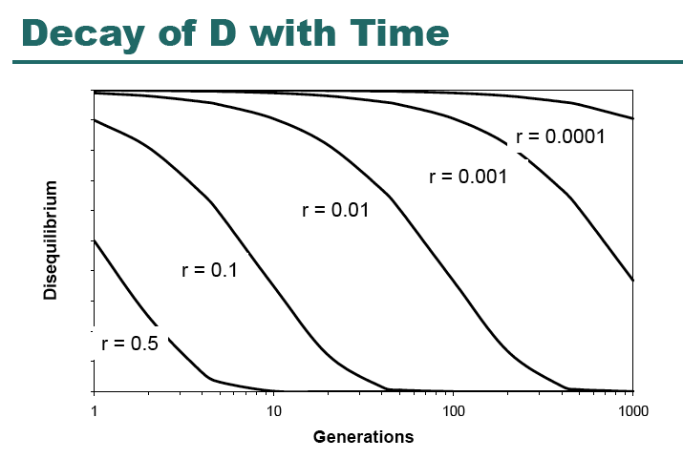
LD over time
Recombination assorts SNPs on haplotypes.
Under assumption of random mating and a large population, LD will break down over time.

Slide 17
Applications of LD
LD is the sine qua non of genetic association studies:
We are interested in testing for an association between disease status and causal mutations
If all polymorphisms were independent at the population level, association studies would have to examine every one of them.
Instead we can test a subset and get information on all of them.
LD is also used in studies of human history, natural selection and the biology of recombination

Slide 18
LD Across a Gene
Genotype at one site can predict genotype at another site
Proportion of sites
are correlated

Slide 19
SNP Selection
We use information about allele frequencies and LD across the genome to make informed choices as to which variants to genotype
Identify SNPs in region of interest
Interested in minimal set of SNPs needed to capture variation in region.

Slide 20
Identify variation for your region
Option 1: sequence individuals in your sample for the entire gene/region of interest
Option 2: sequence a subset of individuals to identify variation in your region
Option 3: Use public databases to identify known variation in your region

Slide 21
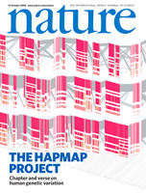
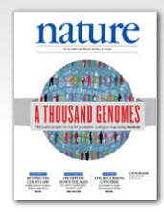
SNP Database Resources
NCBI SNP Database, dbSNP
http://www.ncbi.nlm.nih.gov/SNP/
International HapMap Project
http://www.hapmap.org/
NHLBI Program for Genomic Applications (http://www.nhlbi.nih.gov/resources/pga/)
SeattleSNPs (http://pga.mbt.washington.edu/)
InnateImmunity (http://innateimmunity.net/)
1,000 genomes project
http://www.1000genomes.org
Exome variant server (EVS)
http://evs.gs.washington.edu/EVS/
Notes:
rs522616

Slide 22
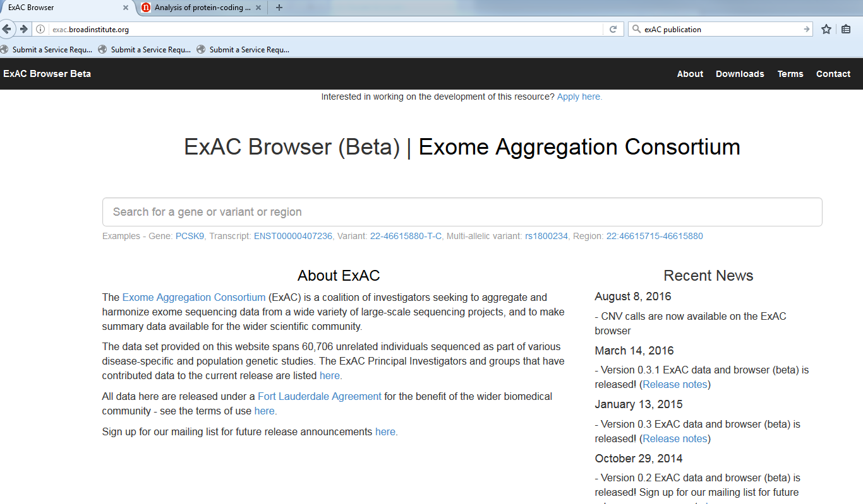
Exome Aggregation Consortium (ExAC)

Slide 23
gnomAD browser
http://gnomad.broadinstitute.org/

Slide 24
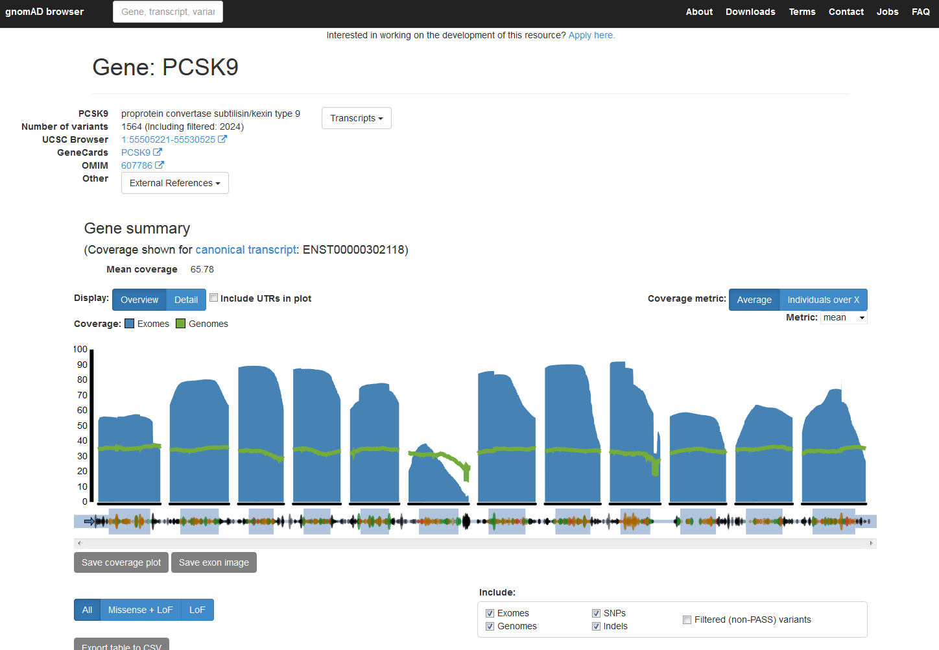

Slide 25
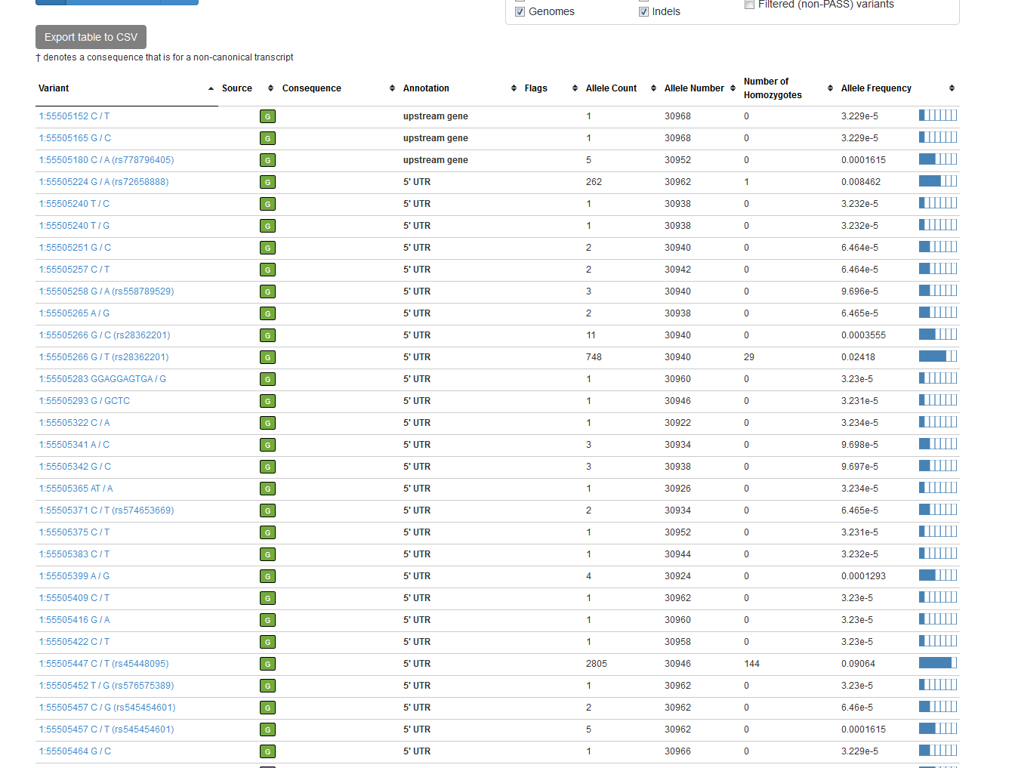

Slide 26
Tag SNPs
tagSNPs
SNPs are selected based on their pair wise ability to predict genotype of untyped SNPs
Based on an r2 concept of LD structure
Example program: LDSelect
haplotype-tagging SNPs (htSNPs)
SNPs are selected to optimize resolution of existing haplotypes
Based on a D’ concept of LD structure
Example program: Haploview, HaploBlockfinder
Multi-marker tagSNPs
Use tagSNP concept, but extend past pair wise LD
Example program: tagger

Slide 27
Tag SNPs – using r² information
A/T
1
G/A
2
G/C
3
T/C
4
G/C
5
A/C
6
Think-Pair-Share
Exercise:
Which SNPs are in high LD?
How many SNPs would you need to genotype to effectively capture the variation across the region?
A
A
G
G
G
T
G
A
C
C
C
C
C
C
C
C
T
T
A
A
G
G
C
C
After Carlson et al. (2004) AJHG 74:106

Slide 28
Tag SNPs – using r² information
A/T
1
G/A
2
G/C
3
T/C
4
G/C
5
A/C
6
Tags:
Test for association:
A
A
G
G
G
T
G
A
C
C
C
C
C
C
C
C
T
T
A
A
G
G
C
C
After Carlson et al. (2004) AJHG 74:106

Slide 29
Tag SNPs are Population Specific
European-Americans
CRP
African-Americans
CRP

Slide 30
Limitations of tag SNPs
Ultimately, we are interested in identifying common polymorphisms that are causally associated with disease risk, we cannot determine if signal is from the tagSNP or from a correlated SNP.
What happens if your tagSNP fails in the genotyping/QC stage?

Slide 31
Imputation
We also use LD information to impute genotype information.
Common example is in genome-wide association studies.
Example: SNPs on a GWAS chip can be used to infer information on all variants in HapMap and 1000 genomes data
Recent literature focuses on appropriate reference populations (see for example Eur J Hum Genet. 2015 Jul;23(7):975-83. )

Slide 32
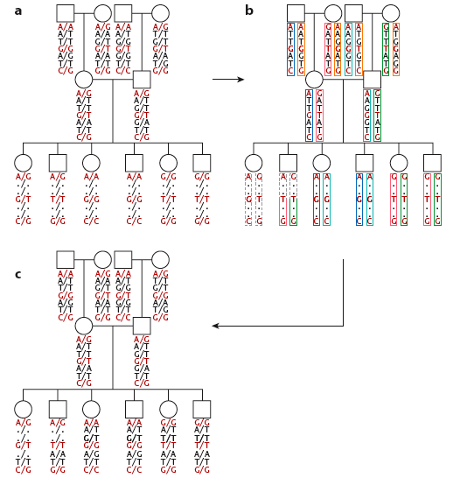
Imputation with family data

Slide 33
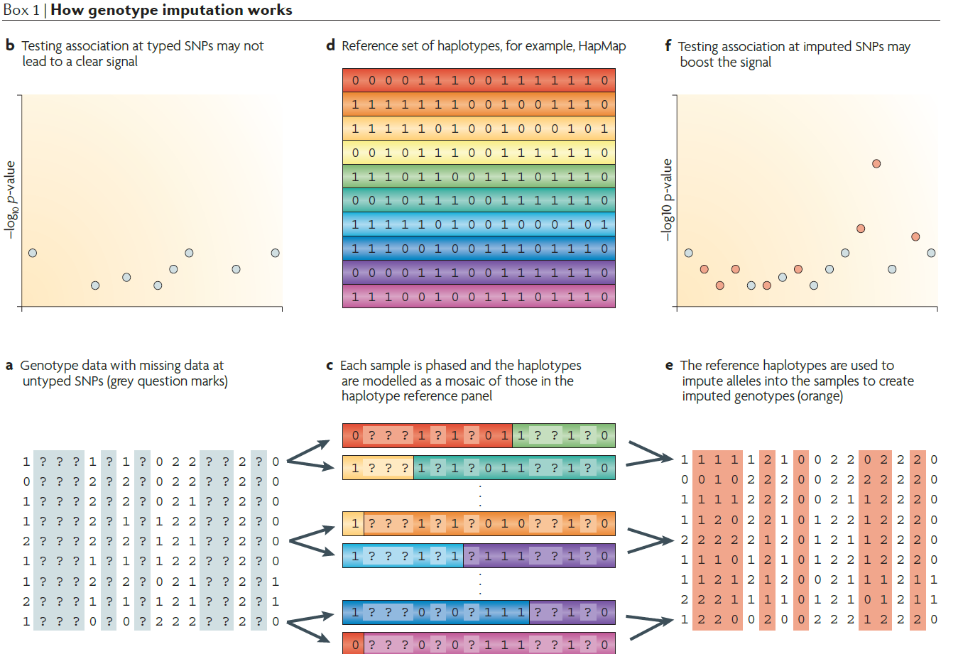
Imputation with Population Data
Nature Reviews Genetics 11, 499-511 (July 2010)

Slide 34
Imputation Programs
IMPUTE2
http://mathgen.stats.ox.ac.uk/impute/impute_v2.html
Beagle
http://faculty.washington.edu/browning/beagle/beagle.html
MaCH/minimac
http://genome.sph.umich.edu/wiki/MaCH:_1000_Genomes_Imputation_Cookbook
http://genome.sph.umich.edu/wiki/Minimac

Slide 35
Example MaCH
Uses a hidden Marcov-model
Iteratively update the phase of each individuals genotype data conditional on haplotype estimates of other samples.
G_{i} is the observed genotype of individual i,
D_{-i} is estimated haplotypes of all other individuals
Z are the hidden states
θ is the crossover parameter between hidden states
η is the error parameter

Slide 36
Imputation Output
A “best guess” genotype (i.e. TT)
Probability of each genotype (i.e. pr(TT), pr(TA), pr(AA))
A “dosage”. If T is 0 and A is 1, then people are on a scale from 0 to 2 (where 0=TT, 1=TA and 2=AA).
dosage=pr(TA)+2*pr(TT)
A quality score (typically an “information” or r2 measure) that captures the uncertainty in the imputation.

Slide 37
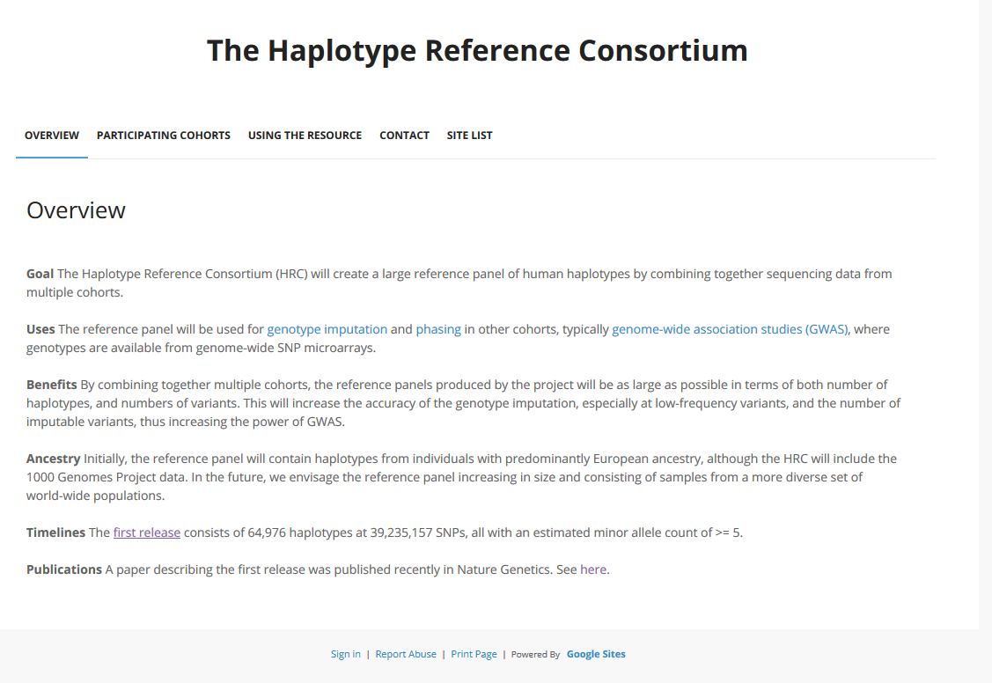
Haplotype Reference Consortium
http://www.haplotype-reference-consortium.org/

Slide 38
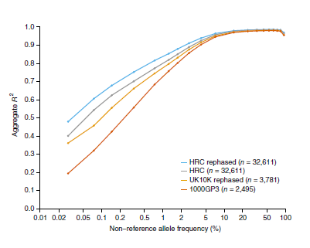
Haplotype Reference Consortium

Slide 39
Summary
Linkage disequilibrium (LD) refers to the nonindependence of alleles at different sites in the genome
LD is shaped by population genetic forces
We exploit LD information in genetic epidemiology
Selecting tagSNPs for association studies
Imputation in GWAS studies
LD complicates interpretation of association studies

Slide 40
Tag SNPs – using r² information
A/T
1
G/A
2
G/C
3
T/C
4
G/C
5
A/C
6
Tags:
SNP 1
SNP 3
SNP 6
3 in total
Test for association:
SNP 1 captures 1 & 2
SNP 3 captures 3 & 5
SNP 6 captures 4 & 6
A
A
G
G
G
T
G
A
C
C
C
C
C
C
C
C
T
T
A
A
G
G
C
C
high r²
high r²
high r²
After Carlson et al. (2004) AJHG 74:106

Slide 41
Picking tag SNPs using multimarker r2
A/T
1
G/A
2
G/C
3
T/C
4
G/C
5
A/C
6
Tags:
SNP 1
SNP 3
2 in total
Test for association:
SNP 1 captures 1+2
SNP 3 captures 3+5
SNP 1 and 3 in combo also captures 4 and 6
A
A
G
G
G
G
G
T
T
G
G
A
C
C
C
C
C
C
C
C
C
C
C
C
T
T
A
A
A
A
G
G
G
C
C
C
http://www.broad.mit.edu/mpg/tagger
Notes:
Back to our tagging cartoon. When you look a little bit more carefully, you can see that the AG haplotype predicts the A allele of SNP 6 (and therefore also the T allele of SNP4). Here’s an opportunity to reduce the genotyping cost by just typing 2 SNPs instead of 3, as long as we remember to test the AG haplotype to capture SNPs 4 and 6. Also, just to emphasize, this tagging method is not dependent on block definitions. (There are several limitations of block-based methods (1) what do you do with the interblock SNPs? (2) there may still be considerable LD ebtween blocks (again that depends on how you defined them)). This method is now part of the Haploview program that you can download from our website.

