Slide 1
Genetic Epidemiology
Introduction
Karen L. Edwards, Ph.D.
Professor
Department of Epidemiology and
Genetic Epidemiology Research Institute
School of Medicine
University of California, Irvine
Irvine, CA

Slide 2
Big Picture Learning Objectives
Familiarity with major study designs used in genetic epidemiology
Familiarity with major issues associated with each approach
Aware of software and web resources used in genetic epidemiology

Slide 3
Course Learning Goals/Objectives
Define genetic epidemiology
Describe the fundamental concepts critical to genetic epidemiology
Describe the major study designs used in genetic epidemiology
Be able to collect family health information and draw a pedigree using a software program
Be familiar with resources and current technology used in genetic epidemiology
Be able to read and discuss the relevant literature

Slide 4
Lecture Outline
Introduction to Genetic Epidemiology
Define genetic epidemiology
Terms and concepts important in genetic epidemiology
http://www.genome.gov/Glossary/
http://www.cdc.gov/excite/library/glossary.htm
Overview of study designs
Collecting family history information and pedigree drawing

Slide 5
Genetic Epidemiology
How would you define Genetic Epidemiology
How does it differ from Epidemiology

Slide 6
Genetic Epidemiology
Goals
To discover and characterize genetic susceptibility to health and disease in human populations
To identify interactions between genetic and environmental factors
Use family based studies and studies of unrelated individuals
Apply principals of epidemiology, biostatistics and genetics/genome science
Rapidly evolving field

Slide 7
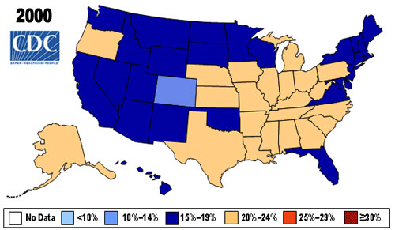
Percent of Obese (BMI > 30) in U.S. Adults

Slide 8
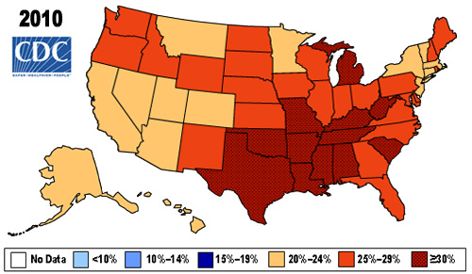
Percent of Obese (BMI > 30) in U.S. Adults

Slide 9
Percent of Obese (BMI > 30) in U.S. Adults

Slide 10
Genetic Epidemiology
Exposure Disease/Outcome
Genotype
Phenotype

Slide 11
Phenotype and Genotype
Phenotype and Genotype are the key components in genetic epidemiologic studies
Phenotype (trait) – observed characteristics that are usually the focus of a genetic epidemiologic study
Not always a direct reflection of genotypes
Examples: Blood pressure, body weight, cholesterol level, eye color, heart disease, diabetes, Parkinson’s disease, cancer, longevity
Quantitative vs. qualitative (discrete) trait

Slide 14
Chromosomes, DNA, Genes
Chromosomes are made up of DNA and are long strands of “genes”
Humans have about 20,000 genes in their genome
Genes have both coding (exon), noncoding (intron) and regions upstream that affect expression (promoter region)
Promoter region – a sequence of DNA found near beginning of a gene and needed to turn a gene on or off
Exons – contain stretches of DNA that code for proteins
Introns come in between the exons – intervening sequences, do not code for proteins
Genes control growth, development, health and disease
Genes are turned on and off in different patterns and at different stages of development = gene regulation

Slide 15
Genotype
The unique genetic information of an individual
Each gene has its own specific location on the chromosome
Genes come in pairs, one version of each gene is inherited from your mother and one from your father (allele)
Variations in the underlying DNA can result in differences between individuals, and may underlie a specific phenotype
Different ways of measuring the genotype and alleles
Single nucleotide polymorphism – most SNPs are not themselves functional, but mark the functional variations that affect disease risk
Sequencing is now common
Factors that affect the expression of the gene (such as environment) are also important to consider (Gene x environment (GxE))

Slide 16
Genotype
Each person inherits 1 chromosome from their biologic father and one from their biologic mother
23 pairs of chromosomes (a total of 46 chromosomes)
22 of the pairs look the same in males and females
The sex chromosomes differ in males (X, Y) and females (X, X)
Genotype – the unique genetic information from an individual
The genetic contribution to the phenotype
Genotype can refer to a collection of genes or the two alleles of a particular gene
Humans have about 20,000 genes

Slide 17
A pair of chromosomes
Body weight gene (alleles b and B)
b
B
Genetic Markers – known locations

Slide 18
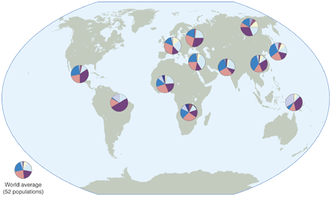
Allele frequencies vary across populations
Humans on the move. Worldwide genetic variation at a neutral marker. Allele frequencies of one randomly chosen microsatellite marker reveal common alleles shared in all populations and the gradual and arbitrary differences in allele frequencies across geographic regions. Populations shown in this example are Yoruba and Bantu (Africa); French, Russians, Palestinians, and Pakistani Brahui (Eurasia); Han Chinese, Japanese, and Yakut (East Asia); New Guineans (Oceania); and Maya and Karitianans (America). From King and Motulsky (2002), Science, 298: 2342-2344.

Slide 19
Identifying genetic effects: Overview

Slide 20
Approaches to understanding genetic influences: Overview of Genetic Epidemiologic Studies
Question | Approach
Is there evidence for genetic influences on a quantitative trait? | Commingling
Is there familial aggregation? | Family Study
Is the familial aggregation caused by genetic factors? | Twin Study
Is there a major gene? Is it dominant or recessive ? | Segregation Study
Where is this major gene in the human genome? | Linkage Analysis
Is there linkage with DNA markers under a specific genetic model? | Parametric Approach
Is there an increased allele sharing for affected relatives (sib pairs) or for relatives with similar phenotype | B. Allele Sharing Approach (sib-pair analyses)
Where is the exact location of this gene and which polymorphism is associated with disease? | Association Study (population and family)
Notes:
Iin this slide talk about next we will look at assoc studies – before we conduct assoc studies we usually have some indication that the trait we are interested in has some evidence for genetic influences

Slide 21
Most human traits have a skewed distribution – which could be consistent with a genetic effect
Body weight as our example
500
Observed frequency of individuals
250
100
10
50
200
400
600
Body weight (lbs)
of US Adults

Slide 22
Basic idea behind Commingling Analysis:
If a single gene has an effect on the variation in a quantitative trait (body weight), each genotype has a particular distribution associated with it
The overall population distribution results from the commingling of these genotype-specific sub-distributions
Assume a gene with alleles B and b: have 3 possible genotypes in the population:
BB - homozygous
Bb - heterozygous
bb - homozygous

Slide 23
A pair of chromosomes from an individual person
Body weight gene (alleles b and B - heterozygous)
b
B

Slide 24
Is the frequency distribution of body weight consistent with the influence of a gene with either dominant or recessive effects?
Frequency
BB, Bb
bb
Body Weight

Slide 25
Commingling Analysis Summary:
Why is it used: To provide preliminary evidence for a single gene that influences a quantitative trait (e.g. body weight, blood pressure, cholesterol level, blood glucose level).
A statistical modeling approach that does not measure the genotype, but assumes genetic principals in the model
Unrelated individuals – faster and easier

Slide 26
Overview of Genetic Epidemiologic Study Design
Question | Approach
Is there evidence for genetic influences on a quantitative trait? | Commingling
Is there familial aggregation? higher risk in relatives of cases | Family Study
Is the familial aggregation caused by genetic factors? MZ twins concordance rate or correlation higher than DZ twins | Twin Study
Is there a major gene? Is it dominant or recessive ? | Segregation Study
Where is this major gene in the human genome? | Linkage Analysis
Is there a linkage with DNA markers under a specific genetic model? | Parametric Approach
Is there increased allele sharing for affected relatives or for relatives with similar phenotype | B. Allele Sharing Approach (sib-pair analyses)
Where is the disease causing gene and which polymorphism is associated with disease? | Association Study (population and family-based)
Notes:
Iin this slide talk about next we will look at assoc studies – before we conduct assoc studies we usually have some indication that the trait we are interested in has some evidence for genetic influences

Slide 27
General comments about twin studies
One of the first approaches used to evaluate evidence for genetic influences on traits
Evaluate both genetic and environmental influences on traits
Measure of interest is the heritability of the trait
Proportion of total variance in the quantitative trait due to additive genetic effects
Population specific
Evaluate evidence for genetic influences on different types of traits
qualitative traits – diabetes
quantitative traits – blood glucose

Slide 28
A twin approach to unraveling epigenetics Jordana T. Bell and Tim D. Spector Trends Genet. 2011 March ; 27(3): 116–125.
Abstract
The regulation of gene expression plays a pivotal role in complex phenotypes, and epigenetic mechanisms such as DNA methylation are essential to this process. The availability of next generation sequencing technologies allows us to study epigenetic variation at an unprecedented level of resolution. Even so, our understanding of the underlying sources of epigenetic variability remains limited. Twin studies have played an essential role in estimating phenotypic heritability, and these now offer an opportunity to study epigenetic variation as a dynamic quantitative trait. High monozygotic twin discordance rates for common diseases suggest that unexplained environmental or epigenetic factors could be involved. Recent genome-wide epigenetic studies in disease-discordant monozygotic twins emphasize the power of this design to successfully identify epigenetic changes associated with complex traits. We describe how large-scale epigenetic studies of twins can improve our understanding of how genetic, environmental and stochastic factors impact upon epigenetics, and how such studies can provide a comprehensive understanding of how epigenetic variation affects complex traits.

Slide 29
Overview of Genetic Epidemiologic Study Design
Question | Approach
Is there evidence for genetic influences on a quantitative trait? | Commingling
Is there familial aggregation? higher risk in relatives of cases | Family Study
Is the familial aggregation caused by genetic factors? MZ twins concordance rate or correlation higher than DZ twins | Twin Study
Is there a major gene? Is it dominant or recessive ? | Segregation Analysis
Where is this major gene in the human genome? | Linkage Analysis
Is there a linkage with DNA markers under a specific genetic model? | Parametric Approach
Is there increased allele sharing for affected relatives or for relatives with similar phenotype | B. Allele Sharing Approach (sib-pair analyses)
Where is the disease causing gene and which polymorphism is associated with disease? | Association Study (population and family-based)
Notes:
Iin this slide talk about next we will look at assoc studies – before we conduct assoc studies we usually have some indication that the trait we are interested in has some evidence for genetic influences

Slide 30
Overview of Genetic Epidemiologic Study Design
Question | Approach
Is there evidence for genetic influences on a quantitative trait? | Commingling
Is there familial aggregation? higher risk in relatives of cases | Family Study
Is the familial aggregation caused by genetic factors? MZ twins concordance rate or correlation higher than DZ twins | Twin Study
Is there a major gene? Is it dominant or recessive ? | Segregation Study
Where is this major gene in the human genome? | Linkage Analysis
Is there a linkage with DNA markers under a specific genetic model? | Parametric Approach
Is there increased allele sharing for affected relatives or for relatives with similar phenotype | B. Allele Sharing Approach (sib-pair analyses)
Where is the disease causing gene and which polymorphism is associated with disease? | Association Study (population and family-based)
Notes:
Iin this slide talk about next we will look at assoc studies – before we conduct assoc studies we usually have some indication that the trait we are interested in has some evidence for genetic influences

Slide 31
Association Studies
Evaluate the association between a particular genetic variant and the trait (disease) in a population
Focuses on unrelated individuals – usually case-control study
Risk is typically estimated by the odds ratio (OR)
Compares the frequency of the genetic variant in those with disease to those without the disease
Measure of the strength of an association
OR=1 is no effect, OR>1 is increased risk, OR< is decreased risk
A follow-up or replication study is an important, but challenging aspect of association studies

Slide 32
Summary
Genetic Epidemiology - the genetic and environmental aspects of disease in human populations
Use a variety of study designs to identify and evaluate evidence of genetic effects and impact on disease risk in populations
Integrates epidemiology, genetics, genomics and biostatistics

Slide 33
Genetic Epidemiology
Collecting Family Data

Slide 34
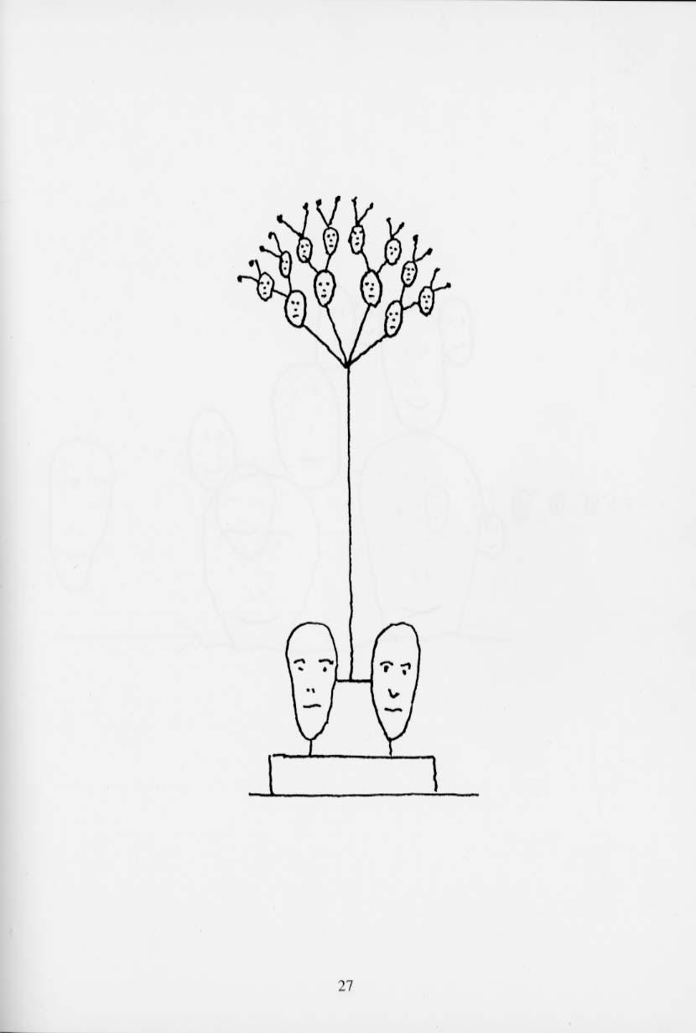

Slide 35
Collecting Family Data
Collecting family data is time consuming and expensive
Need for complete and extended pedigrees
Local relatives vs. all relatives
Collection of phenotype data
Need for accurate description of biologic relationships
Confidentiality and IRB issues in collecting family data

Slide 36
Collecting family data
IRB Issues
Confidentiality of information
Publication of pedigree information, genetic status
Sensitive information
Non-paternity, adoptions, abortions, medical conditions
General approaches to data collection
Proband contact
Individual family members as contacts

Slide 37
Collecting family data
Phenotype Information
Survey
Proband only
Pro: quick and inexpensive
Con: lack of knowledge about some relatives
Relatives
Critical information
Mother and Father ID for ALL related individuals
Measurements
Collecting blood / tissue samples
Physical measurements (height, weight, etc)
Tools for standardized measures (www.phenxtoolkit.org)
PhenX Tool Kit – a catalog of high-priority measures for consideration and inclusion in genetic epi studies

