Slide 1
Family Studies: Family Health History, Segregation and Linkage Analysis
Karen L. Edwards, Ph.D.
Professor
Dept of Epidemiology and
Genetic Epidemiology Research Institute
School of Medicine University of California Irvine
Seattle, WA

Slide 2
Overview of Genetic Epidemiologic Study Design
Question | Approach
Is there evidence for genetic influences on a quantitative trait? | Commingling
Is there familial aggregation? higher risk in relatives or higher correlation in relatives | Family Study
Is the familial aggregation caused by genetic factors? MZ twins concordance rate or correlation higher than DZ twins | Twin Study
Is there a major gene? Is it dominant or recessive ? (likelihood of Mendelian models higher than environmental or polygenic model) | Segregation Analysis
Where is this major gene in the human genome? | Linkage Analysis
Is there a linkage with DNA markers under a specific genetic model? | Parametric Approach
Is there an increased allele sharing for affected relatives (sib pairs) or for relatives with similar phenotype | B. Allele Sharing Approach (sib-pair analyses)
Where is the disease causing gene and which polymorphism is associated with disease? | Association Study (population and family-based)
Notes:
Iin this slide talk about next we will look at assoc studies – before we conduct assoc studies we usually have some indication that the trait we are interested in has some evidence for genetic influences

Slide 3
Family Health History: Application to public health
Advantages:
Reflects multiple genetic, environmental, behavioral factors and interactions
No genetic test can do this
Family history is a predictor of most diseases (diabetes, cancers, CVD)
Effective (public health) interventions exist for many of these diseases
Quitting smoking, maintaining ideal body weight, diet, exercise
Overcomes one of the most important barriers - getting people interested in learning and talking about their health
Goal: Use family history information to motivate behavior change and promote a healthy lifestyle for primary prevention of disease
More personalized health messages that “ fit within pre-existing beliefs about current health status, possible causes and risk factors, course of the disease, magnitude of and potential consequences of the risk, and ways to reduce the risk” See Claassen et al. BMC Public Health 2010, 10:248
Notes:
Why is FH a good bridge?

Slide 4
Genetic Epidemiology
Segregation Analysis

Slide 5
Complex Segregation Analysis (CSA)
A modeling approach used to determine whether there is evidence for a single gene that underlies a trait or disease
Also provides information on mode of inheritance
Dominant, Recessive or Codominant
General method for evaluating the transmission of a trait within pedigrees
Mendelian transmission

Slide 6
CSA, cont
Information from CSA is useful in model based (parametric) linkage methods
LOD method linkage analysis depends on the specification of a reasonable model, including an approximation of the mode of inheritance
Assumes the existence of a Mendelian trait

Slide 7
The goal
To test for compatibility with Mendelian expectations by estimating parameters for a range of genetic models
CSA can provide the statistical evidence for Mendelian control of a trait or disease
As with all methods so far, this evidence can be used to support a genetic cause of the disease, but is not definitive
Simultaneously considers major locus, polygenic and environmental effects

Slide 8
The Approach
A variety of models are fit to the family data and compared using a likelihood ratio test (for nested models)
The null hypothesis is that the data DO fit with some model of inheritance (genetic or not)- a "goodness of fit" approach

Slide 9
The Models
The models are formed by estimating and restricting a specified set of parameters
The most general model, where all parameters are estimated
Single locus models with no polygenic inheritance and differing modes of inheritance
Polygenic model, with no single locus effect
Mixed model, both single gene and polygenic components
Nongenetic model or "environmental model"

Slide 10
Parameters: single locus component
Means (u) for each subdistribution
Variance of each subdistribution
Allele frequencies
Transmission probabilities - should conform to Mendelian expectations
t₁ = P(AA parents transmits A allele to offspring) = 1.0
t₂= P(Aa parents transmits A allele to offspring) = 0.5
t₃ = P(aa parents transmits A allele to offspring) = 0.0

Slide 11
Parameters : Polygenic component
Heritability (h²)
proportion of variance due to additive genetic effects
Not a single major gene
Can reflect “residual genetic effects” not accounted for by a single major locus
Sometimes referred to as multifactorial component

Slide 12
Model Testing
Hypothesis testing for nested models using the LRT (likelihood ratio test)
LRT = -2 [In L(reduced model) - In L(full model)]
LRT is distributed as a chi square with the degrees of freedom (df) equal to the difference in the number of estimated parameters
The likelihood of each model is proportional to the probability of the data, given the model and family structure

Slide 13
Model testing, cont
To compare non-nested models
use the AIC to compare (not test) models to support a particular model over another
AIC= -2(ln likelihood) + 2(number of estimated parameters)
Calculate the AIC for each competing model and select the one with the smallest AIC as being the most parsimonious

Slide 14
Interpretation: Inferring A Major Gene
To infer a major gene
reject nongenetic models
accept a major gene model (single or mixed model)
should always test transmission probabilities in CSA of quantitative traits to safeguard against false inference of a major gene

Slide 15
Ascertainment Correction
Ideal probands would be newly diagnosed, population based (incident) cases
Should correct for ascertainment unless pedigrees (probands) are selected from a random, population based sample
Correction for ascertainment is not straightforward and is not usually done
Estimators for population parameters (allele frequency and heritabilty) will be most affected

Slide 16
Review Table

Slide 17
Am. J. Hum. Genet. 43:311-321, 1988
Sources of Interindividual Variation in the Quantitative Levels of Apolipoprotein B in Pedigrees Ascertained through a Lipid Clinic
Gail Pairitz,* Jean Davignont Helene Maillouxt and Charles F. Singt
*Department of Medicine, Hospital of the University of Pennsylvania, Philadelphia; tDepartment of Lipid Metabolism and Atherosclerosis Research,
Clinical Research Institute of Montreal, Quebec; and tDepartment of Human Genetics, University of Michigan, Ann Arbor
Summary
The quantitative level of apolipoprotein (apo) B associated with low-density lipoprotein (LDL) varies
among individuals within the population. This variation in level of the LDL receptor ligand appears to
have predictive value, and may have an etiologic role, in coronary artery disease. Complex segregation
analysis was used to compare eight different models of transmission. This study confirms the existence
of allelic variations at a single genetic locus with large effects on the interindividual variation in the
level of the serum apo B associated with LDL. This is the first study to consider the possible effects of
inherited polymorphic variation in the apo E molecule when analyzing the components of variation in
apo B associated with LDL. Our analyses suggest that the common alleles coding for the apo E polymorphism act independently of the unmeasured single-gene locus characterized by this study.

Slide 18
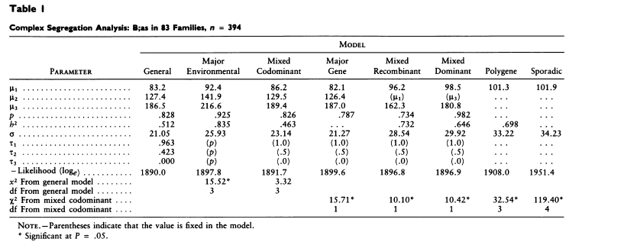

Slide 19
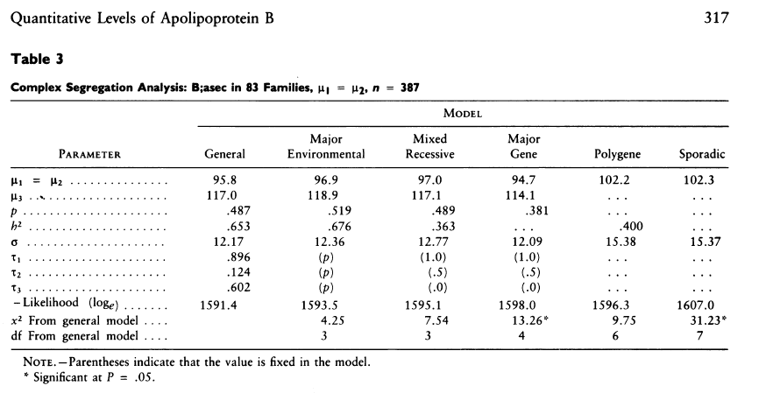

Slide 20
Other Issues to Consider
Nonpaternity seems to have little effect on the ability to select models
Can adjust for covariate effects
Can also consider adjusting for other known genetic factors affecting your trait of interest

Slide 21
Important Limitations in CSA
Implicit assumption of etiologic homogeneity
Power is difficult to estimate as there is no single nongenetic alternative model, but instead a range of competing models
Sample size
Larger extended kindreds with several generations are generally better than small nuclear families
generally requires a large amount of data, with more complex models requiring more data

Slide 22
Summary of CSA
Does not require genotype data
Can be time consuming to complete analyses
Information from CSA is useful for a variety of reasons
Preliminary data, estimates for linkage analyses, choice of phenotype
Assumes the existence of a Mendelian trait

Slide 23
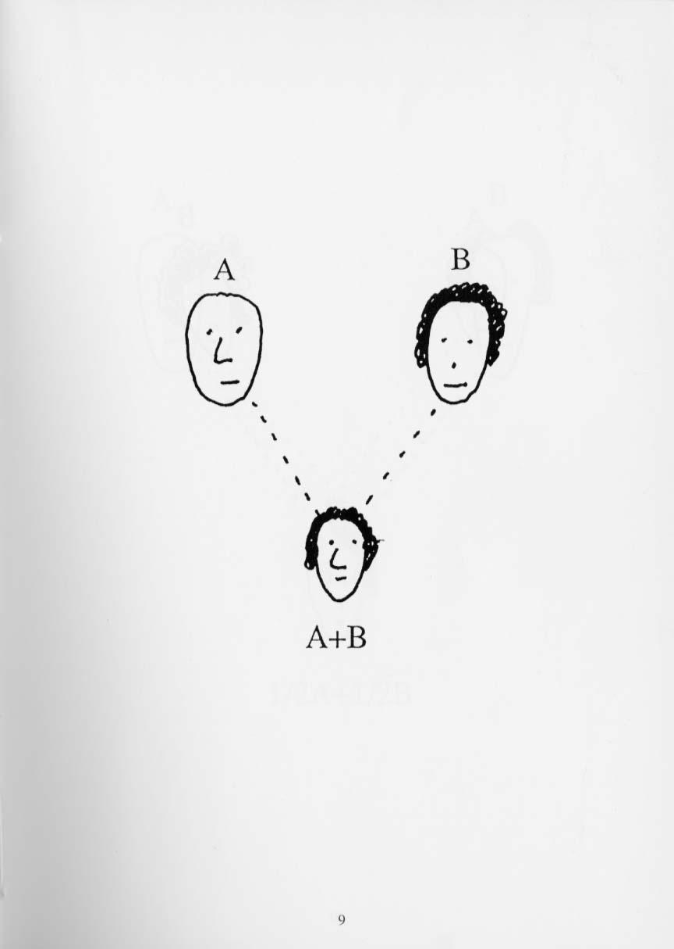

Slide 25
Standardized Human Pedigree Nomenclature: Update and Assessment of the Recommendations of the National Society of Genetic Counselors. Authors: Bennett, French, Resta, Lochner Doyle
Standard format and nomenclature for drawing pedigrees
Pedigrees convey lots of information
Picture is worth a 1000 words
Sensitive information and how to display?
J Genet Counsel (2008) 17:424–433
Notes:
Why is FH a good bridge?

Slide 26
Bennett article - some key points
A medical pedigree is a graphic presentation of a family’s health history
and genetic relationships
A pivotal tool in the practice of medical genetics / genetic epi research
Interpreting a pedigree should be a standard competency of all health professionals
Pedigrees should not contain information about which a subject had no prior knowledge.
a person who had presymptomatic or susceptibility genetic testing through research should not find out about increased or decreased disease risk status from a publication

Slide 27
In Class Exercise: Pedigree Drawing
Let me start with my great-great grandparents: Jim and Ann Flight.
They had two children: Kathy, and Gerry.
Kathy died in a car accident along with her father Jim.
Gerry married Kate Doe.
Kate and Gerry had one child, Kathy
Kathy Flight married David Dewey and they had my dad, Bob. My dad took his mother’s maiden name because David had an affair with someone named Maggie Braun.
After Jim’s death, Ann married Paul Wright. Ann and Paul had one child: Tom Wright.
Tom Wright married Kaisa Stone.
Tom and Kaisa had one daughter: Heather. Heather Wright was wed to Peter Meter and had one child, Jean. Jean married Bob Flight and they had me Jane Flight.

Slide 28
In Class Exercise: Collecting Family History Information
Think about your own family history
Do you know the vital status of your immediate family members, what about more distant relatives?
Do you know the DOB and DOD for your immediate family members, what about more distant relatives?
What health conditions run in your family?
Do you know age or date of onset?
How confident are you in this information?
Draw your pedigree, indicating as much of the following as possible
- vital status, health conditions, age at onset or death

Slide 29
Genetic Epidemiology
Linkage Analysis

Slide 30
Linkage Analysis, overview
Linkage
Location of genetic loci sufficiently close together on a chromosome that they do not segregate independently
linkage is a property of loci (not alleles), and evaluation involves all alleles at the marker locus
the specific alleles segregating in one family may differ from alleles at the same locus segregating in a different family

Slide 31
Linkage vs. Association
Linkage
Cosegregation of a disease or trait with a specific chromosomal region in multiple families
Genetic linkage is the tendency of two loci to be inherited together (e.g. loci are on the same chromosome)
Property of two loci (genes or locations)
Association
Presence of a disease or trait with a specific allele in a gene or marker (in unrelated subjects) – probably due to linkage disequilibrium

Slide 32
Linkage Analysis –background
The aim of linkage analysis is to infer the relative position of two or more loci
Examining patterns of allele sharing or cosegregation of marker and disease in relatives
The location of one locus is known (the marker), the other is unknown (the disease causing gene)
Alleles of loci on the same chromosome can violate Mendels’s law of independent assortment (linkage)
Evidence of linkage between a known marker and a putative gene for a disorder is the ultimate statistical evidence for a genetic component in disease etiology

Slide 33
General Approaches to Linkage Analysis
Genome Wide Scan
Isolate a gene solely on the basis of it's chromosomal location, without regard to it's biochemical function.
This is often referred to as the "positional genetic" approach (i.e. genome screens are often referred to positional cloning)
Candidate gene approach
Select candidate genes based on their function or other known properties

Slide 34
Required data for family studies
At least pairs of related individuals
Accurate pedigree structure / biological relationships
Nuclear family vs. extended kindred
Phenotype data – quantitative or categorical
Genotype data
Location of markers (marker map)

Slide 35
Genetic Markers
A genotype (measurable "trait" ) that is genetically determined, can be accurately classified, has a simple, unequivocal pattern of inheritance (and polymorphic).
Types of genetic markers
Polymorphic markers – lots of alleles / variation
Variable number of tandem repeats (VNTR)
Microsatellites, (e.g. CA repeats), very polymorphic
Single nucleotide polymorphisms (SNP's) - 2 allele markers, very common
Sequence data – exome or whole genome

Slide 36
Statistical Analysis: LOD based Linkage Analysis
Involves comparison of likelihoods of observing the segregation pattern of 2 loci under specific models, including
Under the null hypothesis of no linkage
Independent assortment – loci recombine as if on different chromosomes
Alternative hypotheses of linkage
differ in the extent of crossing over (i.e. different values of recombination events)

Slide 37
LOD Score
LOD score = log (base 10) of the odds of linkage vs. no linkage (not an odds ratio!)
LOD score > 3, supports linkage, corresponds to a genome-wide type 1 error rate of 0.05 (depends on number of markers tested)
LOD score < -2, used to exclude a chromosomal region
Exclusion mapping
add LOD scores from all families to obtain LOD score for your sample
Assumes families are independent

Slide 38
Linkage Mapping of CVD Risk Traits in the Isolated Norfolk Island Population
Abstract: To understand the underlying genetic architecture of cardiovascular disease (CVD) risk traits,
we undertook a genome-wide linkage scan to identify CVD quantitative trait loci (QTLs) in 377
individuals from the Norfolk Island population. The central aim of this research focused on the
utilization of a genetically and geographically isolated population of individuals from Norfolk Island
for the purposes of variance component linkage analysis to identify QTLs involved in CVD risk
traits.
The ancestral origins of the Norfolk Island are well documented and originated from divergent founding paternal and maternal lineages, European and Tahitian, respectively.
1,574 residents
Exhaustive genealogical documents indicate that the population grew from a limited number of initial founders (nine males, twelve females) and in relative isolation in the early generations of population expansion
- Evidence of the Island's strict immigration laws are obvious by the limited numbers of surnames, resulting in the worlds only telephone directory which includes nicknames to differentiate between individuals with the same name
Hum Genet. 2008 December ; 124(5): 543–552. doi:10.1007/s00439-008-0580-y.

Slide 39
Linkage Mapping of CVD Risk Traits in the Isolated Norfolk Island Population
The Norfolk Island genealogy dates back approximately ten generations to the initial founders
and contains 6379 individual entries linked together within 2185 nuclear families. The
complexity of the island's heritage is evident considering 5750 individuals reside within a single
multifamily pedigree exhibiting 1661 marriages and 1233 founders.
Methods: Substantial evidence supports the involvement of traits such as systolic and diastolic blood
pressures (SBP and DBP), high-density lipoprotein-cholesterol (HDL-C), low-density lipoprotein cholesterol
(LDL-C), body mass index (BMI) and triglycerides (TG) as important risk factors for
CVD pathogenesis. In addition to the environmental influences of poor diet, reduced physical
activity, increasing age, cigarette smoking and alcohol consumption, many studies have illustrated
a strong involvement of genetic components in the CVD phenotype through family and twin studies.
We undertook a genome scan using 400 markers spaced approximately 10cM in 600 individuals
from Norfolk Island. Genotype data was analyzed using the variance components methods of
SOLAR.
Results: Our results gave a peak LOD score of 2.01 localizing to chromosome 1p36 for systolic
blood pressure and replicated previously implicated loci for other CVD relevant QTLs.
Hum Genet. 2008 December ; 124(5): 543–552. doi:10.1007/s00439-008-0580-y.

Slide 40
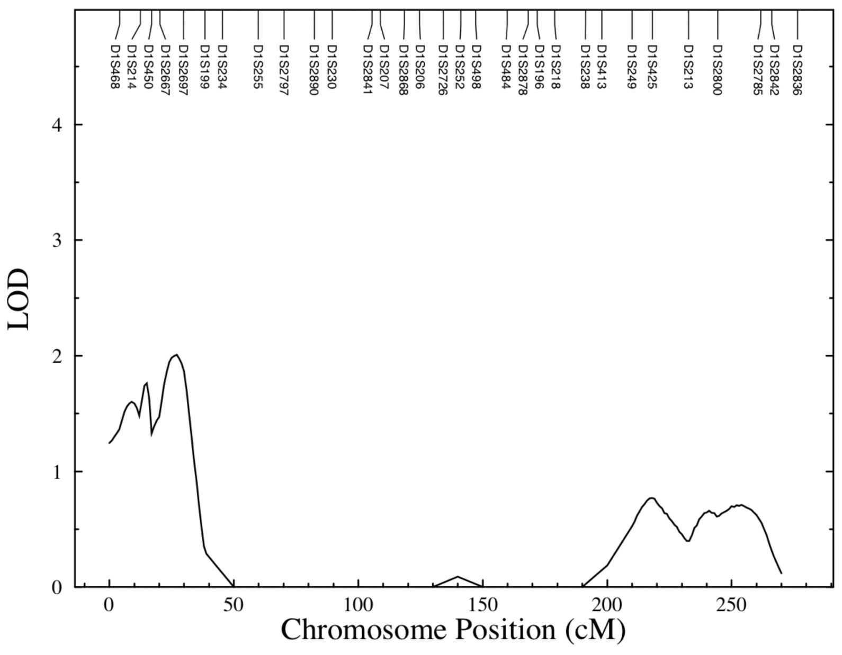

Slide 41
Sib-Pair Linkage Analysis
Sib pairs are generally easier to collect, tend to be more closely matched for age and environment than other relative pairs
Qualitative trait: under linkage, Affected relative pairs should share alleles IBD (inherited from a common ancestor within the pedigree), more often than expected under Mendelian expectations
Quantitative trait: relative pairs should show a correlation between the magnitude of their phenotypic difference and the number of alleles shared IBD

Slide 42
Quantitative sib-pair linkage
A regression approach
Regress the squared within-pair difference of a quantitative trait on the number of marker alleles shared IBD
Null hypothesis - the slope of the squared within pair difference is zero
The alternative hypothesis is that under linkage, the slope is negative.

Slide 43
Identity by descent vs. Identity by state
IBS- two alleles at a given locus are identical in state if they represent the same allelic variant at that locus
IBD- two alleles at a given locus are IBD if they were transmitted from a common ancestor –ie they represent copies of the same ancestral DNA

Slide 44
Quantitative Sib-pair linkage results
100
BMI: Slope of the line is negative
Squared trait difference
50
10
0 1 2
Alleles shared IBD at a specific locus

