Slide 1
Genome Wide Association Studies (GWAS)

Slide 2
Outline
What is a Genome Wide Association Study (GWAS)
Points to consider in Conducting and Interpreting GWAS
Post-GWAS Research
Impact of GWAS findings
Notes:
Genome-wide association & cancer

Slide 3
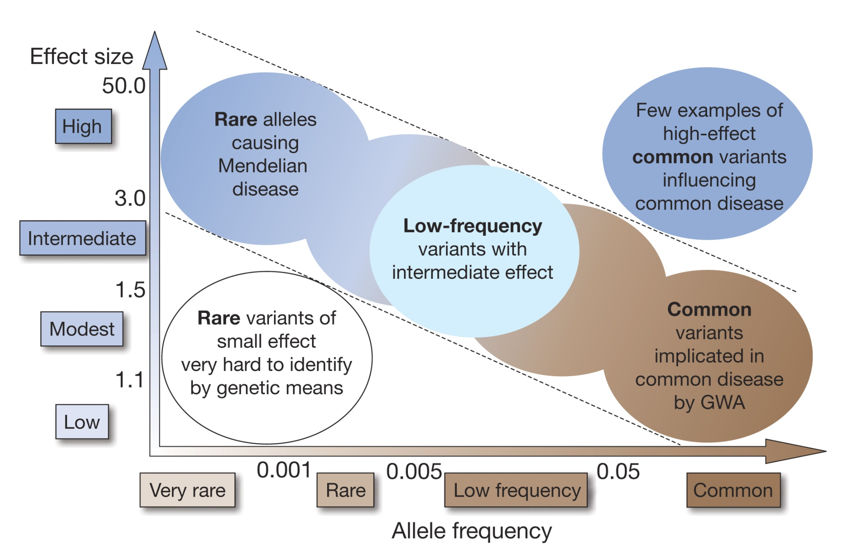
Genetic Variation and Disease Susceptibility
Manolio et al. Nature 2009; 461: 747-753.
Notes:
In the linkage study above we were looking for rare variant with very large effects
Much of the focus in the past few years has been looking for Common variation
And since 1996 we’ve known that Association studies are more powerful than linkage to identify these types of variants
N. Risch and K. Merikangas Science 273: 1516-1517, 1996
So scientists started doing CG association studies which were basically a bust

Slide 4
What is a Genome Wide Association Study (GWAS)

Slide 5
GWAS DEFINITION
A genome-wide association study is an approach that involves rapidly scanning markers across the complete sets of DNA, or genomes, of many people to find genetic variations associated with a particular disease.
Once new genetic associations are identified, researchers can use the information to develop better strategies to detect, treat and prevent the disease.
Such studies are particularly useful in finding genetic variations that contribute to common, complex diseases, such as asthma, cancer, diabetes, heart disease and mental illnesses.
http://www.genome.gov/20019523

Slide 6
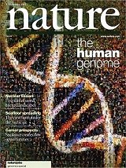


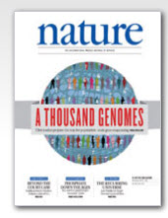
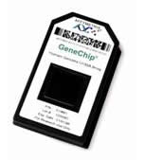
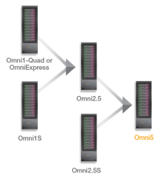
Tools/Discoveries that Made GWAS Possible
First draft of human genome completed June 2000
Identification and characterization of common genetic variation
Advances in genotyping technology, with reduction in costs

Slide 7
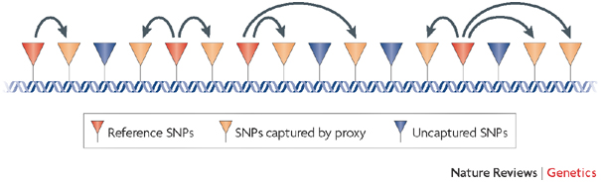
Some Key Concepts for GWAS
Focus on common genetic variants (typically minor allele frequency >5%)
Single Nucleotide Variants (SNPs) are directly genotyped across the genome
SNPs that are genotyped will capture unmeasured variants through linkage disequilibrium.
Kruglyak Nature Reviews Genetics 2008; 9: 314-318.

Slide 8
Points to consider in Conducting and Interpreting GWAS

Slide 9
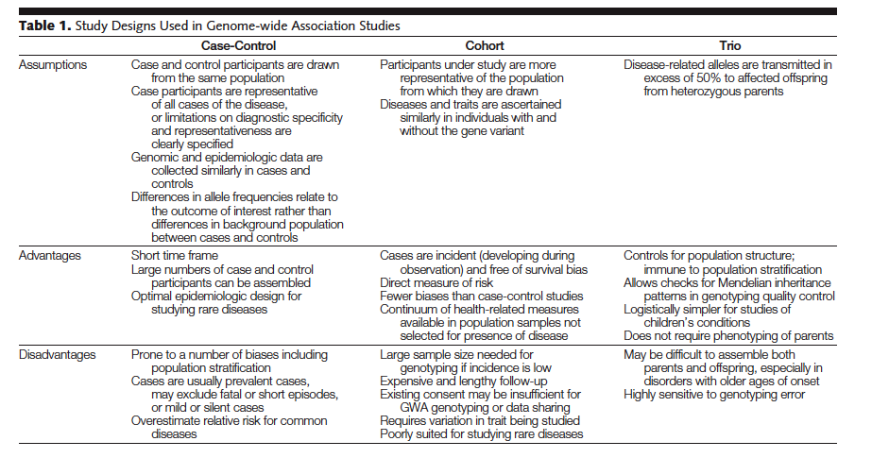
Study Designs Used in GWAS
Pearson & Manolio JAMA 2008; 299:1335-44

Slide 10
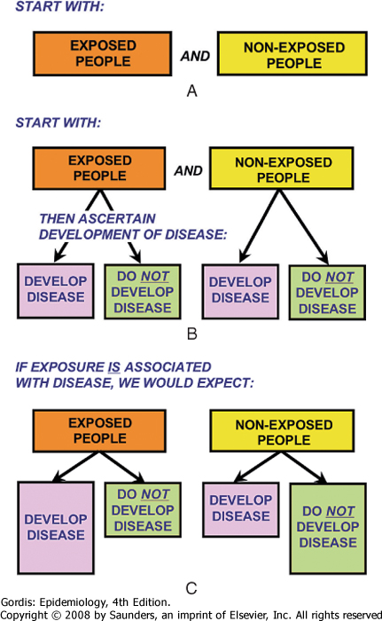
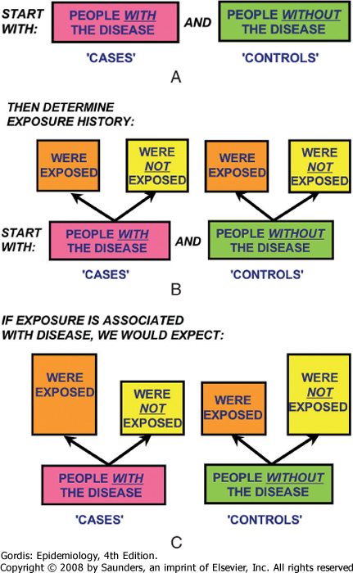
Cohort
Case-Control
Defined group of study participants
People with Variant
People without Variant
Have
Variant
No
Variant
Have
Variant
No
Variant
People with Variant
People without Variant
Have
Variant
No
Variant
No
Variant
Have
Variant
Downloaded from: StudentConsult (on 29 September 2013 04:59 PM)
© 2005 Elsevier

Slide 11
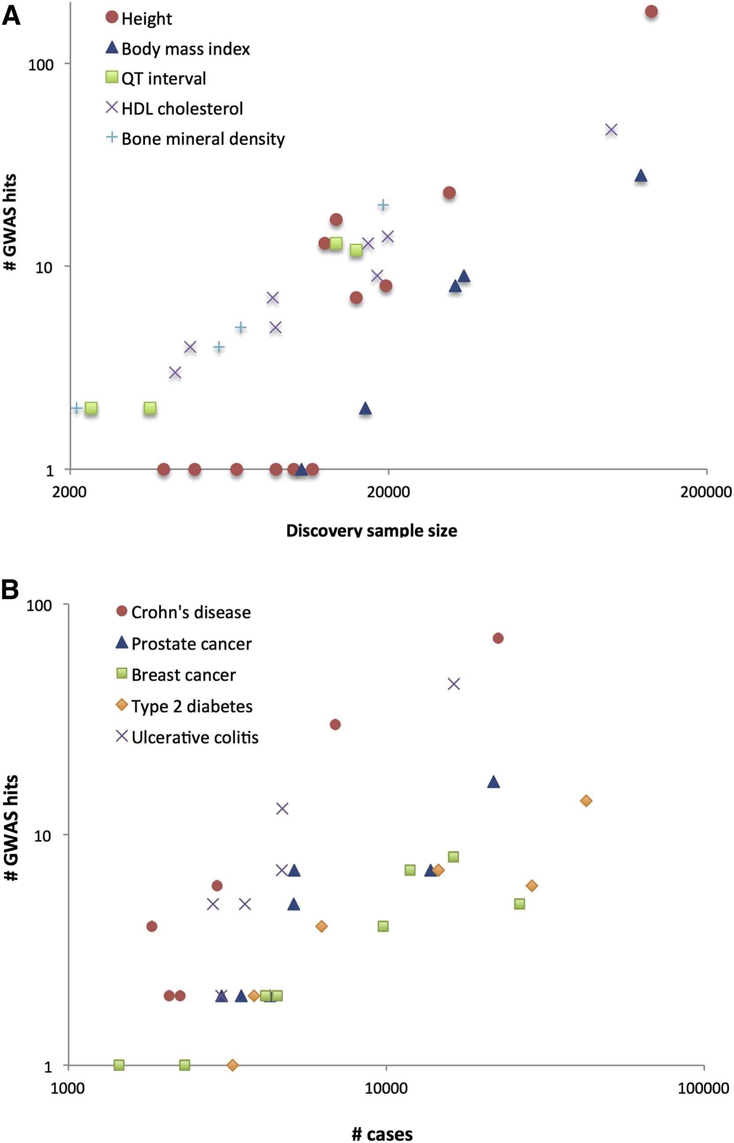
Sample Size
Variants identified by GWAS have modest effect sizes
Very large sample sizes are needed to detect variants
Sample size often achieved through meta-analysis in consortia
Visscher et al. AJHG 2012; 90: 7–24.

Slide 12
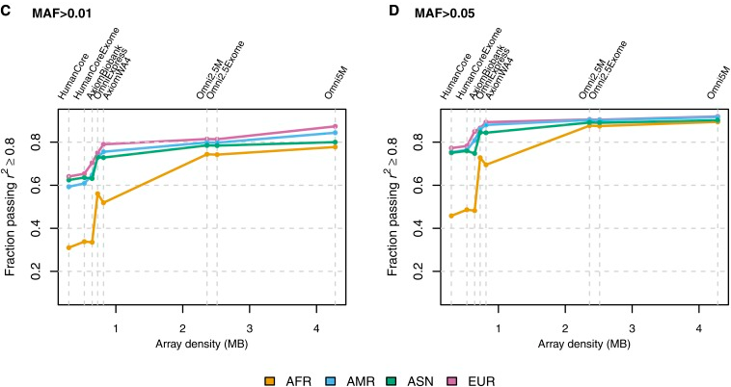
Genomic Coverage of GWAS Chips
estimated by the percent of common SNPs having an r² of 0.8 or greater with at least 1 SNP on the platform.
Platforms comprising 500,000 to 1,000,000 SNPs capture ~67-89% of common SNPs in populations of European and Asian ancestry and 46-66% in populations of African ancestry.
Nelson et al. G3 (Bethesda) 2013; 3: 1795–1807.

Slide 13
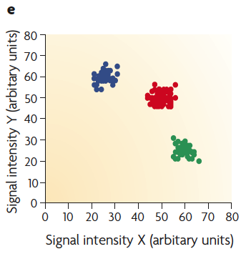
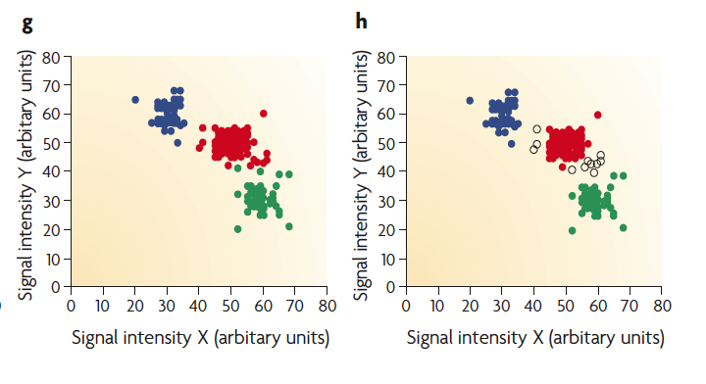
Genotyping and Quality Control in GWAS
Genotype “calling” is based on intensities for the two alleles at each genetic marker
Genotyping errors, must be diligently sought and corrected.
Established quality control features should be applied both on a per-sample and a per-SNP basis.
McCarthy et al. Nat Rev Genet 2008; 9:356-369

Slide 14
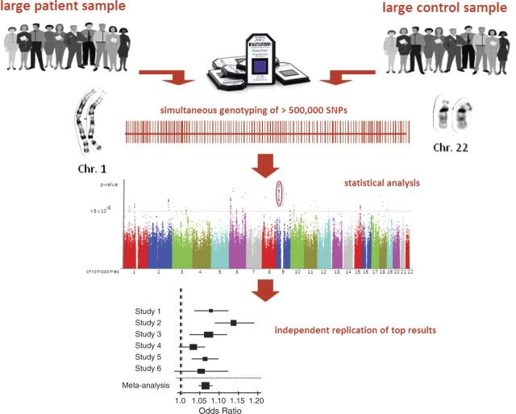
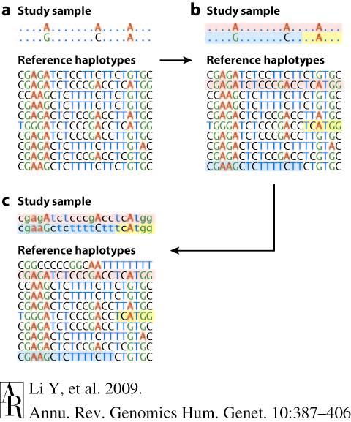
Schematic of Typical GWAS
imputation >2.5 million SNPs
Schunkert H et al. Eur Heart J 2010; 31: 918–925.
Notes:
Principle of genome-wide association studies.

Slide 15
Common Model: Logistic Regression
dose=output estimate of # of alternate alleles from imputation
pc=principle components from principle component analysis (PCA)
Population based Association studies

Slide 16
Principal components analysis
A dimensionality reduction technique used to infer continuous axes of variation.
For GWAS based on SNP x Individual matrix
The first principal component (pc1) is the linear combination of x-variables that has maximum variance
pc2 is the linear combination of x-variables that accounts for as much of the remaining variation as possible, with constraint that correlation between pc1 and pc2 is 0
Continue, with constraint that all pcs are orthogonal
Standard calculation in programs such as Eigenstrat, Plink, R, etc.

Slide 17
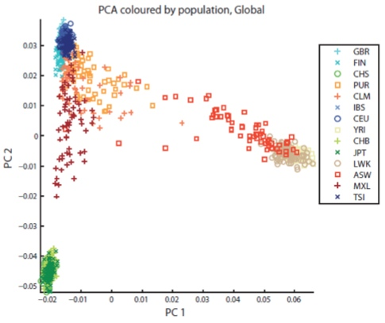
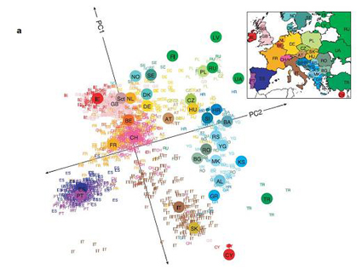
Captures inter- and intra-continental variability
PCA analysis of 1000 Genomes (1000G, Nature 2012)
PCA analysis of European Populations (Nature 2012)

Slide 18
Population Stratification
Population substructure in GWAS data, because allele frequencies differ in different populations
Population stratification= confounding by population substructure
  Example: Lactase gene associated with height in European populations
Methods can be used to control for population stratification
Most common method: adjust for top pcs from principle components analysis

Slide 19
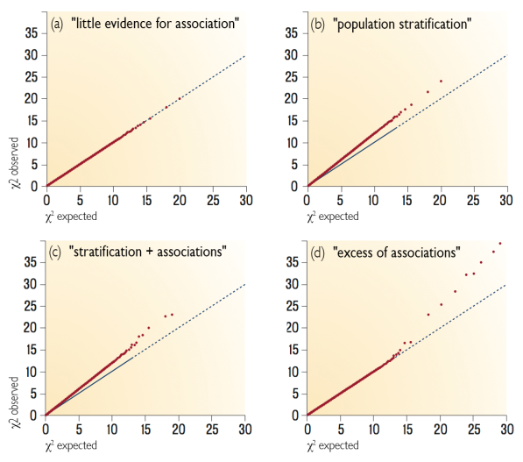
Q-Q plots
(modified by Josh Bis from McCarthy et al.,Nature Reviews Genetics, May 2008)
Notes:
Another common diagnostic plot is the Q-Q plot
Plot the observed p-values from your study against the expected uniform p-value distribution
Since we are performing millions of tests, and don’t expect the entire genome to be associated
Deviations from expectation can indicate differential missingness, lab, imputation, or other technical differences

Slide 20
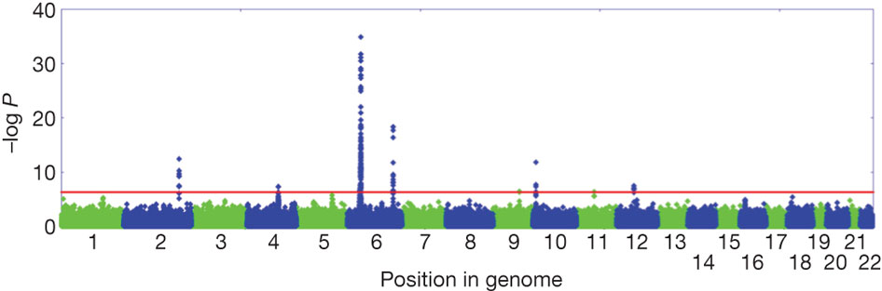
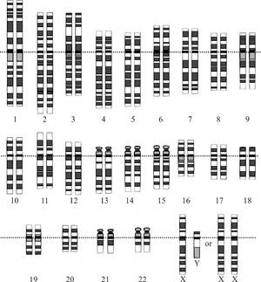
Manhattan Plot
Population based Association studies
Compare genotypes in cases and controls
Odds ratio for an allele:
1.35, p = 6.3 x 10⁻¹⁰
-log₁₀(p)=9.2
Nature 466, 113–117 (01 July 2010)
Notes:
FGFR2: Fibroblast growth factor receptor 2

Slide 21
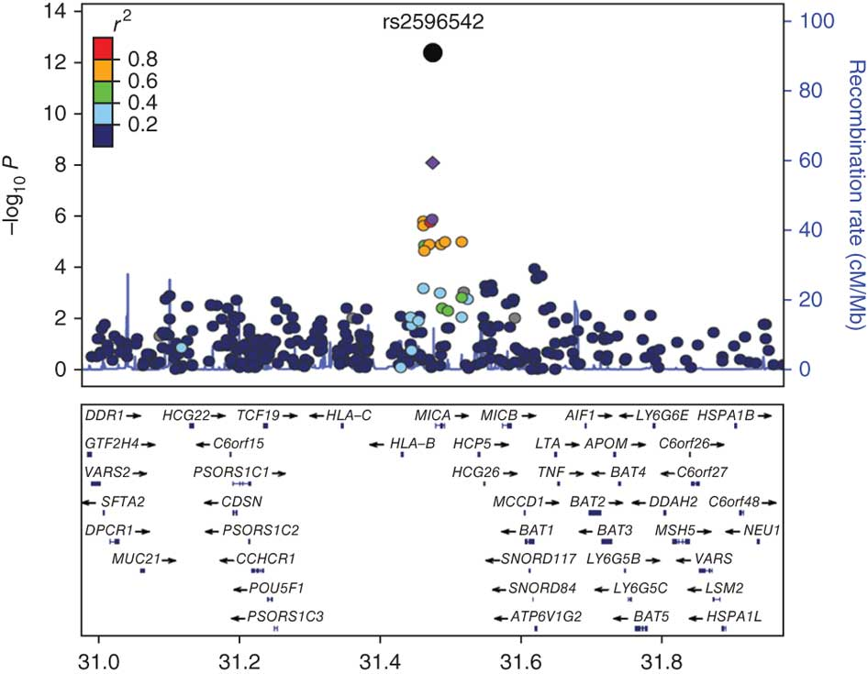
Regional Plots

Slide 22

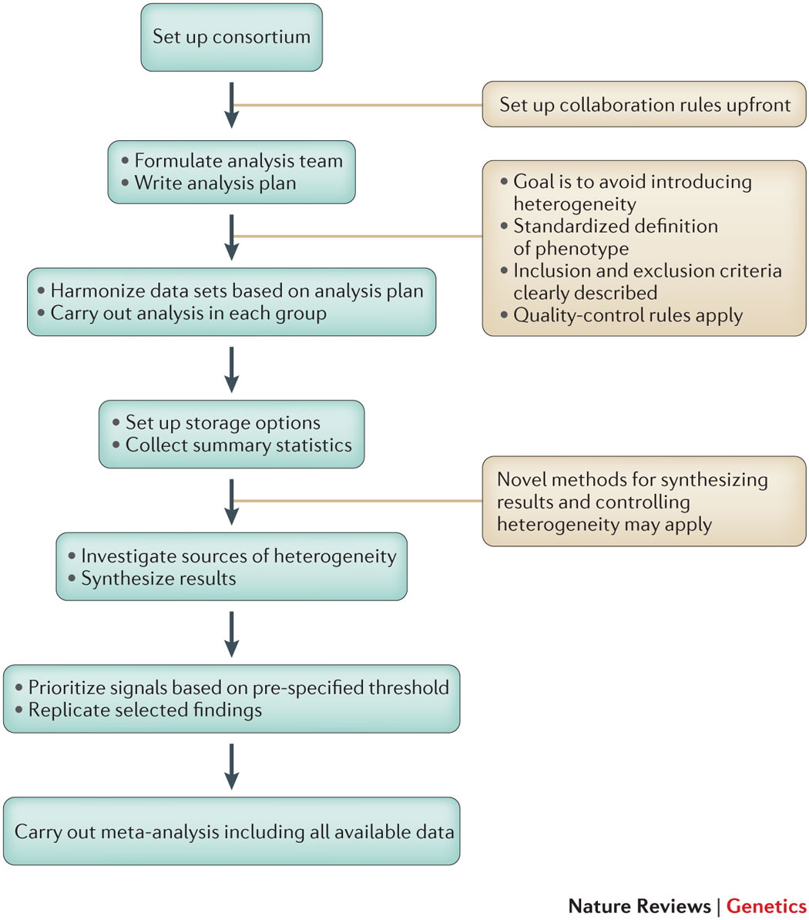
NCI-NHGRI Working Group on Replication in Association Studies. Nature 2007; 447:655-660.
Hirschhorn & Daly, Nat Rev Genet 2005; 6:95-108.
Evangelou & Ioannidis, Nat Rev Genet 2013; 14: 379–389.
Notes:
although this may not be feasible for rare conditions or for associations identified in unique populations.

Slide 23
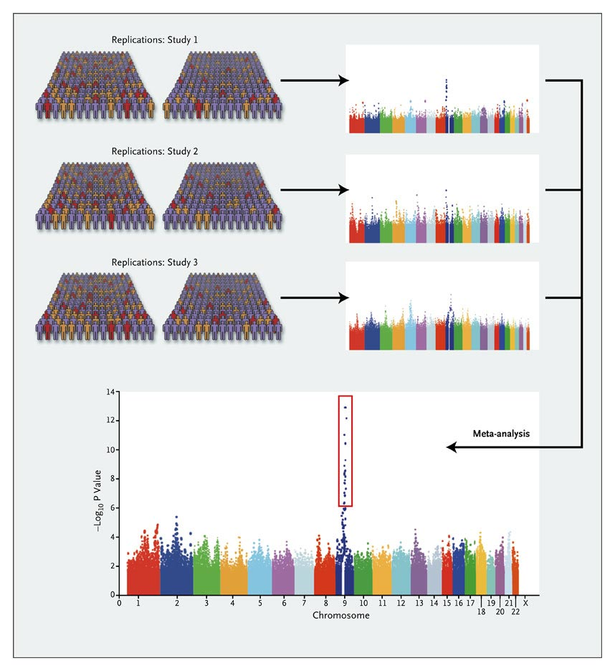
Meta-Analysis
Large sample sizes required because of small effect sizes, p-value threshold, misclassification inherent in using tagSNPs, etc.
Meta-analysis are often used to combine information across studies.
Meta-analysis combines information across studies, creating a weighted average of study specific estimates.

Slide 24
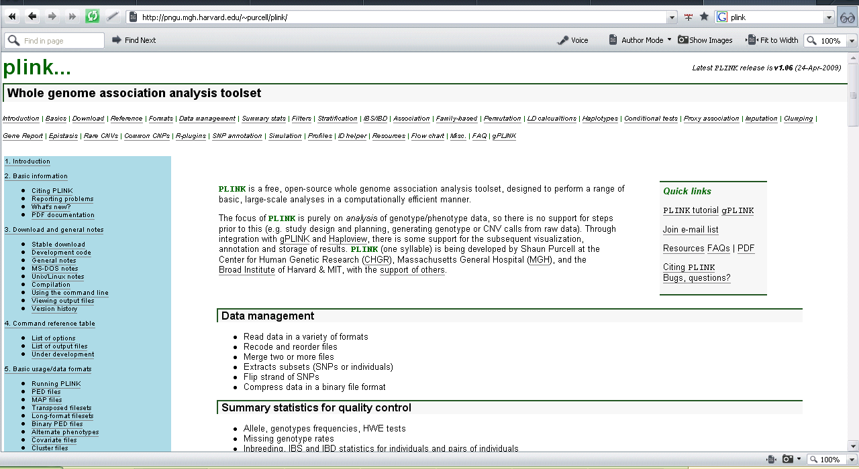
Plink http://pngu.mgh.harvard.edu/~purcell/plink/
PLINK is a free, open-source whole genome association analysis
toolset, designed to perform a range of basic, large-scale analyses in a
computationally efficient manner.

Slide 25
Limitations of GWAS
Countries of recruitment dominated by Europe and North America.
  Starting to be addressed through studies of other ancestries.
Possible biases due to case and control selection and genotyping errors
  Addressed through standards for study design, QC and analysis
The potential for false-positive results
  Addressed through replication, meta-analysis and the use of strict genome-wide significance thresholds.
Lack of information on gene function
  Addressed through post-GWAS functional follow-up studies
Insensitivity to rare variants and structural variants
  Addressed through alternative study designs
Notes:
are important limitations of GWA studies.

Slide 26

“Missing” Heritability
Additional studies needed
Impact of other types of genetic variation
  Less common/rare variants
  Copy number and structural variants
  Epigenomic variability
Interactions (effect modification)
  Gene-environment
  Gene-gene (pairwise and networks)
Limitations of study design and disease definitions
Current heritability estimates may be overestimated
Maher Nature 2008; 456: 18-21.
Manolio et al. Nature 2009; 461: 747-753.

Slide 27
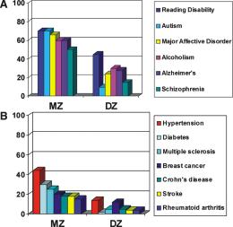
Assess the Heritability of a Trait
Twin Studies
Compare trait in monozygotic and dizygotic twins
Greater concordance in monozygotic twins reflects genetic similarity
Wong A H et al. Hum. Mol. Genet. 2005;14:R11-R18
Cancer Site | Heritable Factors | Environmental Factors Shared Non-shared
Prostate | 0.42 (0.29-0.50) | 0 (0-0.09) | 0.58 (0.50-0.67)
Colorectal | 0.35 (0.10-0.48) | 0.05 (0-0.23) | 0.60 (0.52-0.70)
Bladder | 0.31 (0.00-0.45) | 0 (0-0.28) | 0.69 (0.53-0.86)
Breast | 0.27 (0.04-0.41) | 0.06 (0-0.22) | 0.67 (0.56-0.76)
Lung | 0.26 (0.00-0.49) | 0.12 (0-0.34) | 0.62 (0.51-0.73)
Source: Scandinavian Twin Registry, Lichtenstein et al. New Engl J Med 2000

Slide 28
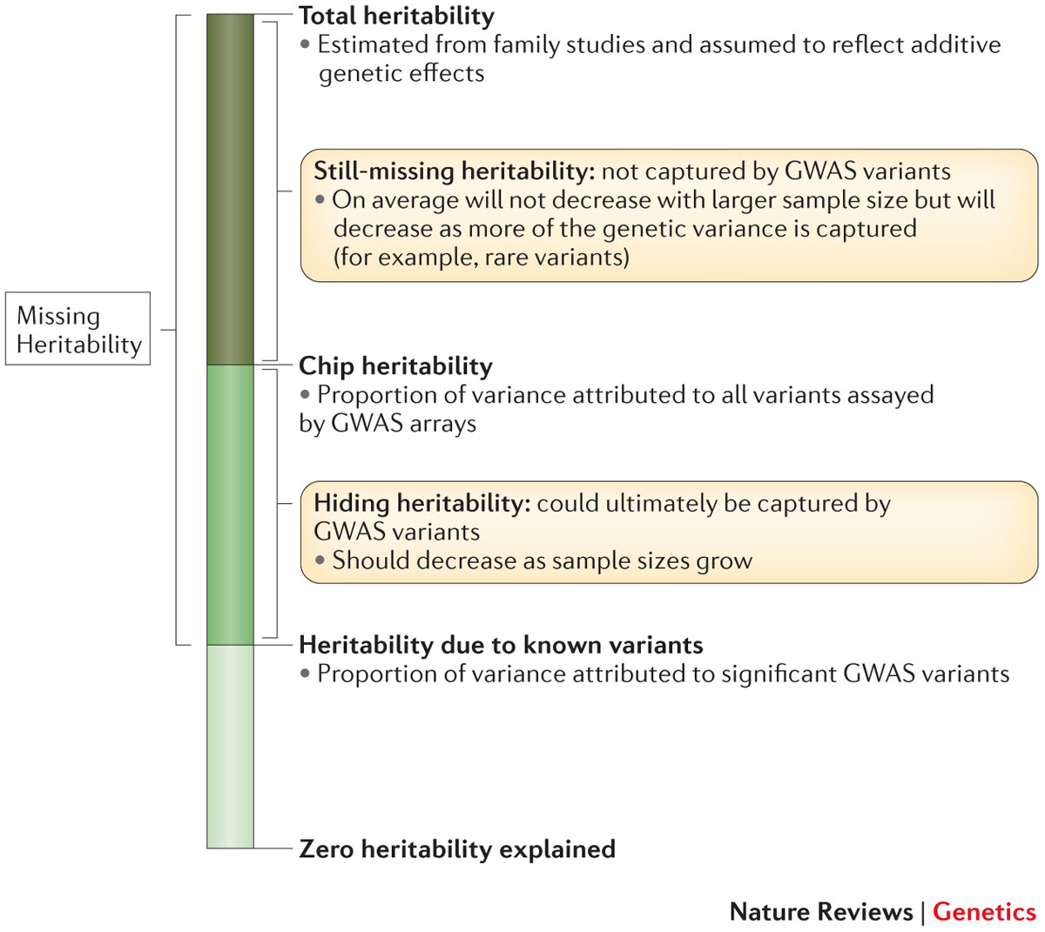
Contribution of Genetic Variants to Disease Heritability
Nature Reviews Genetics
Volume:
  15,
Pages:
  765–776
Year published:
  (2014)
Nature Reviews Genetics
Volume:
  15,
Pages:
  765–776
Year published:
  (2014)
http://www.nature.com/nrg/journal/v15/n11/full/nrg3786.html

Slide 29
GWAS Findings

Slide 30
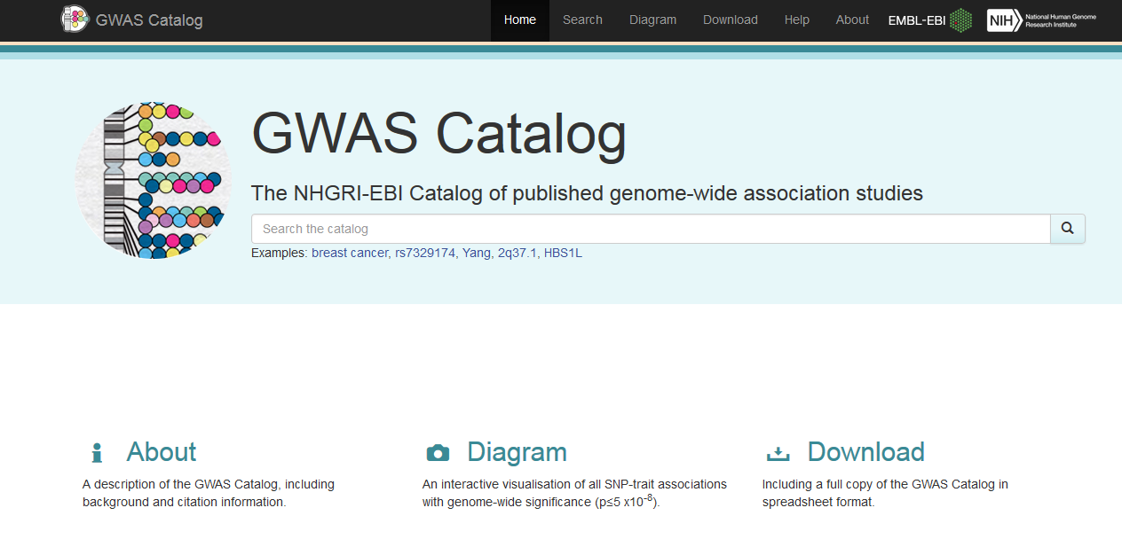
Catalog of Published GWAS
http://www.genome.gov/gwastudies/ now http://www.ebi.ac.uk/gwas/

Slide 31
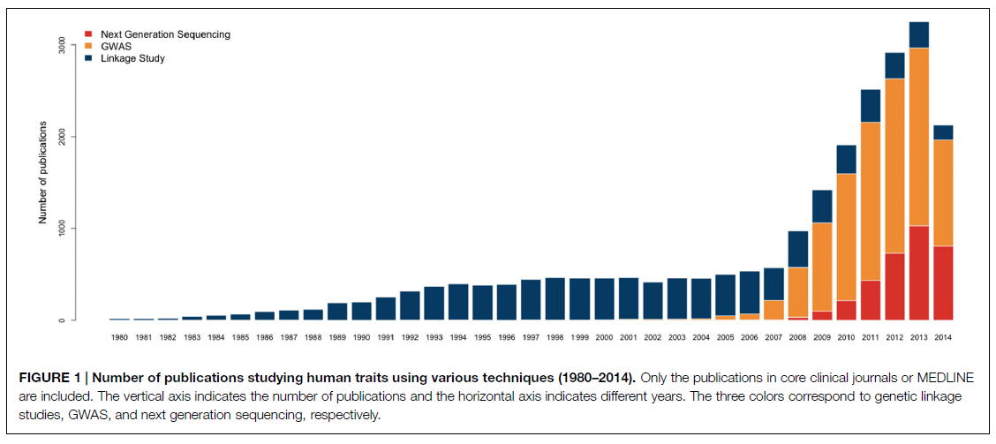
Front. Genet., 20 April 2015 | http://dx.doi.org/10.3389/fgene.2015.00149

Slide 32
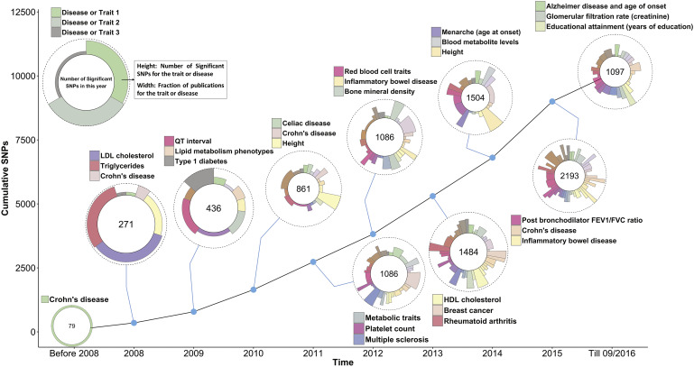
GWAS SNP-Trait Discovery Timeline
Data used for generating the graph were taken from the GWAS Catalogue.¹⁰ SNPs and traits were selected according to the following filters. SNPs were selected with a p value < 5 × 10⁻⁸. For each trait with two or more selected SNPs, SNPs were removed if they had an LD r² > 0.5 (calculated from 1000 Genomes phase 3 data) with another selected SNPs and their p value was larger. For each year of discovery, only the top three traits and diseases with the largest number of SNPs are labeled in the circle.
10 Years of GWAS Discovery: Biology, Function, and Translation
Peter M. Visscher, Naomi R. Wray, Qian Zhang, Pamela Sklar, Mark I. McCarthy, Matthew A. Brown, Jian Yang
Volume 101, Issue 1, 2017, 5–22
http://dx.doi.org/10.1016/j.ajhg.2017.06.005

Slide 33
Post-GWAS Research

Slide 34
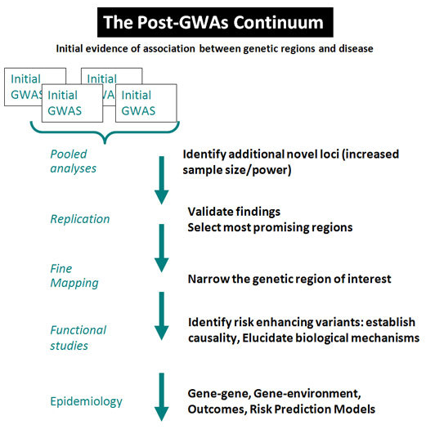
The Post-GWAS Continum
Follow-up studies and analysis to capitalize on and expand GWAS findings
Each step builds on the knowledge gained from the preceding studies
http://epi.grants.cancer.gov/pgwas/index.html

Slide 35
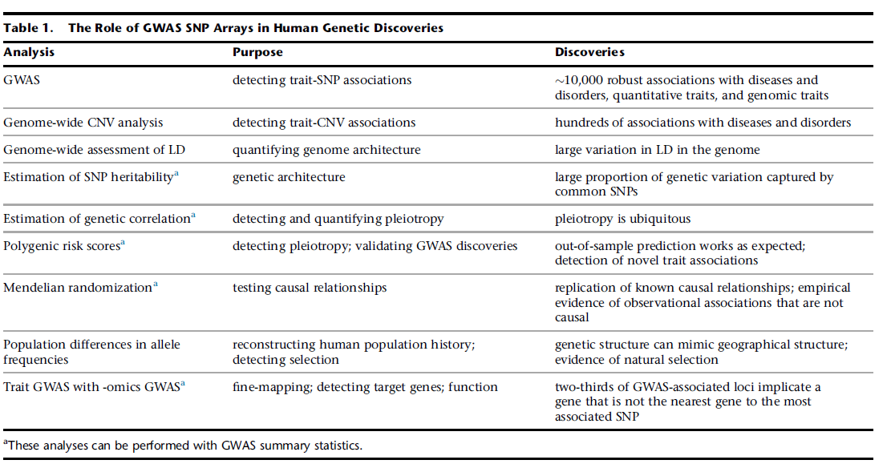
10 Years of GWAS Discovery: Biology, Function, and Translation
Peter M. Visscher, Naomi R. Wray, Qian Zhang, Pamela Sklar, Mark I. McCarthy, Matthew A. Brown, Jian Yang
Volume 101, Issue 1, 2017, 5–22
http://dx.doi.org/10.1016/j.ajhg.2017.06.005

Slide 36
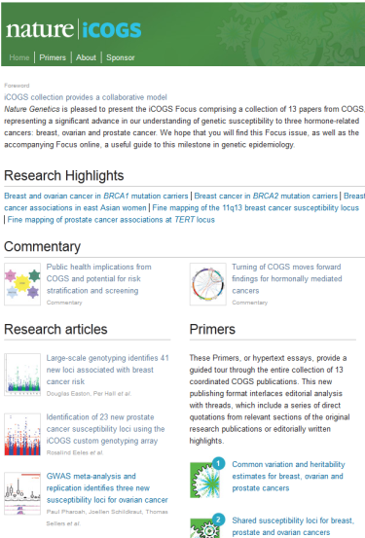
Nature iCOGS
Large scale results for breast, ovarian and prostate cancer
Collaborative Oncological Gene-environment Study (COGS)
Published Online March 27, 2013
Simultaneous publication of 13 papers, commentaries, editorials and hypertexted essays. Includes:
  Commentary:
  Public health implications from COGS and potential for risk stratification and screening
  Primer:
  Risk prediction and population screening for breast, ovarian and prostate cancers
www.nature.com/icogs/

Slide 37
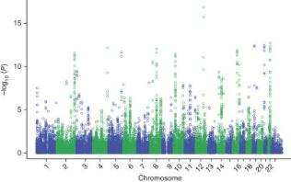
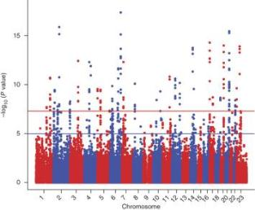
Key COGS Findings
Breast Cancer
Breast Cancer
  GWAS meta-analyis of 10,052 cases and 12,575 controls
  Replication in 45,290 cases and 41,880 controls
  Identified 41 new loci
  Top 5% and 1% of risk distribution have 2.3 fold and 3 fold higher risk than average population.
Prostate Cancer
  GWAS meta-analysis of 11,085 cases and 11,463 controls
  Replication in 25,074 cases and 24,272 controls
  Identified 23 new loci
  Top 1% of risk distribution has 4.7 higher risk than average population.
Prostate Cancer
Michailidou et al. Nature Genetics 2013: 45, 353–361.
Eeles et al. Nature Genetics 2013: 45, 385-391.

Slide 38
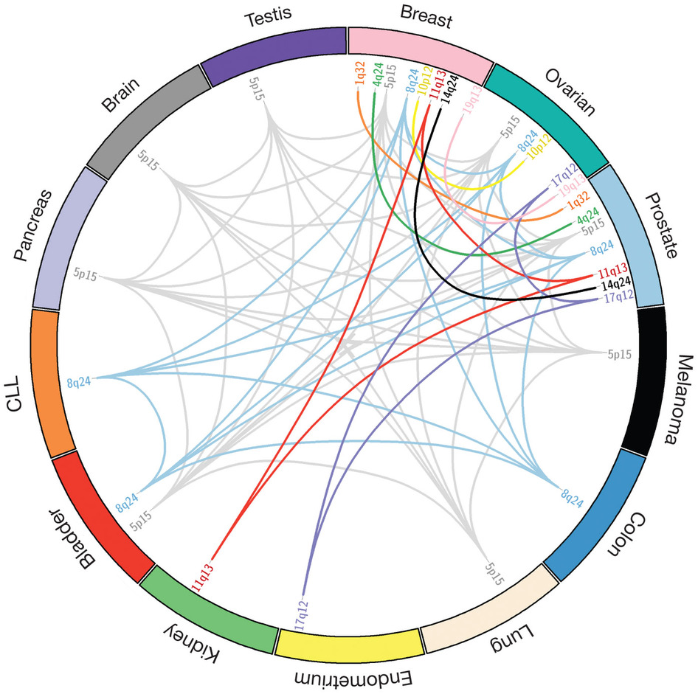
Pleiotropy in COGS and other Cancer GWAS
Pleiotropy= a single locus influencing two or more traits.
Several findings from GWAS are shared among different cancer types.
Sakoda et al. Nature Genetics 2013: 45, 345–348.

Slide 39
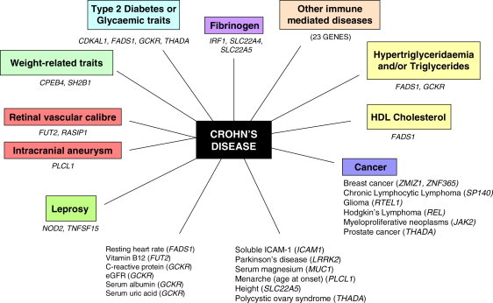
Pleiotropy in GWAS
Numerous examples of GWAS findings impacting more than one trait.
Pleiotropy scans can identify novel loci.
Am J Hum Genet. Nov 11, 2011; 89(5): 607–618.

Slide 40
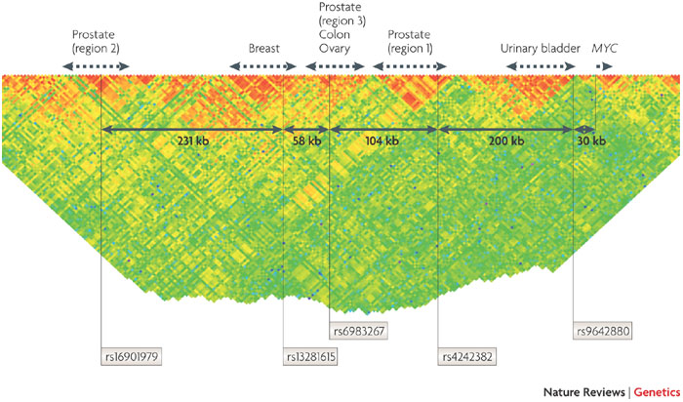
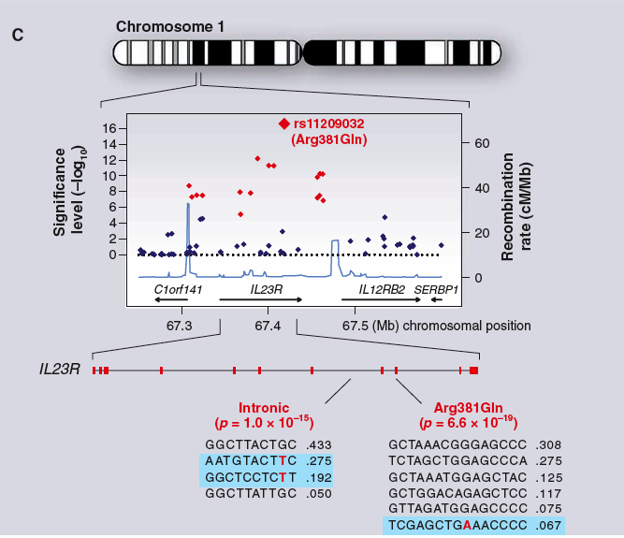
Fine-Mapping
Genotype additional SNPs to narrow down the region of interest
Targeted resequencing, to gain additional information on sequence variation in the area of interest
Ioannidis et al. Nat Rev Genet 2009; 10: 318-329.
Altshuler Science. 2008; 322: 881-8.
Notes:
Fine mapping studies in the complete data set will be necessary to…….
With the goal of identifying the most likely

Slide 41
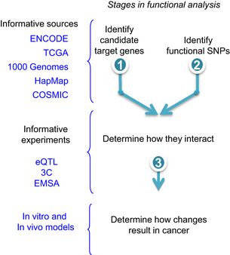
Post-GWAS Biological Studies
Identification of risk-modifying variants
Determination of biological mechanism of risk-enhancement
Examination of functional consequences of variant
Monteiro & Freedman. J Int Med 2013; 274: 414-424.
Notes:
Narrow the genetic region of interest
Functional studies would then be essential to establishing if a particular SNP is indeed the variant causing the disease

Slide 42



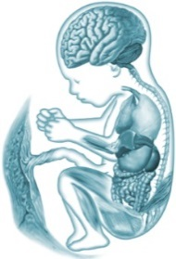
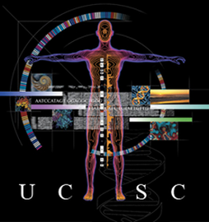
Genome-Wide Functional Annotation
Mostly cell lines
Tissue samples
ANNOTATION DATABASE
Notes:
ENCODE and Roadmap are two large public efforts that have attempted to have looked a many different cell lines and tissues (over 120). ENCODE focuses on cell lines, mostly cancerous. Roadmap focuses on normal tissues.

Slide 43
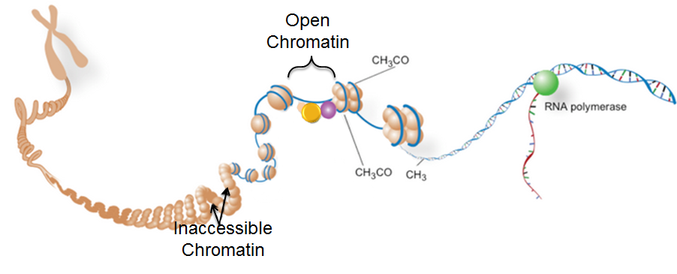
Functional Attributes of Regulatory Regions
DNase I Hypersensitivity
Epigenetic
Transcription Factor/ Protein
Binding
ChIP-Seq
Reference Genome
Enhancer Promoter Gene
Notes:
We can perform these assays across cell-types and tissues. We then take these results, and realign them to the reference genome, and by looking at the accumulation of these various biofeatures can define likely regulatory elements across the genome.

Slide 44
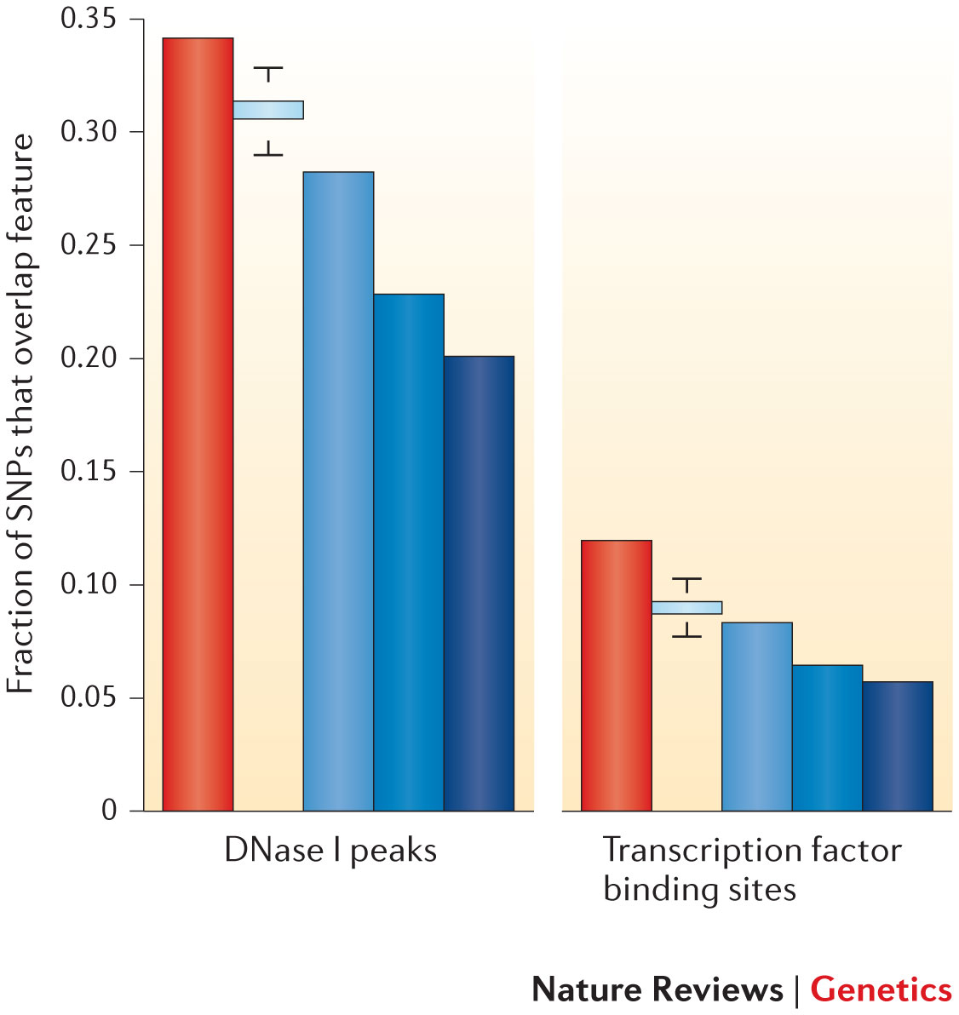
Variants in Regulatory Regions
Use of ENCODE data
SNPs identified in GWAS studies (red bar) often lie in enhancers or other regulatory elements.
Smaller fraction of control SNP sets overlap with these features (blue bars)
  SNPs on Illumina 2.5M chip
  SNPs in 1000 Genomes
  SNPs from 24 personal Genomes
Manolio Nat Rev Genet. 2013; 14: 549-58.

Slide 45
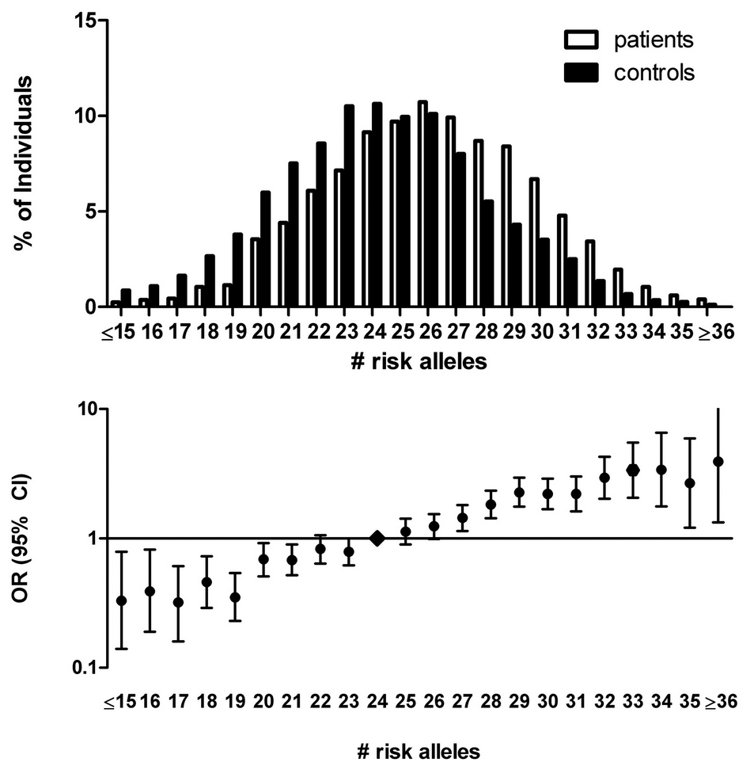
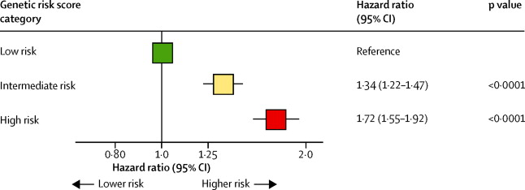
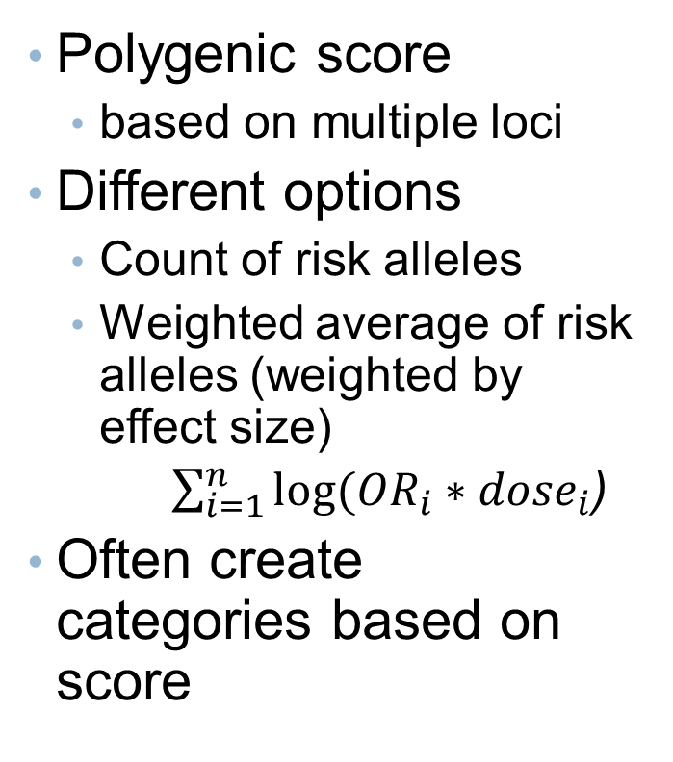
Genetic Risk Scores
Polygenic score
  based on multiple loci
Different options
  Count of risk alleles
  Weighted average of risk alleles (weighted by effect size)
  $\sum_{i=1}^{n}{log⁡({OR}_{i}∗{dose}_{i}}$)
Often create categories based on score
The 31-SNP risk allele distribution in patients with venous thrombosis and control subjects and corresponding ORs.
Blood 2012 120:656-663; doi: https://doi.org/10.1182/blood-2011-12-397752
Figure 1. Summary of risk of coronary heart disease across genetic risk score categories in primary and secondary prevention populations
The Lancet Volume 385, Issue 9984, 6–12 June 2015, Pages 2264-2271

Slide 46
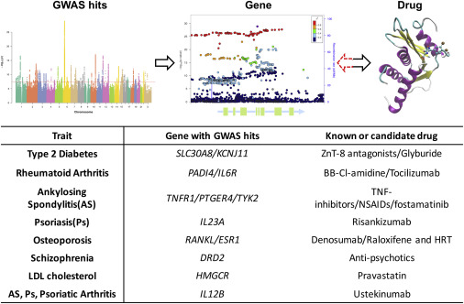
Examples of Links between GWAS Discoveries and Drugs
10 Years of GWAS Discovery: Biology, Function, and Translation
Peter M. Visscher, Naomi R. Wray, Qian Zhang, Pamela Sklar, Mark I. McCarthy, Matthew A. Brown, Jian Yang
Volume 101, Issue 1, 2017, 5–22
http://dx.doi.org/10.1016/j.ajhg.2017.06.005

Slide 47
Take Home Points
Complex diseases are influenced by a combination of genetic and environmental factors.
Genome-wide association studies (GWAS) can be used to identify common genetic variants associated with complex diseases.
GWAS have evolved standards for study design, analysis, replication and interpretation.
GWAS, to date, have identified over 2,000 variants associated with over 300 traits, including hundreds of variants associated with common cancers.
Post-GWAS research includes discovery and replication, biological and functional follow-up and epidemiologic studies.
GWAS have reveled new biology of complex diseases, and some GWAS findings are readily translatable to clinical care.

