Slide 1
Gene-Environment Interactions

Slide 2
Gene-Environment Interactions
Complex diseases result from an interplay of genetic and environmental factors
Why study Gene-environment Interactions (GxE)?
  Studies of GxE may help identify and characterize genetic and environmental effects.
  Studies of GxE may improve our understanding of biological mechanisms.
  Studies of GxE may identify sub-groups for targeted interventions or screening.
Term “GxE” is often used for both biological and statistical interactions. As with other studies of interactions the two concepts are often conflated.

Slide 3
What is Meant by Interaction?
Biological Interaction
  The interdependent operation of two or more biological causes to produce, prevent or control an effect
  Interdependency among the biologic mechanisms of actions for two or more exposures through common pathways, protein complexes or biological products.
Statistical Interaction
  The observed joint effects of two factors differs from that expected on the basis of their independent effects
  Deviation from additive or multiplicative joint effects
Effect Modification (or Effect Measure Modification)
  Differences in the effect measure for one factor at different levels of another factor
  Example: OR differs for males vs. females; AR differs for pre-menopausal and post-menopausal women, etc.

Slide 4
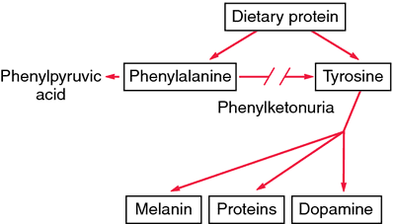
Biological Interaction Example: PKU
Phenylketonuria
Interaction between diet and genetic factor
Can modify diet to address outcomes.
TERATOGENIC!
http://medical-dictionary.thefreedictionary.com/phenylketonuria; Scriver CR (2007) Hum Mutat

Slide 5
Statistical GxE Interaction
This lecture will focus on methods for statistical interaction/effect modification.
Keep in mind these interactions often do not have straightforward biologic interpretation, although some argue for links.
  Non additive effects may imply non-independence of biologic mechanism of actions
    Weinberg (1986), VanderWeele (2008-)
  Multiplicative model may correspond to independent effects on multiple steps of a multi-step carcinogenic model
    Siemiatycki and Thomas (1981)

Slide 6
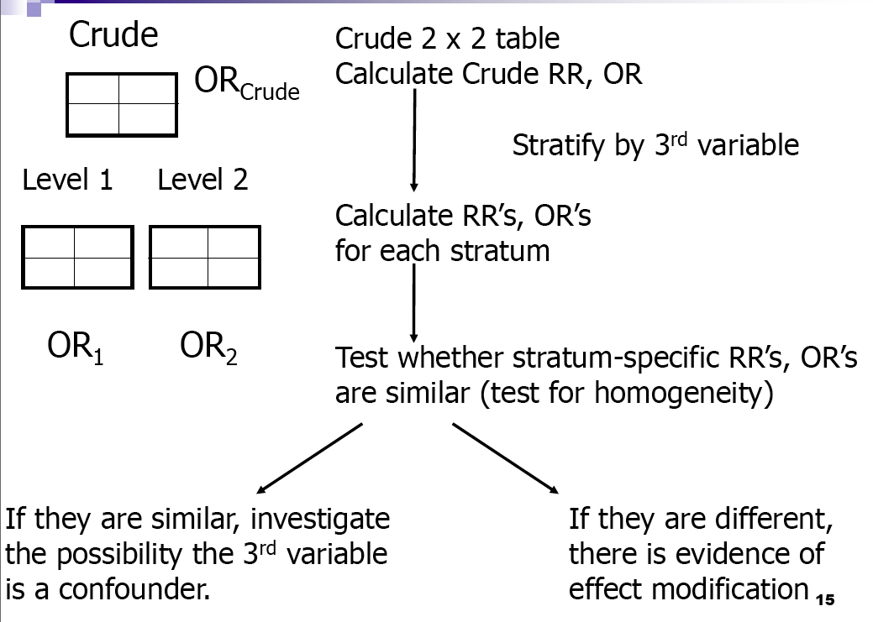
Effect Measure Modification

Slide 7
Venous Thrombosis
Generally manifests as thrombosis of deep leg veins or pulmonary embolism
Incidence in women age 20-49 yrs is ~ 2 /10,000 persons/yr
Case fatality rate is ~ 1% to 2%
  Association between oral contraceptive pill (OCP) and VT: Incidence of VT is ~12 to 34 / 10,000 in OCP users
Notes:
The epidemiology of venous thrombosis is described on this slide.

Slide 8
Factor V Leiden Mutations
R506Q mutation – amino acid substitution
Geographic variation in mutation prevalence
  Frequency of the mutation in populations of European descent is~2% to 10%
  Rare in African and Asians
Relative risk of VT among carriers
  3- to 7-fold higher than non-carriers
Is there a gene-environment interaction?
Notes:
A mutation in Factor V Leiden, which results in an amino acid substitution, also increases risk of VT.

Slide 9
OCP, Factor V Leiden Mutations and Venous Thrombosis
Strata | Cases | Controls
G+E+ | 25 | 2
G+E- | 10 | 4
G-E+ | 84 | 63
G-E- | 36 | 100
OR (95% CI)
OR for G in E+
(25*63)/(2*84)
9.4 (2.1-41.1)
OR for G in E-
(10*100)/(4*36)
6.9 (1.8-31.8)
Total 155 169
Lancet 1994;344:1453
Notes:
These data are presented in the cited manuscript. Individuals who do not carry the mutation but have been exposed to OCP have a ~4-fold increased risk of VT than those who do not carry the mutation and were not exposed to OCP. Those who carry the mutation but have not used OCP have a ~7-fold increased risk of VT compared to those do not carry the mutation or used OCP. However, the risk for individuals with the mutation and exposure to OCP is very high, ~35 times greater than the risk for women with neither the mutation or exposure to OCP.

Slide 10
Alternative way of looking at ORs
Strata | Cases | Controls
G+E+ | 25 | 2
G+E- | 10 | 4
G-E+ | 84 | 63
G-E- | 36 | 100
OR (95% CI)
34.7 (7.8, 310.0)
6.9 (1.8, 31.8)
3.7 (1.2, 6.3)
Reference
Total 155 169
Lancet 1994;344:1453
Notes:
These data are presented in the cited manuscript. Individuals who do not carry the mutation but have been exposed to OCP have a ~4-fold increased risk of VT than those who do not carry the mutation and were not exposed to OCP. Those who carry the mutation but have not used OCP have a ~7-fold increased risk of VT compared to those do not carry the mutation or used OCP. However, the risk for individuals with the mutation and exposure to OCP is very high, ~35 times greater than the risk for women with neither the mutation or exposure to OCP.

Slide 11
Interactions are Scale Dependent
 | G=0 | G=1
E=0 | 1.0 | RR_{G}
E=1 | RR_{E} | RR_{GE}
Multiplicative model
No Interaction: RR_{GE}= RR_{G}× RR_{E}
Relative-risk associated with E is the same by levels of G and reverse
Interaction Relative Risk =RR_{GE}/(RR_{G}× RR_{E})
Additive model
No Interaction: RR_{GE}= RR_{G}+ RR_{E}-1
Risk-difference associated with E is the same by levels of G and reverse
Relative Excess Risk due to Interaction (RERI) =RR_{GE}- RR_{G}- RR_{E}+1

Slide 12
Expectations Using Different Scales
Measurement Scale and Interaction Effect | Cohort Study | Case-control study*
Multiplicative Scale
No Interaction | RR_{GE}=RR_{G}xRR_{E} | OR_{GE}=OR_{G}xOR_{E}
Synergistic Interaction | RR_{GE}>RR_{G}xRR_{E} | OR_{GE}>OR_{G}xOR_{E}
Antagonistic Interaction | RR_{GE}<RR_{G}xRR_{E} | OR_{GE}<OR_{G}xOR_{E}
Additive Scale
No Interaction | RR_{GE}=RR_{G}+RR_{E}-1 | OR_{GE}=OR_{G}+OR_{E}-1
Synergistic Interaction | RR_{GE}>RR_{G}+RR_{E}-1 | OR_{GE}>OR_{G}+OR_{E}-1
Antagonistic Interaction | RR_{GE}<RR_{G}+RR_{E}-1 | OR_{GE}<OR_{G}+OR_{E}-1
* Formulas for the ORs are approximations based on the approximation of the OR to the RR
Adapted from “Genetic Epidemiology: Methods and Applications”. Austin 2013.

Slide 13
OCP, Factor V Leiden Example
 | G=0 | G=1
E=0 | 1.0 | RR_{G}=6.9
E=1 | RR_{E}=3.7 | RR_{GE}=34.7
Multiplicative model
Interaction Relative Risk: RR_{GE}/RR_{G}× RR_{E}
34.7 / 6.9 x 3.7 = 1.4
Additive model
Relative Excess Risk due to Interaction (RERI): RR_{GE}- RR_{G}- RR_{E}+1
34.7 – (6.9 + 3.7 - 1) = 25.1

Slide 14
NAT2, smoking and bladder Cancer
(Garcia-Closas et al., Lancet, 2005)
 | NAT2 rapid/intermediate | NAT2 slow
Never-smoker | 1.0 | 0.9 (0.6-1.3)
Ever-smoker | 2.9 (2.0-4.2) | 4.6 (3.2-6.6)
No effect of NAT2 in the absence of smoking

Slide 15
Kraft and Hunter (2010)

Slide 16
Multiplicative vs. Additive Interactions
Multiplicative
  widely used in practice
    partly due to popularity of logistic regression models
  do not necessarily have mechanistic interpretation
  large sample size is needed to ensure sufficient power
  has been the focus of recent methodologic developments
    case-only, empirical-Bayes, two-stage etc.
Additive model
  much less widely used (although
  has direct relevance for evaluation of targeted intervention and links with mechanistic interaction under the sufficient component framework
  Power is often higher than tests for multiplicative interaction

Slide 17
Aside: Interaction in a Regression Setting
1 if carrier
0 if non-carrier
1 if exposed
0 if unexposed
G
E
Risk of disease
p_{GE} = b₀ + b_{g} G + b_{e} E + b_{ge} GE
Log odds of disease
p_{GE}
log
= β₀ + β_{g} G + β_{e} E + β_{ge} GE
1-p_{GE}
Test for “additive interaction:” H₀ is b_{ge}=0
Test for “(multiplicative) interaction:” H₀ is β_{ge}=0 (Interaction OR e^β_{ge}=1)

Slide 18
In Class ExerCise

Slide 19
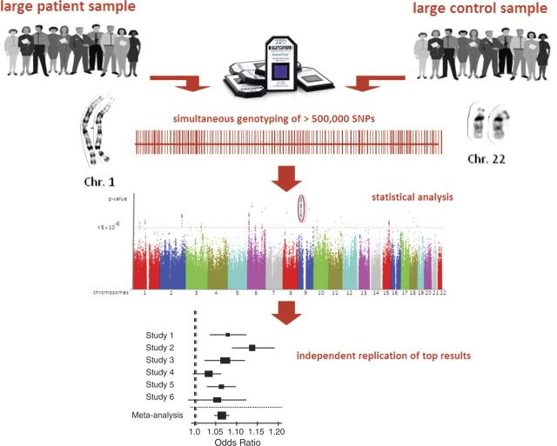
Gene-Environment-Wide Interaction Study
“GEWIS”
Motivated by discovery
Builds on the genome-wide association study model
Gene (G) x environmental factor (E) on a SNP-by-SNP basis across the genome
Schunkert et al.. Eur Heart J. 2010; 31: 918-925.

Slide 20



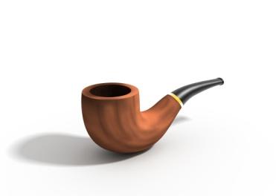

Gene-Environment-Wide Interaction Study
“GEWIS”
Motivated by discovery
Builds on the genome-wide association study model
Gene (G) x environmental factor (E) on a SNP-by-SNP basis across the genome
Schunkert H et al. Eur Heart J 2010;eurheartj.ehq038
Schunkert et al.. Eur Heart J. 2010; 31: 918-925.

Slide 21
Some of the Challenges in “GEWIS”
Power for discovery:
  False-negative findings
  Individual studies with low sample sizes
  Multiple comparisons (multiple G, E and models)
Characterizing and modeling non-genetic risk factors:
  Time dependency
  Measurement error
  Multi-faceted
Interpretation of significant findings:
  Biological plausibility in an agnostic approach
  Heterogeneity and replication
  Translation to clinical or public health relevance
Thomas D. Nat Rev Genet. 2010; 11: 259-72;
Dempfle A. et al., Eur J Hum Genet 2008; 16: 1164-1172.

Slide 22
Goals
Identify methods with high power
Reduce number of false positives

Slide 23
Approaches for GEWIS
Multifactor dimension reduction, and other machine learning techniques
Pathway/hierarchical models
Family based tests
Additive models
Logistic regression-based tests for multiplicative interactions

Slide 24
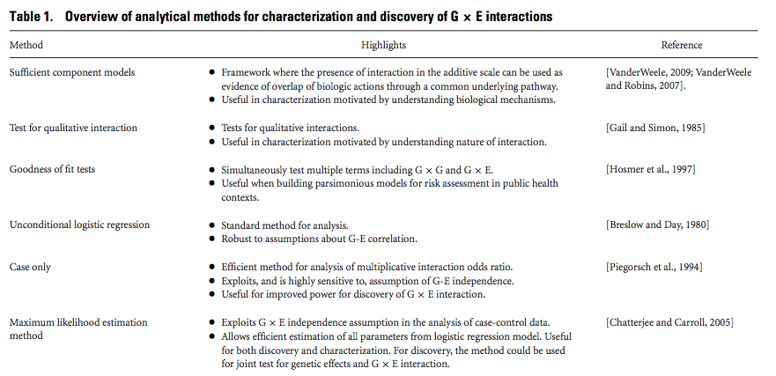
Methods for GxE
See full table in Hutter et al. Genet Epidemiol. 2013 Nov;37(7):643-57. doi: 10.1002/gepi.21756.

Slide 25
Logistic Regression Based Methods for Multiplicative GxE
Method | Key Details
Case-control | Robust model; Does not assume G-E independence; low power for discovery.
Case-only | Gains in power and efficiency under G-E independence.
Data-adaptive estimators (e.g. Empirical Bayes and Bayesian Model Averaging) | Increased power versus case-control and improved control of type 1 error versus case-only.
Two-step procedures | Screening step and testing step. Maintains type 1 error and provides power gain under many settings.
Joint-test of genetic main effect and GxE (2 degree of freedom tests) | Tests null hypothesis that genetic marker is not associated with disease in any stratum defined by exposure.
Modified from Mukherjee et al. Am J. of Epidemiology. 2012; 175(3): 177-190.

Slide 26
Case-only Design
Case-only approach tests the association between the genotype and exposure in the cases only.
Has higher statistical power than standard case-control method with same number of cases.
Relies on assumption that genetic and environmental factors are independent in the source population.
Increased false-positive rate if assumption is violated.

Slide 27
2x2x2 Representation of Unmatched Case-Control Study Examined by Standard Test for GxE Interaction
OR(GxE) = OR(G-E|D=1)/OR(G-E|D=0).
Assuming OR(G-E|D-0)=1 greatly reduces the variability in OR(GxE).
The case-only estimate of OR(GxE) is ag/ce.
Piegorsch (1994)

Slide 28
Extensions of Case-only method.
The gain in power comes from the assumption of G-E independence, not the fact that only cases are used.
Can build assumption into the analysis of case-control data.
  allow for estimation of main effects
  Allow for estimates/tests of interaction effects other than multiplicative odds model.
  See Han et al. AJE 2012.
“Hedge” methods weighted towards case-only method if data supports independence assumption, towards case-control method if assumption appears to be violated.
  Emperical Bayes, model averaging methods
  Mukherjee et al 2012; Li and Conti 2009
Use of case-only design and/or G-E independence assumption in new methods for large-scale GxE analysis

Slide 29
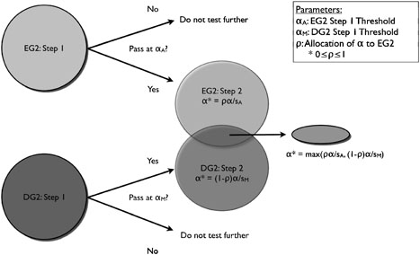
Two-Step Methods
Step 1: Screening Step
Prioritize SNPs for testing:
  Correlation between G and E in full sample of cases and controls
  Marginal association between G and outcome (D)
  Hybrid approaches
Step 2: Testing Step
Test for interaction in prioritized SNPs with appropriate significance levels.
Hybrid approach proposed by Murcray et al 2011.
Murcray CE, et al. Am J Epidemiol 2009; 169: 219-226.
Murcray CE, et al. Genet Epidemiol 2011; 35: 201-210.
Kooperberg C and Leblanc M. Genet Epidemiol. 2008; 32: 255-63.

Slide 30
Modules Framework for GxE Methods
Module A:
Screening
Module B:
Multiple
Comparisons
Module C:
Testing
No Screening
Marginal (G-D association)
Correlation (G-E)
Hybrid approaches
Bonferroni testing
Permutations
Weighted hypothesis testing
Case-control
Case-only
Empirical Bayes
Bayesian Model Averaging
Modified from Hsu et al. Genetic Epidemiology 2012; in press.

Slide 31
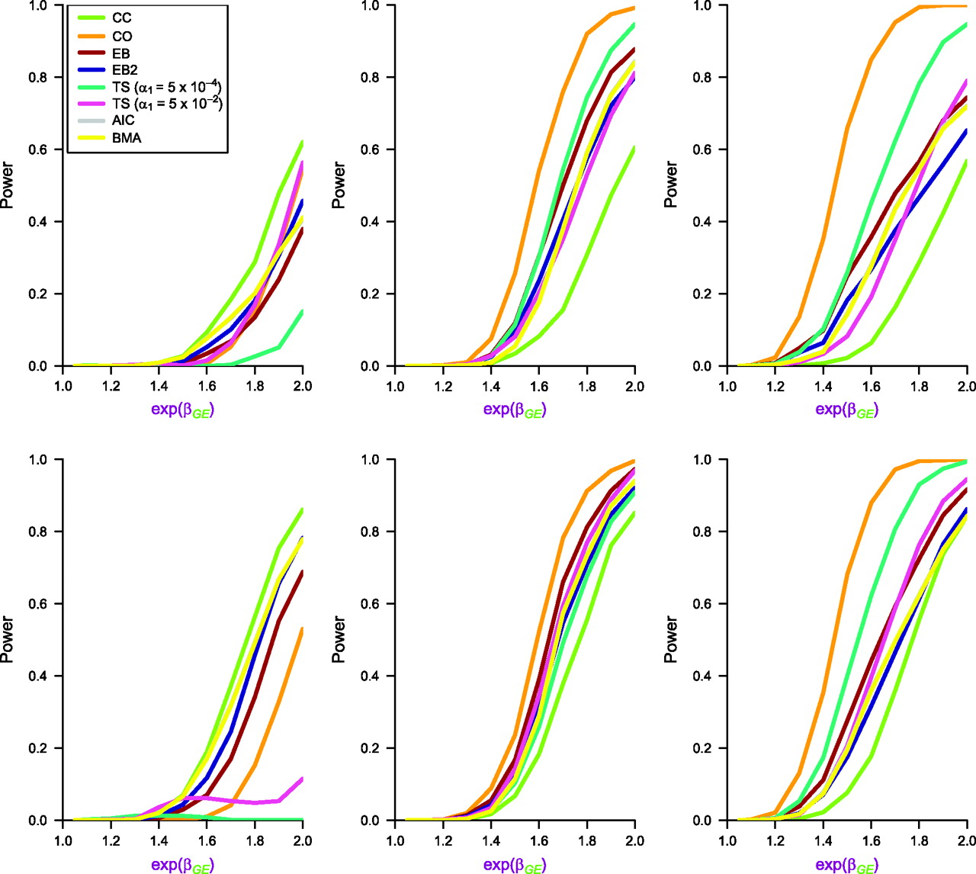
Power Considerations
Rule of thumb is that tests of interactions need sample sizes 4 times larger than tests of main effects.
All methods require large sample sizes (on the order of 10,000 cases) for reasonable effect sizes.
The most powerful method depends on assumptions on underlying interaction.
Hybrid and cocktail methods tend to be relatively powerful over a wider variety of types of interactions.
G,E neg. correlated
G,E independent
G,E pos. correlated
Mukherjee B et al. Am. J. Epidemiol. 2012;175:177-190

Slide 32
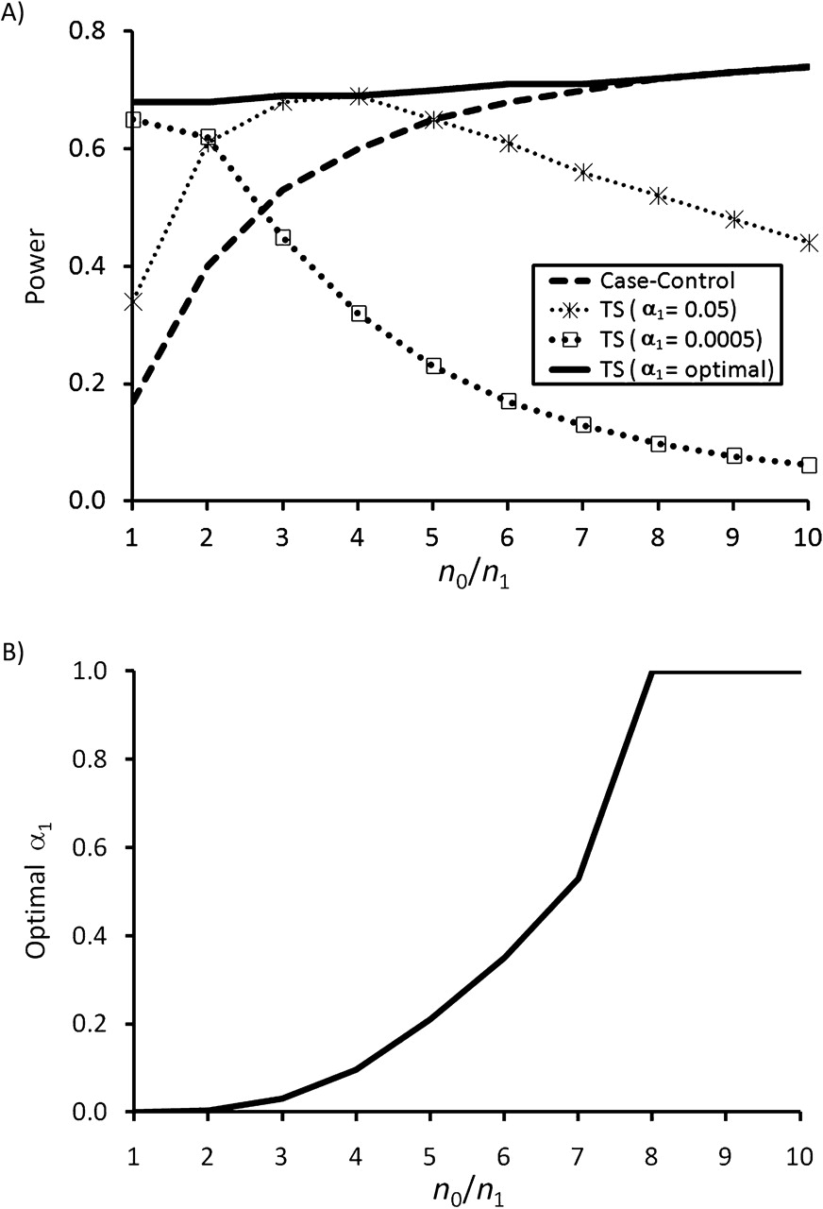
Practical Considerations
Choosing optimal alpha/weights
Case:control ratio
Linkage disequilibrium between top SNPs
Computational needs
Emperical power for two-step methods for diffferent alpha thresholds as a function of the ratio of cases to controls(n_{o}/n₁). N₁=2,000; R_{ge}=1.8; Pr(E)=0.5.
Thomas D, et al. Am. J. Epidemiol. 2012;175:: 203-7.

Slide 33
Software for analysis
Software | Good for | URL
PLINK | GWAS, data handling, GE test, joint test | http://pngu.mgh.harvard.edu/~purcell/plink/
ProbABEL | GWAS, computes robust variance-covariance matrix | http://www.genabel.org/packages/ProbABEL
GxEscan | R script incorporating multiple GWAS GxE tests | http://biostats.usc.edu/software
Multassoc | Test a group of SNPs taking interaction with other G, E into account | http://dceg.cancer.gov/tools/analysis/multassoc
R | Flexible, write your own scripts | http://www.r-project.org/
METAL | Meta-analysis | http://www.sph.umich.edu/csg/abecasis/metal/

Slide 34
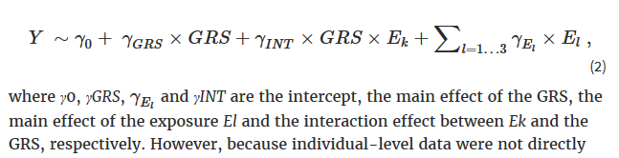
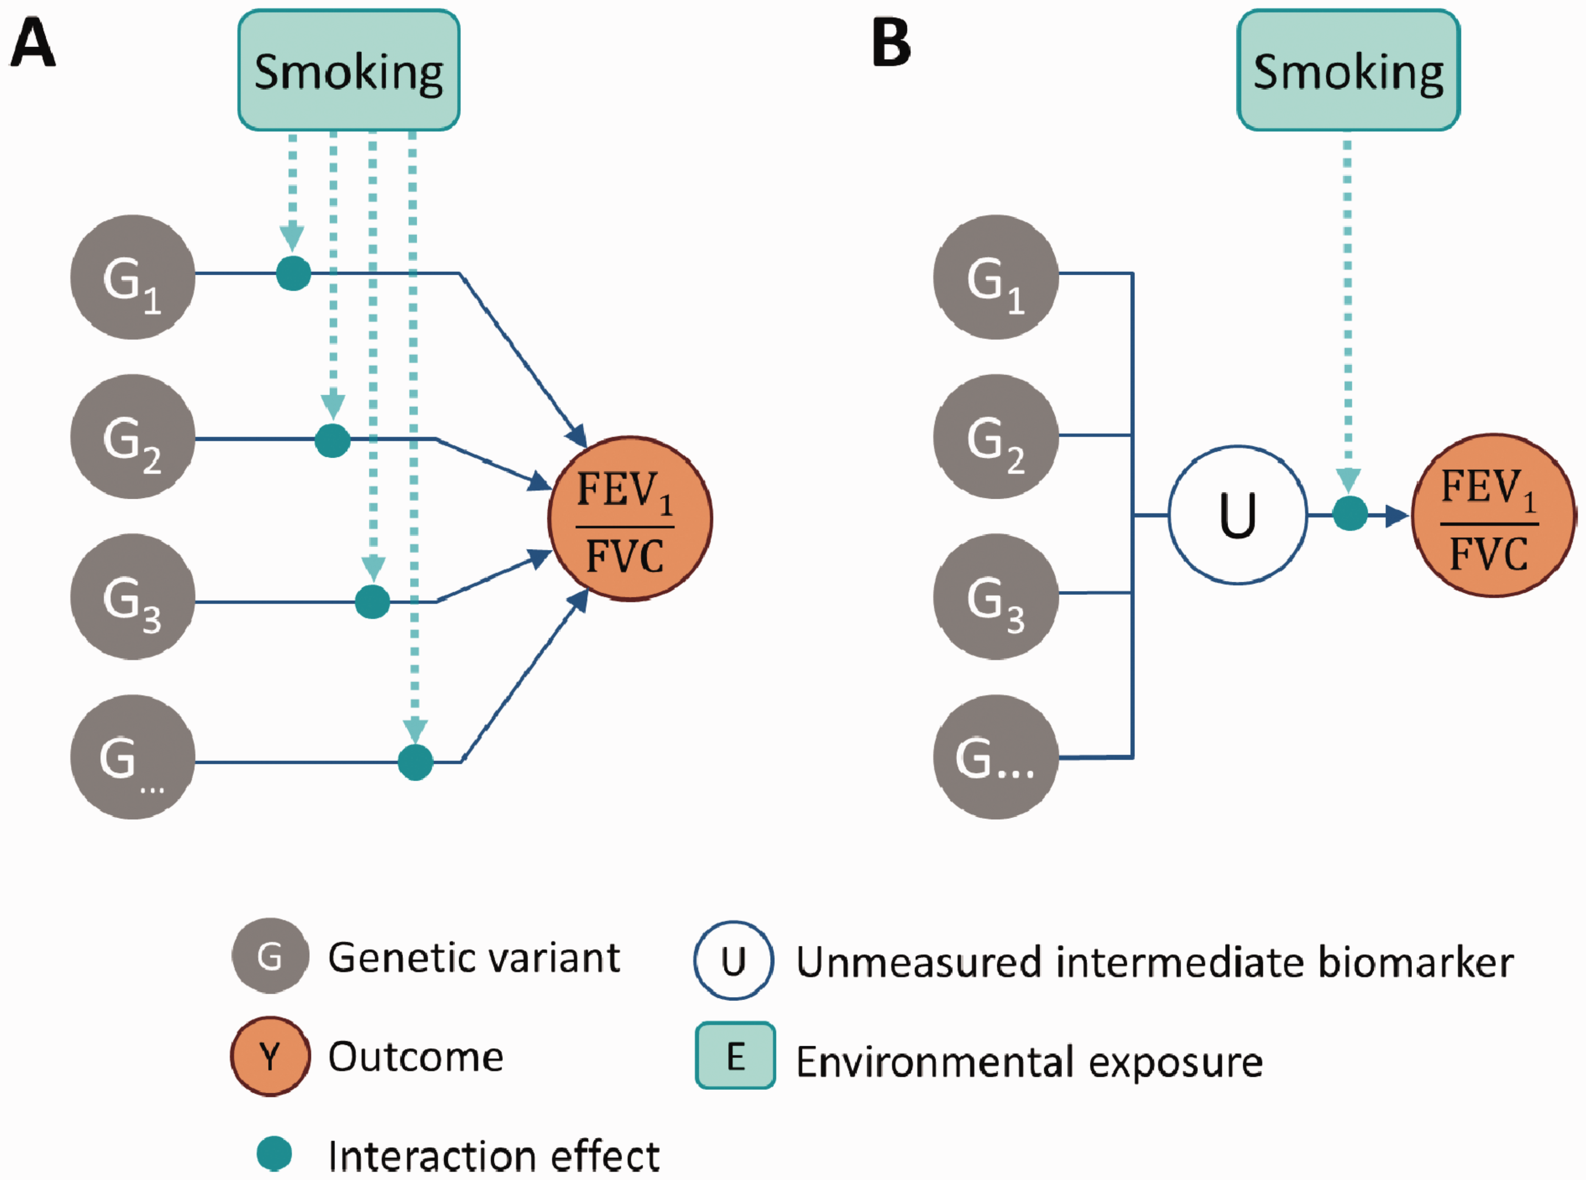
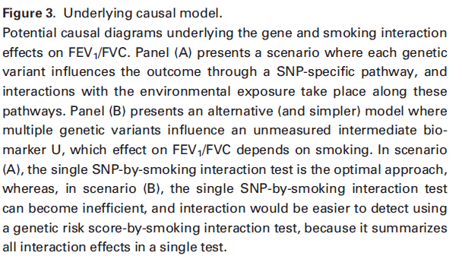
Extending beyond single SNP models
genetic risk score (GRS)-by exposure (E) test
International Journal of Epidemiology, 2017, 1–11; doi: 10.1093/ije/dyw318

Slide 35
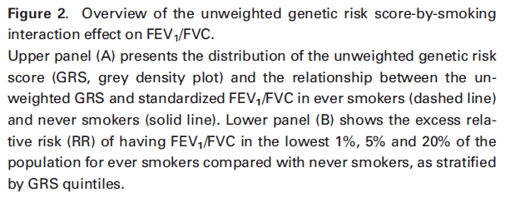
International Journal of Epidemiology, 2017, 1–11; doi: 10.1093/ije/dyw318

Slide 36
Extending beyond single SNP models
Tomorrow we will discuss approaches for rare variant discovery
Additional methods are being developed to consider GxE in the context of rare variants (gene or set based approaches)

Slide 37
Epidemiology of GxE

Slide 38
Different Motivations for Studying GxE
DISCOVERY
CHARACTERIZATION
Identify novel loci
Focus on variants that would not be found in marginal search alone
Priority given to power
Hypothesis generating
Describe interaction
Focus on putative and established variants
Priority given to descriptive model
Provides etiologic insight

Slide 39
Genetic Epidemiology with a Capital “E”
Thomas DC (2000)
Khoury MJ (2011)
Focus on population-based research
Joint effects of genes and the environment
Incorporation of underlying biology
Large scale harmonized cohorts and consortia
Multilevel factors (includes GxE and more) across the lifestyle
Incorporation of underlying biology
Integrating, evaluating and translating knowledge
Slide by Muin Khoury

Slide 40
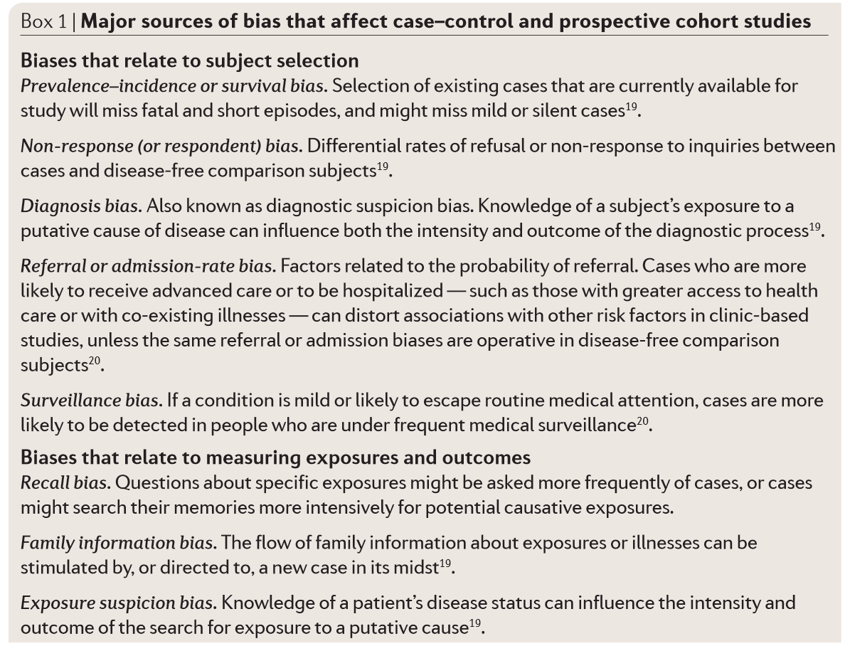
Sources of Bias in Epidemiology
Selection Bias
  Arises from issues in case/control ascertainment
Information Bias
  Arises from measurement error or misclassification in assessing factors of interest.
Confounding
  Arises when there is an extraneous disease risk factor that is also associated with exposure and not in the causal pathway.
Manolio et al. Nat Rev Genet. 2006. 7: 812-820.

Slide 41
Sources of Bias in G and GxE
Method | Key Considerations
Selection Bias | Issues of poor control selection and incomplete case ascertainment. Need to consider non-respondants, people who refuse or are unable to provide DNA/data
Information Bias | Errors in questionnaire, specimen handling Highlights importance of lab QC Can impact type I and type II error for GxE
Confounding | Population stratification for G “Traditional” factors for E Under certain conditions “confounders” can bias the interaction term (see, for example, Tchetgen Tchtgen and VanderWeele 2012).
Concerns of all three of these factors increase when examining GxE in existing genetic studies that used “convenient controls”.
Presence of these biases may contribute to disparate findings in literature and issues in replication.
Modified from Garcia-Closas et al. in Human Genome Epidemiology. 2004.

Slide 42
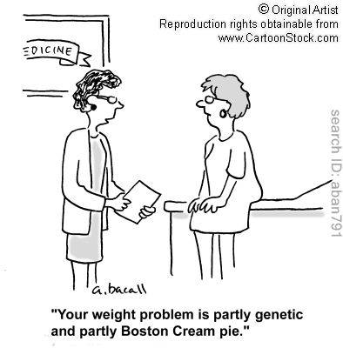
Challenges to Investigations of GXE
“Data harmonization, population heterogeneity, and imprecise measurements of exposures across studies”
Khoury et Al, 2012
“Establishing the existence of and interpreting GXE interactions is difficult for many reasons, including, but not limited to, the selection of theoretical and statistical models and the ability to measure accurately both the G and E components.” Boffetta et Al, 2012

Slide 43
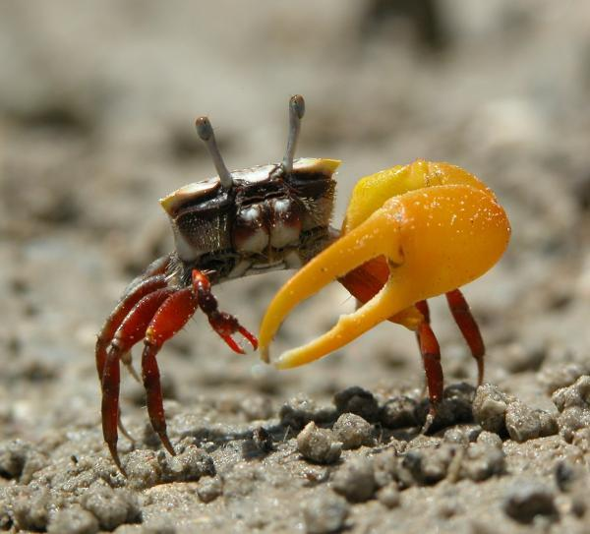
The Fiddler Crab Analogy*
Issues of imbalance in how we look at G and E
Complications with how we look at E:
  Distribution of E
  Measurement error
  Multi-faceted
* Credited to Chris Wild (CEBP, 2005. 14: 1847-1850) via Duncan Thomas

Slide 44
Measurement Error
Environmental factors are often complex, multifaceted and difficult to measure.
Measurement error can lead to both type I and type II error for GxE.
Statistical methods to correct misclassification exist, but are infrequently used for GxE.
Measurement error has strong impact on power to detect GxE.
Additional issues arise when considering GxE across multiple studies

Slide 45
Using Traditional “Environmental Data” in Consortium Settings
Large sample-sizes needed to detect GxE: often need to combine data across studies.
Data harmonization is the process of combining information on key data elements from individual studies in a manner that renders them inferentially equivalent.

Slide 46


Harmonization Resources for Phenotype Data
Identify and document a set of core variables
Assess the potential to share each variable between studies
Define appropriate data processing algorithms
Process and synthesize real data.
Develop a recommended minimal set of high priority measures
Toolkit provides standard measures related to complex diseases, phenotypic traits and environmental exposures
Fortier I et al. Int. J. Epidemiol. 2011;40:1314-1328
Hamilton CM et al. Am J Epidemiol. 2011; 174:253-60.

Slide 47

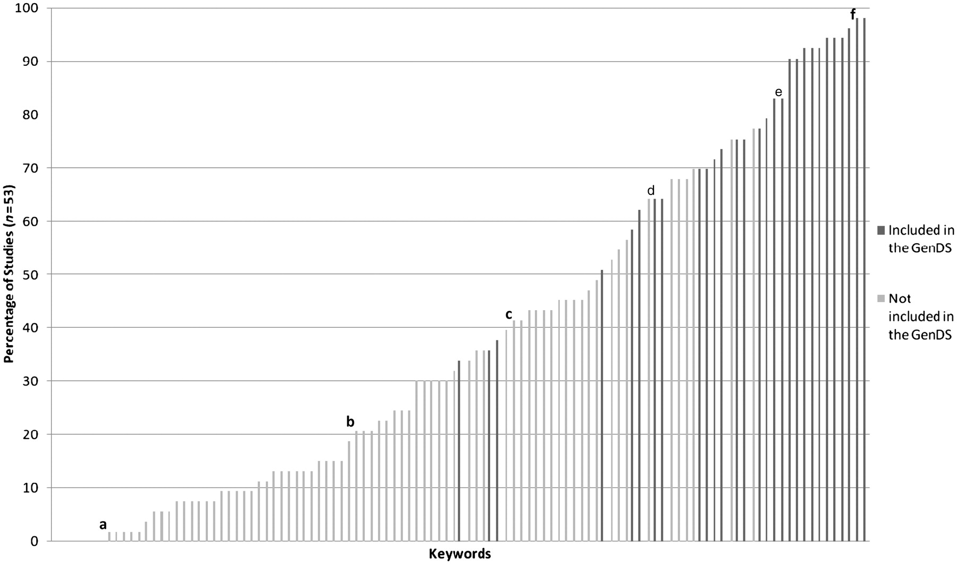
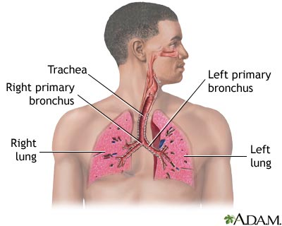
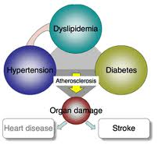
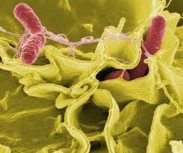

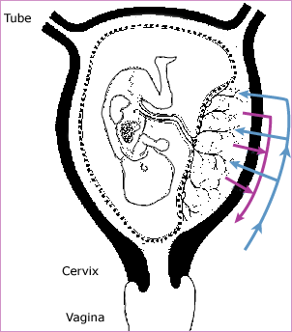
Some variables are more “harmonizable” than others (DataSHaPER approach across 53 studies).
Fortier I et al. Int. J. Epidemiol. 2011;40:1314-1328
Notes:
Percentage of studies covering keywords included and not included in the Generic DataSchema. Example of keywords not included in the Generic DataSchema (percentage of studies covering): (a) Certain conditions originating in the perinatal period (2%); (b) Language (21%) and (c) Certain infectious and parasitic diseases (42%). Example of keywords included in the Generic DataSchema (percentage of studies covering): (d) Endocrine, nutritional and metabolic diseases (64%); (e) Diseases of the respiratory system (83%) and (f) Tobacco use (98%)‏

Slide 48

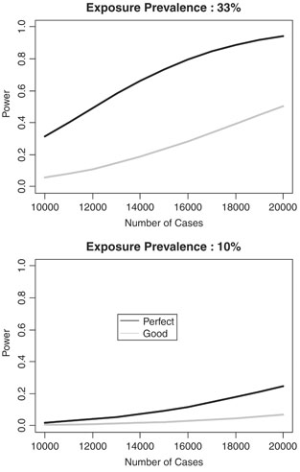
Trade-offs in Data Harmonization
Cost of collecting rich phenotype information can put restrictions of sample size for detailed measures
Genetic and environmental heterogeneity are likely present in large samples from multiple studies
Combining across studies may require identifying the “least common denominator”
Harmonization can induce misclassification and heterogeneity.
Power to detect GxE when exposure is measured perfectly or via a good proxy (77% specificity and 99% sensitivity). Interaction OR=1.35, type 1 error=5x10-8.
Bennett SN, et al. Genet Epidemiol. 2011; 35: 159-173.

Slide 49
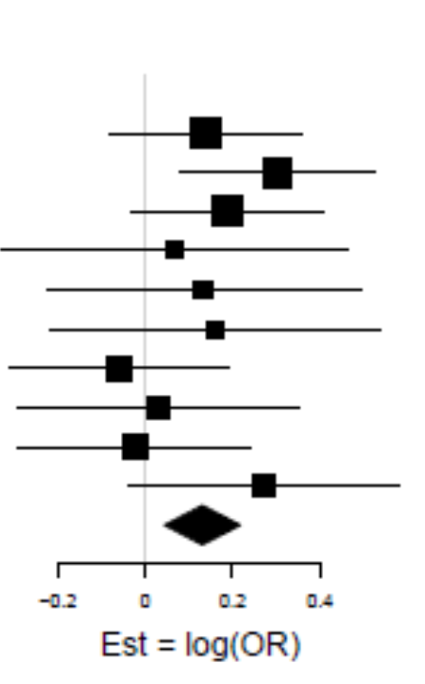
Heterogeneity
“If explanations can be found for heterogeneity, there is an opportunity for insights about the complexity of the disease, but spurious inconsistency due to methodological or data-quality differences will just add confusion”
- Thomas 2010

Slide 50
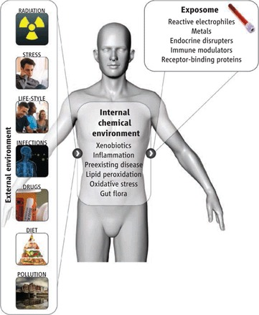
Beyond Data Harmonization
We may be missing key environmental factors
Measuring the environment often does not have the same “economy of scale”
The multifactoral and dynamic nature of exposure/risk can complicate the study of environmental factors
Rappaport SM and Smith MT. Science 2010; 330: 460-461.

Slide 51
Summary
Gene-environment wide interaction studies are used for discovery and characterization.
Remember distinction between biological and statistical interaction.
Important to consider scale (additive vs. multiplicative)
Large sample sizes are needed for GxE studies, particularly for GEWIS.
Data harmonization allows core variables to be combined across studies.
We need to give the “E” similar, if not more, attention than we give the “G” for GxE analysis.

Slide 52
In Class ExerCise

Slide 53
In Class Exercise:
You continue to work with collaborators on the FAKE study. They decide to follow-up on their candidate gene study with a genome-wide association study (GWAS). They were only able to afford genome-wide genotyping on a subset of the subjects, so they decide to reach out to their collaborators in the Meta-Analysis of Diet and Environment for Understanding Phenotypes (MADE-UP) consortia. The next page has “table 1” for the 8 studies in this consortia. Brainstorm with your group about the following:
  What are potential issues/challenges that you might encounter in analyzing this data?
  What are solutions might you use for some of these challenges?
  What additional information would be most helpful for you to have?

Slide 54
