Slide 1
Genetic Epidemiology
Instructors: Carolyn Hutter & Karen Edwards

Slide 2
Big Picture Learning Goals
Familiarity with major study designs used in genetic epidemiology
Familiarity with major issues associated with each approach
Aware of software and web resources used in genetic epidemiology

Slide 3
Course Objectives
The objective of this course is to provide an introduction to methods and applications of genetic epidemiology.
Students will be exposed to basic concepts and principles of genetic epidemiology, including:
study designs for family based and population based studies
analytical methods used in studies of linkage and association
modern approaches to gene-environment interactions and rare variant analysis
key web resources for analysis and interpretation
relevant literature in the field

Slide 4
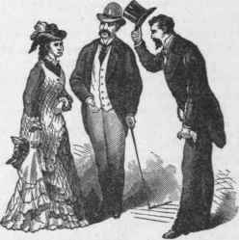
Class introductions
Break into groups of 2-3
Introduce yourselves to one-another, and you will introduce your group members to the class.
Items to include:
Name
“Day-job”
Main objective for taking this course
Thing most excited to learn in over the next 3 days

Slide 5
Introduction to Epidemiology

Slide 6
Definitions, Objectives and Historic Examples

Slide 7
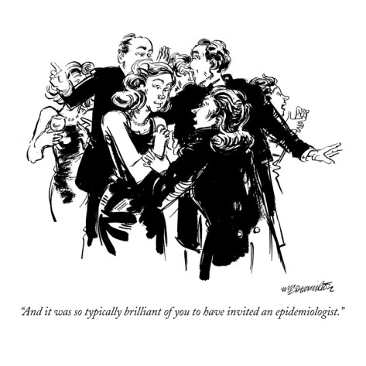
THINK-PAIR-SHARE ACTIVITY 1. Define “Epidemiology”
2. Give an example of what an epidemiologist does

Slide 8
Definitions of Epidemiology

Slide 9
Definitions of Epidemiology
Greek Etymology
Epi - upon, among, on, over
Demos- people, populance
Logos- study, word, discourse, count
the study of the distribution and determinants of health-related states in specified populations, and the application of this study to control health problems - Last
the study of how disease is distributed in populations and the factors that influence or determine this distribution – Gordis
a branch of medical science that deals with the incidence, distribution, and control of disease in a population – Merriam-Webster
Epidemiology is the study (or the science of the study) of the patterns, causes, and effects of health and disease conditions in defined populations. - Wikipedia

Slide 10
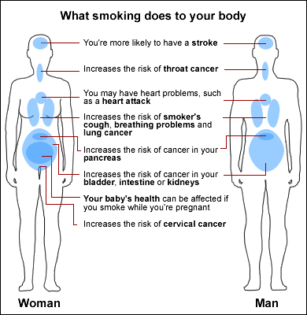
Objectives of Epidemiology
Identify disease etiology
Determine the burden of disease
Study the natural history of disease
Evaluate preventive and therapeutic measures
Provide foundation for public policy
http://www.webmd.boots.com/a-to-z-guides/tc/smoking-what-will-happen

Slide 11
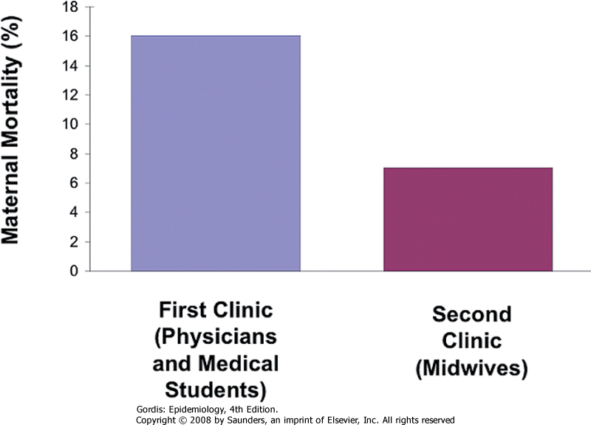
Ignaz Semmelweis - 1846
Childbed Fever
Major cause of death post childbirth
Theories included putrid air, solar influences, etc.
Obstetrical Clinics of the Allgmeine Krankenhaus
1st Clinic
Physicians and Medical Students
Performed autopsies at start of the day
Mortality: 16%
2nd Clinic
Midwives
No autopsies
Mortality: 7%
© 2005 Elsevier

Slide 12
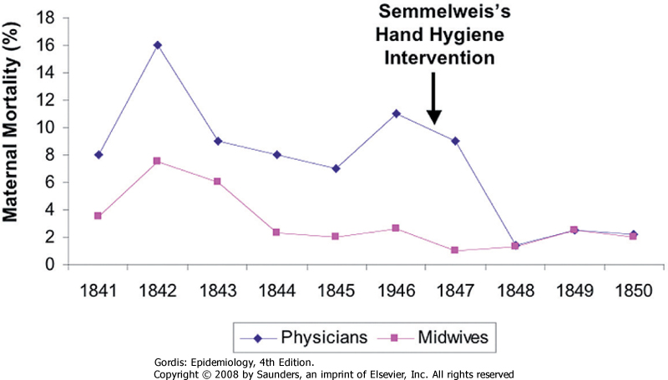
Suggested transmission of disease from cadavers to women
Noted a colleague died from similar infection after being punctured during an autopsy
Implemented policy that physicians and students wash hands and scrub nails after autopsy, before contact with patients:

Slide 13
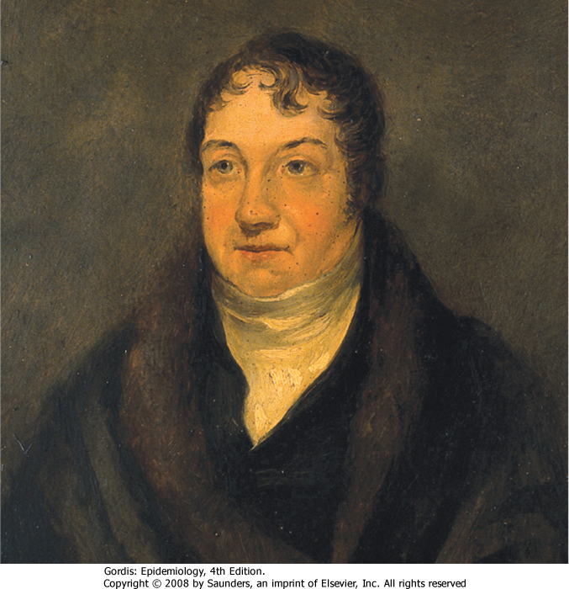
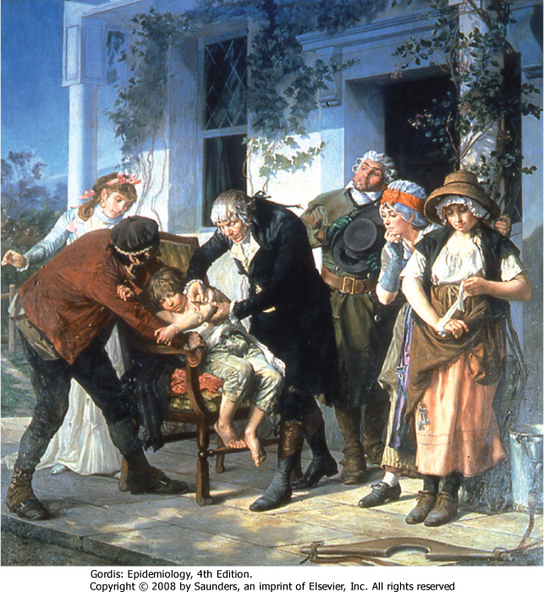
Edward Jenner - 1796
Smallpox
400,000 people died per year in Europe
Devastating when introduced to Americas (biological warfare)
Case fatality rate of 40-60%
Variolation and vaccination
Originally infected healthy individuals with material from smallpox patients.
Jenner noted that dairy maids, who were exposed to cowpox, did not develop smallpox.

Slide 14
Smallpox Eradication
1967
~15 million cases per year
~2 million deaths
WHO starts efforts to eradicate smallpox
1980
WHO certifies that smallpox has been eradicated
Last natural case in 1977
Last US vaccinations in 1972
2001
Increased concern about smallpox and bioterrorism
2014
Small pox found in NIH storage refrigerator

Slide 15
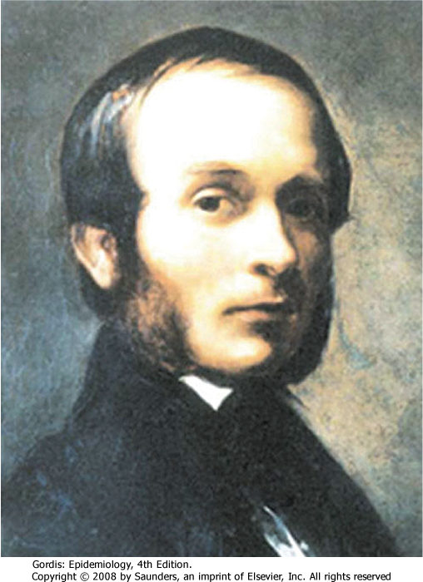
John Snow- 1854
Cholera
Severe bacterial infection
Miasmatic theory of disease
London in the 1800s
Multiple cholera pandemics 1831-1854
1949 John Snow published that cholera was caused by water

Slide 16
“Father of Modern Epidemiology”
Combined field work with statistical methods to examine water sources used by people with cholera.
Broad Street Pump
Collected records on 83 deaths
Noted unexpected non-cases
Grand Experiment
Multiple companies supplied same
Neighborhoods
Noted that the Lambeth Company
moved intake to a less polluted source
Notes:
Workhouse with only 5/535 inmates
Brewery where workers drank beer

Slide 17
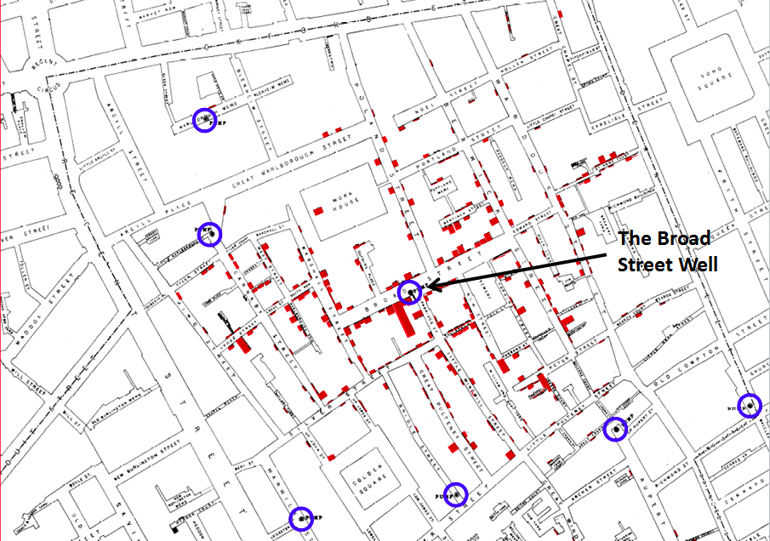
John Snow’s Map
http://scienceblogs.com/significantfigures/index.php/2013/03/11/200-years-of-dr-john-snow-a-significant-figure-in-the-world-of-water/
http://www.youtube.com/watch?v=Pq32LB8j2K8

Slide 18
Richard Doll and Bradford Hill- 1952
Smoking and lung cancer
1920s health care workers noted that many lung cancer patients also smoked
Incidence of lung cancer in men over 45 rose 6 fold from 1930 to 1945
Cars or other industrial changes.
Experimental design
Case-control study
Looked at hospital patients with and without cancer.
Cohort study
Prospectively followed >40,000 physicians

Slide 19
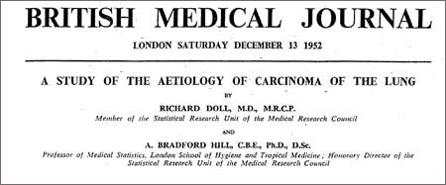
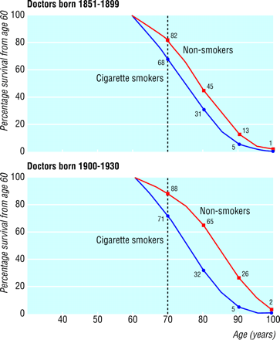
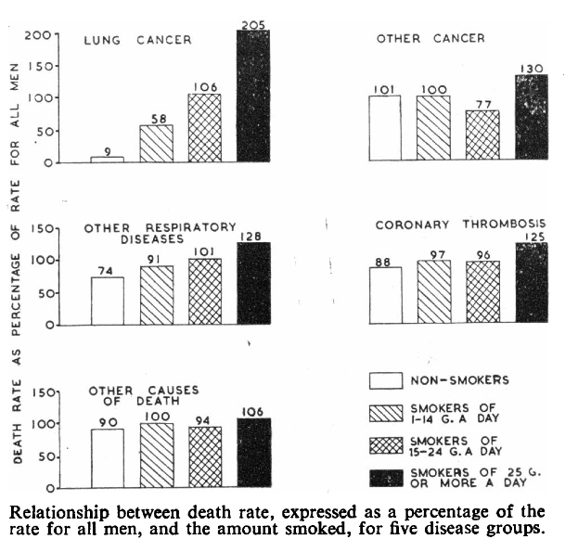
BMJ 2004;328:1519

Slide 20
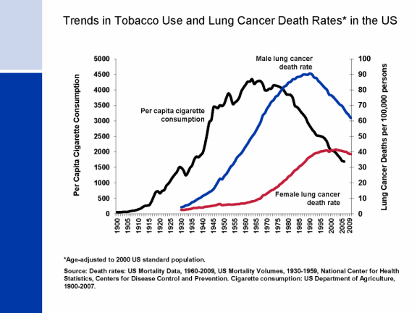
US Lung Cancer Trends

Slide 21
Descriptive and Analytic Epidemiology

Slide 22
Descriptive vs. Analytical Epidemiology
Descriptive Epidemiology
Includes activities related to characterizing the distribution of diseases within a population
Analytical Epidemiology
Concerns activities related to identifying possible causes for the occurrence of diseases

Slide 23
Objectives of Descriptive Epidemiology
To evaluate trends in health and disease and allow comparisons among countries and subgroups within countries
To provide a basis for planning, provision and evaluation of services
To identify problems to be studied by analytic methods and to test hypotheses related to those problems
PLACE
TIME
PERSON
Think of this as the standard dimensions used to track the occurrence of a disease.

Slide 24
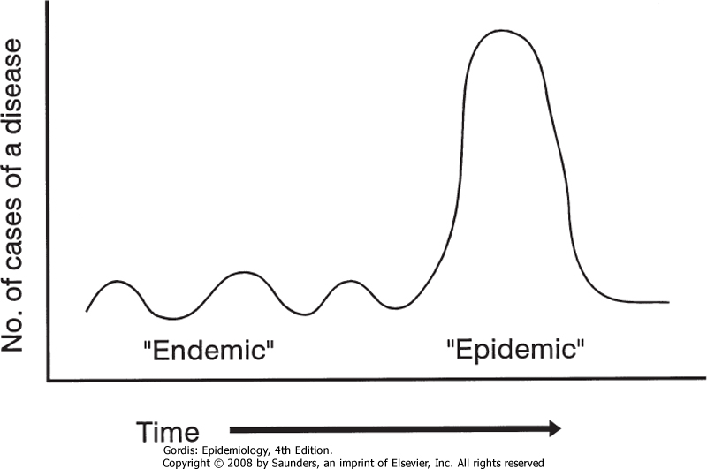
Some Definitions
Endemic
Habitual presence of a disease in a given area
Usual prevalence of disease within such an area
Epidemic
Occurrence in a community or region of a group of illnesses of similar nature in excess of normal expectancy.
Derived from common or propagated source.
Often called “outbreak”
Pandemic
Epidemic over a wide geographic area.

Slide 25
Key Measures in Epidemiology
Morbidity Measures
Mortality Measures
Incidence (new cases)
Cumulative incidence (proportion)
Incidence rate (new cases per unit time)
Prevalence (Existing cases)
Existing cases
Point prevalence (proportion)
Period prevalence
Mortality rate (number of deaths per unit time)
Cumulative mortality (proportion)
Case-fatality rate (proportion of subjects with disease that die from that disease)
Proportionate mortality (proportion of people who die, who died from a specific disease- be careful when using this measure)
The denominator is a key part of measures in epidemiology.

Slide 26
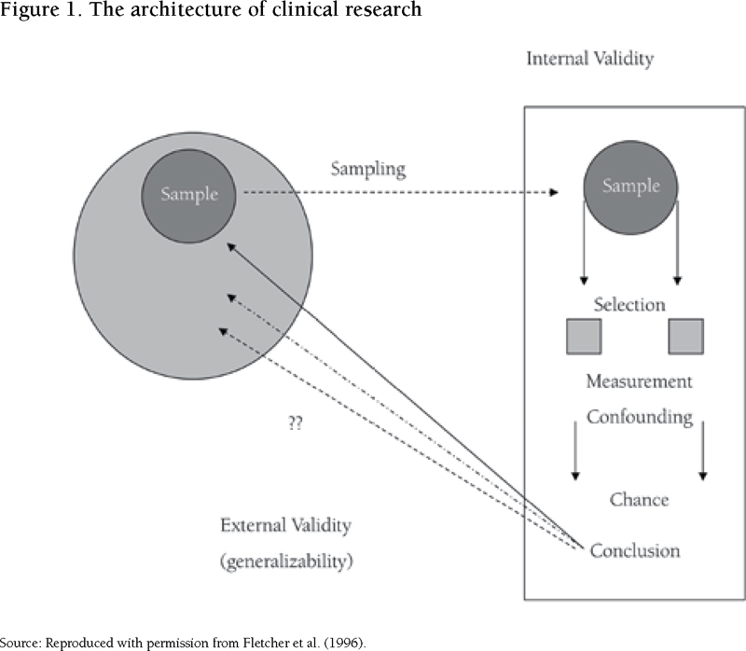
Goal in Analytical Epidemiology
Test a hypothesis about relationship between exposure(s) and disease(s)
Consider Internal Validity
Ideal: Free from bias in design,
implement, analyze and interpretation
Reality: We need to address biases
Consider External Validity
Ideal: Generalizable
Reality: Applies to study population,
infer more broadly

Slide 27
Study Designs for Analytical Epidemiology

Slide 28
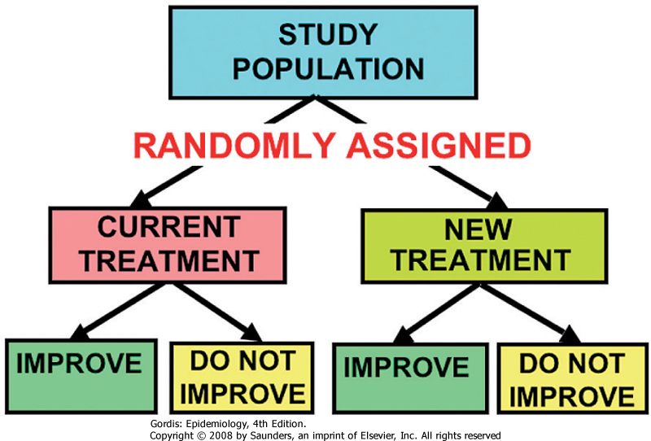
Randomized Trials
RCTs
Randomized Clinical Trials
Randomized Control Trials
Often used for studies of treatment/drugs in relation to prognosis
Can also be used in other settings, including studies of risk and prevention
Key elements:
Study population is defined
Study population is randomly assigned to two (or more) study “arms”
Outcomes are compared for the different arms

Slide 29
Cohort and Case-Control Studies
Observational study designs used in epidemiology
Consider strengths, limitations and sources of bias
Cohort Study
Steps: Define cohort, take baseline measurements and exposure status, ascertain outcome information, compare incidence in exposed and unexposed
Can be prospective or retrospective
Case-Control Study
Steps: Identify cases, identify/select controls, collect exposure history prior to disase onset, compare odds of exposure in cases to odds in controls
Key step is identifying an appropriate control group
© 2005 Elsevier

Slide 30
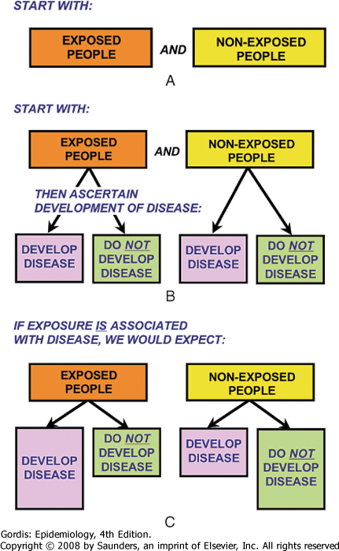
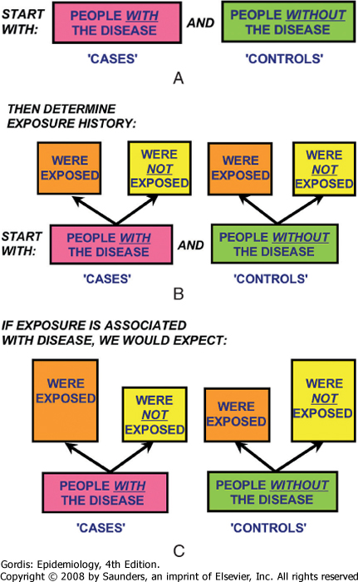
Cohort
Case-Control
Downloaded from: StudentConsult (on 29 September 2013 04:59 PM)
© 2005 Elsevier

Slide 31
Cohort Study
Strengths
Limitations
Temporal sequence
Allows measurement of incidence rate and risk
Can examine multiple outcomes
Allows examination of rare exposures
Minimizes information bias for exposure
Minimizes survivor bias
Ineffective for rare diseases
Often requires large sample
Often requires long time to complete (lag-time)
Expensive
Attrition/sensitive to loss to follow-up
May have differential ascertainment of outcome
Confounding can occur

Slide 32
Case-Control Study
Strengths
Limitations
Can examine multiple exposures
Allows examination of rare diseases
Minimizes information bias for exposure
Applicable when long lag time
Compared to cohort studies, they are often smaller and require less time and money
Control selection can be difficult
Recall limitations and recall bias
Sample size issues for rare exposures
Cannot directly estimate incidence rates, relative risks or attributable risk.

Slide 33
Measures of Association
Note: Some slides in this lecture come from:
http://www.teachepi.org/documents/courses/fundamentals/Pai_Lecture4_Measures%20of%20Effect%20and%20Impact.pdf
Others from University of Washington EPI 420 materials

Slide 34
Main Measures of Association
Relative Risk
measure of the relative probability of developing disease based on exposure status
Attributable Risk
measure of the amount of excess disease incidence attributed to the exposure of interest
Odds Ratio
measure of the relative odds of exposure based on disease status (can approximate the RR)

Slide 35
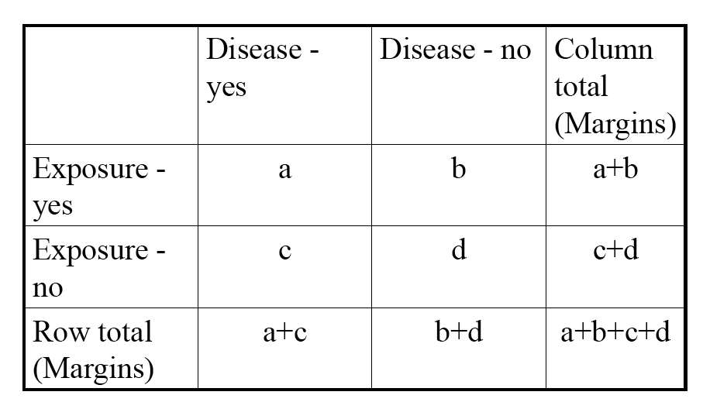
The 2x2 Table For Count Data

Slide 36
Relative Risk (RR) For Count Data
Used in Randomized trials Cohort studies
Based on cumulative incidence measure
AKA: Risk Ratio
If no association RR=1
Disease
Exposure
+
-
Total
+
a
b
a+b
-
c
d
c+d
RR =
a/(a+b)‏
=
(Incidence of Disease in Exposed)‏
c/(c+d)‏
(Incidence of Disease in Unexposed)‏

Slide 37
Attributable Risk (AR) for Count Data
Disease
Used in Randomized trials and Cohort studies
AKA: Risk Difference*
Difference in risk between exposed and unexposed
If no association AR=0
Exposure
+
-
Total
+
a
b
a+b
-
c
d
c+d
AR =
a/(a+b) - c/(c+d)‏
=
Incidence(exposed) – Incidence(unexposed)‏
* Note: Some argue that you should use the term risk difference when testing for association, and only use “Attributable Risk” for when you have established causality.

Slide 38
Odds Ratio (OR) for Count Data
Used primarily in Case Control Studies (also in Cohort)‏
AKA: Relative Odds
Good estimate of RR
If no association OR=1
Disease
Exposure
+
-
Total
+
a
b
a+b
-
c
d
c+d
OR =
a/c
=
a*d
=
(Odds of Exposure among Cases)‏
b/d
b*c
(Odds of Exposure among Controls)‏

Slide 39
What are Odds?
Odds: Ratio of ways an event can occur to ways the event can not occur.
Odds of 1:1 indicate both options are easily likely.
When rolling dice, probability of getting a 2 is 1/6
Odds of getting a 2 is 1:5.
Used in epidemiology, because of situations where we calculate odds ratios
Case-control studies
Logistic regression
If P=probability of event, then odds=
If P is very small, 1-P≈1 and odds=

Slide 40
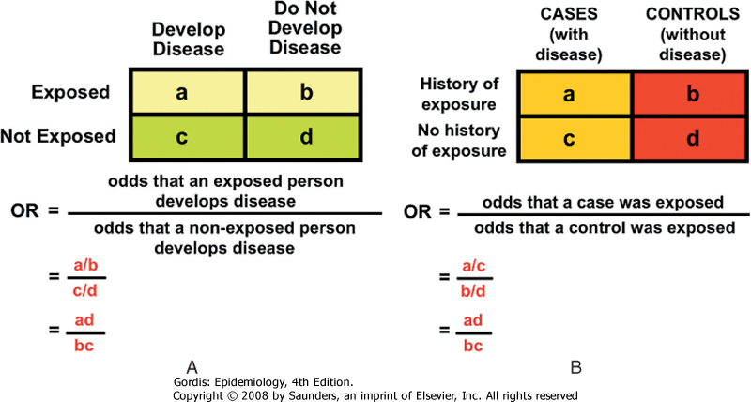
Odds Ratio in Cohort Study and Case-Control Study Reduce to Same Calculation

Slide 41
Odds Ratio Estimates Relative Risk When Disease is Rare
The OR will be a good estimate of the RR if the outcome is rare.
If the outcome is common, and association is positive, then the OR will overestimate the RR
This overestimation can be quite large for common outcomes.

Slide 42
Confidence Intervals and p-values
Presentation so far has focused on point estimates
Gives information on magnitude of association
Statistical software will also provide estimate of confidence intervals and p-values
Important to consider precision and statistical significance, along with estimate of magnitude of association.

Slide 43
Bias, Confounding, and Causal Inference

Slide 44
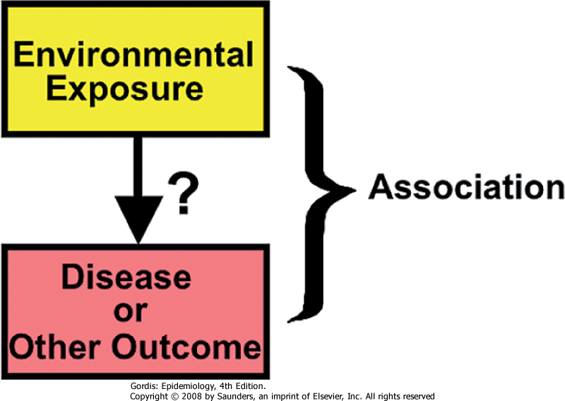
Association and Causality
An exposure and outcome are associated if there is a differential distribution:
Incidence of outcome differs for exposed and unexposed group; or
Prevalence of exposure differs between cases and controls
An exposure is causal for the outcome if the presence (or absence) of the exposure directly or indirectly influences whether the outcome occurs.

Slide 45
Sources of Bias in Epidemiology
What we are trying to measure
What we actually measure
Bias = Systematic error in the design, conduct or analysis of a study that results in a mistaken estimate of an exposure’s effect on the risk of disease
2
Phillips, C.V. 2003. Epidemiology. 14(4):459-466.

Slide 46
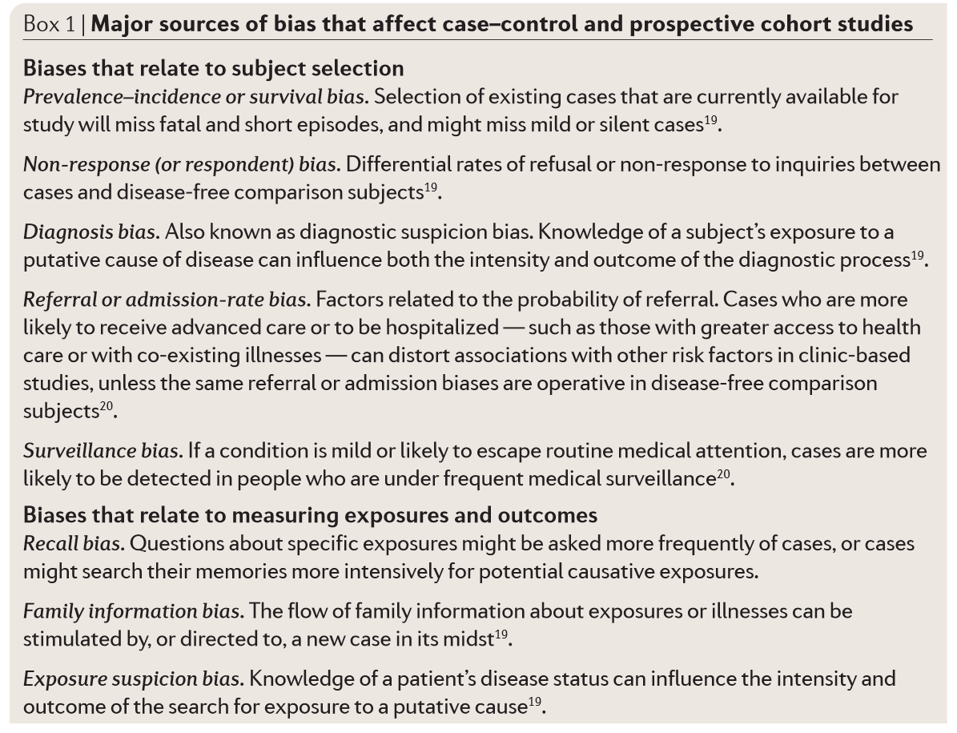
Sources of Bias in Epidemiology
Selection Bias
Arises from issues in case/control ascertainment
Information Bias
Arises from measurement error or misclassification in assessing factors of interest.
Confounding*
Arises when there is an extraneous disease risk factor that is also associated with exposure and not in the causal pathway.
*Some argue confounding is not technically a bias
Manolio et al. Nat Rev Genet. 2006. 7: 812-820.

Slide 47
Confounding
Confounding is a key topic in epidemiology
A confounder is often defined as a factor that is:
A risk factor for disease
Associated with exposure
Not a direct result of exposure
Confounding can lead to “spurious” associations
Confounders
Exposure
Outcome

Slide 48
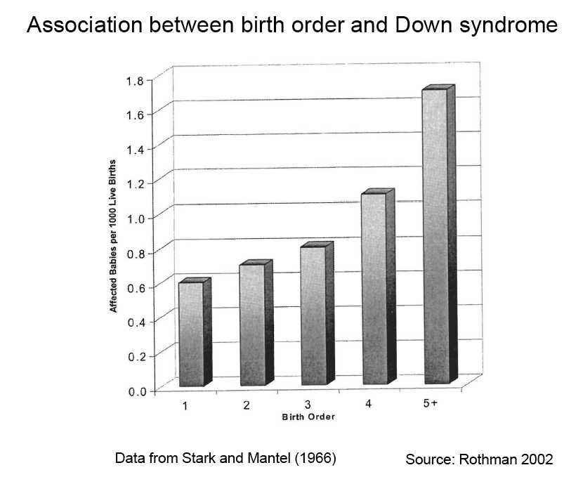
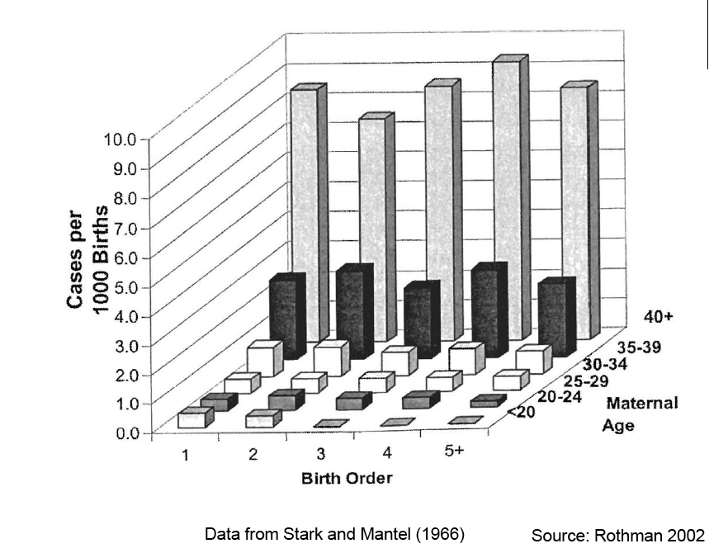
Example of Confounding
Birth order and Down syndrome
Birth order is associated with Down syndrome, later order children with higher risk
Maternal age is associated with birth order
Maternal age is associated with Down Syndrome
Stratifying on maternal age, there is no longer evidence of an association between birth order and Down syndrome

Slide 49
Approaches to Handling Confounding
In Design of Study
In Analysis of Data
Randomization
Restriction
Matching
Group Matching
Individual Matching
Standardization
Adjustment
Stratification

Slide 50
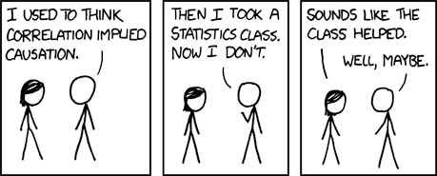
Guidelines for Judging Whether an Association is Causal
Temporal relationship (exposure should proceed outcome)
Strength of association (size of odds ratio or relative risk)
Dose-response relationship
Cessation of exposure leads to reduction in outcome
Replication of finding (multiple independent studies)
Biological plausibility
Consistency with other knowledge
Consideration of alternative explanations (ability to rule them out)
Specificity of the association

Slide 51
What is Meant by Interaction?
Biological Interaction
The interdependent operation of two or more biological causes to produce, prevent or control an effect
Two causes interact on a biological level to cause a disease or outcome
Statistical Interaction
The observed joint effects of two factors differs from that expected on the basis of their independent effects
Deviation from additive or multiplicative joint effects
Effect Modification (or Effect Measure Modification)
Differences in the effect measure for one factor at different levels of another factor
Example: OR differs for males vs. females; AR differs for pre-menopausal and post-menopausal women, etc.

Slide 52
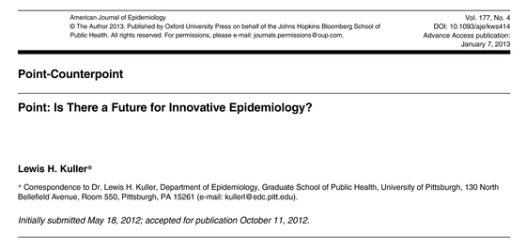
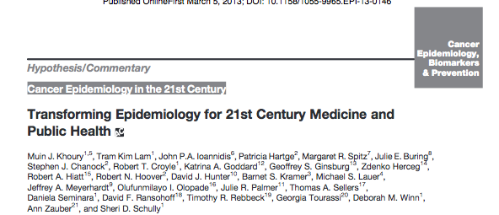
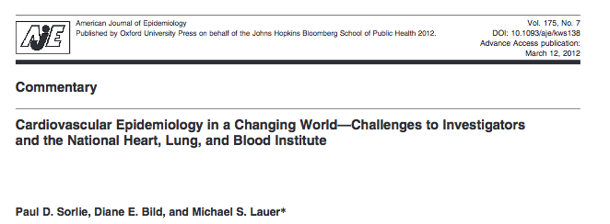
Future Directions in Epidemiology

Slide 53
Summary
Epidemiology is the study of the distribution and determinants of health-related states in populations
Historic examples demonstrate objectives of epidemiology
Study design is a key component of epidemiology
Relative risks, risk differences and odds ratios are used to measure association
It is important to consider and address bias in epi studies
Selection bias and information bias are two main classes of bias
Understanding confounding and effect modification are important in studies of association
Future directions are transforming the field of epidemiology

