Slide 1
Precision Medicine / Precision Health
Karen L. Edwards, PhD
Professor, Dept. of Epidemiology
School of Medicine
University of California, Irvine
Irvine, CA

Slide 2
Outline
Two National Initiatives
  Precision Medicine Initiative
  Cancer Moonshot Initiative

Slide 3
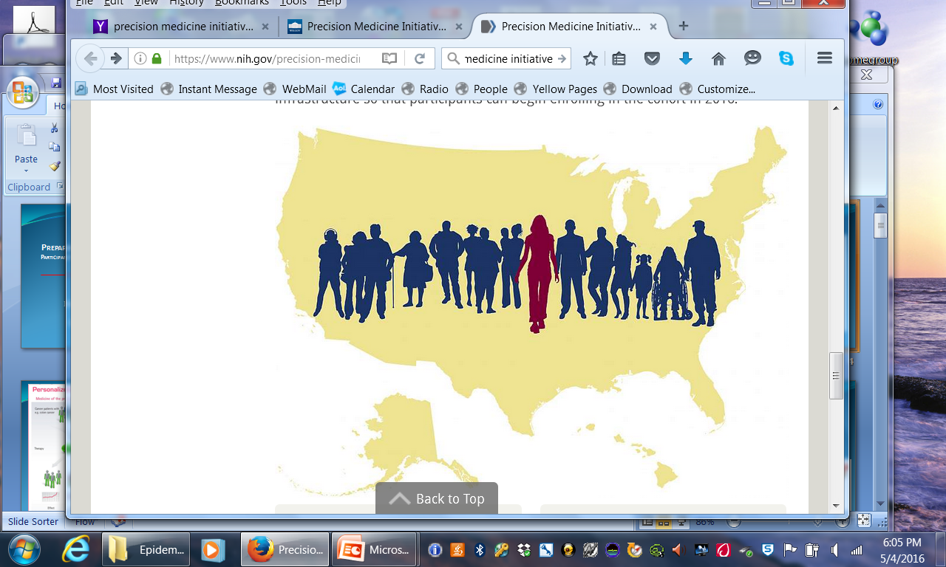
The Precision Medicine Initiative

Slide 4
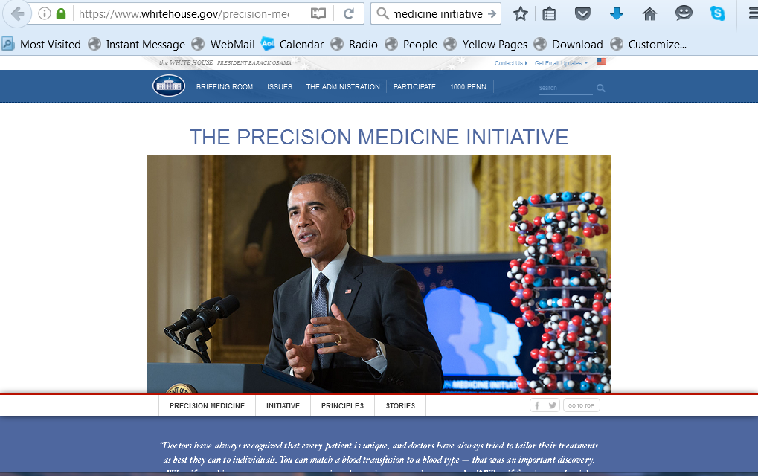
PMI Announced in 2015 State of Union Address

Slide 5
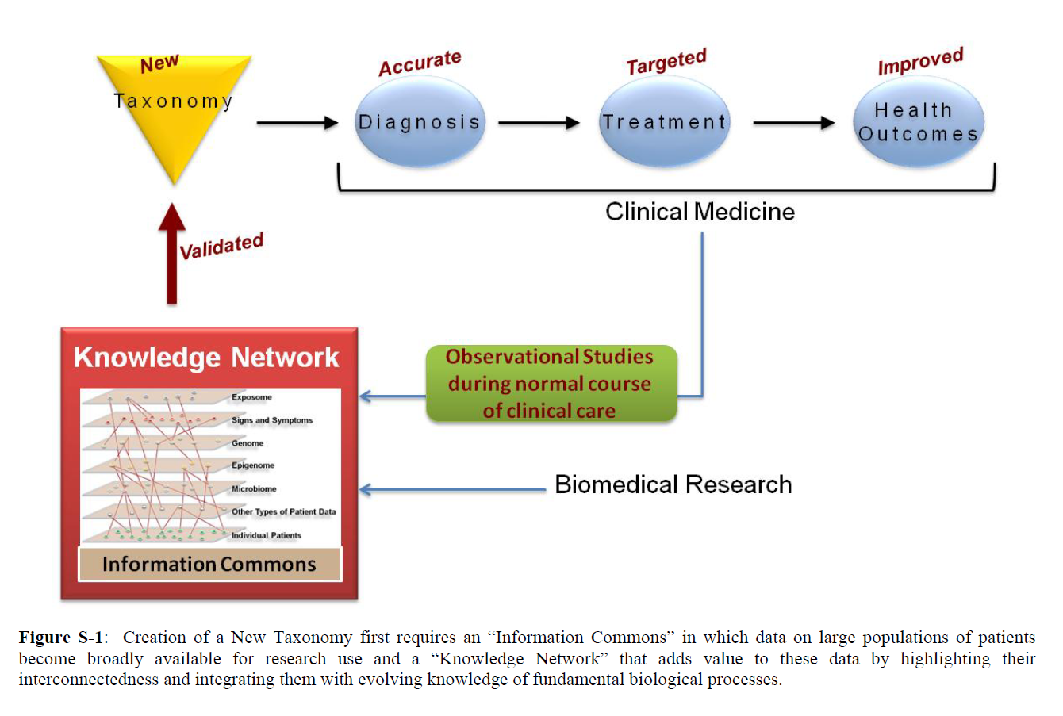
2011: National Academies of Sciences
a "new taxonomy" that defines disease based on underlying molecular and environmental causes, rather than on physical signs and symptoms
http://dels.nas.edu/Report/Toward-Precision-Medicine-Building-Knowledge/13284

Slide 6
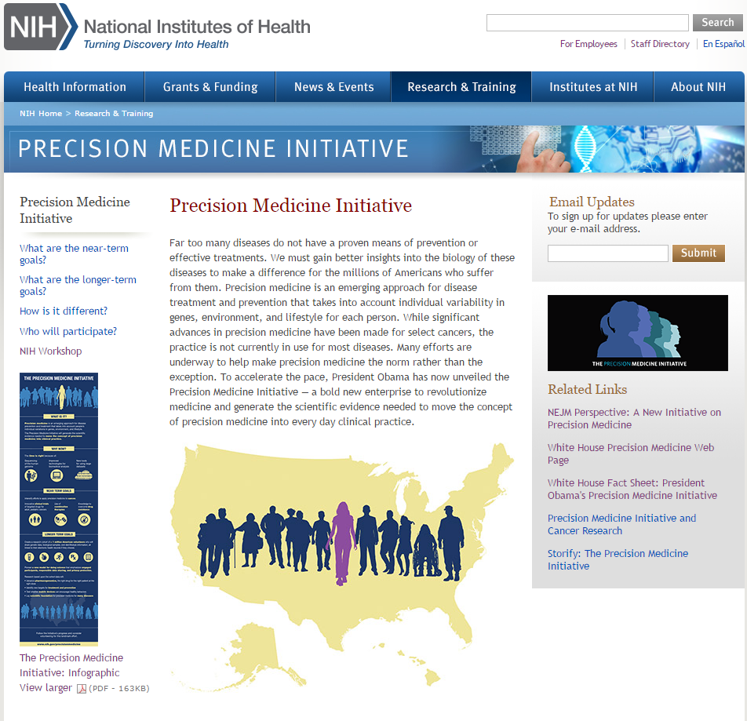
www.nih.gov/precisionmedicine

Slide 7
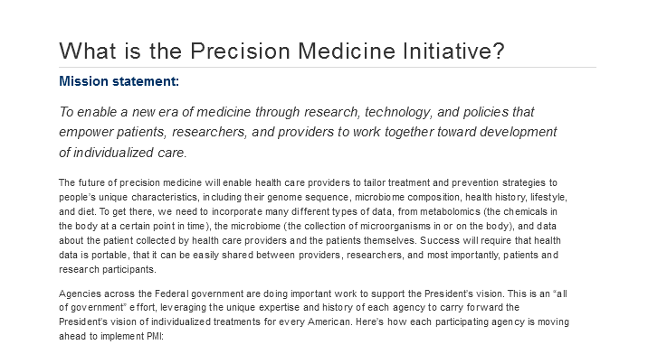

Slide 8
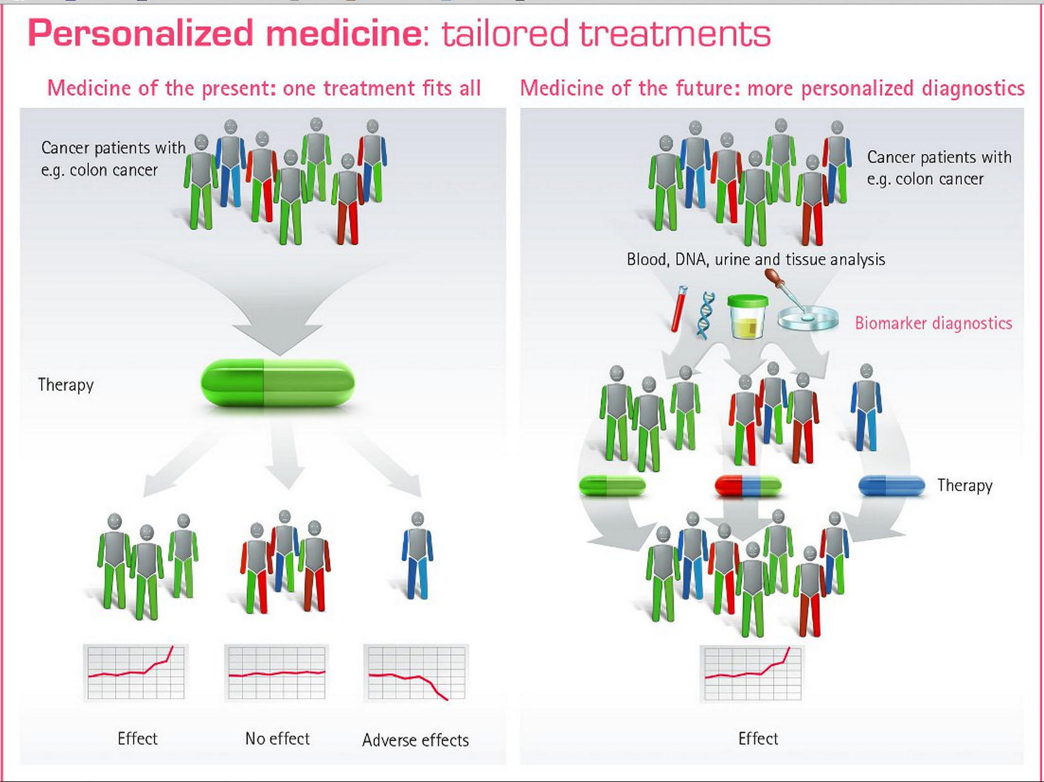
Credit: www.bayerpharma.com/en/research-and-development/research-focus/oncology/personalized-medicine/index.php

Slide 9
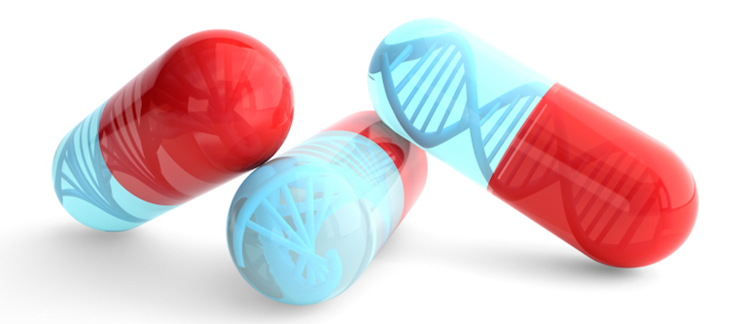
Pharmacogenomics
Pharmacogenomics (sometimes called pharmacogenetics) is a field of research focused on understanding how genes affect individual responses to medications. The long-term goal of pharmacogenomics is to help doctors select the drugs and dosages best suited for each person.
  NIGMS Pharmacogenomics Fact Sheet (https://www.nigms.nih.gov/education/pages/factsheet-pharmacogenomics.aspx)
https://precisionmedicine.duke.edu/researchers/precision-medicine-programs/pharmacogenomics

Slide 10

Genomic Medicine
Genomic Medicine: An emerging medical discipline that involves using genomic information about an individual as part of their clinical care (e.g., for diagnostic or therapeutic decision-making) and the other implications of that clinical use.
  NHGRI Definition (https://www.genome.gov/27552451/what-is-genomic-medicine/)

Slide 11
Precision Medicine
Goal of the national Precision Medicine Initiative (PMI) is to provide precise health advice, diagnoses, and treatments for each individual in the population
Approach: identify subsets of (homogeneous) patients most likely to benefit from a particular treatment or intervention
Molecular profiling to create diagnostic, prognostic and therapeutic strategies tailored to each patient
Individualized or Precision Prevention is in the future
  Will require understanding Gene -Environment interactions
  Role of Epigenetics
  Approaches to change behavior
National Research Council (US) Committee on A Framework for Developing a New Taxonomy of Disease. Toward Precision Medicine: Building a Knowledge Network for Biomedical Research and a New Taxonomy of Disease. Washington (DC): National Academies Press (US); 2011. Available from: http://www.ncbi.nlm.nih.gov/books/NBK91503/

Slide 12
Precision Medicine Cohort Program
Goal is to enroll 1 million people
Health Systems
Volunteers
Diverse sample that represents the US population
  Age, gender, race, ethnicity
  Without regard to disease or health status
    Participation will require
      Provision of a biological sample for genetic analysis
      Clinical examination
      Access to medical records and health information
      Regular updates of information and longitudinal participation
      Willingness to enroll in other studies
      Collection of data via other mechanisms and new technology
    Return of Results and Access to data by Participants

Slide 13

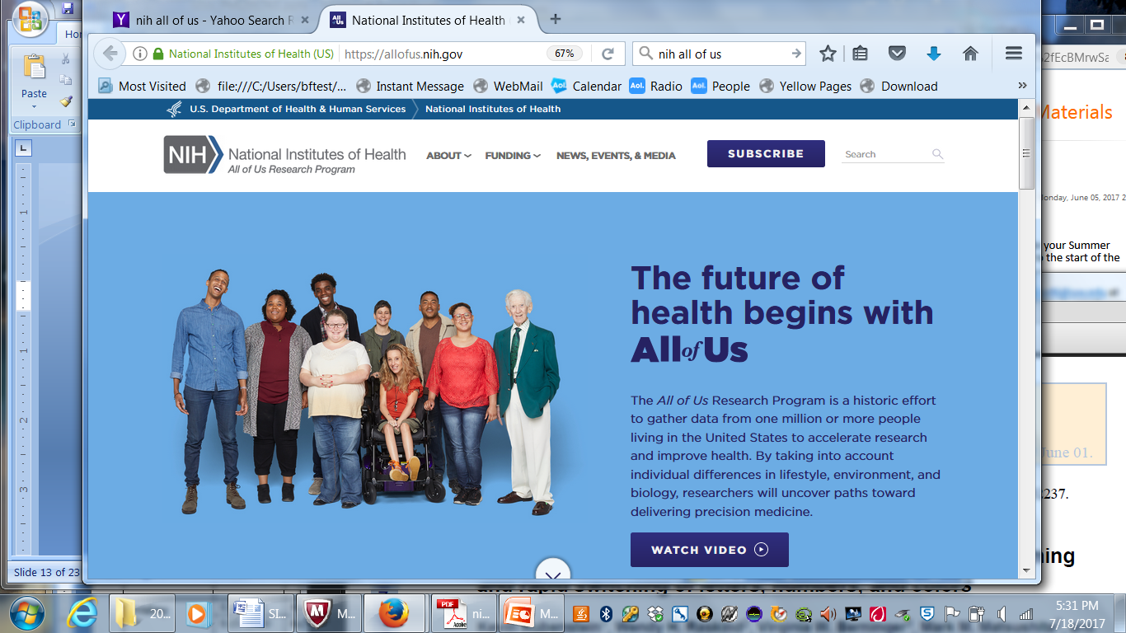
PMI Cohort Program announces new name

Slide 14
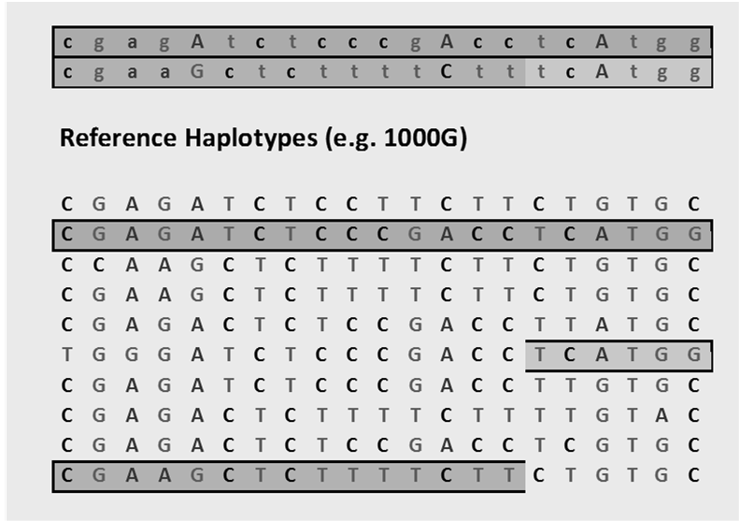
Sequence Data

Slide 15
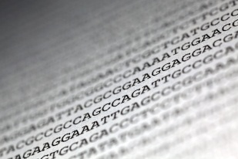
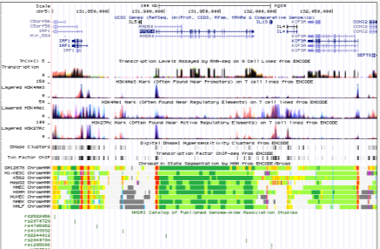


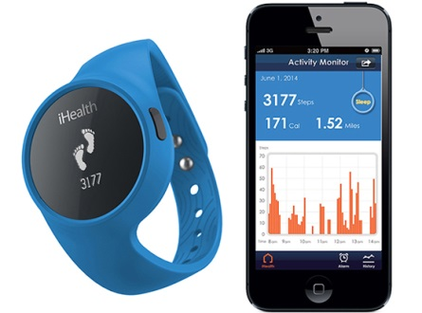
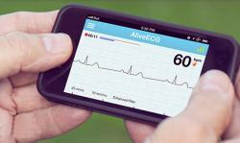


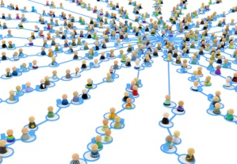

Genomics
EHRs
Technologies
Data Science
Patient Partnerships

Slide 16
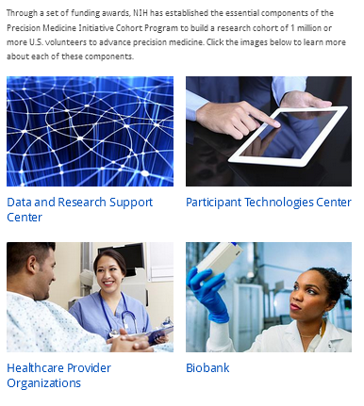
Program Components

Slide 17


Program Components
Mayo Clinic Biobank
Rochester, MN
Community Health Center, Inc.
Middletown, CT
Title: Illinois Precision Medicine Consortium
Chicago, IL
Hudson River Health Care
Peekskill, NY
Columbia/Cornell
/Harlem Hospital Precision Medicine Initiative HPO
New York, NY
Scripps and Vibrent Participant Technologies/ Direct Volunteer Opps
La Jolla, CA
University of Arizona - Banner Health Precision Medicine Initiative Cohort
Enrollment Center
Tucson, Arizona
Cherokee Health Systems
Knoxville, TN
Precision Approach to healthCARE enrollment Site (PA CARES)
Pittsbugh, PA
San Ysidro Health Center
San Ysidro, CA
Eau Claire Cooperative Health Center
Columbia, SC
Jackson-Hinds Comprehensive Health Center
Jackson, MS
Biobank
Vanderbilt/Broad/Verily Data and Research Support Core
Nashville, TN
Data and Research Support Center
Federally Qualified Health Centers
Recruitment at VA Hospitals
Direct volunteer recruitment nationwide
Regional Medical Centers
Participant Technology Center

Slide 18
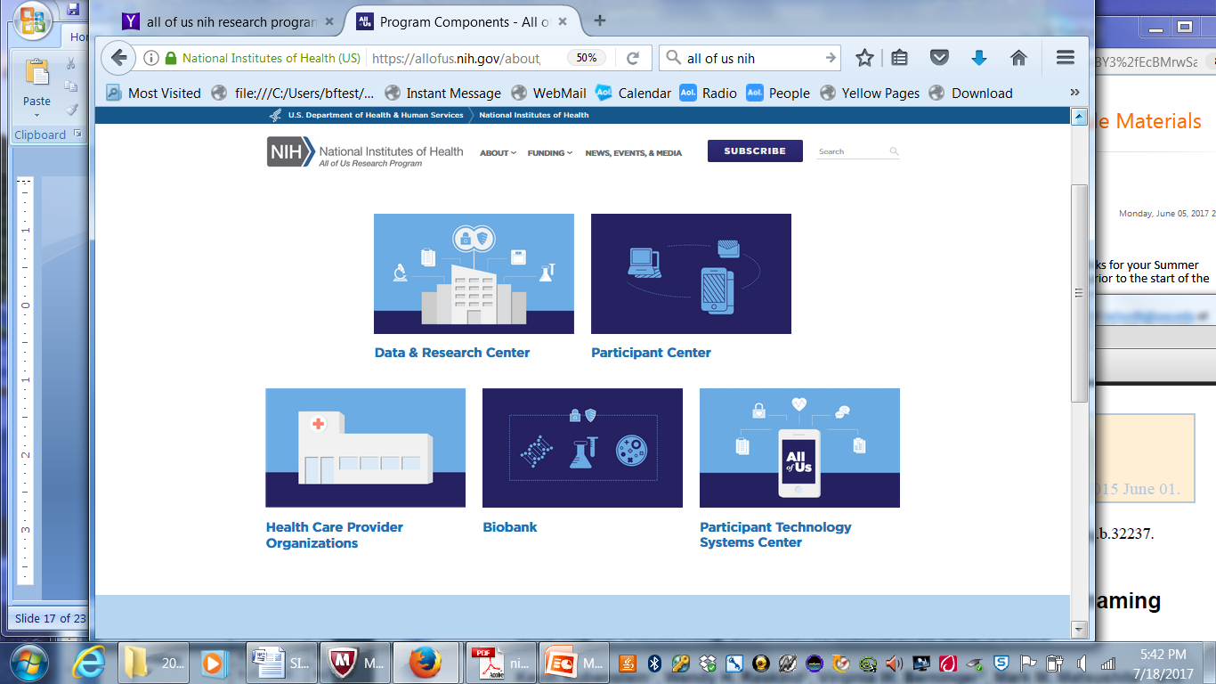
Program Components

Slide 19
Precision Medicine
Genomics is an integral component
Genetic Epidemiology will play a central role

Slide 20
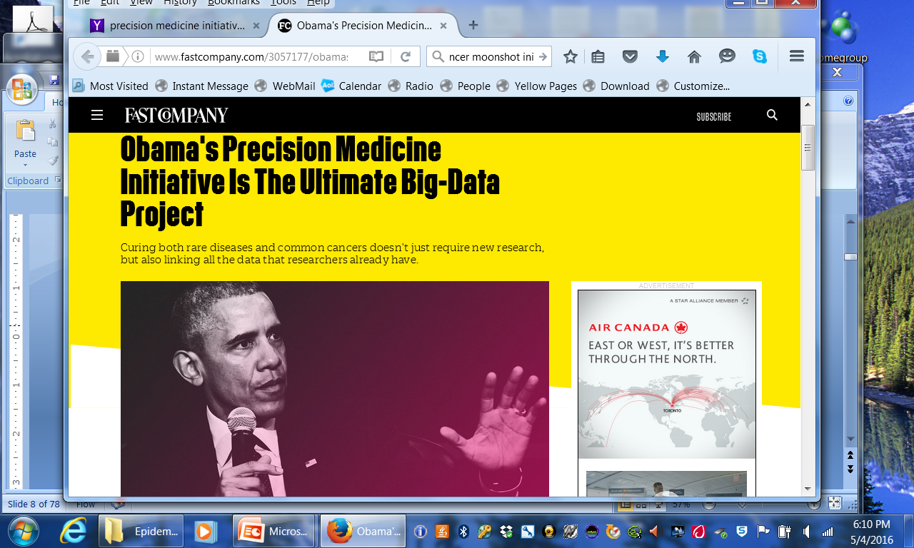
Requires participation on a scale we have not seen before

Slide 21
Annotation
Annotation is the process of marking genes or other biological features in a DNA sequence
In genetic epi it is used to identify genes, predict function of genes and their variants
  Study design – focus assessment on genes / variants that are likely functional
  Interpretation – what is the function of the gene / variant that we have identified
Continually updated and changing

Slide 22
Bioinformatics
Primary goal is to increase understanding of biological processes
With growing amount of (genomic) data, it is not practical to analyze manually
  Develops and applies techniques to manage and analyze large volumes of data
  Create and promote databases, algorithms, computational and statistical techniques and theory related to management and analysis of biologic (genomic) data
  End users of the data
Some overlaps with genetic epidemiology

Slide 23
Precision Medicine: What is needed
(a genetic epidemiologist’s perspective)
Ability to stratify patients, tumors, population into more homogeneous subgroups
  Genomic and epigenomic profiling
  Biomarkers
  Evidence for Clinical Validity and Utility
Large samples – 1 million person national PM cohort
  Big Data – linking with EHR and other data sources
  Will rely on existing studies and data
  May be a need for new data collection to fill in gaps
  Engaging research participants
Stakeholder input
  Incorporate input from broad stakeholder groups, including research participants
Incorporate environmental and lifestyle factors for Prevention
  Focus on Gene x Environment interactions
    Modifiable environmental and lifestyle factors
  Approaches for behavior change that promote adoption of risk reducing factors

Slide 24
