Slide 1
What is old is new
Rare Variants
Karen L. Edwards, Ph.D.
Professor
Department of Epidemiology and
Genetic Epidemiology Research Institute
University of California, Irvine
Irvine, CA
kedward1@uci.edu

Slide 2
This session
Why study rare variants and where do they come from?
Association analysis of rare variants
Using new technology in family studies

Slide 4
Why Study Rare Variants?
Problem of “missing heritability”
GWAS studies have thus far focused on common SNPs
Have identified over 500 strong independent SNP associations
However, most common variants (SNPs) identified only explain a small proportion of the total genetic variance of complex diseases
10-20% depending on the disease
These associations tend to be with non functional variants, and not causal polymorphisms
There are additional susceptibility loci to be found

Slide 5
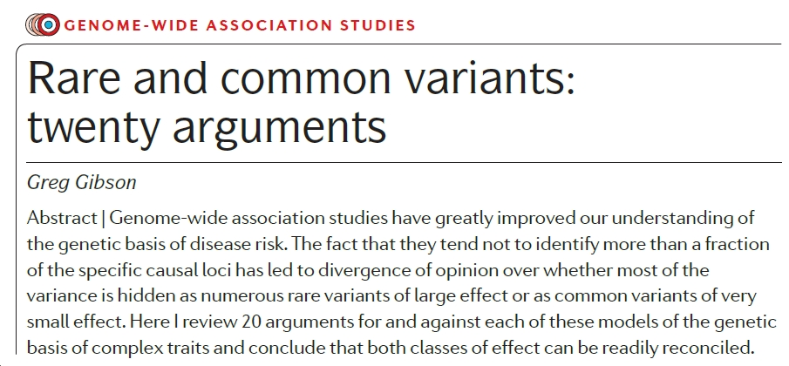
Nice thought piece on the rare versus common variant debate…

Slide 6
A Paradigm Shift in Genetic Epi?
Common Variant-Common Disease (CDCV) hypothesis
Common diseases are due to common genetic variation
Basis for most GWAS studies
Common Disease—Rare Variant (CDRV) hypothesis
Multiple rare DNA sequence variations, each with relatively high penetrance and “large” effects, are the major contributors to genetic susceptibility to complex disease

Slide 7
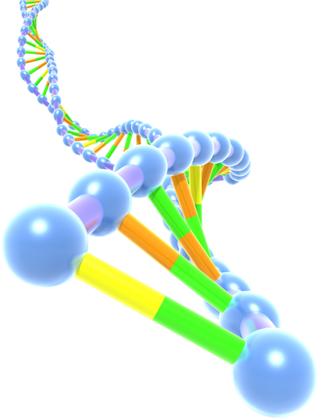
What is a rare variant?
GWAS
From: Cirulli ET, Goldstein DB: Uncovering the roles of rare variants in common disease through whole-genome sequencing. Nature reviews. Genetics 2010, 11:415–25.
LESS COMMON
1% < MAF < 5%
RARE
MAF < 1%
PRIVATE
Unique to Proband
From Dr. S. Santorico – UCD Dept of Statistics
Notes:
Very common SNPs well captured on GWAS arrays
Less common if not captured on a GWAS Array, may be able to impute them through use of 1000 genomes data to test for association in your own data…may be able to. It will depend on imputation quality. If it has little to no LD with any common SNPs, then imputation quality will be poor.

Slide 8
Rare Variants
Genetic architecture of most complex traits has not been fully described
Rare variants (MAF < 1%) are “common” and make up most of the polymorphic sites in the human genome.
Rare variants may have larger effect s, explain some of the missing heritability, and should identify new susceptibility loci for both common and Mendelian disorders

Slide 9
Significance of Rare Variants
Discovering the genetic basis of common diseases, such as diabetes, heart disease, and schizophrenia, is a key goal in biomedicine. Genomic studies have revealed thousands of common genetic variants underlying disease, but these variants explain only a portion of the heritability. Rare variants are also likely to play an important role, but few examples are known thus far, and initial discovery efforts with small sample sizes have had only limited success.
Zuk et al., www.pnas.org/cgi/doi/10.1073/pnas.1322563111

Slide 10
Challenges of studying Rare Variants
They are rare!
Impacts power and sample size
Definition of rare varies
In general, a minor allele frequency (MAF) of less than 1% is considered rare
MAF between 0.1% and 3% are defined as rare
MAF <0.1% as novel
In contrast to GWAS where the MAF for most variants is about 5% or greater
Private mutations may be found in a single individual or family
Rare variants are not generally in LD with common variants and may have different population histories

Slide 11
Considerations in Rare Variants Analysis
What to Sequence and Who
Sequencing Depth
Analyzing data
Rare variant association study (RVAS) vs. Common variant association study (CVAS – aka GWAS)
Filtering
Using Annotation

Slide 12
Rare vs. Common Variants Analysis
Genome Wide Association Study (GWAS)
RVAS CVAS

Slide 13
Sequencing: Who, what and why?
Sequencing is still “expensive”
Unrelated cases and controls
Families
Extremes – affected and unaffected
Sequencing for discovery
Whole Exome Sequencing (WES) (coding regions)
Whole Genome Sequencing (WGS)
Targeted regions
Followup with targeted genotyping of identified rare variants in larger samples

Slide 14
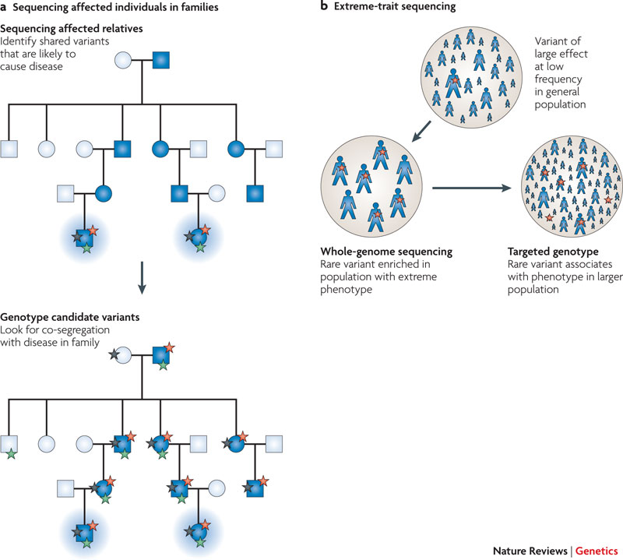
Two discovery strategies using sequencing
http://www.nature.com/nrg/journal/v11/n6/full/nrg2779.html
Notes:
Two discovery strategies using next-generation sequencing are likely to be of particular importance while sequencing costs remain high: sequencing in families with multiple affected individuals (a; shaded individuals are affected), and sequencing individuals at one or both ends of a trait distribution (b; the size of the individual represents the severity of the phenotype). In the case of family-based sequencing, it may often prove economical to first sequence the most distantly related co-affected individuals. Under either scenario, it is likely that follow-up genotyping in additional families or cohorts will be of particular importance to confirm the role of candidate variants. Red stars represent the causal variant. In a, stars of other colours represent variants that are shared by the sequenced individuals and do not segregate in the family.

Slide 15
Sequencing Depth
Most current sequencing platforms generate millions of short sequence reads
High-depth reads (e.g. 30x) to exhaustively identify variation
Decreased sequencing depth studies are increasing – requires more samples – detection and calling accuracy can be compromised.
Reads are then aligned to a reference genome
Variant calling is performed to identify sites at which one or more samples differ from the reference sequence
Focus is on SNPs, copy number variation is less straightforward at this point

Slide 16
Overview of steps taken in the search for low-frequency and rare variants affecting complex traits
Human Molecular Genetics, 2013 R1–R6
doi:10.1093/hmg/ddt376

Slide 17
Rare Variant Reference Panels
1000 Genomes Project
Catalog of common and uncommon variation identified through WGS and exome sequencing across several global populations
NHLBI Exome Sequencing Project (NHLBI-ESP) (http://esp.gs.washington.edu)
WES of 6500 samples in phenotyped sets from the USA.
UK10K Project (www.uk10k.org)
High-depth WES of 6000 and low-depth WGS of 4000 well-phenotyped individuals from the UK

Slide 18
Rare Variant Association Analysis
Statistical considerations for analyzing rare variants are important
Testing for associations are challenging due to rareness and the large number of rare variants
Approaches
Single variant analysis
Single-point analysis of rare variants is under-powered
Do not have enough copies of the rare variant allele in most association studies

Slide 19
Rare Variant Association Testing
Consider a variant with a frequency of 0.001
Significance level of 5x10⁻⁶
Corresponds to 100,000 single independent tests
Disease prevalence of 10%
Detecting a 2 fold increase in risk requires 33,000 cases and 33,000 controls
Detecting a 3 fold increase in risk requires 11,000 cases and 11,000 controls

Slide 20
Rare Variant Association Testing
Power Depends on:
MAF
Effect Size
For Single Variant Tests need very large sample sizes even if effect sizes are larger than we have observed for common variants

Slide 21
Rare Variant Association Analysis
Alternate Approaches
A multivariate approach that combines information across multiple rare variant sites within a defined region
Defined regions of the genome may include
gene (locus) - for exome or candidate gene studies
or other functional unit
defined genomic region- such as a sliding window for whole genome studies
Numerous locus-specific statistical approaches have been developed
Correcting for multiple comparison is still needed – remember there are a lot more rare variants than common in the genome

Slide 22
Burden vs. Single Variant Test
 | Single Variant | Combined Test
10 variants/all have OR=2/ all have MAF .005 | 0.05 | 0.86
10 variants/all have OR=2/ unequal MAF | 20.0 | 0.85
10 variants/Avg OR=2, but varies/ all have MAF .005 | 0.11 | 0.97
Power calculated in simulations for 250 cases and 250 controls
Combining variants can greatly increase power
Appropriately combining variants is key to rare variant studies

Slide 23
Rare Variant Association Tests
The original Li and Leal paper (2008) simply collapsed rare variants into a single allele
Multiple Refinements have been proposed
Count the number of rare variants per individual
Weight rare variants
MAF
Computational algorithms to prioritzie variants:
Annotation such as conservation score or another indicator of function

Slide 24
Statistical approaches for analysis of rare variants
Two Primary Approaches
Collapsing and Aggregation Methods (Burden tests)
Non-Burden tests

Slide 25
Statistical approaches for analysis of rare variants: Burden Tests
Collapsing methods/Burden tests
Aggregate information on rare variants across multiple variants into a single quantity to evaluate cumulative effects (burden) of multiple variants in a defined genomic region of interest
Test for trait association with an accumulation of rare minor alleles
Vary in the way they collapse variants
Assume all collapsed variants are associated with the disease and variants can be either deleterious or protective
Most powerful when ALL rare variants are causal with the same effect sizes (and direction of effect)

Slide 26
Statistical approaches for analysis of rare variants: Non-Burden Tests
Non-Burden tests
Multivariate tests that combine single-variant test statistics
Make no assumption about direction and magnitude of effect of each rare variant – more flexible and more powerful in some scenarios
Sequence Kernal Association Test (SKAT)
Specifying weights can improve power
Choice of weights is not always clear

Slide 27
Rare Variant Methods, cont
Vary in way variants are collapsed
Model the phenotype using a regression approach
as a function of the proportion or count of rare variants in the defined region at which an individual has the minor allele (Burden test)
Or as a function of the presence or absence of a minor allele at any rare variant site within the locus or region of interest - (Collapsing method)
Limitation is that we ignore directionality (eg both deleterious and protective variants are treated in the same way)
Assume equal contribution from each variant
Most powerful when most variants are causal and in the same direction (eg deleterious)
Weighted aggregation tests – weight each variant based on other evidence, these weights contribute to the “burden”
SKAT tests are more powerful when most variants are not causal or when the effects of causal variants are in different directions – a regression framework
A unified approach between the collapsing methods and SKAT has been developed
SKAT-O ; maintains power under both scenarios

Slide 28
Do these approaches work?

Slide 29
A Groupwise Association Test for Rare Mutations Using a Weighted Sum Statistic
Bo Eskerod Madsen1, Sharon R. Browning2*
Abstract
Resequencing is an emerging tool for identification of rare disease-associated mutations. Rare mutations are difficult to tag
with SNP genotyping, as genotyping studies are designed to detect common variants. However, studies have shown that
genetic heterogeneity is a probable scenario for common diseases, in which multiple rare mutations together explain a
large proportion of the genetic basis for the disease. Thus, we propose a weighted-sum method to jointly analyse a group
of mutations in order to test for groupwise association with disease status. For example, such a group of mutations may
result from resequencing a gene. We compare the proposed weighted-sum method to alternative methods and show that it
is powerful for identifying disease-associated genes, both on simulated and Encode data. Using the weighted-sum method,
a resequencing study can identify a disease-associated gene with an overall population attributable risk (PAR) of 2%, even
when each individual mutation has much lower PAR, using 1,000 to 7,000 affected and unaffected individuals, depending
on the underlying genetic model. This study thus demonstrates that resequencing studies can identify important genetic
associations, provided that specialised analysis methods, such as the weighted-sum method, are used.
Citation: Madsen BE, Browning SR (2009) A Groupwise Association Test for Rare Mutations Using a Weighted Sum Statistic. PLoS Genet 5(2): e1000384. doi:10.1371/journal.pgen.1000384

Slide 30
Wu et al AJHG 2011: SKAT
Dallas Heart Study Data
Sequence data on 93 variants in ANGPTL3, ANGPTL4, and ANGPTL5
3476 individuals
Test for association between log-transformed serum triglyceride (logTG) levels and rare variants in these genes
Adjusted for sex and ethnicity (white, black, Hispanic)
SKAT has much higher power than burden tests for continuous outcomes and outperfoms several alternative rare-variant association tests
Similar performance for dichotomous outcomes
Small loss of power with imputed genotypes for all methods

Slide 31
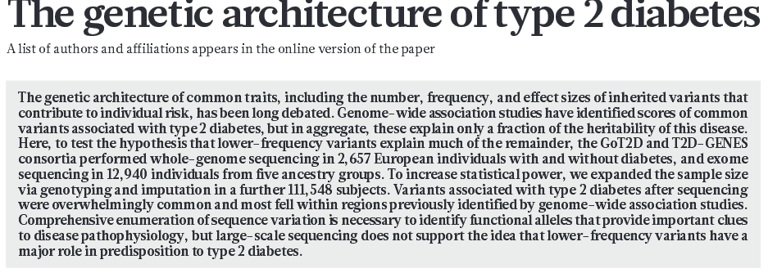
00 MONTH 2016 | VOL 000 | NATURE | 1

Slide 32
Improving power
Filtering based on likelihood of function
Alternatively, could incorporate weights according to probability of being functional
Good weight choices can improve power
Based on MAF – under assumption that rarer variants are more likely to be deleterious according to natural selection theory
Implemented in a number of different tests and based on internal information from your sample
Functional annotation predictions
Weights are based on external information
GERP or PhastCons- Measures of Conservation
PolyPhen-2 – computational predictions that a variant is likely to be damaging
CADD – Combined Annotation Dependent Depletion – a measure of deleteriousness

Slide 33
Searching for missing heritability: Designing rare variant association studies Or Zuka,b,1, Stephen F. Schaffnera, Kaitlin Samochaa,c,d, Ron Doa,e, Eliana Hechtera, Sekar Kathiresana,e,f,g, Mark J. Dalya,c, Benjamin M. Nealea,c, Shamil R. Sunyaeva,h, and Eric S. Landera,i,j,2
Genetic studies have revealed thousands of loci predisposing to hundreds of human diseases and traits, revealing important biological pathways and defining novel therapeutic hypotheses. However, the genes discovered to date typically explain less than half of the apparent heritability. Because efforts have largely focused on common genetic variants, one hypothesis is that much of the missing
heritability is due to rare genetic variants. Studies of common variants are typically referred to as genomewide association studies, whereas studies of rare variants are often simply called sequencing studies. Because they are actually closely related, we use the terms common variant association study (CVAS) and rare variant association study (RVAS). In this paper, we outline the similarities and differences between RVAS and CVAS and describe a conceptual framework for the design of RVAS. We apply the framework to address key questions about the sample sizes needed to detect association, the relative merits of testing disruptive alleles vs. missense alleles, frequency thresholds for filtering alleles, the value of predictors of the functional impact of missense alleles, the potential utility of isolated populations, the value of gene-set analysis, and the utility of de novo mutations. The optimal design depends critically on the selection coefficient against deleterious alleles and thus varies across genes. The analysis shows that common variant and rare variant studies require similarly large sample collections. In particular, a well-powered RVAS should involve discovery sets with at least
25,000 cases, together with a substantial replication set.
This article contains supporting information online at www.pnas.org/lookup/suppl/doi:10.
1073/pnas.1322563111/-/DCSupplemental.

Slide 34
Important Considerations
Population stratification is an important consideration
Rare variants show increased population specificity
Rare variants can show stronger patterns of population stratification than common variants
Most of the rare variant tests allow adjustment for covariates including PCA’s
Some studies have shown that genomic control and PCA have not been effective at controlling population stratification
Underscores the need for attention to study design
Case and Control Selection
Replication

Slide 35
Unrelated Individuals and Family Studies
Case-control association studies will require large sample sizes
Burden and non-burden tests increase the overall MAF, but power is still a concern
Family studies are making a come back
Variants that are rare in the population will be “enriched” in families where the variant is causal
Incorporation of new technology is a focus
Analytic approach varies
Discovery
Follouwp on previous linkage regions
Combine linkage and association testing

Slide 36
Main Points to Remember
Emerging Area
Methods are evolving
Families and Unrelated individuals
No consensus yet on approach
As data / evidence accumulates we will likely see more “standardized” approaches as with GWAS
Functional information and annotation will also continue to improve
Basic factors still need to be considered
Appropriate selection of your sample
Adjustment for covariates, including population stratification
Adjustment for multiple comparisons
Recurring themes
What is old is new
Emerging methods that build on fundamentals

Slide 37
Example: Identifying susceptibility genes for metabolic syndrome in a multi-ethnic family study

Slide 38
Multivariate Linkage Analyses
Notes:
Figure 1 Legend: Candidate Regions (CRs) of Interest: Each line represents the LOD score by chromosomal position (cM) from a linkage analysis in European American (EA) , and Mexican American (MA) GENNID families with traits shown in the legend. The three candidate chromosomal regions are labeled as CR1-CR3. The African American (AA) linkage results were obtained from the Elbein et al. (10), where T2D refers to type 2 diabetes and AOD=age of T2D diagnosis.

Slide 39
Project Overview
All subjects in all families
Selected Extreme subjects within linked families
Non-sequenced family members and families
Step1:Linkage analysis (~410 microsatellites)
Step 3:Custom Genotyping + Whole Genome array
Step 2:Whole Exome Sequencing (WES) (~71.8K variants, ~66.9K variants after QC)
Extreme subjects within linked families
Notes:
Step 1: Linkage analysis
-Goal: Reanalysis of pedigrees (after recleaning with pedcheck – kept pedigrees intact when possible and merged families with overlapping subjects, try to resolve individual genotypes that are inconsistent in the pedigree by (1) blanking Mendelian Inconsistent genotypes or (2) updated MI genotypes with pedcheck genotypes with the least evidence of uncertainty) identified four Candidate Regions (CR2, CR5, CR8, CR11).
ALSO used a different phenotype (to reduce the burden of estimating covariates): inverse normal of the standardized residuals after adjusting for agebest, sex, and dmdx (this trait transformation was implemented in SOLAR)
Step 2: Whole Exome Sequence (WES) Analysis (28 EA subjects from 5 families, other ethnic groups = 55 subjects)
-Goal: Obtain variants for custom chip
-Decided to WES all ethnic groups and then develop one custom chip for all ethnic groups
Step 3: Genotyping (~519 EA subjects)
-One custom chip and genotyping array for all subjects across ethnic groups

Slide 40
Aim 2: Whole Exome Sequencing and Filtering
A. Pedigree Selection
Linked families (2 families for each candidate region-overlap)
Select Subjects in Linked families (via ExomePicks and Extreme Affected/Unaffected status)
B. Obtain Exome Data
Focus on Candidate Regions
C. Screening Step
(1) Weighted Allele Frequency Comparison (extreme affected vs. unaffected): Weights relate to Functional and conservation Scores
QC and filtering of variants
LD & Bioinformatics pipeline for inclusion of additional variants
(II) Fisher’s test (unweighted)
Notes:
Selected Pedigrees: highest
Selected Subjects using ExomePicks: to ensure Mendelian error checking
& used Extreme affected/unaffected status
Performed WES
Then the screening step
Fisher’s test not weighted
Allele Comparison is weighted

Slide 41
Framework for selecting variants for custom genotyping
i. Bioinformatics
Functional scores (CADD) and PolyPhen, for WES variants in candidate regions
Conservation scores: GERP, PhastCons
ii. Statistical screening (affected vs unaffected)
iii. Variant Inclusion based on LD & Bioinformatics
Take exome variants and tagSNPs for nominated genes
Include variants in intronic regions using HaploReg
VARIANTS
Unweighted Fisher’s Allelic Association Test
Weighted Allele Frequency Comparison of rare variants
WEIGHTS
Notes:
Sample overview: Sequence other ethnic groups now and genotype
For EA families, but the same process/overview applies to the other ethnic groups, currently we are exome sequencing the other ethnic groups and will make the custom chip all at one time.
Add two boxes in center
Statistical screening with functional information
Statistical screening unbaised

Slide 42
Statistical approaches for analysis of rare variants
Many Approaches have been developed:
Collapsing and Aggregation Methods (Burden tests)
Non-Burden tests
Collapsing methods/Burden tests
Aggregate information across multiple variants into a single quantity to evaluate cumulative effects (burden) of multiple variants in a defined genomic region of interest
Test for trait association with an accumulation of rare minor alleles
Vary in the way they collapse variants
Assume all collapsed variants are associated with the disease and variants can be either deleterious or protective
Non-Burden tests
Multivariate tests that combine single-variant test statistics
Make no assumption about direction and magnitude of effect of each rare variant – more flexible and more powerful in some scenarios
Sequence Kernal Association Test (SKAT)

Slide 43
The SKAT
Uses a multiple linear regression or logistic regression to relate individual variants to a trait, e.g.,
SKAT assumes each β_{j} follows an arbitrary distribution with a mean of zero and a variance of w_{j}τ, where τ is a variance component and w_{j} is a prespecified weight for variant j.
To test H₀: β=0 is equivalent to testing H₀: τ =0
SKAT uses a variance-component score test in the corresponding mixed model
Indicator of disease
Covariate
Effects
Vector of coded genotypes for variants
From Dr. S. Santorico – UCD Dept of Statistics
Notes:
BIG difference here. The effects of the SNPs are random. This is a nice way of getting around testing each one individually.

