Slide 1
Precision Oncology
Carolyn M. Hutter, PhD

Slide 2
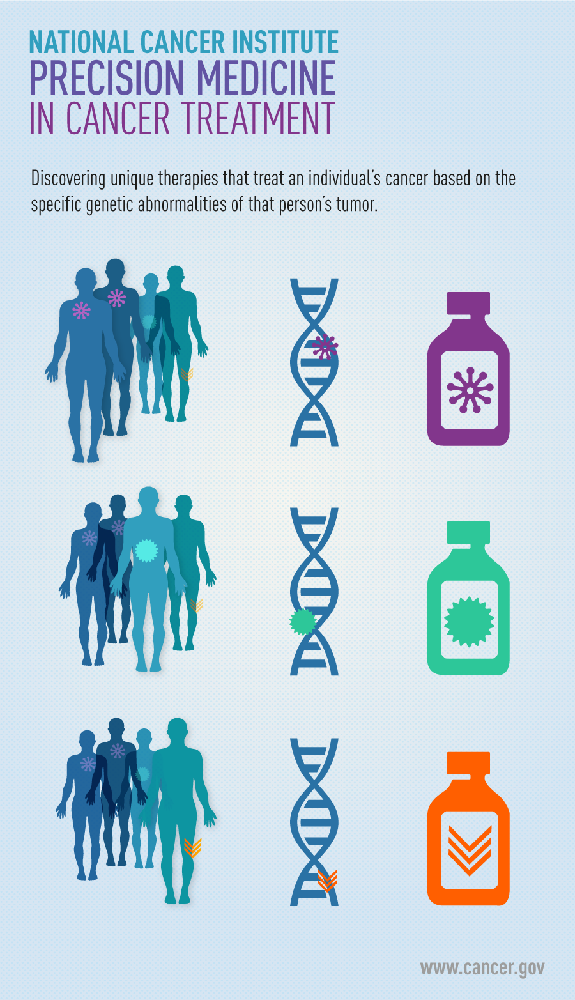
2015 Precision Medicine Initiative: Two Components: Cancer & National Cohort
“An emerging approach for disease prevention and treatment that takes into account people’s individual variations in genes, environment, and lifestyle”

Slide 3
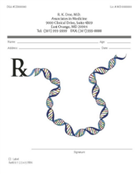
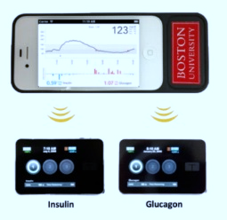
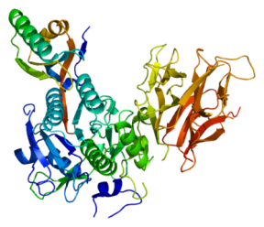
Why Precision Medicine
Clinical:
Many diseases lack effective preventive strategies, diagnostics, or treatments
Options fail to consider key differences among individuals: genes, lifestyle, environment
Research and participants:
Need enough research to draw on for scientific and clinical evidence
Need to overcome siloed data and data resources

Slide 4
Building a Knowledge Base
Key Concept underlying most Precision Medicine Efforts
Collect multi-dimensional information on large numbers of participants
Share this knowledge
Analyze the information
Apply it in ways that impact individual and population health

Slide 5
Levels of Prevention
Primary
Reduction of risk factors
Impact before disease develops
Secondary
Early detection/Screening
Asymptomatic phase of disease
Tertiary
Treatment to improve disease outcomes
Existing symptomatic disease

Slide 6
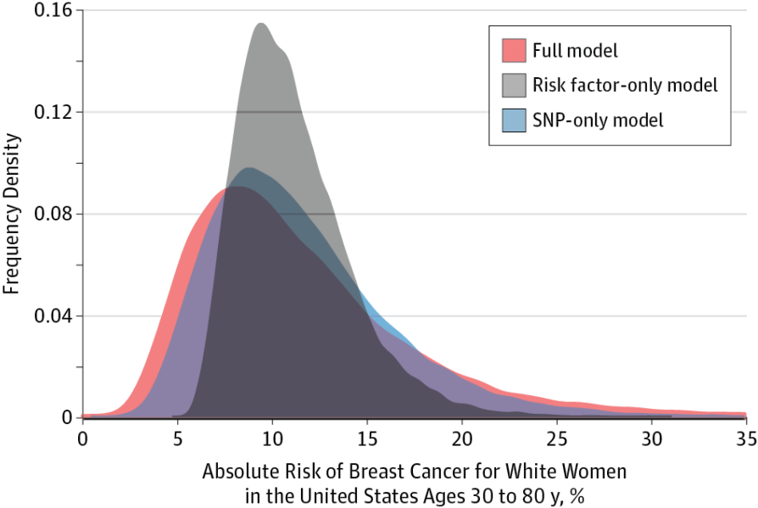
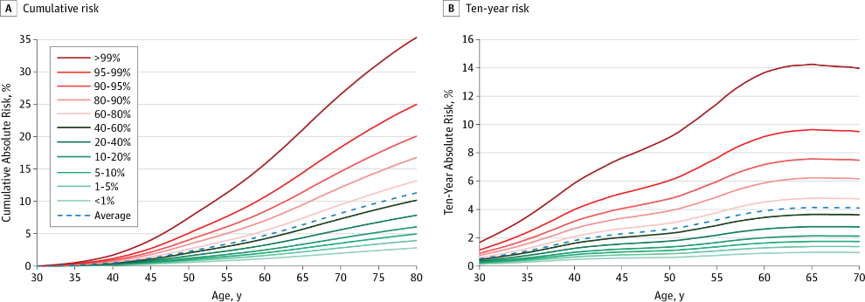
Precision Medicine is NOT just genomics!
Precision medicine is an emerging approach for disease treatment and prevention that takes into account individual variability in lifestyle, environment, and genes.
Breast Cancer Risk From Modifiable and Nonmodifiable Risk Factors Among White Women in the United States
JAMA Oncol. 2016;2(10):1295-1302. doi:10.1001/jamaoncol.2016.1025

Slide 7
Multi-Gene Panels
Increasingly commonly used in cancer risk setting
But how strong is the evidence that variation in the genes on the panel cause the disease in question?
7

Slide 8
ClinGen Clinical Validity Summary Matrix
Assertion criteria | Description | Number of Points
 |  | 0 | 1 | 2 | 3 | 4 | 5 | 6 | 7
# Probands | Total # of unrelated probands with variants that provide convincing evidence for disease causality across all curated literature | N/A | 1-3 | 4-6 | 7-9 | 10-12 | 13-15 | 16-18 | 19+
Functional evidence | Points given based on the gene-level functional evidence supporting a role for this gene in disease | 0 | 1 | 2 | 3 | 4 | 5 | 6+
# Publications | # of curated Independent publications reporting human variants in the gene under consideration | N/A | 1 | 2 | 3 | 4 | 5+
Time (yrs) | # of years since first publication reporting a disease association (if ≤2 publications --> then 1 is max score for time) | this yr | 1-3 yr | ≥3 yr
Is there valid contradictory evidence? |  | Y/N? | Classification |  | Total Score | Assertion:
Description of Contradictory Evidence: |  |  | Limited: |  | 2-8
 |  |  | Moderate: |  | 9-12
 |  |  | Strong: |  | 13-16
 |  |  | Definitive: |  | 17-20
Explanatory video available at: http://calculator.clinicalgenome.org/ashg-2015

Slide 9
“Building a genomic knowledge base
to improve patient care.”

Slide 10
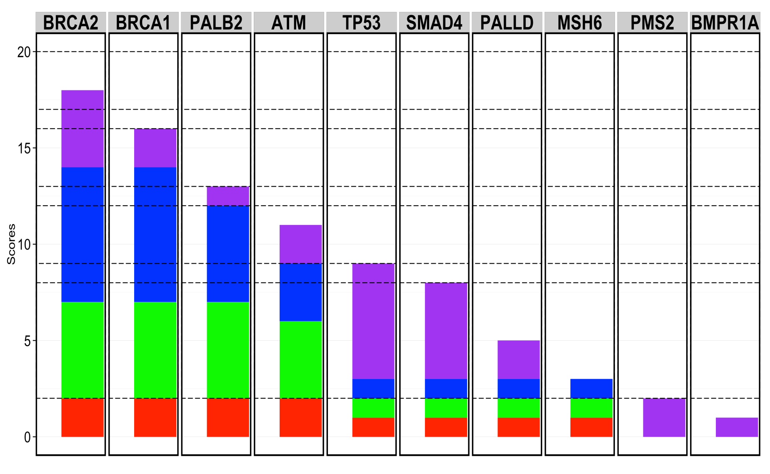
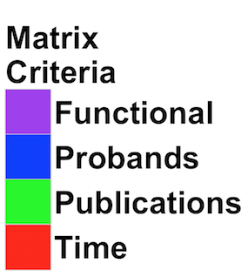
Hereditary Cancer WG: Preliminary classifications suggest 50% of curated genes on clinical multigene panels for pancreatic cancer demonstrate only limited evidence
Definitive
Strong
Moderate
Limited
Figure by Raj Ghosh
* Pending expert review

Slide 11
Precision Cancer Genomics
Applications of Genomics in Clinical Cancer Care
Diagnostic sub-classifications
Novel prognostic biomarkers
Genomic predictors of response to therapies
Genomic mechanisms of resistance to therapies

Slide 12
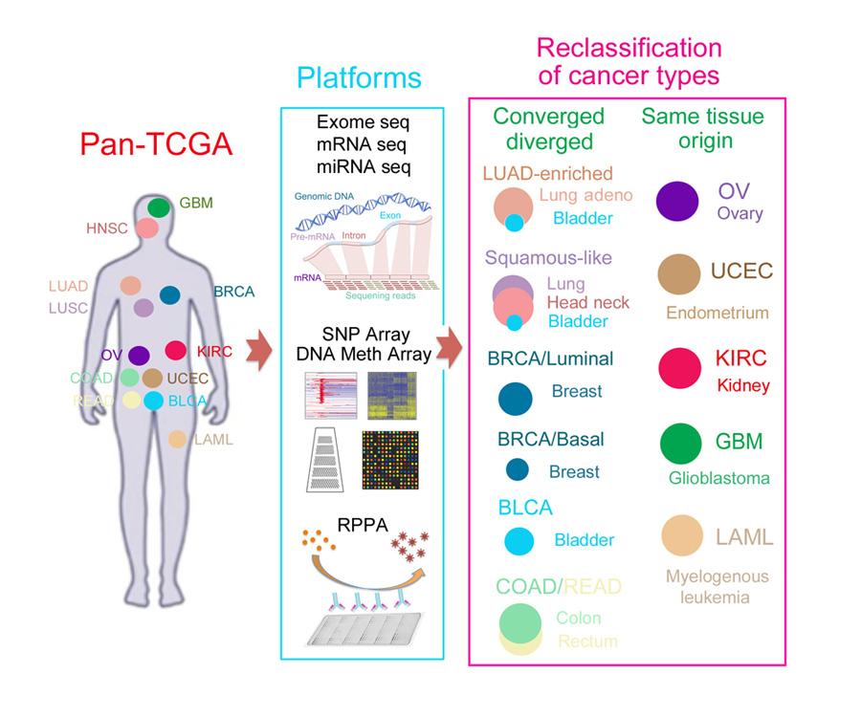

Slide 13
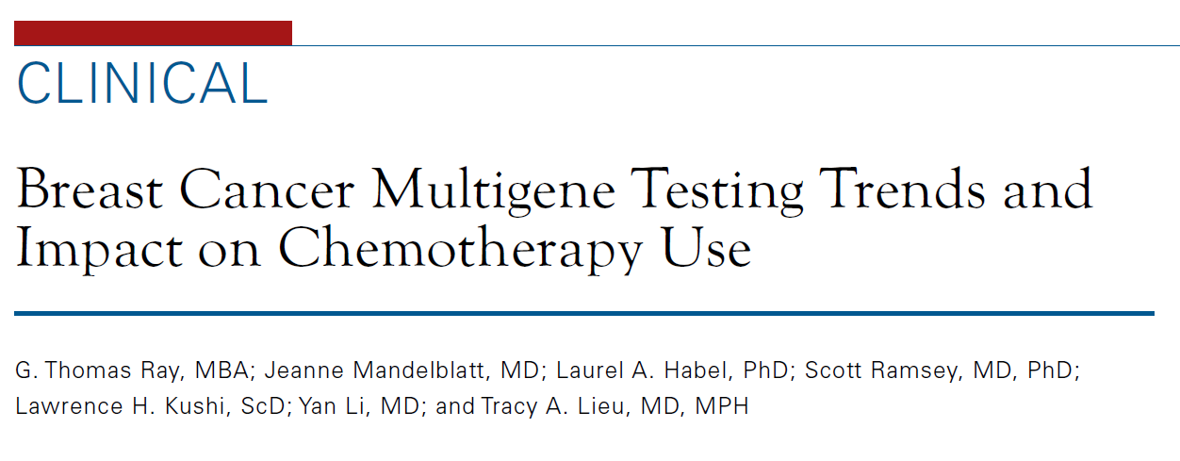
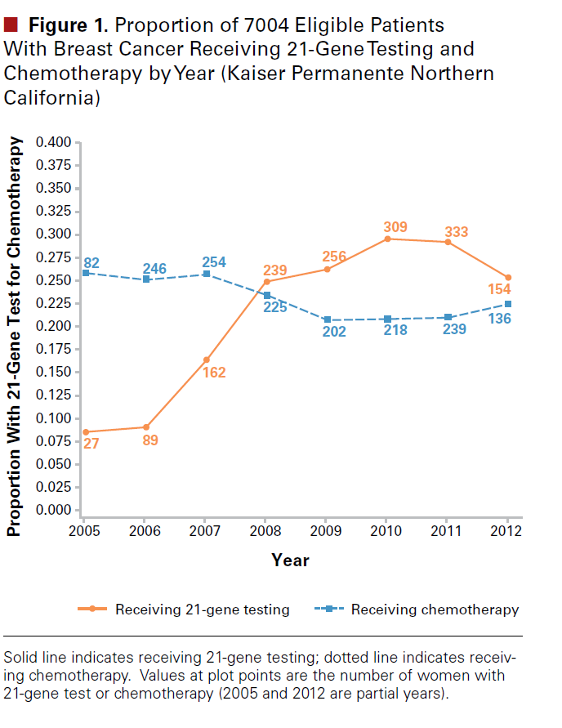
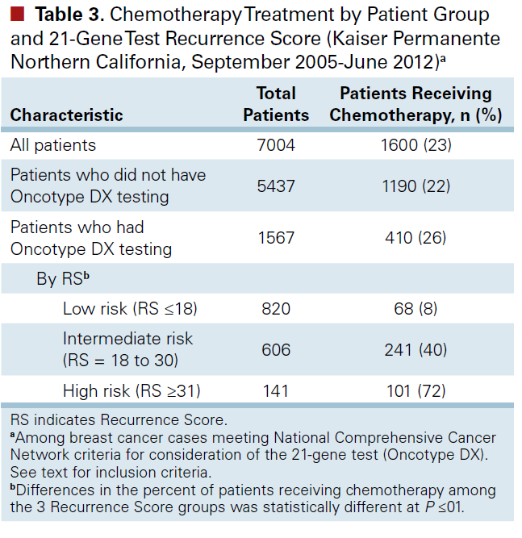
21 gene test that predicts recurrence for HR+ women
Only 22% of those who meet guidelines were actually tested
Recurrence risk scores correlated with use of chemotherapy
Introduction of test associated with modest decrease in overall chemotherapy use

Slide 14
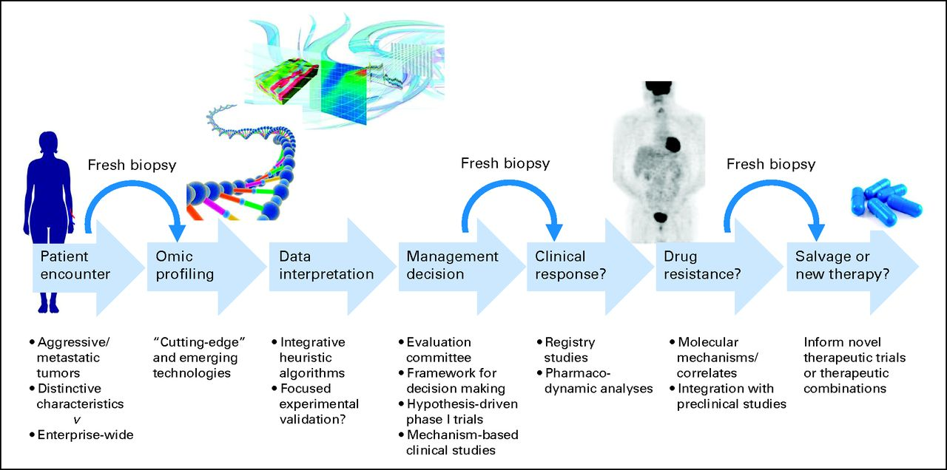
Paradigm for Cancer Precision Medicine
Levi Garraway, Journal of Clinical Oncology, 2013

Slide 15
Assigning Meaning: What is an Actionable Tumor Genomic Alteration?
An “actionable” tumor genomic alteration is a Clinically Relevant genomic finding in a patient’s tumor sample that has implications for clinical care.
Therapeutic implications
Sensitivity to Therapies
Resistance to Therapies
Prognostic implications
Diagnostic implications
Slide by Nick Wagle
Examples:
BRAF V600E mutations may predict sensitivity to RAF inhibitors in melanoma
KRAS codon 12 and 13 mutations may predict resistance to anti-EGFR antibody treatment in colorectal cancer
Certain IDH1 mutations may predict favorable prognosis in gliomas
BCR-ABL translocations are diagnostic, prognostic, and predictive of response to treatment with imatinib

Slide 16
NCI and the Precision Medicine Initiative®
NCI is focusing its PMI activities on four broad areas:
Expanding Precision Medicine Clinical Trials
Overcoming Drug Resistance
Developing New Laboratory Models for Research
Developing a National Cancer Knowledge System

Slide 17
Genomically Based Clinical Trials
Umbrella Trials
Basket Trials
Same Tumor
Different mutations
Test impact of different drugs on different mutations in a single cancer type
Different tumors
Similar mutations
Test effect of a drug on single mutation in a variety of cancer types

Slide 18
NCI Precision Medicine Trials: Lung-MAP

Slide 19
NCI Precision Medicine Trials: NCI Match

Slide 20
Basket Trial Example

Slide 21
Pediatric MATCH

Slide 22
Ethical, Legal, and Social Implicaitons (ELSI) Study

Slide 23
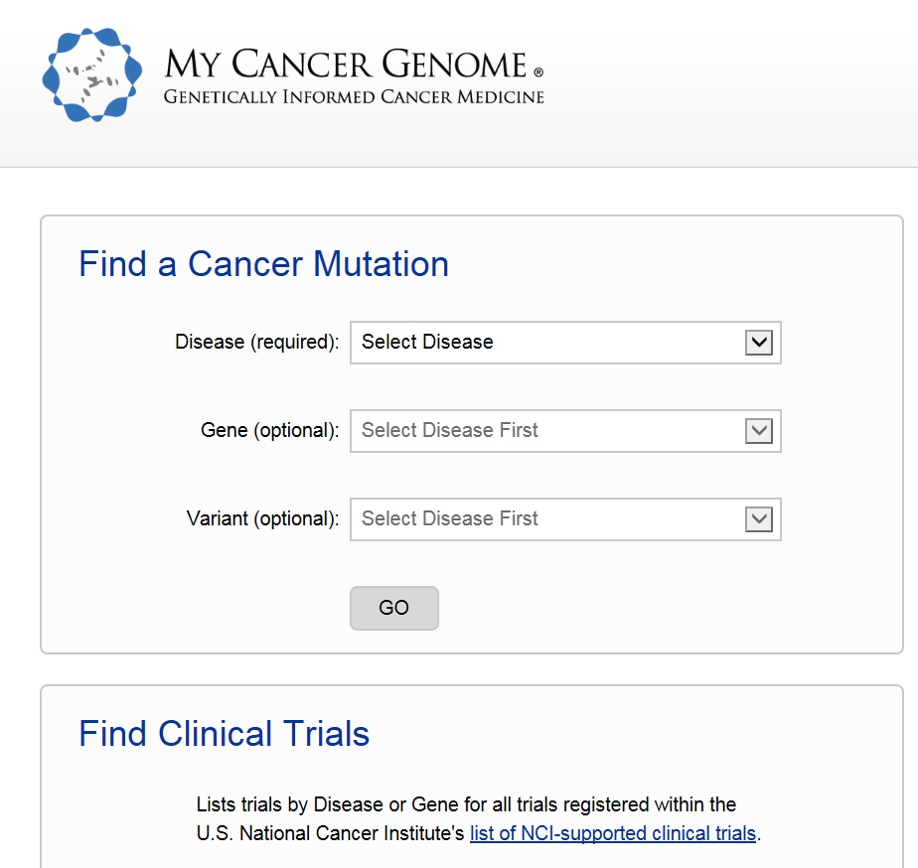
Sharing Clinical Interpretation in Cancer Genomics

Slide 24
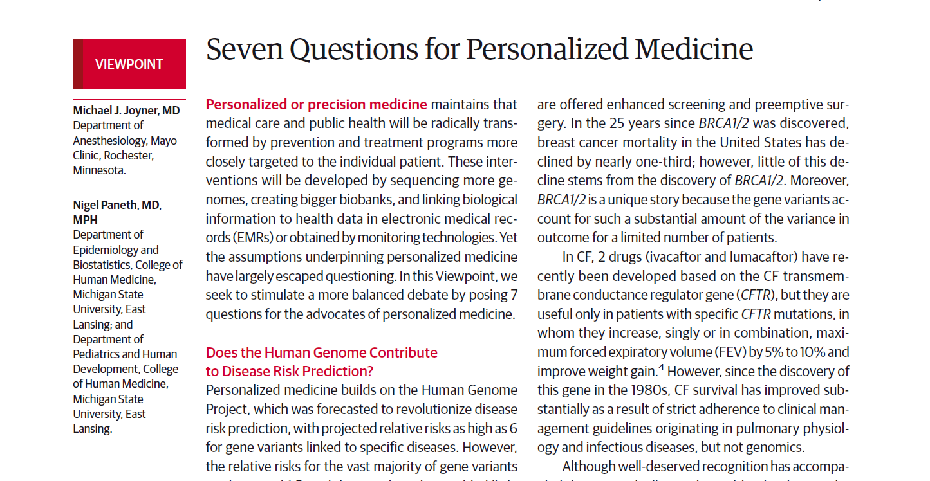
Tension Between Precision Medicine and Public Health
JAMA, June 2015
Too much emphasis on healthcare!
“We worry that an unstinting focus on precision medicine… is a mistake — and a distraction from the goal of producing a healthier population.”
Bayer and Galea, NEJM, 2015

Slide 25
Summary
Precision Medicine takes into account individual differences in people’s genes, environments, and lifestyles.
Precision Medicine may impact cancer at primary, secondary and tertiary prevention
Cancer genomics is on the leading edge of genomic medicine (as are pharmacogenomics and rare diseases applications)
Current precision medicine efforts include a focus on building knowledge basis and knowledge systems, including genomics

