Slide 1
Epidemiology 101
Epidemiology is the study of the distribution and determinants of health-related states in populations
Study design is a key component of epidemiology
Relative risks, risk differences and odds ratios are used to measure association
It is important to consider and address bias in epi studies
Understanding confounding and effect modification are important in studies of association
Disease
Exposure
+
-
Total
+
a
b
a+b
-
c
d
c+d

Slide 2
Overview of Genetic Epidemiology
Different study designs in genetic epidemiology answer different questions about genetic basis of disease.
Collecting family data and family history data is important but challenging.
Pedigrees provide visual representations of family data.

Slide 3
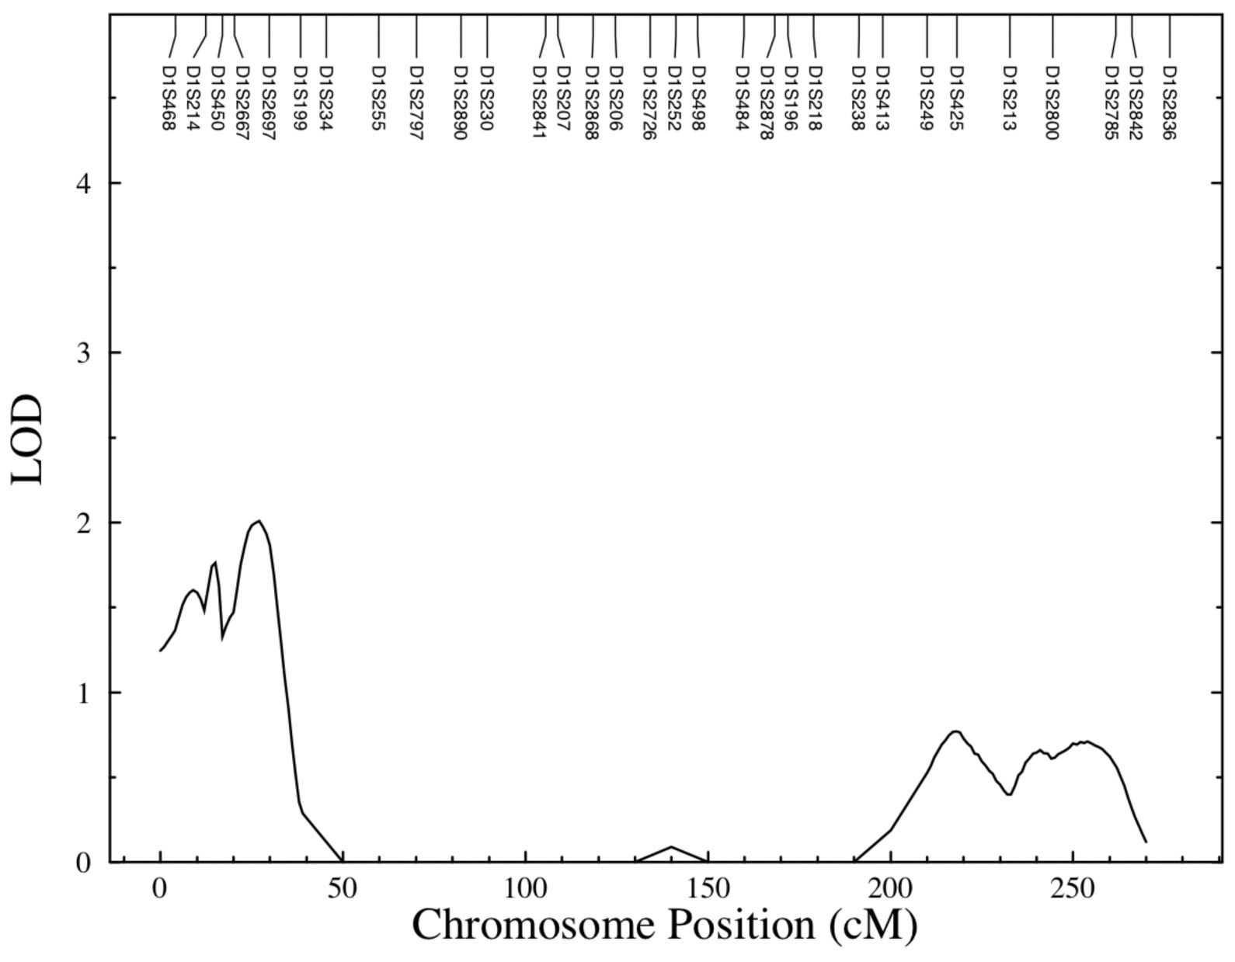
Segregation and Linkage Analysis
Complex segregation analysis is a modeling approach for evaluating the transmission of a trait within a pedigree.
Linkage analysis focuses on the co-segregation between a marker locus and a putative disease locus using family data.

Slide 4
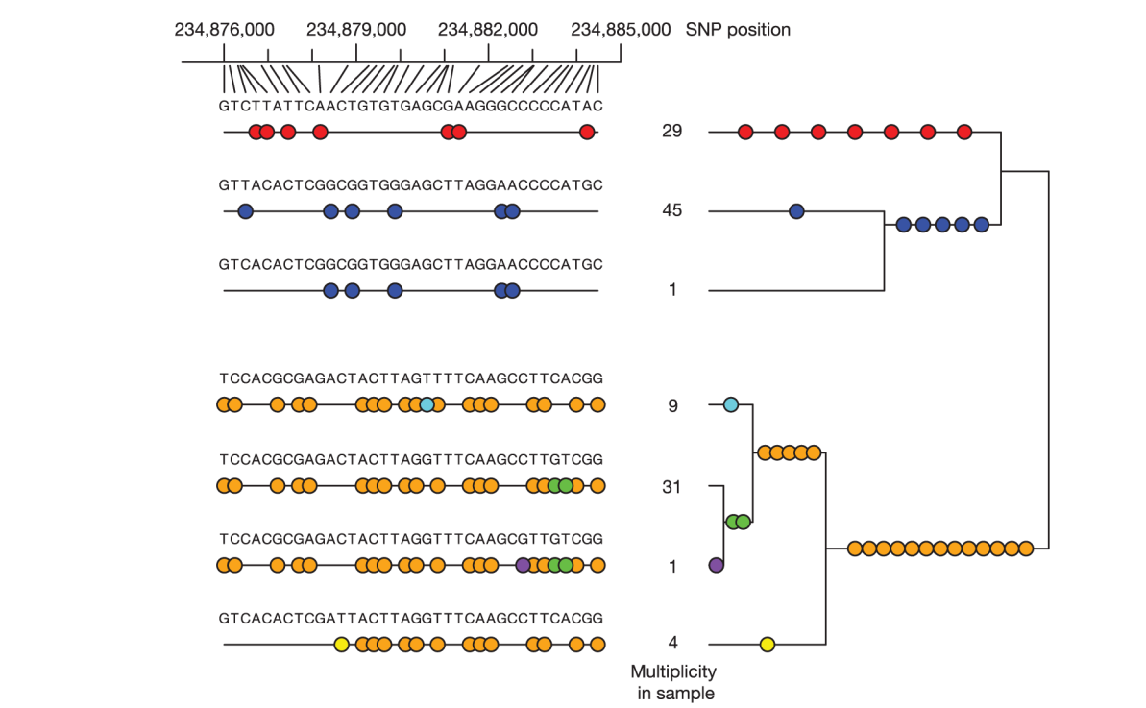
Linkage Disequilibrium
LD refers to nonindependence of alleles
Measures of LD include D, D’ and r²
LD is exploited for association studies, imputation and GWAS
LD in turn causes challenges in interpreting association findings and identifying the causal allele(s)

Slide 5
Association Studies
Focus on association between a particular allele and disease in a population.
Need to consider potential impact of population stratification.
Family based association studies.
Need to consider power and sample size in design and analysis of association studies.
Population based Association studies

Slide 6
Genome Wide Association Studies
GWAS perform association analysis on markers across the genome.
Standards for QC, analysis and presentation.
GWAS have been highly successful at identifying common variants with modest effect sizes associated with disease.
Post-GWAS studies focus on functional characterization and epidemiologic interpretation.
Increasing examples of applications of GWAS findings.

Slide 7
Gene-Environment Interactions
Focus on interplay between genetic and environmental factors
Need to consider scale (additive and multiplicative)
Novel methods to improve power
Attention needs to be given to measuring and analyzing both the G and the E

Slide 8
Sequencing Studies
Next-generation sequencing allows us to examine rare and low-frequency variants.
Gene-level tests are sometimes needed to evaluate this data.
Family based study designs can be useful for identifying rare variants associated with disease phenotypes.

Slide 9
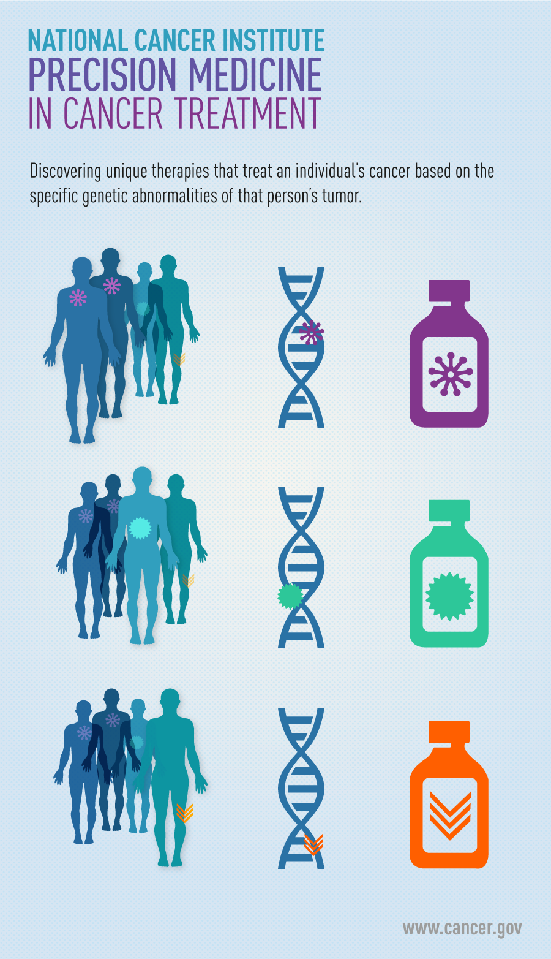
Precision Medicine

