Slide 1
Descriptive Statistics and Exploratory Data Analysis

Slide 2
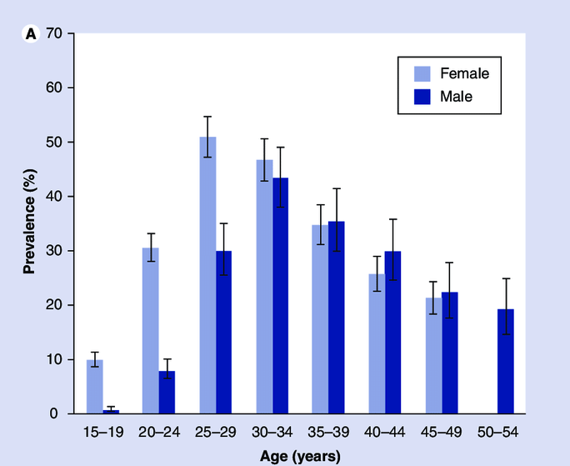
Exploratory/Descriptive Statistics
“Exploratory data analysis can never be the whole story, but nothing else can serve as the foundation stone- the first step” John Tukey, founder of EDA “school”
Summarization and presentation of data
Generally one of first steps to scientific discovery
Definitely one of first steps to scientific understanding
  If you can’t see it, question it

Slide 3
Inferential/Confirmatory Statistics
Generalization of conclusions:
sample population
Assess strength of evidence
Make comparisons
Make predictions
Tools:
  Modeling
  Estimation and Confidence Intervals
  Hypothesis Testing

Slide 4
Exploratory vs Inferential Data Analysis
Exploratory (Descriptive)
Forming ideas/hypotheses
Inferential (Confirmatory)
Investigating predefined ideas/hypotheses
Historically these approaches have been studied separately, but there is ongoing modern research into unifying them (2010 – present)

Slide 5
Types of Data
Categorical (qualitative)
  1) Nominal scale - no natural order
  - sex at birth, gender identity, nationality, …
  2) Ordinal scale - natural order exists
  - low/medium/high, BMI categories …
Numerical (quantitative)
  1) Discrete - (few) integer values
  - number of children in a family
  2) Continuous - measure to a given level of precision
  - blood pressure, weight
Different types of data require different analysis and graphics tools
e.g., categorize zip code

Slide 6
Samples
In statistics, we usually analyze a sample of observations or measurements.
We will denote a sample of N numerical values as:
X₁, X₂, X₃,…,X_{N}
where X₁ is the first sampled datum, X₂ is the second, etc.
e.g. Ages of 3 people:
X₁ = 60
X₂ = 33
X₃ = 41

Slide 7
Ordered Samples
Sometimes it is useful to order the measurements. We denote the ordered sample as:
X₍₁₎, X₍₂₎, X₍₃₎,…,X_{(N)}
where X₍₁₎ is the smallest value and X_{(N)} is the largest.
Consider age example:
X₁ = 60
X₂ = 33
X₃ = 41
X₍₁₎ = 33
X₍₂₎ = 41
X₍₃₎ = 60

Slide 8
Arithmetic Mean
The arithmetic mean is the most common measure of the central location of a sample. We use to refer to the mean and define it as:
The symbol ∑ is shorthand for “sum” over a specified range. For example:

Slide 9

Pause- break time then work on exercises

Slide 10
Question 1
Categorize the following variables into nominal, ordinal, discrete, or continuous
  Viral load
  Age measured in years
  Price of your lunch
  Zip code of your residence

Slide 11
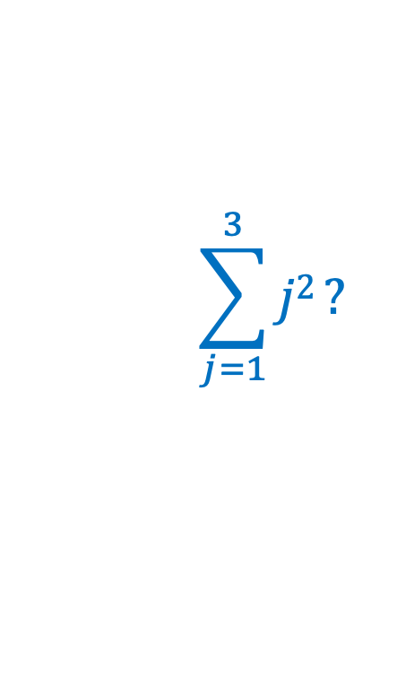
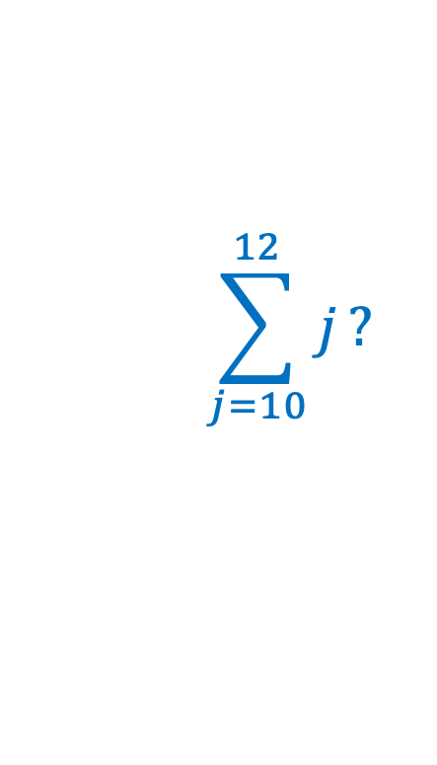
Questions 2, 3, 4
$$\sum_{j=10}^{12}{j}?$$
What is
What is
What is the mean of -5, 10, and 0?
$$\sum_{j=1}^{3}{j2}?$$

Slide 12
Question 5
If I buy a bag of 3 bagels, and they weigh 85g, 95g and 90g, what is the mean weight?
If I buy a bag of 3 bagels and they weigh 0.085 kg, 0.095 kg and 0.09 kg, what is the mean weight?
If I add 20 grams of cream cheese to each of my bagels, what is the mean (combined) weight of my breakfast?

Slide 13
Some Properties of the Mean
Often we wish to transform variables. Linear changes to variables impact the mean in a predictable way:
Adding a constant to all values adds that constant to the mean
Multiplication by constant multiplies the mean by that constant
CAREFUL: This does not happen for all transformations. For example, the logarithm of the mean is not the mean of the logarithms.

Slide 14
Median
Another measure of central tendency is the median - the “middle one”. Half the values are below the median and half are above. Given the ordered sample, X_{(i)}, the median is:
N odd:
N even:
Mode
The mode is the most frequently occurring value in the sample.
5’5, 5’7, 5’7, 5’7

Slide 15
Comparison of Mean and Median
Mean is sensitive to a few very large (or small) values - “outliers”
Median is “resistant” to outliers
Mean has useful mathematically properties

Slide 16
What is different between these 2 experiments and what is the same?
20,23,34,26,30,22,40,38,37
30,29,30,31,32,30,28,30,30

Slide 17
Same mean but the variance differs.
20,23,34,26,30,22,40,38,37
30,29,30,31,32,30,28,30,30
Variance is a way to assess the spread of the data.

Slide 18
Measures of Spread: Range
The range is the difference between the largest and smallest observations:
Alternatively, the range may be denoted as the pair of observations:
The latter form is useful for data quality control.
Disadvantage: the sample range increases with increasing sample size.

Slide 19
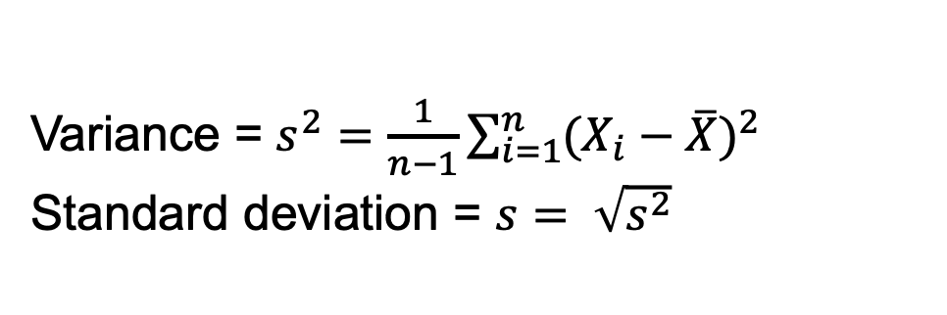
Measures of Spread: Variance
Variance = 16
Std dev = 4
Variance = 100
Std dev = 10
Most common way to assess spread: variance
Variance is a measure of the distance from each observation to the center of the observations
Variance = $s^{2}=\frac{1}{n−1}\sum_{i=1}^{n}{{(X_{i}−\overline{X})}^{2}}$
Standard deviation = $s= \sqrt{s^{2}}$

Slide 20
Properties of the variance/standard deviation
Variance and standard deviation are ALWAYS greater than or equal to zero.
Linear changes are a little trickier than they were for the mean:
(1) Adding a constant to all values does not change the variance or standard deviation
(2) Multiplying by a constant changes the standard deviation by that constant
(3) Multiplying by a constant changes the variance by that constant-squared

Slide 21
Measures of Spread: Percentiles and Quartiles
The median is the sample value that has 50% of the data below it.
More generally, we define the p^{th} percentile as the value which has p% of the sample values less than or equal to it.
Quartiles are the (25, 50, 75) percentiles. The interquartile range is Q_{.75}-Q_{.25} and is another useful measure of spread. The middle 50% of the data is found between Q_{.25} and is Q_{.75}.

Slide 22
Boxplot
A graphics display of the quartiles of a dataset, as well as the range. Extremely large or small values are also identified.
Note that this is the same data as previously plotted as a histogram:

Slide 23
Summary
Numerical Summaries
  1. location - mean, median, mode.
  2. spread - range, variance, standard deviation, IQR
Graphical Summaries
  1. Boxplot
  2. Histograms

Slide 24

Pause- break time then work on exercises

Slide 25
Question 6
If I buy a bag of 3 bagels, and they weigh 85g, 95g and 90g, what is the variance and standard deviation of the weight?
(Recall that the mean was 90g)
What is the variance and standard deviation of the weight of the 3 bagels if 20g of cream cheese is added to each bagel?

Slide 26
Probability Distributions
I

Slide 27
Probability: Why is it of interest?
Most of the time we are not interested in the samples that we obtained. We are interested in using the samples to inform a more general understanding.
To understand how well our samples generalize to a broader population, we need to know how reliable/representative/variable our samples were.
Population Sample
Probability distribution Frequency distribution
Parameters Estimates

Slide 28
Probability Distribution
Definition: A random variable is a characteristic whose obtained values arise as a result of chance factors.
Definition: A probability distribution gives the probability of obtaining all possible (sets of) values of a random variable. It gives the probability of the outcomes of an experiment.

Slide 29
Theoretical Distributions
Used to provide a mathematical description of outcomes. Examples include…
A. Discrete variables
1. Binomial - sums of 0/1 outcomes
- underlies many epidemiologic applications
- basic model for logistic regression
2. Multinomial – generalization of binomial
- a basic model for log-linear analysis
B. Continuous variables
1. Normal - bell-shaped curve; many data summaries are approximately normally distributed.
2. t-distribution – similar to the Normal distribution
3. Chi-square distribution (χ²)

Slide 30
Binomial Distribution - Motivation
Suppose a new student has joined your lab and is learning how to culture cells. Their reference letter says that 25% of the new student’s experiments fail. They only have time to create 3 cultures.
What's the probability that all experiments succeed?
What's the probability that only 1 experiment fails?
What's the probability that at least 1 experiment fails?

Slide 31
Bernoulli Trial
A Bernoulli trial is an experiment with only 2 possible outcomes, which we denote by 0 or 1 (e.g. coin toss)
Assumptions:
1) Two possible outcomes - success (1) or failure (0).
2) The probability of success, p, is the same for each trial.
3) The outcome of one trial has no influence on later outcomes (independent trials).

Slide 32
Binomial Random Variable
A binomial random variable is simply the total number of successes in n Bernoulli trials.
Example: number of successful experiments out of 3
To assign probabilities to outcomes of binomial random variables, we first need to know
1. How many ways are there to get k successes (k=0,…3) in n trials?
2. What’s the probability of any given outcome with exactly k successes (does order matter)?

Slide 33
Example of a Binomial Random Variable
How many ways are there to get k successes (k=0,…3) in 3 trials?
  Experiment succeeds = +
  Experiment fails = -
  Experiment number
1 2 3 Outcomes
+ + + 3 successful
+ + - 2 successful
+ - + 2 successful
- + + 2 successful
+ - - 1 successful
- + - 1 successful
- - + 1 successful
- - - 0 successful

Slide 34

Combinations
Fortunately there is a general formula:
If $C_{k}^{n}$ is the number of ways to get k successes in n attempts, then
where
“n factorial” = n! = n × (n-1) × … × 1

Slide 35
What are the probabilities of these outcomes?
Experiment number
1 2 3 Outcomes # ways
p p p 3 successful 1
p p 1-p 2 successful
p 1-p p 2 successful 3
1-p p p 2 successful
p 1-p 1-p 1 successful
1-p p 1-p 1 successful 3
1-p 1-p p 1 successful
1-p 1-p 1-p 0 successful. 1
sequence of k +’s (0, 1, 2, or 3) and (3-k)
–’s will have probability
p^{k}(1-p)^{3-k}
But there are such sequences, so in general…

Slide 36
Binomial Probabilities
What is the probability that a binomial random variable with n trials and success probability p will yield exactly k successes?
This formula is called the probability mass function for the binomial distribution.
Assumptions:
1) Two possible outcomes - success (1) or failure (0) - for each of n trials.
2) The probability of success, p, is the same for each trial.
3) The outcome of one trial has no influence on later outcomes (independent trials).
4) The random variable of interest is the total number of successes.

Slide 38
Binomial Models
Important Assumptions:
1) Two possible outcomes - success (1) or failure (0) - for each of n trials.
2) The probability of success, p, is the same for each trial.
3) The outcome of one trial has no influence on later outcomes (independent trials).
4) The random variable of interest is the total number of successes.

Slide 39
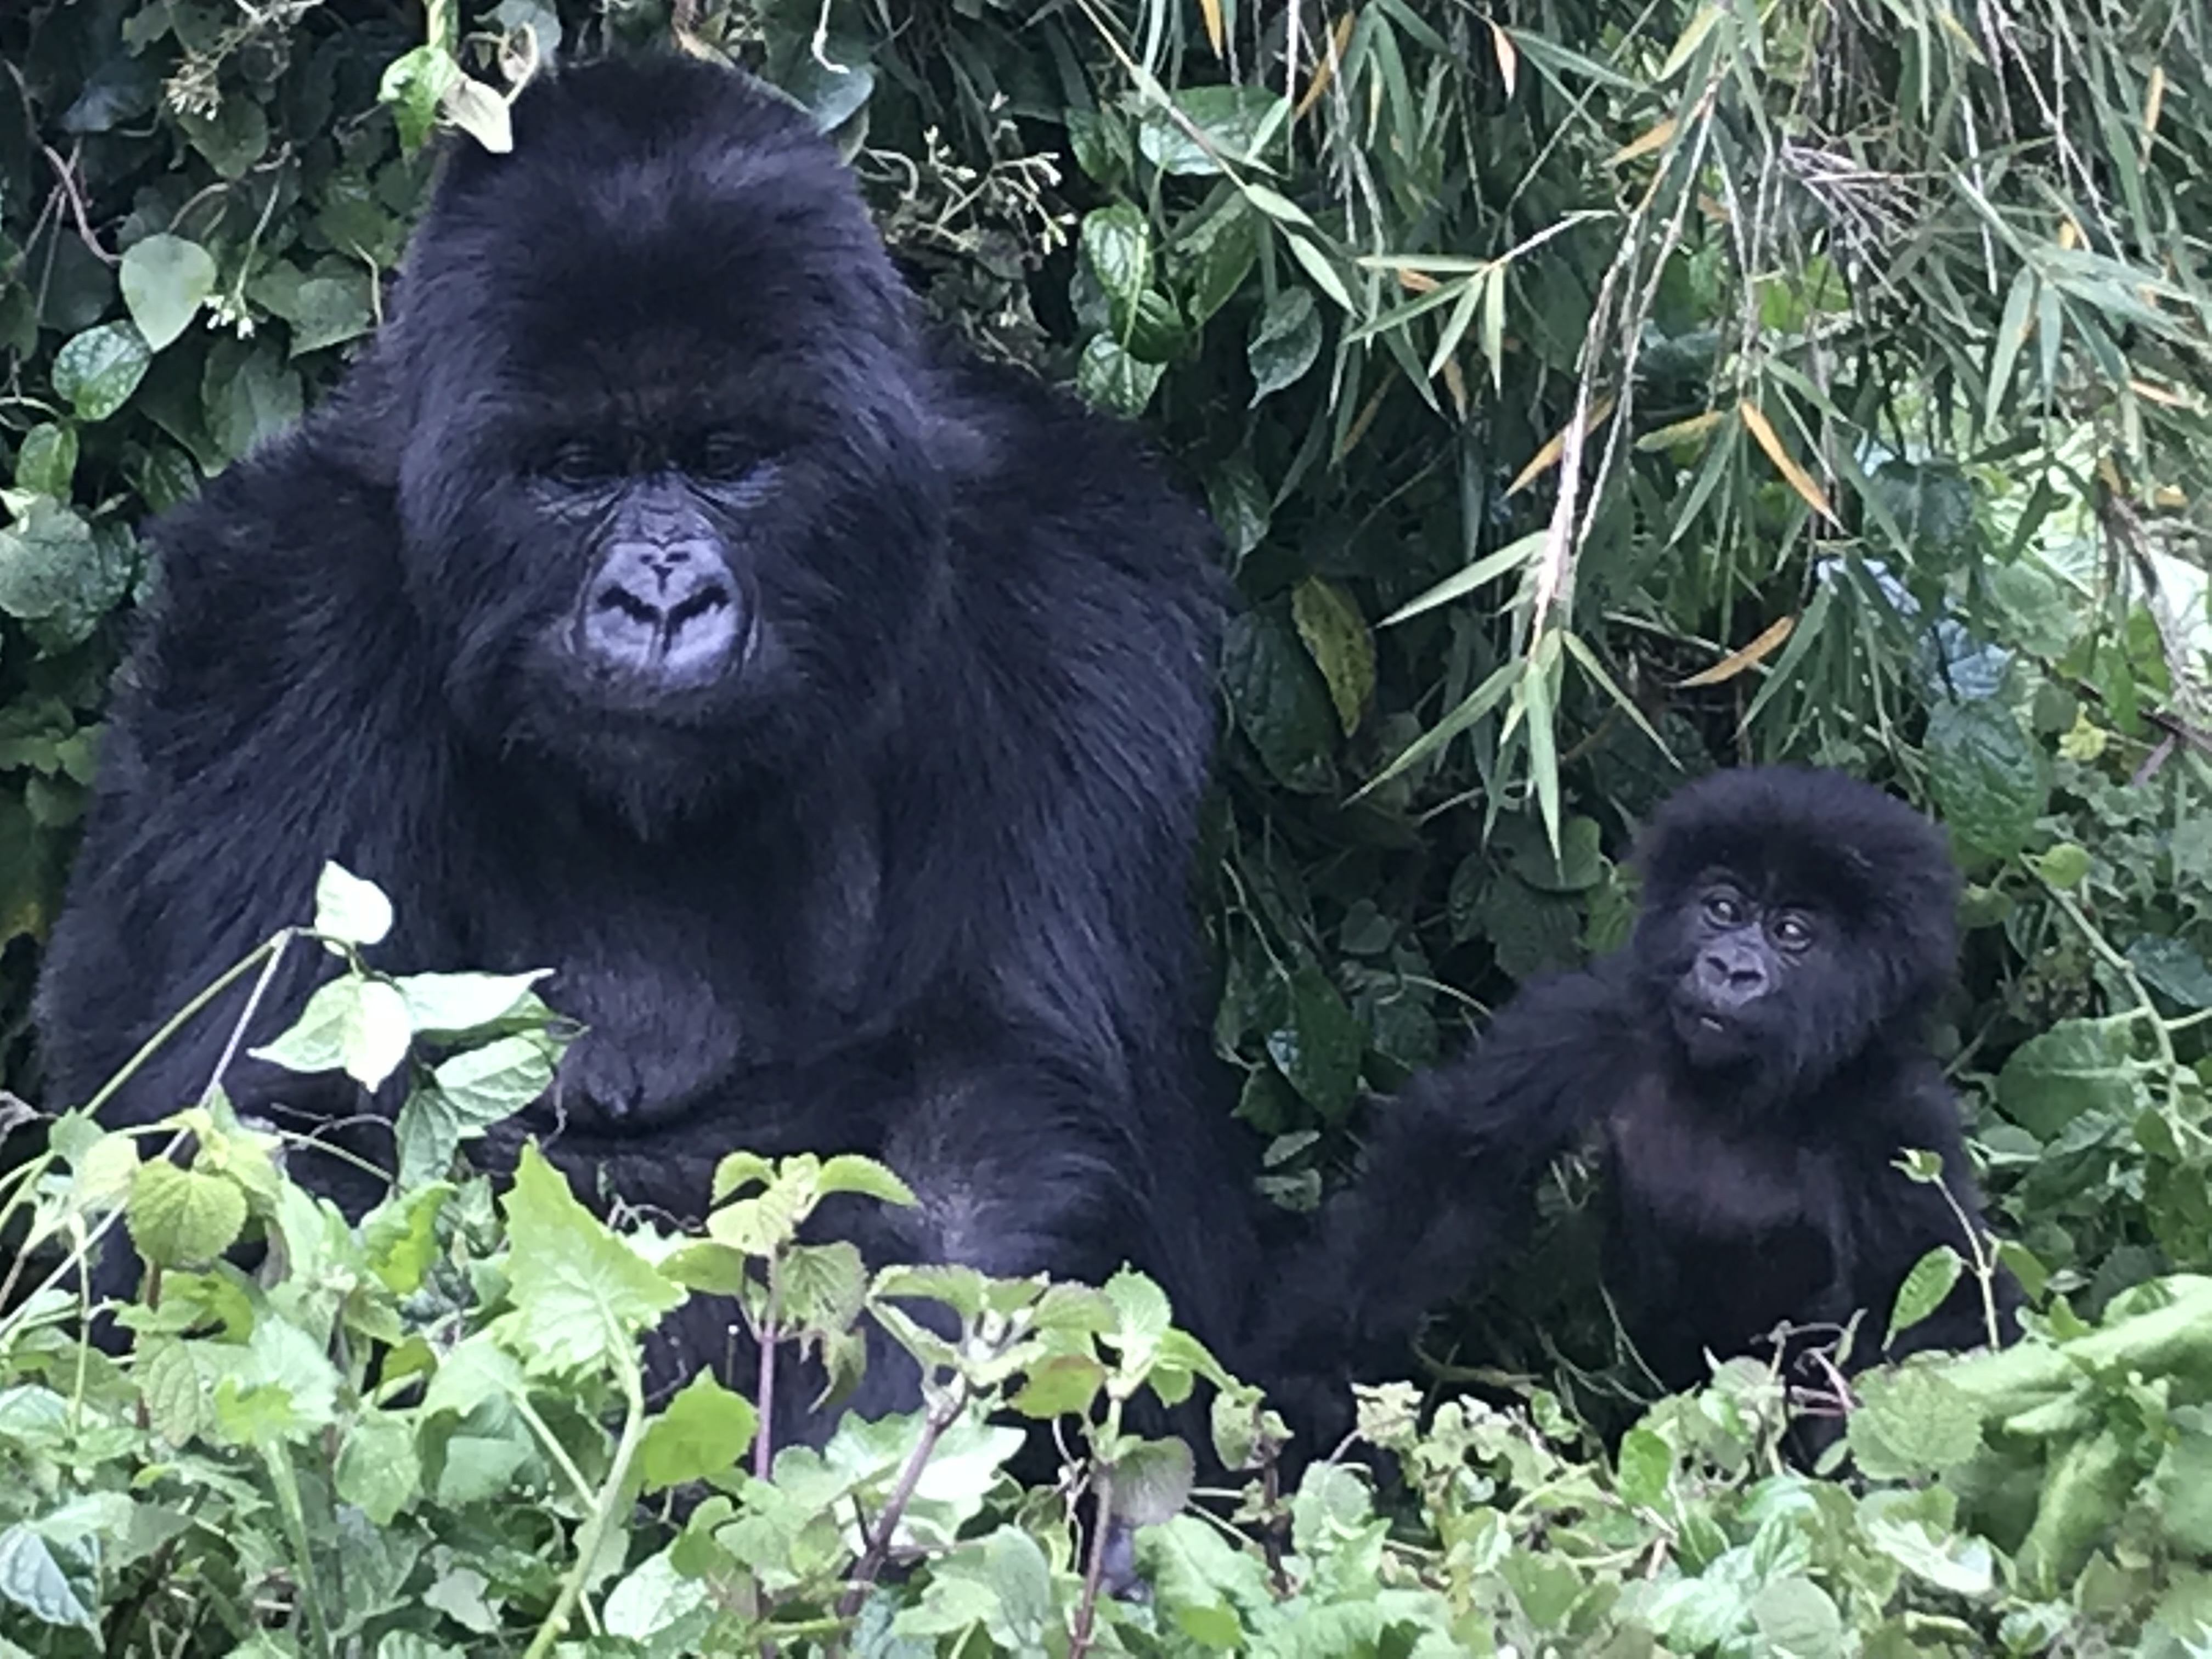
Pause- break time then work on exercises

Slide 40
Questions 7, 8, 9
Suppose a new student has joined your lab and is learning how to culture cells. Their reference letter says that 25% of the new student’s experiments fail. They only have time to create 3 cultures.
What's the probability that exactly 1 experiment fails?
What's the probability that at least 1 experiment fails?
What's the probability that all experiments succeed?
Recall:
where, e.g., 4! = 4 x 3 x 2 x 1 = 24

Slide 41
Mean and Variance of a Discrete Random Variable
Given a theoretical probability distribution we can define the mean and variance of a random variable which follows that distribution. These concepts are analogous to the summary measures used for samples except that these now describe the value of these summaries in the limit as the sample size goes to infinity (i.e. the parameters of the population).
Suppose a random variable X can take the values {x₁,x₂,…} with probabilities {p₁,p₂,…}. Then
Mean:
Variance:

Slide 42
Mean and Variance Example
Consider a Bernoulli random variable with success probability p.
P[X=1] = p
P[X=0]=1-p
Mean:
Variance:

Slide 43

Mean and Variance of Binomial Random Variable
Consider a binomial random variable with success probability p and sample size n.
X ~ Bin(n,p)
Mean:
Variance:

Slide 44
Means and Variance of the Sum of Independent Random Variables
Recall that a binomial RV is just the sum of n independent Bernoulli random variables.
If X₁, X₂, …,X_{n} are independent random variables and if we define Y= X₁+ X₂+ …+X_{n}
1. Means add:
E[Y]= E[X₁]+E[X₂]+ …+E[X_{n}]
2. Variances add:
V[Y]= V[X₁]+V[X₂]+ …+V[X_{n}]
We can use these results, together with the properties of the mean and variance that we learned earlier, to obtain the mean and variance of a binomial random variable (Question 10 of the exercises).

Slide 45
Binomial Distribution Summary
1. Binomial RVs are discrete.
2. Parameters - n (sample size), p (probability of success)
3. Sum of n independent 0/1 outcomes
4. Sample proportions, logistic regression

Slide 46

Pause- break time then work on exercises

Slide 47
Questions 10, 11
A couple intends to have 5 children and both are carriers of myotonic dystrophy, a dominant trait. Therefore, the probability that a child has the trait is 0.75. What is the probability that at least 1 child will have the trait?
Calculate the mean and variance of a binomially distributed random variable with n trials and success probability p.

