Slide 1
Descriptive Statistics
Critical first step in any data analysis
Used to summarize the data
Can help postulate ideas to be assessed via statistical inference/hypothesis testing
Data types:
  Qualitative (nominal, ordinal)
  Quantitative (discrete, continuous)
Measures of location/central tendency: mean, median
Measures of spread: variance, quantiles (e.g., min, max, IQR)

Slide 2
Probability Distributions
Allows a generalization from the sample to the population
The theoretical distributions of outcomes let us to calculate the probability of a given outcome
  e.g., binomial distribution of binary outcomes, normal distribution of continuous outcomes
Mean and variance of a random variable X
  Properties of these can be used to calculate the mean and variance of any linear transformation of X

Slide 3
Question 1
Categorize the following variables into nominal, ordinal, discrete, or continuous
  Viral load
  Age measured in years
  Price of your lunch
  Zip code of your residence
  Answers
a) continuous
b) discrete
c) continuous
d) nominal

Slide 4
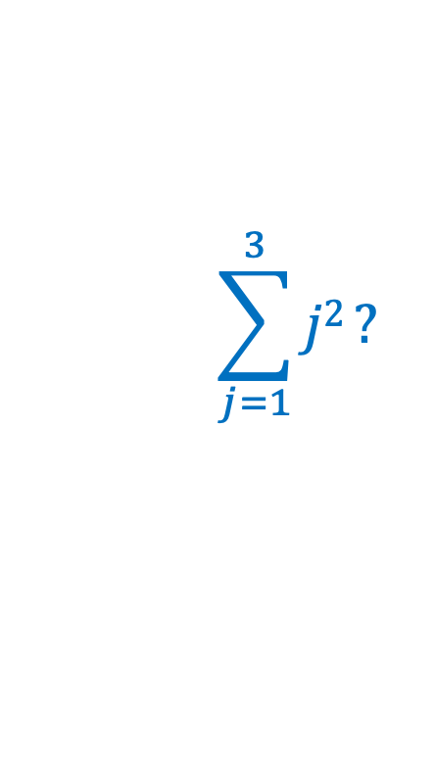
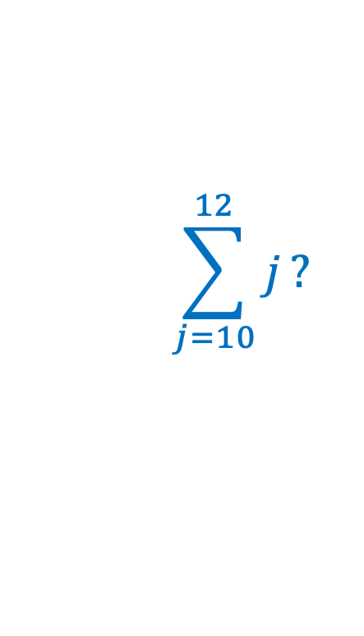
Questions 2, 3, 4
$$\sum_{j=10}^{12}{j}?$$
What is
What is
What is the mean of -5, 10, and 0?
  Answers
2. = 10 + 11 + 12 = 33
3. = 1² + 2² + 3² = 1 + 4 + 9 = 14
4. (-5 + 10 + 0)/3 = 5/3 = 1.667
$$\sum_{j=1}^{3}{j2}?$$

Slide 5
Question 5
If I buy a bag of 3 bagels, and they weigh 85g, 95g and 90g, what is the mean weight?
If I buy a bag of 3 bagels and they weigh 0.085 kg, 0.095 kg and 0.09 kg, what is the mean weight?
If I add 20 grams of cream cheese to each of my bagels, what is the mean (combined) weight of my breakfast?
  Answers
a) = (85g + 95g + 90g)/3 = 90g
b) = (0.085kg + 0.095kg + 0.09kg)/3 = 0.090kg
c) = (105g + 115g + 110g)/3 = 110g

Slide 6
Question 6
If I buy a bag of 3 bagels, and they weigh 85g, 95g and 90g, what is the variance and standard deviation of the weight?
(Recall that the mean was 90g)
What is the variance and standard deviation of the weight of the 3 bagels if 20g of cream cheese is added to each bagel?
Answers
a) s² = [(85-90)² + (95-90)² + (90-90)²]/(3-1)
= [25 + 25 + 0]/2
= 50/2
= 25
s = 5
b) s² = 25, s = 5 (adding a constant doesn’t change the variance or standard deviation estimate)

Slide 7
Questions 7, 8, 9
Suppose a new student has joined your lab and is learning how to culture cells. Their reference letter says that 25% of the new student’s experiments fail. They only have time to create 3 cultures.
What's the probability that exactly 1 experiment fails?
What's the probability that at least 1 experiment fails?
What's the probability that all experiments succeed?
Recall:
where, e.g., 4! = 4 x 3 x 2 x 1 = 24

Slide 8
Questions 7, 8, 9
Answers
7.
8.
9.

Slide 9
Question 10
A couple intends to have 5 children and both are carriers of myotonic dystrophy, a dominant trait. Therefore, the probability that a child has the trait is 0.75. What is the probability that at least 1 child will have the trait?
The probability of any single child having the trait is 0.75, and the carrier status of each child is independent of every other. The number of children with the trait (X) is therefore a binomially-distributed random variable with n = 5 and p = 0.75.

Slide 10
Question 11
Calculate the mean and variance of a binomially distributed random variable with n trials and success probability p.
If X ~ Bin(n,p) and Y₁, Y₂…Y_{n} are independent Bernoulli random variables with success probability p, then X has the same distribution as Y₁ + Y₂ + … + Y_{n}.
So,

