Slide 1
Probability Distributions II
Discrete distributions cont’d
Multinomial distribution- generalization of the binomial distributions to random variables with more than 2 outcomes
Assumptions:
1) J possible outcomes – only one of which can be a success (1) a given trial.
2) The probability of success for each possible outcome, p_{j}, is the same from trial to trial.
3) The outcome of one trial has no influence on other trials (independent trials).
4) Interest is in the (sum) total number of “successes” over all the trials.

Slide 2
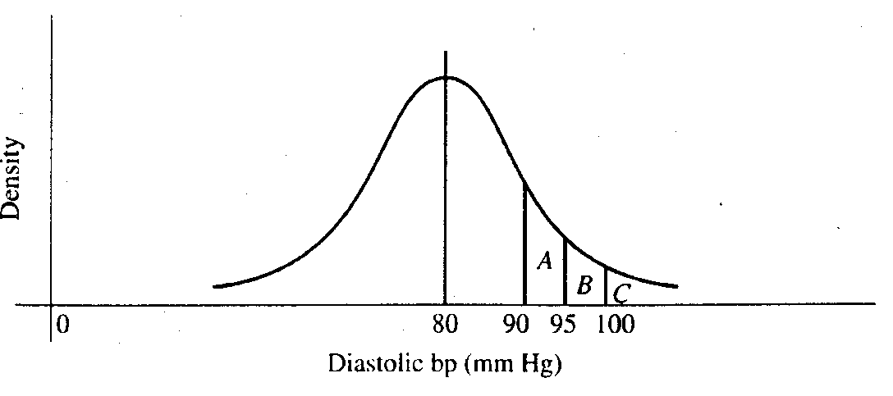
Continuous distributions
Calculate the probability of an interval rather than a single value as with discrete distributions.
probability density function
probability mass function

Slide 3
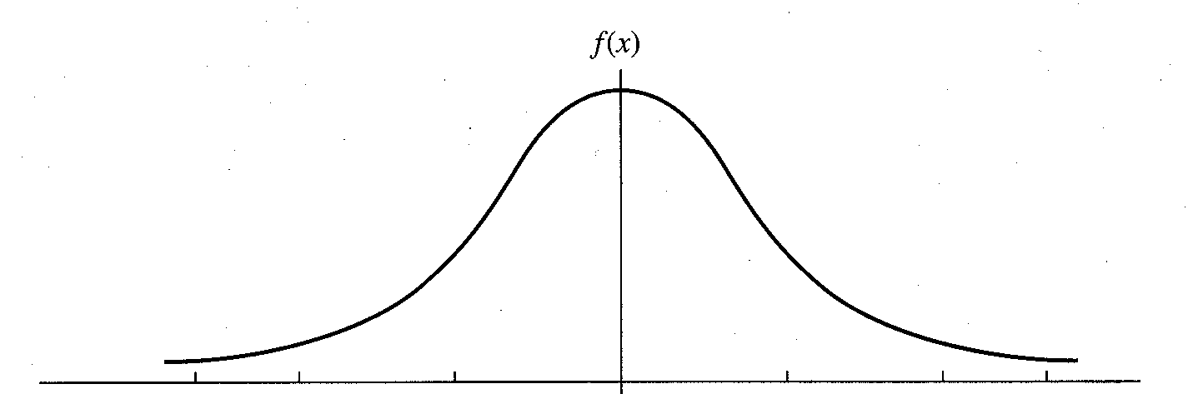
The Normal distribution
Common probability distribution for continuous data
Symmetric about mean/median/mode
Ranges from -∞ to ∞
Parameterized by the mean and variance

Slide 4
Calculating probabilities using the Normal distribution
When np(1-p) is “large” (e.g. ≥ 3), Normal approximation to binomial distribution holds: X ~ N(np, np(1-p)) where X~bin(n,p)
continuity correction for discreteness:
P(X ≤ x) is a discrete binomial so to calculate it from a continuous Normal, use P(X ≤ x + 0.5)

Slide 5
Question 1
Recall, carrier=Aa with Pr(Aa) = ½
unaffected=AA with Pr(AA) = ¼
affected=aa with Pr(aa) = ¼
What is the probability that all three offspring will be carriers?

Slide 6
Question 2
Recall, carrier=Aa with Pr(Aa) = ½
unaffected=AA with Pr(AA) = ¼
affected=aa with Pr(aa) = ¼
What is the probability that exactly two offspring will be affected and one a carrier?

Slide 7
Question 2+
Recall, carrier=Aa with Pr(Aa) = ½
unaffected=AA with Pr(AA) = ¼
affected=aa with Pr(aa) = ¼
2+. What is the probability that exactly two offspring will be carriers?

Slide 8
Questions 3, 4, 5, 6
Google “cdf normal distribution calculator” and find the following if Z ~ N(0,1)
3. P(Z ≤ 1.65) = 0.9505
4. P(Z ≥ 0.5) = 0.3085
5. P(-1.96 ≤ Z ≤ 1.96) = 0.975 – 0.025 = 0.95
6. P(-0.5 ≤ Z ≤ 2.0) = 0.9772 - 0.3085 = 0.6687

