Slide 1
Hypothesis Testing

Slide 2
Hypothesis Testing
Motivation
1. Is the chance of getting a cold different when participants take vitamin C than when they take placebo? (Pauling 1971 data).
2. Suppose that 6 out of 15 students in a grade-school class develop influenza, whereas 20% of grade-school children nationwide develop influenza. Is there evidence of an excessive number of cases in the class?

Slide 3
Hypothesis Testing Motivation cont’d
3. In a study of 49 HIV+ pregnant women, we find a mean arterial pressure of 79.4 mm Hg. In the general population of pregnant women, the mean arterial pressure is 78.8 mm Hg with standard deviation of 1.4 mm Hg.
Are the data from our study consistent with the data from the general population?
What if = 80.1 mm Hg?
What if = 81.3 mm Hg?
What if the sample was of size n=100 instead of 49?

Slide 4
Hypothesis Testing
Define:
μ = population mean arterial pressure for HIV+ pregnant women at 36 weeks gestation
Hypotheses:
1. Null Hypothesis: Generally, the hypothesis that the unknown parameter equals a fixed value.
H₀: μ = 78.8 mm Hg
2. Alternative Hypothesis: contradicts the null hypothesis.
H_{A}: μ ≠ 78.8 mm Hg

Slide 5
Hypothesis Testing
α = “size”
1 - β = “power”
Decision and Truth:
We assume that either H₀ or H_{A} is true. Based on the data we will choose one of these hypotheses.
Truth
Fail to reject H₀
Decision
Reject H_{0 ,}
Accept H_{A}

Slide 6
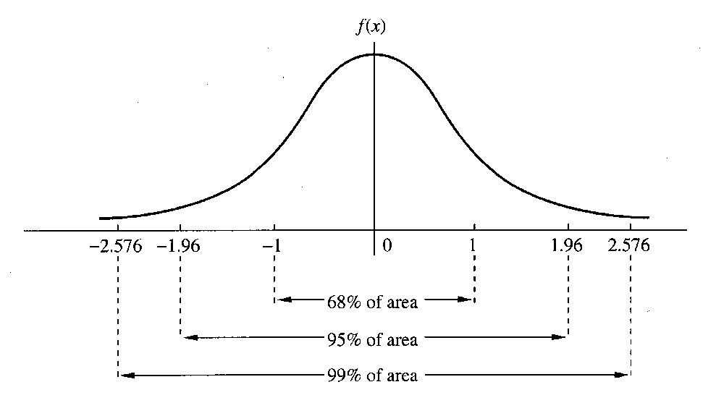
Hypothesis Testing
Let’s fix α, for example, α = 0.05.
0.05 = α = P[ choose H_{A} | H₀ true ]
α = P[ reject H₀ | H₀ true ]
Q: How to construct a procedure that makes this error with only 0.05 probability?
A: Suppose we assume H₀ is true and suppose that, using that assumption, the data should give us a standard normal, Z.
If μ = 0 then |Z| is rarely “large”. A “large” |Z| would make me question whether μ = 0 .

Slide 7
Hypothesis Testing
Therefore, we reject H₀ if |Z| > 1.96.
α = P[reject H₀ | H₀ true] = 0.05
Then if we do find a large value of |Z| we can claim that:
Either H₀ is true and something unusual happened (with probability α)…
or H₀ is not true.
But note that we operate under the assumption that H₀ is true and look for evidence suggesting it is false. We can reject the null but we can’t prove it is true. Therefore, we say:
  If |Z| > 1.96, then we reject H₀ and accept H_{A}.
  If |Z| < 1.96, then we fail to reject H₀.

Slide 8
Hypothesis Testing Example
Mean Arterial Pressure Example:
Let μ be the mean arterial pressure for HIV+ pregnant women at 36 weeks. In our sample of 49 women:
= 79.4 mm Hg
Also, we are told that for the general population of pregnant women at 36 weeks...
μ₀ = mean arterial pressure = 78.8 mm Hg
= std. dev. of mean arterial pressure = 1.4 mm Hg
Null hypothesis (H₀): mean for HIV+ pregnant women (μ) is the same as the mean for the general population of pregnant women (μ₀).
Alternative hypothesis (H_{A}): mean for HIV+ pregnant women (μ) is different than the mean for the general population of pregnant women (μ₀).
H₀ : μ = μ₀ = 78.8 mm Hg
H_{A} : μ ≠ μ₀ (μ ≠ 78.8 mm Hg)

Slide 9
Hypothesis Testing Example
Mean Arterial Pressure Example:
Test H₀ with significance level α = 0.05.
Under H₀ we know:
Therefore,
Reject H₀ if > 1.96 gives an α = 0.05 test.
Reject H₀ if

Slide 10
Hypothesis Testing Example cont’d
Test: Reject H₀ if
= 79.4 therefore we reject the null and accept the alternative hypothesis.
In terms of Z:
or
or
We reject H₀ if Z < -1.96 or Z > 1.96

Slide 11
Reject Ho
if

Slide 12
Hypothesis Testing and the P-value
p-value:
a measure of how well the data fits the null hypothesis
probability of obtaining a result as extreme or more extreme than the actual sample (when H₀ is true)
not the probability that the null (or alternative) is true

Slide 13
Hypothesis Testing and the P-value Example
p-value: Mean arterial pressure example
= 79.4 mm Hg n = 49 σ = 1.4 mm Hg
H₀ : μ = 78.8 mm Hg
H_{A} : μ ≠ 78.8 mm Hg
p-value is given by: 2 * P[ > 79.4] =0.0027

Slide 14
(Somewhat Outdated) Guidelines for Judging the Significance of p-value
If .05 ≤ p < .10, than the results are marginally significant.
If .01 ≤ p < .05, then the results are significant.
If .001 ≤ p < .01, then the results are highly significant.
If p < .001, then the results are very highly significant.
If p > .1, then the results are considered not statistically significant (sometimes denoted by NS).
Significance is not everything!

Slide 15
American Statistical Association Guidelines for the Use of P-values
In March 2016, the ASA provided these guidelines:
P-values can indicate how incompatible the data are with a specified statistical model.
P-values do not measure the probability that the studied hypothesis is true, or the probability that the data were produced by random chance alone.
Scientific conclusions and business or policy decisions should not be based only on whether a p-value passes a specific threshold.
Proper inference requires full reporting and transparency.
A p-value, or statistical significance, does not measure the size of an effect or the importance of a result.
By itself, a p-value does not provide a good measure of evidence regarding a model or hypothesis.

Slide 16
Hypothesis Testing and Confidence Intervals
Hypothesis Test: Fail to reject H₀ if:
Confidence Interval: Plausible values for μ are given by:

Slide 17
Hypothesis Testing
“How many sides?”
Depending on the alternative hypothesis, a test may have a one-sided alternative or a two-sided alternative. Consider
H₀ : μ = μ₀
We can envision (at least) three possible alternatives
H_{A} : μ ≠ μ₀ (1)
H_{A} : μ < μ₀ (2)
H_{A} : μ > μ₀ (3)
(1) is an example of a “two-sided alternative”
(2) and (3) are examples of “one-sided alternatives”
The distinction impacts:
  Rejection regions
  p-value calculation

Slide 18
1-sided Hypothesis Testing
Mean Arterial Pressure Example: Instead of the two-sided alternative considered earlier we may have only been interested in the alternative that HIV+ pregnant women have higher mean arterial pressure.
H₀ : μ = 78.8
H_{A} : μ > 78.8
Given this, an α = 0.05 test would reject when
We put all the probability on “one-side”.
The p-value would be half of the previous,
p-value = P[ > 79.4]
= 0.0014
1.64

Slide 19
Take Home Points
Hypothesis Testing Steps
1. Identify H₀ and H_{A}
2. Identify a test statistic
3. Determine a significance level, α = 0.05, α = 0.01
4. Critical value determines rejection / acceptance region
5. Calculate p-value
6. Interpret the result

