Slide 1
Probability

Slide 2
Probability
Definitions:
1. Classical: P(E) = m/N
If an event can occur in N mutually exclusive, equally likely ways, and if m of these possess characteristic E, then the probability of E is equal to m/N.
2. Relative Frequency:
If a process or an experiment is repeated a large number of times, n, and if the characteristic, E, occurs m times, then the relative frequency, m/n, of E will be approximately equal to the probability of E.
Pr(E) ≈ m/n
3. Personal Probability

Slide 3
Basic Properties of Probability
1. Two events, A and B, are said to be mutually exclusive (disjoint) if only one or the other, but not both, can occur in a particular experiment.
2. The probability of any event is non-negative and less than 1.
3. The sum of the probabilities of an exhaustive collection (i.e. at least one must occur) of mutually exclusive outcomes is 1:
The probability of all events other than an event A is denoted by P(A^{c}) [A^{c} stands for “A complement”]. P(A^{c}) = 1 - P(A)
P(A or B) = the probability that event A or event B (or both) occurred.
P(AB) = the probability that both A and B occurred.
P(A|B) = the probability of A among the subset of cases in which B is known to have occurred.

Slide 4
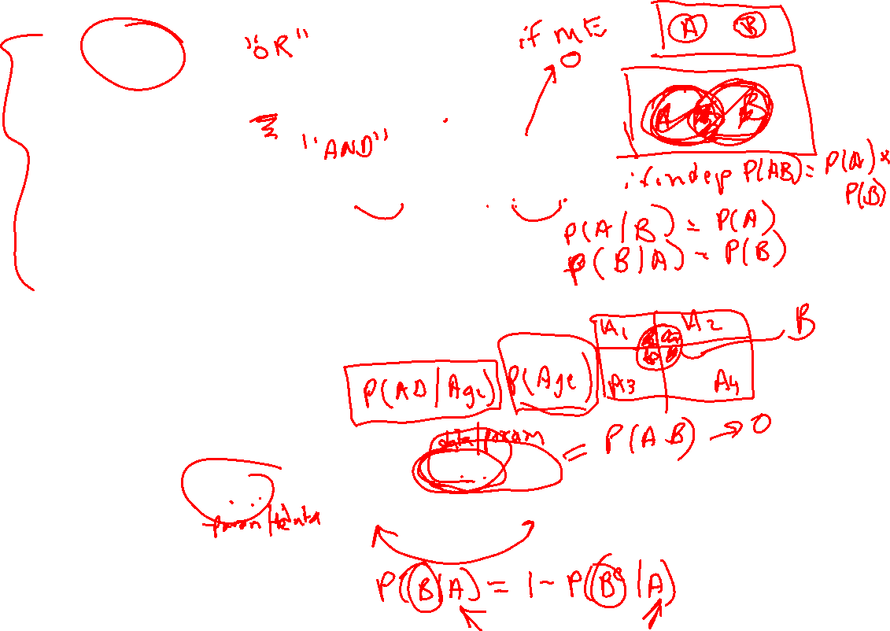
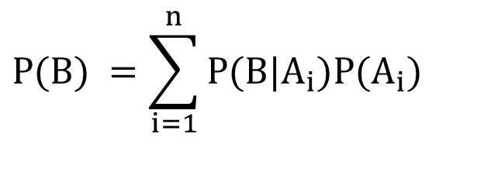
General Probability Rules
Addition rule
$$P(A \text{or} B)=P(A)+P(B)−P(\text{AB})$$
Multiplication rule
$$P(\text{AB})=P(A|B)P(B)=P(B|A)P(A)$$
Total Probability Rule
If A₁,…A_{n} are mutually exclusive, exhaustive events, then
$$P(B) =\sum_{i=1}^{n}{P(B|A_{i})P(A_{i})}$$
IV. Bayes Rule
$$\begin{matrix}P(A|B) & = & \frac{P(B|A)P(A)}{P(B|A)P(A)+P\left(\text{B} \right|A^{c})P(A^{c})} \\ & & \end{matrix}$$

Slide 6
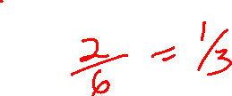
Basic Properties of Probability
Suppose you toss a single die
Consider the following events:
E₁ = roll a 1
E₂ = roll an even number
E₃ = roll a 4, 5 or 6
E₄ = roll a 3 or 5
What is Pr(E₄)?
Are E₂ and E₃ mutually exclusive? E₂ and E₄?
Find a mutually exclusive, exhaustive collection of events. Do the probabilities add to 1?
What is Pr(E₄^{c})?

Slide 7
Conditional Probability
Suppose we screen 10,000 people for a disease using a new screening test. Here are the results:
What is P(test positive)?
What is P(test positive and disease positive)?
What is P(test positive or disease positive)?
What is P(test positive | disease positive)?
What is P(disease positive | test positive)?

Slide 8
General Probability Rules
In a group of 30 symptomatic women attending a clinic, some had cervical infections with Chlamydia trachomatis (C) or Neisseria gonorrhea (G), and some were harboring both organisms and some had neither. Seven women had C only, 5 women had G only and 8 women had both (B).
a) What is the probability of chlamydia (C)?
b) What is the probability of gonorrhea (G)?
c) What is the probability of gonorrhea (G) or chlamydia (C)?
d) Are gonorrhea and chlamydia mutually exclusive?

Slide 9
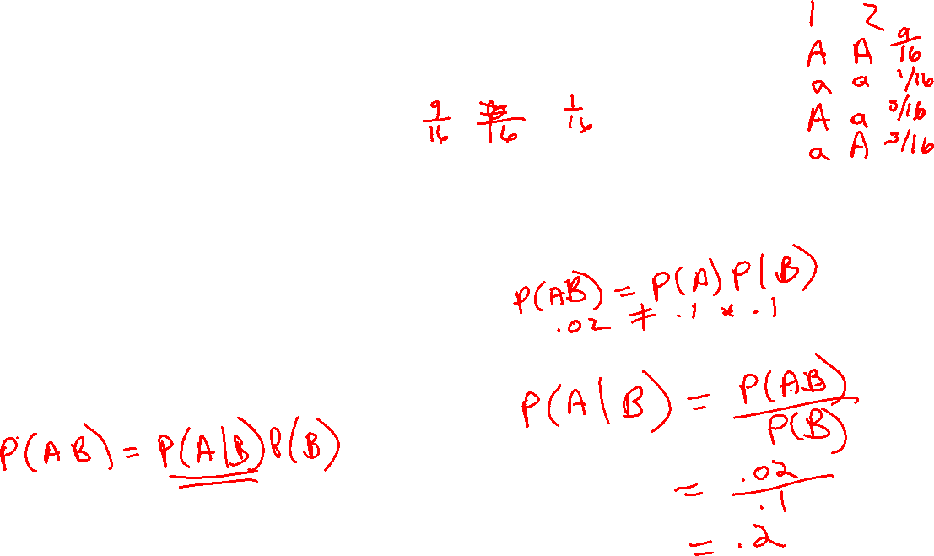
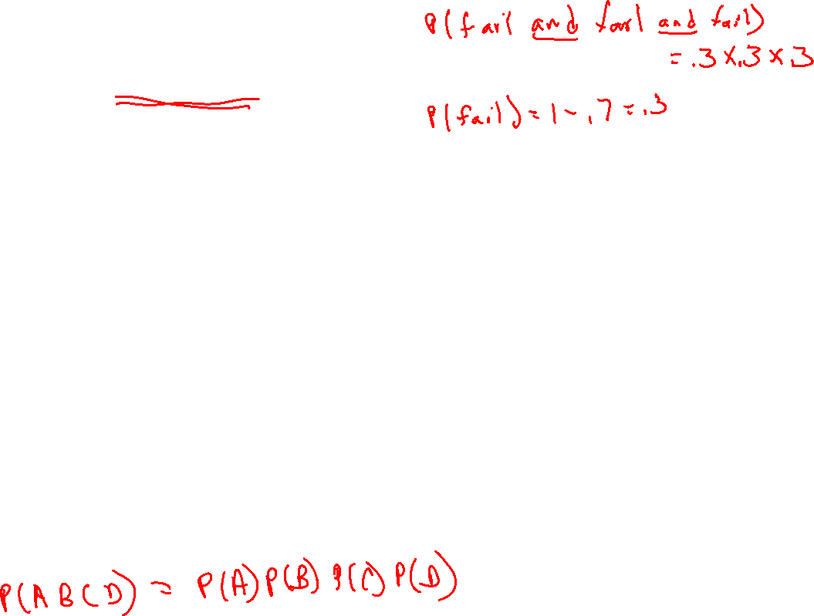
General Probability Rules
A certain operation has a survival rate of 70%. If this operation is performed independently on three different patients, what is the probability all three operations will fail?
If allelle A has frequency 3/4 and allelle a has frequency 1/4 , what are the prevalances of the 3 genotypes AA, Aa and aa in the population (assuming random mating)?
Suppose an influenza epidemic strikes a city. In two child families the older child has influenza 10% of the time (event A), the younger child has influenza 10% of the time (event B) and both children have influenza 2% of the time .
Are the events A and B independent?
What is the probability that the older child has influenza if we know the younger child has influenza?

Slide 10
General Probability Rules
The following table gives the probability of a low birthweight (<2500g) baby for different gestational ages. What is the overall probability of having a LBW infant in this population?
Length of Gestation | Proportion born at this gestational age | Prob. LBW at this gestational age
< 20 weeks | .0004 | .540
20 – 27 weeks | .0059 | .813
28 – 36 weeks | .0855 | .379
> 36 weeks | .9082 | .035

Slide 11
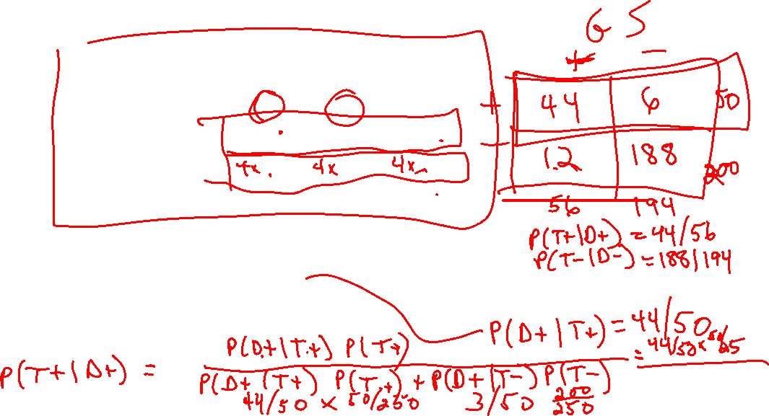
Bayes’ Rule
An investigator wants to determine the characteristics of a screening test for bacterial vaginosis (BV). The investigator obtains screening results on 250 women and finds 50 who screen positive and 200 who screen negative. The “gold standard” (i.e. true measure of disease status) is a gram stain test but this test is more expensive to do. Therefore, the investigator decides to do gram stains on all 50 women who screened positive and a random sample of 50 of the women who screened negative. The following results are obtained
Estimate the sensitivity and specificity of the screening test.
Estimate the positive predictive value of the screening test.
(Hint: Fix the table – or use Bayes rule – so it mimics the results you would get if all 250 women were tested by the gold standard)
 |  | Gram stain
 |  | + | -
Screening test | + | 44 | 6 | 50
 | - | 3 | 47 | 50
 |  | 47 | 53

Slide 12
Extra Problems
The following table gives estimates of the proportion of individuals with Alzheimer’s disease (AD) in various age and gender groups. Suppose an unrelated 77 year old woman, 76 year old man and 87 year old woman are selected and tested for AD.
The sample space for this “experiment” consists of all possible outcomes of the testing. List these (Hint: there are 8 possible outcomes).
What is the probability all three have AD?
What is the probability at least one has AD?
What is the probability exactly one has AD?
Age Group | Males | Females
65 – 69 | 0.016 | 0.0
70 – 74 | 0.029 | 0.022
75 – 79 | 0.049 | 0.032
80- 84 | 0.088 | 0.078
85+ | 0.35 | 0.28

Slide 13
Extra Problems
Randomized response surveys (RRS) are sometimes used to get unbiased responses to sensitive questions such as “Have you used illegal drugs in the past 6 months?” In one version of a RRS a respondent is first told to secretly flip a coin. If the coin toss is a head, the respondent is instructed to answer “Yes” to the sensitive question, regardless of the truth; if the coin toss is a tail, he is instructed to answer the sensitive question truthfully. This removes the stigma associated with a “Yes” answer since no one except the participant can tell if a “Yes” response is answering the sensitive question.
Suppose the true proportion of the population who have used illegal drugs in the past 6 months is R. Write an equation that gives the proportion of the respondents expected to answer “Yes” to the sensitive question in terms of R (Hint: Use the total probability rule and assume that the probability of a head on the coin flip is 0.5)
In a RRS, 60 out of 100 participants respond “Yes” to the question “Have you used illegal drugs in the past 6 months?”. Give an estimate, based on part (a), of the proportion of this population that have used illegal drugs in the past 6 months.

Slide 14
Extra Problems
The following table summarizes a cross-sectional study by Jerushalmy et al that sparked controversy concerning the value of various screening procedures for disease detection.
 | No TB | TB
Negative X-ray | 1739 | 8 | 1747
Positive X-ray | 51 | 22 | 73
 | 1790 | 30 | 1820
a) If one of the 1820 records were randomly selected, what is the probability it would be a person with TB?
b) For a randomly selected record, what is the probability that it belongs to a person who has TB and has a positive X-ray?
c) If you are told that a randomly selected record is for a person with a positive X-ray, what is the probability that it belongs to a person with TB?
d) What is the probability that a randomly selected record belongs to a person with TB or a person with a positive X-ray?

Slide 15
Session 1 Solutions
a) 2/6 b) E2,E3 no; E2, E4 yes c) E1, E2, E4 d) 4/6
a) 89/10000 b) 9/10000 c) 90/10000 d) 9/10 e) 9/89
a) 15/30 b) 13/30 c) 20/30 d) no
P(fail,fail,fail) = P(fail)P(fail)P(fail) = .3*.3*.3 = .027
P(AA) = (3/4)*(3/4)= 9/16 P(Aa) = 2*3/16 = 6/16 P(aa) = 1/16
a) No, since .1*.1 ≠ .02
b) P(O | Y) = P(O,Y)/P(Y) = .02/.1 = .2
Prob = .0004*.54 + .0059*.813 + .0855*.379 + .9082*.035 = .069
a) sens = 44/(44 + 3*4) spec = 47/(6 + 47*4)
b) ppv = 44/50

Slide 16
Session 1 Solutions
Extra Problems
a) Let A = has AD; a = does not have AD
77yo 76yo 82yo Prob
A A A .049*.023*.078
A A a .049*.023*(1-.078)
A a A etc
A a a
a A A
a A a
a a A
a a a
b) .049*.023*.078 = 8.7906e-05
c) 1 – P(aaa) = 1 – (1-.049)(1-.023)(1-.078) = .143
d) P(Aaa)+P(aAa)+P(aaA) = .136
10) a) Pr(Yes) = .5 + .5*R b) R = .2
11) a) 30/1820 b) 22/1820 c) 22/73 d) (30+73-22)/1820

