Slide 1
Probability Distributions
II

Slide 2
Multinomial Distribution - Motivation
Suppose we modified assumption (1) of the binomial distribution to allow for more than two outcomes.
For example, we might be interested in calculating the following probabilities for the offspring of parents that are heterozygote carriers of a recessive trait.
Q₁: One of their n=3 offspring will be unaffected (AA), 1 will be affected (aa) and one will be a carrier (Aa),
Q₂: All of their offspring will be carriers,
Q₃: Exactly two of their offspring will be affected (aa) and one will be a carrier.

Slide 3
Multinomial Distribution - Motivation
For each child, we can represent each of these possible outcomes with three indicator variables for the i^{th} child as:
Y_{i1} = 1 if i^{th} child is unaffected (AA) & =0 otherwise
Y_{i2} = 1 if i^{th} child is a carrier (Aa) & =0 otherwise
Y_{i3} = 1 if i^{th} child is affected (aa) & =0 otherwise
Notice only one of the three Y_{i1}, Y_{i2}, Y_{i3} can be equal to 1 (Y_{i1} +Y_{i2}+Y_{i3}= 1).
For the binomial distribution with 2 outcomes (e.g., unaffected vs. carrier/affected), there are 2^{n} unique outcomes in n trials. In the family with n=3 children, there are 2³ = 8 unique outcomes.
For the multinomial distribution with 3 outcomes, the number of unique outcomes in n trials is 3^{n}. For the family of 3, that’s 3³=27 unique outcomes.

Slide 4
Possible Outcomes
Combinations: As with the binomial distribution, when order doesn’t matter, the total number of possible outcomes, can be straightforwardly calculated. For the multinomial distribution, the combinations are calculated as
where the k_{j} (j=1, 2,…, J) correspond to the totals for the different outcomes.
e.g. n=2 children
J=3 possible outcomes (unaffected/carrier/affected)
Child number
1 2 Outcomes
AA AA 2 unaffected, 0 carrier, 0 affected
AA Aa 1 unaffected, 1 carrier, 0 affected
Aa AA 1 unaffected, 1 carrier, 0 affected
AA aa 1 unaffected, 0 carrier, 1 affected
aa AA 1 unaffected, 0 carrier, 1 affected
Aa Aa 0 unaffected, 2 carrier, 0 affected
aa Aa 0 unaffected, 1 carrier, 1 affected
Aa aa 0 unaffected, 1 carrier, 1 affected
aa aa 0 unaffected, 0 carrier, 2 affected

Slide 5
For n=2 children, what are the probabilities of various outcomes?
E.g. (n=2, k₁=number of unaffected, k₂=number of carrier, k₃=number of affected)
Child number
1 2 Outcomes # ways
p₁ p₁ k₁=2,k₂=0,k₃=0 1
p₁ p₂ k₁=1,k₂=1,k₃=0 2
p₂ p₁ k₁=1,k₂=1,k₃=0
p₁ p₃ k₁=1,k₂=0,k₃=1 2
p₃ p₁ k₁=1,k₂=0,k₃=1
p₂ p₂ k₁=0,k₂=2,k₃=0 1
p₃ p₂ k₁=0,k₂=1,k₃=1 2
p₂ p₃ k₁=0,k₂=1,k₃=1
p₃ p₃ k₁=0,k₂=0,k₃=2 1
For each possible outcome, the probability Pr[Y₁=k₁, Y₂=k₂, Y₃=k₃] is p₁^{k1}p₂^{k2}p₃^{k3}
There are sequences for each probability, so in general…

Slide 6
Multinomial Probabilities
The probability that a multinomial random variable with n trials and success probabilities p₁, p₂, …, p_{J} will yield exactly k₁, k₂,…k_{J} successes is:
Assumptions:
1) J possible outcomes – only one of which can be a success (1) a given trial.
2) The probability of success for each possible outcome, p_{j}, is the same from trial to trial.
3) The outcome of one trial has no influence on other trials (independent trials).
4) Interest is in the (sum) total number of “successes” over all the trials.
k₁ k₂ k₃ k₄
k_{J-1} k_{J}
n = Σ_{j} k_{j} is the total number of trials.

Slide 7
Multinomial Probabilities - Examples
Returning to the original questions:
Q₁: One of n=3 offspring will be unaffected (AA), one will be affected (aa) and one will be a carrier (Aa) (recessive trait, carrier parents)?
Solution: For a given child, the probabilities of the three outcomes are:
p₁ = Pr[AA] = 1/4 p₂ = Pr[Aa] = 1/2 p₃ = Pr[aa] = 1/4
We have

Slide 8
Paws- break time then work on exercises

Slide 9
Questions 1, 2
Recall, carrier=Aa with Pr(Aa) = ½
unaffected=AA with Pr(AA) = ¼
affected=aa with Pr(aa) = ¼
What is the probability that all three offspring will be carriers?
What is the probability that exactly two offspring will be affected and one a carrier?

Slide 10
Example - Mean and Variance
The (marginal) outcomes of the multinomial distribution are binomial. We can immediately obtain the means for each outcome, e.g, Y_{j} = k_{j}, the j^{th} outcome: Mean:
Variance:

Slide 11
Multinomial Distribution Summary
1. Multinomial RVs are discrete
2. Parameters - n, p₁, p₂,…,p_{J}
Each outcome Y_{j} = k_{j} is the sum of n independent Bernoulli outcomes
Extends binomial distribution
5. Contingency tables, polytomous regression

Slide 12
Continuous Distributions

Slide 13
Continuous Distributions
For measurements like height and weight which can be measured with arbitrary precision, it does not make sense to talk about the probability of any single value. Instead we talk about the probability for an interval.
P[weight = 70.000kg] ≈ 0
P[69.0kg < weight < 71.0kg] = 0.08
For discrete random variables, we had a probability mass function to give us the probability of each possible value. For continuous random variables we use a probability density function to tell us about the probability of obtaining a value within some interval.

Slide 14
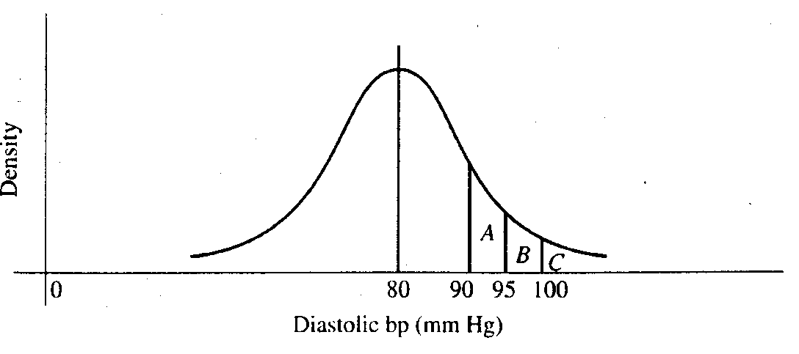
With discrete probability distributions, we can determine the probability of a single outcome, e.g.:
With continuous probability distributions, we can determine the probability across a range of outcomes:
For any interval, the area under the curve represents the probability of obtaining a value in that interval.

Slide 15
Probability density function
1. A function, typically denoted f(x), that gives probabilities based on the area under the curve.
2. f(x) ≥ 0
3. Total area under the function f(x) is 1.
Cumulative distribution function
The cumulative distribution function, F(t), tells us the total probability that X is less than some value t.
F(t) = P(X ≤ t)

Slide 16
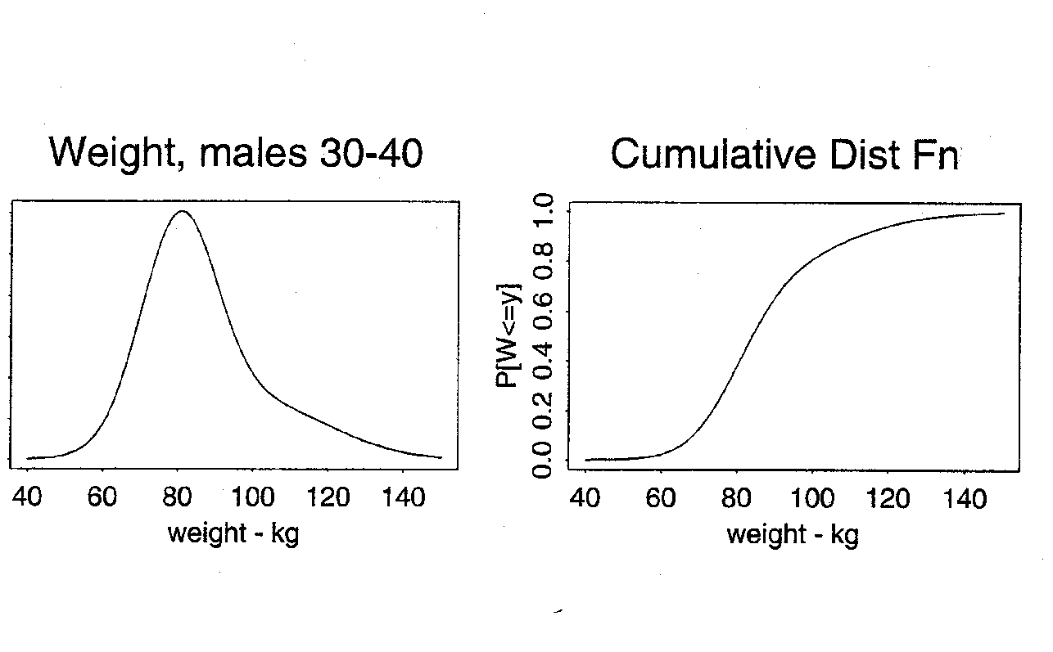
f(t)
F(t)
Prob[weight < 80] = 0.40
Area under the curve

Slide 17
Normal Distribution
A well-known probability model for continuous data
Bell-shaped curve
takes values between -∞ and + ∞
symmetric about mean
mean = median = mode
Common examples (that don’t always hold):
birthweights
blood pressure
CD4 T cell counts (transformed)
The normal distribution is more useful
as a derived distribution,
as we will see when we talk about the
central limit theorem.

Slide 18
Normal Distribution
Specifying the mean and variance of a normal distribution completely determines the probability distribution function and, therefore, all probabilities.
The normal probability density function is:
where
π ≈ 3.14 (a constant)
Notice that the normal distribution has two parameters:
μ = the mean of X
σ = the standard deviation of X
We write X~N(μ , σ²).
The standard normal distribution, N(0, 1), is a special case where μ = 0 and σ² = 1.

Slide 19
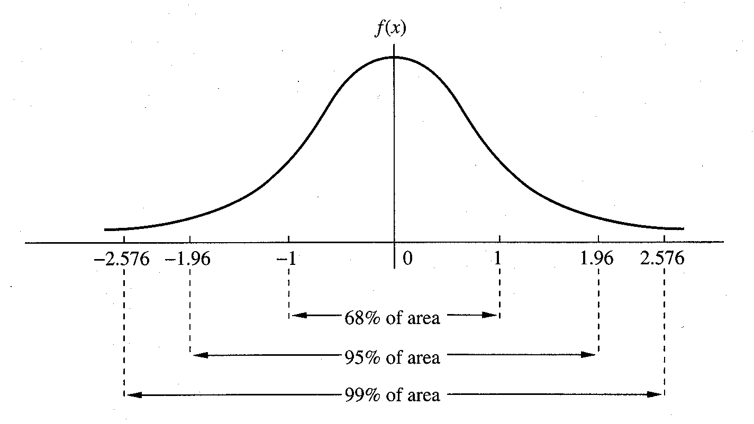

Slide 20
Normal Distribution - Calculating Probabilities
Example 5.20: Rosner, Fundamentals of Biostatistics
Serum cholesterol is approximately normally distributed with mean 219 mg/mL and standard deviation 50 mg/mL. If the clinically desirable range is < 200 mg/mL, then what proportion of the population falls in this range?
X = serum cholesterol in an individual.
μ = 219 mg/mL
σ = 50mg/mL
negative values for cholesterol ??

Slide 21
Standard Normal Distribution - Calculating Probabilities
First, let’s consider the standard normal - N(0,1). We will usually use Z to denote a random variable with a standard normal distribution. The probability density function of Z is:
and the cumulative distribution of Z is:
Any computing software can give you the values of f(z) and Φ(z)

Slide 22
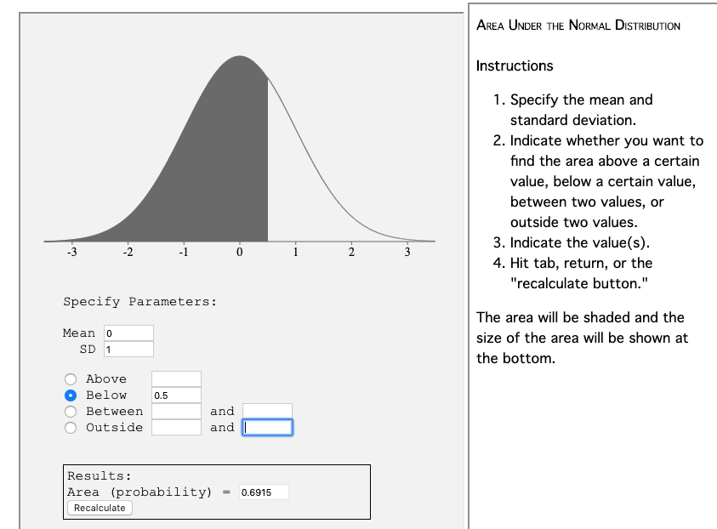
Standard Normal Distribution - Calculating Probabilities
Pr(Z ≤ 0.5) = 0.6915

Slide 23
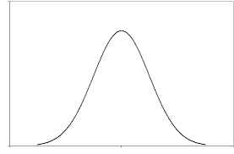
Facts about probability distributions
P(Z ≤ z) = a
P(Z > z) = 1- a
P(Z ≤ x) = b, P(Z ≤ y) = c
Pr(x < Z ≤ y ) = c - b
a
1-a
z
c
b
c-b
x
y

Slide 24
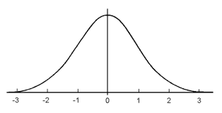
Facts about the standard normal distribution
Because the N(0,1) distribution is symmetric around 0,
Pr(Z ≤ -y) = Pr(Z ≥ y) = d
d
d
-y
y

Slide 25
Pause- break time then work on exercises

Slide 26
Questions 3, 4, 5, 6
Google “cdf normal distribution calculator” and find the following if Z ~ N(0,1)
3. P(Z ≤ 1.65) =
4. P(Z ≥ 0.5) =
5. P(-1.96 ≤ Z ≤ 1.96) =
6. P(-0.5 ≤ Z ≤ 2.0) =

Slide 27
Normal Approximation to Binomial Distribution
Example:
Suppose the prevalence of HPV in women 18-22 years old is 0.30. What is the probability that in a sample of 60 women from this population that 9 or fewer would be infected?

Slide 28
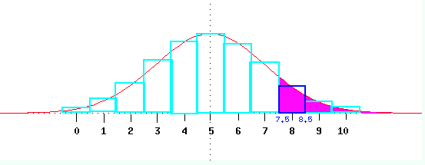
Normal Approximation to Binomial Distribution
Binomial
When np(1-p) is “large” (e.g. ≥ 3), the normal distribution may be used to approximate the binomial distribution.
X ~ bin(n,p)
E(X) = np
V(X) = np(1-p)
X is approximately N(np, np(1-p))
Apply continuity correction for discreteness:
P(X ≤ x) is a discrete binomial so to calculate it from a continuous normal, use P(X ≤ x + 0.5)
http://www.cs.uni.edu/~campbell/stat/prob9.html

Slide 29
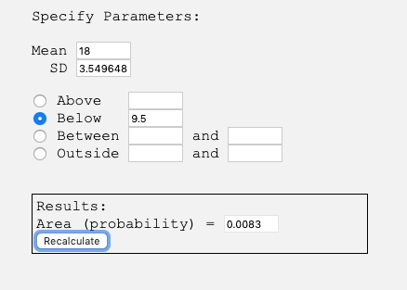
Application of Normal Approximation to Binomial Distribution
Example:
Suppose the prevalence of HPV in women 18 -22 years old is 30%. What is the probability that in a sample of 60 women from this population that 9 or less would be infected?
Solution
X = number infected out of 60
X ~ Binomial(n=60, p =0.3)
X close to Normal distribution with mean 60*0.3=18 and variance 60*0.3*(1-0.3)=12.6
Therefore, P(X ≤ 9.5) = 0.0083

