Slide 1
Sampling Distributions

Slide 2
The most important distinction in statistics
sample
vs
population
When analyzing data (or reading the literature), think about whether you want to discuss the sample that you observed or want to make statements that are more generally true.
Statistics is the only field that gives us the correct framework to generalize from our sample to the population.

Slide 3
Sample vs. Population
Example: T cell counts from 40 women with triple negative breast cancer were observed. What can we do with this information?
Option 1: Discuss the 40 women. What was the mean T cell count? What was its variation?
Option 2: Generalize the information about the 40 women to make statements about all women with triple negative breast cancer.
These are 2 different approaches to using the same information.

Slide 4
Language for making these distinctions
Sample
Size = n
Sample Mean
Sample variance =
Population
Size = N (usually ∞)
Mean
Variance

Slide 5
Generalizing the sample to the population
Issue: While we can calculate the sample mean and sample variance from our data, the true mean and true variance are generally unknown.
Fortunately, statisticians have learnt some things about how to recover, with high probability, the true mean and true variance based only on sample means and sample variances.

Slide 6
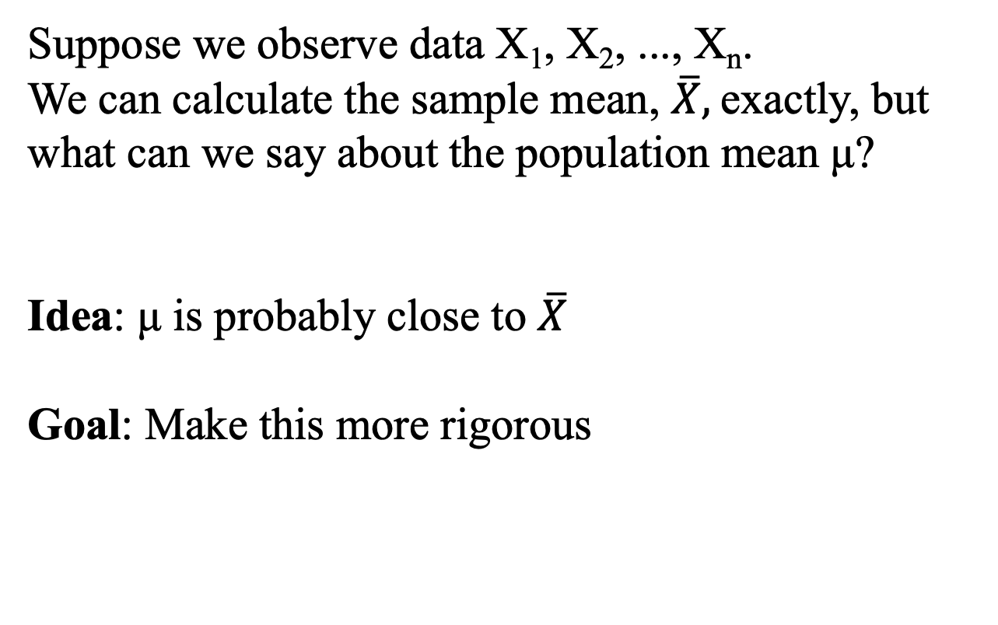
How do sample means behave?
Suppose we observe data X₁, X₂, ..., X_{n}.
We can calculate the sample mean, $\overline{X},$exactly, but what can we say about the population mean μ?
Idea: μ is probably close to $\overline{X}$
Goal: Make this more rigorous

Slide 7
Sums and Means of Normal Random Variables
In general, neither the sum nor mean of the data will have the same distribution as the data
Example:
X₁, X₂, X₃ follow F-distributions.
X₁+ X₂+ X₃ does not follow an F-distribution
(X₁+ X₂+ X₃)/3 does not follow an F-distribution
Exception to the rule:
If X₁, X₂, ..., X_{n} are independent and normally distributed with means μ_{i} and σ_{i}²,
X₁+…+X_{n}
follows a normal distribution with mean
μ₁+…+ μ_{n}
and variance
σ₁² +…+ σ_{n}²
But a lot of data are not normally distributed!

Slide 8
What can we do instead? Use the central limit theorem.
Central limit theorem:
If X₁, X₂, ..., X_{n} are independent and have the same distribution, and the variance of that distribution is σ², then if n is large,
approximately and under relatively weak conditions.
In general, this applies for n ≥ 30.
As n increases, the normal approximation improves.

Slide 9
Distribution of the Sample Mean
Population of X’s (mean = μ)
sample of size n
sample of size n
sample of size n
sample of size n
sample of size n
μ

Slide 10
Central Limit Theorem Illustration
Population
X is not normally distributed…
…but the means of X, even for n=5, are close to normally distributed

Slide 11
…and the means of X for n=10 and 30 become closer and closer to normally distributed

Slide 12
Central limit theorem
The central limit theorem allows us to use the sample (X₁…X_{n}) to discuss the population (μ)
We do not need to know the distribution of the data to make statements about the true mean of the population!

Slide 13
Distribution of the Sample Mean
Example:
Suppose that for sixth grade students in Seattle, the mean number of missed school days is 5.4 days with a standard deviation of 2.8 days.
What is the probability that a random sample of size 49 will have a mean number of missed days greater than 6 days?

Slide 14
Find the probability that a random sample of size 49 from the population of Seattle sixth graders will have a mean greater than 6 days.
μ = 5.4 days
σ = 2.8 days
n = 49
= 0.00668
😭

Slide 15

Pause- break time then work on exercises

Slide 16
Question 1
What is the probability that a random sample (size 49) from this population of Seattle sixth graders has a mean between 4 and 6 days?
Recall: μ = 5.4 days, σ = 2.8 days

Slide 17
Confidence Intervals

Slide 18
Confidence Intervals
“(L, U) is a 95% confidence interval for a parameter θ”
means that
The true parameter θ has probability at least 0.95 of being between L and U.
In repeated samples, 95% of the resulting confidence intervals would contain θ.”
We calculate L and U from our data to get an interval estimate of θ, an idea of its plausible values.
Note: Confidence intervals are about parameters. Prediction intervals (different!) are intervals about random variables.

Slide 19
95% Confidence Interval for the Mean
Because
we know that
Rearranging gives us that
is a 95% confidence interval for the true mean μ

Slide 20
(1- ⍺) Confidence Interval for the Mean
If we want a (1 - α) confidence interval we can derive it based on the statement
That is, we find constants and that have exactly (1 - α) probability between them.
A (1 - α) Confidence Interval for the Population Mean

Slide 21
Confidence Intervals Example
Suppose gestational times are normally distributed with a standard deviation of 6 days. A sample of 30 second-time mothers have a mean pregnancy length of 279.5 days. Construct a 95% confidence interval for the mean length of second pregnancies based on this sample.
1.96
(277.35, 281.65)

Slide 22
Confidence intervals when σ unknown:
use t distribution
When σ is unknown we replace it with the estimate, s, and use the t-distribution. The statistic
has a t-distribution with n-1 degrees of freedom.
We can use this distribution to obtain a confidence interval for μ even when σ is not known.
A (1-α) Confidence Interval for the Population Mean when σ is unknown

Slide 23
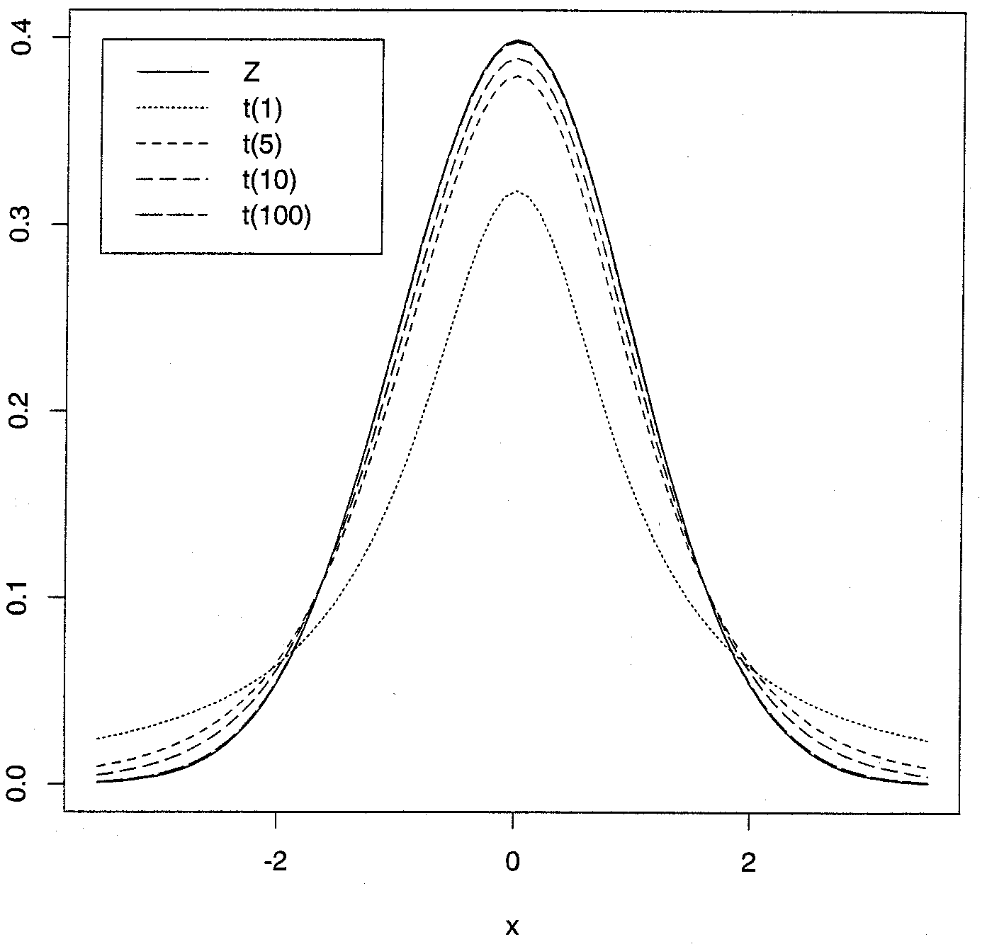
Normal and t distributions

Slide 24
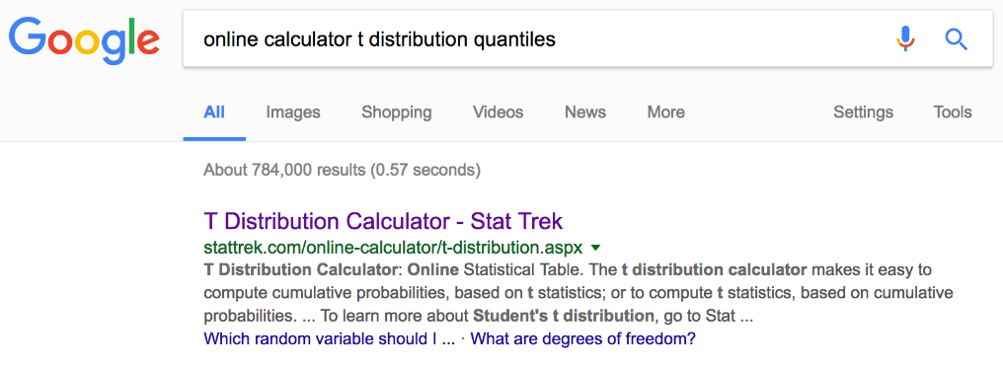
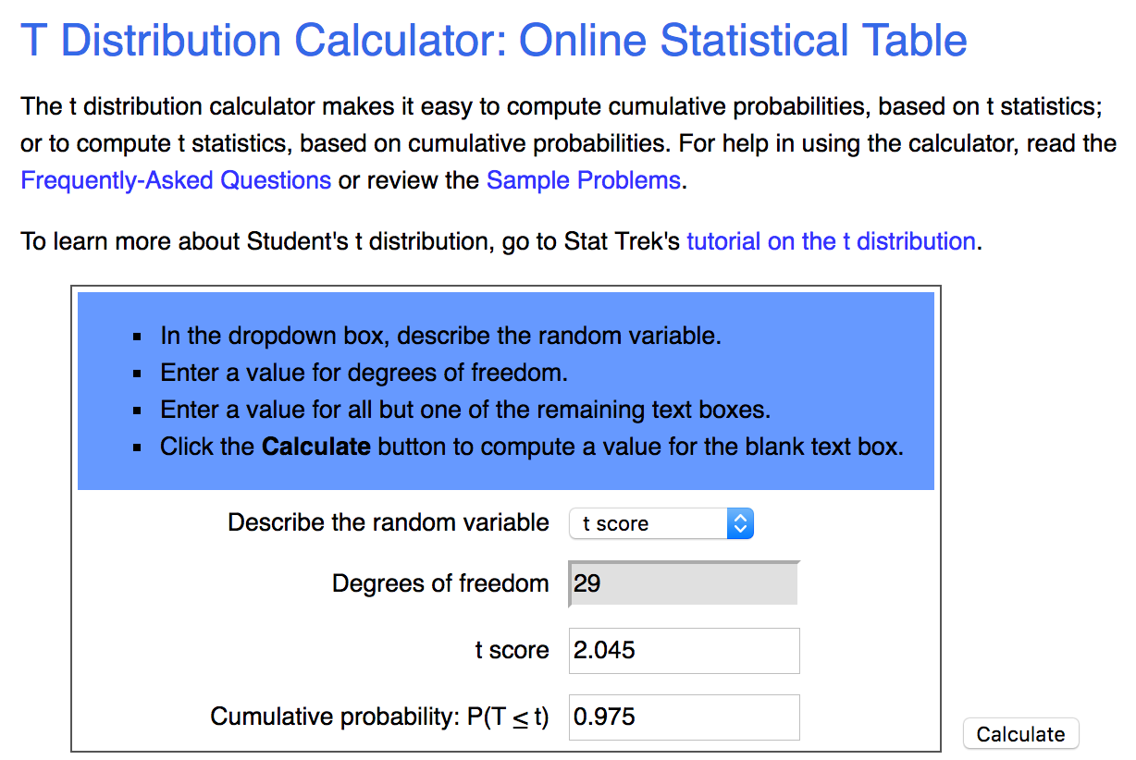
Confidence Intervals for σ² unknown
Example
Given our 30 mothers with a mean gestation of 279.5 days and a variance of 28.3 days², we can compute a 95% confidence interval for the mean length of pregnancies for second-time mothers using the t-distribution:
e.g.,
https://stattrek.com/online-calculator/t-distribution.aspx

Slide 25
Take Home Points
General (1 - α) Confidence Intervals:
  Confidence intervals are only for parameters
  Greater confidence → wider interval
  Larger sample size → narrower interval
CI for true population mean μ when σ assumed known → use a standard normal, Z.
CI for μ, σ unknown → use a t-distribution.

Slide 26

Pause- break time then work on exercises

Slide 27
Questions 2, 3
Suppose we take a larger sample of second-time mothers. Instead of only sampling n=30, we sample n=45 and the sample mean is the same, 279.5 days.
2: What is a 95% confidence interval for the mean length of second pregnancies based on this larger sample?
3: How does it compare to the 95% CI calculated from the n=30 second-time mothers?

