Slide 1
Applications In Epidemiology
Paired Binary data
Typically (but not exclusively) a matched case-control study
Cases uniquely matched to controls; create a table showing concordance/discordance of pairs
Use McNemar’s chi-square test to test association
Effect Modification
Effect of exposure on outcome varies by level of a 3rd variable
Depends on measure of effect chosen (i.e. RR, OR, RD)
Confounding
Typically, exposure groups are imbalanced with respect to a 3rd variable that is also a risk factor for the outcome
Creates bias in estimate of “causal” effect of exposure on outcome
Control/adjust for the 3rd variable using stratification (other methods also available)

Slide 2
Adjusting the OR via Stratification
Compute separate OR for each stratum (OR₁, OR₂, … Or_{k})
Assess homogeneity of OR’s across strata (Is there EM?)
Ho: OR₁ = OR₂ = … = OR_{K}
Ha: not all stratum-specific OR’s are equal
Pool OR’s: use weighted average (Adjust for confounding)
Global test Ho: OR_{pool} = 1 (Is there association, after adjustment?)
Same idea for RR and RD

Slide 3
Exercise 1: Compute χ² and the estimated OR for the AMI paired binary data dataset

Slide 4
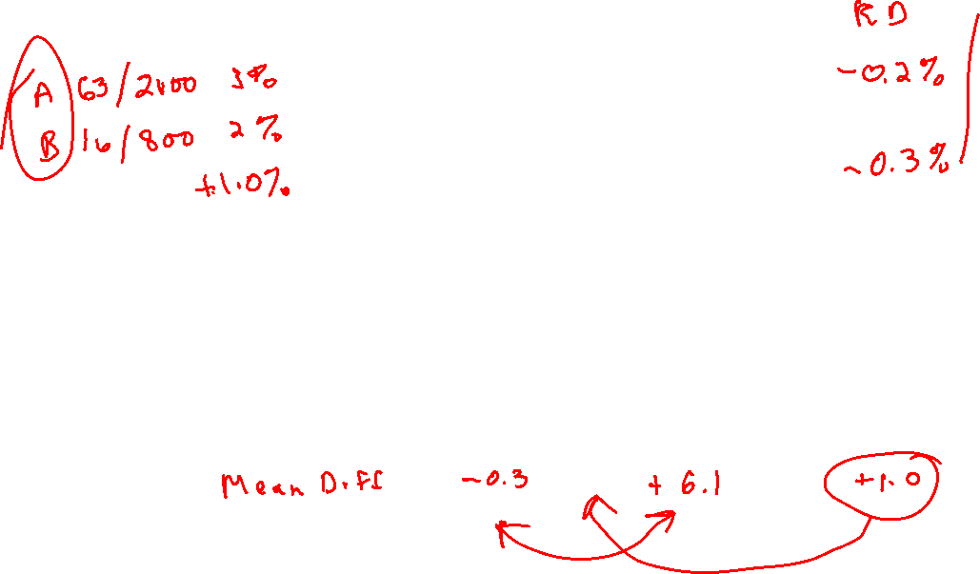
Exercise 2: In each case, decide whether this is an example of confounding or effect modification
Two hospitals are compared with respect to the rate death following a particular type of surgery. Here are the data … is risk group a confounder or effect modifier (use RD)?
A randomized clinical trial is conducted to determine if a new drug can increase levels of HDL cholesterol among men and women. Using the mean difference as a measure of effect, is sex a confounder or effect modifier?
 | Mean HDL
 | Women | Men | All
New Drug | 38.9 | 45.2 | 40.2
Placebo | 39.2 | 39.1 | 39.2

Slide 5
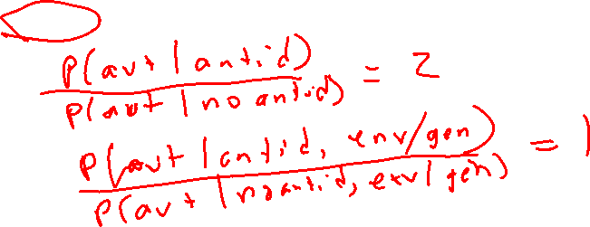
Exercise 2: In each case, decide whether this is an example of confounding or effect modification
Researchers at the International Agency for Research on Cancer in France found that women infected with both HPV and HSV-2 were nearly three times more likely to get cervical cancer compared to women with only HPV infection.
Does HSV-2 confound or modify the effect of HPV on cervical cancer?
If the mother took antidepressant medication during the first trimester, without accounting for other possible influences, children had roughly twice the risk of having autism. The researchers then compared siblings in families where the mother used antidepressants in one pregnancy but not the other. This helped account for all of the factors that make siblings similar — their shared genetics and environment. In the sibling matchup, the children had essentially the same risk for autism, ADHD and poor fetal growth whether they were exposed to antidepressants in the womb or not.
Do genetic factors confound or modify the effect of antidepressants on autism?

Slide 6
Exercise 3
Based on the abundance of specific bacterial genera, the human gut microbiota can be divided into two relatively stable groups (enterotypes) that might play a role in personalized nutrition. We studied these simplified enterotypes as prognostic markers for successful body fat loss on two different diets. A total of 62 participants with increased waist circumference were randomly assigned to receive a New Nordic Diet (NND) high in fiber/wholegrain or an Average Danish Diet (ADD) for 26 weeks. At enrollment, participants were grouped into two discrete enterotypes by their relative abundance of Prevotella spp. divided by Bacteroides spp. (P/B ratio) obtained by quantitative PCR analysis. Among individuals with high P/B the NND resulted in a 3.15 kg larger body fat loss compared to ADD whereas virtually no difference (0.88 kg) was observed among individuals with low P/B. Consequently, a 2.27 kg difference in responsiveness to the diets were found between the high and low P/B groups. In summary, subjects with high P/B-ratio appeared more susceptible to lose body fat on diets high in fiber and wholegrain than subjects with a low P/B-ratio.
) Which of the following best describes the design of this study?
Cross-sectional survey
Case-control study
Prospective cohort
b) Identify the role of diet, weight loss, and P/B ratio using one of the following terms – Outcome, Exposure, Effect modifier, Confounder

Slide 7
Session 8 Solutions
(note cases and controls flipped from earlier table; results are the same)
| Controls |
Cases | Exposed Unexposed | Total
-----------------+------------------------+------------
Exposed | 73 23 | 96
Unexposed | 14 103 | 117
-----------------+------------------------+------------
Total | 87 126 | 213
McNemar's chi2(1) = 2.19 Prob > chi2 = 0.1390
Exact McNemar significance probability = 0.1877
Proportion with factor
Cases .4507042
Controls .4084507 [95% Conf. Interval]
--------- --------------------
difference .0422535 -.0181247 .1026318
ratio 1.103448 .9684942 1.257207
rel. diff. .0714286 -.0197486 .1626057
odds ratio 1.642857 .8101776 3.452833

Slide 8
Session 8 Solutions
a) Confounder b) Effect modifier c) Effect modifier d) Confounder
a) Prospective cohort
b) Diet: Exposure Weight loss: Outcome P/B ratio: Effect Modifier

