Slide 1
Introduction to
Population Genetics
Timothy O’Connor
timothydoconnor@gmail.com
Ryan Hernandez
Ryan.Hernandez@ucsf.edu

Slide 2
Learning Objectives
Describe the key evolutionary forces
  Drift and Mutation
  Migration and Selection
  How they function in concert with one another.
How demography can influence the site frequency spectrum
  Be able to interpret a site frequency spectrum
  Understand how the SFS is affected by evolutionary forces
  How we can use the SFS to understand evolutionary history of a population.

Slide 3
Review: What are the assumptions of Hardy-Weinberg?
There must be no mutation
There must be no migration
Individuals must mate at random with respect to genotype
There must be no selection
The population must be infinitely large
How do these affect allele frequencies?

Slide 4
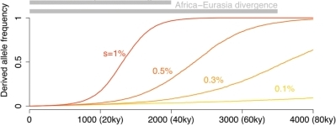
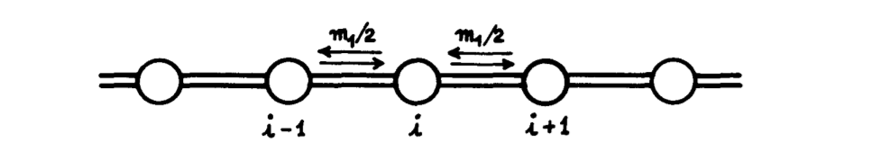
Drift, migration, mutation, and selection
Genetic Drift
Mutation
10²
10³
10⁴
10⁵
Natural Selection
Migration
Kimura and Weiss (1964)
0 1000 2000 3000 4000
Notes:
Usually denoted by the letter s, it compares the fitness of a phenotype to another favored phenotype, and is the proportional amount that the considered phenotype is less fit as measured by fertile progeny. s = 0 then is selectively neutral compared to the favored phenotype, while s = 1 indicates complete lethality. For example, if the favored phenotype produces 100 fertile progeny, and only 90 are produced by the phenotype selected against then s = 0.1. An alternative way of expressing this is to describe the fitness of the favored phenotype as 1.0 and that of the phenotype selected against as 0.9.^{[1]} The terminology is used in the same way to refer to the selective differences between genotypes^{[2]} to which it extends in a natural fashion.
http://en.wikipedia.org/wiki/Selection_coefficient

Slide 5
Genetic drift: Cereal Serial founder effect
The initial population has variation from generations of accumulation and history.
When a small group leaves and starts a new founder population (e.g. Amish) this results in a bottleneck and subsequent expansion leads to a change in allele frequencies.
When done multiple times in series this is a serial founder effect.
Figure by Michael Kessler

Slide 6
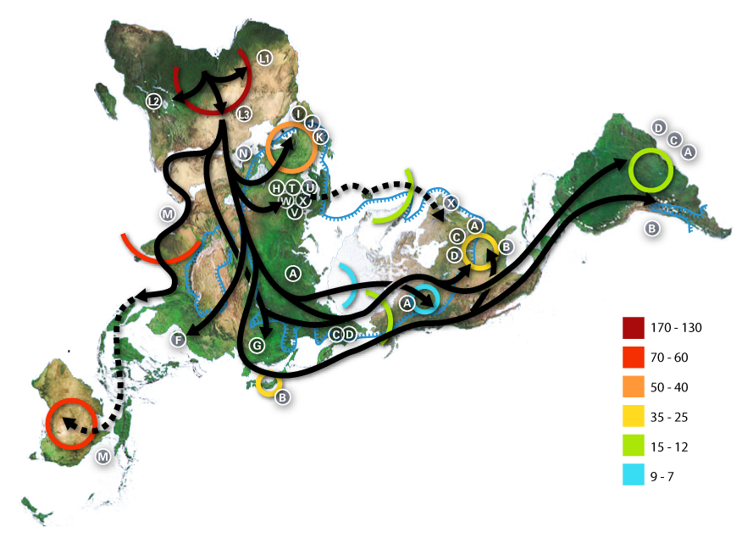
We now have an excellent “road map” of how humans evolved in Africa and migrated to populate the rest of the earth.
Out of Africa Model!
Africa
Europe
Americas
Asia
North
Australia

Slide 7
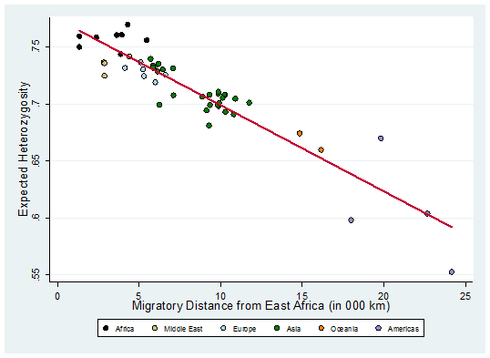
Heterozygosity is correlated with distance from East Africa
Ramachandran et al. 2005 PNAS

Slide 8
Mutation: How often do mutations arise?
Uchimura et al. (2015) Genome Research
Notes:
20 generations of mice

Slide 9
Mutation is a major source of phenotypic variation
Uchimura et al. (2015) Genome Research

Slide 10
Mutation: How often do mutations arise in Humans?
Scally and Durbin (2012) Nature Rev. Genet.

Slide 11
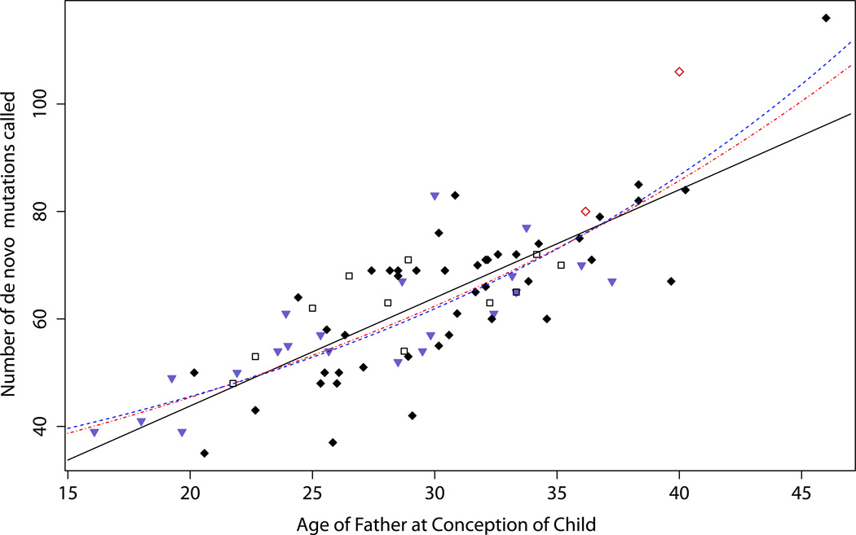
What are the effects of paternal age on mutation rate?
Kong et al. (2012) Nature

Slide 12
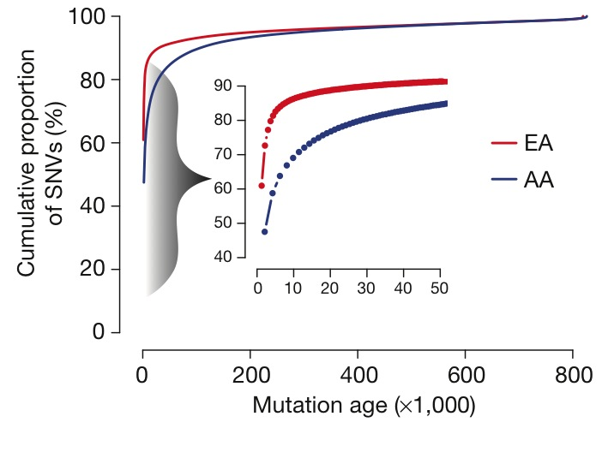
When did most variation arise?
Fu et al. (2013) Nature

Slide 13
Most SNVs are very rare
57% singletons
72% singletons+doubletons+tripletons
Tennessen et al. (2012) Science
Notes:
One of the chief characteristics of the data is that most variation is rare
Axis are log transformed
x is the numeric count
y is the frequency @ which it is found

Slide 14
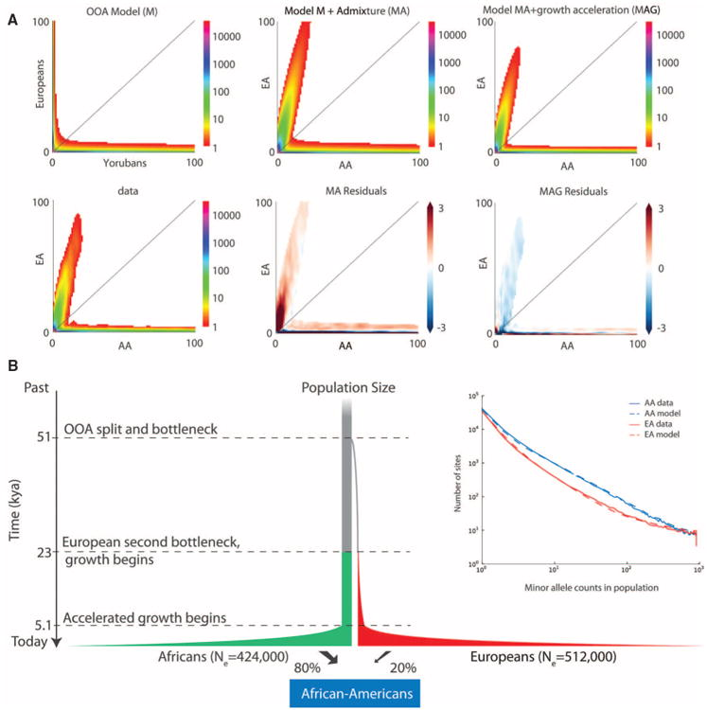
How has our population size grown?
Tennessen et al. (2012) Science

Slide 15
Most SNVs are population specific
AA (n = 1,089)
EA (n = 1,351)
Proportion Private SNVs
503,481 SNVs
Tennessen et al. (2012) Science
Notes:
Another characteristic is that the variants are population specific. Oon this slide I have summarized the number of single nucleotide variants (SNVs) discovered in the european-american sample in red and african-american sample in blue. As you can see, about 80% of SNVs are private –that is found in only one of the populations. As you might expect, the vast majority of private SNVs are extremely rare, about 80% have a minor allele frequency less than 0.5%. Thus, in this data set, most protein coding variants are geographically restricted, these variants are very rare.
20% may be an inflated estimate of overlap as AA are admixed

Slide 16
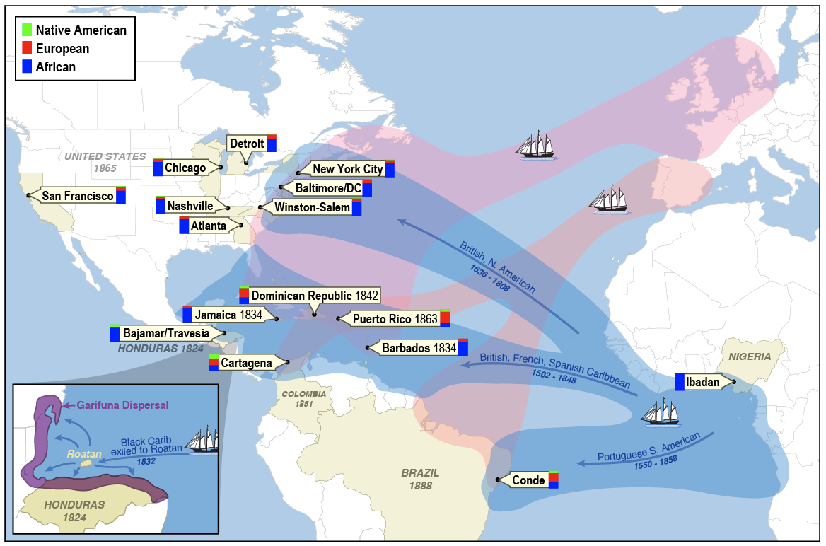
Migration: Admixture is migration between diverged populations
Mathias et al. (2016) Nature Comm.
Notes:
Whole Genome Sequencing in >1,000 asthmatics & non-asthmatics from North, South, & Central America, the Caribbean, & continental Africa, to represent a large spectrum of African ancestry.
Develop a custom, gene-centric SNP chip (~750K) appropriate for individuals of African descent to complement current, commercially available genome-wide chips.
N=952

Slide 17
Estimates of global ancestry
CAAPA
Reference
European (CEU)
African (YRI)
Native American
Mathias et al. 2016 Nature Comm.

Slide 18
Local ancestry of a single individual
Bryc et al. 2009 PNAS
Notes:
Blue = African Ancestry
Green = Both
Red = European Ancesty

Slide 19
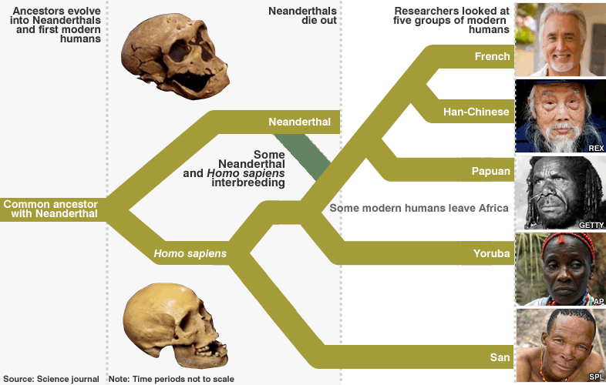
Ancient admixture: Neanderthals are still among us
Recent genetic data suggests that 1-4% of non-African genomes are derived from Neanderthals

Slide 20
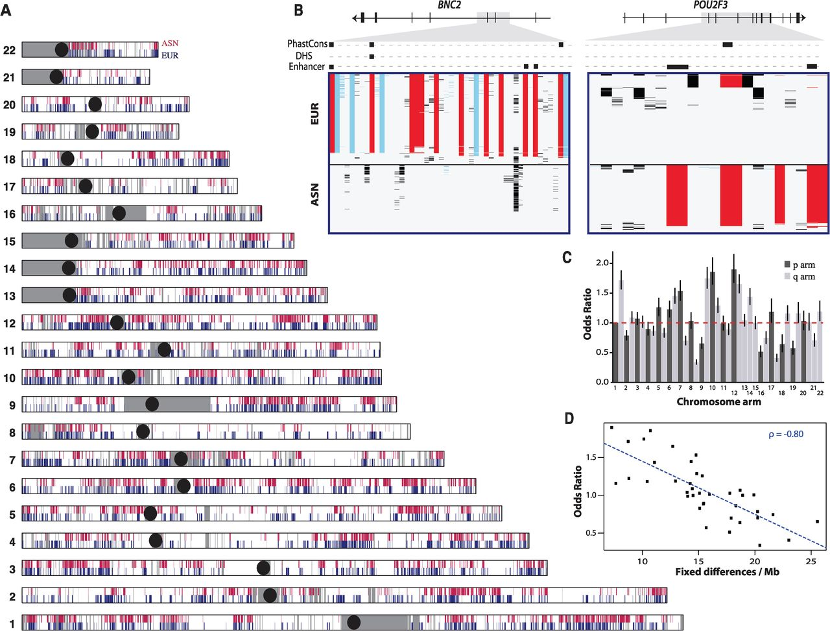
Neanderthals are still among us
Notes:
(A) Neandertal lineages identified in East Asians (ASN, red) and Europeans (EUR, blue). Gray shading denotes regions that did not pass filtering criteria (10); black circles represent centromeres. (B) Visual genotype illustrations of introgressed sequences identified in the BNC2 and POU2F3 genes. Rows denote individuals, columns indicate variant sites, and rectangles are colored according to genotype (red, predicted Neandertal variant that matches the allele present in the Neandertal reference genome; blue, predicted Neandertal variant that does not match the allele present in the Neandertal reference genome; black, other variants). Introgressed variants that overlap a PhastCons conserved element, DNaseI hypersensitive site (DHS), or putative enhancer elements are shown as boxes (10). (C) Odds of finding an introgressed lineage on each chromosomal arm calculated from a logistic regression model (10). Odds ratios (ORs) are expressed using chromosome 1p as the baseline level. Horizontal bars represent 95% CIs. (D) Relation between the OR and the number of fixed differences per megabase between humans and Neandertals. ρ, Spearman’s rank correlation coefficient.
Introgressed haplotypes in two of these regions span genes that play important roles in the integumentary system: BNC2 on chromosome 9 and POU2F3 on chromosome 11. BNC2 encodes a zinc finger protein expressed in keratinocytes and other tissues (17) and has been associated with skin pigmentation levels in Europeans (18). The adaptive haplotype has a frequency of ~70% in Europeans and is completely absent in East Asians (Fig. 2B). POU2F3 is a homeobox transcription factor expressed in the epidermis and mediates keratinocyte proliferation and differentiation (19, 20). The adaptive haplotype in East Asians has a frequency of ~66% and is found at less than 1% frequency in Europeans (Fig. 2B). No coding introgressed variants were found in BNC2 or POU2F3, although several highly differentiated introgressed variants were located in functional noncoding elements (21)

Slide 21
Dog breeding has produced divergent groups
Parker et al. (2017) Cell Rep.

Slide 22

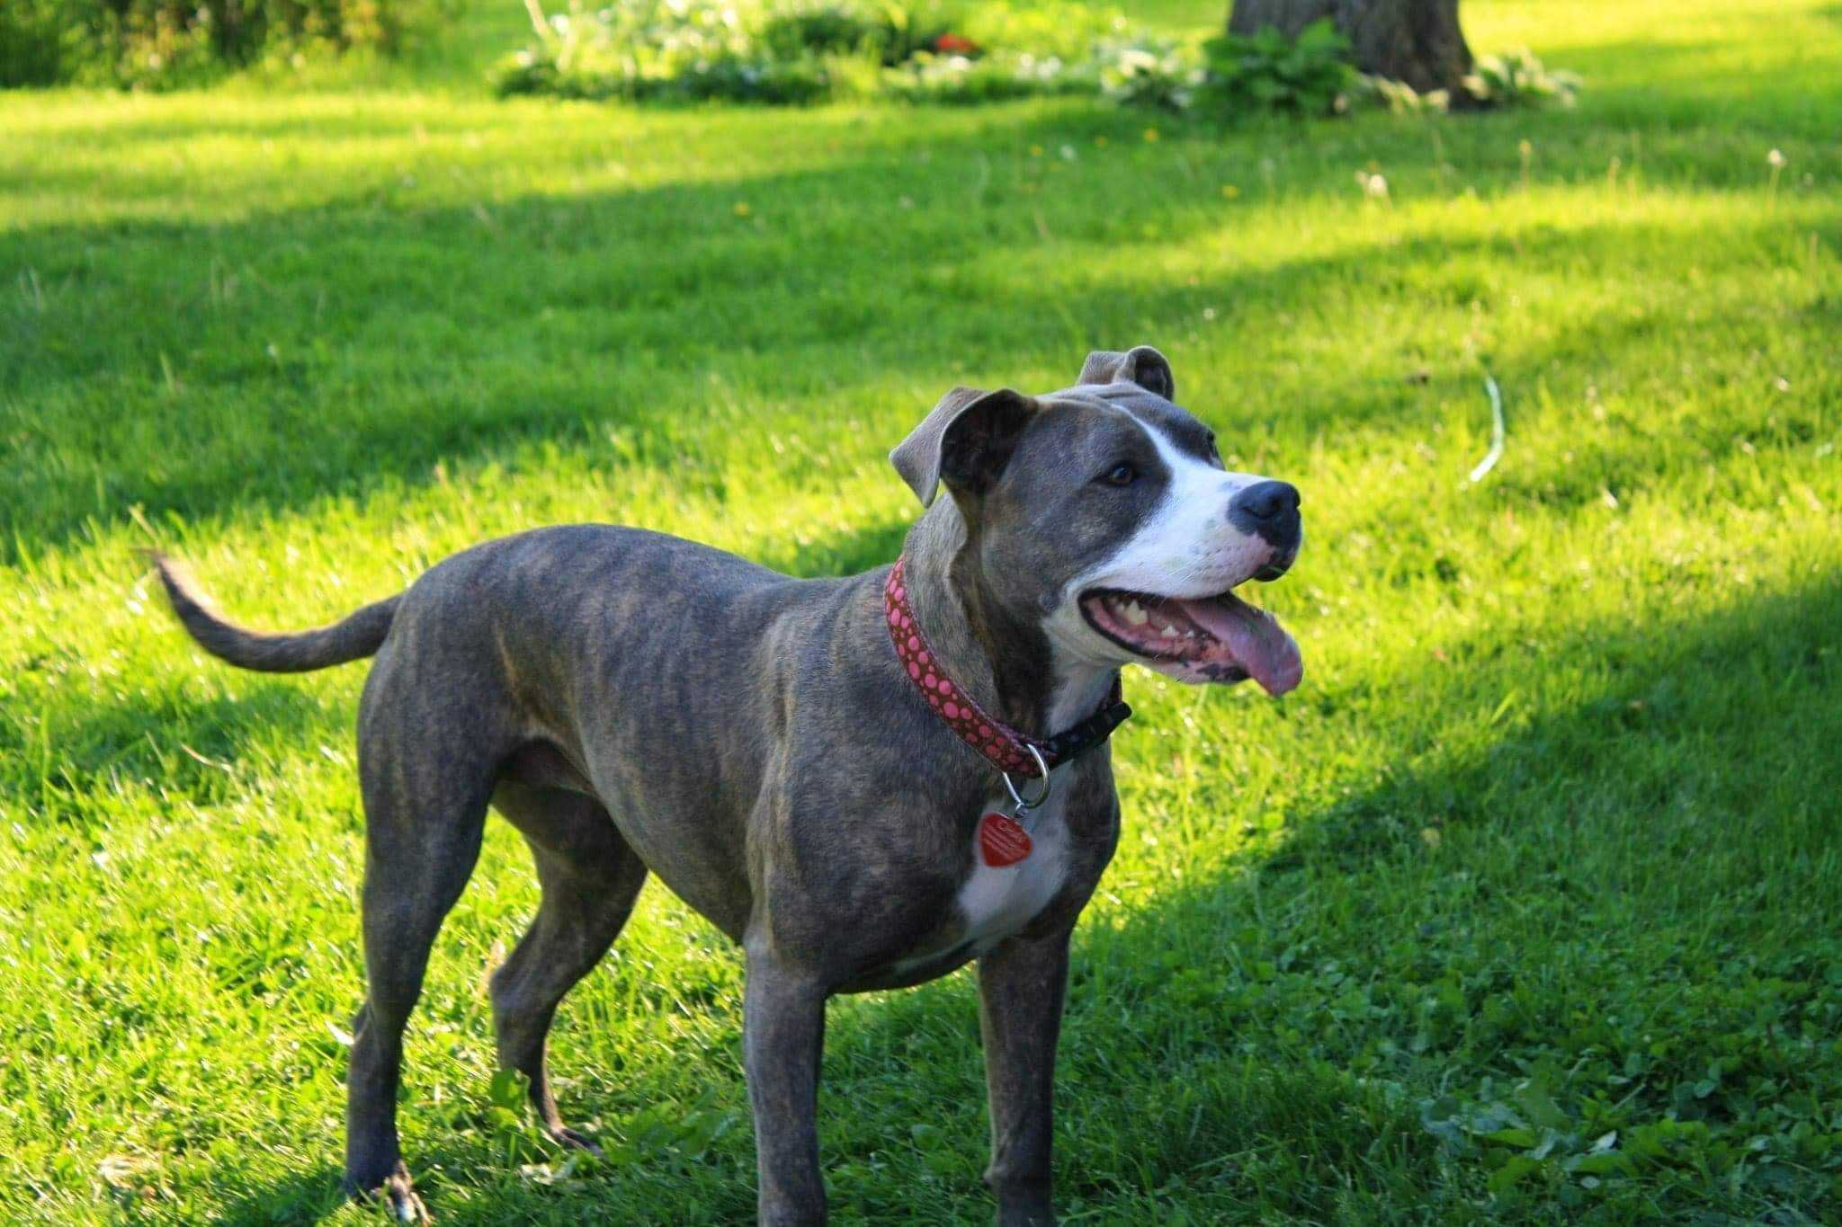
Dog breeding has produced divergent groups
Parker et al. (2017) Cell Rep.

Slide 23
Dog breeding has produced both divergent groups and recent cross breeding is migration
Parker et al. (2017) Cell Rep.

Slide 24
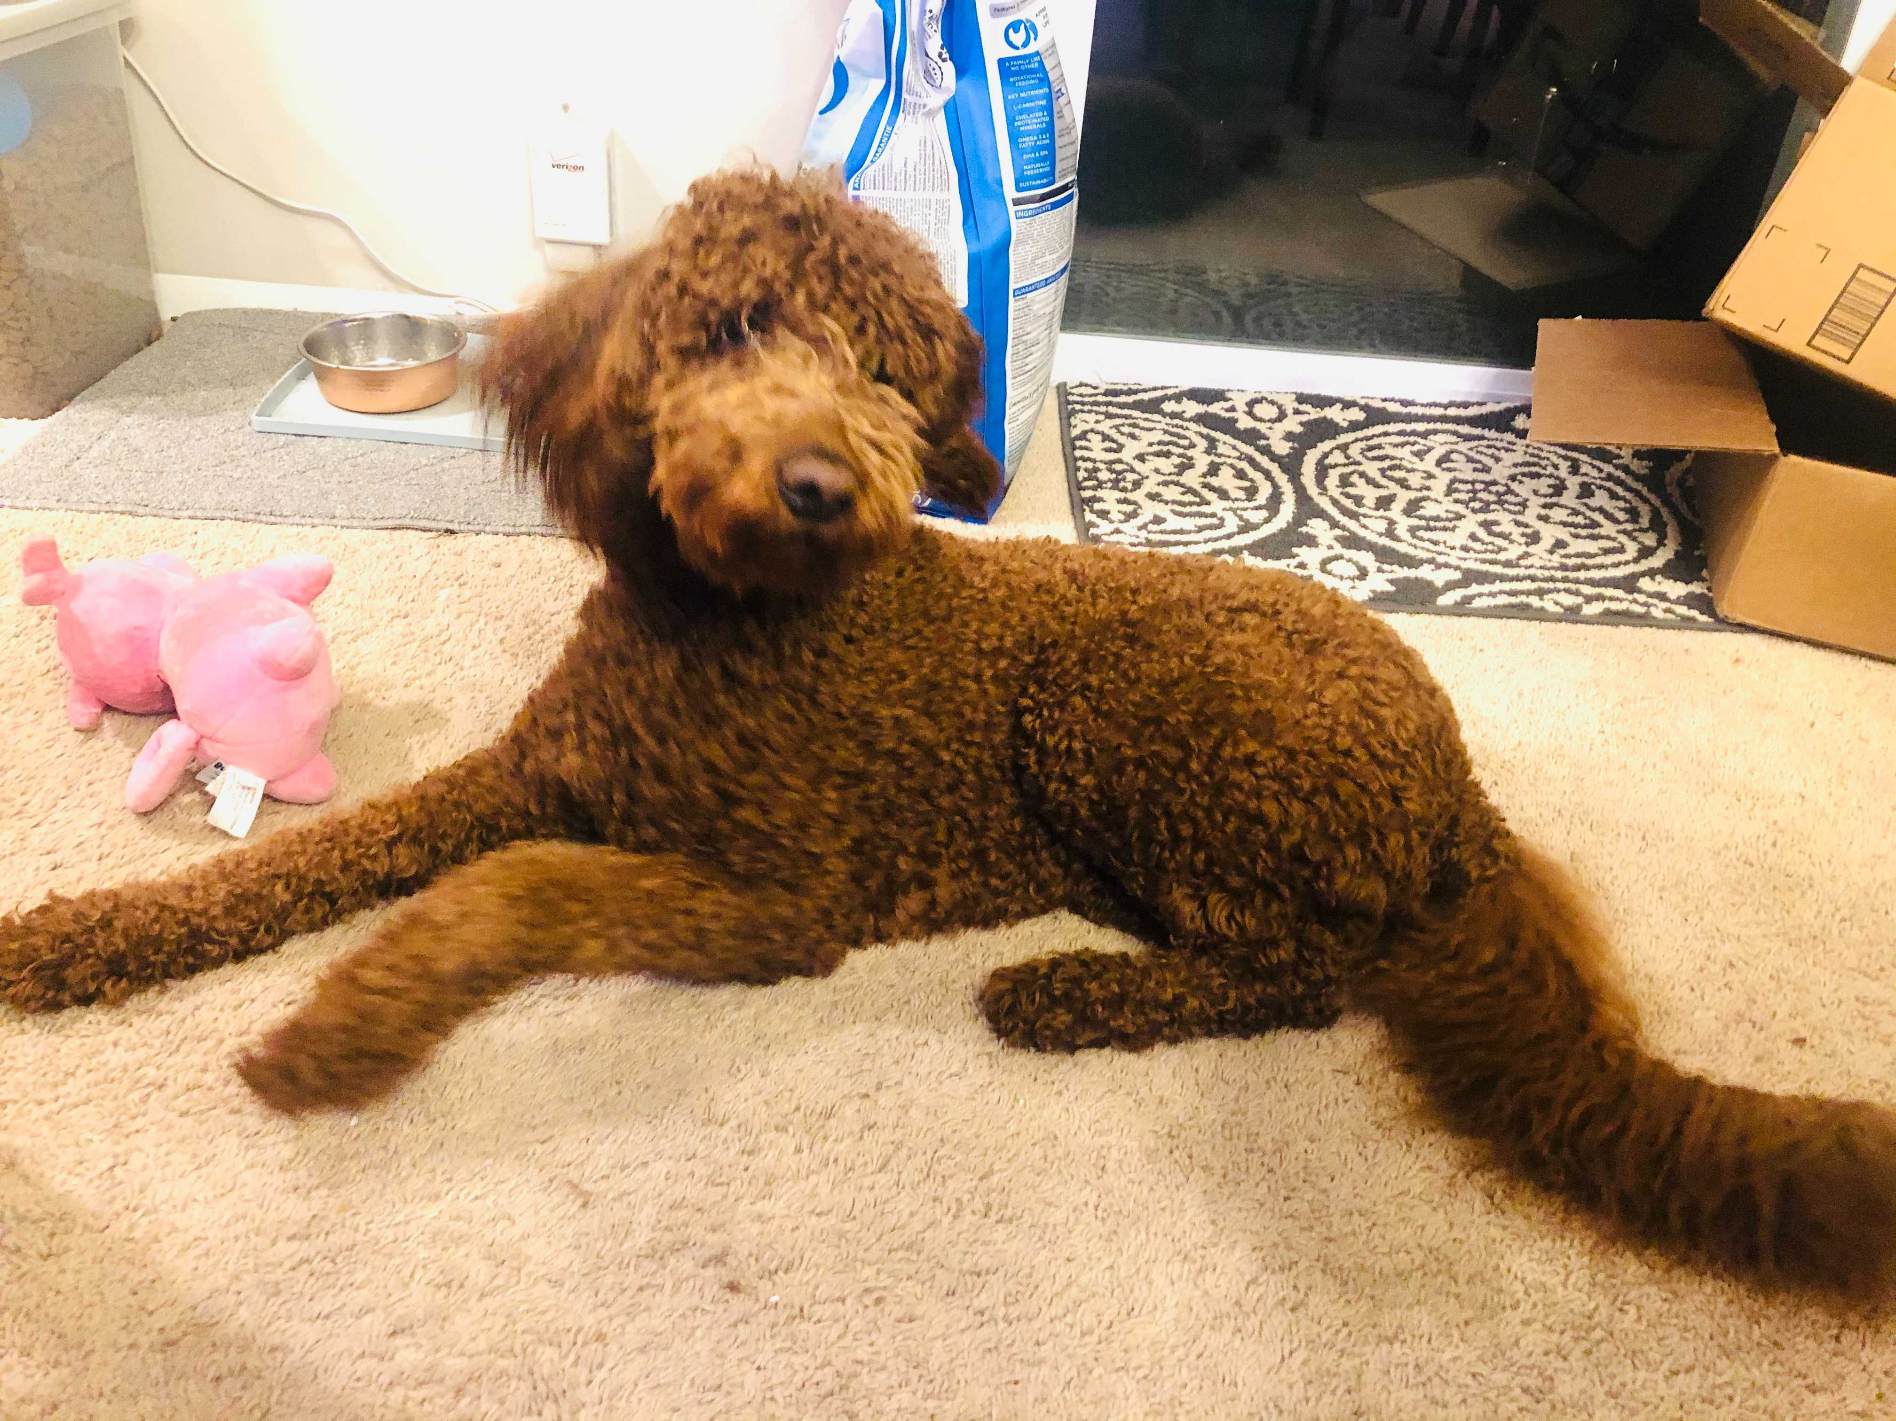
Dog breeding has produced both divergent groups and recent cross breeding is migration
Parker et al. (2017) Cell Rep.
Notes:
https://en.wikipedia.org/wiki/Labradoodle#/media/File:Labradoodle_Laying_2375px.jpg

Slide 25
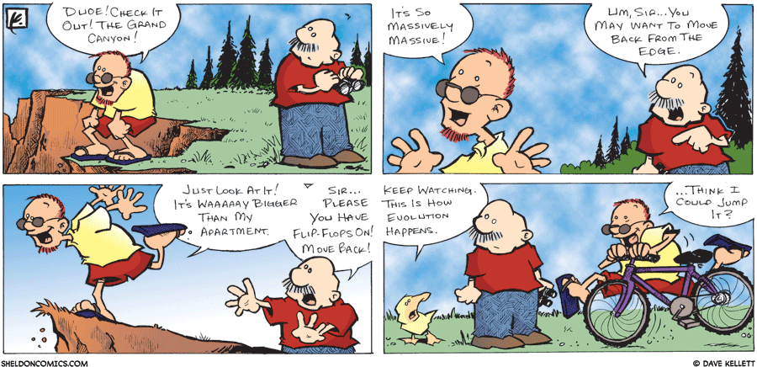
Adaptive (Darwinian) Selection
“I have called this principle, by which each slight variation, if useful, is preserved, by the term Natural Selection.”—Charles Darwin from "The Origin of Species”, 1859

Slide 26


Antibiotic resistance is an example of adaptive evolution
Initial Population
After Antibiotic
Final Population
G
T
Not Resistant
Resistant

Slide 27
Reading the genome for signatures of positive selection
Neutral
Advantageous Mutation
Fixation
This process imparts “signatures” on patterns of genetic variation that we can use to find adaptively evolving genes

Slide 28
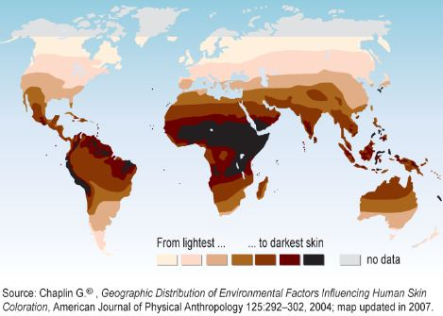
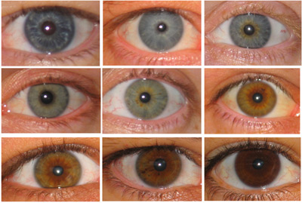
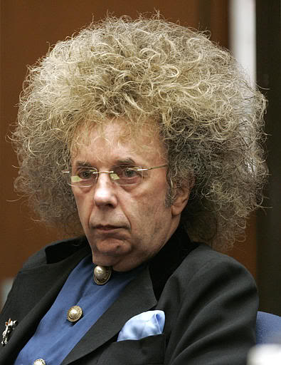
Genes that influence physical traits have been targets of recent selection
Skin Pigmentation
Eye Color
Hair Texture
EDAR
HERC2
SLC24A5, OCA2, TYRP1

Slide 29
Non-independence of evolutionary forces: Adaptive-migration (introgression)
Mio et al. (2017) Molecular Biology and Evolution

Slide 30
Non-independence of evolutionary forces: Drift (Selfing) and Selection
Hartfield et al. (2017) Trends in Genetics

Slide 31
These forces all affect the Site Frequency Spectrum (SFS)

Slide 32
Primer on coalescent

Slide 33
Primer on coalescent
Cui and Zhang (2014) https://dornsife.usc.edu/assets/sites/406/docs/505b/MATH505b_Project_Report_HailongCui_WangshuZhang.pdf

Slide 34
Site Frequency Spectrum (SFS)

Slide 35
Joint Site Frequency Spectrum (JSFS)

Slide 36
Genetic Drift can profoundly shape allele frequencies
Gutenkunst et al. 2009 PLoS Genet.

Slide 37
Useful equations
Growth: N(t) = N(0)e^{−tα}
Recombination: ρ = 4N_{ref}r
r is the recombination rate between the ends of a unit length sequence
Migration: M_{ij} = 4N_{ref}m_{ij}
m_{ij} is the fraction of subpopulation i that is made up of migrants from subpopulation j in forward time.
Time: t = T/(4*N_{ref}*Gen)
N_{ref} = reference or ancestral population size
Gen = number of years per generation
T = chronological years
θ = 4*N_{ref}*μ*Length;
μ = mutation rate
Length is the bp of the segment simulated (aka nsites for recombination)

Slide 38
How can the SFS help us understand what happened?
δaδi – Gutenkunst et al. (2009) – Using diffusion approximation to identify the maximum likelihood (ML) of the SFS given a demographic model.
Moments – Jouganous et al. (2017) – Similar likelihood but uses alternative ordinary differential equation techniques to estimate model parameters making more complicated models possible.
Approximate Bayesian Computation – Review: Csilléry et al. (2010) – A generalized framework to sidestep some of the difficulties in ML to enable the assessment of complex models by simulation.

Slide 39
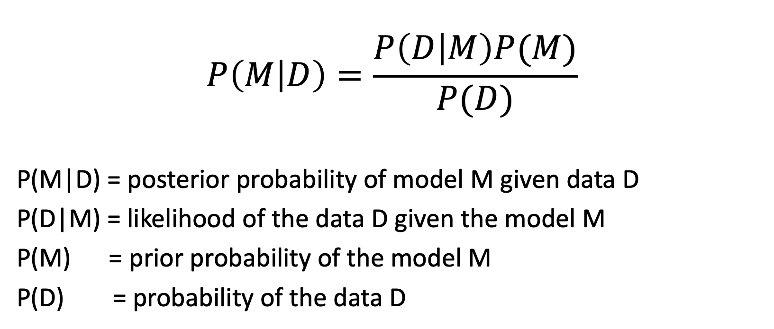
Bayes’ Rule
$$P\left(M | D\right)=\frac{P\left(D | M\right)P(M)}{P(D)}$$
P(M|D) = posterior probability of model M given data D
P(D|M) = likelihood of the data D given the model M
P(M) = prior probability of the model M
P(D) = probability of the data D

Slide 40
Likelihood is really hard!
Gutenkunst et al. (2009) PLoS Genet.
Notes:
So L is the product of Poisson likelihoods, one for each entry in the AFS.
S is the observed SFS, which can be modeled as Poisson random variables
M is the mean which depends on the model theta

Slide 41
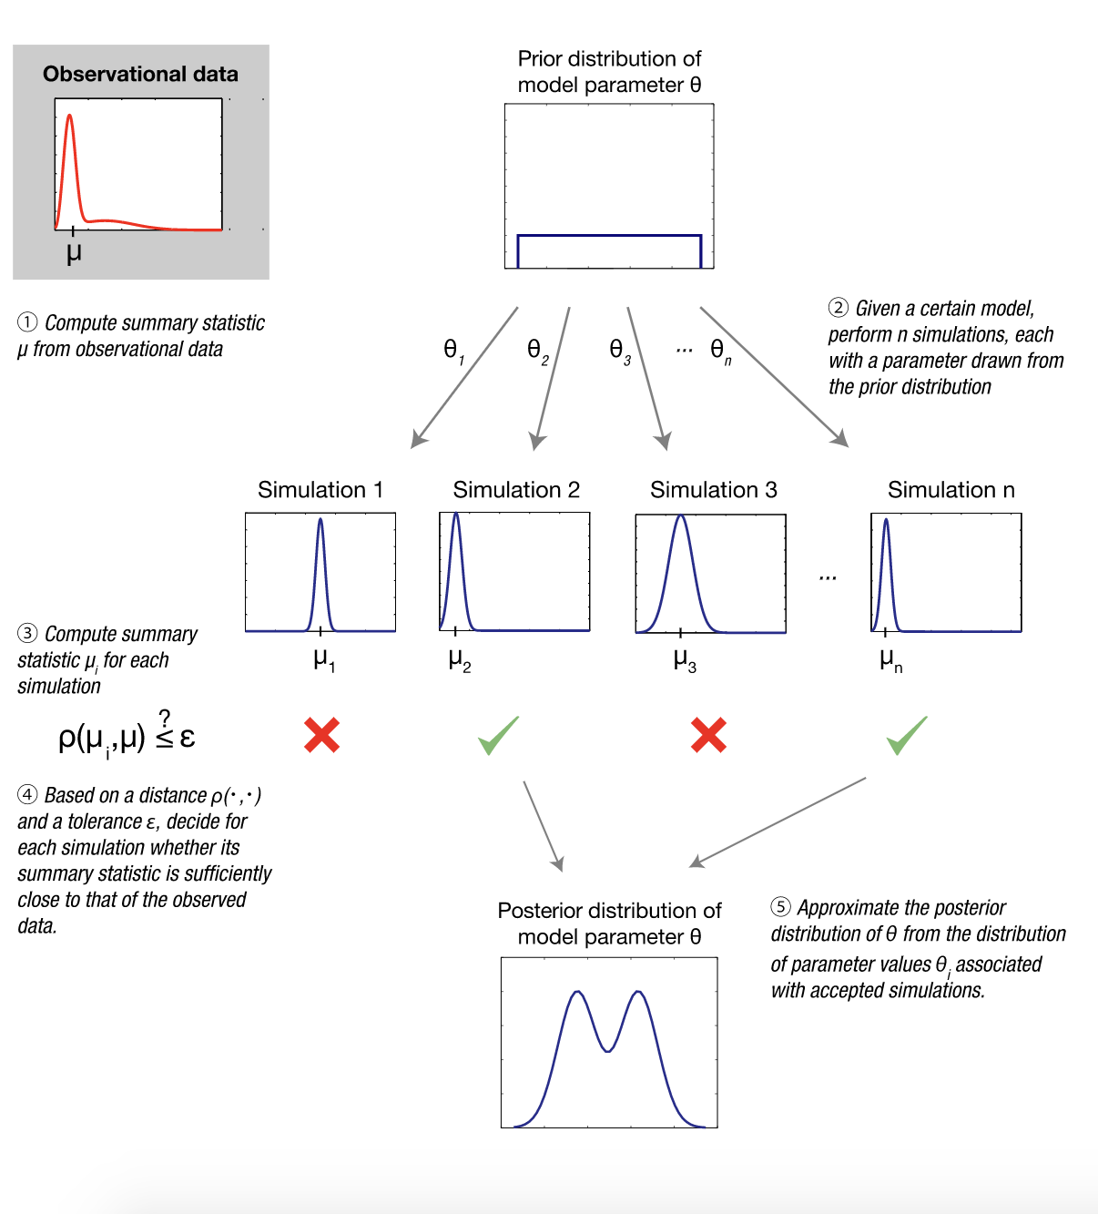
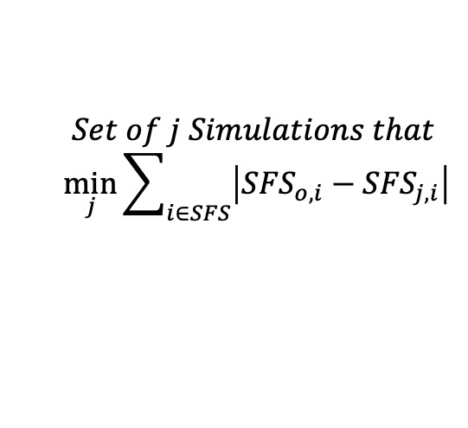
So is there a way around it with simulation?
Yes, yes there is 😄
$$Set of j Simulations that$$
$$\min_{j}{\sum_{i∈SFS}{\left|{SFS}_{o,i}−{SFS}_{j,i}\right|}}$$
https://en.wikipedia.org/wiki/Approximate_Bayesian_computation#/media/File:Approximate_Bayesian_computation_conceptual_overview.svg

Slide 42
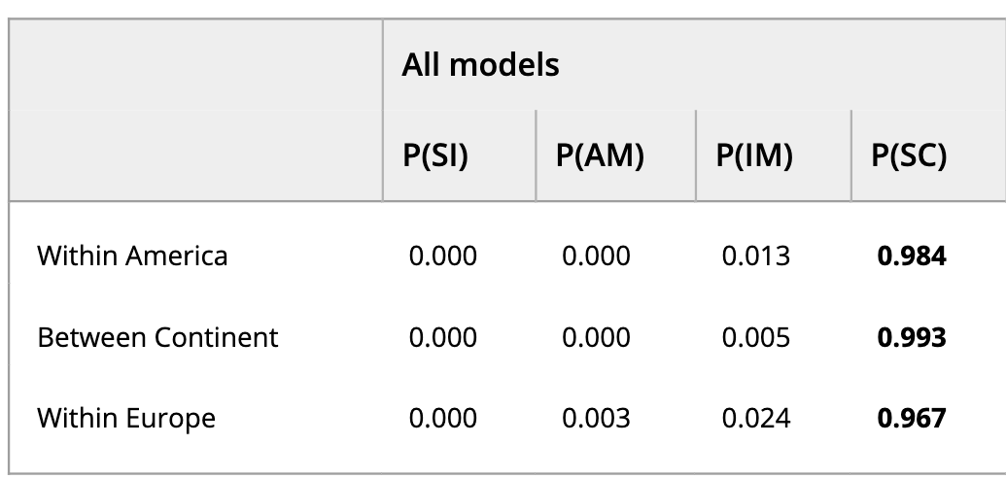
ABC in action
Divergence models of Atlantic Salmon from North America and Eurasia
  2035 individuals from 77 locations
  5034 SNPs from a genotyping array
  19 summary statistics
  3500 best simulations (out of 14 × 1 million)
Rougemont & Bernatchez (2018) Evolution

Slide 43
Concluding Summary
Four main evolutionary forces are: Mutation, migration, selection, and drift.
These forces interact and rarely act independently.
These forces change the site frequency spectrum in informative ways that we can use for both demographic analysis and simulation.

