Slide 1
Population Structure Analysis

Slide 2
Learning objectives
Methods to identify global estimates of population structure
  Principal Component Analysis (PCA)
  Admixture
Local ancestry can identify segments of the genome corresponding to different ancestries.
Local ancestry can be applied in a number of different ways
  Demographic modeling
  Selection
  Refining PCA signals
  Association analyses

Slide 3
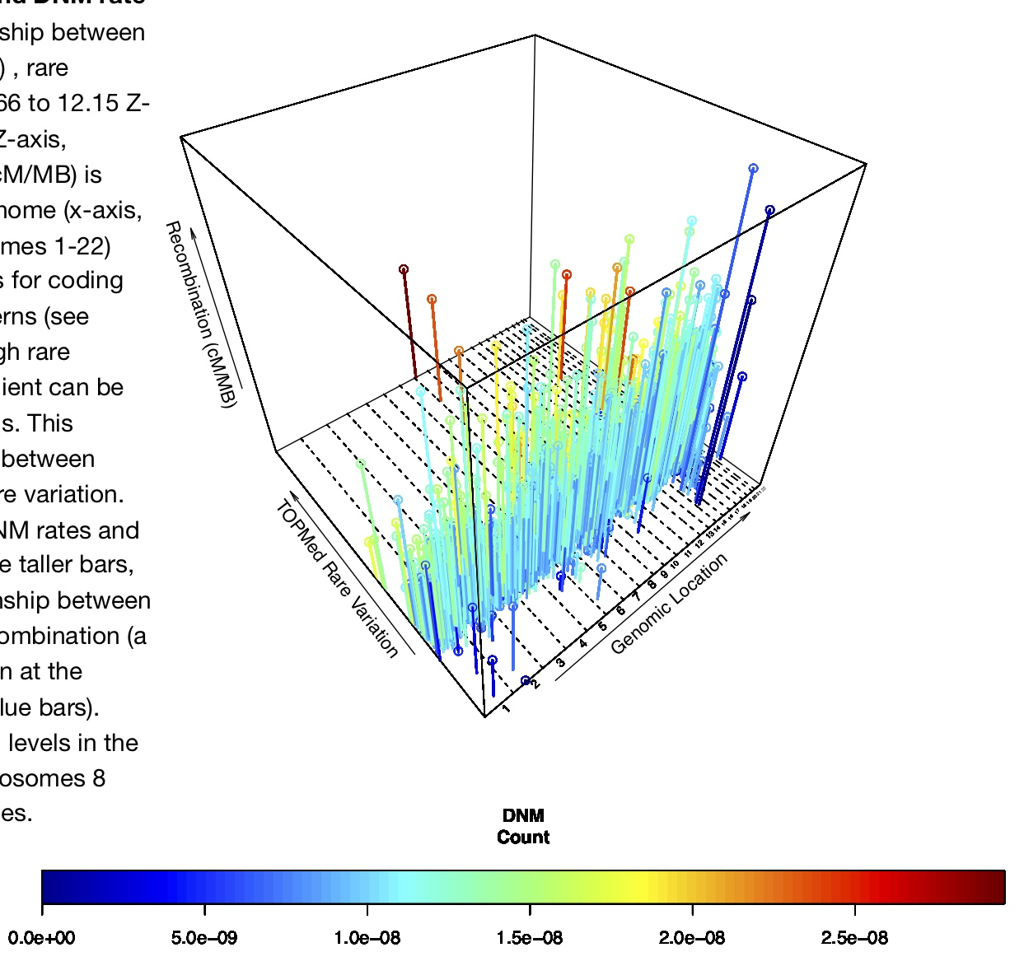
Have you ever tried visualizing 10,000 variables (dimensions)?
This is four variables and already is complicated.
Kessler et al. (2020) PNAS

Slide 4
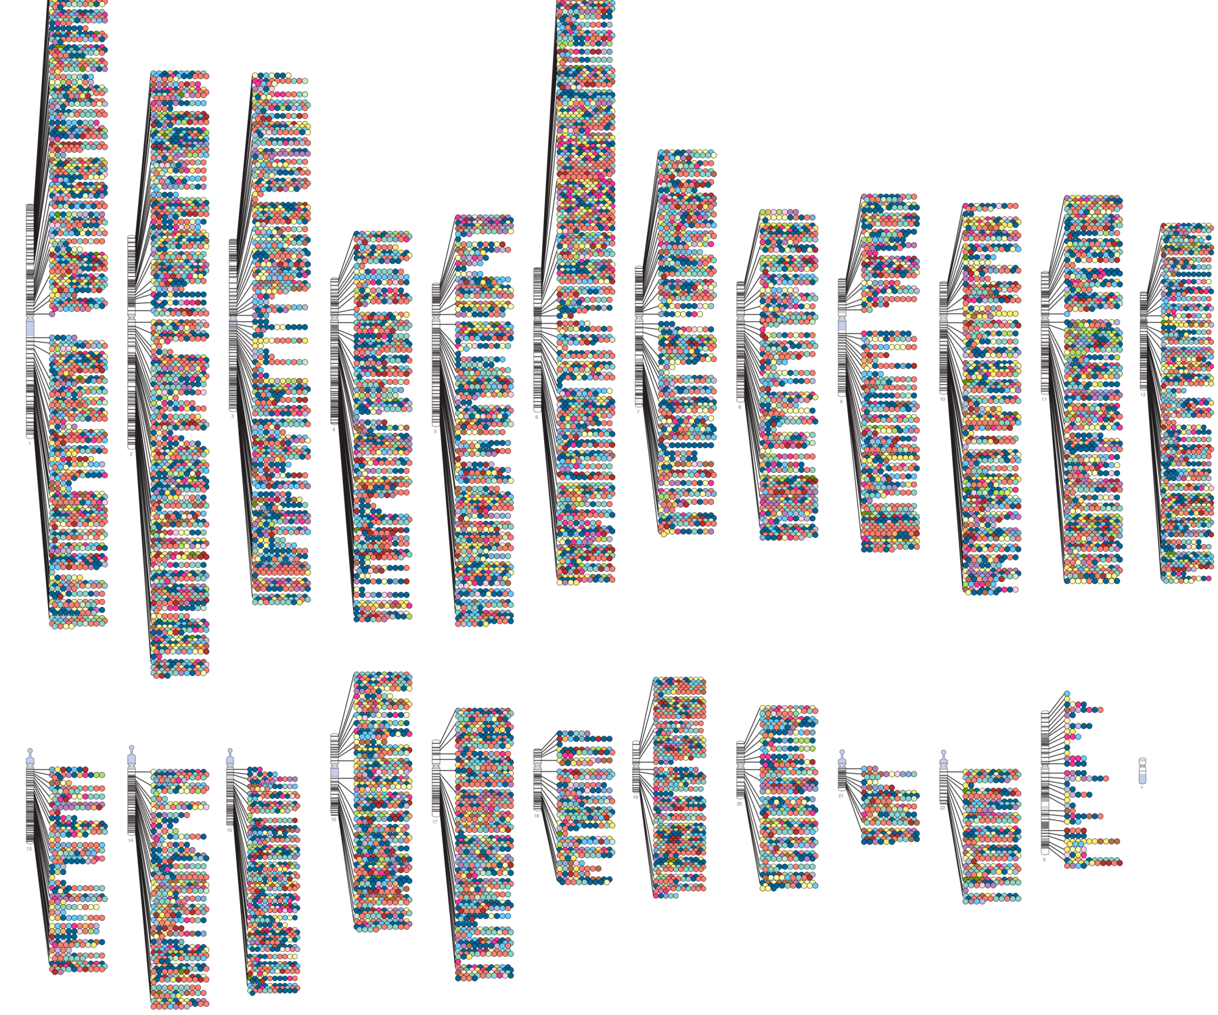
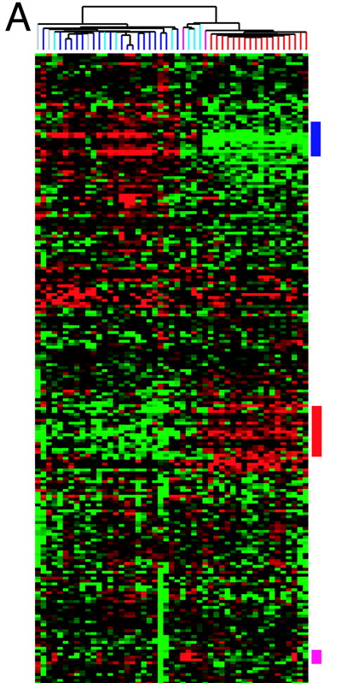

Now we see more than 10,000 variables in many different areas
Expression
GWAS results
Ecology
https://www.ebi.ac.uk/gwas/diagram
Sauer et al. (2013) North American Fauna
Sørlie et al. (2003) PNAS
https://goku.me/blog/EHR

Slide 5
PCA: How does it work?
R code:
pca = prcomp(data,
center=TRUE,
scale.=TRUE)
Normalize the data
Find the covariance matrix between all variables
Calculate the eigenvectors and eigenvalues of the matrix
Transform or project the original data onto this new set of coordinates (PC-space)
PC1 is orthogonal (uncorrelated) with PC2, and so on.
0 1 2
Variable values
Variables 1-100 (of 10000)

Slide 6
PCA: How does it work?
0 1 2
Variable values
PC2 (13%)
PC1 (19%)
Variables 1-100 (of 10000)

Slide 7
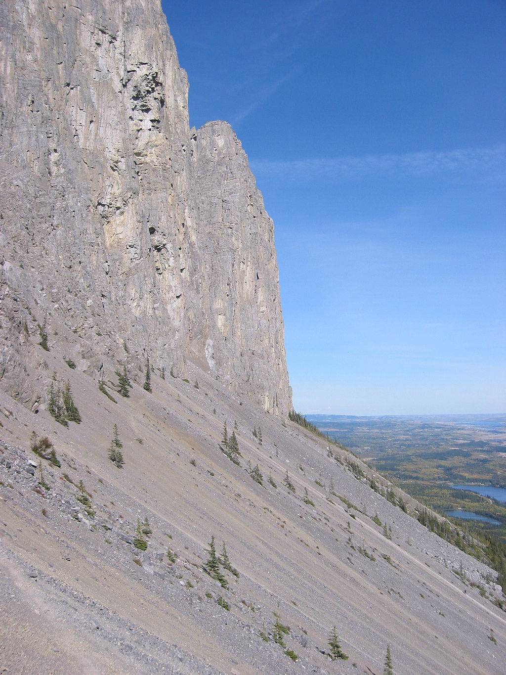
PCA: How does it work?
This is known as a Scree plot.
This is a Scree geological formation.
    Var[PC] = Eigenvalue/sum(All Eigenvalues)
Proportion of variation explained (Var[PC])
Mount Yamnuska, Alberta, Canada. https://commons.wikimedia.org/wiki/File:Yamnuska_bottom_cliff.jpg
1
2
3
4
5
6
7
8
9
10
PC 1-10 (of 10000)
Notes:
PC1 explains the most variation, then PC2 and so on
Eigenvalues corresponding to each PC can give you the variance explained
Variance(PC) = Eigenvalue/sum(All Eigenvalues)

Slide 8
PCA: Uses
  Highly sensitive summary of all the data
  Summarize structure within the data
  Identify groups, when paired with K-means cluster
  Sanity check for study design
    E.g. Diseased individuals cluster vs controls, first batch and second batch don’t cluster together
  Sanity check when combining data

Slide 9
PCA: Assumptions and Pitfalls
Assumptions
  Linear relationship between data
  Variables are independent
Pitfalls
  Only look at the first few PCs
  All axes are biological/non-technical (once first few are)
  Identifying significance of an axis is non-trivial

Slide 10
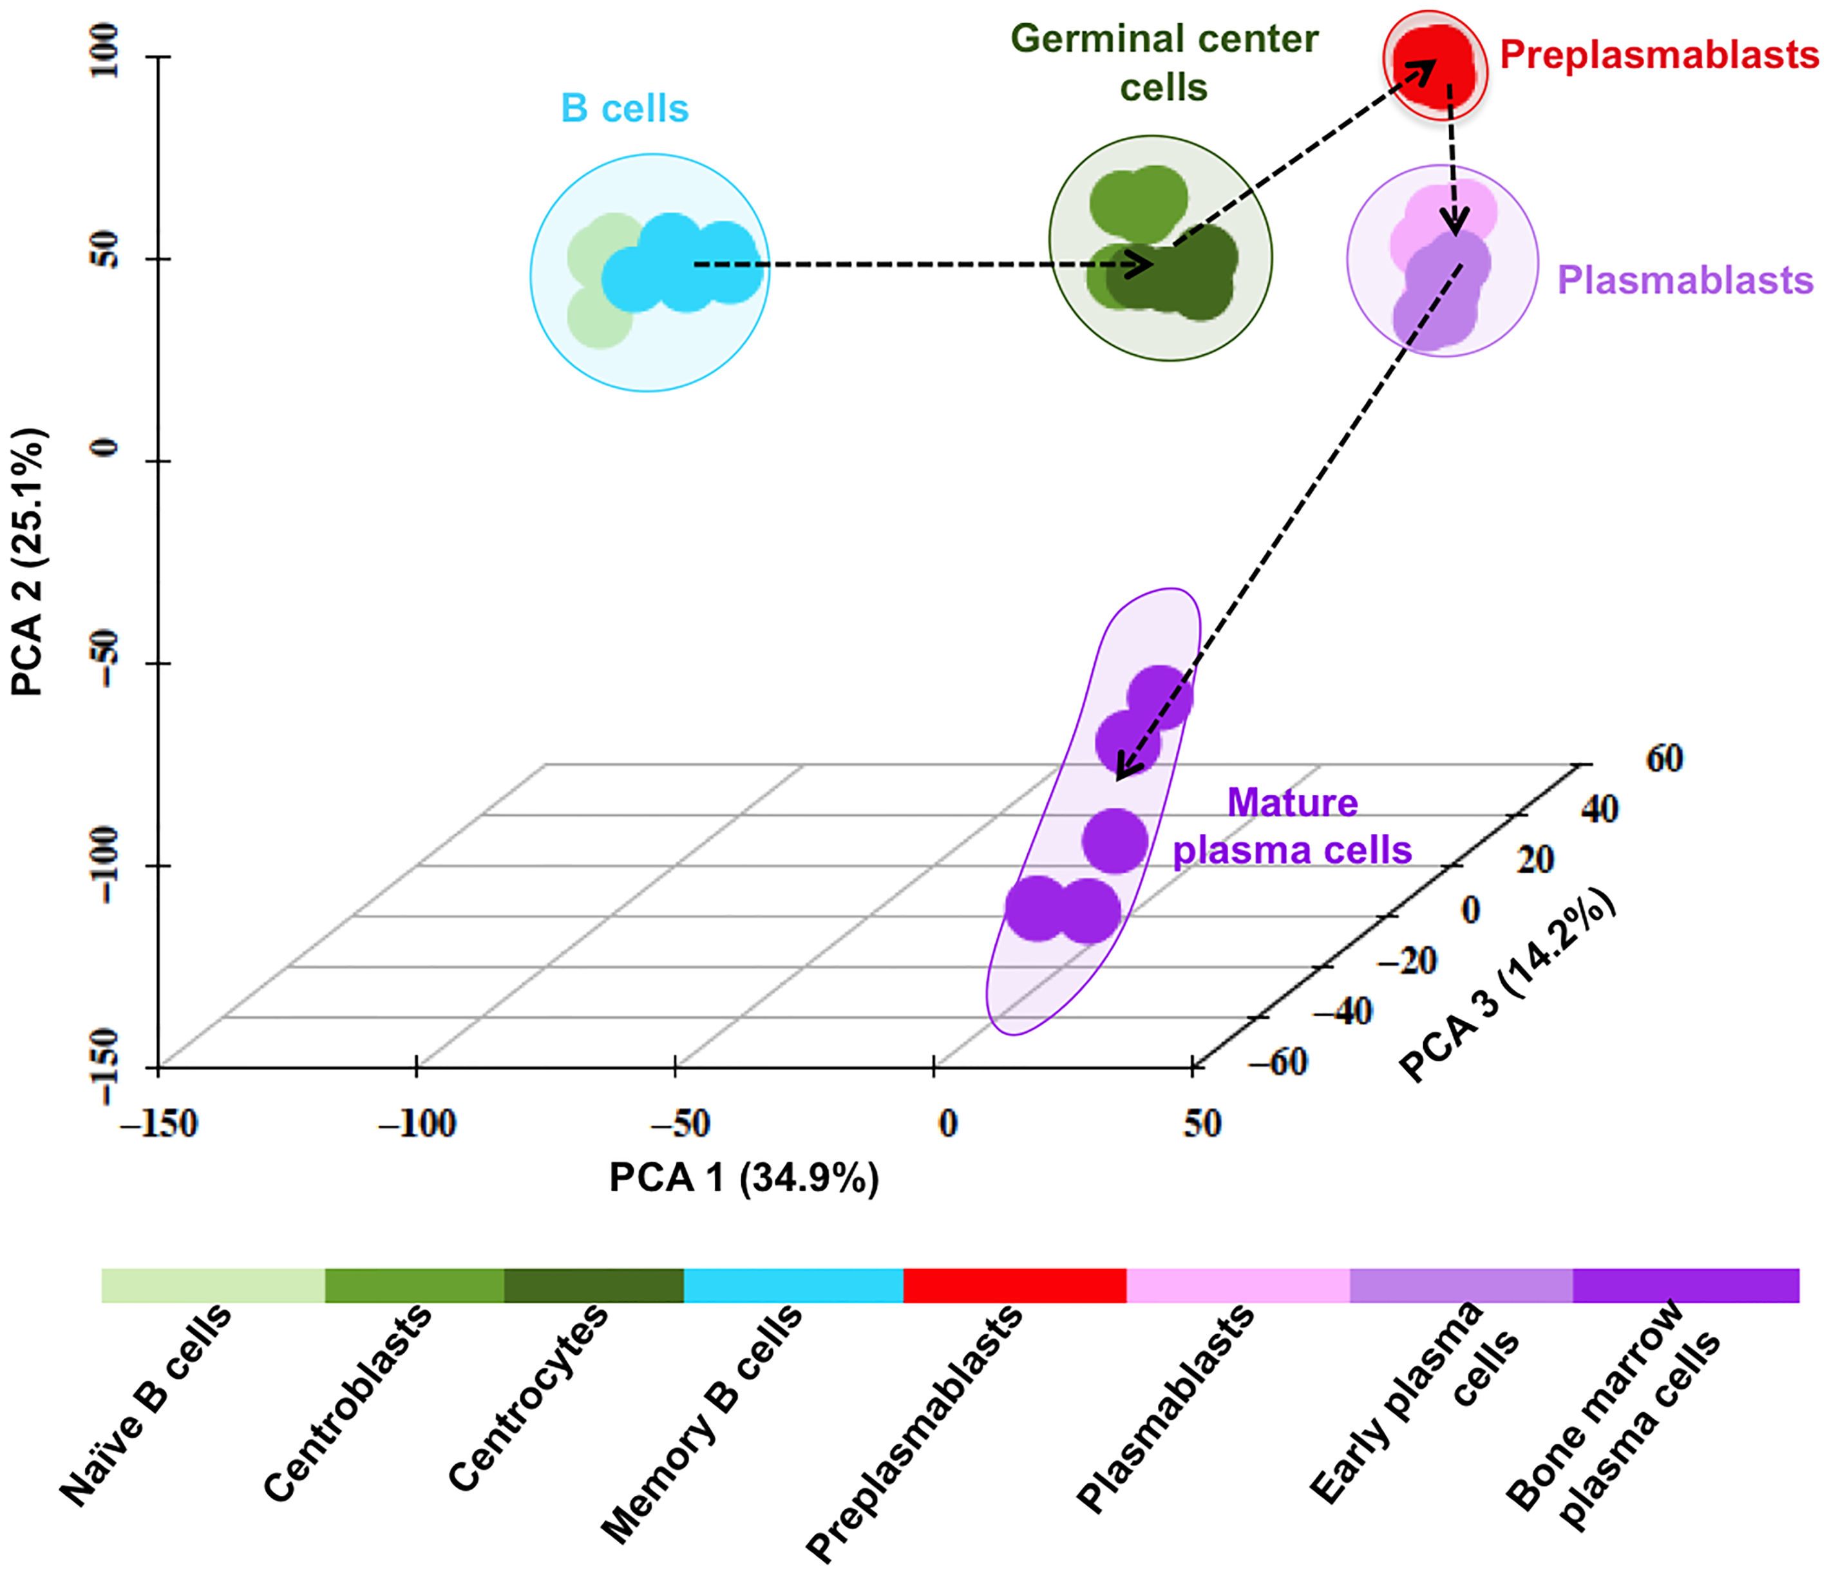
PCA Example 1: Gene expression by cell population
Expression of 9,303 genes reduced to THREE main axes of variation, explaining 75% of the original data.
Kassambara et al. (2015) PLoS Comp. Biol.

Slide 11
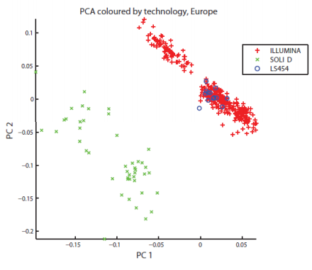
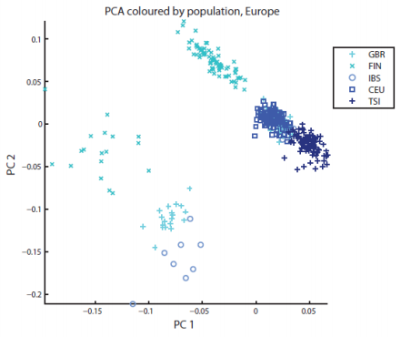
PCA Example 2: Technical Issues
Whole genome reduced to TWO main axes of variation that tightly correlate with sequence technology and geographic origin.
The 1000 Genomes Project Consortium (2012) Nature

Slide 12
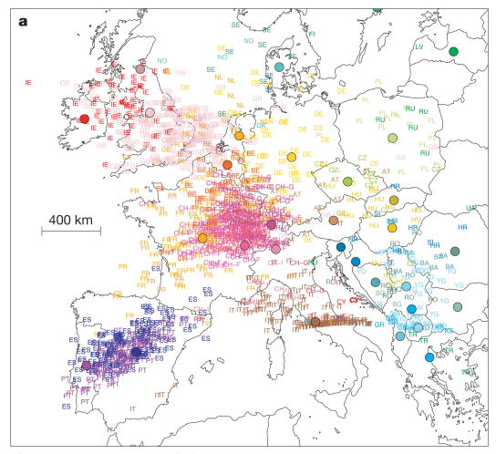
PCA Example 3: “Genes mirror geography within Europe”
500K single nucleotide polymorphisms reduced to TWO main axes of variation that tightly correlate with sampling origin
Novembre et al. (2008) Nature

Slide 13
ADMIXTURE (Alexander et al. 2009)
Samples
Variants
Genotypes
Samples
Clusters
Admixture Proportions
Clusters
Variants
Ancestral Allele Frequencies
Notes:
Admixture uses a likelihood function similar to that implemented in the bayes program STRUCTURE.
STRUCTURE has a method of determining K, but doesn’t work on modern genomic scale data (too slow).

Slide 14
Admixture analyses
Cross River
G.beringei
Captive
Congo
Cameroon
K=3
K=4
K=5
K=6
Prado-Martinez et al. (2013) Nature
Notes:
Little more messy as Western Gorillas seem to form a continuum of admixture. Within populations, individuals are ordered by PCA values. Easterns form a cluster all their own throughout.
1) Kokomo seems to have about 15% admixture from Cross River. We are playing with some alternative hypotheses to explain this, but so far it has been a robust estimate.

Slide 15
Admixture analyses: when is the K correct?
Cross River
G.beringei
Captive
Congo
Cameroon
“In practice, people often try different K, and choose the K that makes most biological sense.”
-Frappe Manual
K=3
K=4
K=5
K=6
Prado-Martinez et al. (2013) Nature
Notes:
Little more messy as Western Gorillas seem to form a continuum of admixture. Within populations, individuals are ordered by PCA values. Easterns form a cluster all their own throughout.
1) Kokomo seems to have about 15% admixture from Cross River. We are playing with some alternative hypotheses to explain this, but so far it has been a robust estimate.

Slide 16

The K Problem
How many different means are there?
1 2 3

Slide 17
ADMIXTURE: using cross validation to identify the best K
Alexander and Lange (2011) BMC Bioinformatics
Notes:
“Prediction error is estimated by averaging the squares of the deviance residuals for the binomial model” (Alexander & Lange 2011)
D(g,h) = g*log(g/h)+(2-g)*log[(2-g)/(2-h)], where g is genotype and h is g_hat

Slide 18
How well X-validation performs
Alexander and Lange (2011) BMC Bioinformatics

Slide 19
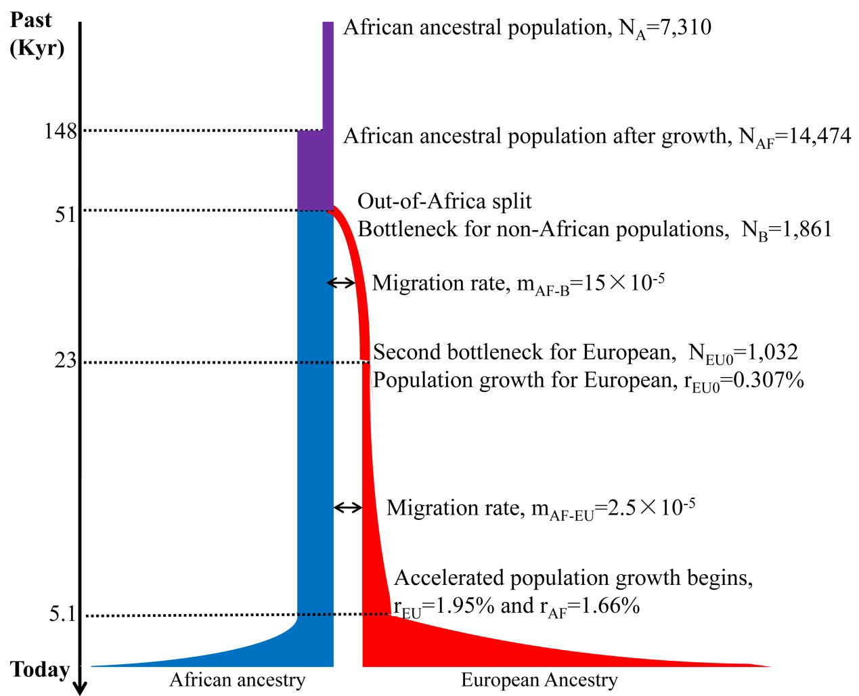
Test it with ESP inspired simulations
Fu et al. (2012) Nature

Slide 20
X-validation’s performance as a function of split time
~14,000
Pop A
Pop B
Time of Separation = 0
Time of Separation = 20,000
O’Connor (2015) Source Code for Biol. and Med.

Slide 21
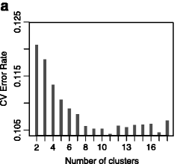
ADMIXTURE example looking at population structure of Casava in Ghana
1045 Casava plants representing 64 reference strains and 495 households were sampled
56,489 SNP markers were targeted sequenced (Genotype by Sequencing)
They tested Admixture K =2 to 18 with K=11 was selected as the lowest error.
Rabbi et al (2015) BMC Genetics
Notes:
https://bmcgenomdata.biomedcentral.com/articles/10.1186/s12863-015-0273-1

Slide 22
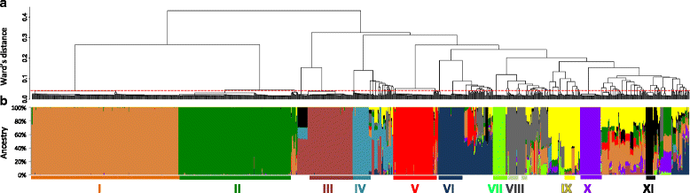
ADMIXTURE example looking at population structure of Casava in Ghana
Each bar represents a single plant.
In a they used hierarchical clustering to show the relationship between the clusters.
One negative is that they used clones which caused the admixture to pick them up as their own clusters (roman numerals).
Rabbi et al (2015) BMC Genetics

Slide 23
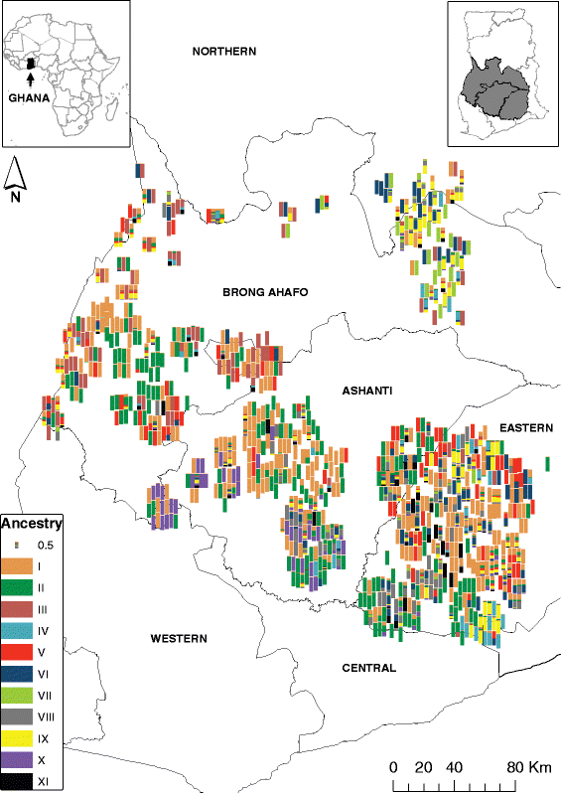
ADMIXTURE example looking at population structure of Casava in Ghana
Rabbi et al (2015) BMC Genetics

Slide 24
Tricks to effectively use ADMIXTURE
This is a Maximum Likelihood framework with many parameters
  Run multiple times (I usually use >10) for each K taking the best log-likelihood (an output parameter).
  This deals with local minimum problems.
Sometimes the lowest K that has X-validation identifies is less than what we thought. Though this is possible (see previous power figure), it doesn’t mean we have objective evidence other than the K it found.
Sometimes we get greater K than we expect or can explain. In such situations it might be better to move to a supervised learning version (also available in ADMIXTURE).

Slide 25
Local vs Global Ancestry
Gravel et al. (2013) Genetics
Mathias et al. (2016) Nat. Comm.

Slide 26
Local ancestry calling:
RFMix as an example
Maples et al. (2013) AJHG
Notes:
Figure 1. The LAI Algorithm
To illustrate the working of RFMix, we consider a single admixed chromosome from an individual with ancestry from two diverged populations.
(A) For building reference panels, samples are collected from proxy popula- tions related to the ancestral populations. Phased chromosomes are divided into windows of equal size on the basis of genetic distance.
(B) For each window, a random forest is trained to distinguish ancestry by using the reference panels.
(C) Considering the admixed chromo- some, each tree in the random forest gen- erates a fractional vote for each ancestry by following the path through the tree cor- responding to the admixed sequence.
(D) These votes are summed, producing posterior ancestry probabilities within each window. These posterior probabilities are used for determining the most likely sequence of ancestry across windows via MAP inference (black line) or via max marginalization of the forward-backward posterior probabilities (not shown).
(E) The local ancestries inferred by MAP across the admixed chromosome.

Slide 27
Demographic modeling with local ancestry
Gravel et al. (2013) Genetics

Slide 28
Demographic modeling with local ancestry
Gravel et al. (2013) PLoS Genet.

Slide 29
Recent selection by looking for local ancestry biases
Tang et al. (2007) AJHG
Though see Bhatia et al. (2014) AJHG

Slide 30
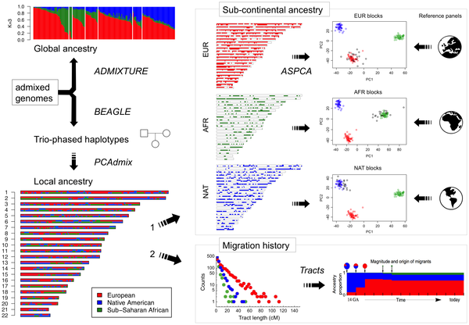
Combining Local Ancestry and PCA to give Ancestry Specific PCA (or ASPCA)
Moreno-Estrada et al. (2013) PLOS Genet.

Slide 31
Peruvian population structure with PCA
Harris et al. (2018) PNAS

Slide 32
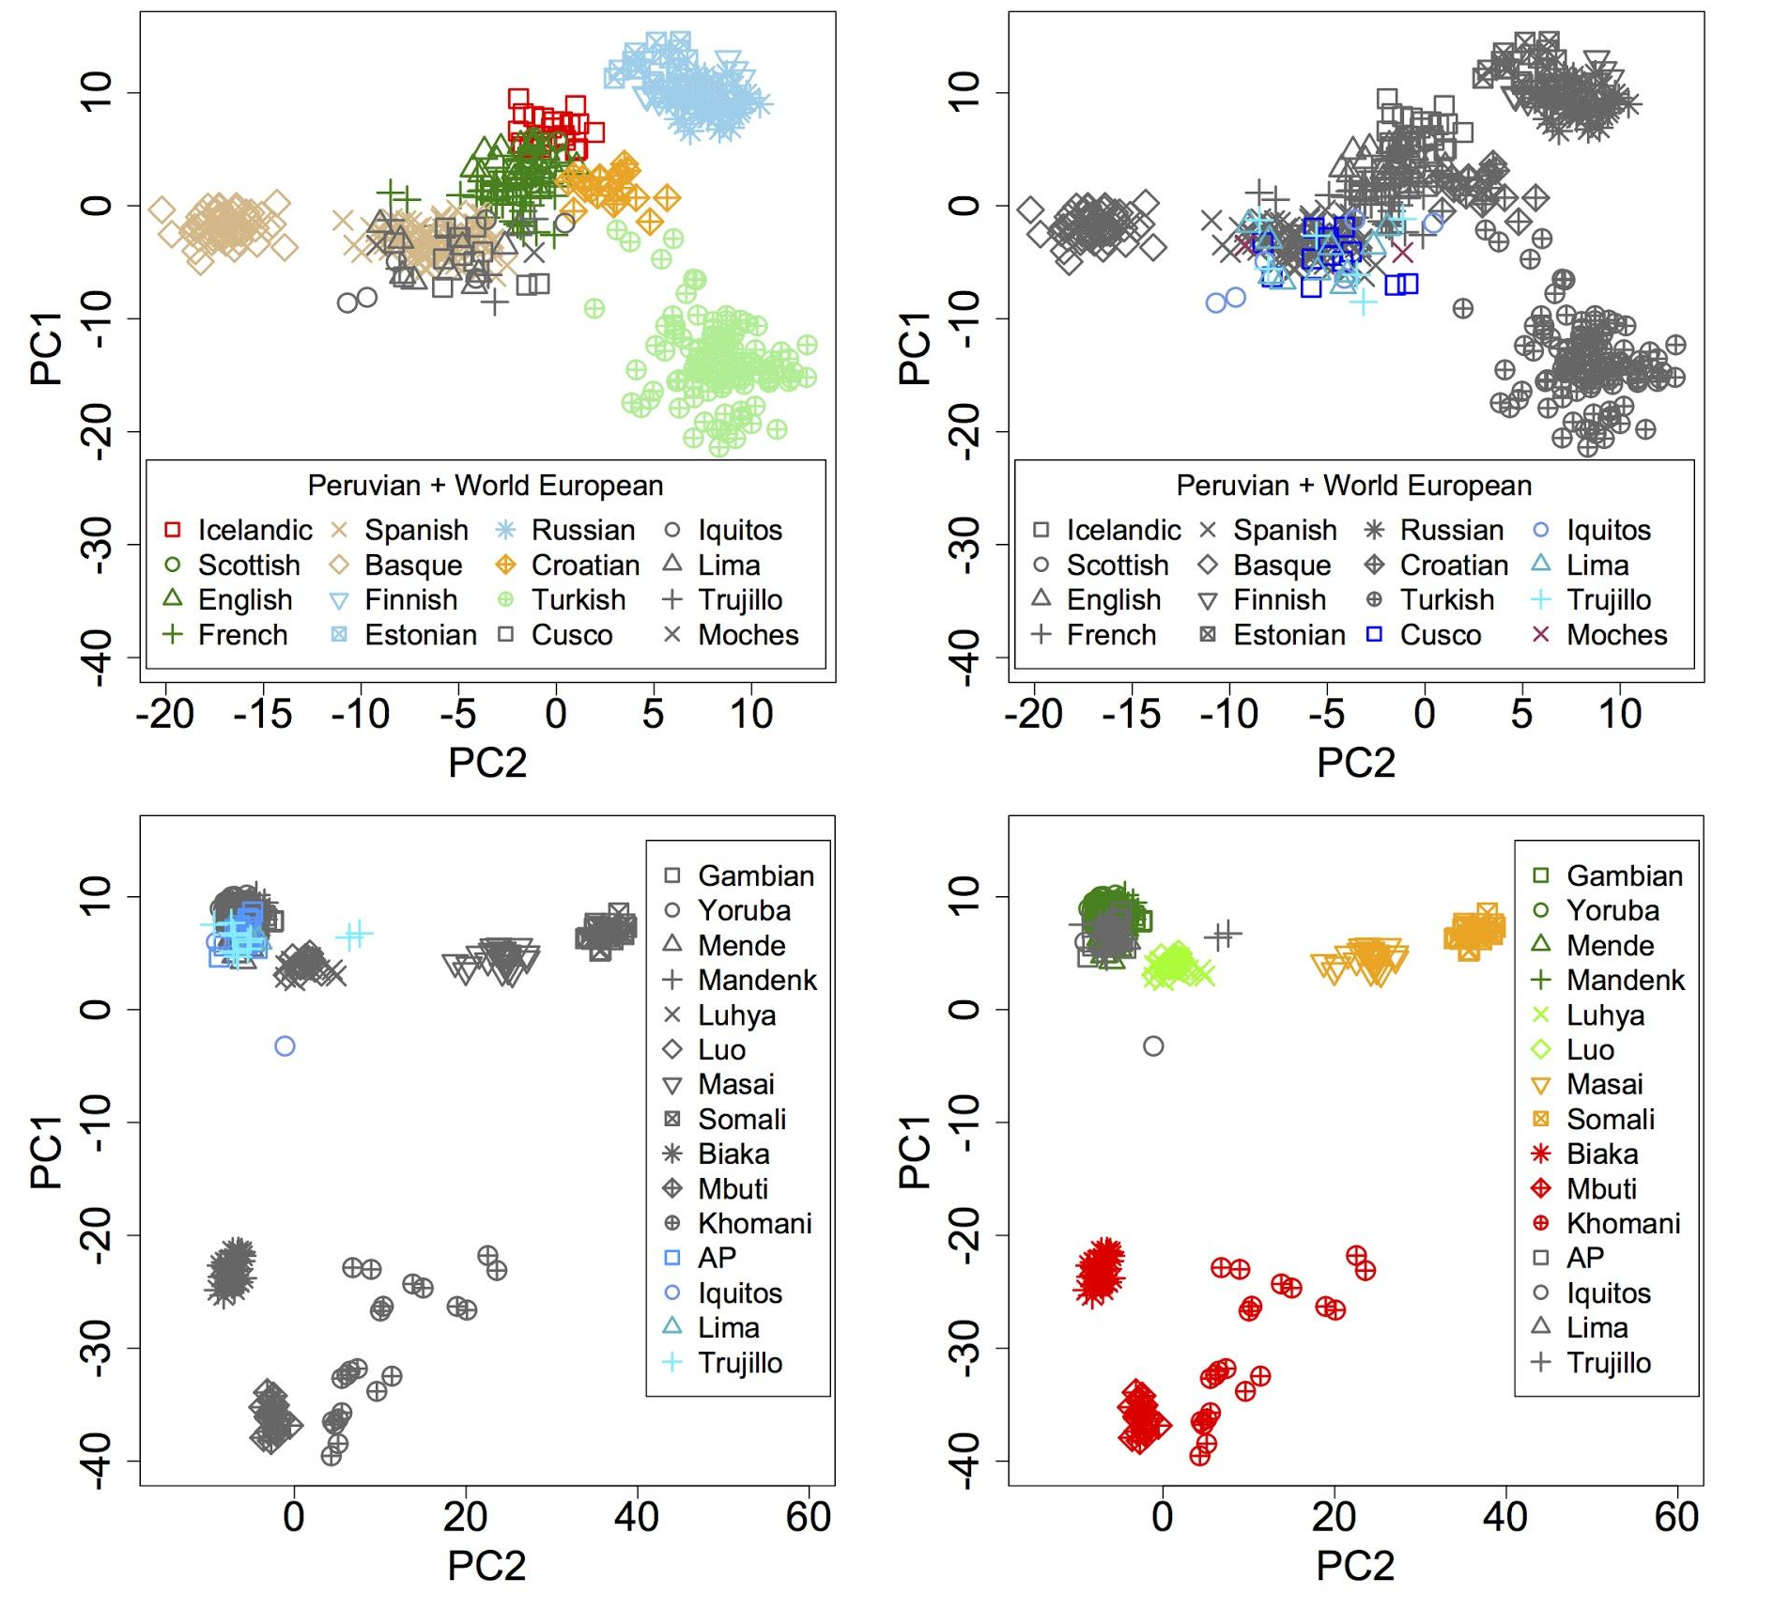
Ancestry specific PCA: Europe and Africa
Harris et al. (2018) PNAS

Slide 33
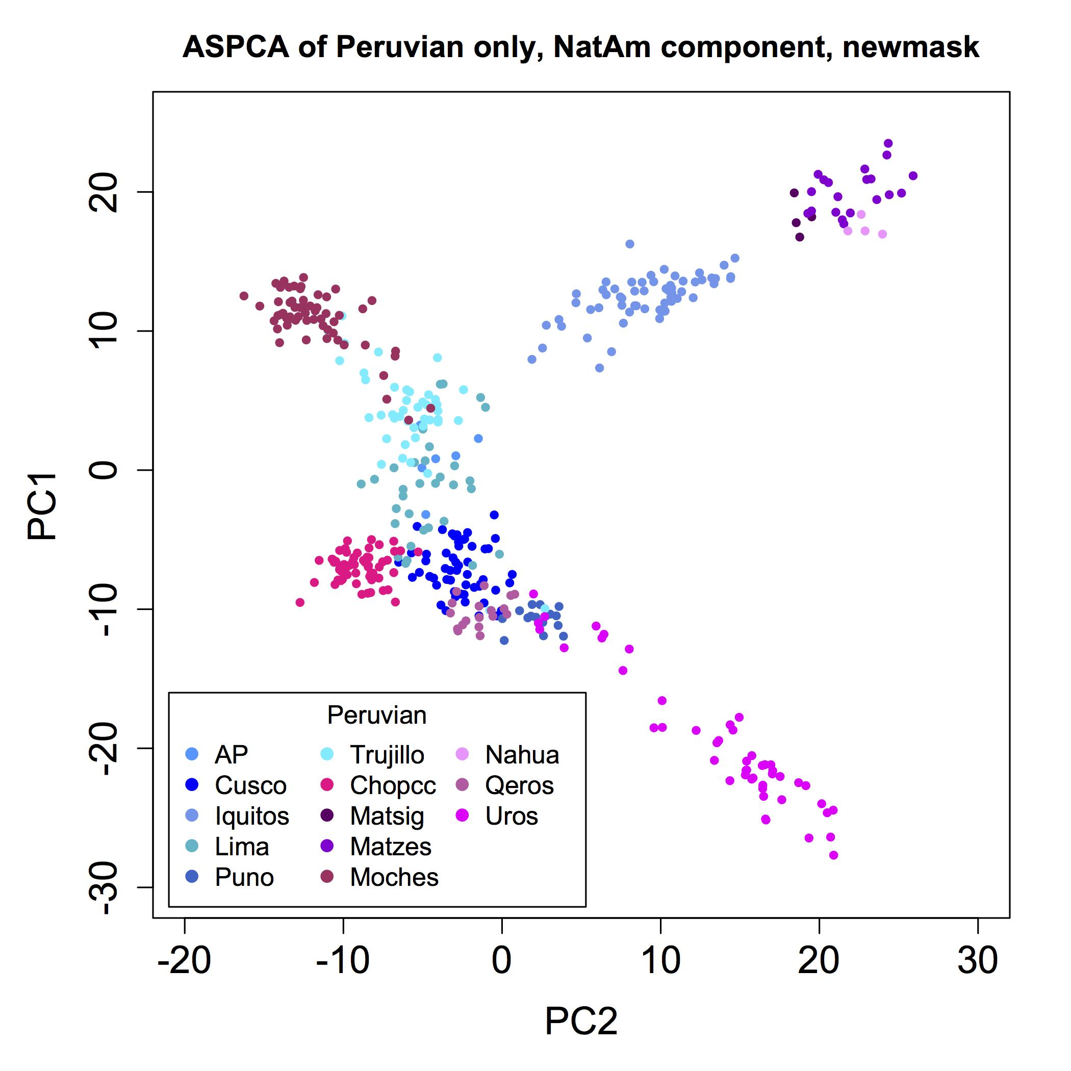
Peruvian population structure using Ancestry Specific PCA
North
East
West
South
Harris et al. (2018) PNAS

Slide 34
Admixture is not just a nuisance for association
Differences in genetic architecture are not just nuisance values that need to be ‘adjusted’ for in association models.
  Extension Studies
  Admixture Mapping

Slide 35
Extension Studies
Extension of findings to other ancestries is important to:
  Determine association’s potential public health impact
  Provide additional evidence supporting association
  Useful in fine-mapping an association signal
  Finding risk variation in non-homogenous populations (like African Americans)

Slide 36
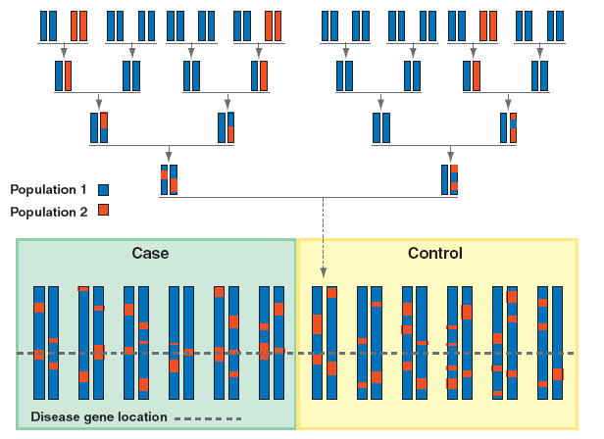
Admixture mapping - Concept
Darvasi et al. (2005) Nature Genet.

Slide 37
Example of an Admixture scan
Patterson et al. (2004) AJHG

Slide 38
Concluding Summary
PCA and Admixture analyses can summarize the ancestry found across the entire genome
Local ancestry refines this inference to genomic segments with broad applications including demographic modeling and association analyses.

