Slide 1
Cryptic Relatedness and fine-scale population structure

Slide 2
Learning objectives
Define fine-scale population structure and cryptic relatedness
Introduce various methods for how is it identified
  Identity-by-descent
  Rare variation
  Estimated Effective Migration Surfaces
  Ancestral recombination graphs (ARG)

Slide 3
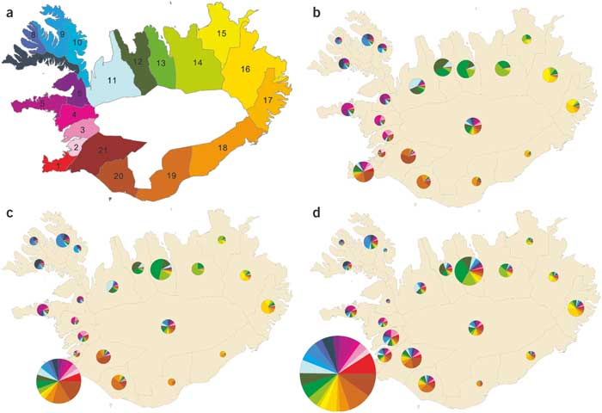
Cryptic Population Structure
Helgason et al. (2004) Nature Genet.
Notes:
Figure 1. The distribution of geographic ancestry in three cohorts of Icelanders.
(a) A color-coded map of Icelandic counties. Each county is identified by number, starting with Gullbringusysla (county 1), which contains the capital city Reykjavik, going clockwise around the country and ending with Arnessysla (county 21). The central highland region is uninhabited. (b) The geographic ancestry of Icelanders born between 1850 and 1875. Each pie represents the geographic ancestry of the inhabitants of the corresponding county. The size of each pie indicates the total number of ancestors identified for each county. The slices in each pie reflect the proportions of ancestry traced, five generations back, to each of the 21 counties, using the color coding shown in a. For example, more than 50% of the ancestors five generations back of the inhabitants of region 14 came from the same region. The pie in the central highland region represents the geographic ancestry of those members of the 1850−1875 cohort who do not have a location in the genealogy database. (c) The geographic ancestry of Icelanders born between 1910 and 1935. (d) The geographic ancestry of Icelanders born between 1970 and 1995.

Slide 4
“A large number of loci is required to reveal fine-scale population structure using PCA”
Novembre & Peter (2017) Curr Opin Genet Dev.

Slide 5
Demographic Inference Time Frames
0
75 gen
Moderate
Divergence
Greater Divergence
ADMIXTURE
PCA
F_{ST}
Common Variants
Haplotypes,
IBD
Rare
Variants
Phylogenetics
EEMS

Slide 6
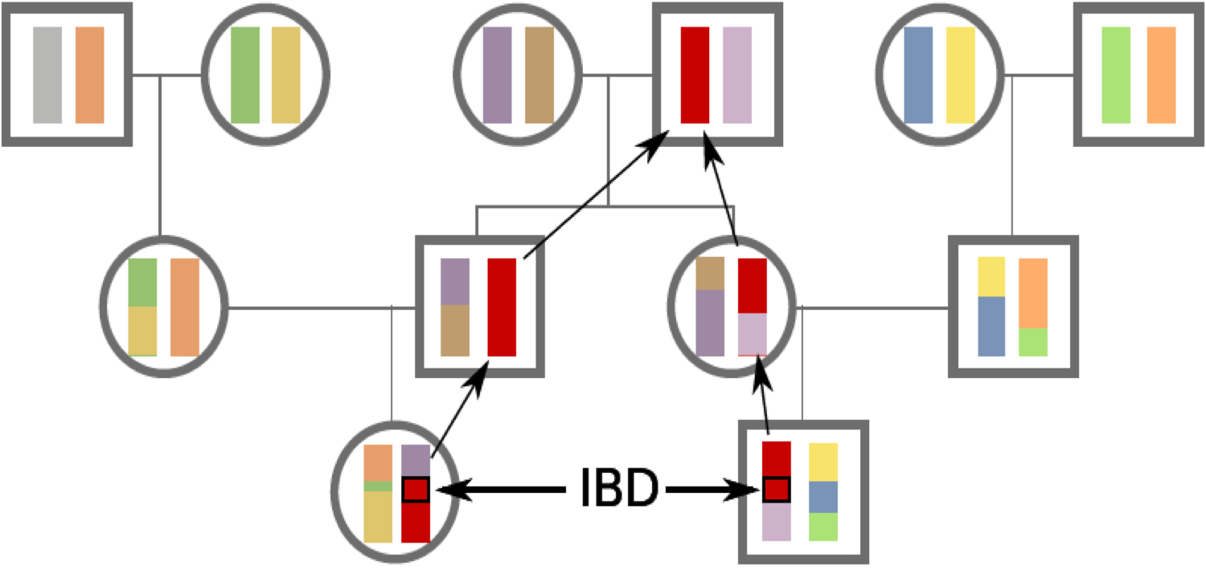
Identity by Decent (IBD): A method to find both distant and recent relationships
Siblings
The smaller the segments in common, the more distant the relationship.
Recombination event
Cousins
Notes:
Analisis de pedegree

Slide 7

IBD length is correlated with historical relationships.
$$E[g|l]≅\frac{3}{2 ∗l}$$
Baharian et al. (2016) PLoS Genet.
Palamara and Pe’er (2013) Bioinformatics

Slide 8
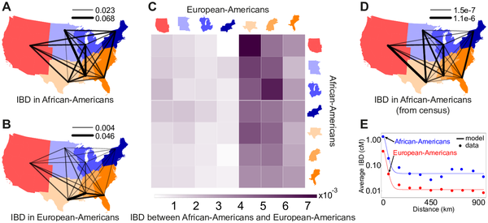
Pairwise genetic relatedness across
Baharian et al. (2016) PLoS Genet.

Slide 9
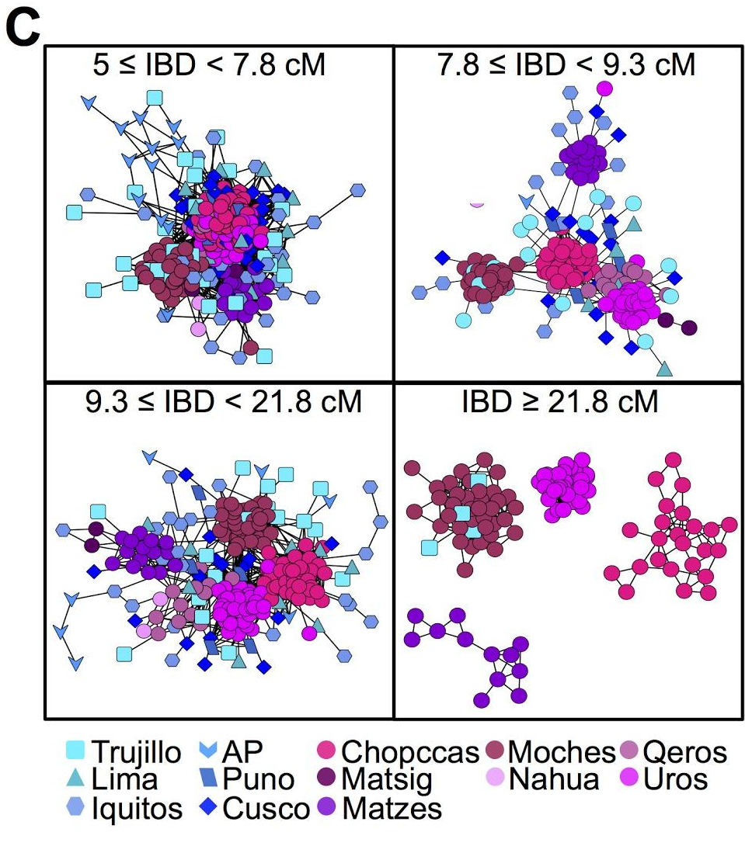
Identity-by-descent as a means to look at fine-scale structure over time
Harris et al. (2018) PNAS

Slide 10
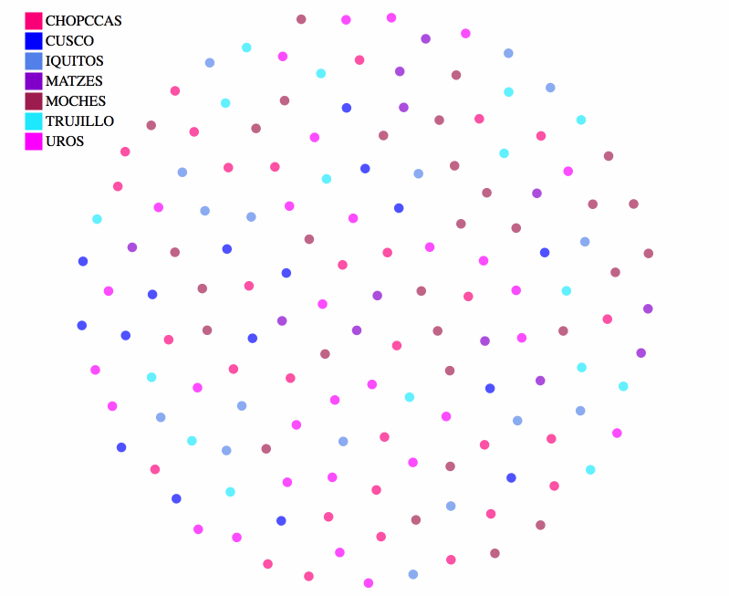
Identity-by-descent as a means to look at fine-scale structure over time
Harris et al. (2018) PNAS

Slide 11
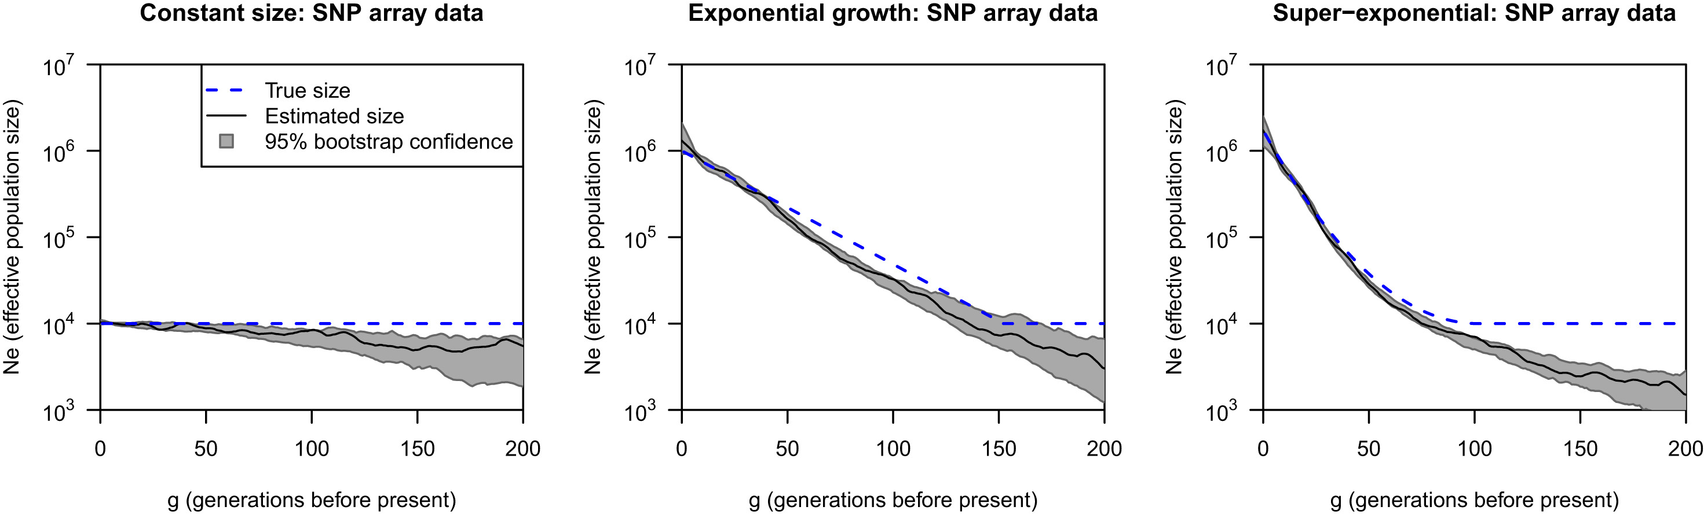
IBD can estimate effective population size over time.
Browning &Browning (2016) Am. J. Human Genetics

Slide 12
IBDNe in Samoa!
Harris et al. (https://papers.ssrn.com/sol3/papers.cfm?abstract_id=3329885)

Slide 13
IBD on a large scale
Han et al. (2017) Nature Comm.

Slide 14
IBD on a large scale
Han et al. (2017) Nature Comm.

Slide 15
Do rare variants help identify recent population structure?
1000 Genomes Project (2012) Nature

Slide 16
Do rare variants help identify recent population structure?
1000 Genomes Project (2012) Nature
Novembre et al. (2012) Science

Slide 17
Rare VS Common:
Population Structure Simulations
N_{A}
= 10,000
Time of Separation
Time of Bottleneck = 0, 5000, or 10000
N_{B} = 1,000
O’Connor et al. (2014) Mol. Biol. Evol.
N_{F} = 2,000,000
Pop A
Pop B
Notes:
From the population specific result we are interested in seeing if different signals in the rare and common
First I will show you some simulation results to establish some theory then return to the ESP data
The point of this model is to generate data where we know the population splits and test who rare and common variation are able to detect that over a range of split times and other demographic parameters
-go through each parameter
-emphasize Ts and Te
-For example, Africans and Europeans separated at a time of about 50-80KYA
-Or in a more recent scenario Italians and the Dutch probably split in the last 10-20KYA
So how well can common or rare identify individuals belonging to their correct population?
Especially considering the timing of split between the two test groups?

Slide 18
Rare VS Common:
Assignment of Ancestry Proportions
Ave. Correctly Predicted Ancestry
Pop A
Pop B
Time of Separation = 0
Time of Separation = 20,000
Time of Separation
O’Connor et al. (2014) Mol. Biol. Evol.

Slide 19
Rare VS Common: Which has Greater Information? And When?
Information Gain: how well a variant can distinguish between populations. (Rosenberg et al. 2003)
Expected Info. Gain
Expected Information Gain
Calculate for a specific site count
Correct for missing data
Weighted average to calculate across a range of frequency (rare or common)
Time of Separation
O’Connor et al. (2014) Mol. Biol. Evol.
Notes:
Info Gain for maf=0.005 allele in perfect(as can be) association = 0.00348
Maf of 0.25 = 0.2157

Slide 20
Rare Variants Identify Cryptic Populations
Common (MAF > 10%)
O’Connor et al. (2014) Mol. Biol. Evol.
Notes:
Points:
One question we have had is what are the similarities/differences in patterns of population structure between rare/common variants
Common we see again the AA admixture but we also see a spread in EA which is partially explained by the N/S European cline.
In the rare plot we see a much more discrete clustering (not a continuum), though they are higher in common plot
common VS rare PC1 r² = 0.918; PC2 r² = 0.661
I’ll refer to the cluster as EArare
bamshad_1 1
bamshad_2_group_1 1
bamshad_2_group_2 9
bi 23
carlson_1 2
carlson_2 13
tracy_1 10
---------
Target/Center
ccds_2008.HG19/UW 13
uwrefseq_2009.HG19 23
Broad 23
---------
Cohort
ARIC 3
CF 1
CHS 3
EOMI 23
FHS 4
LHS_of_COPD 1
PAH 9
WHI 15
---------
Sample Project
bamshad_1 1
bamshad_2 10
carlson_1 2
Carlson_2 13
EOMI 23
LDL 8
tracy_1 2

Slide 21
Rare Variants Identify Cryptic Populations
Common (MAF > 10%)
Rare (MAF < 0.5%)
O’Connor et al. (2014) Mol. Biol. Evol.
Notes:
Points:
One question we have had is what are the similarities/differences in patterns of population structure between rare/common variants
Common we see again the AA admixture but we also see a spread in EA which is partially explained by the N/S European cline.
In the rare plot we see a much more discrete clustering (not a continuum), though they are higher in common plot
common VS rare PC1 r² = 0.918; PC2 r² = 0.661
I’ll refer to the cluster as EArare
bamshad_1 1
bamshad_2_group_1 1
bamshad_2_group_2 9
bi 23
carlson_1 2
carlson_2 13
tracy_1 10
---------
Target/Center
ccds_2008.HG19/UW 13
uwrefseq_2009.HG19 23
Broad 23
---------
Cohort
ARIC 3
CF 1
CHS 3
EOMI 23
FHS 4
LHS_of_COPD 1
PAH 9
WHI 15
---------
Sample Project
bamshad_1 1
bamshad_2 10
carlson_1 2
Carlson_2 13
EOMI 23
LDL 8
tracy_1 2

Slide 22
What is Their Geographic Ancestry?
O’Connor et al. (2014) Mol. Biol. Evol.
Notes:
Only European HGDP
Before the inclusion of Behar et al.
Procrustes finds correlations between Long/Lat and PC space thus projecting genetic signal onto the map
This is 2 PCs using the long/lat from HGDP without Earare
Using this mapping we can predict the local of Earare
From around the Mediteranian
Gives us the impetus to include Behar et al, which had greater sampling of Europeans in that area (Turkish, Cypriots, and others) as well as Jewish individuals
On a PCA with Europeans from HGDP and the 1M SNP EArare data we project the Procrustes (Wang et al. 2010) mapping to long/lat for EArare
An analysis with Middle Eastern individuals places them closer to the Europeans.

Slide 23
PCA of Global Diversity Including Cryptic Population
Unknown
O’Connor et al. (2014) Mol. Biol. Evol.
Notes:
This is a global PCA with both Earare, HGDP, and the Behar data sets
Earare is in red and near European and Middle Eastern groups
ZOOM
With a closer look we see that they fall outside Euro, but within some groups of Jewish individuals

Slide 24
PCA of Global Diversity Including Cryptic Population
Unknown
O’Connor et al. (2014) Mol. Biol. Evol.
Notes:
This is a global PCA with both Earare, HGDP, and the Behar data sets
Earare is in red and near European and Middle Eastern groups
ZOOM
With a closer look we see that they fall outside Euro, but within some groups of Jewish individuals

Slide 25
Population Average PCA with More Axes
Unknown
O’Connor et al. (2014) Mol. Biol. Evol.
Notes:
1)Same PCA as previous slide, but only plotting average of Jewish populations and EArare
2) Shows that EArare falls within the distribution of Jewish individuals for the first 5 PCs
1) Specifically near Ashkenazi, Sephardic, and Moroccan
3)Highlight PC4
4)Our theory then is they are Jewish Americans of Ashkenazi origin
1)To confirm we ran two additional analyses: an Admixture plot, and genetic distance between populations

Slide 26
Population Average PCA with More Axes
Unknown
O’Connor et al. (2014) Mol. Biol. Evol.
Notes:
1)Same PCA as previous slide, but only plotting average of Jewish populations and EArare
2) Shows that EArare falls within the distribution of Jewish individuals for the first 5 PCs
1) Specifically near Ashkenazi, Sephardic, and Moroccan
3)Highlight PC4
4)Our theory then is they are Jewish Americans of Ashkenazi origin
1)To confirm we ran two additional analyses: an Admixture plot, and genetic distance between populations

Slide 27
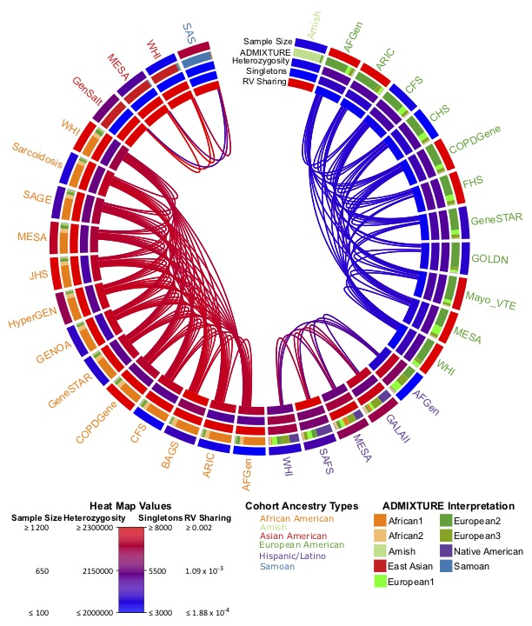
Trans-Omics for Precision Medicine (TOPMed) Cohorts
N ≅ 55K
Predominantly African, Latino, and European American
  Samoa
  Amish
All are well characterized for heart, lung, blood, and sleep phenotypes
Taliun et al. (2021) Nature

Slide 28
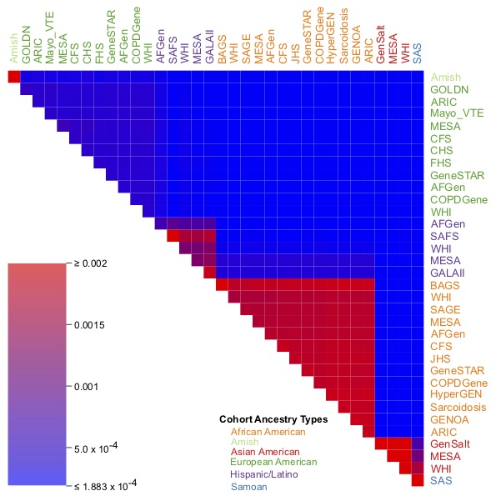
Rare variant sharing across cohorts
Allele Count 2 to 100
Corrected for:
  sample size
  Genome-wide heterozygosity
Taliun et al. (2021) Nature

Slide 29
Rare variant sharing across cohorts
European
Allele Count 2 to 100
Corrected for:
  sample size
  Genome-wide heterozygosity
Taliun et al. (2021) Nature

Slide 30
Rare variant sharing across cohorts
European
Allele Count 2 to 100
Corrected for:
  sample size
  Genome-wide heterozygosity
African
Taliun et al. (2021) Nature

Slide 31
Rare variant sharing across cohorts
European
Latino
Allele Count 2 to 100
Corrected for:
  sample size
  Genome-wide heterozygosity
African
Asian
Taliun et al. (2021) Nature

Slide 32
Quick background on Samoa
Harris et al. 2020 PNAS

Slide 33
Quick background on Samoa
Harris et al. 2020 PNAS

Slide 34
PCA with all variants can’t distinguish the two islands well.
Harris et al. 2020 PNAS

Slide 35
Rare variant Sharing in Samoa
Harris et al. 2020 PNAS

Slide 36
Genome-wide Association Studies of Latin America
1.3% of Individuals
2.2% of studies
4% of associations
https://www.ebi.ac.uk/gwas/docs/ancestry-data

Slide 37
Latin America is NOT a homogenous group
Manichaikul et al. (2012) PLoS Genetics
Continental ancestry varies dramatically by region

Slide 38
Height is strongly correlated with Indigenous American ancestry in Peru
r = -0.98,
p-value=3.7x10⁻⁷
Asgari et al. (2020) Nature

Slide 39
The results of a GWAS for height find one genome-wide significant locus: FBN1
p-value < 5x10⁻⁸, N = 3,134
FBN1 is key to Marfan lipodystrophy syndrome, which has a height component
One population-specific missense variant rs200342067 MAF = 4.7%
p-value = 8.0x10⁻¹⁰, effect size = -2.2 cm
SE = 0.4
Asgari et al. (2020) Nature

Slide 40
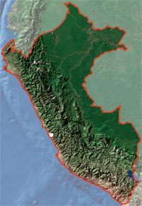
The variant is far more common in the Peruvian coast than other areas
Amazon
Andes
Coast
Asgari et al. (2020) Nature

Slide 41
GLAD project: an effort to better represent Latin America
Collect as much genomic information as is possible for Latin Americans.
  Understand the demography and population structure unique to different places.
Make GLAD readily available to the scientific community while protecting and preserving individual‘s consent and rights.
  We can provide controls for studies in Latin America.
Create a Latin American genomic biobank, but with a hodgepodge origin.

Slide 42
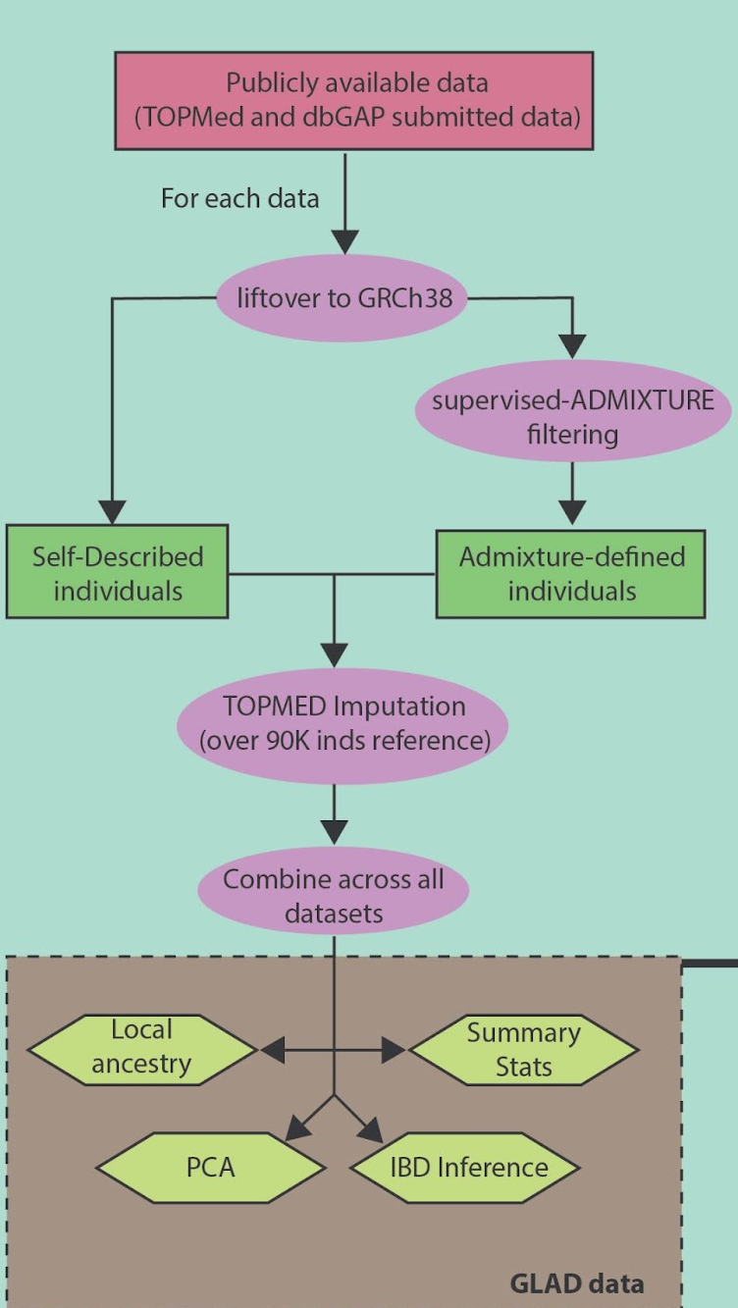
We have made our first freeze! N=61,781
The Genetics of Latin American Diversity (GLAD) project is a collaboration to collect and combine available genomes from public data.
To date, our team has searched through hundreds of thousands of genomes and have found more than 61K putative Latino samples (~75% self-described).
  We look for self-described Hispanic/Latino
  Also, we estimate Native American ancestry on unknown origin samples
We then combine them using a common data set as a reference TOPMed Project.
9.2M variants imputed >0.3 in each studies.
Figure 1. Workflow for building the GLAD database. We will identify any self-described (*) and/or ancestry-determined individuals with at least 2% of Native American ancestry(**). This identification will be performed using supervised ADMIXTURE with four parental panels. Then, each cohort will be imputed using the Michigan Imputation center using the TOPMED data (~90K individuals) as an imputation panel(✢). We are not imputing high coverage WGS data, especially not from the TOPMed Project. Samples were removed before imputation if they had >10% missing data. The imputation server returns imputed and phased data. After imputation, we will select the best imputed loci (r² > 0.9) and merge the data. To characterize the GLAD dataset, we will perform kinship, principal component analysis, Local ancestry and Identical by descent analyses. This information coupled with phenotype data will be used for the matching step.

Slide 43
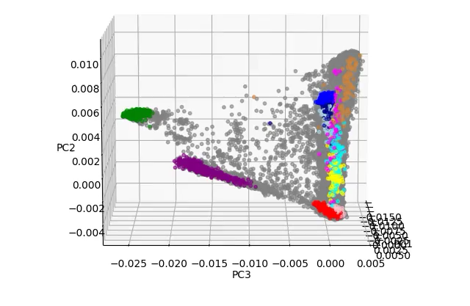
PCA of GLAD samples demonstrates a wide diversity of ancestry

Slide 44
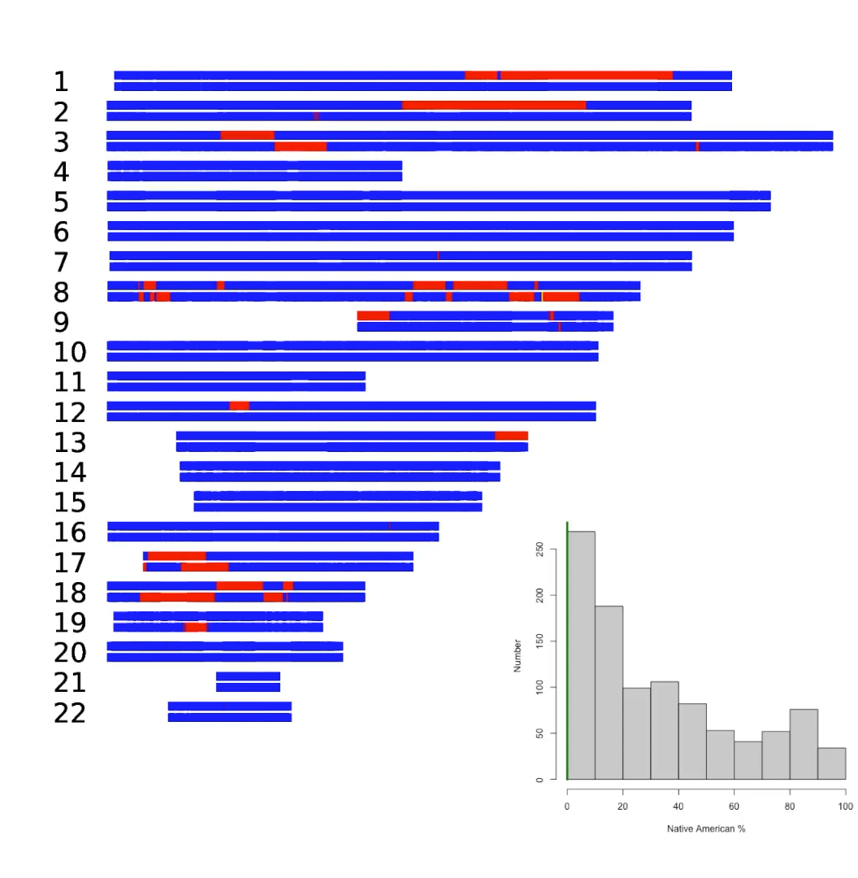
Local ancestry of 1000 Latin American individuals ordered by % Native American Ancestry

Slide 45
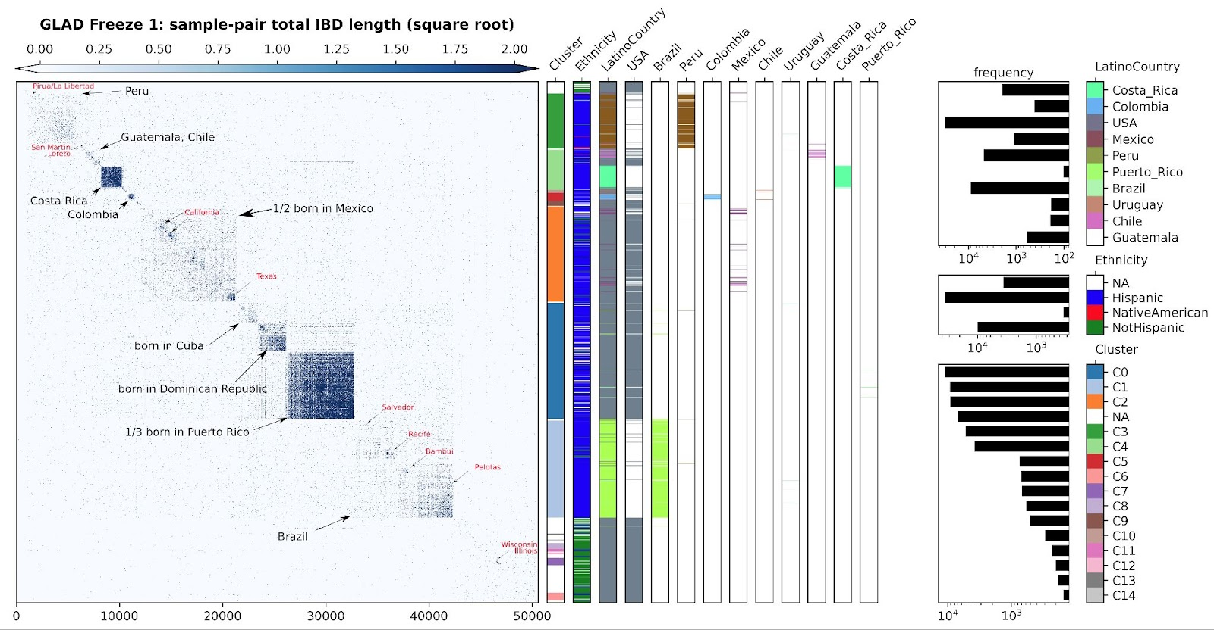
Identity-by-descent connects across countries but shows substantial substructure within ~50K GLAD individuals.

Slide 46
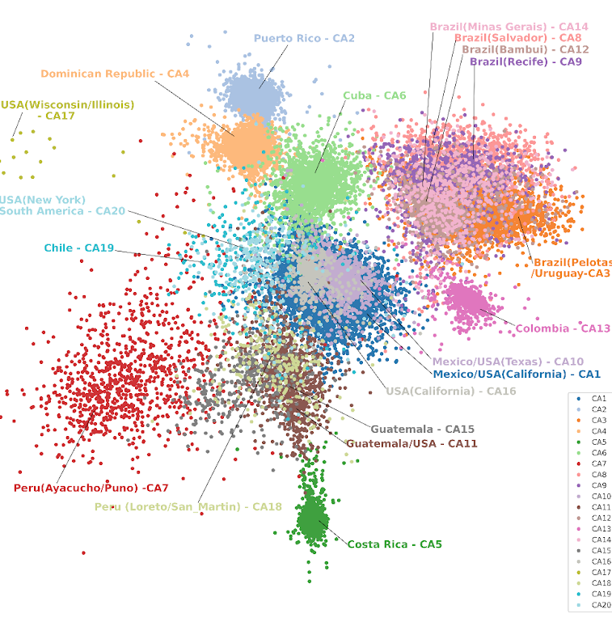
Community detection of IBD network
Community detection is an network algorithm to identify clusters of closely related samples
Here we used it on an IBD network to find major populations groups within GLADdb

Slide 47
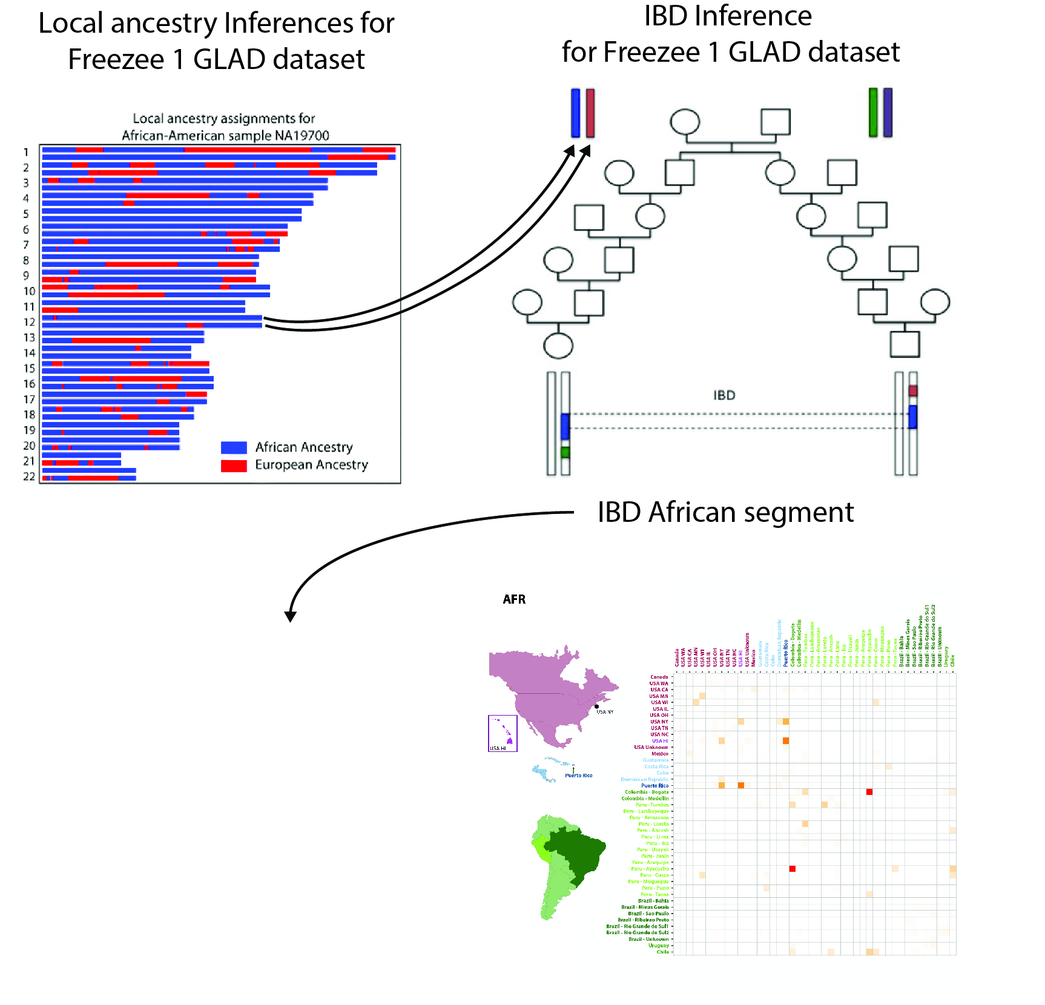
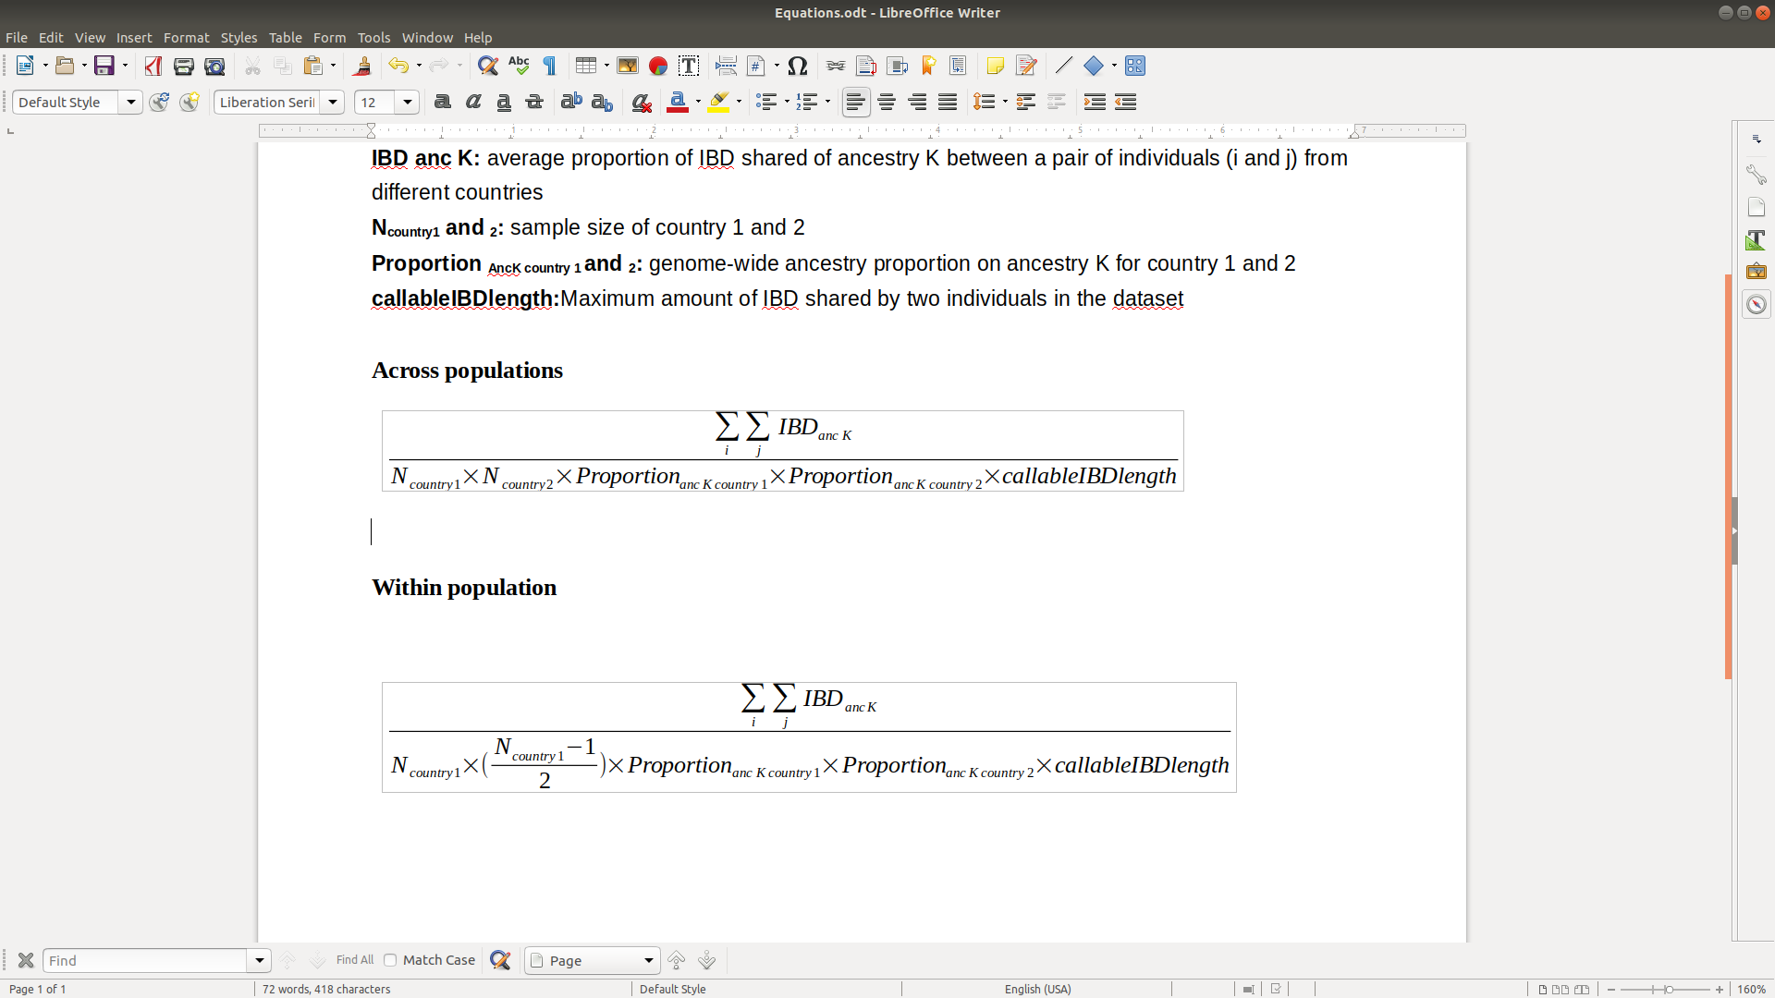
Combining Local ancestry and IBD segments in GLAD gives us insights into fine-scale ancestral composition
Across populations
Within populations

Slide 48
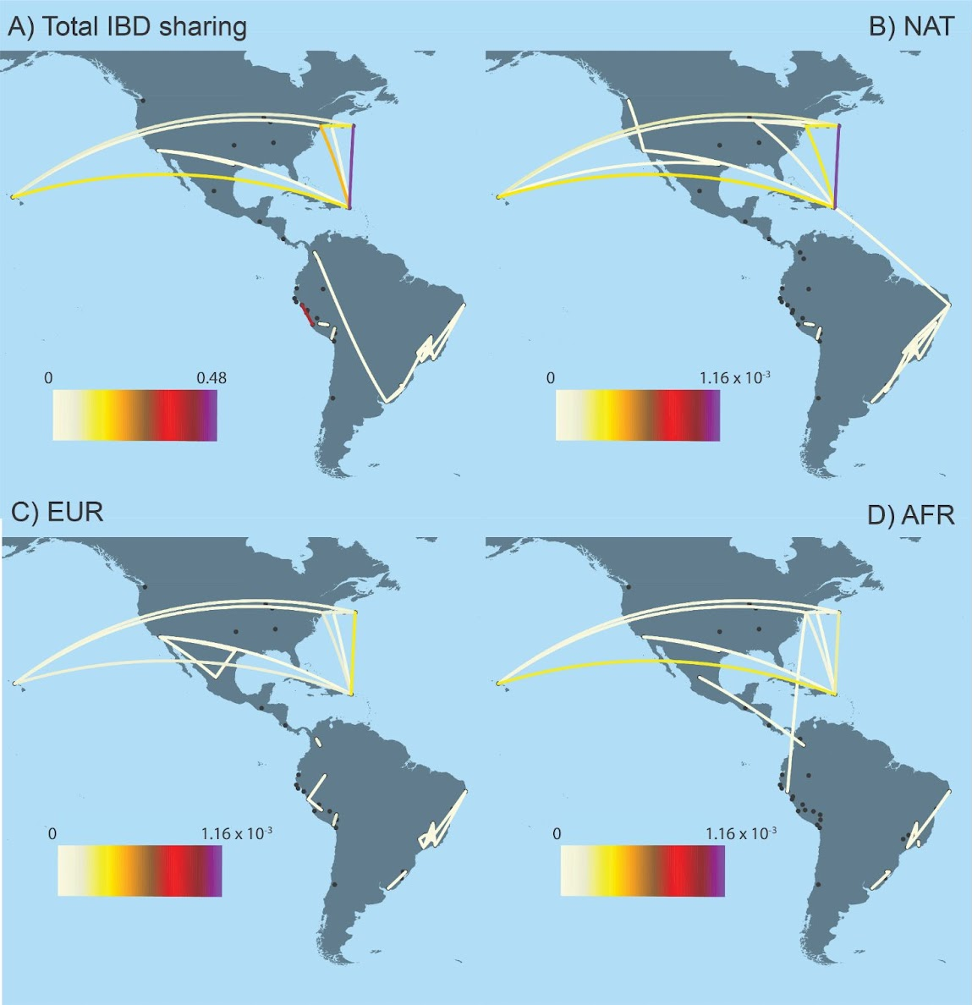
We find different intensities of fine-scale relationships from multiple ancestral backgrounds
Pop1 | Pop2 | AFR IBD Sharing | EUR IBD Sharing | NAT IBD Sharing
Puerto Rico | Puerto Rico | 3.78E-04 | 5.14E-04 | 1.10E-03
Puerto Rico | Hawaii | 4.15E-04 | 1.84E-04 | 4.99E-04
Puerto Rico | New York Puerto Rico | 8.03E-05 | 1.32E-04 | 4.34E-04

Slide 49
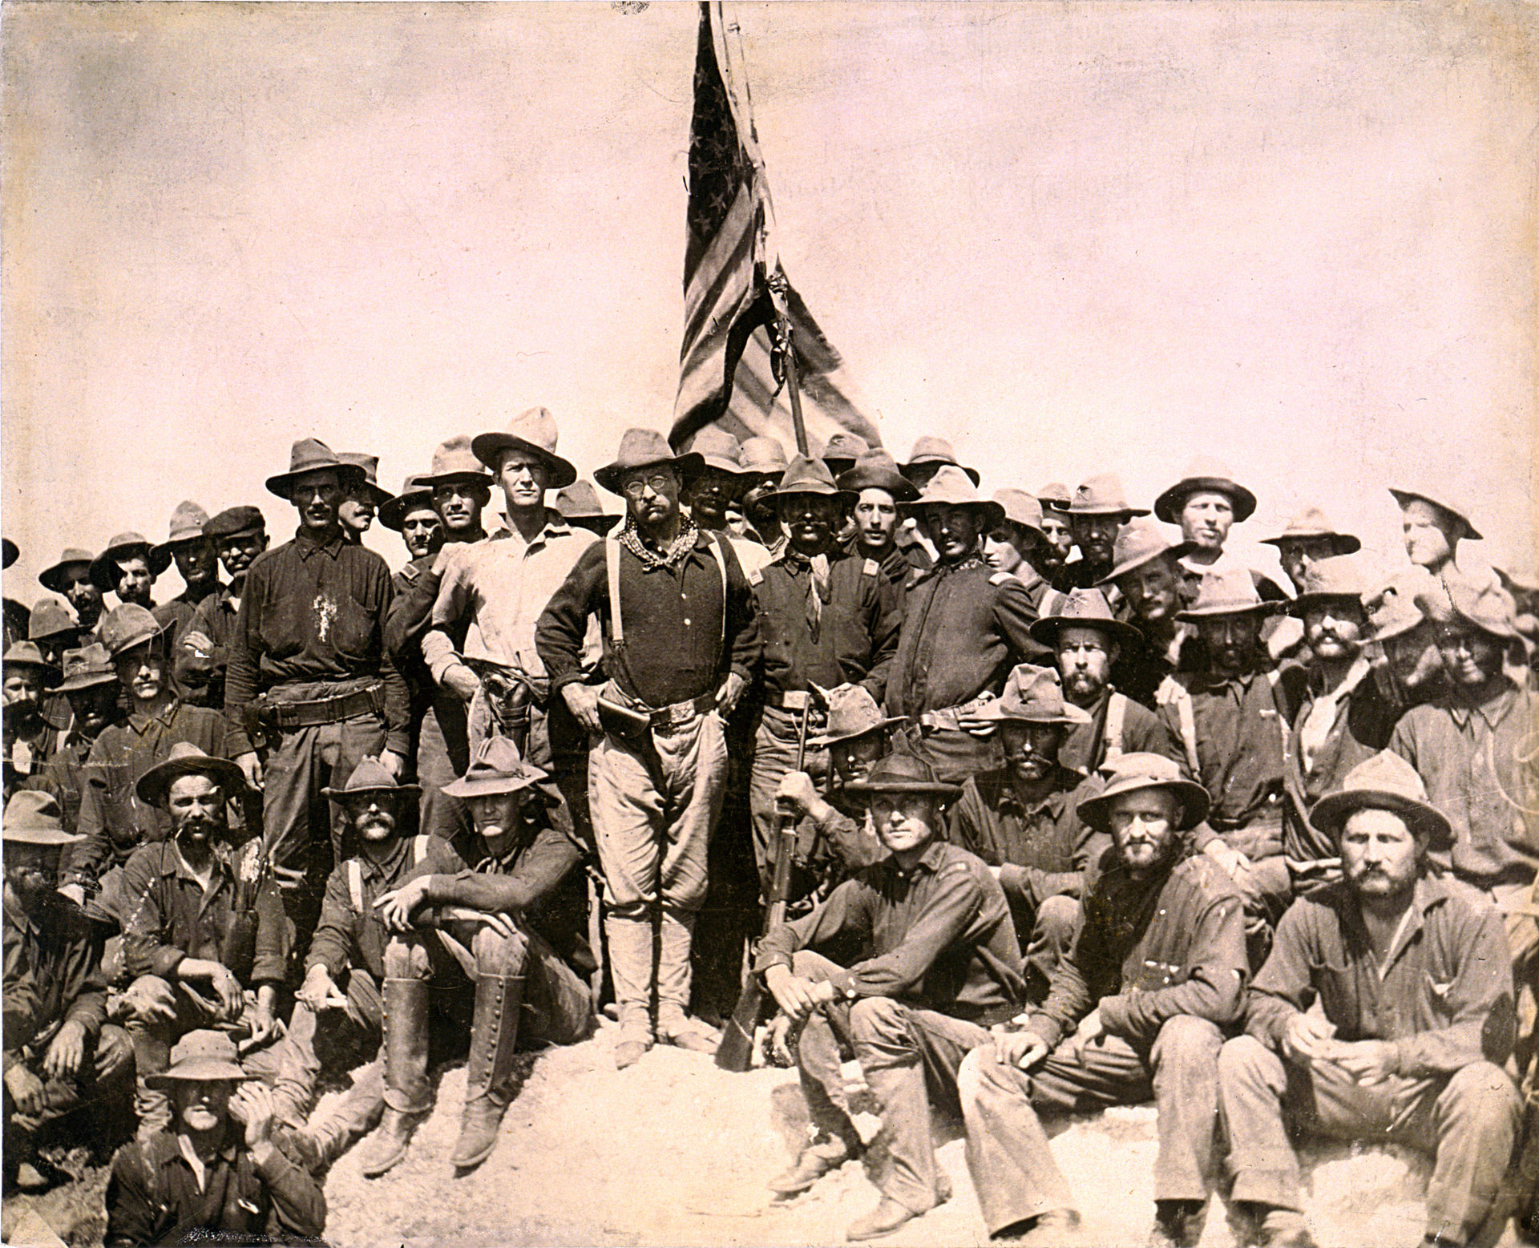
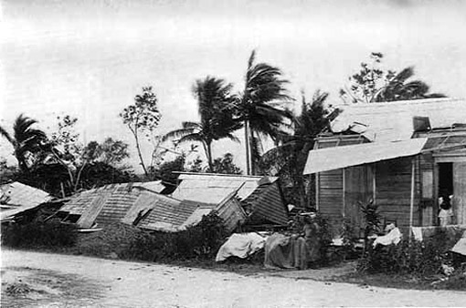


History of the Puerto Rican Diaspora
1898: Spanish-American War concluded with Puerto Rico as a US territory.
1899: Two massive hurricanes destroyed most of the cane sugar crops.
1900: Many Puerto Ricans migrated to Hawai’i to farm sugar cane.
Our current hypothesis is that there has been an ancestry biased migration to the two locations.
1898-: After the war many well to do families moved to New York City

Slide 50
Estimated Effective Migration Surfaces (EEMS)
Petkova et al. (2015) Nature Genet.

Slide 51
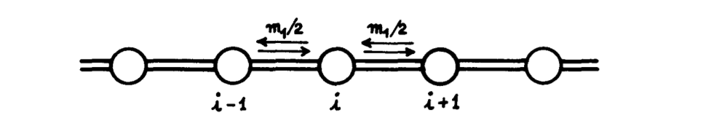
Assumptions: Stepping Stone Model
Migration can only occur between adjacent demes
Migration rate between each deme is assumed to be equal
Kimura and Weiss (1964)
Notes:
51.1

Slide 52
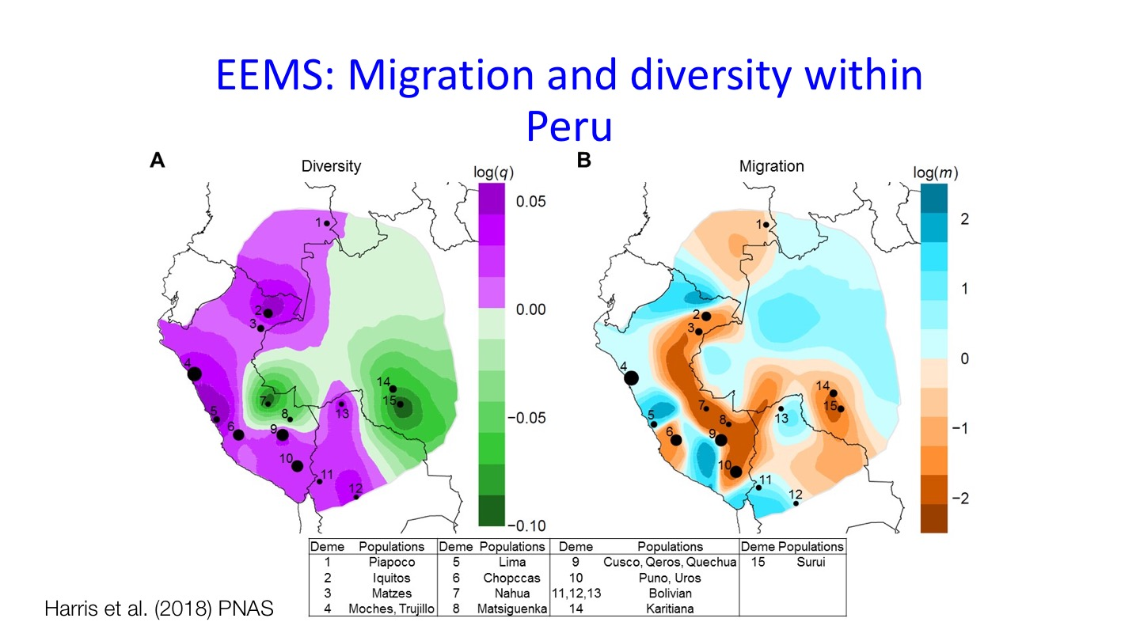

Slide 53
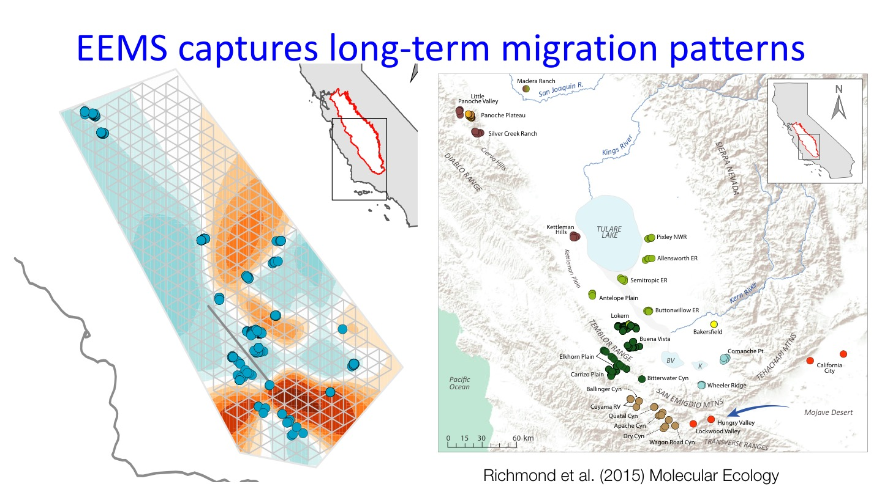

Slide 54
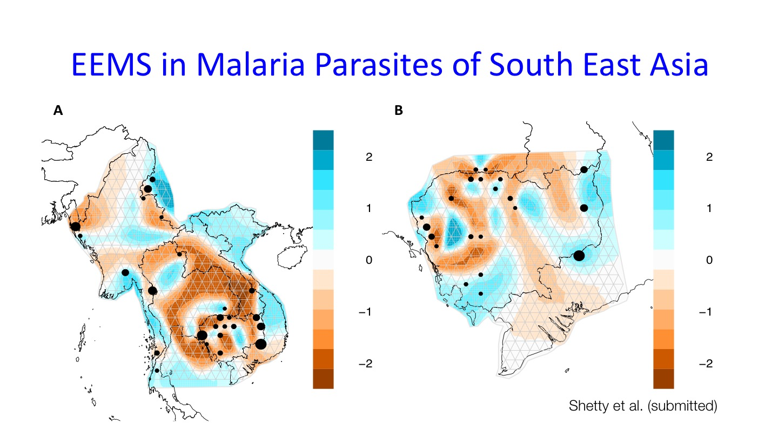
Shetty et al. (2019) Nature Communications

Slide 55
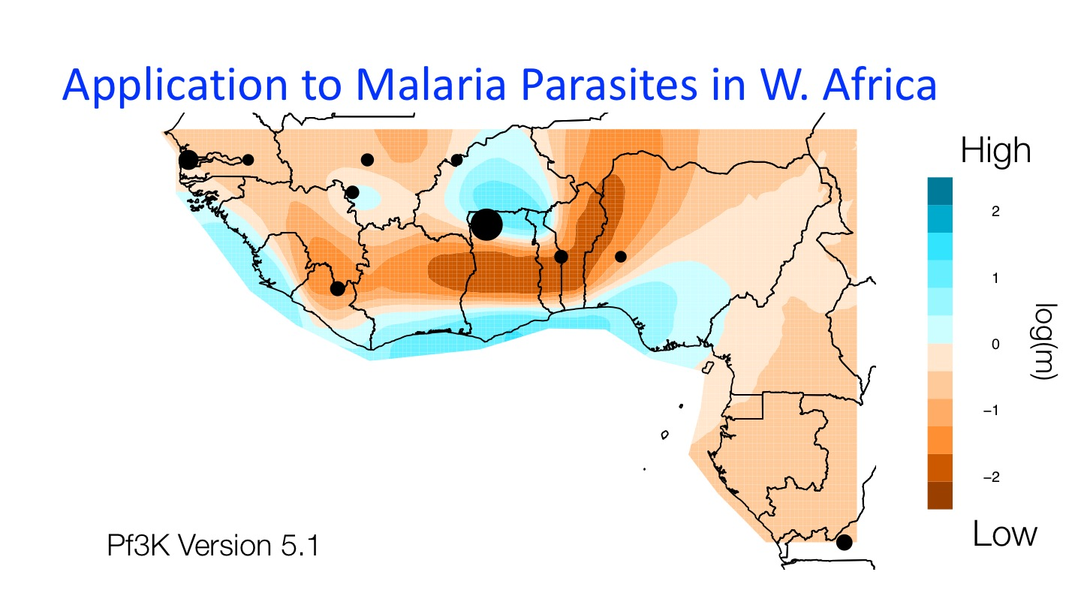

Slide 56
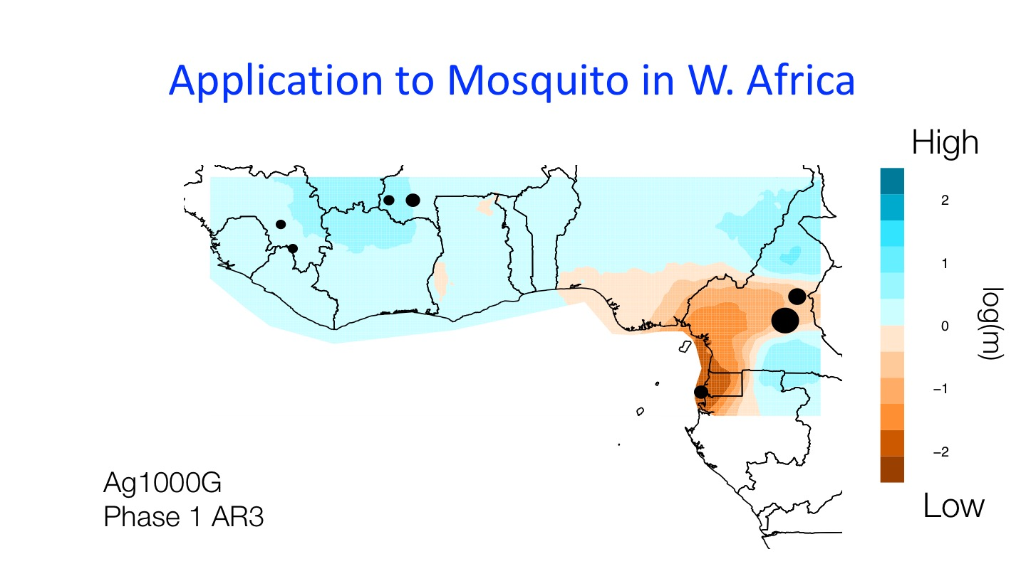

Slide 57
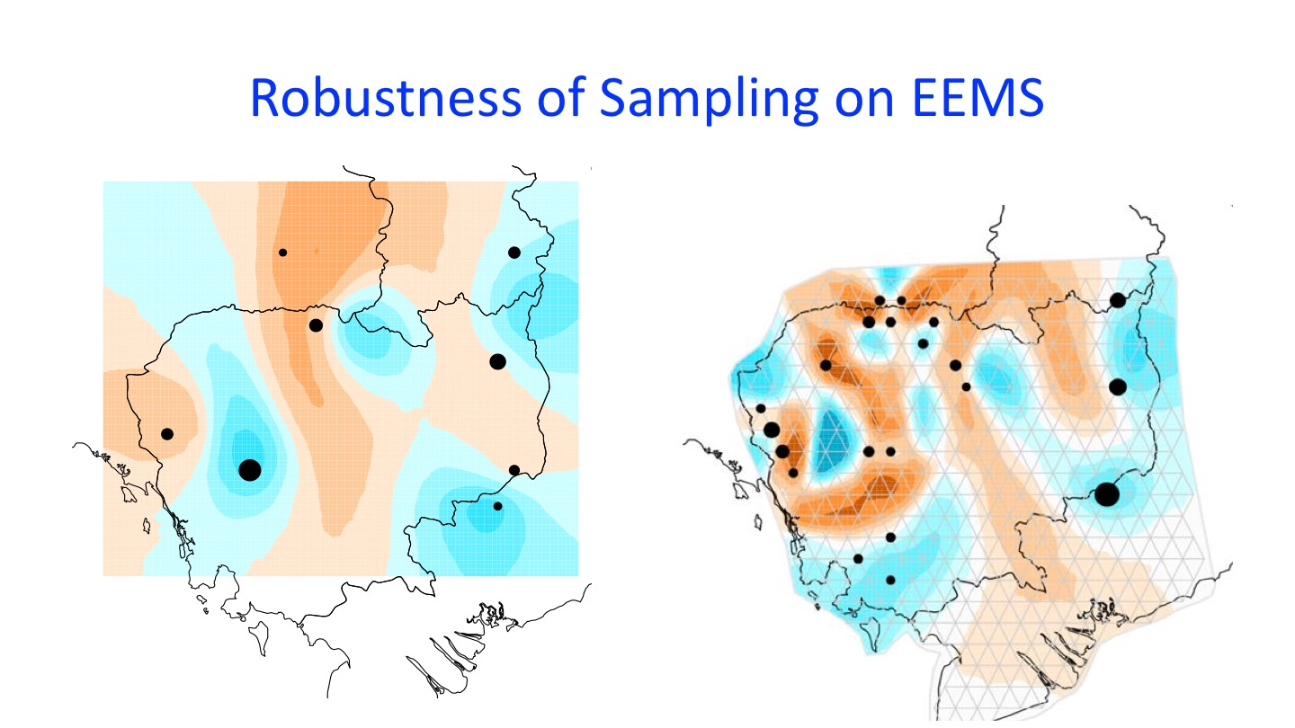

Slide 58
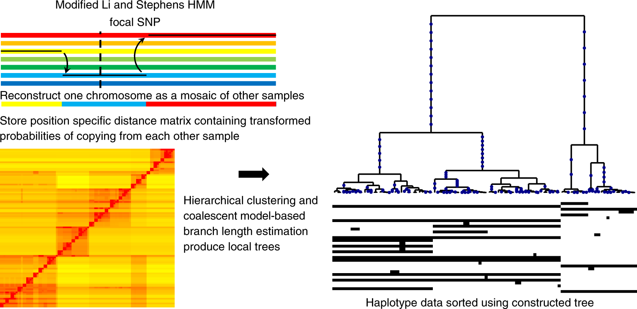
RELATE: a means of finding ancestral recombination graphs (ARGs)
Speidel et al. (2019) Nature Genetics

Slide 59
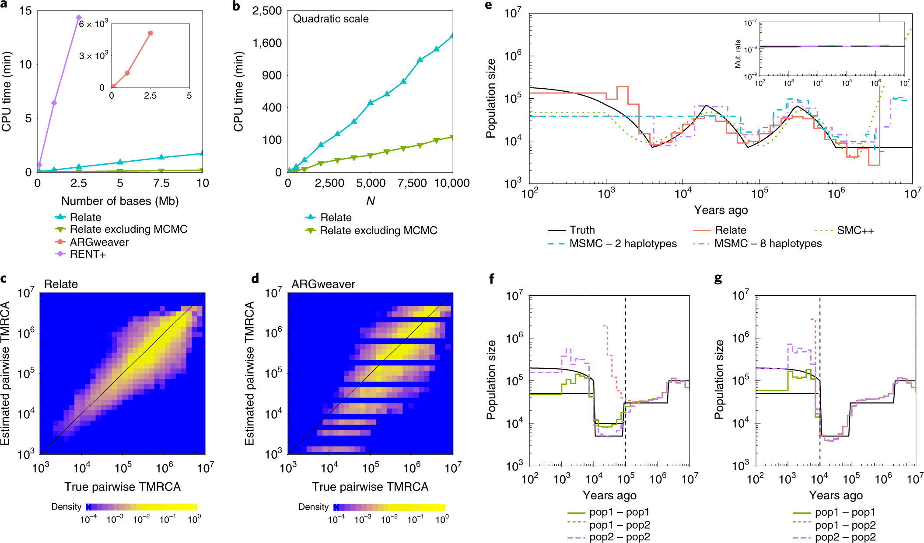
RELATE of course was tested with simulation!
Speidel et al. (2019) Nature Genetics

Slide 60
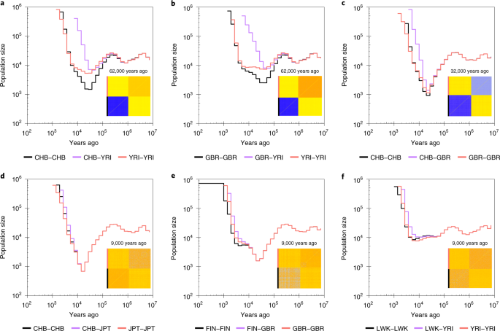
RELATE tested on 1000 Genomes Data
Speidel et al. (2019) Nature Genetics

Slide 61
Concluding summary
Fine-scale population structure is subdivisions of individuals on an ever increasingly granular scale
Identity-by-descent and rare variant sharing are a powerful methods of identifying recent relationships and can be scaled by time.
EEMS can visualize migration patterns on a fine-scale illustrating cryptic structure not observed with other methods
ARGs attempt to capture the full history for each site and across the genome

Slide 62
Questions?

