Slide 1


Introduction to Genetics and Genomics
1. Genes and Inheritance
2016
ggibson.gt@gmail.com
http://www.cig.gatech.edu

Slide 2
Course Outline
1. Genes and Inheritance (GG)
2. Molecular Biology of the Genome (JL)
3. Association Studies (GG)
4. Population and Evolutionary Genetics (JL)
Evolution and Disease Risk (JL) / Precision Medicine (GG)

Slide 3
Genotype and Phenotype
The genotype of an organism is the sequence of it’s genes.
The phenotype of an organism the way it appears.
In general, genes are not deterministic. Genotypic variation among organisms specifies the information that, in combination with the environment, influences the phenotype.
Pleiotropy refers to the ability of single genes to influence multiple phenotypes.
Penetrance is the proportion of individuals with a genotype who have the phenotype / disease.
Expressivity is the degree / severity of the phenotype in affected individuals.

Slide 4
Mendelian Genetics
A
A
a
a
x
F0: Pure breeding parents
A
a
A
a
x
F1: Heterozygous offspring
A
A
A
a
a
A
a
a
;
;
;
F2: Mendelain proportions of
Homozygotes + Heterozygotes

Slide 5
3 Models of Complex Disease
CDCV: Common Disease / Common Variant
The proposition that most disease susceptibility can be attributed to 10 to 20 loci, each of which explain around 5% of disease risk.
RAME: Rare alleles of Major Effect
The proposition that diseases are highly heterogeneous, with hundreds or thousands of rare mutations causing individual cases of disease.
Infinitesimal:
The proposition that we all carry thousands of very weak susceptibility alleles, and those unlucky enough to have too many are at highest risk, where rare variants or environmental triggers push us over the edge.

Slide 6
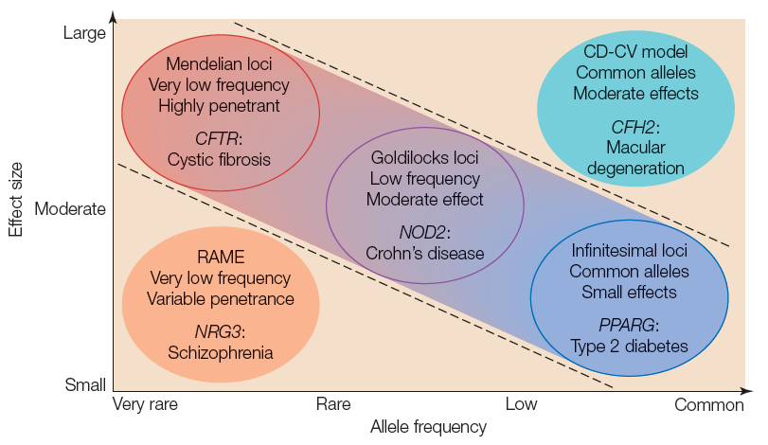
Models of the Genetics of Complex Traits
Manolio et al (2009) Nature 461: 747-753

Slide 7
Heritability
Heritability is the proportion of variance in a population that can be attributed to genotypic differences
h² = V_{G}/V_{P} where V_{P} = V_{G} + V_{E}
The phenotypes may be discrete, such as disease status; categorical, such as number of digits; or continuous, such as height or a biochemical measure.
1. Heritability is not a statement about individuals.
A heritability of 50% for diabetes does not imply that half the reason why someone is diabetic is genetic, the other half environmental. Rather, it suggests that there would be half as much diabetes in the population if everyone was genetically identical.
2. Heritability is only a statement about a single population.
A heritability of 80% for height does not imply that most of the average difference in height between populations is due to genetic differences. Heritability estimates alone should not be used to draw inferences about genetic divergence between groups.
3. Heritability is not the same as inheritance.
Inheritance is the correspondence between children and their biological parents. It can be due to environmental, including cultural, factors that are shared by family members, or to effects. The only way to confidently interpret heritability is to actually measure the genotypic contribution.
4. Very low heritability does not imply very little genetic contribution.
It may either be due to relatively high environmental variance (hence, a large demominator V_{P}), or to an absence of variance in the genes that contribute. Many important genes, including drug targets, are not polymorphic and will only be discovered through other types of approach including model organism research.

Slide 8
Dominance ratio

Slide 9
V_{P} = V_{A} + V_{D} + V_{I} + V_{GxE} + V_{E}
Loci are said to have Additive effects if the contributions of each individual allele can simply be added algebraically to arrive at a prediction of a phenotype given a genotype.
Dominance refers to the observation that heterozygotes resemble one class of homozygotes more than the other.
Epistasis refers to a locus-by-locus Interaction, such as when alleles at two loci antagonize or synergize with one another.
V_{E} is the environmental variance

Slide 10
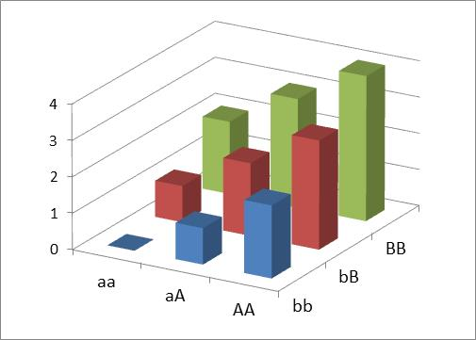
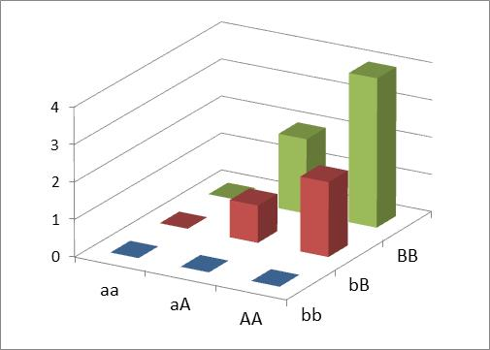
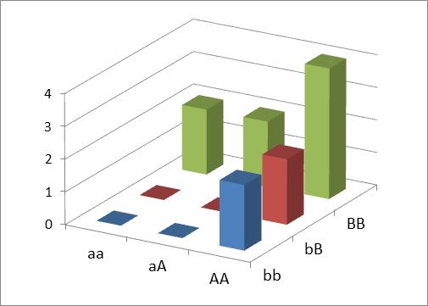
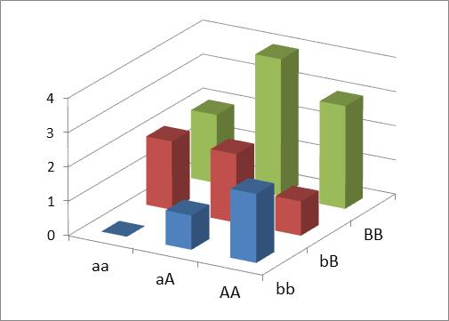
Broad Sense Heritability
V_{G} = V_{A} + V_{D}+ V_{I} + V_{G×E}
Narrow sense heritability is only the additive component whereas Broad sense heritability includes dominance, interaction and genotype-by-environment effects.
Additive
Multiplicative
Recessive
Epistatic

Slide 11
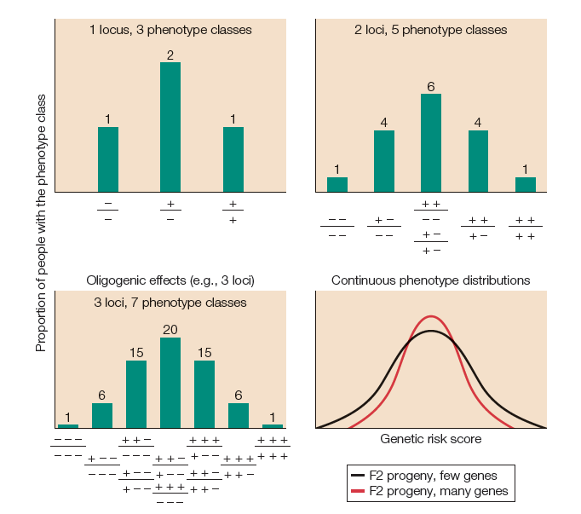
From Mendelian to Quantitative genetics

Slide 12
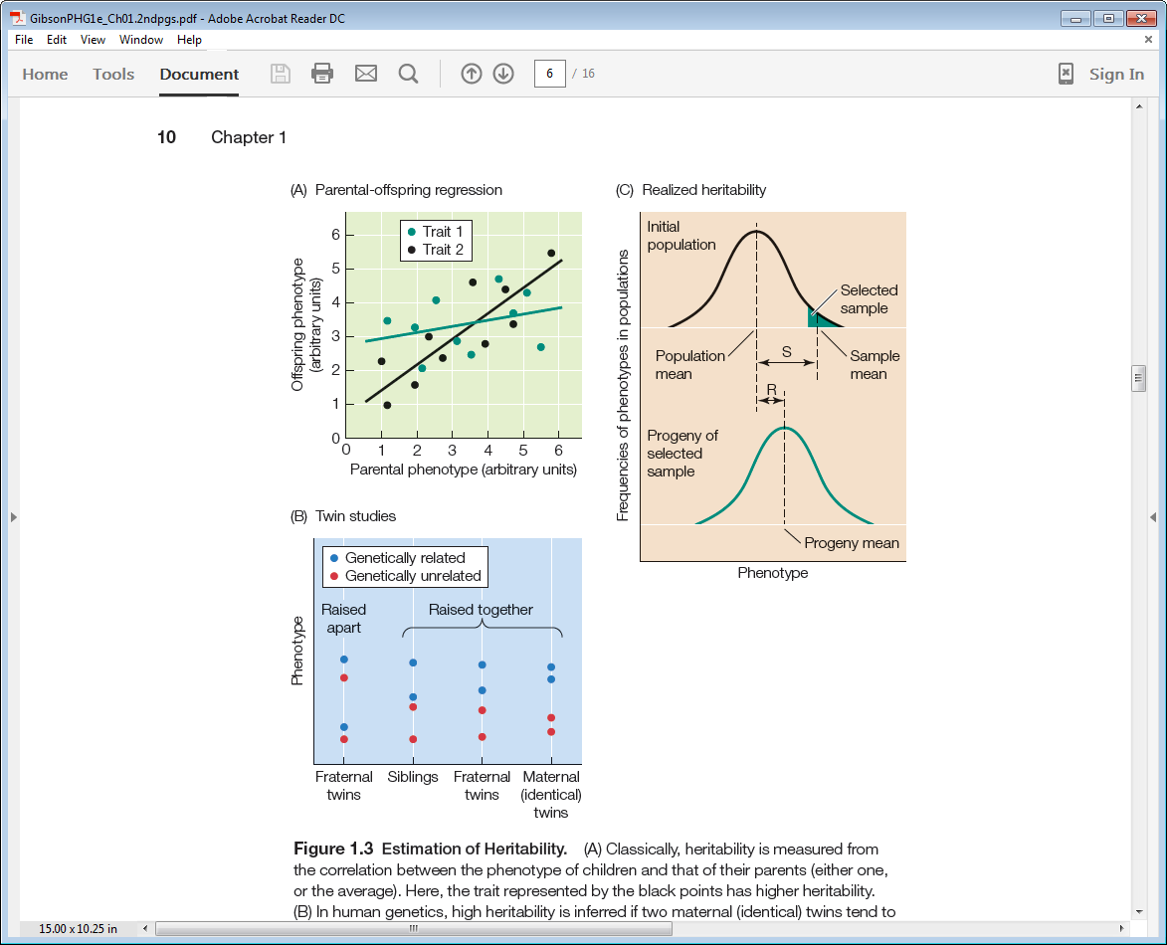
Estimating Heritability

Slide 13
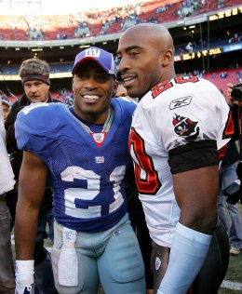
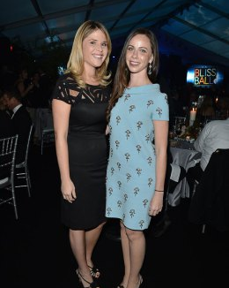
Twin Studies
Identical / Maternal
Dizygotic / Fraternal
Tiki and Ronde Barber
Jenna and Barbara Bush
r_{mz} = A + C
r_{dz} = ½A + C
A = Additive Genetic component; C = Common Environment (smaller if reared apart)
E = unique environment = 1 – r_{mz}
r_{dz} should be greater than r_{sib} since C is larger where the womb/upbringing is shared

Slide 14
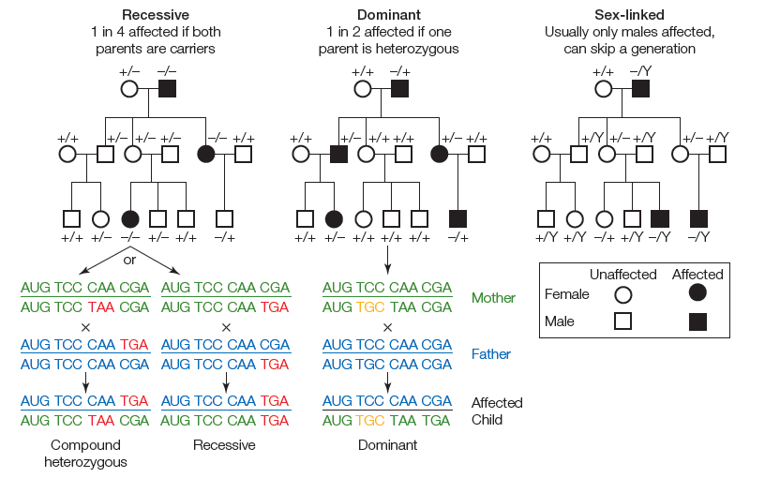
Mendelian Pedigree Studies

Slide 15
Monogenic Disorders
Approximately 1 in 3,700 Americans have Cystic Fibrosis
Assuming p² = 0.00027, then p = 0.016, the mutant allele frequency
That is, 1 in 30 people are carriers (which is 120 times as many people as have CF),
that is, 3% of Caucasians are carriers, and less than 0.03% sufferers.
It is very likely that someone in this class is a carrier of a CF mutation
A CF carrier has a 1 in 30 chance of marrying another carrier by chance, and
1 in 4 of their children will be expected to have CF, and only half of all 2-child families will have an affected child
There are hundreds of similar conditions (rare recessives with p ~ 0.01), so we are all carriers for multiple Mendelian disease genes. Collectively, as many as 1 in 25 couples should expect to be dual carriers for a recessive Mendelian disorder, corresponding to an approximate 1% affected rate in all children
Around 1 in 400 children have an inherited Inborn Error of Metabolism, namely an enzyme deficiency affecting amino acid, lipid or other organic molecule biosynthesis. For example:
  Phenylketonuria 1/15,000 mental retardation syndrome
  Galactosemia 1/40,000 liver dysfunction and cataracts
  Gaucher’s Disease 1/60,000 facial dysmorphology, liver disease
  Zellweger Syndrome 1/50,000 seizures, low muscle tone
  Lesch-Nyhan Syndrome 1/380,000 self-inflicted injury, gout / kidney disease

Slide 16
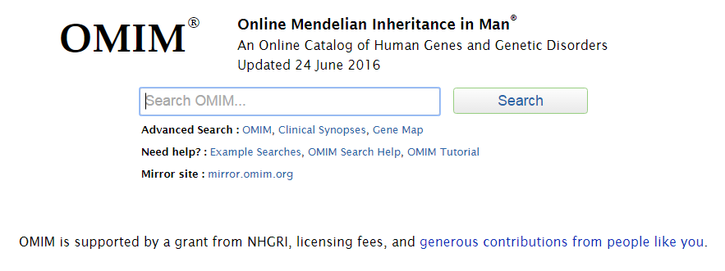

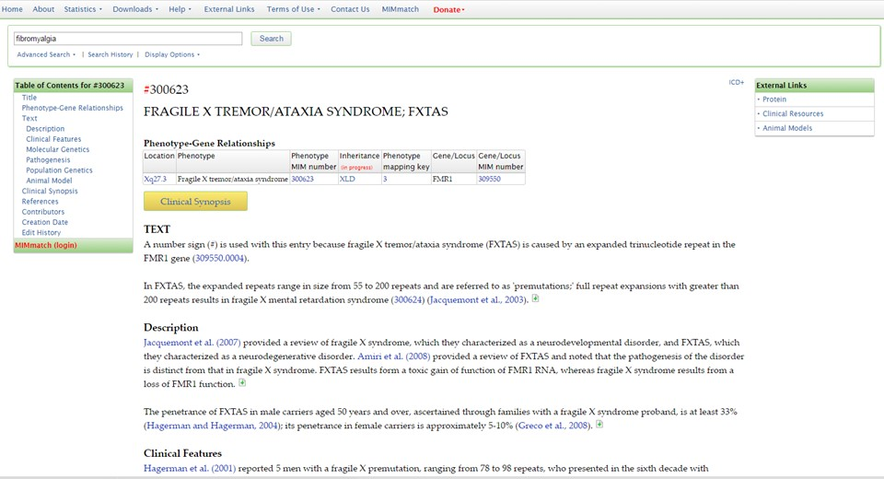
Online Mendelian Inheritance in Man (OMIM)

Slide 17
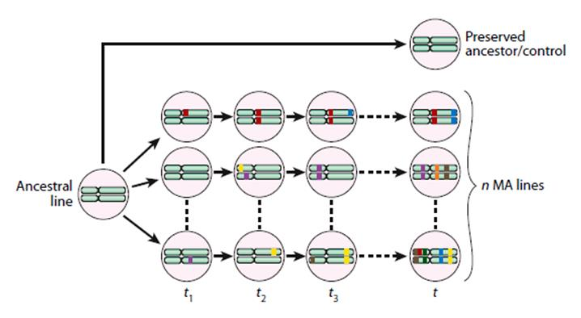
Mutation Accumulation
G60
G30
G0
Frequency
0.9 0.95 1.0
Mean Line viability
In each generation, slightly deleterious mutations add ~ 0.1% of the standing environmental variance to the heritability of traits, also reducing viability.
Halligan and Keightley (2009) Annu Rev Ecol Evol Syst. 40: 151-172

Slide 18
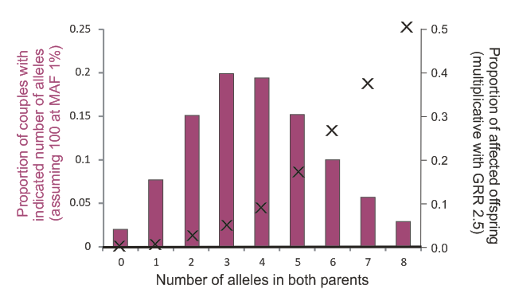
Multiplicative Rare Alleles of Major Effect
Assume there are 100 mutations at 1% frequency, each of which increases the
risk of disease 2.5-fold over a baseline environmental risk of 1%.
Whence 0 alleles have a risk of 1%, 1 of 2.5%, 2 of 6%, 3 of 15%, 4 of 39%, 5 or more is highly penetrant.

Slide 19
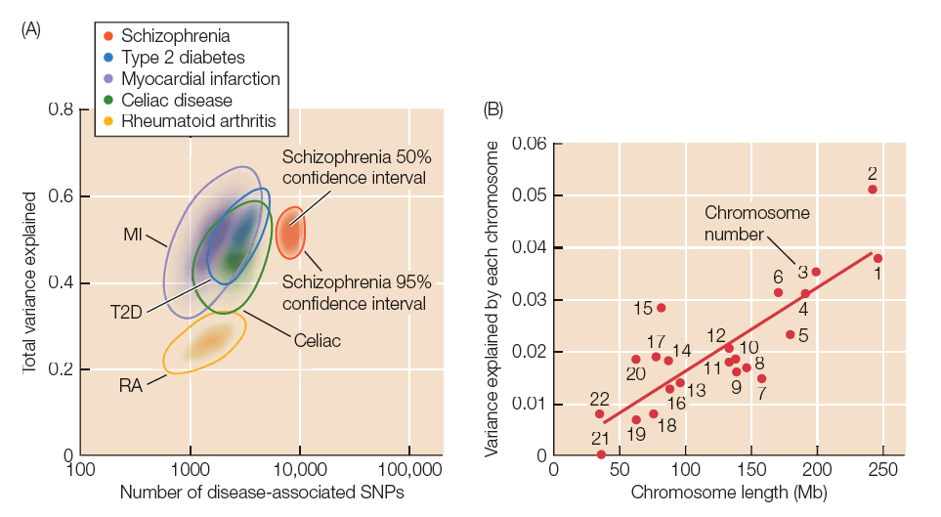
The Infinitesimal Model Triumphs – for now

Slide 20
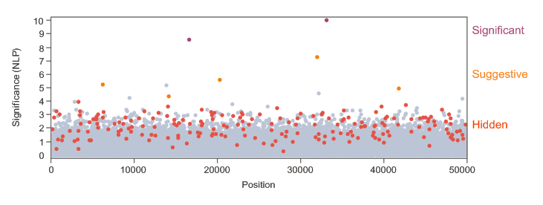
The Complexity of Disease Risk
The missing heritability problem is that variants discovered by GWAS only explain a minor fraction of the expected heritability. This may be because:
The effect sizes are much smaller than previously thought (GRR 1.1 rather than 2)
Narrow sense heritability has been over-estimated in pedigree studies
It is rare, not common, variants, that contribute most of the variation
Epigenetic inheritance accounts for much of the resemblance among relatives
Broad sense heritability is prevalent, but hard to detect
Genotyping chips do not tag causal variants effectively enough

