Slide 1


Introduction to Genetics and Genomics
3. Association Studies
2016
ggibson.gt@gmail.com
http://www.cig.gatech.edu

Slide 2
Outline
General overview of association studies
Sample results
Three steps to GWAS:
primary scan, replication, fine mapping

Slide 3
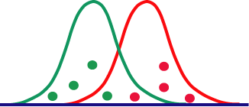
Principle of Association Studies
Individual Site Score
1 A T C C G A 9
2 A C T C G A 8
3 A C C A - G 3
4 T T C A G A 5
5 A T C A G A 2
6 A C C C - G 7
7 T C T A - G 4
8 A T C C G A 8
Individual Site Score
1 A T C C G A 9
2 A C T C G A 8
3 A C C A - G 3
4 T T C A G A 5
5 A T C A G A 2
6 A C C C - G 7
7 T C T A - G 4
8 A T C C G A 8
Individual Site Score
1 A T C C G A 9
2 A C T C G A 8
3 A C C A - G 3
4 T T C A G A 5
5 A T C A G A 2
6 A C C C - G 7
7 T C T A - G 4
8 A T C C G A 8
Individual Site Score
1 A T C C G A 9
2 A C T C G A 8
3 A C C A - G 3
4 T T C A G A 5
5 A T C A G A 2
6 A C C C - G 7
7 T C T A - G 4
8 A T C C G A 8
Are the phenotype scores associated with each class of SNP drawn from the same or different distributions ?

Slide 4
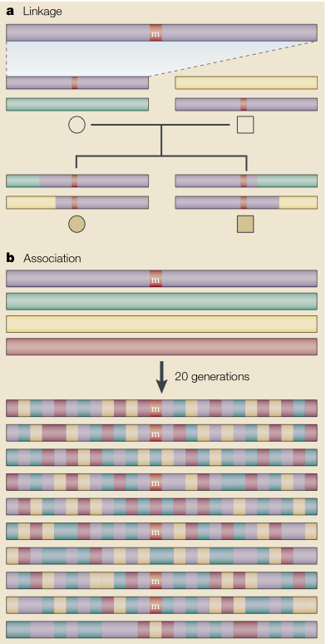
Linkage versus Association
Linkage examines recent recombination events in a pedigree:
- over just several generations
- large chromosomal regions detected
- no information on allele frequency
Association examines historical recombination events in a population:
- basically a 10,000 generation pedigree
- resolution to single genes
- estimates effect size and frequency
Cardon & Bell. 2003. Nat. Rev. Genet. 2:91

Slide 5
Why LD happens
A
A
A
A
A
T
T
T
C
C
G
G
G
A
A
T
T
T
T
T
A
A
A
A
G
T
C
C
C
C
A
A
A
A
A
T
T
C
C
C
G
G
G
G
A
T
T
T
T
T
G
G
G
G
G
T
T
T
T
T
A
A
A
G
G
T
T
T
C
C
When a mutation occurs, by definition it is only on one chromosome and hence
“associated” with the genotypes elsewhere on that chromosome.
Over time, the mutation increases in frequency and becomes a polymorphism.
It remains in LD with the genotypes on the chromosome it appeared on.
Eventually recombination breaks up the LD, in proportion to genetic distance.

Slide 6
Measurement of LD
LD is the non-random association of genotypes.

Slide 7
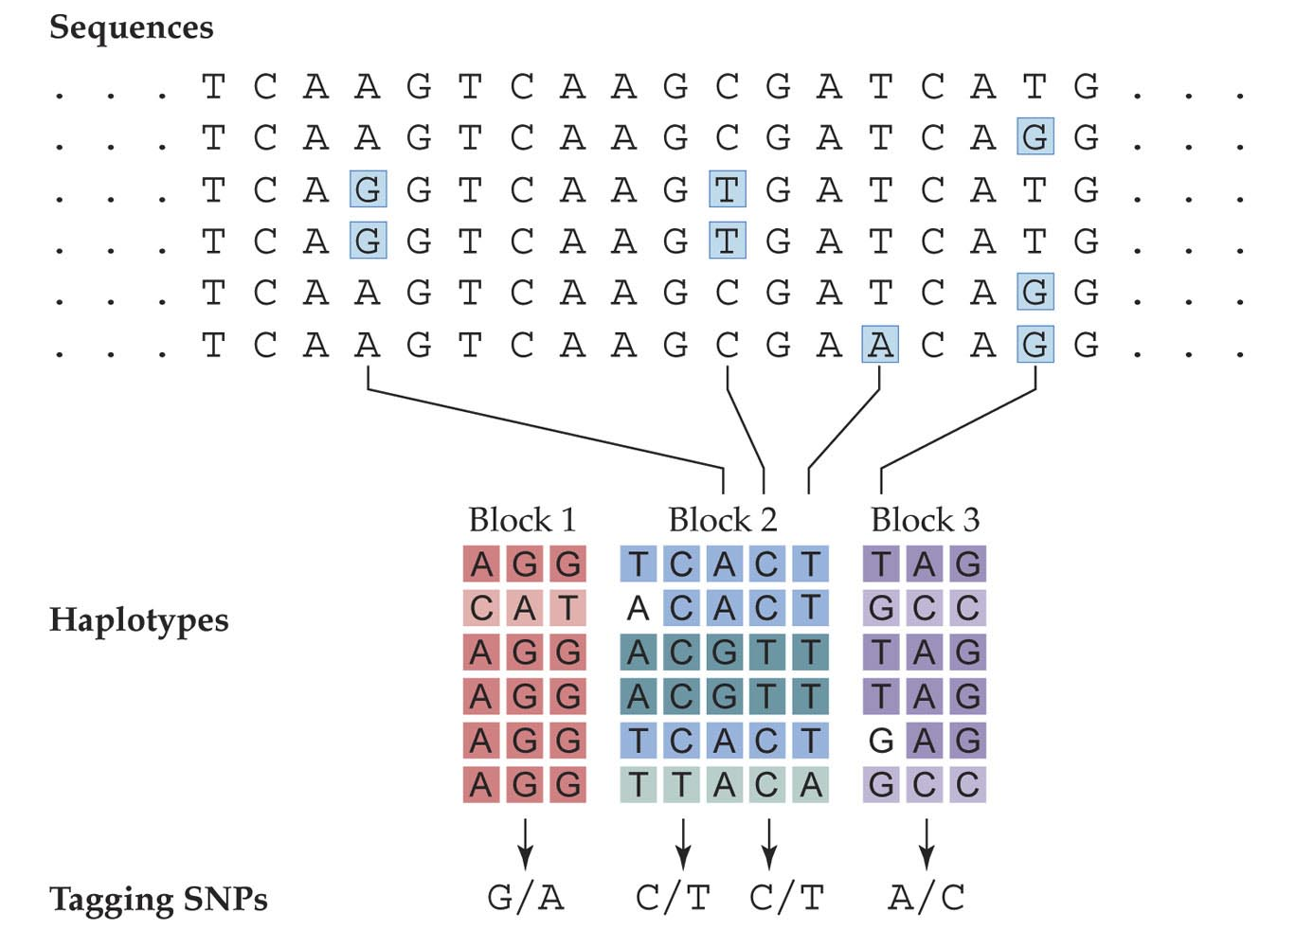
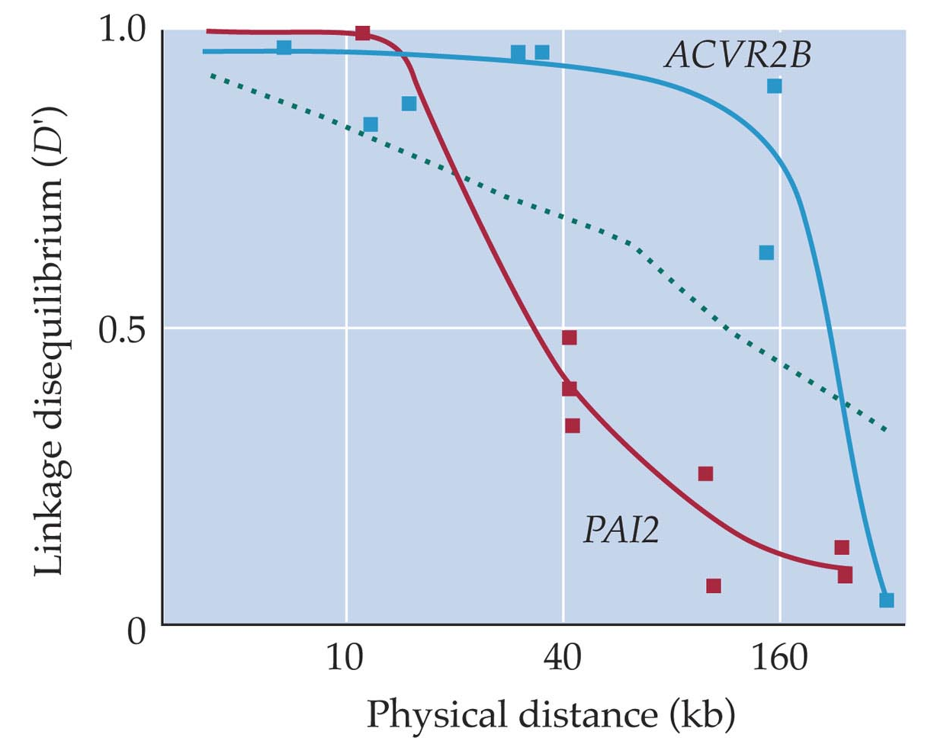
Haplotypes and Tagging SNPs

Slide 8
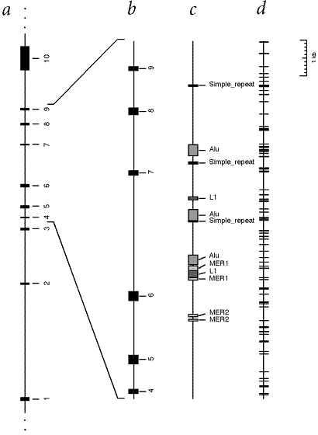
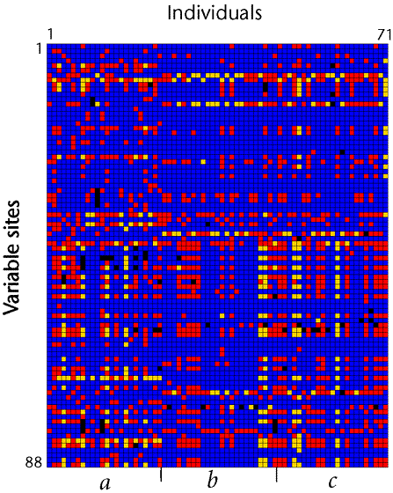
LPL example
African Finnish Minnesota

Slide 9
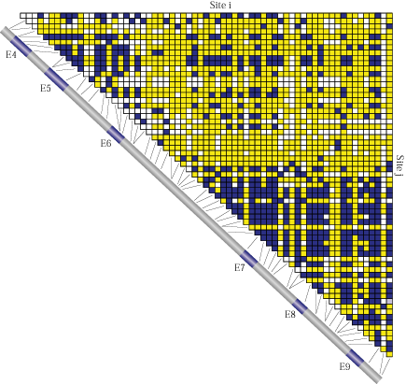
LD plots

Slide 10
Key Parameters for LD Mapping
Polymorphism: Flies 1/30 bp, 10×> Human 1/kb
Haplotype structure/LD:
Fly LD decays over 200 bp, Human LD decays over 100 kb
Population structure:
  Panmixia and clinality v. Structure and admixture
Allele frequencies:
    Much more power for common alleles (infinitesimal model)

Slide 11

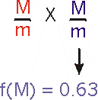
Case-Control and TDT designs
Observed Expected
Allele M Allele m Allele M Allele m
Affected 34 278 61 265
Unaffected 69 256 62 269
χ² = 14.0 P <0.001
Transmitted Allele
M m
Observed 78 46
Expected 62 62
χ² = 8.2 P < 0.001

Slide 12
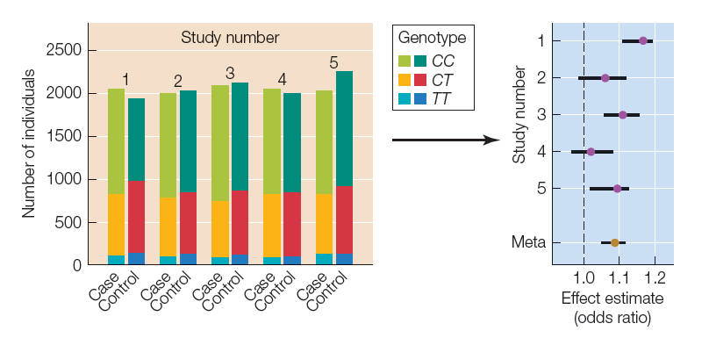
Repeatability and Forest Plots

Slide 13
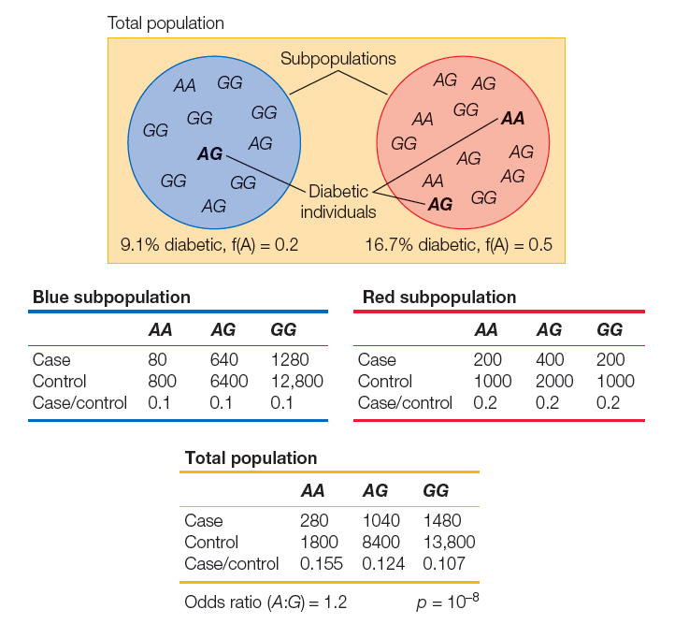
Population Structure

Slide 14
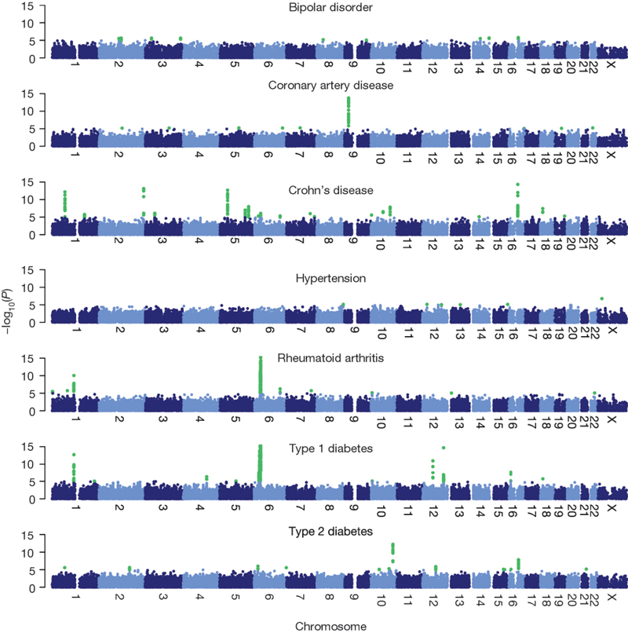
The Genetics of 7 Diseases
GWAS first appeared 24 months ago, now several new diseases each month
Inflammatory diseases show multiple associations, with some common variants (notably the MHC)
Depression and Hypertension show nothing: likely no variants with a relative risk greater than 1.5

Slide 15
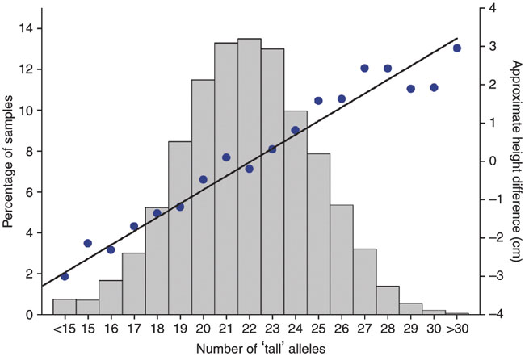
The Genetics of Height
700 loci clearly influence height in combined analysis of 250,000 people
Diverse roles:
Hedgehog signalling
Chromatin structure
Cell cycle regulation
Extracellular matrix deposition
Possible contribution of some of these loci to osteoarthritis, cancer, athleticism
Half the genes have at least two independent associations
But … they only explain 15% of the variation for height (one fifth of the heritability)

Slide 16
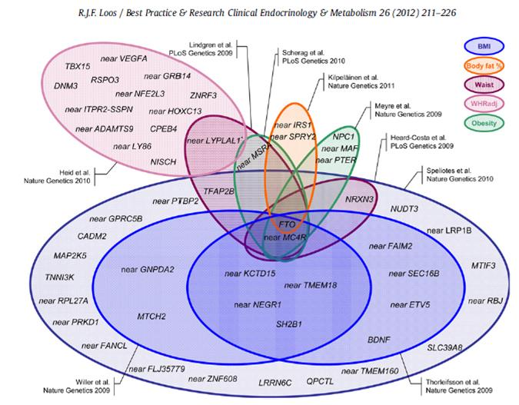
The Genetics of Obesity
Heritability of obesity ~ 60%
2/3 Americans BMI > 25
One gene, FTO, is repeatedly associated with BMI, hip circumference and weight, in most human populations
Homozygote classes differ in weight by up to 2 kg
Study of 230,000 people →
49 loci for WHR, many linked to adipose, insulin biology 20 loci only in women
Study of 340,000 people →
97 loci for BMI, many linked to neuronal function
Little overlap with WHR

Slide 17
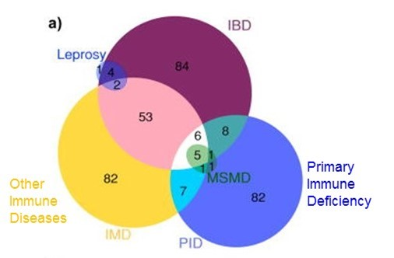
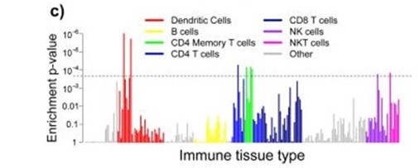
The Genetics of IBD
Inflammatory Bowel Disease affects ~1% of adults either as Crohn’s or Ulcerative Colitis
Two genes, IL23R and NOD2, each explain 1% of the variance
Another 160 genes each explain less than 0.25% of it
Strongly overlap with PID and other autoimmune diseases
Vast majority are in immune function genes, and ongoing efforts suggest activity in specific immune cell types

Slide 18
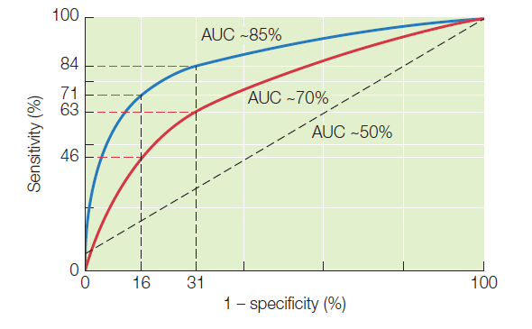
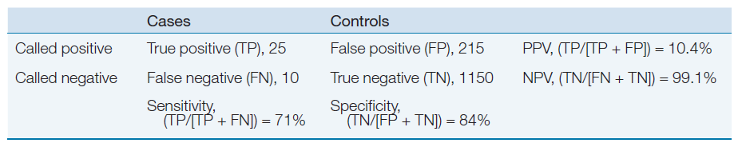
Prediction, Specificity, and Sensitivity

Slide 19
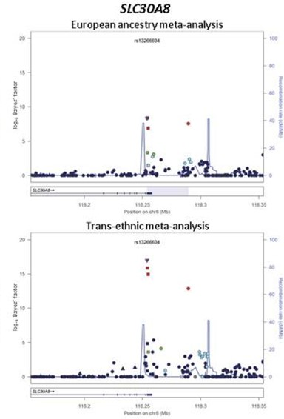
The Genetics of Type 2 Diabetes
54 established Fasting Glucose or Fasting Insulin loci tend to have pancreatic islet cell functions
23 replicate in African Americans in Trans-ethnic analyses
TCF7L2 is the strongest risk locus for T2D in Caucasians. The ancestral allele is the risk allele: it is found in 90% of Africans, 40% of Europeans, and just 5% of Asians
Considering the top 18 loci:
1% of CAU have >24 alleles
2% of CAU have <12 alleles
They differ 4-fold in odds of T2D

Slide 20
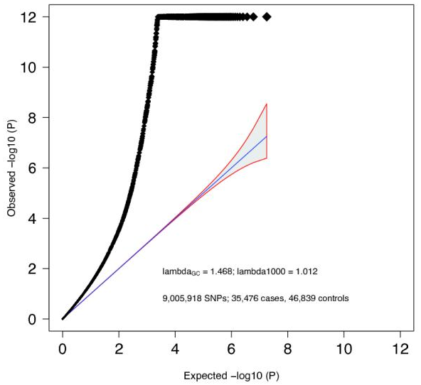
The Genetics of Schizophrenia
128 independent SNP associations from GWAS of 37,000 cases
Strong enrichment in genes expressed in certain neuronal cell types or implicated in synaptic transmission
But at least 5% of cases attributable to CNV: copy number variation
3 major chromosomal deletions of >100kb at frequency <1% are almost exclusively found in schizophrenics

Slide 21
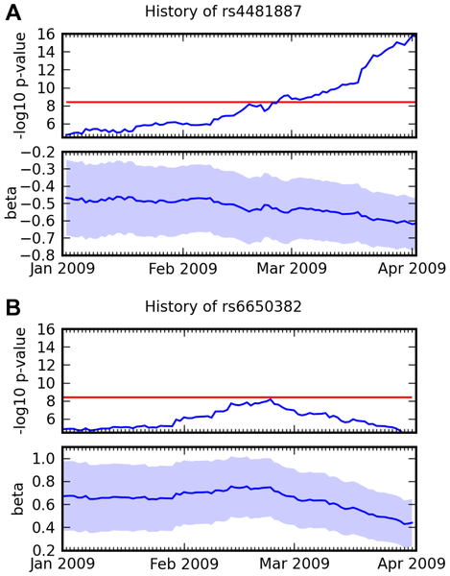
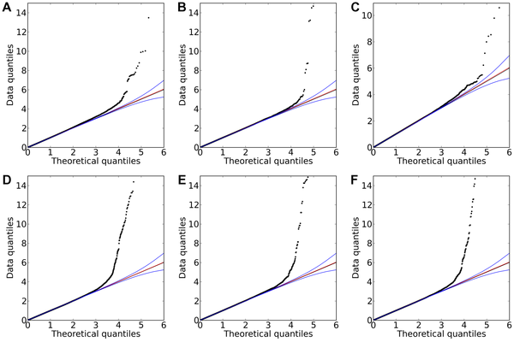
23andme studies
Other interesting traits:
Endurance Runner vs Sprinter
(30% of people change their answer if they know their ACTN3)
Left vs Right Handedness
(nothing striking)
Have you ever needed braces or wisdom teeth surgery?
Breast size (finds breast cancer risk loci)
Hand-clasp dominance …
Hair curl
Asparagus
anosmia
Photic sneeze
reflex
Freckling
Hair color
Red hair
Eriksson et al, (2010) PLoS Genetics 6: e1000993

Slide 22
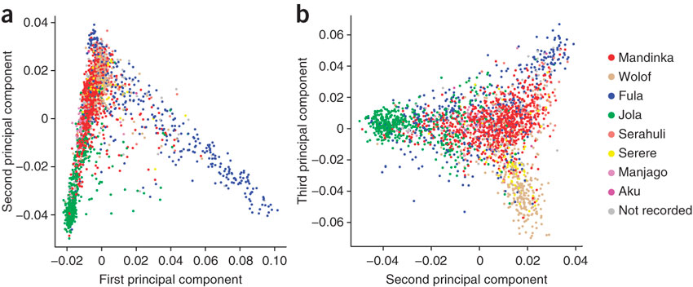
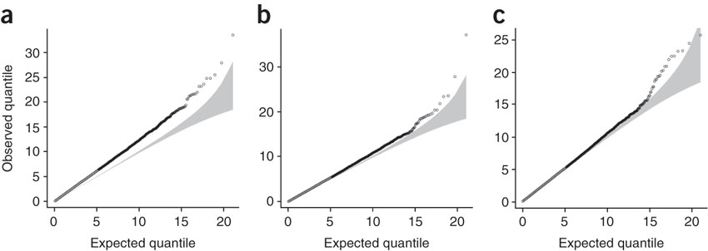
Genetics of malaria susceptibility
The Gambia
Population structure
Raw Self-report PC adjusted

Slide 23
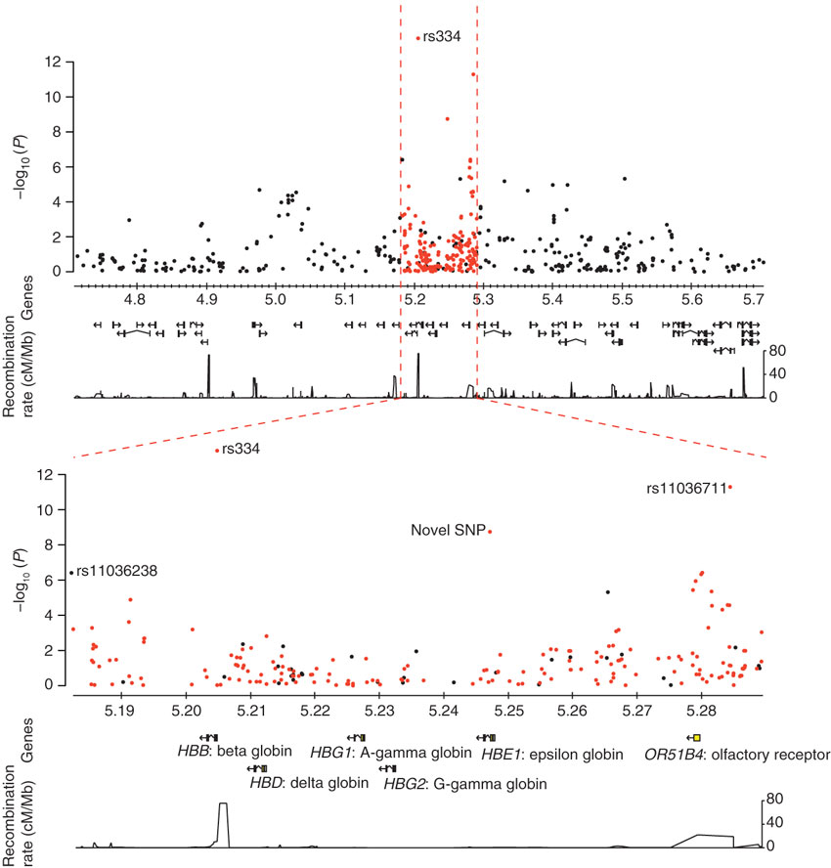
Imputation and resequencing
Black SNPs on 550K genotyping panel; red ones imputed after sequencing a subset of participants
rs334 is the HbS sickle cell variant that explains 2% of malaria susceptibility
Direct typing rs334 yields NLP > 27! The original hit rs11036238 is not strictly GWAS

Slide 24
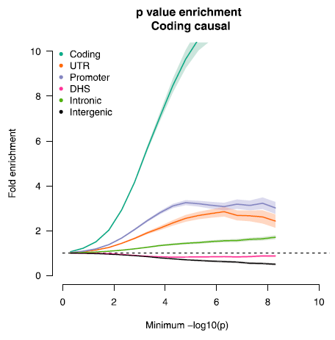
Partitioning Heritability
Most GWAS variants are regulatory

Slide 25
Some references
The Wellcome Trust Case Control Consortium (2007) Genome-wide association study of 14,000 cases of seven common diseases and 3,000 shared controls. Nature 447: 661-678
Ioannidis, J.P., G. Thomas and M.J. Daly (2009) Validating, augmenting and refining genome-wide association signals. Nature Reviews Genetics 10: 318-329
Shungin, D. et al. (2015) New genetic loci link adipose and insulin biology to body fat distribution. Nature 518: 187-196.
Locke, A.E. et al (2015) Genetic studies of body mass index yield new insights for obesity biology. Nature 518: 197-206.
Wood, A.R., et al (2014) Defining the role of common variation in the genomic and biological architecture of adult human height. Nature Genetics 40: 575-583
Jostins, L. et al (2012) Host-microbe interactions have shaped the genetic architecture of inflammatory bowel disease. Nature 491: 119-124.
DIAbetes Genetics Replication And Meta-analysis (DIAGRAM) Consortium. (2014) Genome-wide trans-ancestry meta-analysis provides insight into the genetic architecture of type 2 diabetes susceptibility. Nature Genetics 46: 234-244.
Schizophrenia Working Group of the Psychiatric Genomics Consortium. (2014) Biological insights from 108 schizophrenia-associated genetic loci. Nature 511: 421-427.
Gusev, A. et al (2015) Partitioning heritability of regulatory and cell-type-specific variants across 11 common diseases. Am J Hum Genet 95: 535-552.
Jallow, M. et al (2009) Genome-wide and fine-resolution association analysis of malaria in West Africa. Nature Genetics 41: 657-665
Visscher, P.M, Brown, M.A., McCarthy, M.I., and Yang, J. (2012) Five years of GWAS discovery. Am J Hum Genet. 907-24.

