Slide 1
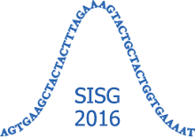
Introduction to Genetics and Genomics
4. Population and Evolutionary Genetics
lachance.joseph@gmail.com
https://popgen.gatech.edu/

Slide 2
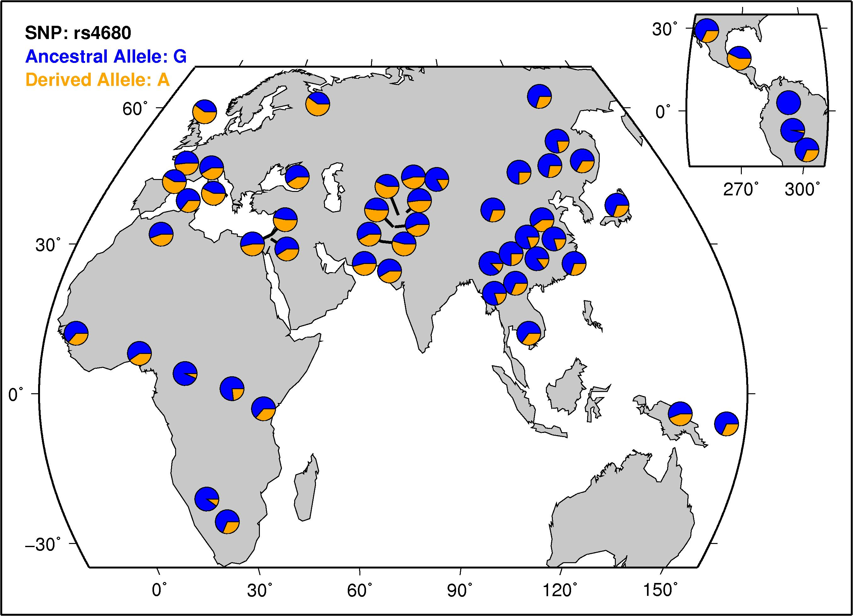
Case Study #1
COMT (catechol-O-methyltransferase) and test-taking anxiety
What is wrong with this claim?
“Some scholars have suggested that we are all Warriors or Worriers. Those with fast-acting dopamine clearers are the Warriors, ready for threatening environments where maximum performance is required. Those with slow-acting dopamine clearers are the Worriers, capable of more complex planning. Over the course of evolution, both Warriors and Worriers were necessary for human tribes to survive. In truth, because we all get one COMT gene from our father and one from our mother, about half of all people inherit one of each gene variation, so they have a mix of the enzymes and are somewhere in between the Warriors and the Worriers. About a quarter of people carry Warrior-only genes, and a quarter of people Worrier-only.”
Why Can Some Kids Handle Pressure While Others Fall Apart?
Po Bronson and Ashley Merryman, New York Times, February 6, 2013

Slide 3
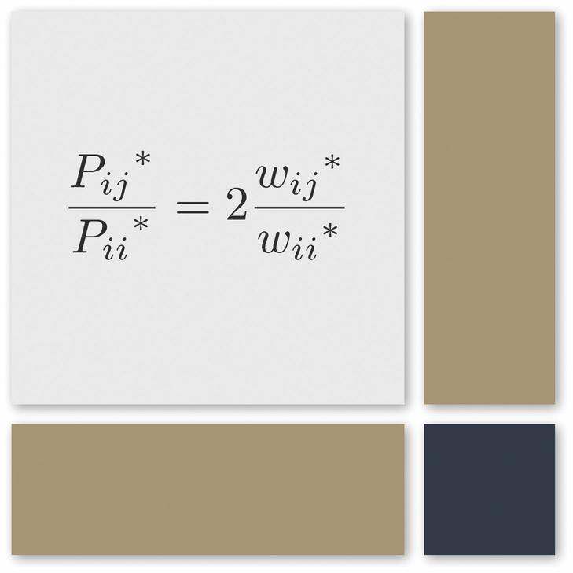
Clearing up some common misconceptions
Dominant alleles need not be the major (most common) allele
Higher fitness alleles need not be major allele
Higher fitness alleles are not always dominant (and vice versa)

Slide 4
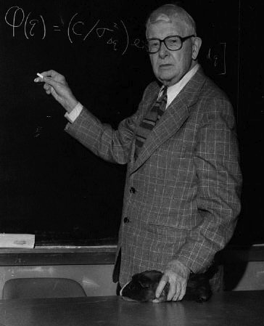
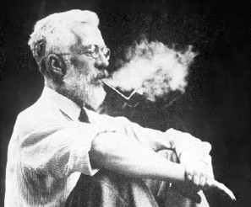
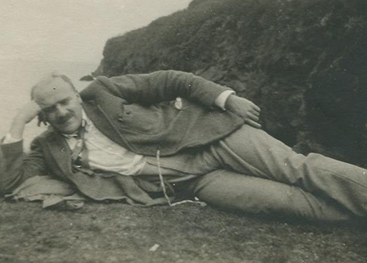
Giants of population genetics
RA Fisher
JBS Haldane
Sewall Wright
Used mathematics to describe the genetics of populations
Integrated evolutionary biology and Mendelian genetics
Neo-Darwinism and the Modern Synthesis

Slide 5

Gene pool
Definition: the totality of the genes in a population
Each individual contributes to a pool of gametes
Contributions to the gene pool are weighted by fitness
Genotypes next generation found by binomial sampling (w/ replacement)

Slide 6
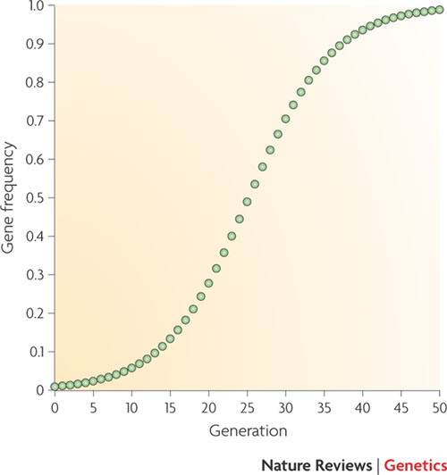
Allele and genotype frequency space
Allele frequency
Allele and genotype frequencies sum to one
A diploid population can be represented by a point in genotype frequency space
Allele and genotype frequencies can be tracked over time
When alleles are rare most copies are found in a heterozygous state

Slide 7
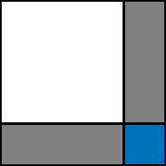
Hardy-Weinberg principle
p² + 2pq + q² = 1
p: frequency of A allele
q: frequency of a allele
p²: frequency of AA homozygotes
2pq: frequency of Aa heterozygotes
q²: frequency of aa homozygotes
Modified Punnett Square
p
q
p
p²
pq
q
pq
q²

Slide 8
Hardy-Weinberg principle
Allele frequencies used to calculate genotype frequencies
Equilibrium reached in a single generation
(so long as assumptions hold)
Assumptions
  Infinite population size
  No selection
  No mutation
  No migraton
  Random mating
p
q
p
p²
pq
q
pq
q²

Slide 9
Hardy-Weinberg example
Initial genotype frequencies: P_{AA}=0.8, P_{AB}=0, P_{BB}=0.2 Initial allele frequencies: p=0.8, q=0.2
After one generation: P_{AA}=0.64, P_{AB}=0.32, P_{BB}=0.04 AIlele frequencies: p=0.8, q=0.2
After another generation: P_{AA}=0.64, P_{AB}=0.32, P_{BB}=0.04 AIlele frequencies: p=0.8, q=0.2

Slide 10
Testing for departures from HW proportions
Chi-square test with 1 degree of freedom
χ² > 3.84 indicates statistical significance (p-value < 0.05)
Example:
Genotype | Observed | Expected | χ²
AA | 145 | 131.31 | 1.426
AB | 68 | 95.37 | 7.854
BB | 31 | 17.32 | 10.815
Total | 244 | 244 | 20.095

Slide 11
Major processes of population genetics
Genetic drift
Natural selection
Mutation
Migration (gene-flow)
Mating structure
These processes are mechanisms of evolution
Additional factors:
  Recombination (and linkage), gene conversion, ploidy, dominance, epistasis, developmental constraints

Slide 12
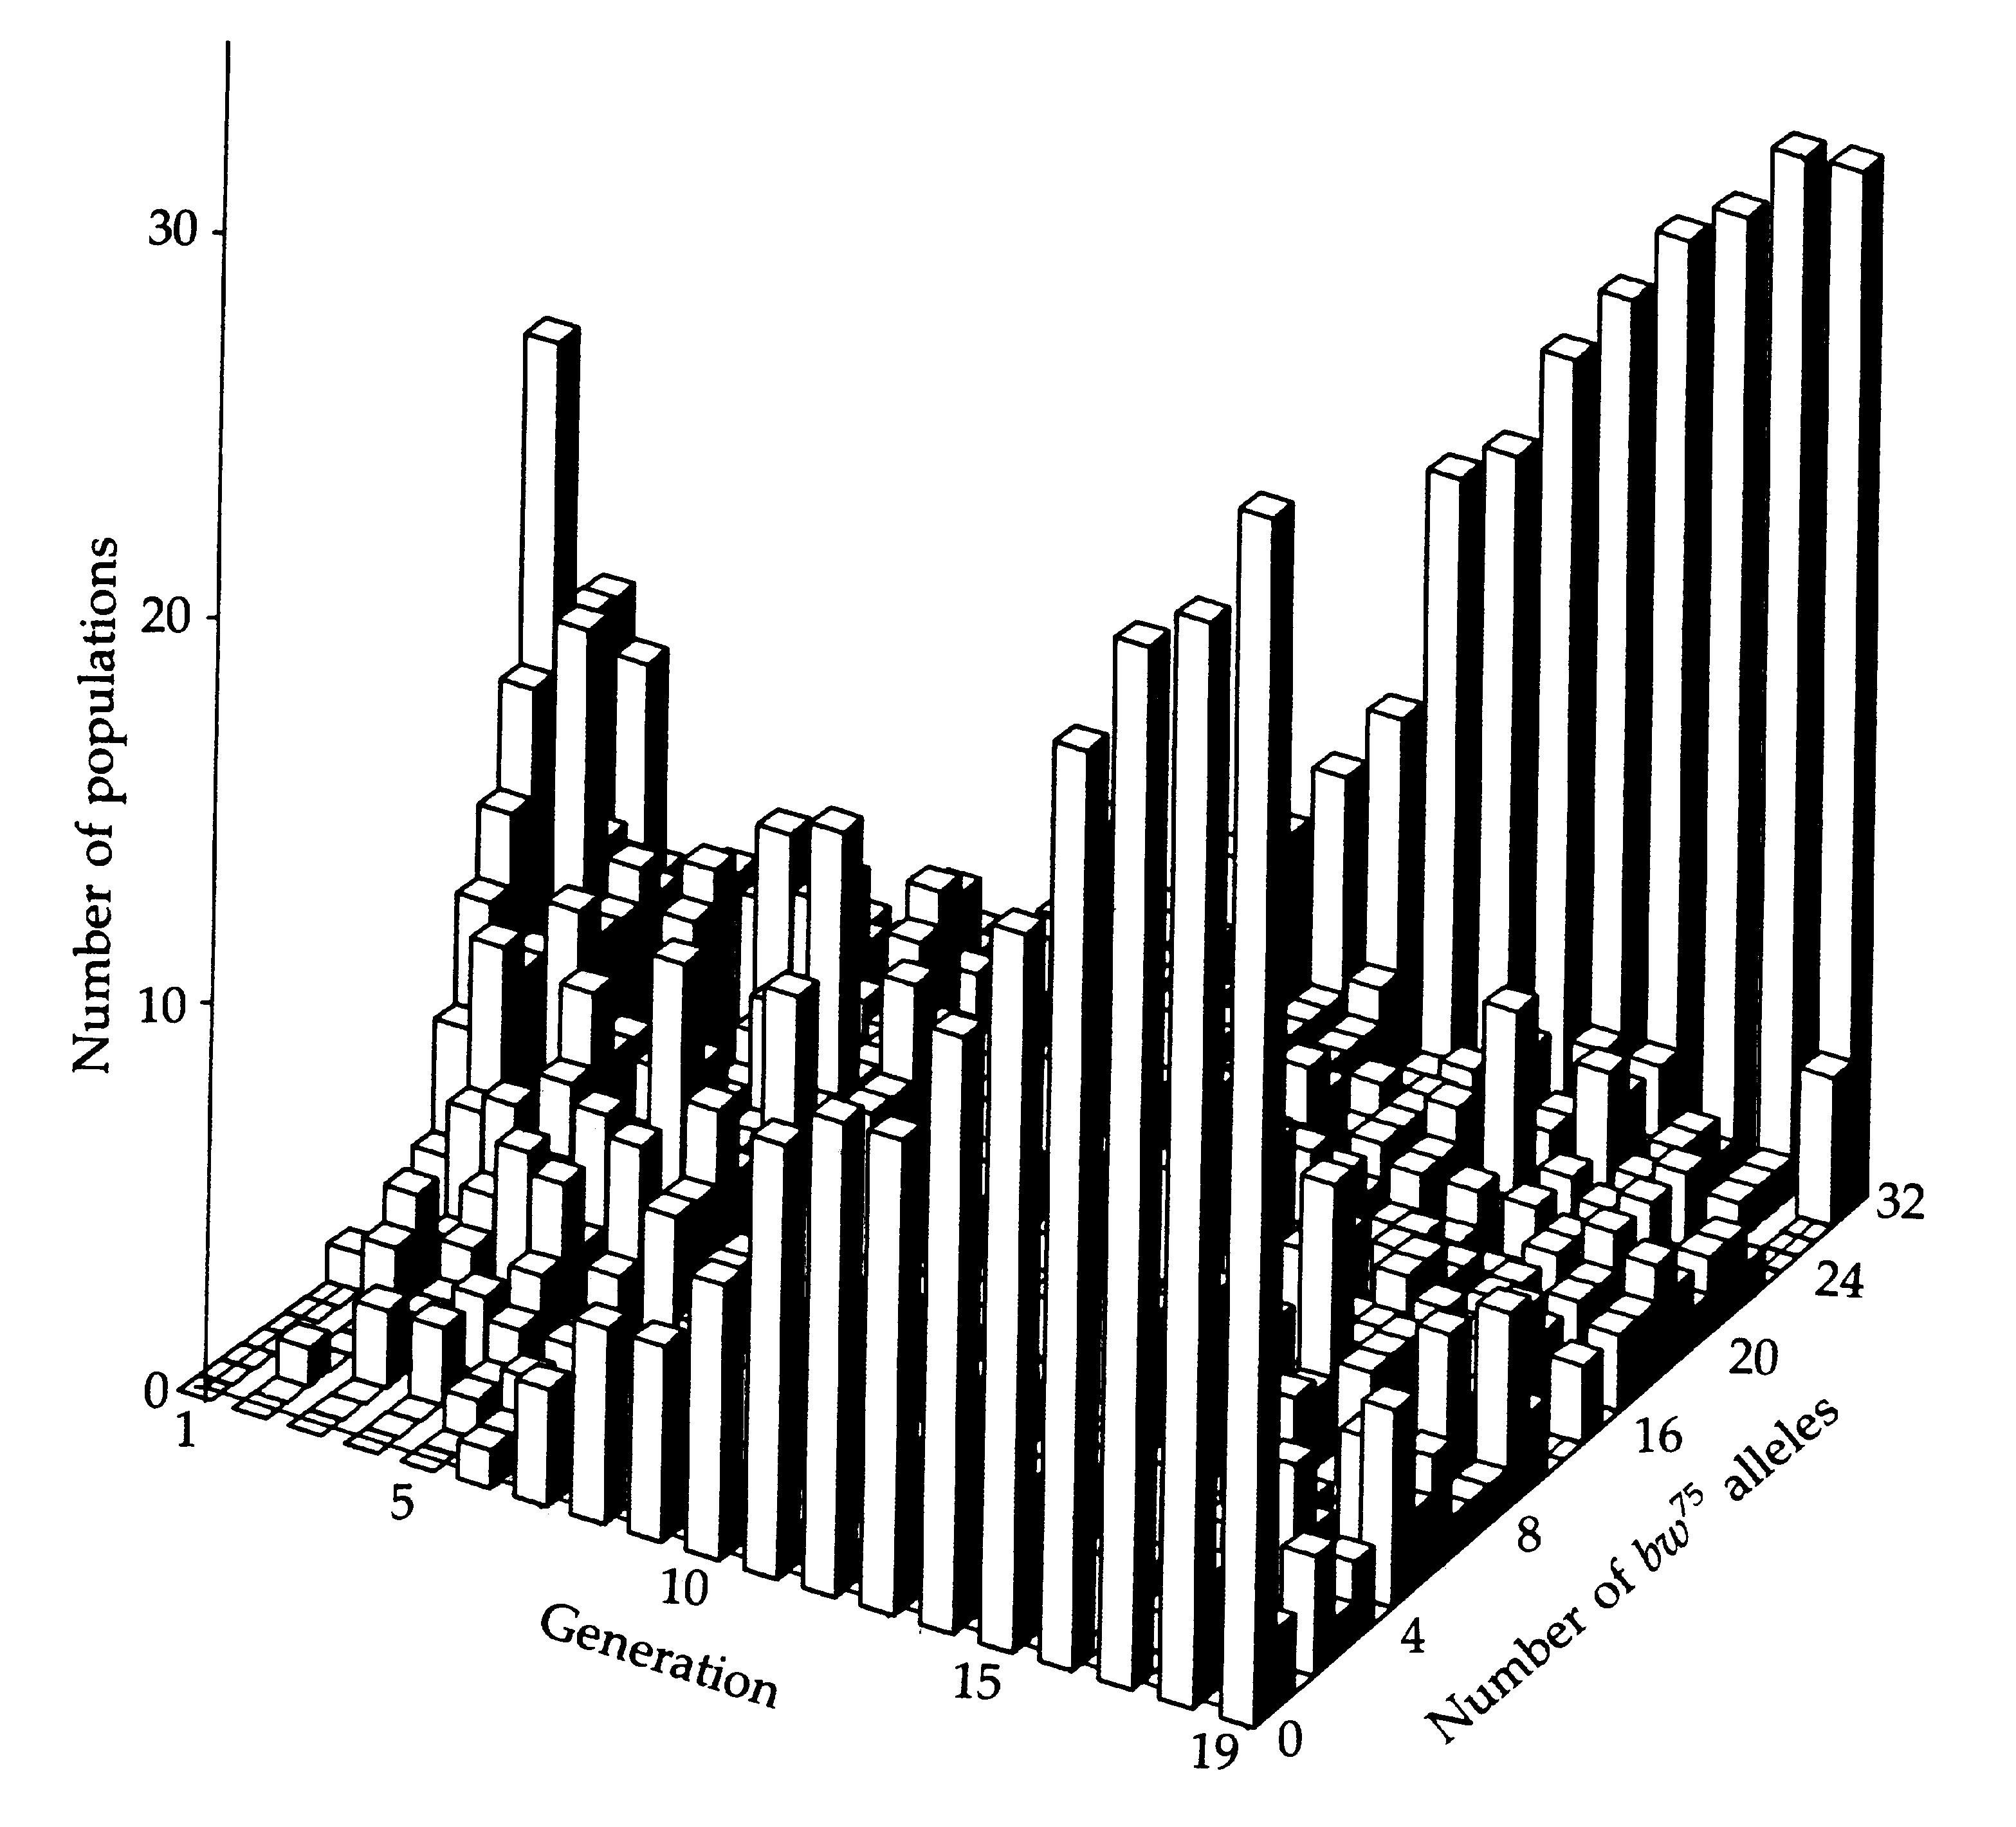
Random genetic drift
In small populations there is a decay of heterozygosity:
The net effect of drift is to reduce the amount of genetic variation segregating in a population
Buri’s 1956 experiment:
107 replicate population cages with segregating alleles at the brown locus (D. melanogaster)
Figure from Hartl and Clark (1989) Principles of Population Genetics Sinauer, Sunderland, MA.

Slide 13
Random genetic drift
Random walks through allele frequency space
Genetic drift is stronger in small populations
Can lead to differentiation between isolated populations
Relatively slow process (relative to selection)
  Mean time for new mutation to reach fixation = 4N generations

Slide 14
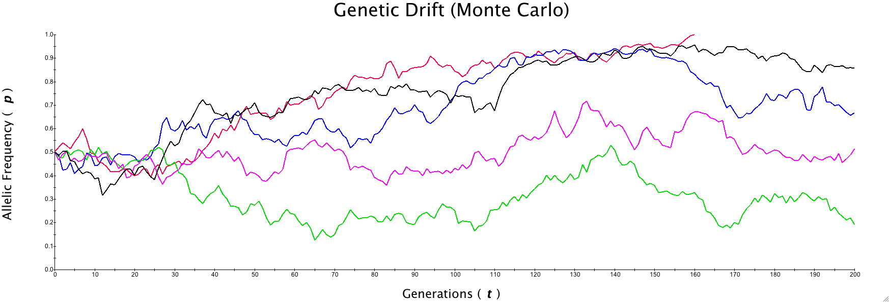

Simulations of genetic drift

Slide 15
Genetic drift and effective population size
Effective population size (N_{e}): The idealized (haploid) population size that behaves the same way with respect to drift as a population of size N
N_{e} due to unequal sex ratio
N_{e} due to variance in reproductive success
N_{e} due to changing population size
Caveat: N_{e} is a descriptive term, and two populations with the same effective population size can have quite different dynamics

Slide 16
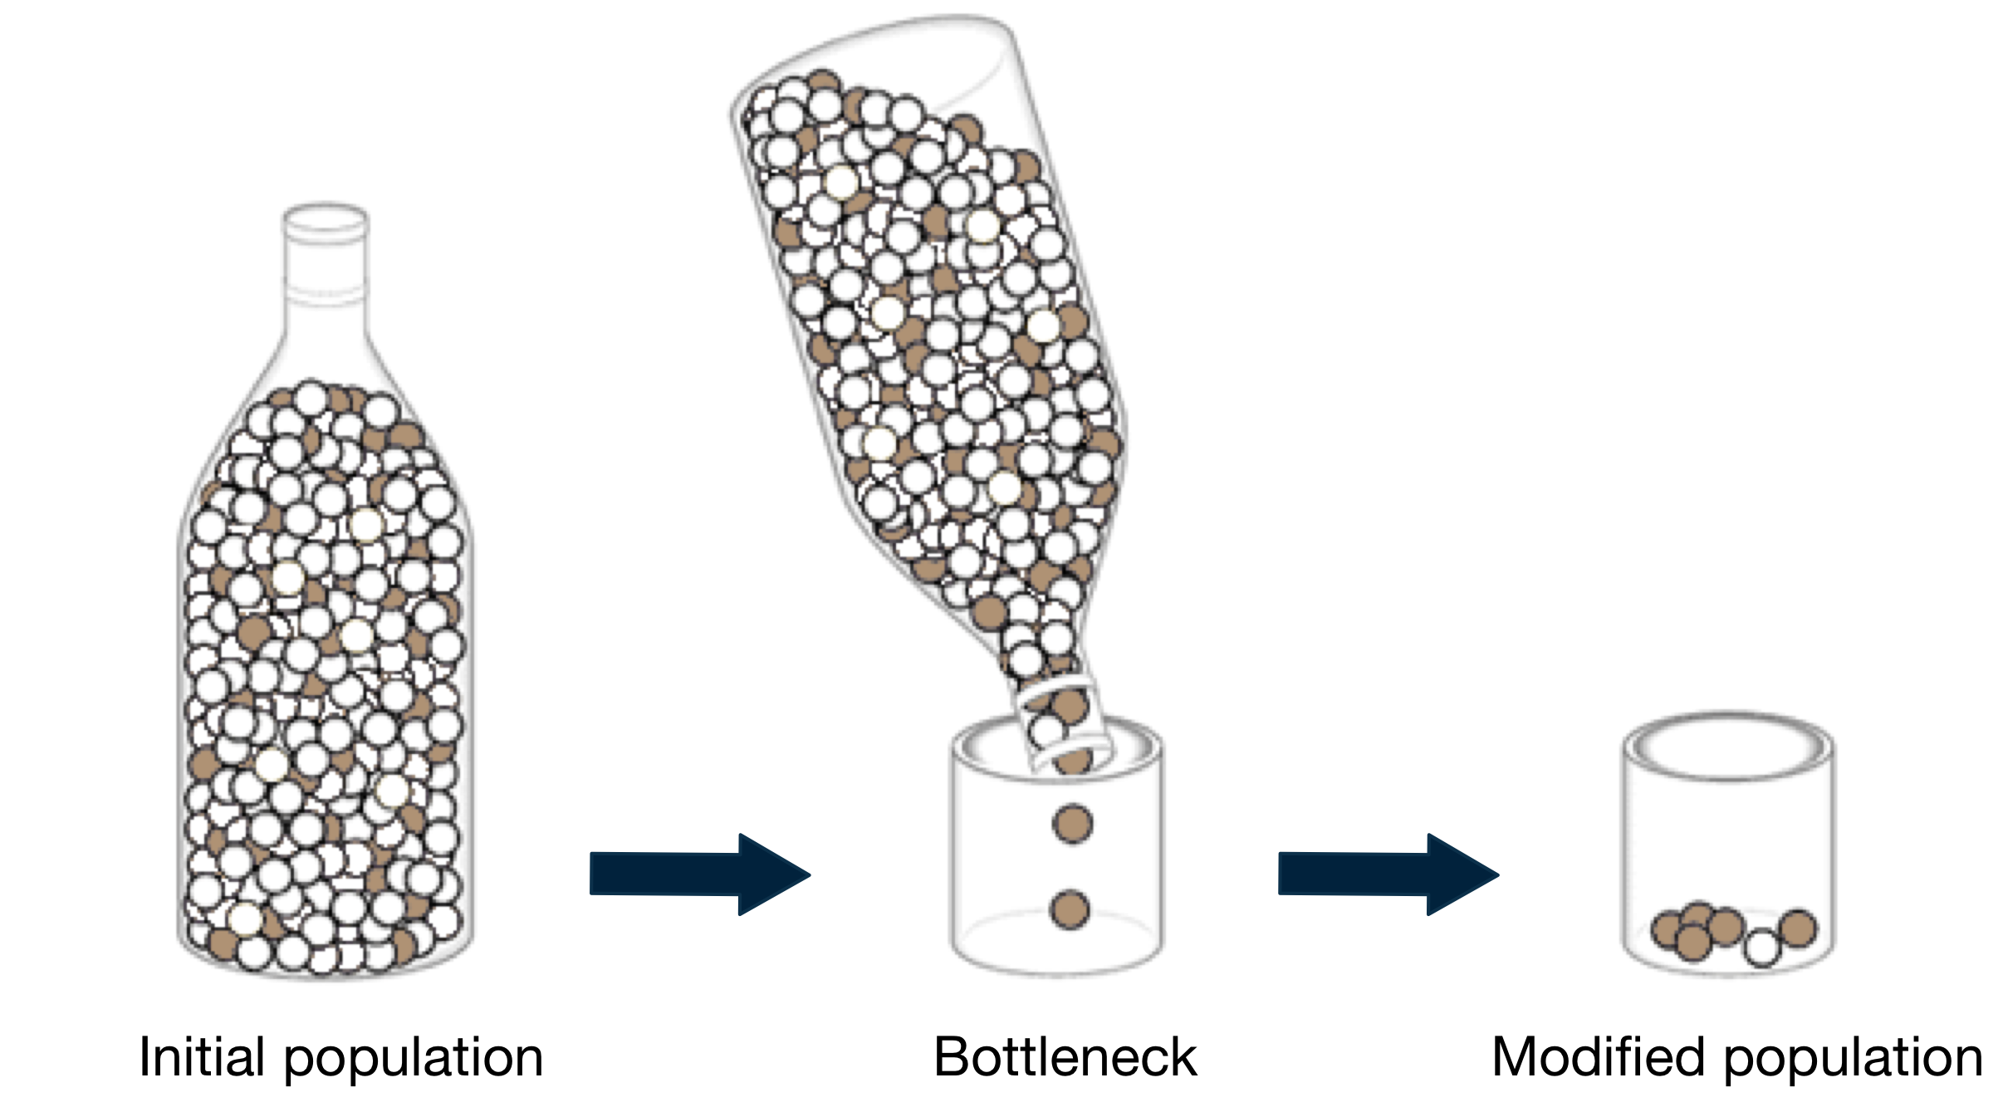
Population bottlenecks and founder effects
Population bottleneck: A sharp reduction in the size of a population
Founder effect: Bottleneck caused by the founding of a new population
Random chance determines whether an allele increases or decreases in frequency

Slide 17
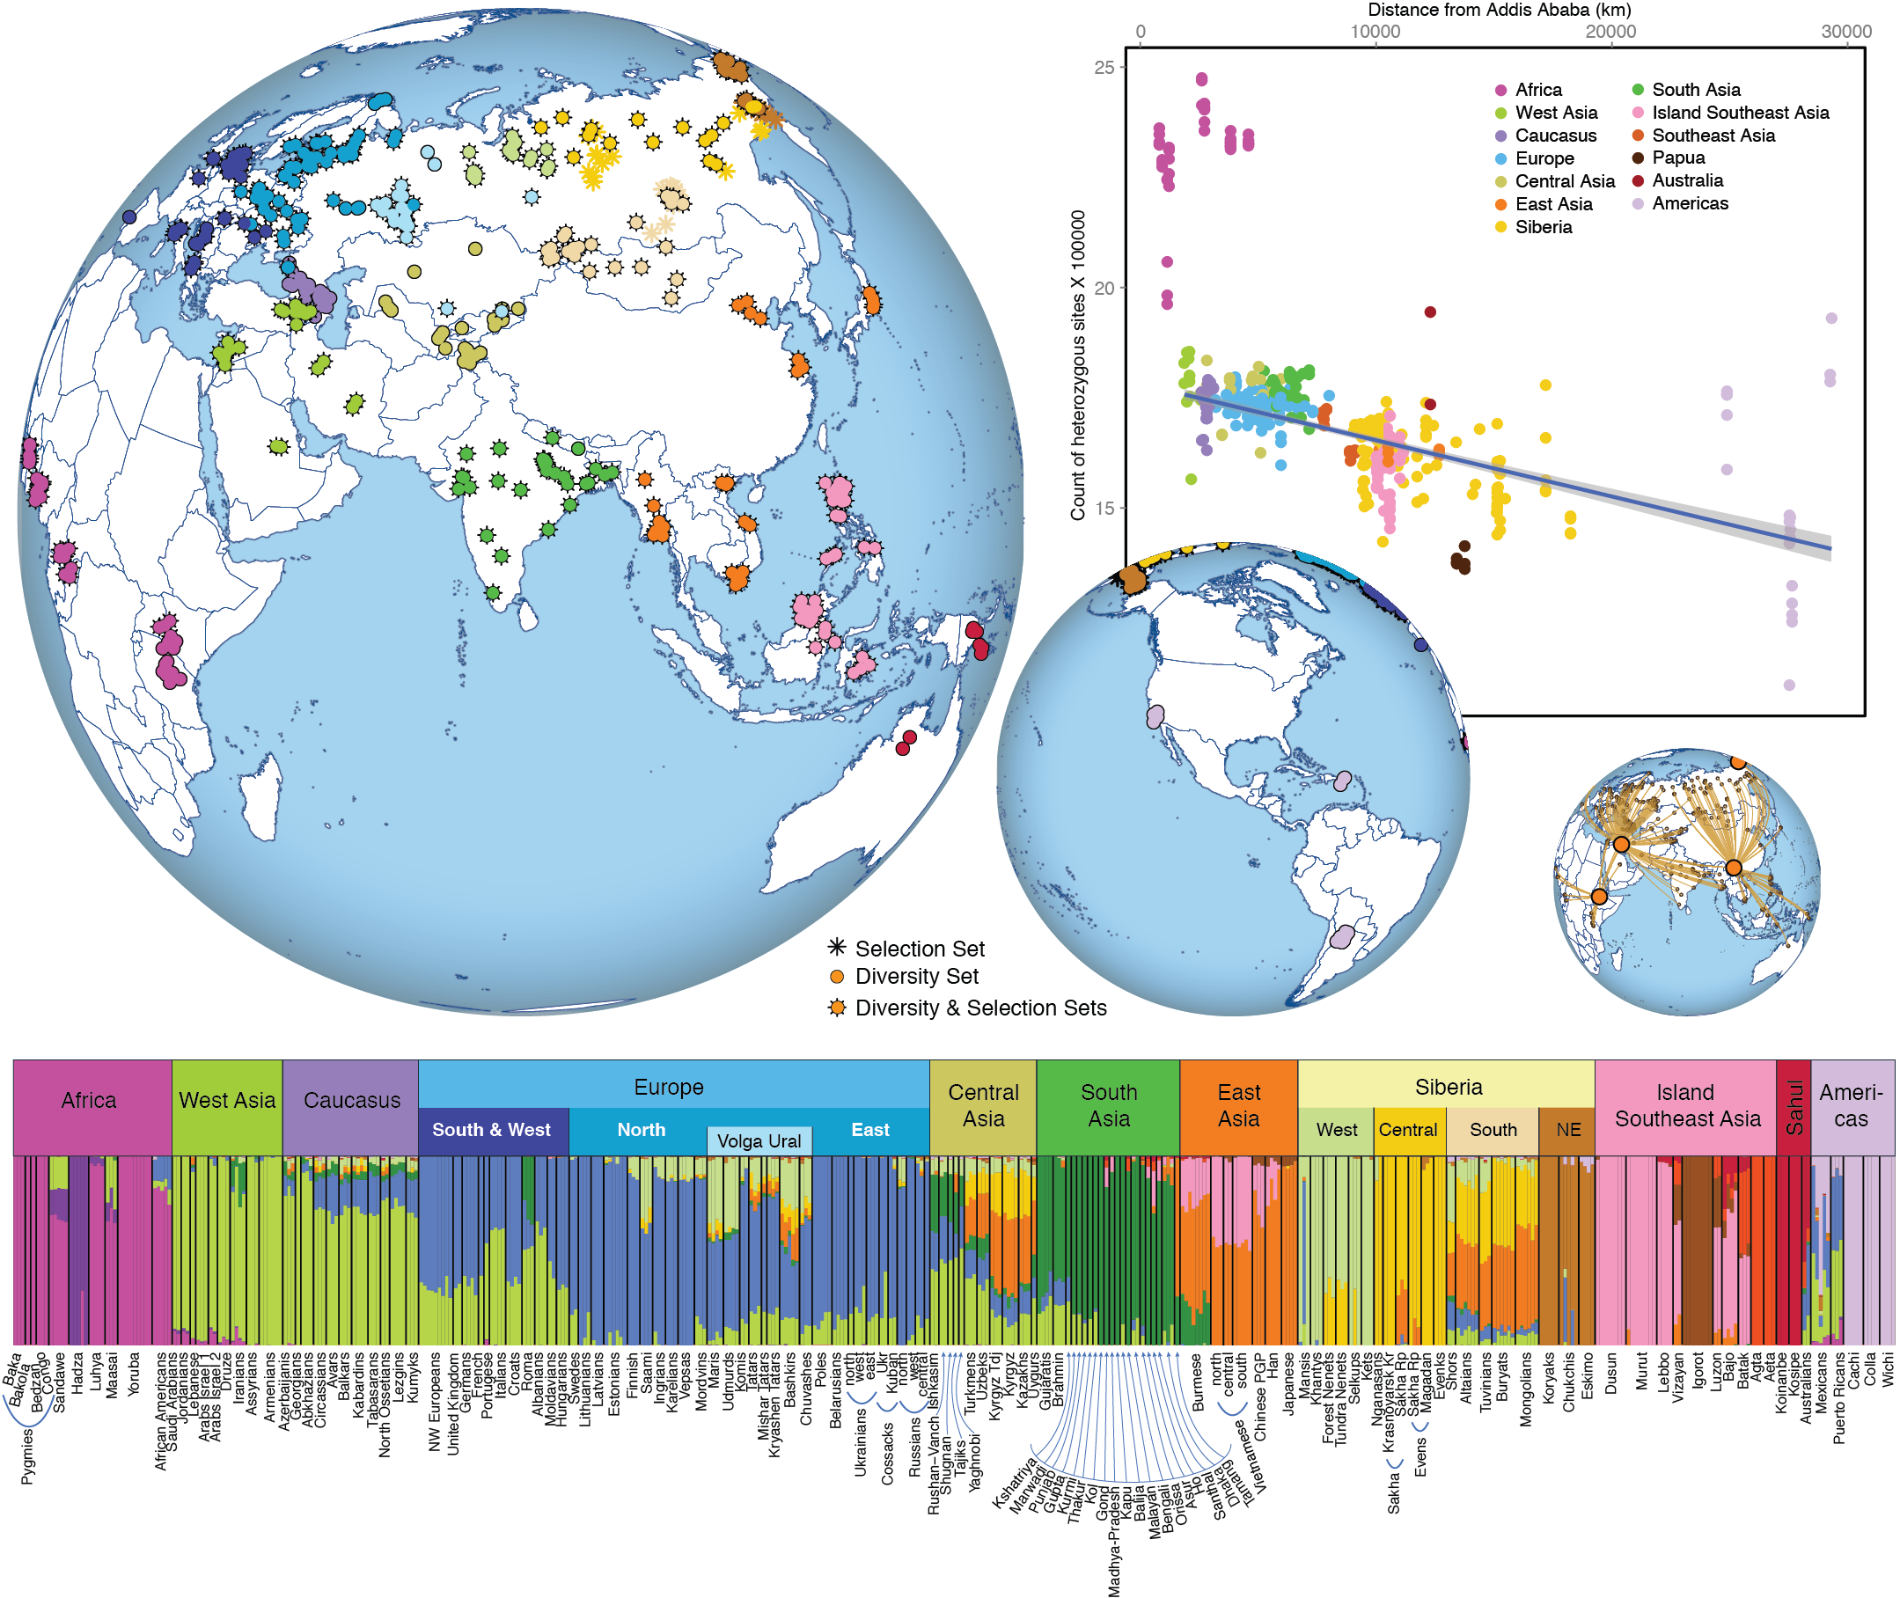
Genetic drift example
Figure from Pagani et al. 2016 (Nature)

Slide 18
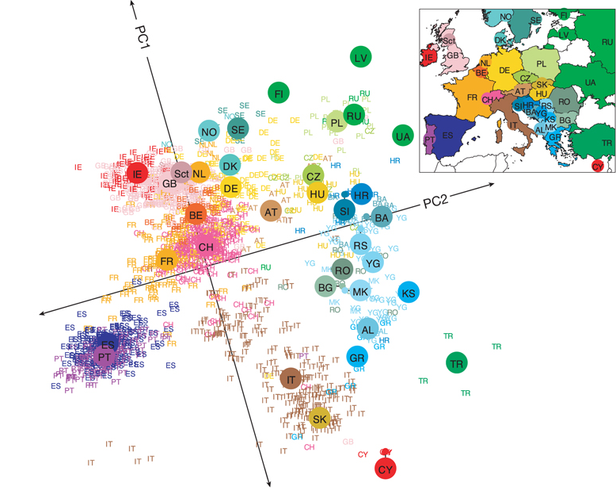
Genes mirror geography in Europe
Novembre et al. (2008, Nature)

Slide 19
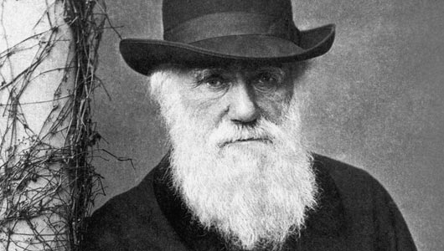
Natural selection
Natural selection: The differential survival and/or reproduction of different genotypes due to unequal fitnesses
Natural selection is not the same thing as evolution
Selection coefficient (s)
  s = 0.01 indicates a 1% fitness advantage
  |s| tends to be close to 0
Operates on short time scales (~1/s generations)
The outcome of natural selection depends on fitnesses and initial frequencies
Probability of fixation: ~2s
  Most advantageous mutations are not fixed

Slide 20
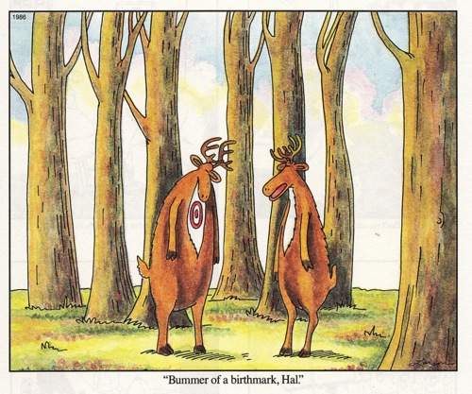
Natural selection: fitness
Genotype-specific fitness is often represented by the parameter w
Relative fitness determines allele frequency changes over time
Absolute fitness determines population growth rates
Neutral genotypes have a fitness of 1
Advantageous genotypes have a fitness greater than 1
Deleterious genotypes have a fitness less than 1
The Far Side
(Gary Larson)

Slide 21
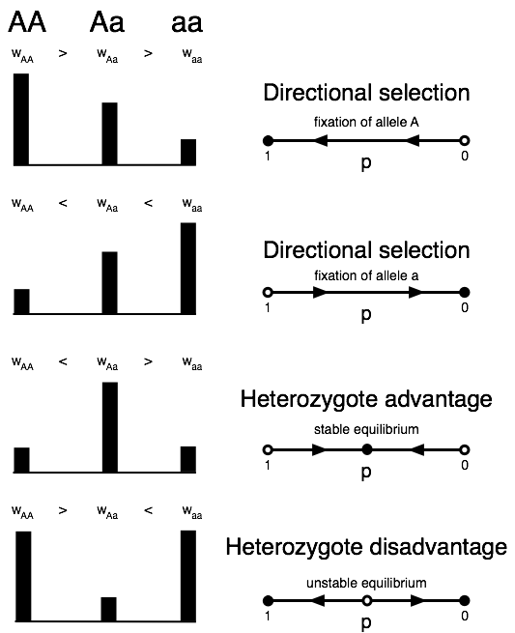
Types of natural selection
Directional selection
Overdominant selection
  Heterozygte advantage
Underdominant selection
  Heterozygote disadvantage
Frequency dependent selection

Slide 22
Mathematics of natural selection
Haploid scenario
Allele frequency next generation can be found by weighting alleles by how much they contribute to the gene pool (fitness)
Allele frequency at an arbitrary point in time:

Slide 23
Mathematics of natural selection
Diploid scenario with fitness dominance
Frequencies next generation can be found by weighting contributions to the gene pool

Slide 24
Mathematics of natural selection
General equation for single generation allele frequency change:
Response to selection hinges on:
  Allele frequencies
  The relative fitness of an allele
  Mean fitness of a population

Slide 25
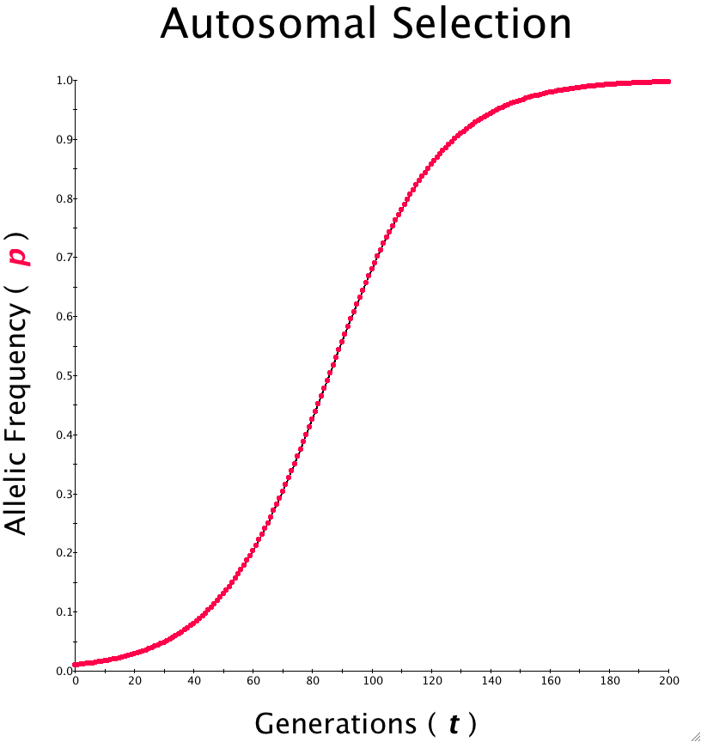
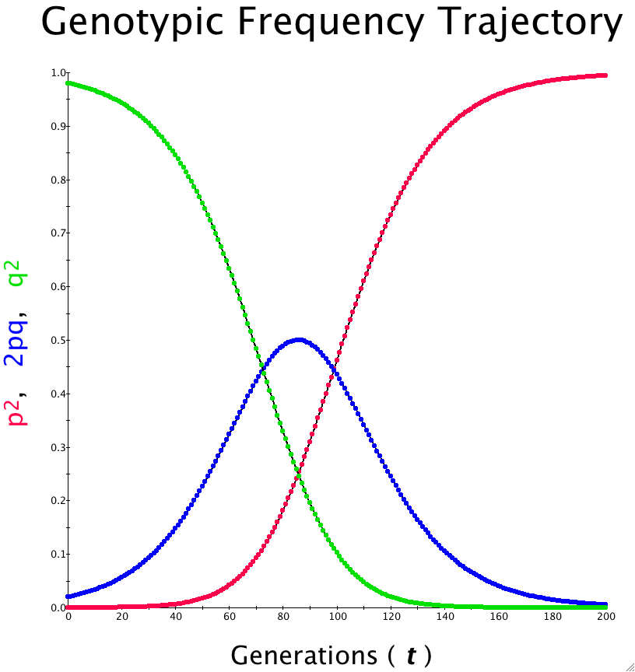
Simulations of directional selection

Slide 26
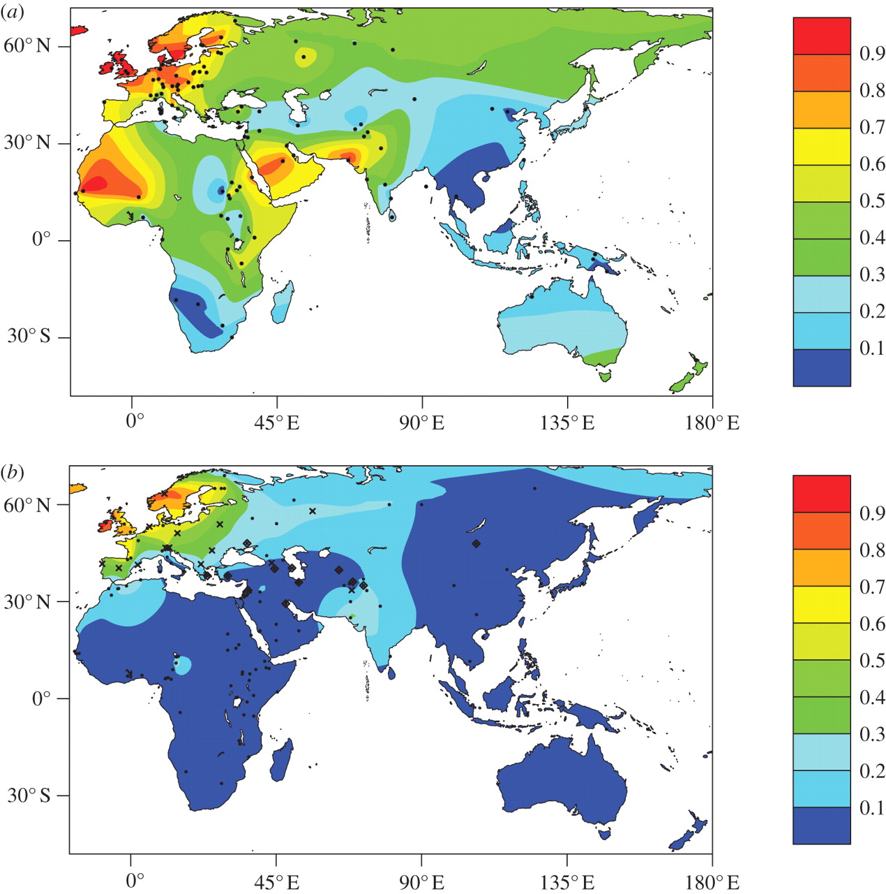
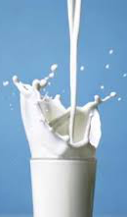
Natural selection example
Lactase persistence phenotype
Distribution of the 13910T allele
Figures from Gerbault et al. 2011 (Phil Trans Roy Soc B)
Lactase persistence alleles show evidence of positive selection
Different causal alleles in Africa (convergent phenotypic evolution)

Slide 27
Mutation
A “Goldilocks” scenario: Too low a mutation rate and populations lack genetic diversity. Too high of a mutation rate and natural selection is unable to purge deleterious mutations.
Evolutionary genetics tends to focus on germline mutations, as opposed to somatic mutations (most germline mutations occur during DNA replication)
Mutation rates vary across the genome (much more common at CpG sites)

Slide 28
Human germline mutation rates
Figure from Ségurel et al 2015 (Annual Review of Genomics and Human Genetics)

Slide 29
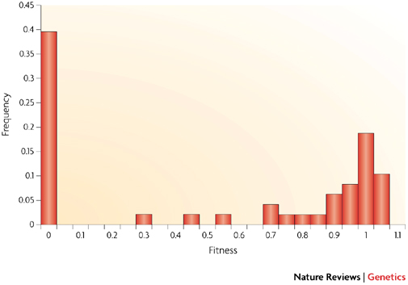


Distribution of fitness effects (DFE)
Vesicular stomatitis virus data
Most mutations are deleterious or neutral
(they do not increase Darwinian fitness)
Alas, most mutations don’t result in hopeful monsters (a la Goldschmidt)
Marvel

Slide 30
Mutation and molecular clocks
The rate of neutral substitution depends on mutation rate alone (surprisingly it is independent of population size)
Derivation:
  A population of N diploid alleles
  mutations per generation
  Each of the 2N alleles present as an equal chance to be fixed
  Rate of fixation=(population-level rate of mutation) × (probability of fixation)
  Assumes that mutation rates are low ( )

Slide 31
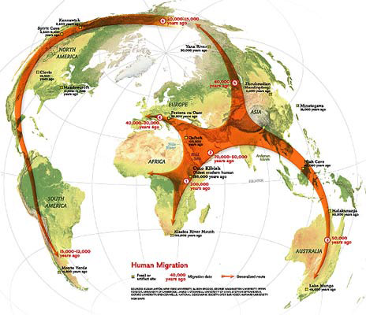
Migration
When population geneticists refer to migration they mean gene flow
The parameter m equals the proportion of alleles in a population that are from immigrants
Gene flow homogenizes populations
Local differentiation occurs when there is
< 1 migrant per generation (i.e. Nm < 1)
National Geographic

Slide 32
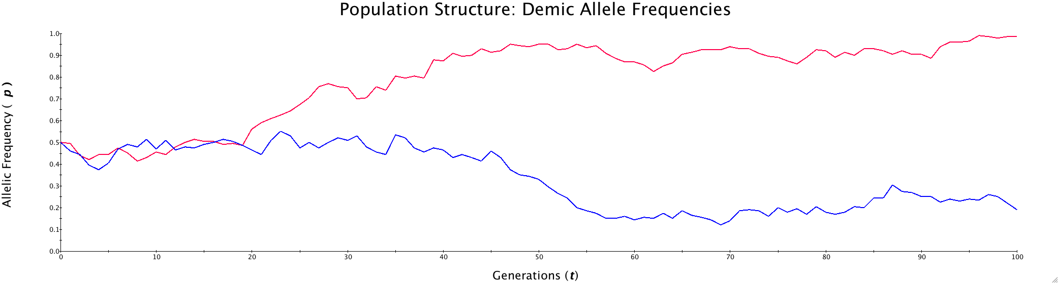
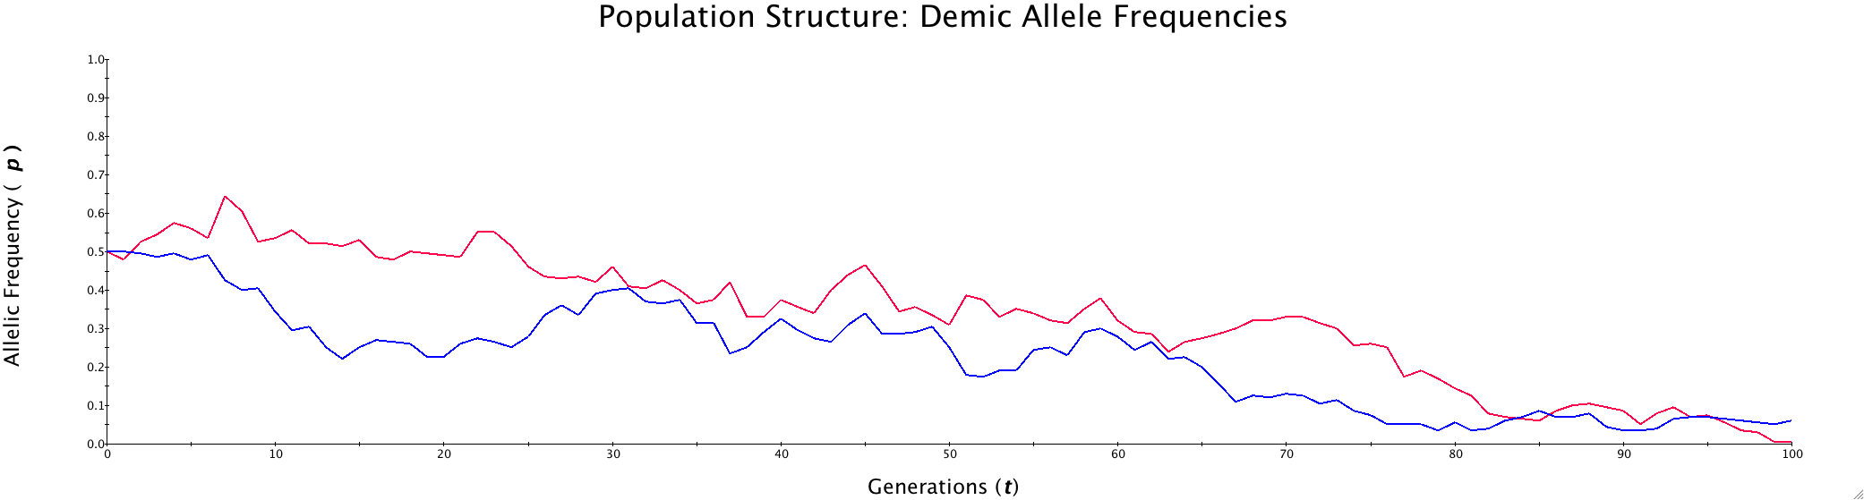
Simulations of migration (and genetic drift)
No gene flow: N=100, m =0
Substantial gene flow: N = 100, m = 0.01

Slide 33
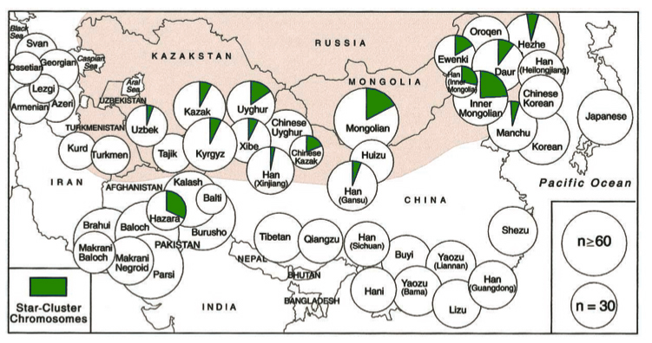
Migration example
Geographic proximity results in genetic similarity
The Y-chromosome legacy of Ghengis Khan
(Zerjal et al. 2003, American Journal of Human Genetics)

Slide 34
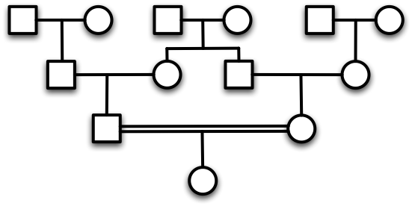
Mating structure
Panmixia: random-mating
Assortative mating
  Non-random
  Leads to departures from Hardy-Weinberg genotype frequencies
  Allele frequencies can remain unchanged
Inbreeding
  Preferential mating with relatives

Slide 35
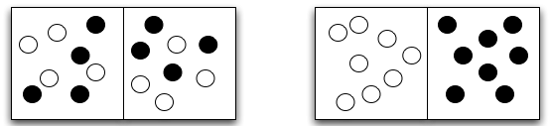
Mating structure: F_{ST}
F_{ST} = 0 F_{ST} = 1
F_{ST} measures how much genetic variation can be explained by sub-populations within the total population
F_{ST} between divergent populations increases over time
Migration reduces F_{ST} (island model)

Slide 36
Mating structure: inbreeding
Inbreeding coefficient (F): Another F-statistic can be used to quantify the effects of inbreeding (the inbreeding coefficient
Inbreeding results in an excess of homozygotes
As many deleterious alleles are recessive this can result in adverse effects

Slide 37
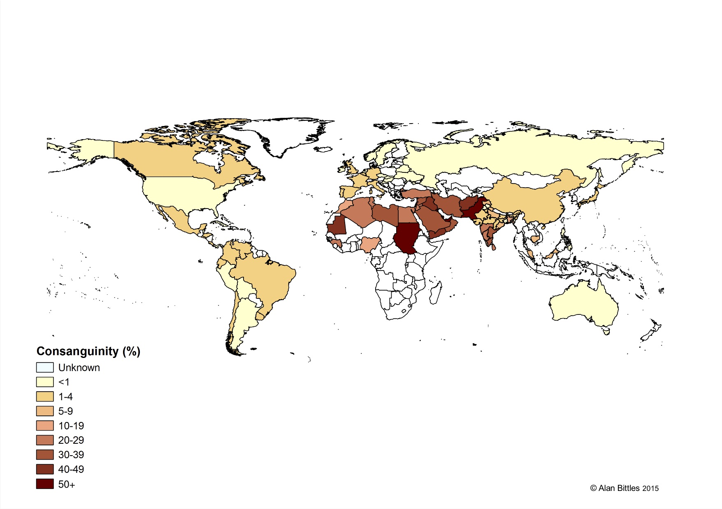
Mating structure example (inbreeding)
Consanguinity: closer than 2nd cousin mating (F > 0.015625)

Slide 38
Effects of each major process
 | Genetic Drift | Natural Selection | Mutation | Migration | Mating Structure
Time-scale | Medium | Fast | Slow | Medium | Fast
Effect on variation | Reduced | Mixed | Increased | Homogenized | Indirect

Slide 39
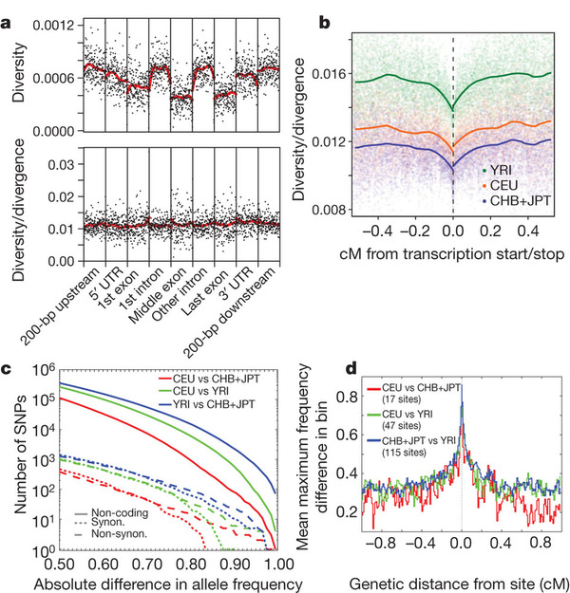
Case study #2
Polymorphism data from the 1000 Genomes Project (Nature, 2010)
What do you think causes these patterns?
Genetic
Diversity

Slide 40
Advanced concepts in population genetics
Genetic drift | Natural selection | Mutation | Migration | Mating structure
Genetic drift | Nearly-neutral theory (Ohta) | Neutral theory (Kimura) | Gene flow | Inbreeding | Genetic drift
 | Natural selection | Mutation-selection balance | Migration-selection balance | Sexual selection | Natural selection
 |  | Mutation | Geographical genetics | Private alleles | Mutation
 |  |  | Migration | Wahlund effect | Migration
 |  |  |  | Mating structure | Mating structure

Slide 41
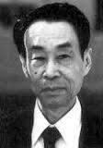
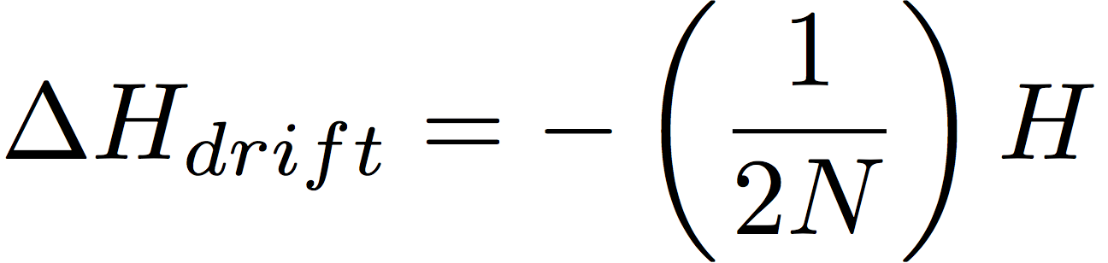
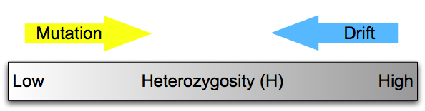
Neutral theory of evolution (Kimura)
Drift + mutation
Most mutations are deleterious (bad)
Most polymorphisms are neutral (neither good nor bad)
  Synonymous changes (codon change, but same amino acid)
  Pseudogenes: “dead genes” that are no longer expressed
  Intergenic DNA
A balance exists between a decrease in variation due to drift and an increase in variation due to mutation

Slide 42
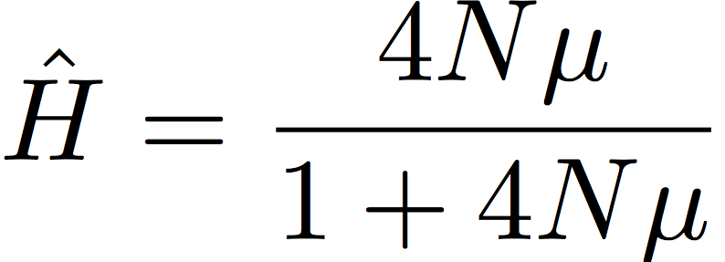
Neutral theory of evolution (Kimura)
Substantial genetic variation is maintained if
Population-level mutational input is important
pervades population genetics and coalescent theory
The neutral theory provides a null hypothesis for studies of molecular evolution

Slide 43
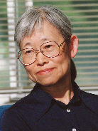
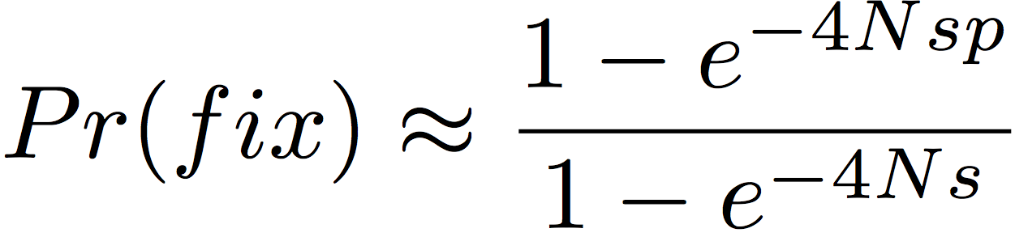
Nearly-neutral theory (Ohta)
The critical value is 4Ns
  When |4Ns| >> 1, alleles undergo selection
  When |4Ns| << 1, alleles are effectively neutral

Slide 44
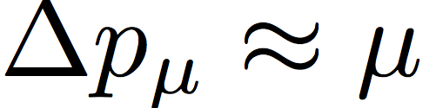
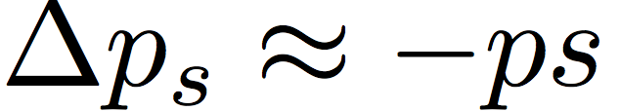
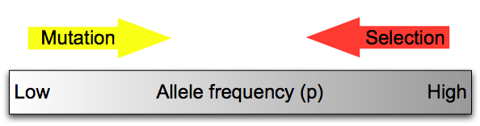
Mutation-selection balance
Mutation + selection
Deleterious mutants increase in frequency by mutation
Deleterious mutants are reduced in frequency by selection
There exists an equilibrium allele frequency where the magnitude of these two forces are balanced:
Alleles under mutation-selection balance are rare

Slide 45
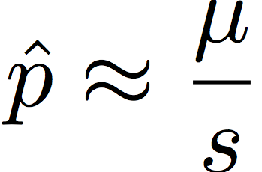
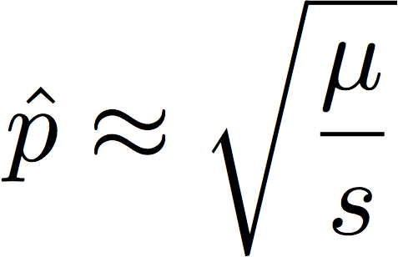
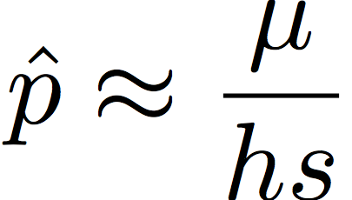
Mutation-selection balance
Ploidy and dominance affect equilibrium allele frequencies
  Haploid
  Diploid, completely recessive
  Diploid, intermediate dominance
Deleterious alleles are more common when recessive

Slide 46
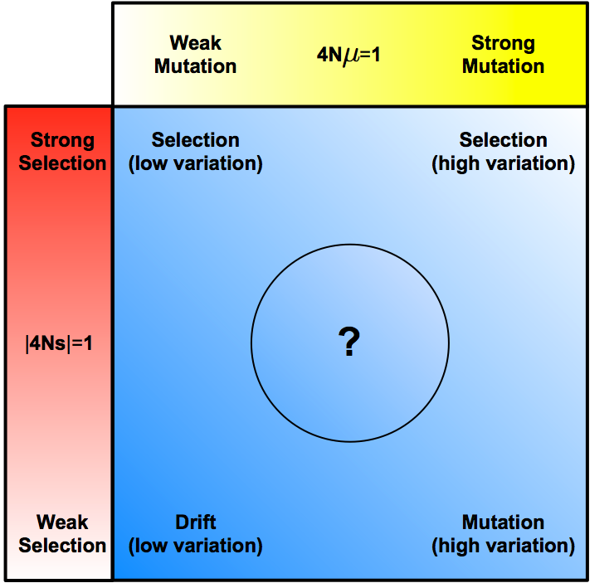
Selection, drift, and mutation
Large populations are in the upper right and small populations are in the lower left
Where in the blue part of this figure would you expect to find:
  Protein coding genes?
  Disease causing genes?
  miRNA genes?
  Pseudogenes?
  MHC genes?
  Transposons?
  Microsatellites?
  Cis-regulatory elements?

Slide 47
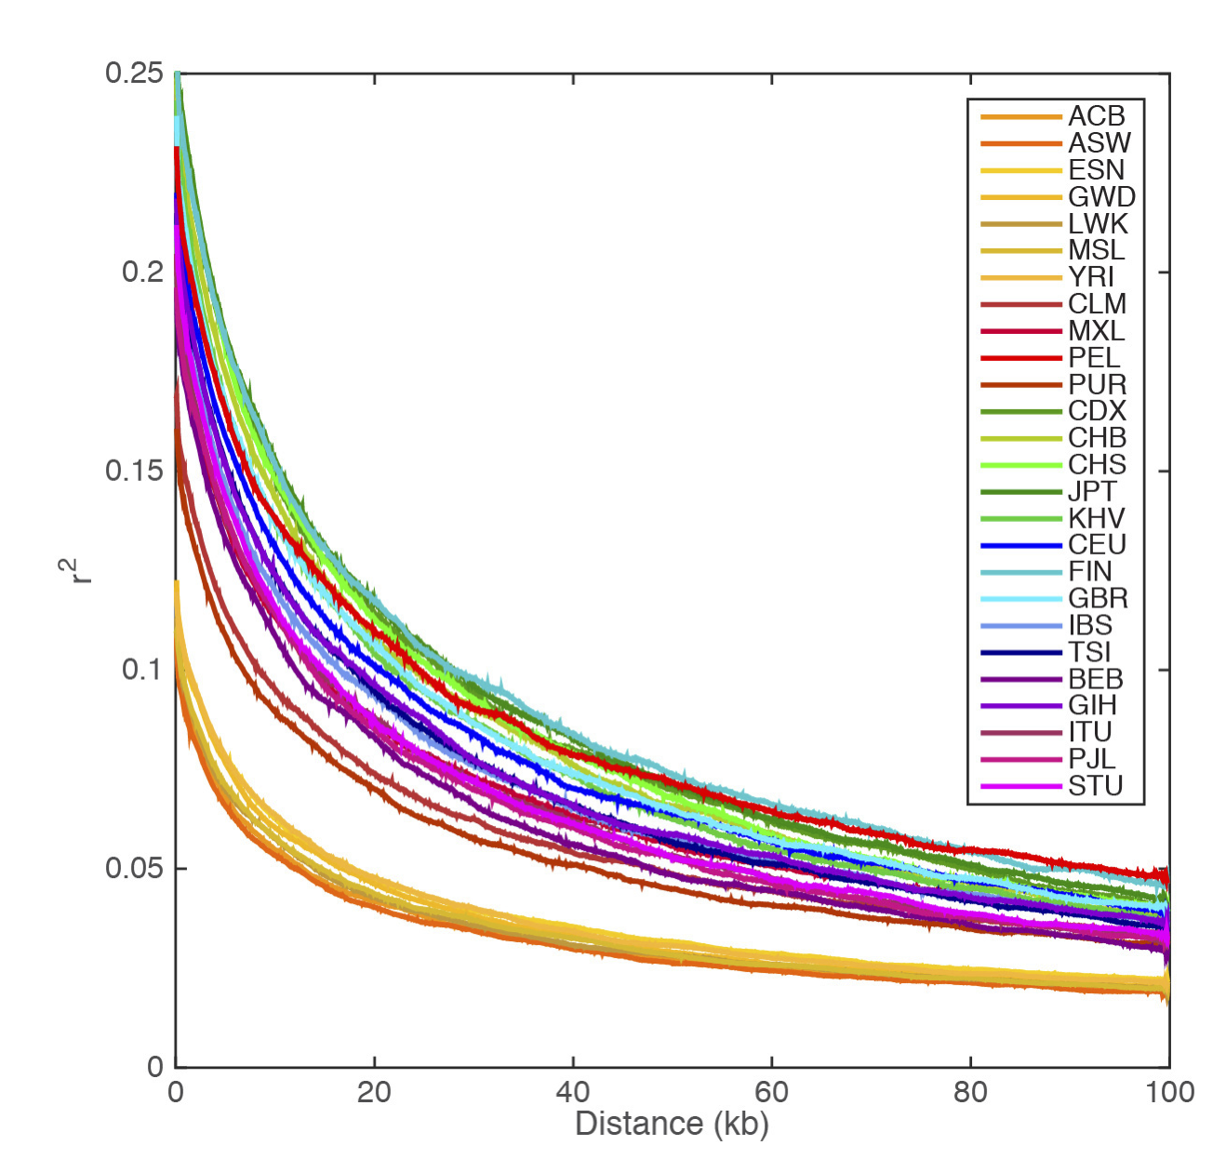
Linkage disequilibrium in human populations
Phase 3 data from the 1000 Genomes Project (Nature, 2015)
Non-African populations have higher amounts of LD

