Slide 1

Introduction to Genetics and Genomics
5a. Evolution and Disease Risks
lachance.joseph@gmail.com
https://popgen.gatech.edu/

Slide 2
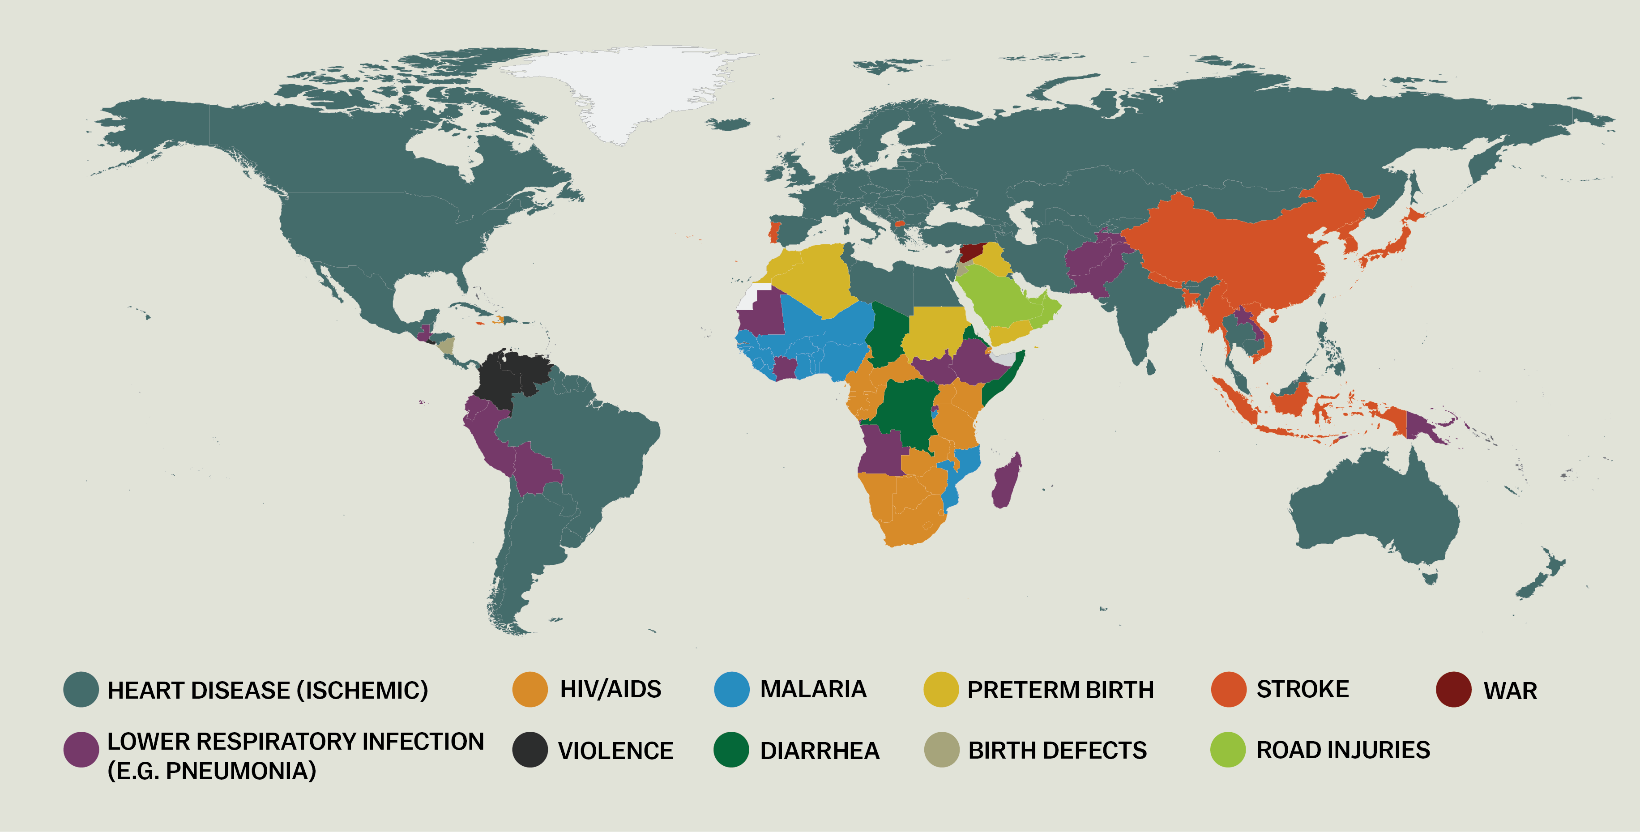
Leading causes of lost years of life (2013)
Source: Vox and The Lancet

Slide 3
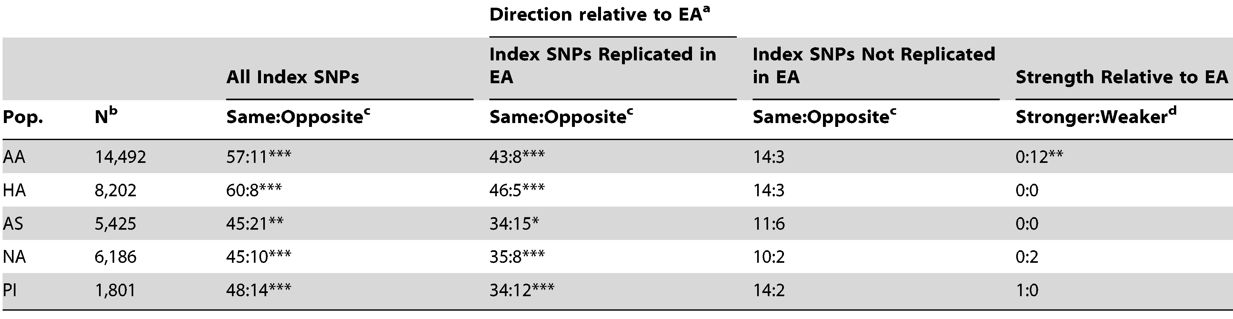
Replicating GWAS in multiple populations
EA: European Americans, AA: African-Americans, HA: Hispanic Americans, AS: Asian Americans, NA: Native Americans, PI: Pacific Islanders
PAGE Study traits and diseases: BMI, lipid levels, and T2D
Cases and controls need to be matched by ethnicity
Odds ratios, risk allele frequencies, and LD can differ across populations
Do you expect to find the same “hits” in each population?
Carlson et al. (2013, PLoS Biology)

Slide 4
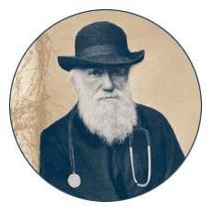
Contributing factors
Environment
Genetic architecture
Population bottlenecks
Natural selection

Slide 5
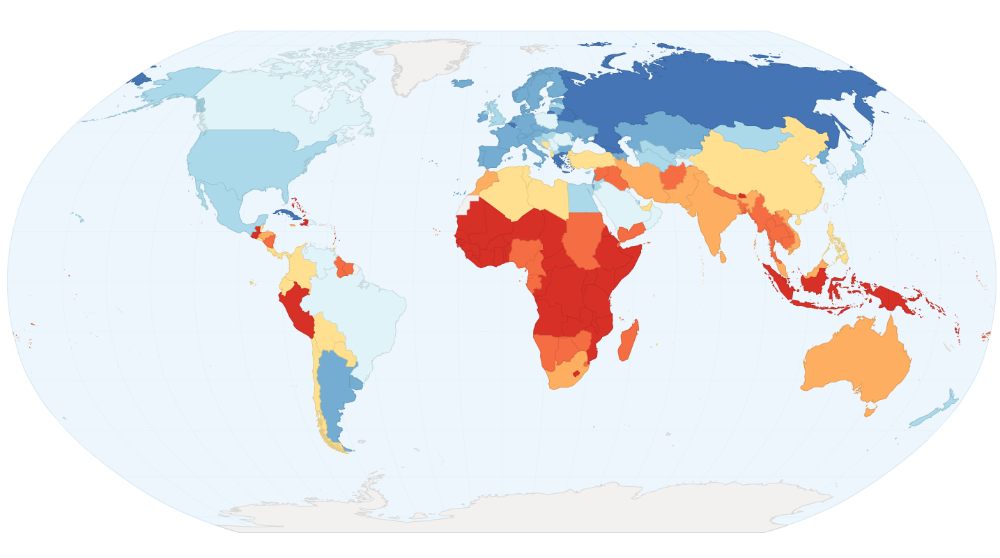
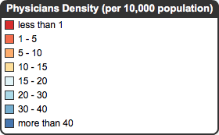
Access to health care
Source data: World Health Organization (2010)

Slide 6
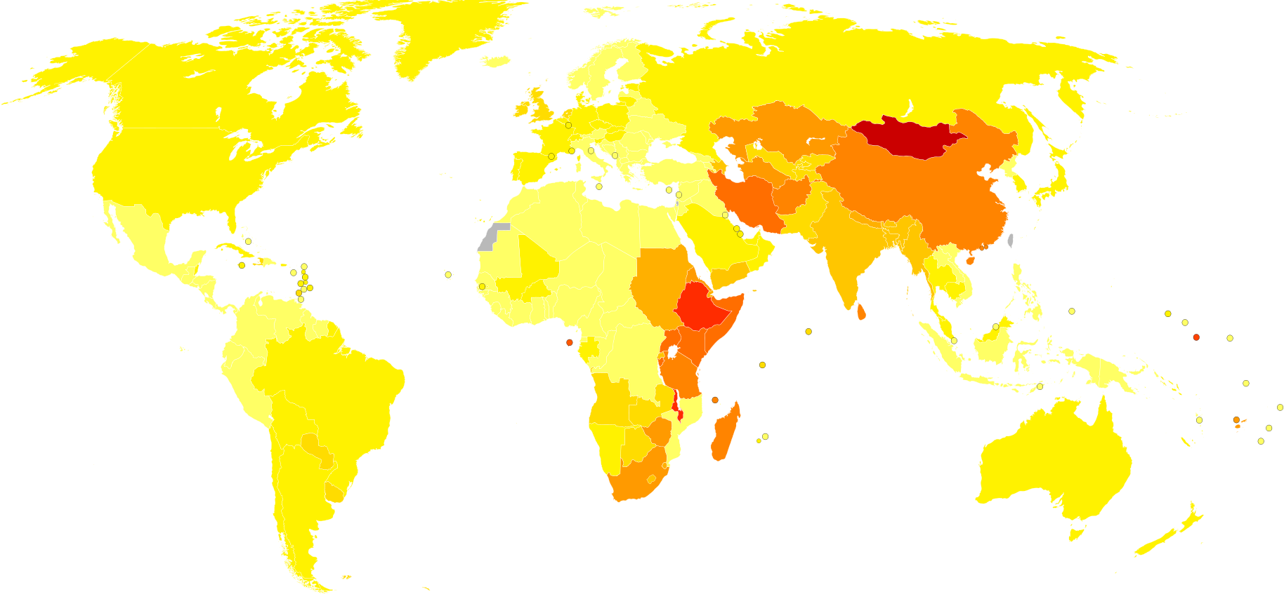
Environmental risk factors
Esophageal cancer death rates
(World Health Organization, 2004)
Many different environmental risk factors exist
(e.g. smoking, Plasmodium falciparum, famine - Dutch Hongerwinter of 1944)
Environmental factors supply contexts in which natural selection acts
Geographic patterns may help identify factors that contribute to diseases

Slide 7
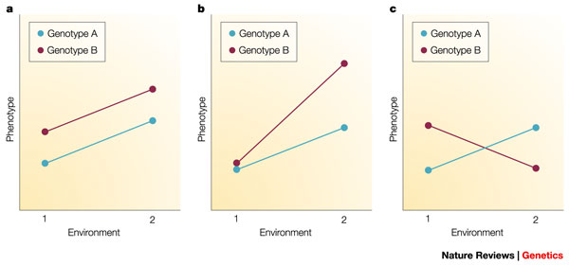
Genotype-by-environment (GxE) interactions
Reaction norms describe the range of phenotypes produced by a genotype in different environment

Slide 8
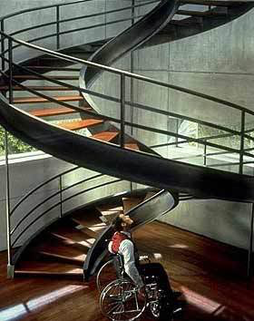
Genetic architecture: monogenic disorders
Single gene disorders are more likely to contribute to health disparities
What are some evolutionary forces processes that can lead to large allele frequency differences across populations?
Image from GATTACA (Columbia Pictures)

Slide 9
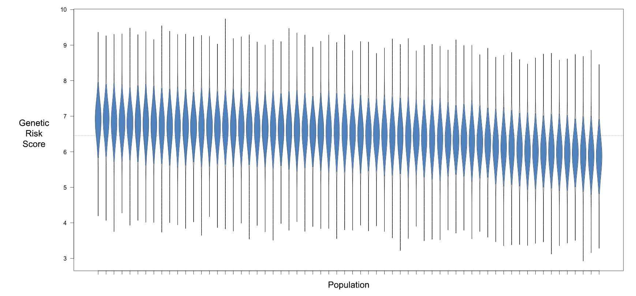
Genetic architecture: polygenic disorders
If a large number of loci contribute to a disease… it is less likely that there will be large differences in genetic risk across populations

Slide 10
Dominance and recessivity
Population | Allele frequency | Homozygote frequency
Population A | 0.1 | 0.01
Population B | 0.2 | 0.04
Small differences in allele frequencies are magnified for recessive diseases

Slide 11
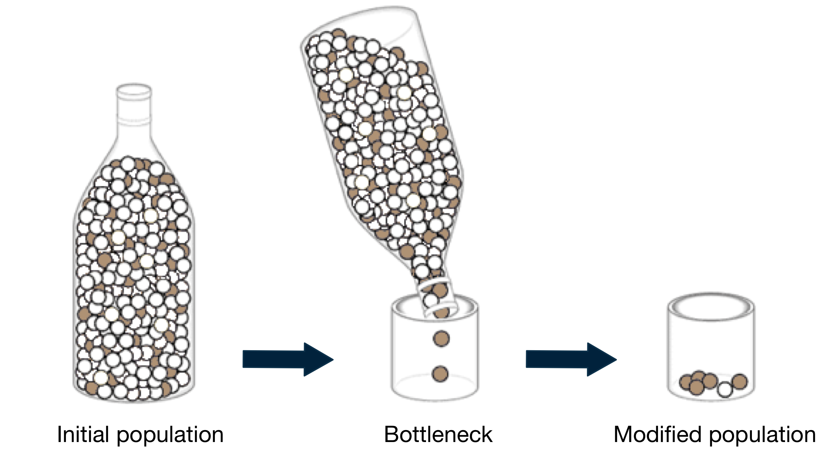
Population bottlenecks and founder effects

Slide 12

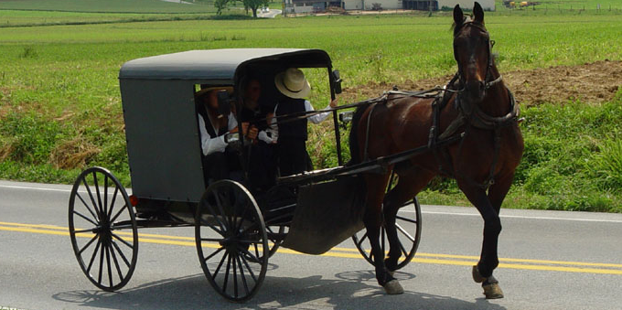
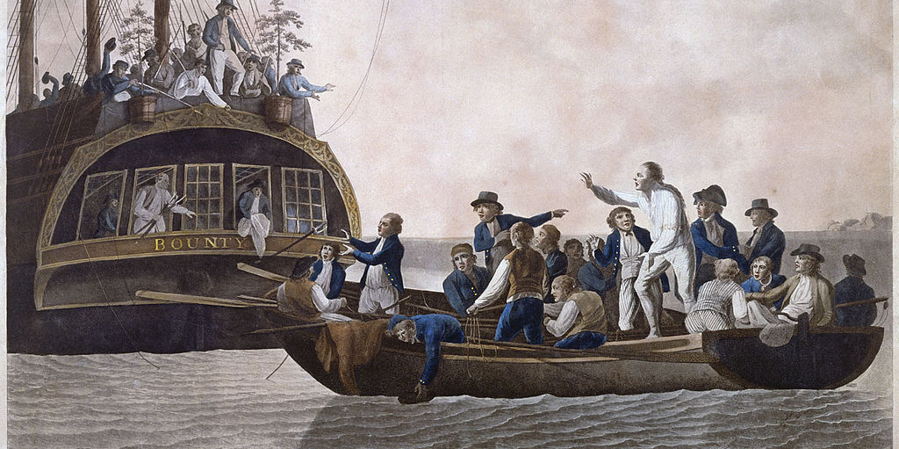
Examples of founder effects
French Canadians (Québécois)
Old Order Amish
HMS Bounty mutineers and Pitcairn Island
Images rights: Wikimedia Commons

Slide 13
Diseases associated with founder effects
Population | Disease
Afrikaners in South Africa | Fanconi anemia
Ashkenazi Jews | Tay-Sachs disease
Lake Maracaibo area, Venezuela | Huntington’s disease
Island of Tristan de Cunha | Retinitis pigmentosa

Slide 14
Genetic load
Natural selection eficiently eliminates deletious alleles when |4N_{e}s| > 1
Since non-African populations have experienced population bottlenecks in the last 75,000 years, they have a lower effective population size
This means that purging of mildly deleterious alleles is likely to have been lest effective in non-African populations
Non-African genomes also have increased homozygosity (which can be an issue if deleterious alleles are recessive)

Slide 15
Do non-African populations have greater load?
Simons et al. (Nature Genetics, 2014) state that human demographic history has “probably had little impact on the average burden of deleterious mutations.”
Do et al. (Nature Genetics, 2015) find little difference in the efficacy of natural selection across different human populations.
But see Lohmueller (Current Opinion in Genetics and Development, 2014)…

Slide 16
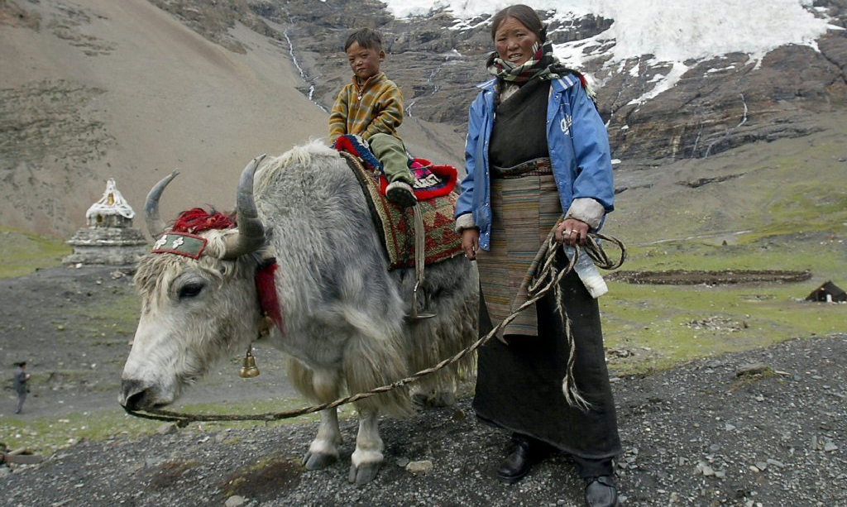
Local adaptation
Image rights: LA Times

Slide 17
Approaches used to detect adaptation
Comparative genomics Haplotype statistics
Allele frequencies Multiple populations
Modified from: Lachance and Tishkoff (2013, AREES)

Slide 18
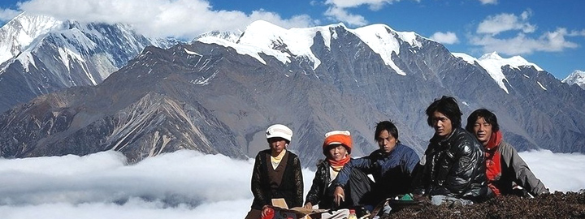
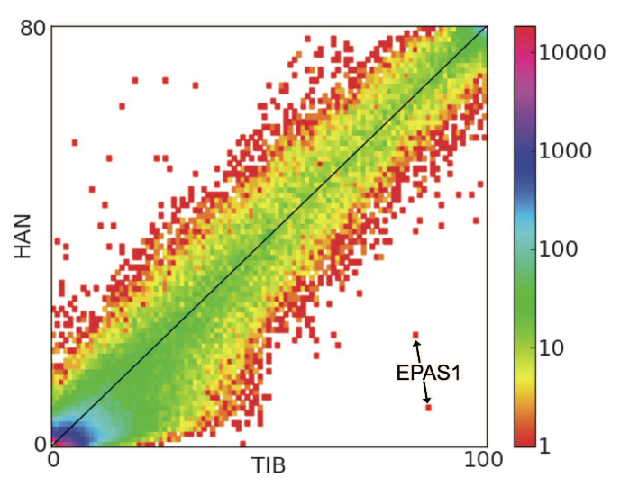
EPAS1 and high-altitude
Reduced [O₂] is a strong selective pressure
Allele frequencies compared between Tibetans (TIB) and Han Chinese from Beijing (HAN)
Outlier SNPs are located near EPAS1, a hypoxia-induced transcription factor
The Tibetan EPAS1 haplotype comes from Denisovans (Huerta-Sanchez et al. 2014)!!!
Positively selected EPAS1 haplotype contains a deletion that occurred 12kya (Lou et al. 2015)
Image rights: EasyTourChina
Yi et al. (2010, Science)

Slide 19
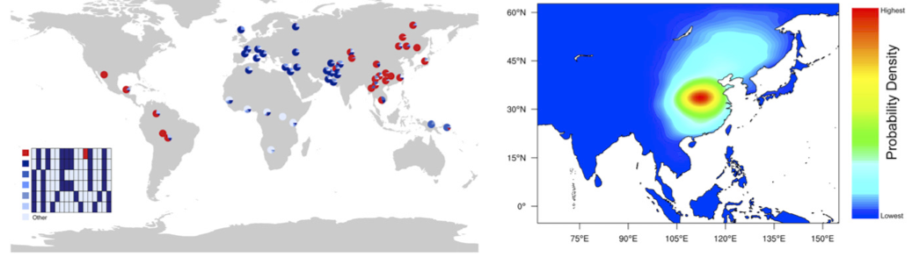
EDAR and eccrine glands
CMS scans reveal that the EDAR V370A allele is a target of selection
EDAR encodes the Ectodysplasin receptor
Relevant phenotypes in humans and mice
  Increased hair thickness
  Increased eccrine (sweat) gland density
Kamberov et al. (2013, Cell)

Slide 20
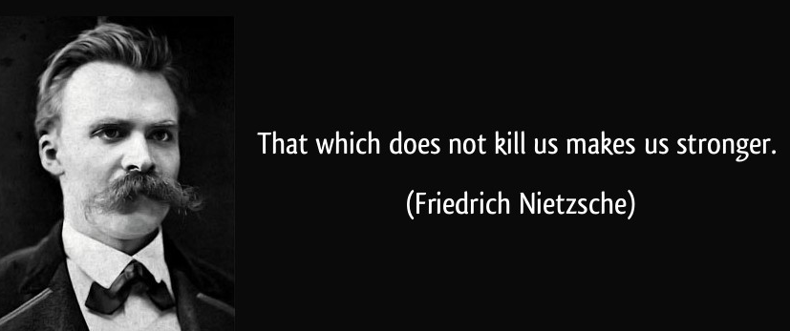
The benefits of a challenging past
Multiple mechanisms
  Positive selection increases the frequency of protective alleles
  Negative selection decreases the frequency of risk alleles
  High environmental risks can coincide with lower genetic risks
Example: CCR5 32 and HIV resistance in Europe

Slide 21
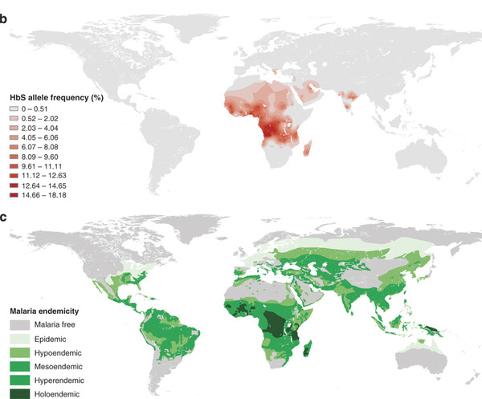
Trade-offs
Piel et al. (2010, Nature Communications)

Slide 22
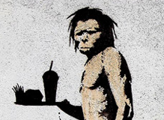
The thrifty gene hypothesis
Type 1 diabetes (T1D)
  Early onset and insulin deficiency
Type 2 diabetes (T2D)
  Adult onset and insulin resistance
James Neel (1962): Paleolithic feast-famine cycles may have selected for the ability to fatten rapidly. “Thrifty genes” confer a predisposition to diabetes.
How much support is there for this hypothesis? Ayub et al. (2014, AJHG) found only minimal support for positive selection at T2D loci.
Art by Banksy

Slide 23

The dangers of story telling
It is a little too easy to make up stories of adaptive evolution
Be careful when identifying traits that have been under selection in the past
Allele surfing and gene conversion can mimic signatures of positive selection
Convincing narratives of selection can be made for random sets of loci (Pavlidis et al. 2012)

Slide 24
Mismatch diseases
Acid reflux/heartburn | Endometriosis | Lactose intolerance
Acne | Flat feet | Lower back pain
Asthma | Glaucoma | Metabolic syndrome
Athlete’s foot | Gout | Myopia
Carpal tunnel syndrome | Hemorrhoids | OCD
Cavities | High blood pressure | Osteoporosis
Coronary heart disease | Iodine deficiency | Pre-eclampsia
Crohn’s disease | Impacted wisdom teeth | Rickets
Diabetes (Type 1) | Insomnia | Scurvy
Eating disorders | Inflammatory bowel disease | Stomach ulcers
Table modified from Evolutionary Medicine by Stearns and Medzhitov

Slide 25
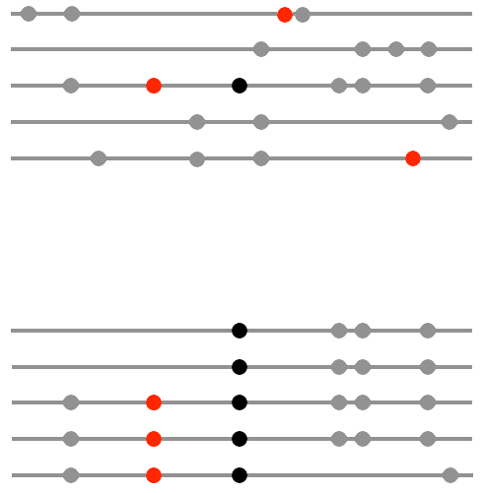
Genetic hitchhiking
Disease alleles can hitchhike to high frequency if they are linked to locally adaptive alleles
This can lead to large allele frequency differences if selection pressures differ across populations

Slide 26
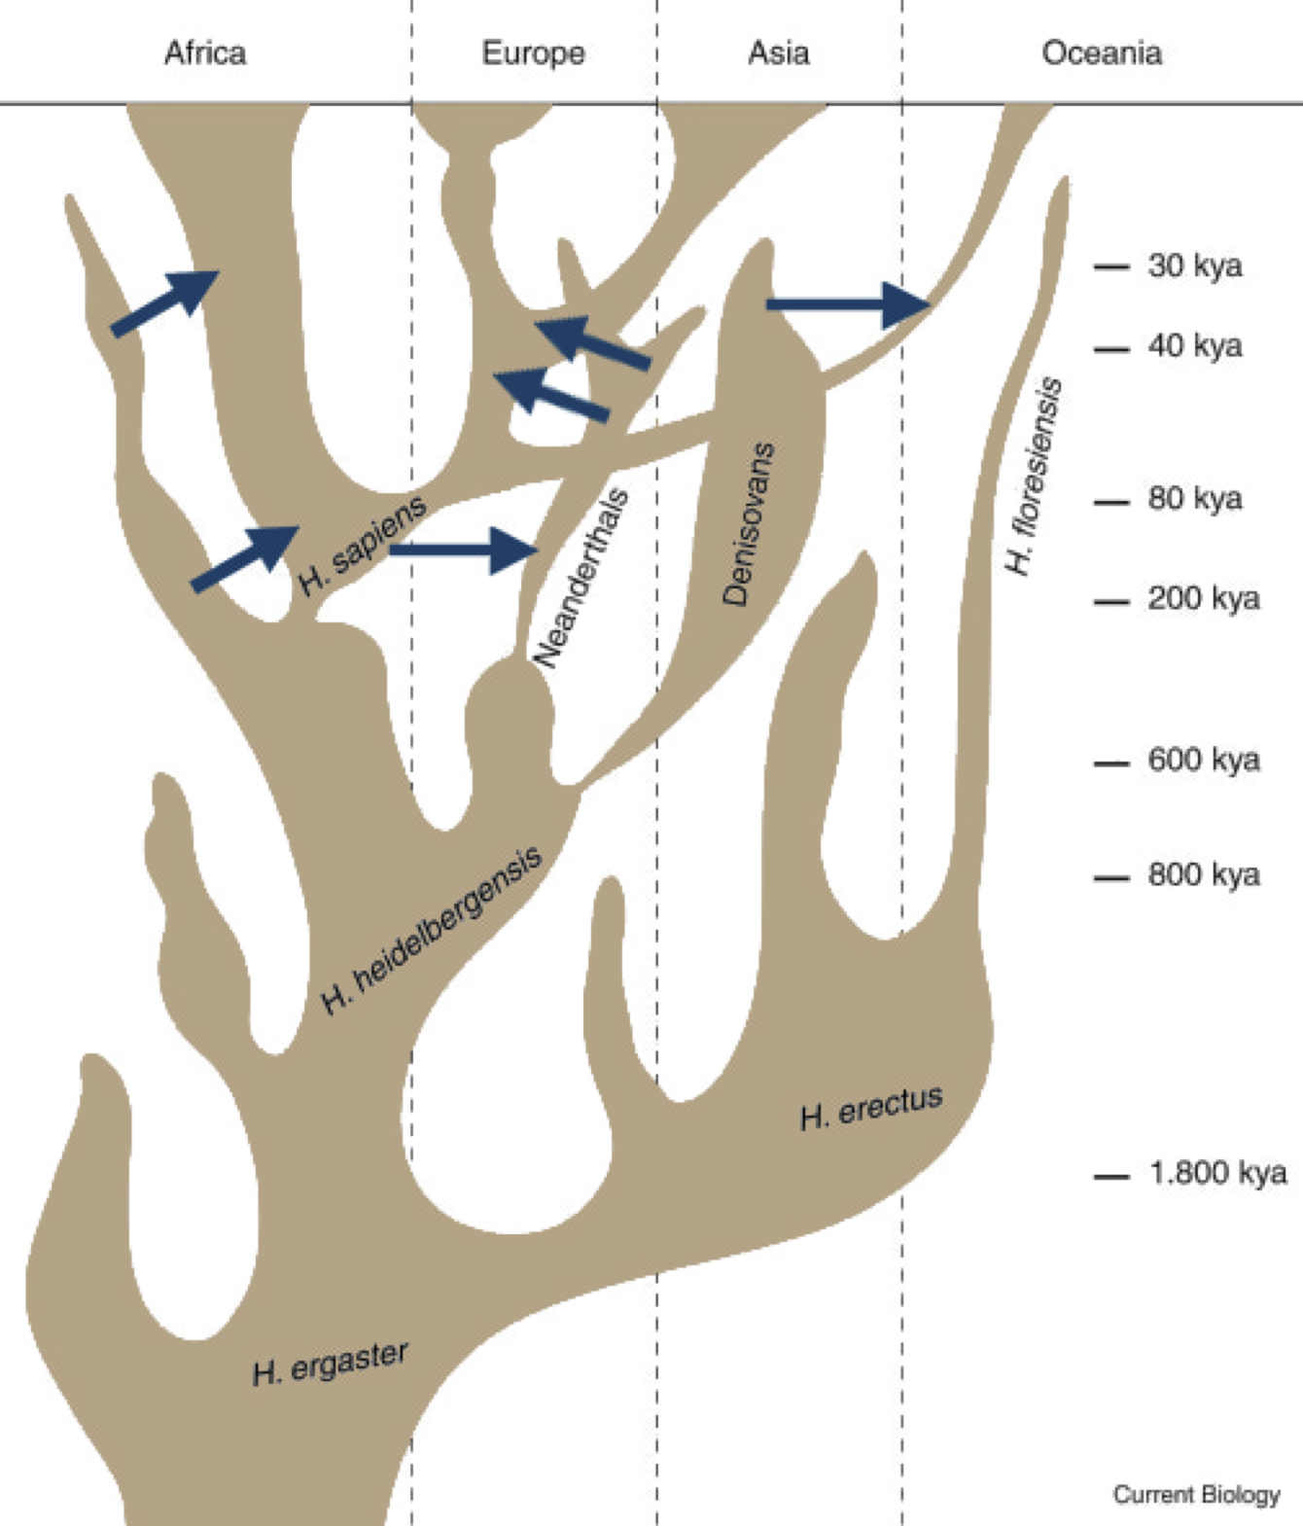
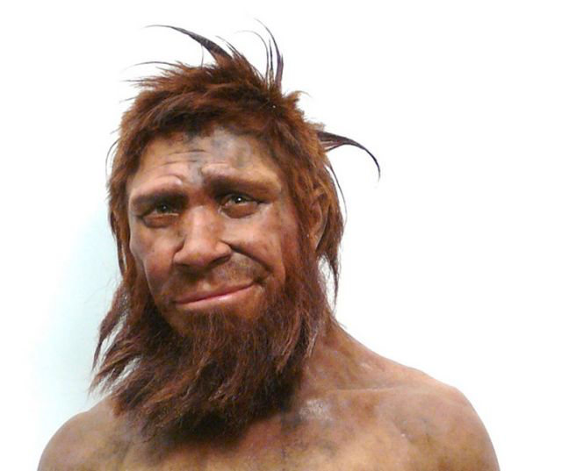
Many opportunities for archaic introgression?
Ars Technica
Figure modified from Lalueza-Fox and Gilbert (2011, Current Biology)

Slide 27
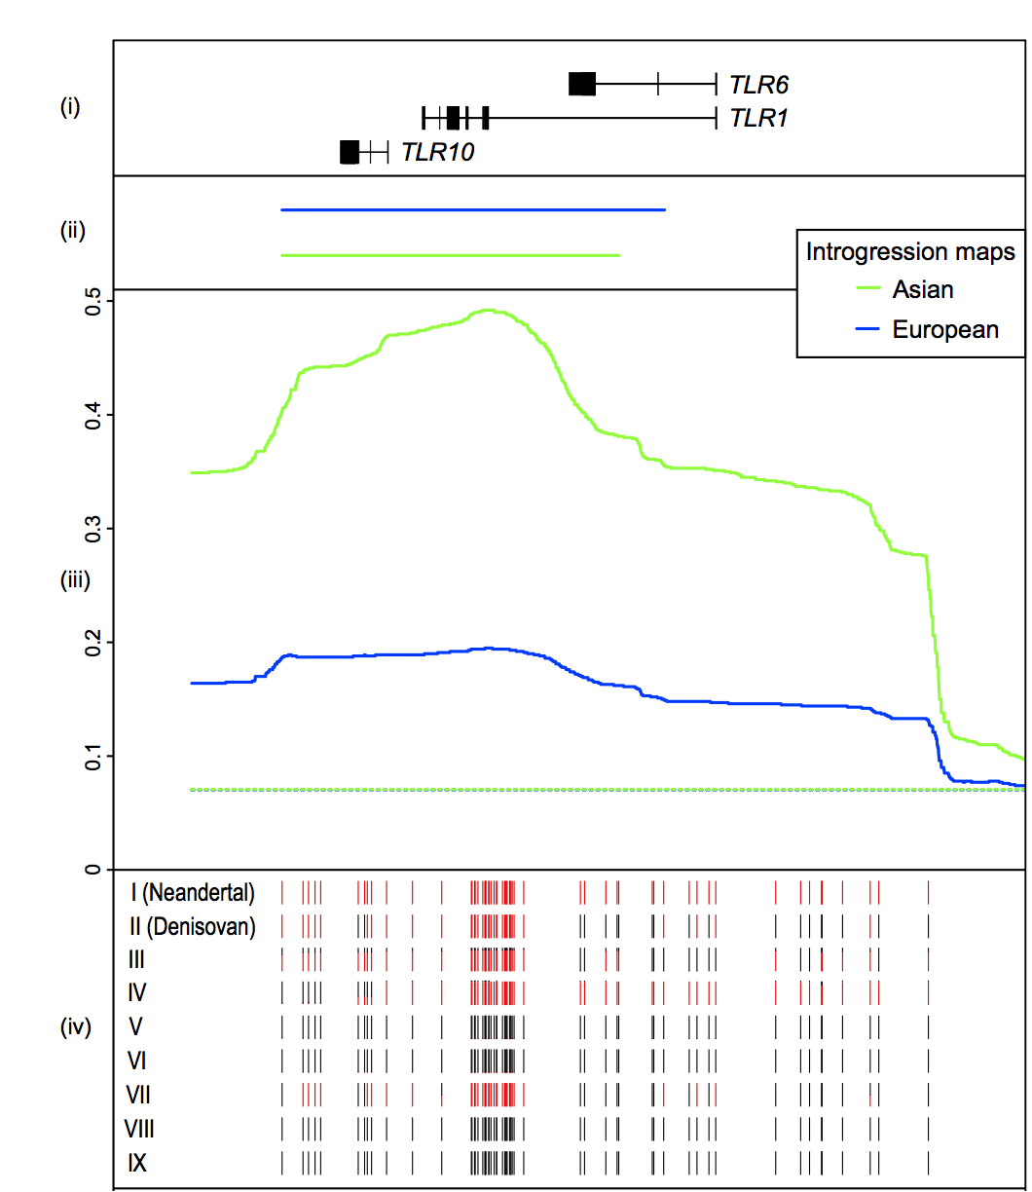
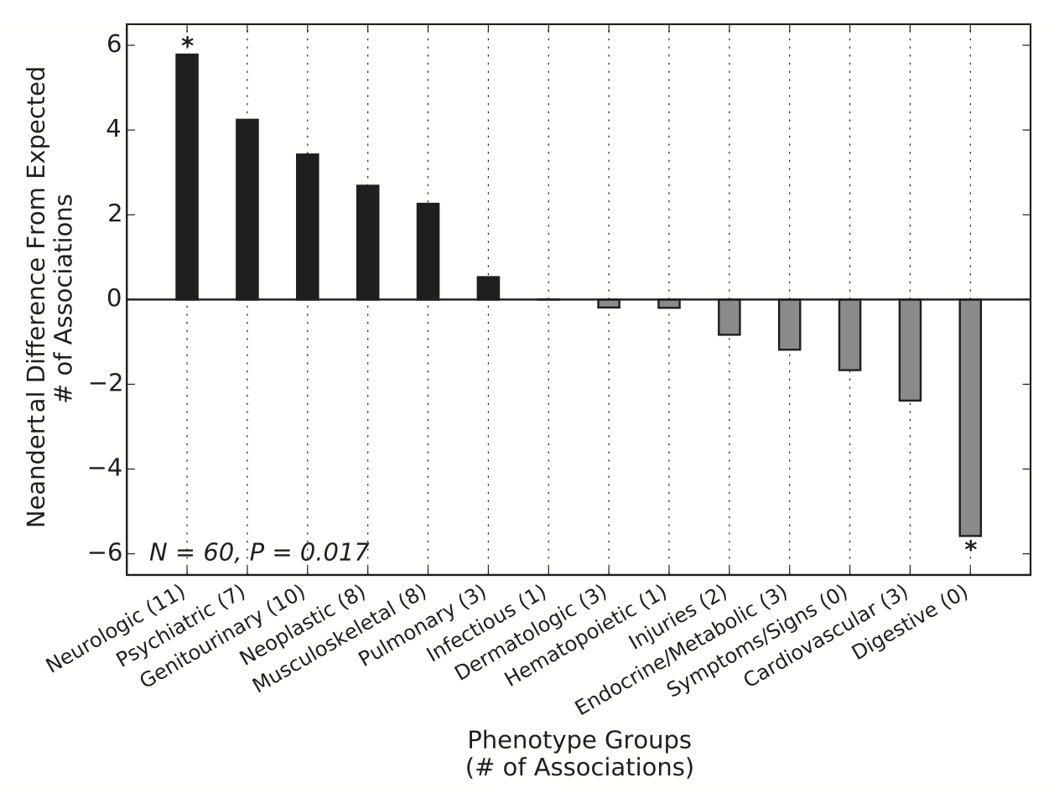
Introgression of disease and resistance alleles
Figure from Simonti et al (2016, Science)
Figure from Danneman et al (2016, AJHG)
Electronic health records and SNP data: Neanderthal DNA contributes to depression and skin lesions in humans (1 to 2% of risk explained)
Introgressed Neanderthal and Denisovan TLR genes contribute to innate immunity, including antimicrobial and inflammatory response

Slide 28
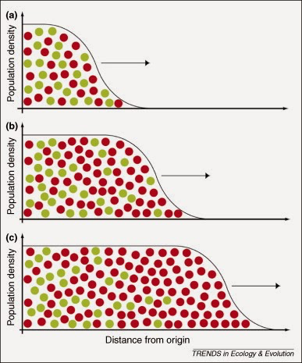
Allele surfing

