Slide 1
Introduction to Genetics and Genomics 5b. Personalized Genomics
2016
ggibson.gt@gmail.com
http://www.cig.gatech.edu

Slide 2
Firsst genome sequencing success story
Diagnosed at age 5 with dopa-responsive dystonia
Worsening respiratory and neuromuscular disease not responsive to dopamine precursor therapy
WGS shows mutation in SPR “sepiapterin reductase” gene
5-HT serotonin precusor supplementation had immediate impact
The Beery twins
Bainbridge, M. N. et al. (2011) Sci. Transl. Med. 3, 87re3

Slide 3
Some Personal Genomics Companies

Slide 4
Some Public Initiatives

Slide 5
Precision Medicine and Predictive Health
Precision Medicine is molecular pathology based on a patient’s genome sequence. It is about finding the mutation or perturbed genetic pathway that is largely responsible for a congenital birth defect, or for a specific cancer.
Predictive Health is about using your own clinical and genomic profile to make better decisions about wellness in an effort to prevent the onset of chronic disease.
Personalized genomic medicine encompasses both, and essentially captures the idea that each person’s individual genome sequence will eventually be part of their own medical care.

Slide 6
Types of Predictive Health Information
Clinical, Survey, and Anthropomorphic Data
Family History
Genotypes and Genome Sequence
- Common variants
- Rare mutations
4. Gene Expression Profile
Metabolome Profile
Microbiome Profile

Slide 7
Types of things you might like to know about
Your Ancestry
Things that are just plain interesting
- eye and hair color, handedness, unusual features
3. Things that you might be able to act on
- BRCA, warfarin resistance, metabolic deficiencies
(Scary) things that you cannot do anything about
- Predispositions to late onset disease
Things you might want to know about before having kids
- Mendelian disease carrier status
Things you might consider selecting for (or against) in the future
- Intelligence, athletic ability, good looks
- OR against depression, complex disease risk

Slide 8
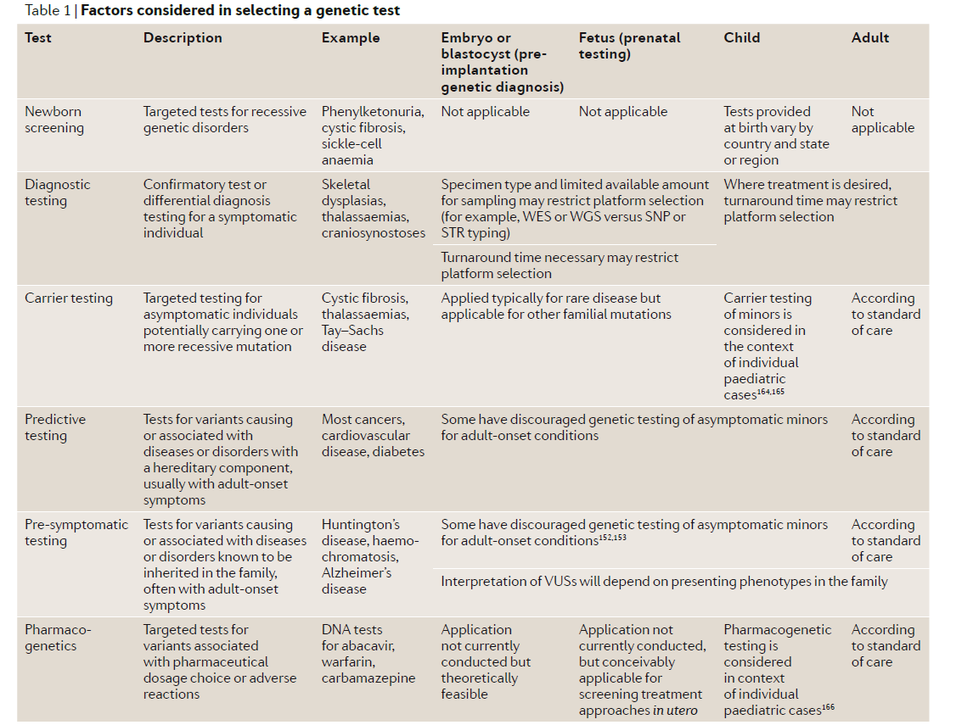
Types of Genetic Test
Katsanis and Katsanis (2013) Nat Rev Genet. 14: 415-426

Slide 9
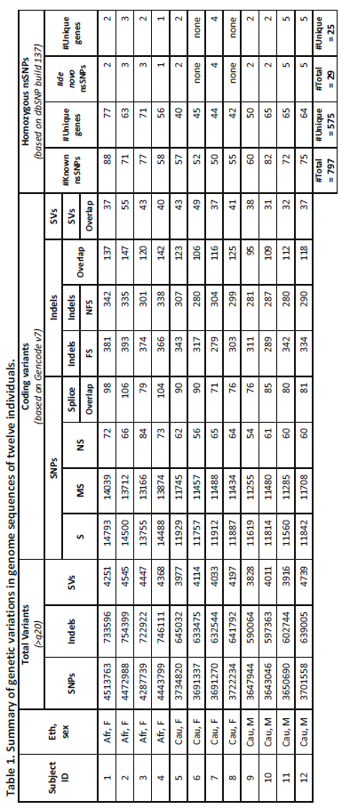
Variation in 12 genomes
Patel, Sivadas et al (2013) Genome Med. 5: 58.

Slide 10
The UK Deciphering Developmental Disorders (DDD) Study
The DDD Consortium scanned for CNV and sequenced the exomes of 1133 previously undiagnosed children with developmental disorders, and identified 400 rare, potentially pathogenic variants. Filtering on the biological parents’ exomes, they estimate a diagnostic yield of 27%.
Wright et al (2015) Lancet 385: 1305-1314.

Slide 11
StatSeq: Genomic Analysis in the PICU in 24 hours
Stephen Kingsmore, formerly of Children’s Mercy Hospital in Kansas City, now at Rady Children’s in San Diego, is pioneering efforts to sequence the genomes of very sick newborns within 24 hours. In a pilot of 35 kids, 20 were ‘diagnosed’, 4 of these were able to have positive interventions, and 6 were given immediate palliative care.
Kingsmore et al (2015) Genome Med. 7: 82.

Slide 12
Resilience and Rare Pathogenic Variants
Chen et al (2016) Nature Biotech 34: 531-538 surveyed the exomes of 590,000 people and discovered 13 cases where a healthy adult is homozygous for an unambiguously pathogenic rare mutation. 3 of them were in the CFTR They conclude that for rare pathogenic alleles with a MAF < 0.1%, penetrance is typically about 90%.
Narisamhan et al (2016) Science 352: 474-477 surveyed the exomes of 3,222 Britons of Pakistani heritage with high consanguinity, and found that one third of them are homozygous for a loss of function allele embedded in an autozygous stretch. These cases were 13% less prevalent than expected, implying lethality, and that we each carry 1.6 lethal-equivalent mutations. But also that our genomes are full of rare mutations that look pathogenic but are not.
Zanoni et al (2016) Science 351: 1166-1171 surveyed the exomes of 328 people in the upper 5% of HDL, found one case homozygous for a knock-out scavenger receptor, and argued that it may be causing mild heart disease. This study to me highlights the extreme difficulties we face predicting disease from genome sequences.

Slide 13
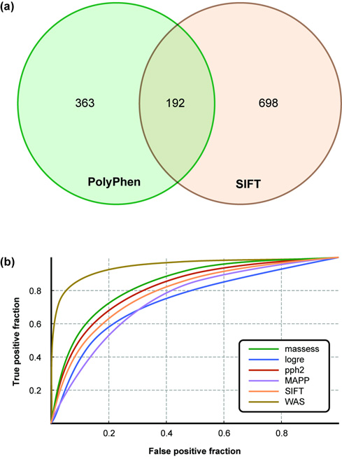
Predicting Pathogenicity
Predictions on the Venter Genome for 7,534 non-synonymous SNPS
WAS is a consensus deleterious score (Condel) averaging the others
Katsanis and Katsanis (2013) Nat Rev Genet. 14: 415-426

Slide 14
Levels of Evidence
Previously ascribed clinical function
Bioinformatic prediction from protein structure or attributes
Evolutionary conservation
Experimental validation (animal models, cellular manipulation, in vitro studies)
BUT, it is easy to get trapped in a genetically deterministic worldview:
- even Mendelian variants have incomplete penetrance
- expressivity is modified by genetics and environment
- deleterious to the protein is not necessarily deleterious to the organism
We do not have parallel methods for evaluating function of regulatory variants
Bottom line: N = 1 genetics is in its infancy

Slide 15
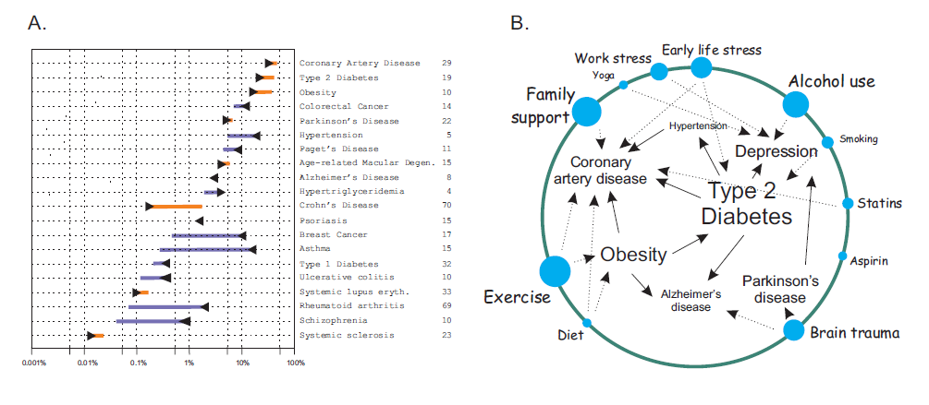
Common Variant Risk-o-Grams
Ashley et al (2010) Lancet 375: 1525-1535

Slide 16
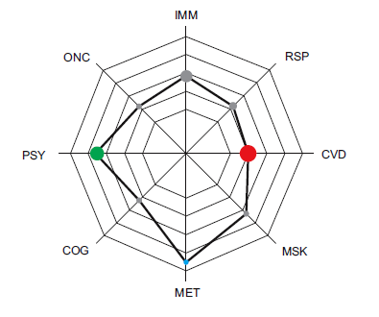
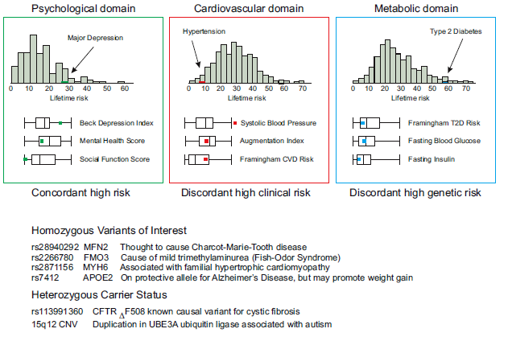
A Sample Predictive Health Profile
Patel, Sivadas et al (2013) Genome Medicine 5: 58

Slide 17
Prediction and Stratification
For complex traits, the upper limit of the correlation between an as yet unobserved phenotype and a genetic predictor is h, the square root of the heritability (h2).
Imagine if we had a perfect genetic predictor for height (e.g. all causal variants known without error) then the prediction error for any individual would be 7*√(1-0.8) = 3.1cm, assuming that h²=0.8 and that the standard deviation for height is 7cm. So we would predict someone's height with a 95% confidence interval of about +/- 6cm. The top and bottom 10% of any sample are generally 1.6 standard deviation units above or below the average. For height that translates to 1.6*7*√(0.8) = 10cm, so individuals at the genetic tails will tend to be 20cm apart. That’s about the same as we get from knowing the parents.
However, the point is not to predict so much as to classify. Personalized medicine is about targeting therapy: who is most likely to need the drug; or perhaps more importantly, who is unlikely to benefit from it and hence can be spared the expense and the common deleterious side-effects.
Some suspect, though, that genetic prediction may also be used to guide pre-implantation diagnosis: given a choice among 10 embryos, how many parents would choose the one with a probable IQ 10 points higher than the mean?

Slide 18
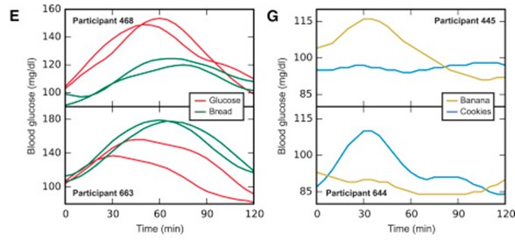
Microbiome-directed personalized nutrition
How can pre-diabetics control their blood glucose given that we each respond differently to different diets? In part, by monitoring our micriobiome, which in combination with other tests, is remarkably predictive.
Zeevi et al (2015) Cell 163: 1079-1094

