Slide 1
Treatment and Immune Control of Malaria and TB
Unit 4
Paul Thomas
Paul.Thomas@stjude.org
Department of Immunology
St. Jude Children’s Research Hospital

Slide 2
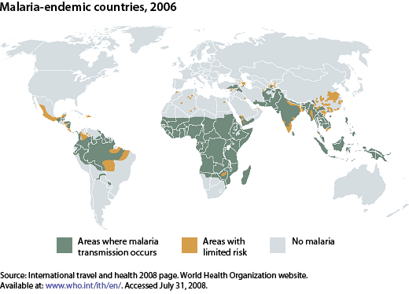
Malaria Prevalence
~350-500 million infections/year
1-2 million deaths/year, most of them among children under 5

Slide 3
Malaria life cycle

Slide 4
Plasmodium spp.
In humans:
Plasmodium falciparum: causes the most severe form of malaria and can be fatal. Can cause chronic infections (up to 2–3 years), but does not form hypnozoites (dormant stages that persist in hepatocytes) and does not relapse.
Plasmodium vivax: a major cause of clinical malaria, but is rarely fatal. Distribution is restricted by the absence of Duffy antigen (which determines entry into red blood cells) in African populations. This parasite forms hypnozoites and might relapse many years after apparent cure.
Plasmodium malariae: infrequent cause of clinical malaria, especially in Africa. Untreated infections can persist as low-grade parasitaemia for several decades.
Plasmodium ovale: infrequent cause of mild–moderate clinical malaria, but might be found in mixed infections with other species. Forms hypnozoites and might relapse.
In mice:
Plasmodium chabaudi (P. chabaudi chabaudi AS and P. chabaudi adami): used to study immune mechanisms and immunoregulation by cytokines, to identify susceptibility loci and to study the immune basis of pathology. P. chabaudi chabaudi AS causes non-lethal infection in resistant mouse strains and lethal infection in susceptible mouse strains. P. chabaudi adami causes a mild, non-lethal infection.
Plasmodium berghei (P. berghei ANKA and P. berghei K173): widely used to study pathogenesis. P. berghei ANKA serves as a model of experimental cerebral malaria (ECM); there is genetic variation in the development of ECM between inbred mouse strains, which correlates with the production of pro-inflammatory cytokines.
Plasmodium yoelii (P. yoelii 17XL, P. yoelii 17XNL and P. yoelii YM): used to study immune mechanisms and pathogenesis, including ECM, as recombinant merozoite surface protein 1 (MSP1) is available. P. yoelii 17XL is widely used to identify vaccine-induced immune responses.
Plasmodium vinckei: P. vinckei vinckei, which causes a lethal infection, is used to study pathogenesis and for chemotherapy studies; P. vinckei petteri, which causes a non-lethal infection, is used to study immune mechanisms.
From Nature Reviews Immunology 4, 169-180 (March 2004)

Slide 5
Plasmodium spp.: life cycle determine disease severity
Exoerythrocytic schizogony and prepatent and incubation periods
 | P. falciparum | P. vivax | P. ovale | P. malariae
Prepatent period (days) | 6-9 | 8-12 | 10-14 | 15-18
Incubation period (days) | 7-14 | 12-17 | 16-18 | 18-40
Merozoite maturation (days) | 5-7 | 6-8 | 9 | 12-16
Merozoites produced | 40,000 | 10,000 | 15,000 | 2000

Slide 6
P. Falciparum also causes a more severe disease presentation
Severe fevers are characteristic of any malaria, but the frequency and duration of relapse are the key features of falciparum and vivax malaria

Slide 7
Variation of symptoms among Plasmodium species
Disease Severity and Duration
 | vivax | ovale | malariae | falciparum
Initial Paraoxysm Severity | moderate to severe | mild | moderate to severe | severe
Average Parasitemia (mm³) | 20,000 | 9,000 | 6,000 | 50,000-500,000
Maximum Parasitemia (mm³) | 50,000 | 30,000 | 20,000 | 2,500,000
Symptom Duration (untreated) | 3-8+ weeks | 2-3 weeks | 3-24 weeks | 2-3 weeks
Maximum Infection Duration (untreated) | 5-8 years | 12-20 months | 20-50+ years | 6-17 months
Anemia | ++ | + | ++ | ++++
Complications |  |  | renal | cerebral
Modified from Markell and Voge's Medical Parasitology
While falciparum is the only species associated with severe mortality, the others (particularly vivax) inflict a high degree of morbidity
Some species can persist in the liver for years, while others persist in the blood stages as a low level infection

Slide 8
Malaria in Mice
Early during infection, P. berghei strain ANKA is a good model of cerebral malaria (CM), and processes identified using this model have been subsequently validated in humans. Inbred mouse strains differ markedly in their susceptibility, showing the importance of host genetic variation in immunopathogenesis. Similarly, different strains of P. berghei (K173 versus ANKA) differ in some aspects of pathogenesis, indicating the influence of parasite genetic variation in induced pathology.
Infection with P. yoelii strain 17XL (a lethal strain) induces CM that is associated with the sequestration of parasitized red blood cells, and it has been used together with P. yoelii strain 17XNL (a non-lethal strain) to study experimental vaccine-induced immune responses.
P. chabaudi chabaudi strain AS causes a non-lethal infection in resistant mouse strains and a lethal infection in susceptible mouse strains. Lethality, however, results from haemolysis that is secondary to hyperparasitaemia, which might not be relevant to the human disease processes. This Plasmodium strain has been used to study experimental vaccines and immunological processes that control hyperparasitaemia. Infections with P. chabaudi adami are self-resolving, non-pathogenic and non-lethal.
P. vinckei vinckei causes an aggressive, overwhelming hyperparasitaemia.
Immunological processes in malaria pathogenesis Louis Schofield and Georges E. Grau Nature Reviews Immunology 5, 722-735 (September 2005) doi:10.1038/nri1686

Slide 9
Immune Responses mediate plasmodium pathology

Slide 10
Typical “Th1-Type” immunity contributes to malaria protection and pathology
In infected mice, antigen is presented in the spleen where Th1 cells regulate innate and adaptive immune responses, including stimulating anti-parasite antibody and effector mechanisms such as ROI and RNI

Slide 11
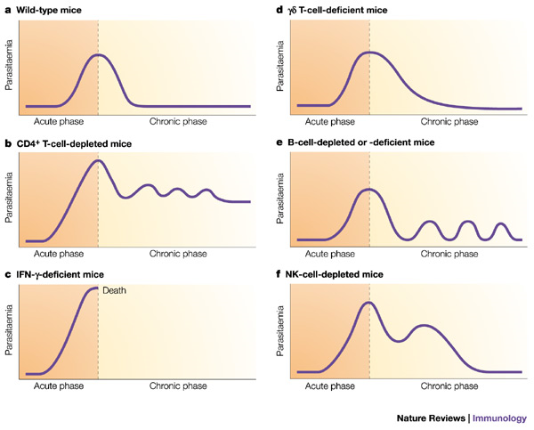
Immune mechanisms to control malaria
Antibodies block invasion of sporozoites into liver cells
Interferon- (IFN-) and CD8⁺ T cells inhibit parasite development in hepatocytes
Antibodies block invasion of merozoites into erythrocytes
Antibodies prevent sequestration of infected erythrocytes by preventing binding to adhesion molecules on the vascular endothelium
IFN- and CD4⁺ T cells activate macrophages to phagocytose intra-erythrocytic parasites and free merozoites
Antibodies neutralize parasite glycosylphosphatidylinositol and inhibit induction of the inflammatory cytokine cascade
Antibodies mediate complement-dependent lysis of extracellular gametes, and prevent fertilization of gametes and the development of zygotes
Mary M. Stevenson & Eleanor M. Riley
Nature Reviews Immunology 4, 169-180 (March 2004)

Slide 12
Fatal Disease in malaria infection

Slide 13
Antigenic variation and Sequestration: Pathological implications
PfEMP1 variation leads to distinct waves of parasitemia
This receptor also causes RBC clumping and sequestration to avoid clearance and detection in the spleen
These effects can be particularly deleterious in the placenta and the brain

Slide 14
Different Malaria Species Utilize Diverse host receptors
The strength of malaria as an evolutionary pressure can be observed in West Africa, where mutations to eliminate expression of the Duffy blood group protect individuals from P. vivax

Slide 15
Platelets can play important immunological roles
Platelets are activated by TNF and can secrete other pro-inflammatory mediators such as IL-1, leading to an increased local inflammation and providing additional receptors for the recruitment of parasitized blood cells

Slide 16
Pathology of Cerebral Malaria
A cascade of immunological stimulation leads to the accumulation of effector cell types and systemic hypercytokinemia, permebalizing endothelial layers and contributing to blockages

Slide 17
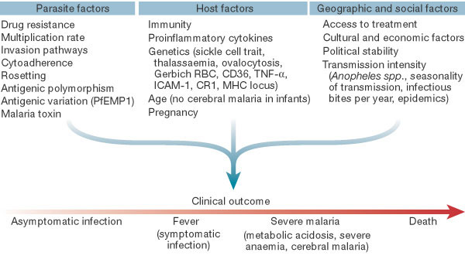
Host/Parasite/Treatment combine to determine outcome from Disease
Important to consider that only 1/200-500 infections is lethal
The most important considerations are likely the parasite (only falciparum is commonly lethal) and immunity

Slide 18
Anti-Malarial Drugs

Slide 19
Resistance limits drug efficacy
Each new drug introduction has seen a rapid development and spread of resistance worldwide
Most drug targets are enzymatic allowing parasite mutation to overcome drug sensitivity
Chloroquine targeted a chemical process—resistance developed more slowly, but is now widespread

Slide 20
Emerging Resistance to Artemisinin
No total resistance noted, but increased clearance times developing
Monotherapies may be one cause of increased resistance (now banned in Cambodia)
Mass treatment approach in heavily endemic areas also considered

Slide 21
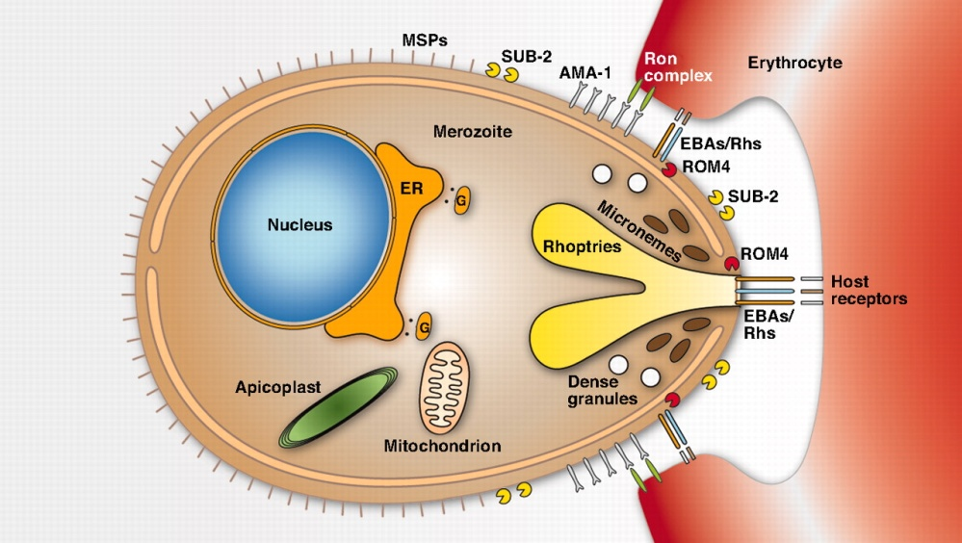
New and Old Targets of the Merozoite stage
Molecular characterization of the merozoite itself and the process of RBC invasion may provide novel targets that will hopefully have minimal side effects due to their unique structure and function

Slide 22
Vector Control
Vector control efforts range from basic bed nets, to spraying insecticides externally and on house walls, to more sophisticated “vector engineering” efforts to produce malaria-resistant mosquitoes, among many others
Math modeling of infectious spread has led to some hypotheses about which of these methods are the most effective (bed nets, house wall spraying) and which are unlikely to be effective (releasing resistant mosquitoes)

Slide 23
Malaria Vaccine Targets
Three types of vaccines have been proposed, with variations in each group:
Pre-erthyrocytic vaccines: the only truly “sterilizing” protection, but hard to generate enough antibody immunity (to prevent any infection) or CD8 immunity (to clear every single infected liver cell)
Blood-stage vaccine: designed to enhance clearance of infected red blood cells, therapeutic but not sterilizing
Gametocyte vaccines: Potentially strong antigen candidates and immune complexes can be carried to the mosquito—”altruistic vaccine”

Slide 24
RTS,S Vaccine Approved for Stage III in Infants
The vaccine candidate farthest along is RTS,S, a pre-erythrocytic vaccine against the circumsporozite protein
Mechanism is presumed to be antibody, but cellular responses have been shown
Vaccine is adjuvanted and protein is linked to hepatitis B antigen

Slide 25
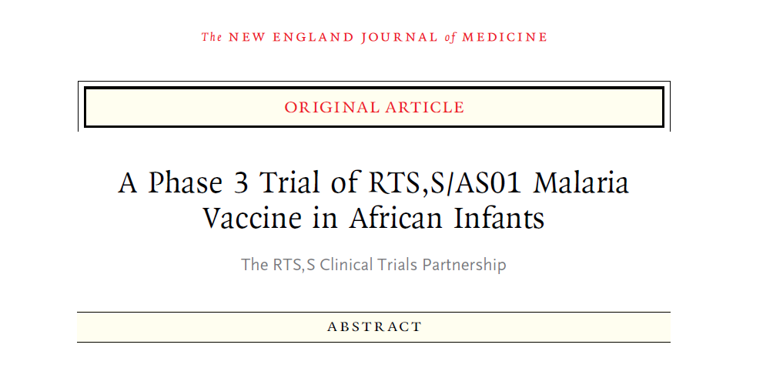
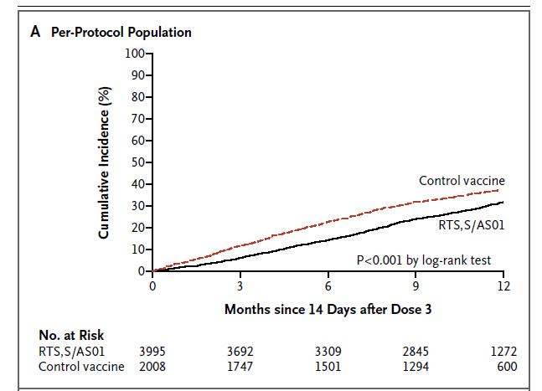
RTS,S showed modest efficacy in infants
~30% efficacy shown in latest trial
Generally viewed as disappointing, but still moving forward (previous trial had ~61% efficacy, but was much smaller and in a different transmission area)
Late 2013 results—47% efficacy in children over longer follow up

Slide 26
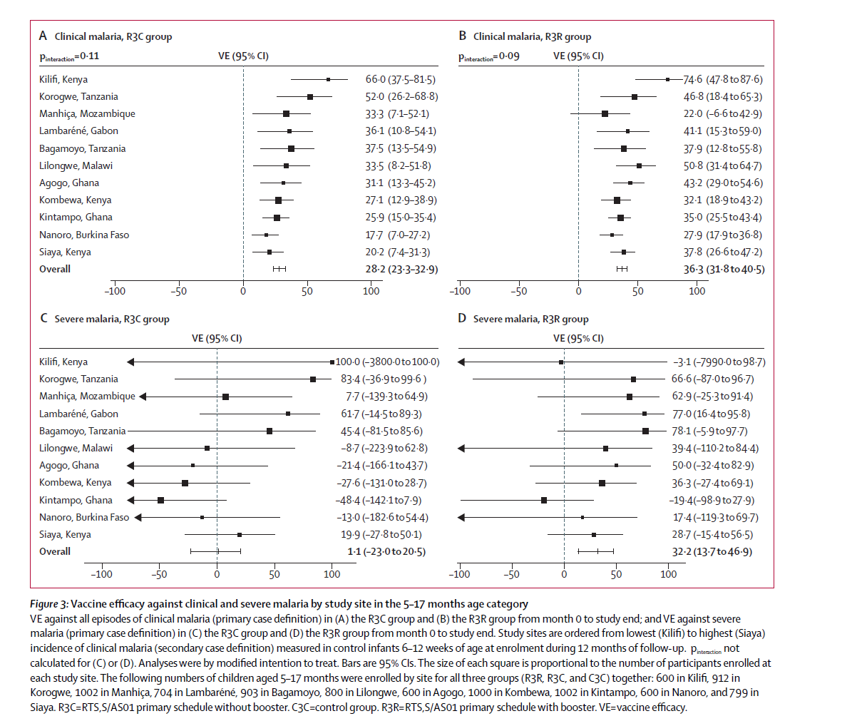

Slide 27
Can cellular responses work against infected liver cells?
Prime-boost-boost approach to drive extraordinarily high numbers of antigen-specific CD8 T cells (1% of all T cells needed)
“Threshold” effects demonstrating effective surveillance of liver stage infection by CD8 T cells
Proc Natl Acad Sci U S A. 2008 September 16; 105(37): 14017–14022.

Slide 28
Math Modeling and Malaria
Transmission models have contributed substantially to the understanding of malaria control
Within host modeling is crucial to determine the potential efficacy of the three types of vaccine candidates
The “threshold” effects of malaria infection (immunity is helpful in endemic regions, but requires frequent low grade re-infection) are particularly suited to a quantitative approach

Slide 29
Immune Control of Mycobacterium tuberculosis

Slide 30
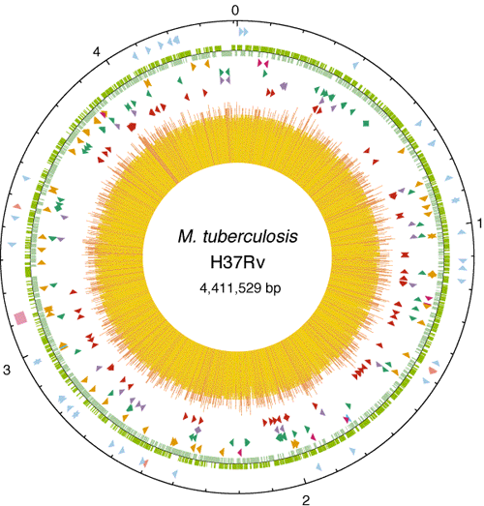
Mycobacterium Tuberculosis (Mtb)
Acid-fast, rod-shaped bacillus
Unique wax-rich cell wall composed of long chain fatty acids and glycolipids
250 genes dedicated to fatty-acid metabolism
Slow, 20 hour replication time

Slide 31
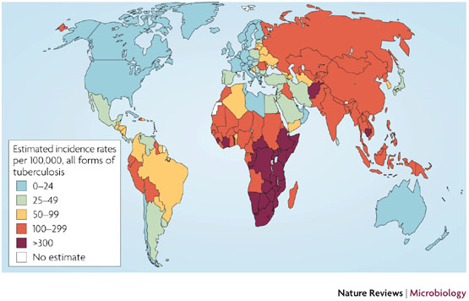
Mtb infection Worldwide

Slide 32
Mtb impact
2.2 million deaths/year
Burden of diseases in DALY (disability-adjusted life years)
Total Disability Adjusted Life Years: 45 million (3.1%).
2 billion individuals infected with M. tuberculosis
10% risk of developing disease following infection
Untreated, disease mortality is 50%
8 million new tuberculosis cases per year (1 new case every 4 seconds)
10–15 individuals infected annually by a single untreated patient

Slide 33
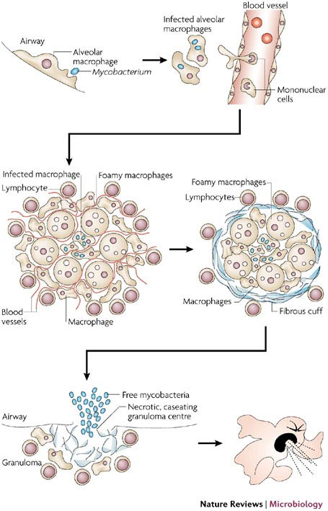
Mtb Life Cycle
MTb replicates in and accumulates in macrophages, mostly in the lung (though other tissue sites are possible)
The accumulation of infected macrophages, surrounded by other leukocytes forms a unique structure called the granuloma, the characteristic feature of MTb-associated lung damage

Slide 34
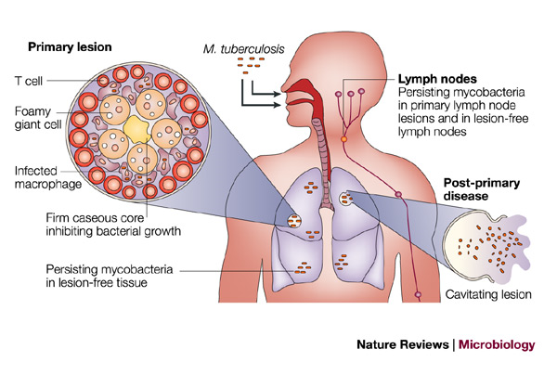
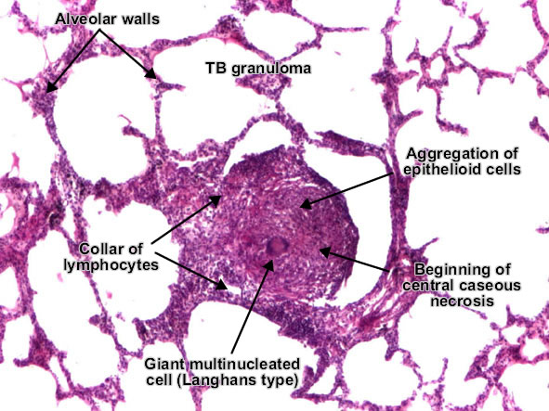
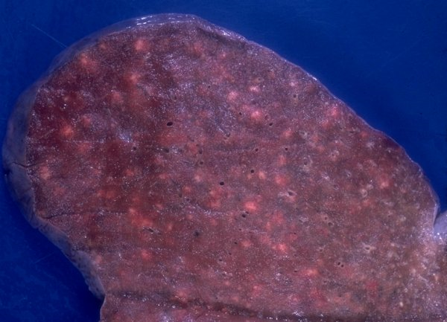
Mtb Life Cycle Part 2

Slide 35
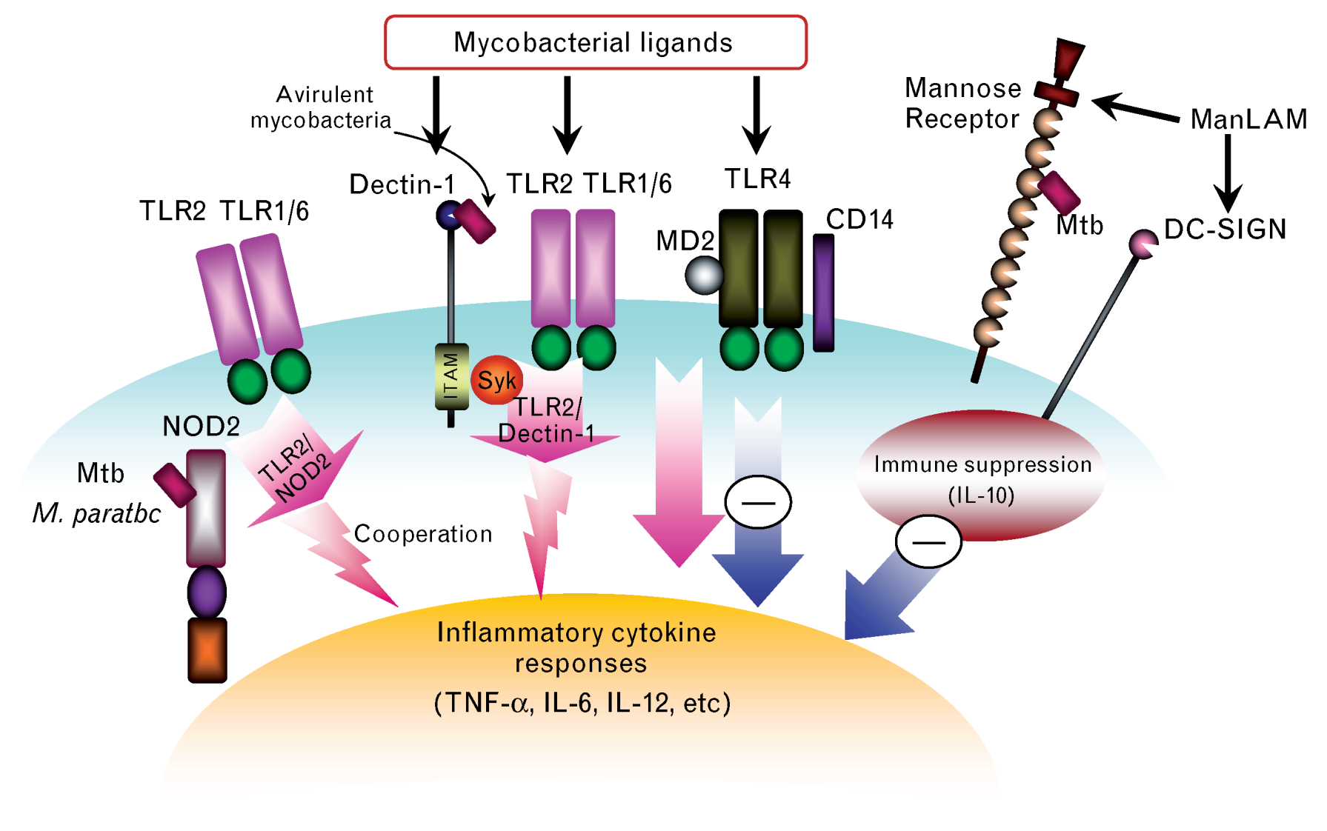
Innate Recognition of Mtb

Slide 36
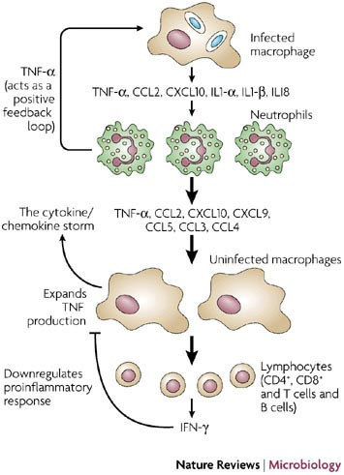
Activation of Cytokine Storm
Macrophages do respond to the infection, even if they fail to clear
Recruitment of other monocyte/macrophages/inflammatory cells to the lesion, promoting granuloma formation and enhancement of cytokine signaling
Eventually recruits adaptive response which acts through “traditional” cell-mediated clearance and regulation of macrophage effector function

Slide 37
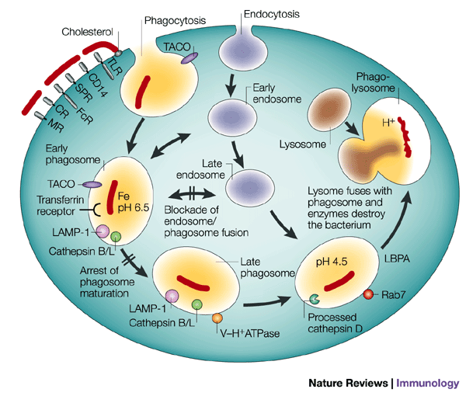
Endosomal/Lysosomal Dysregulation
After uptake by scavenger receptors, MTb arrests the maturation and fusion of the phagosome with the endosome
Highly activated macrophages (IFN-g stimulation) can complete maturation and destroy the bacteria—otherwise, the bacteria remain latent or can grow

Slide 38
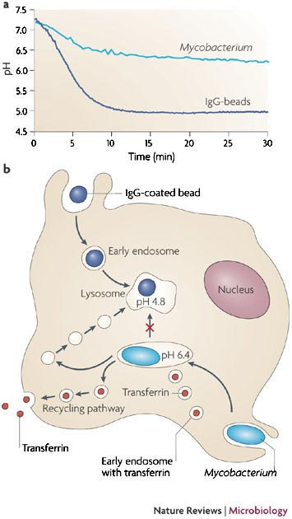
Prevention of acidification leads to persistence
MTb uses active processes to prevent acidification
Inert latex beads complete the cycle and are rapidly “acidified” within five minutes of uptake
Persistence also requires important metabolic adaptations (low oxygen environment) that allow continued bacterial growth and survival

Slide 39
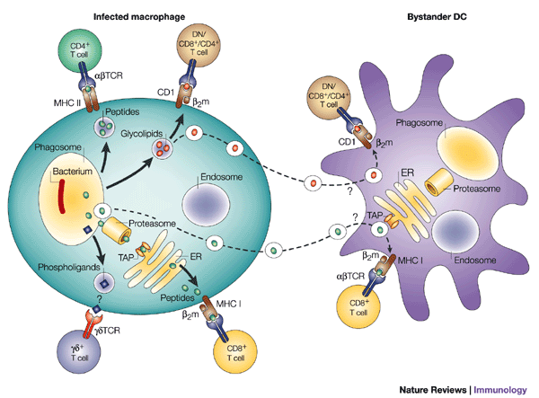
Initiation of the Adaptive Response
The cytokine storm initaited by the innate response determines the character of the ensuing adaptive response
Non-classical T cells (gamma-delta, CD1 restricted) play an important role in MTb control, but are not conserved between humans and mice, making their study difficult (one reason why guinea pigs are often used in MTb studies)
Both CD4 and CD8 functions (cytokine regulation and direct cell clearance) are associated with protection from disease

Slide 40
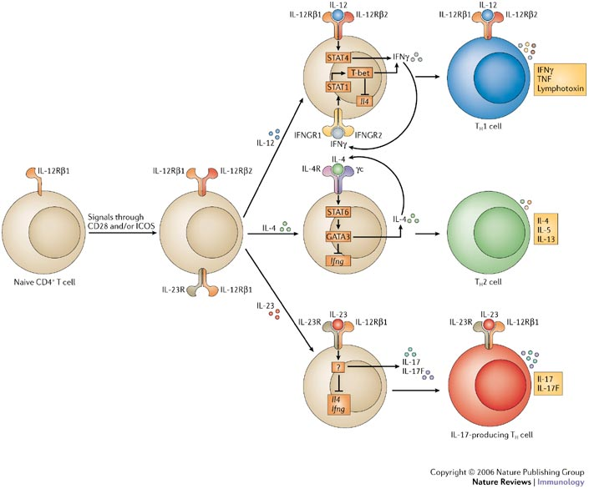

Slide 41
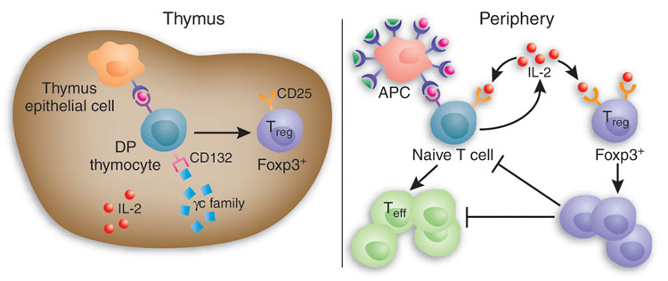
Generation of Antigen-Specific Regulatory T cells

Slide 42
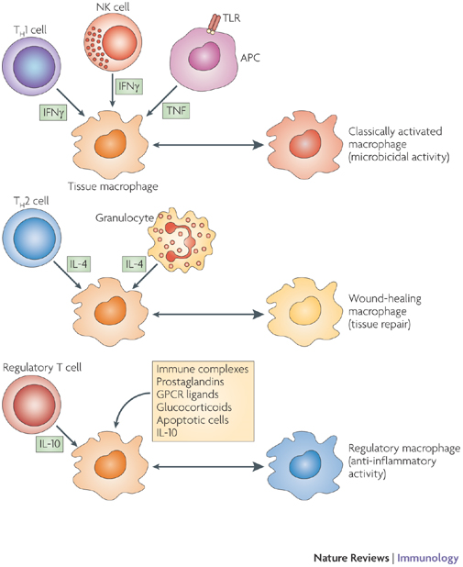
T cell regulation of Macrophage effector Function
The balance of regulatory vs. effector signals (and the various types of those signals) determine the activation mileu of the granuloma and the infected macrophage
Immune-associated pathology is also a risk, so some regulatory balance is required to maintain the lung physiology while achieving clearance or control

Slide 43
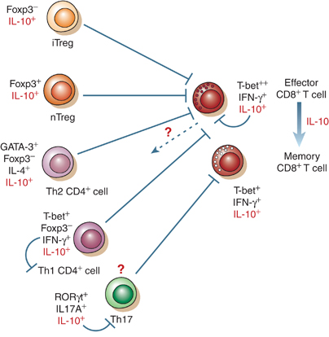
IL-10 regulation of lung pathology
IL-10 has been shown in multiple infections to be a key regulatory of pathology
In influenza, IL-10 produced by multiple cell types is required for survival in certain models of infection
The pleiotropic effects of this cytokine are still poorly understood at a mechanistic level

Slide 44
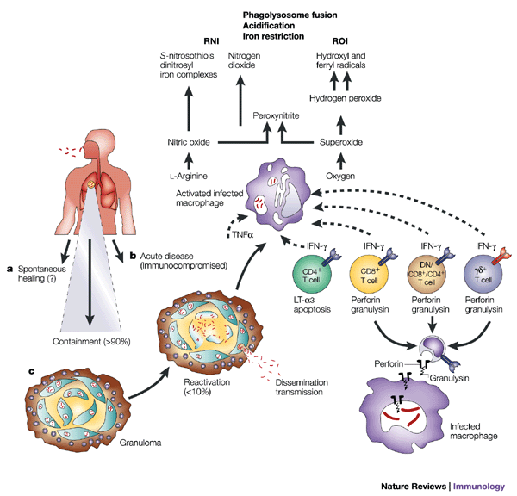
Control of Mtb

Slide 45
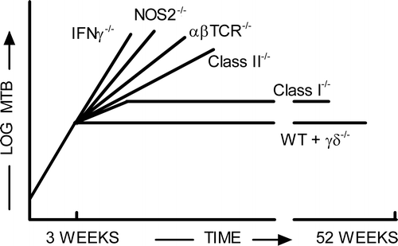
Summary of Control mechanisms
Phagolysosomal destruction is the most important mechanism for removing bacteria
IFNg stimulates the maturation of the phagolysosome, overcoming the inhibitory signals used by MTb
The most effective form of this killing involves ROI and RNI
Adaptive immunity is important for regulating the cytokine environment and, to a smaller extent, for cytolytic killing

Slide 46
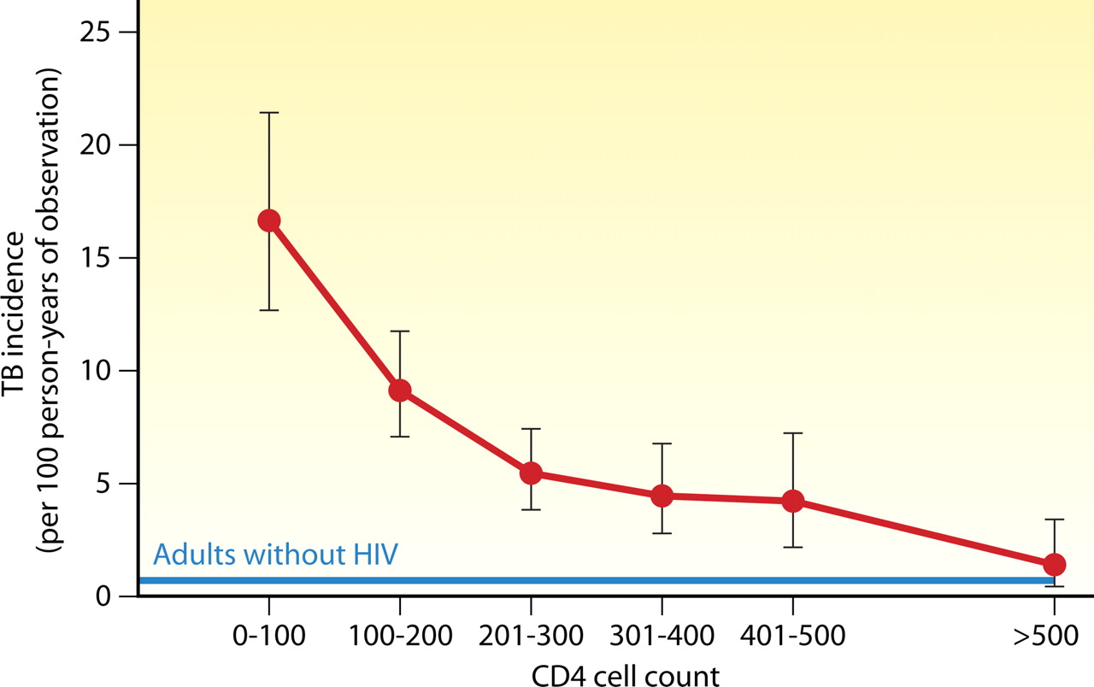
TB incidence rates decrease with recovery of CD4 cell counts during antiretroviral therapy.
Candice K. Kwan, and Joel D. Ernst Clin. Microbiol. Rev. 2011;24:351-376
Notes:
TB incidence rates decrease with recovery of CD4 cell counts during antiretroviral therapy. TB incidence is defined as incident TB cases per 100 person-years, with 95% confidence intervals shown. The blue line represents baseline TB incidence (0.7 cases/100 person-years) in adults without HIV in a comparable neighboring community. (Adapted from reference 156 with permission of the publisher.)‏

Slide 47
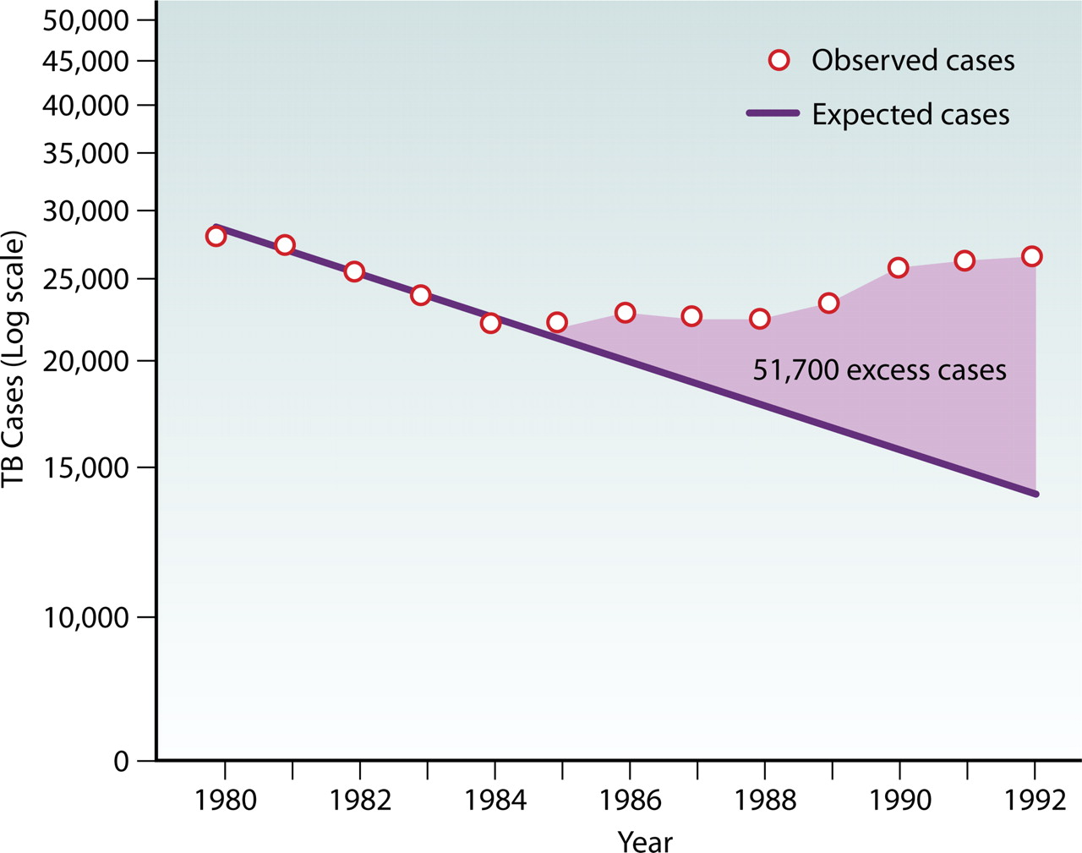
Estimated excess TB cases attributed to the worsening HIV epidemic in the United States from 1985 to 1992.
Candice K. Kwan, and Joel D. Ernst Clin. Microbiol. Rev. 2011;24:351-376
Notes:
Estimated excess TB cases attributed to the worsening HIV epidemic in the United States from 1985 to 1992. (Reprinted from reference 44.)‏

Slide 48
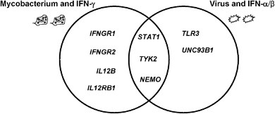
Human Genetic Deficiencies
The primary phenotype of individuals with genetics deficiencies in IFN-g signaling or activation is susceptibility to Mycobacterial disease
In contrast, deficiencies in Type I IFNs result in viral susceptibilities

Slide 49
What causes reactivation?
In developing countries, post-primary disease rate peaks in young adult age groups (common feature of several types of infections—endocrine influence?)
Immunosuppression of innate or adaptive immunity results in reactivation (HIV, TNF blockade)
Immune senescence (aging)

Slide 50
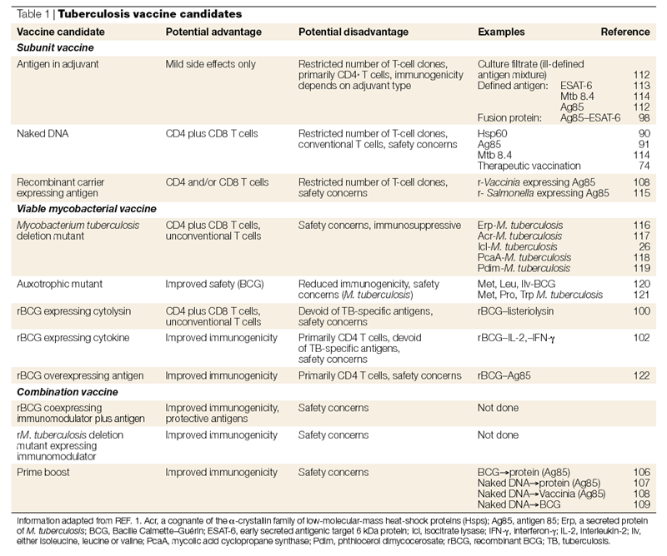

Slide 51
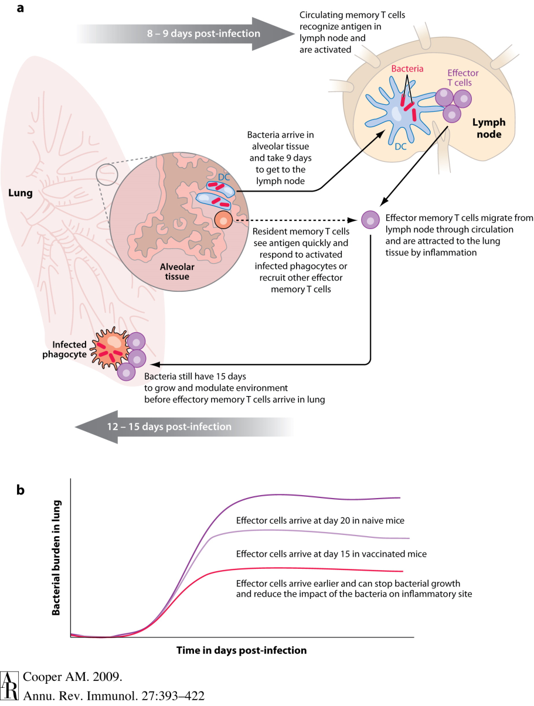
Rate of adaptive response correlates with control

Slide 52
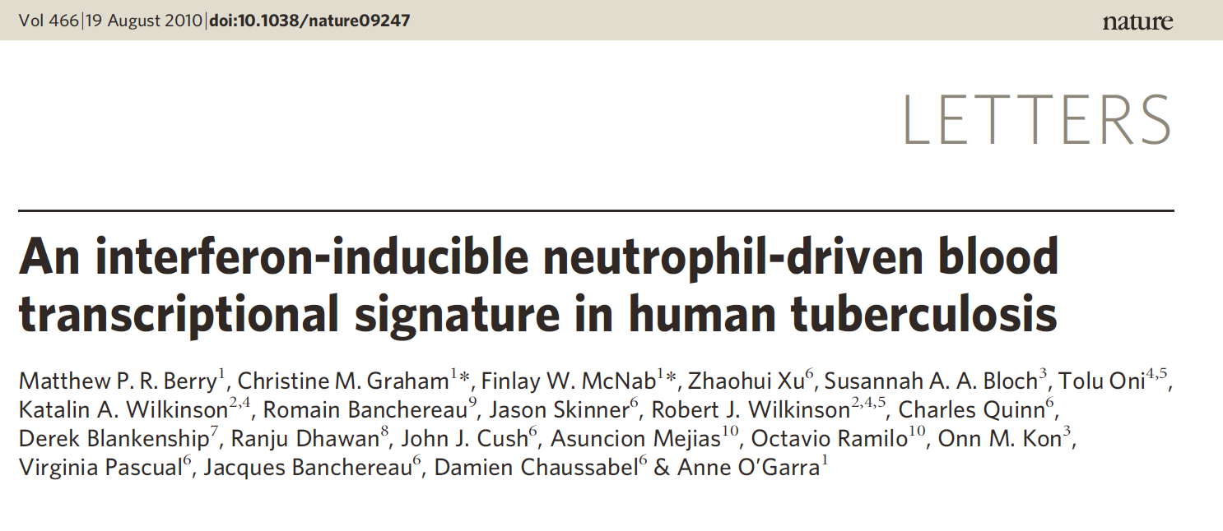
What controls Reactivation?
Diagnosis and assessment of TB still relies on chest radiography
Rapid sequencing approaches might provide a platform for greater diagnostic discernment with less invasive techniques
These studies also generate hypotheses that can lead to better understanding and prediction of reactivation

Slide 53
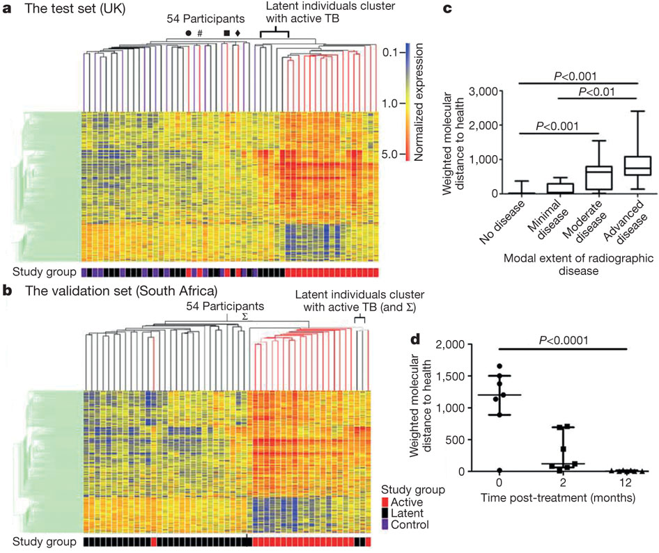

Slide 54
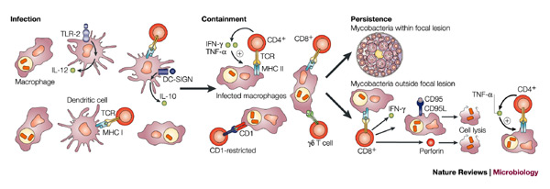
Summary and Perspectives
MTb is never completely cleared following initial infection
The primary effector mechanisms are macrophage bactericidal functions, but their success is determined by the cytokine and cellular regulatory environment
Small subtle shifts over time or dramatic short-term changes lead to reactivation and disease

