Slide 1
Summer Institutes of Statistical Genetics, 2020
SISG Module 6: Gene Expression Profiling
Lecture 10: Co-occurrence for scRNAseq Analysis
Peng Qiu and Greg Gibson
Georgia Institute of Technology

Slide 2
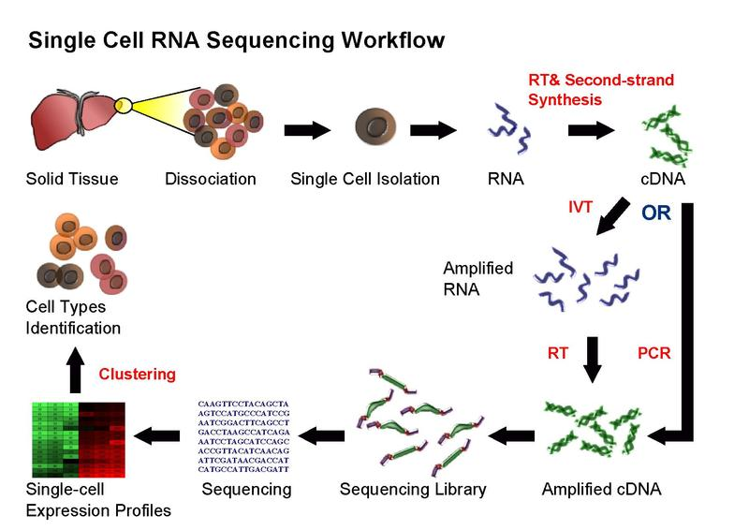
Single-cell RNA-seq

Slide 3
Dropout
Dropout is an important phenomenon that occurs in scRNA-seq data, where a gene is observed at a moderate expression level in one cell but is not detected in another cell of the same cell type
Why dropouts occur?
  Low amounts of RNA in individual cells
  Insufficient RNA capture
  Stochasticity of gene expression
How big of a problem is it?
  droplet-based techniques, dropout rate is 90%~97%
  fcas-based techniques, dropout rate is 70~80%
How are people handling the dropouts?
  Select highly variable genes
  Perform dimension reduction (PCA, tSNE, etc)
  Imputation

Slide 4
How are people handling the dropouts?
PCA to derive reduced features by combining genes
Select highly variable genes
which are less affected by dropouts
Subsequent analysis
cells
cells
Highly variable genes
PCs
cells
genes
raw
data
cells
genes
Imputed
data
Subsequent analysis
Impute the data based on gene-gene similar or cell-cell similarity

Slide 5
Imputation methods for addressing dropout
Existing imputation methods: MAGIC, scImpute, SAVER, netSmooth, …
In general, there are two schools of thoughts about dropouts
  Dropout affects the observed expression counts of all the genes in all the cells. Therefore, the entire count matrix needs to be corrected.
  Only a subset of the zeros are caused by dropout, while many of the zeros in the data are supposed to be zeros. Therefore, we should only correct the zeros that are likely caused by dropout.
My opinion
  The first approach of imputing/updating the entire count matrix is TOO MUCH. Some of the zeros in the raw data are probably supposed to be zeros, and should be left untouched by imputation.
  The second approach of imputing/updating a subset of zeros is NOT ENOUGH. Many of the non-zero values in the raw data probably should also be updated/elevated.
  A better approach: imputing/updating all the non-zeros values and a subset of zeros ???

Slide 6
Motivation of my recent work
Everyone treats dropouts as noise/problem that needs to be fixed
I would like to explore an opposite view. Can I treat dropouts as a signal, and do something useful with it?

Slide 7
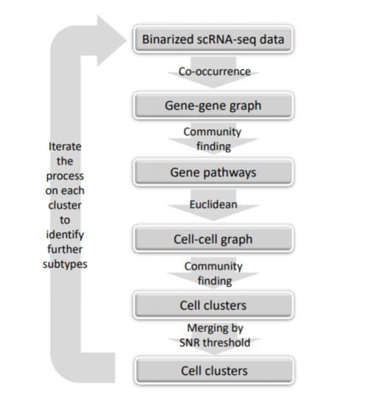
Co-occurrence clustering (unsupervised)

Slide 8
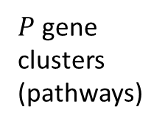
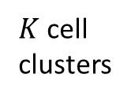


Co-occurrence clustering (unsupervised)
Starting point/input
cells
cells
genes
genes
raw
data
Binarize the data
genes
binary
data
Compute
gene-gene
similarity by
co-occurrence
genes
cooc
Community
finding
to identify
gene clusters
$P$ gene
clusters
(pathways)
Compute the activity (average detection rate) for each gene cluster
cells
Community
finding
to identify
cell clusters
cells
Euclidean
distance
cells
$K$ cell
clusters
$P$ gene
clusters
$$d(x,y)$$
Iterate and perform the same analysis for cells in each cell cluster separately
until stopping criteria are met (difference among the cell clusters too small)

Slide 9
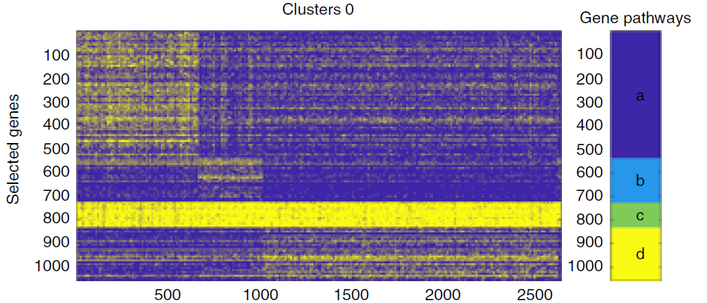
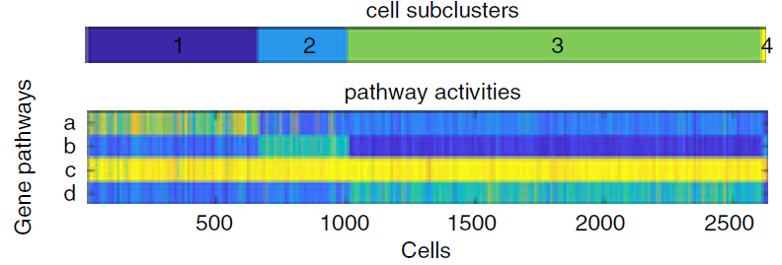
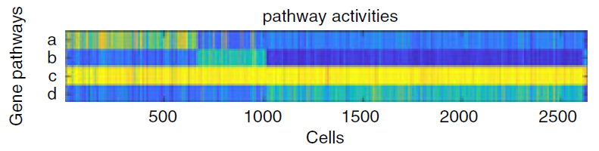
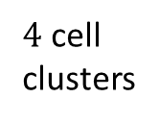
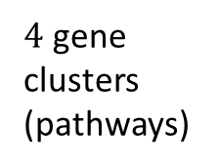
Results – Human PBMC
(profiled by 10x, 32738 genes * 2700 cells, 97% dropout)
Starting point/input
2700 cells
2700 cells
32738 genes
32738
genes
raw
data
Binarize the data
32738
genes
binary
data
Compute
gene-gene
similarity by
co-occurrence
32738
genes
cooc
Community
finding
to identify
gene clusters
$4$ gene
clusters
(pathways)
Compute the activity (average detection rate) for each gene cluster
cells
Community
finding
to identify
cell clusters
cells
Euclidean
distance
cells
$4$ cell
clusters
4 gene
clusters
$$d(x,y)$$
Iterate and perform the same analysis for cells in each cell cluster separately
until stopping criteria are met (difference among the cell clusters too small)

Slide 10
Results – Human PBMC
Data: PBMC profiled by 10x, 32738 genes * 2700 cells, 97% dropout
Result: 9 co-occurrence clusters
COOC gene clusters are highly enriched by relevant biological pathways
COOC clusters are highly consistent with
Seurat based on highly variable genes
COOC is able to identify cell clusters that Seurat misses.

Slide 11
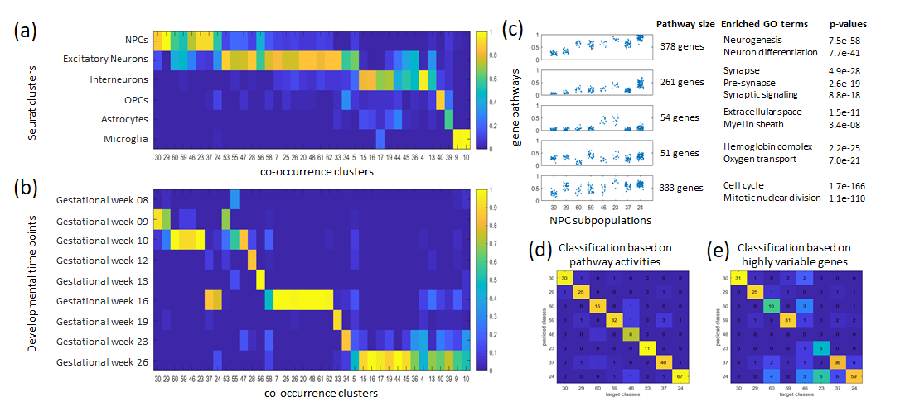
Results – Human prefrontal cortex
Data: human prefrontal cortex cells, SMARTseq2, 24153 genes * 2394 cells, 82% dropout
Result: 37 co-occurrence clusters
COOC gene clusters are highly enriched by relevant biological pathways
COOC clusters are highly consistent with known cell types.
COOC clusters are highly consistent with developmental time points.
COOC is able to identify cell clusters that Seurat misses.

Slide 12
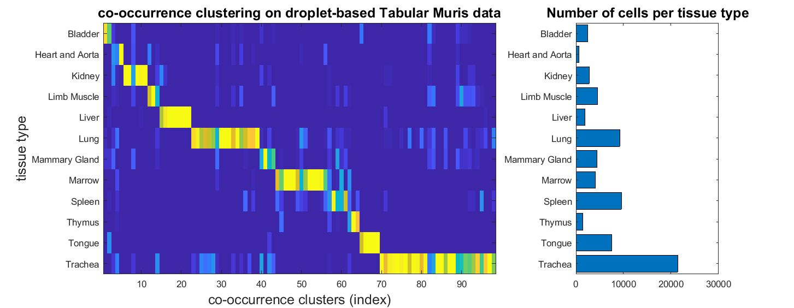
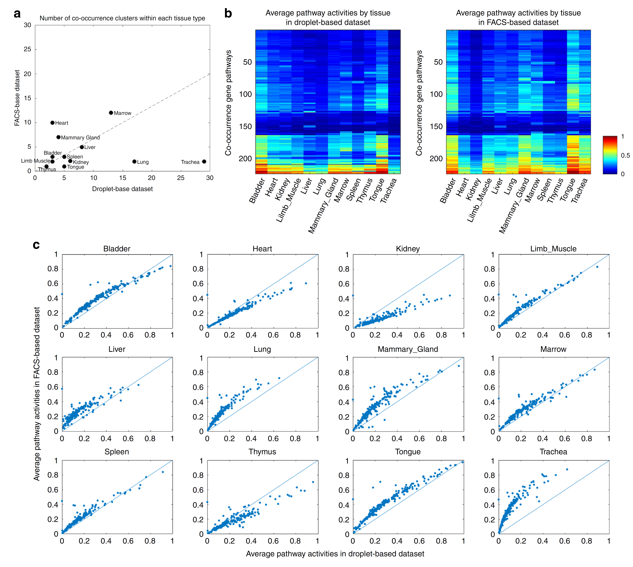
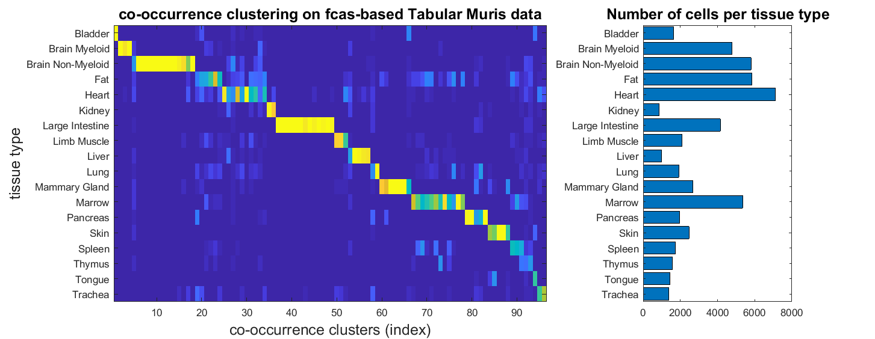
Results – Mouse Cell Atlas
Data: mouse cells from ~20 organs and tissues
profiled by 10x, 23433 genes * 70118 cells, 93% dropout
Profiled by SMARTseq2, 23433 genes * 53760 cells, 89% dropout
Result: ~100 co-occurrence clusters in each dataset
Binary signals highly consistent between two experimental protocols.
COOC clusters highly consistent with known tissue types.

Slide 13
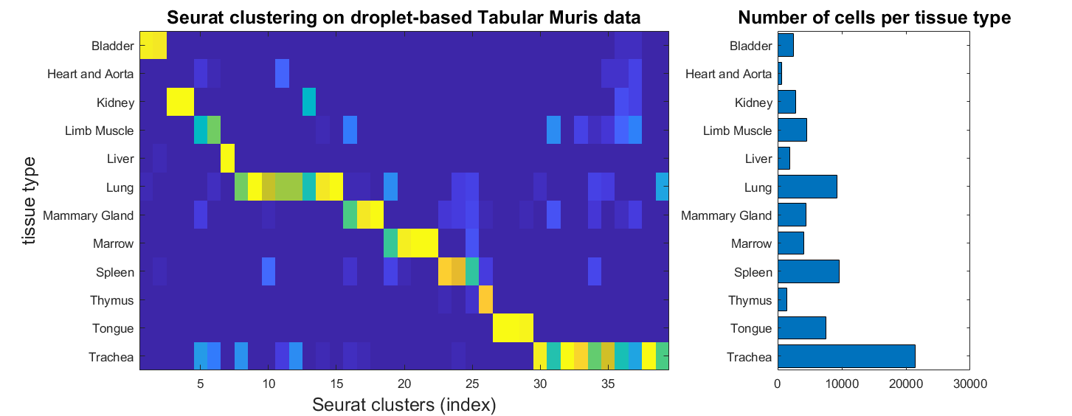
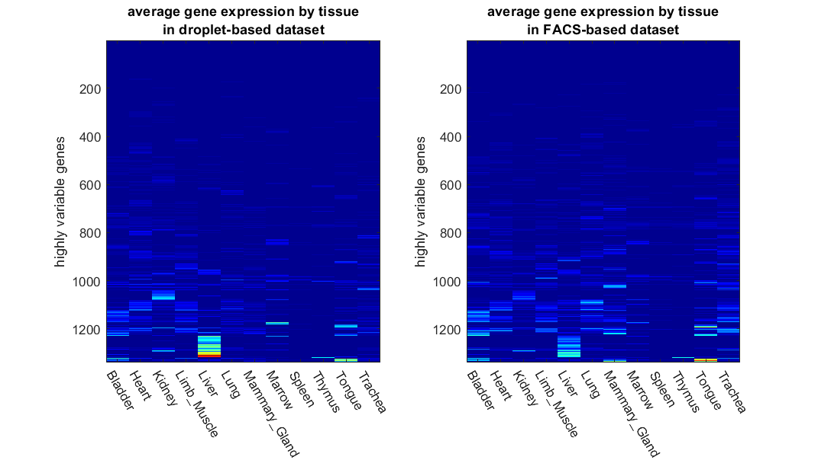
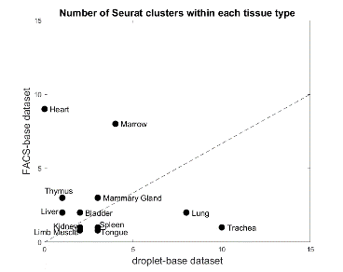
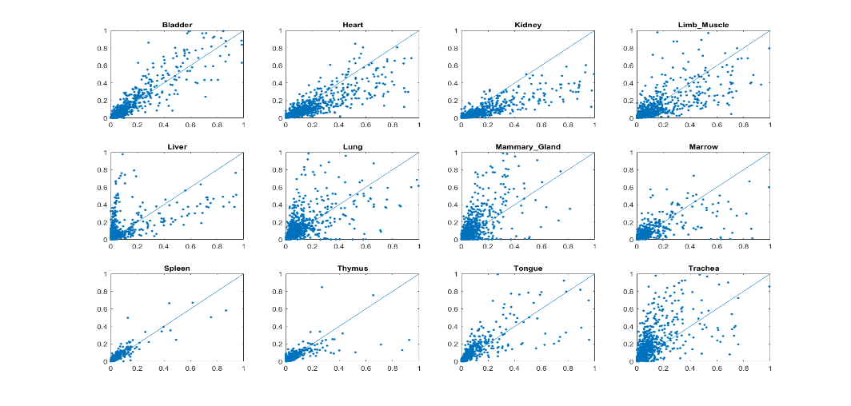
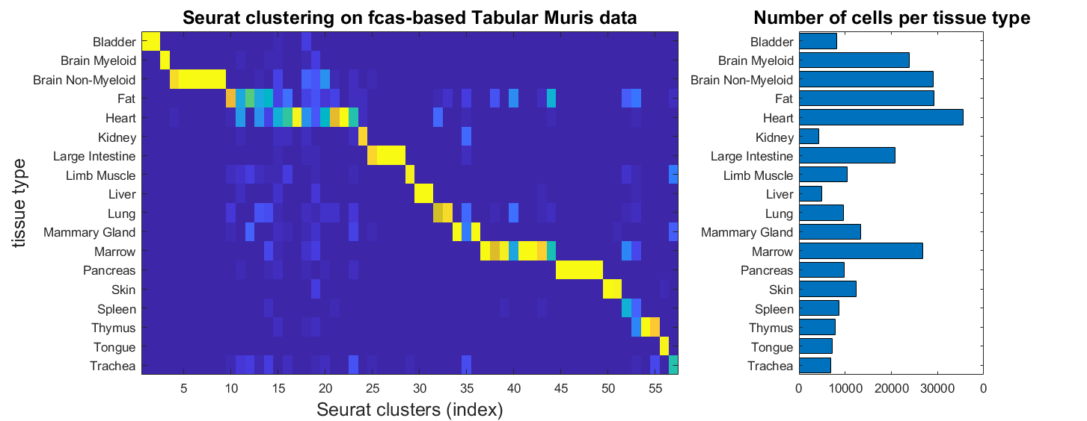
Results – Mouse Cell Atlas
Data: mouse cells from ~20 organs and tissues
profiled by 10x, 23433 genes * 70118 cells, 93% dropout
Profiled by SMARTseq2, 23433 genes * 53760 cells, 89% dropout
Result: ~100 seurat clusters in each dataset
Quantitative signals less consistent between two experimental protocols.
Seurat clusters highly consistent with known tissue types.

Slide 14
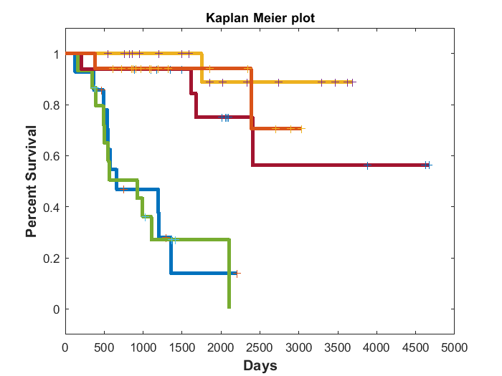
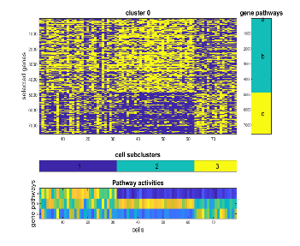
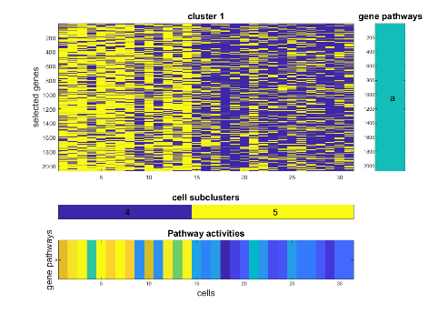
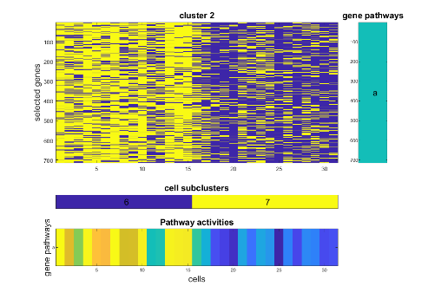
Results – Bulk tissue gene expression data of cancer
Data: TCGA cancer samples of one cancer type (ACC), ~60,000 transcripts * 79 patients, 56% dropout
Result: 5 co-occurrence clusters
This idea also works on bulk tissue gene expression data, and revealed patient clusters with distinct survival outcomes.

Slide 15
Conclusions so far
Opposite to the common view in the literature, dropout is actually useful !!!
For the purpose of clustering cells, the binary dropout pattern of all the genes is as informative as the quantitative expression data of highly variable genes
The co-occurrence clustering algorithm performs well on the binary data.
Qiu P, "Embracing the dropouts in single-cell RNA-seq analysis"
Nature Communications, published in March 2020
https://www.nature.com/articles/s41467-020-14976-9

