Slide 1
Summer Institutes of Statistical Genetics, 2020
Module 6: GENE EXPRESSION PROFILING
Greg Gibson and Peng Qiu
Georgia Institute of Technology
Lecture 1: EXPERIMENTAL DESIGN
greg.gibson@biology.gatech.edu http://www.cig.gatech.edu

Slide 2
SISG Module 6 Schedule
Date | Time (PST) | Time (EST) | Topic | Instructor
Wednesday, July 15 | 11:30 – 12:00 | 2:30 – 3:00 | Introductions
 | 12:00 – 1:00 | 3:00 – 4:00 | Experimental Design for Gene Expression Profiling | GG
 | 1:00 – 1:20 | 4:00 – 4:20 | Break
 | 1:20 – 2:20 | 4:20 – 5:20 | Hypothesis Testing, Significance and Power | GG
Thursday, July 16 | 8:00 – 9:00 | 11:00 – 12:00 | Foundations of Clustering | PQ
 | 9:00 – 9:20 | 12:00 – 12:20 | Break
 | 9:20 – 10:20 | 12:20 – 1:20 | Normalization of Transcriptome Datasets | GG
Thursday, July 16 | 12:00 – 1:00 | 3:00 – 4:00 | ATACseq, Methylation, and Intro to scRNAseq | GG
 | 1:00 – 1:20 | 4:00 – 4:20 | Break
 | 1:20 – 2:20 | 4:20 – 5:20 | Dimension Reduction Approaches | PQ
Friday, July 17 | 8:00 – 9:00 | 11:00 – 12:00 | Clustering for scRNAseq Analysis | PQ
 | 9:00 – 9:20 | 12:00 – 12:20 | Break
 | 9:20 – 10:20 | 12:20 – 1:20 | Trajectory Finding for scRNAseq Analysis | PQ
Friday, July 17 | 12:00 – 1:00 | 3:00 – 4:00 | eQTL and Genetics of Gene Expression | GG
 | 1:00 – 1:20 | 4:00 – 4:20 | Break
 | 1:20 – 2:20 | 4:20 – 5:20 | Co-occurrence Clustering for scRNAseq Analysis | PQ

Slide 3
Steps in a Gene Expression Profiling Study
Experimental Design (this afternoon)​
RNA Sequencing (next)​
Short read alignment (this afternoon)​
Normalization (tomorrow morning)​
Hypothesis testing (after the break today)​
Downstream analyses (Module 10)​
Genetic analysis (Friday afternoon)

Slide 4
RNAseq Workflow

Slide 5
Modes of Bulk RNA sequencing
RNA is prepared, mRNA is captured on polyT beads, fragmented, and converted to cDNA using either a stranded or unstranded protocol, usually with 12-24X multiplexing
Single-end reads
Maximizes the total number of independent reads (50M optimal)
When RNA is degraded, eg FFPE specimens
2. Paired-end reads
Slightly more accurate alignment
But typically lower coverage (25M reads)
Better for estimation of alternate splicing and ASE
3. 3’ targeted
Lexogen protocol is one fifth the cost ($70 vs $350 per sample)
Ideal for large sample studies when funds are a concern
Single Cell drop digital dd-scRNASeq is also 3’ targeted

Slide 6
RNAseq Software
Short Read Alignment
STAR https://github.com/alexdobin/STAR/releases
HISAT2 https://ccb.jhu.edu/software/hisat2/index.shtml
2. Read counting
HTseq http://www-huber.embl.de/HTSeq/doc/overview.html
SAMtools http://www.htslib.org/
3. Differential Expression
DESeq https://bioconductor.org/packages/release/bioc/html/DESeq2.html
DExSeq https://www.bioconductor.org/packages/release/bioc/html/DEXSeq.html
edgeR https://bioconductor.org/packages/release/bioc/html/edgeR.html
Voom http://web.mit.edu/~r/current/arch/i386_linux26/lib/R/library/limma/html/voom.html
Data Normalization
SVASeq https://www.bioconductor.org/packages/release/bioc/html/sva.html
Combat https://www.rdocumentation.org/packages/sva/versions/3.20.0/topics/ComBat
PEER http://www.sanger.ac.uk/science/tools/peer
SNM https://www.bioconductor.org/packages/release/bioc/html/snm.html
Another option is the Tuxedo protocol (Bowtie, Tophat, Cufflinks, Cuffdiff, https://ugene.net/wiki/display/WDD31/RNA-seq+Analysis+with+Tuxedo+Tools

Slide 7
Read Alignment

Slide 8
Basics of Experimental Design: Levels of Replication
Often you will have a fixed budget that constrains how many arrays can be processed. So your first task is to determine what levels of replication you can afford, and how they will impact statistical power.
Technical Replication:
- RNA preparation (eg. from adjacent biopsies)
- cDNA synthesis (pooling minimizes outlier effects)
- library preparation
- sequencing lane or array hybridization (usually a minimal effect)
Biological Replication:
Fixed effects: - sex
- treatment (drug, growth regimen, tissue)
- time of sampling (repeated measures in some cases)
- genotype (IF specifically chosen and resampled)
Random effects - individual from a population
- field plot

Slide 9
Basics of Experimental Design: Specifying Contrasts of Interest
At the same time, you need to be aware of the contrasts you wish to make since by tweaking the design you may gain a lot in terms of what you can infer.
Suppose you want to compare B cells and T cells from Healthy controls and COVID-19 patients, and you have the funds to generate 24 RNASeq profiles
What is the best design?
- 6 controls and 6 patients, each donating both a B and a T cell sample
- 12 controls and 12 patients, each donating either a B or a T cell sample
- 3 controls and 3 patients, each donating a B and a T cell sample, processed twice
- 3 controls and 3 patients, each donating 2 B and 2 T cell samples, on separate days
- same as above, but only men or only women
- 12 controls and 12 patients, each donating either a B or a T cell sample, but pooling two visits
Main effects can only be contrasted if you have biological replicates:
reducing the number of individuals may allow you to address intra-individual variability
Interaction effects allow you to ask questions like whether B cells and T cells differ more between healthy volunteers or patients

Slide 10
Two Hypothetical Sets of Results Illustrating Design Principles
Expression level
Healthy B Healthy T COVID B COVID T
Conclusions: COVID induces expression
T < B only in healthy people
Expression level
Healthy B Healthy T COVID B COVID T
Additional
Conclusions: Variability is low in Healthy controls
Flu B cell response is individualized
Flu T cell response is hypervariable

Slide 11
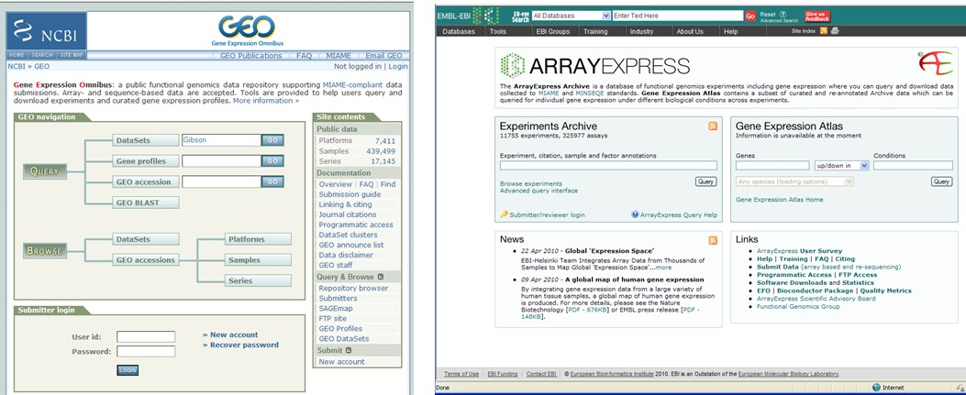
Reporting Results to Public Databases
GEOquery is R code for retrieving datasets from GEO:
https://www.bioconductor.org/packages/release/bioc/vignettes/GEOquery/inst/doc/GEOquery.html

