Slide 1
Summer Institutes of Statistical Genetics, 2021
SISG Module 6: Gene Expression Profiling
Lecture 03: Foundations of Clustering and Dimension Reduction
Peng Qiu and Greg Gibson
Georgia Institute of Technology

Slide 2
Unsupervised learning
examples
Goals of unsupervised learning are almost always:
Clustering
Trajectory finding
Dimension reduction / visualization
features
Challenge/Issue:
What is the ground truth?
What is the right answer?
Sad Reality:
Impossible to guarantee the right answer computationally
There typically is no right answer
Sad Solution:
Let’s leave the decisions to downstream analysis

Slide 3
Unsupervised clustering methods
- Hierarchical clustering
- k-means
- Spectral graph analysis
- Community finding
- Density-based clustering

Slide 4
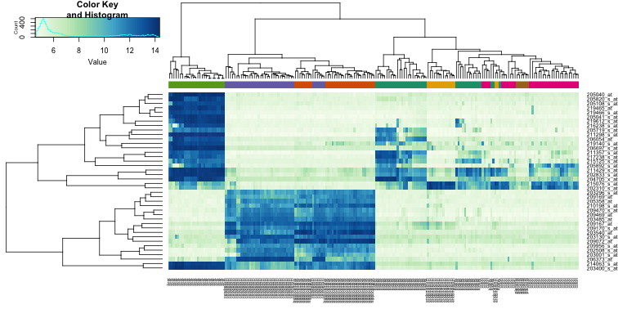
Hierarchical clustering
http://genomicsclass.github.io/book/pages/clustering_and_heatmaps.html
Notes:
Just a random hierarchical clustering heatmap found online
can cluster genes, or samples

Slide 5
Agglomerative hierarchical clustering
Basic algorithm:
(1) Start with each point in a cluster of its own
(2) Repeat the following until there is only one cluster left
  (2.1) Find the “closest” pair of “clusters”
  (2.2) Merge them
(3) Return a tree structure of the merges
Notes:
Draw a simple illustrative diagram on board

Slide 6
Distance metric and Linkage
Distance metric:
L2 distance (Euclidean)
L1 distance
Correlation distance (1-corr)

Slide 7
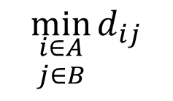
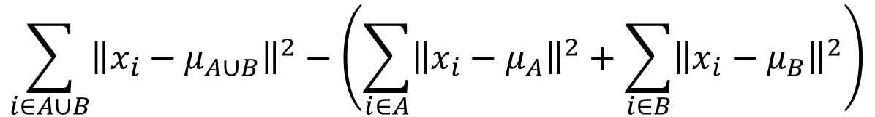

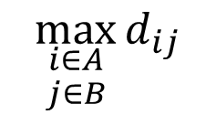
Distance metric and Linkage
Linkages:
Single linkage of two sets of points A & B:
Complete linkage
Average linkage
Ward’s linkage
$$\min_{\begin{aligned}i∈A \\ j∈B\end{aligned}}{d_{ij}}$$
$$\max_{\begin{aligned}i∈A \\ j∈B\end{aligned}}{d_{ij}}$$
$$\frac{1}{\left|A\right||B|}\sum_{i∈A}{\sum_{j∈B}{d_{ij}}}$$
$$\sum_{i∈A∪B}{{\left\|x_{i}−μ_{A∪B}\right\|}^{2}}−\left(\sum_{i∈A}{{\left\|x_{i}−μ_{A}\right\|}^{2}}+\sum_{i∈B}{{\left\|x_{i}−μ_{B}\right\|}^{2}}\right)$$
Notes:
Look at the distance b/w all nodes in A and all nodes in B, pick the smallest (MST)
Pick the largest
Pick the average
Look at the increase of variance (sum of squares) before and after merge

Slide 8
Distance metric and Linkage
Effect of choice of linkage:
If the data form compact and well-separated clusters, all the linkages are equally good choices
In real data without cluster separations
  Single linkage focus on connectedness/closeness
  Complete linkage focus on compactness
  The other two are in-between, and are popular choices
Single linkage
Complete linkage

Slide 9
Unsupervised clustering methods
- Hierarchical clustering
- k-means
- Spectral graph analysis
- Community finding
- Density-based clustering

Slide 10
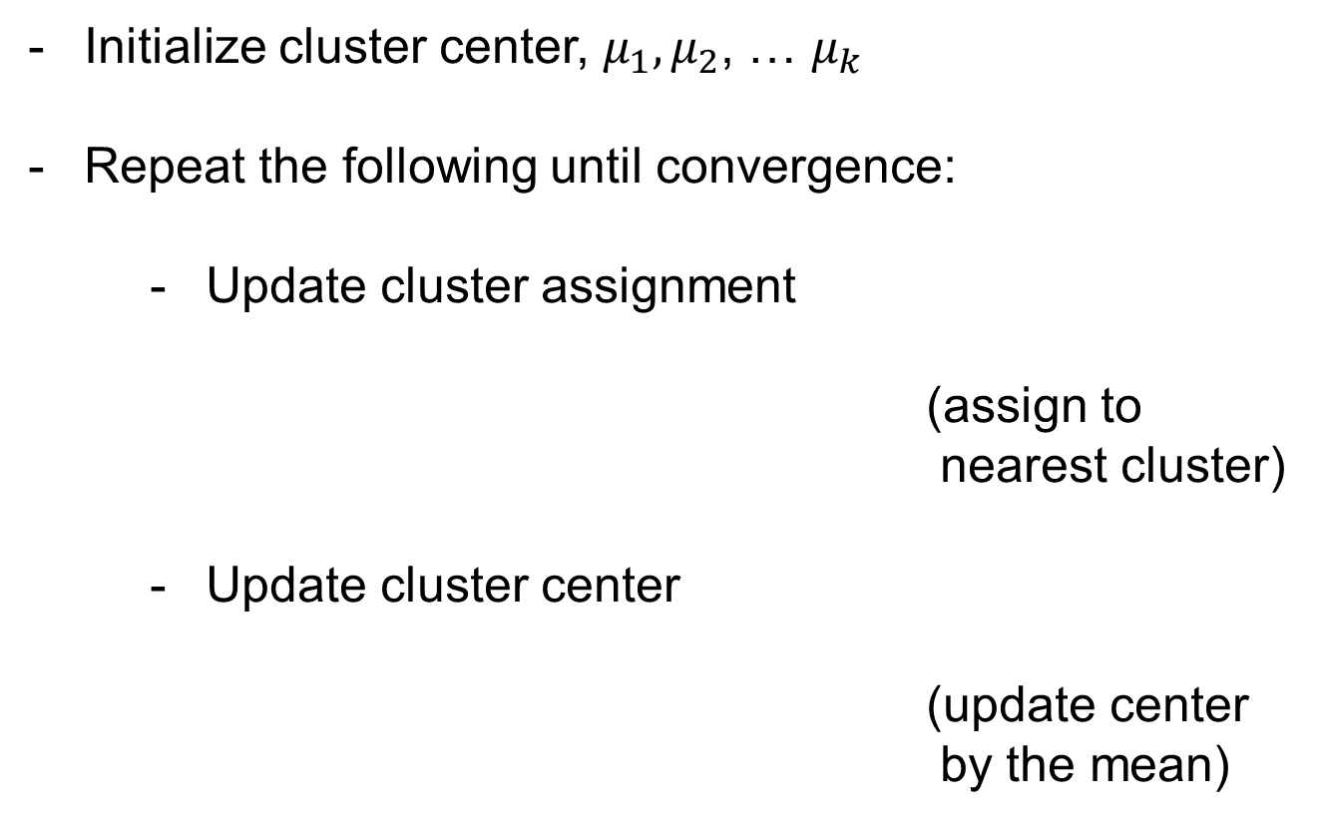

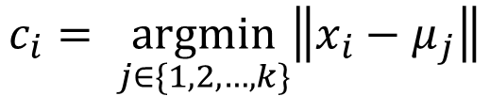
k-means
Initialize cluster center, $μ_{1},μ_{2}$, … $μ_{k}$
Repeat the following until convergence:
  Update cluster assignment
  (assign to nearest cluster)
  Update cluster center
  (update center
  by the mean)
$$c_{i}= \underset{j∈\{1,2,…,k\}}{argmin}\left\|x_{i}−μ_{j}\right\|$$
$$μ_{j}=\frac{\sum_{c_{i}=j}{x_{i}}}{\sum{{(c}_{i}=j)}}$$
Notes:
There is theoretical guarantee to converge

Slide 11
Problems/Variations of k-means
Local optimal
  run it multiple times with different initial, and find consensus
Cluster can disappear
  drop it or re-initialize
Center outside data
  K-medoids
Randomness
  Deterministic k-means
# of clusters
  Gap statistics

Slide 12
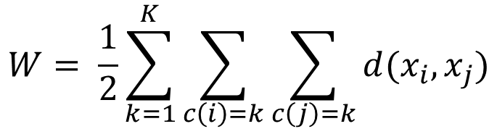

Gap statistics for k-means
Define within cluster distance as the total distances of all pairs of points in the sample cluster
Run k-means with increasing k, and plot
Randomly generate uniformly distributed data from a rectangle containing the original data, run k-means with different k
Find the largest gap
$$W= \frac{1}{2}\sum_{k=1}^{K}{\sum_{c\left(i\right)=k}{\sum_{c\left(j\right)=k}{d(x_{i}, x_{j})}}}$$
$$\log{\frac{W_{k}}{W_{1}}}$$

Slide 13
Gap statistics for k-means
data = [randn(2,500)+[1;10], randn(2,500), randn(2,500)+[10;1]];
figure(1); plot(data(1,:),data(2,:),'o')
for k=1:10
idx = kmeans(data',k,'OnlinePhase','off');
W(k) = compute_W(data, idx);
end
figure(2); plot(1:length(W), log(W/W(1)),'-o')
for i=1:100
random_data = [rand(1,size(data,2))*(max(data(1,:))-min(data(1,:)))+min(data(1,:)); ...
rand(1,size(data,2))*(max(data(2,:))-min(data(2,:)))+min(data(2,:))];
if i==1
figure(3); plot(random_data(1,:), random_data(2,:),'o'); axis([-10,20,-10,20])
end
for k=1:10
idx = kmeans(random_data',k,'OnlinePhase','off');
W_rand(i,k) = compute_W(random_data, idx);
end
end
figure(2); hold on;
errorbar(mean(log(W_rand./W_rand(:,1))), std(log(W_rand./W_rand(:,1))))
hold off; title('log(W_k/W_1)')
figure(4); plot(mean(log(W_rand./W_rand(:,1)))-log(W/W(1)),'o-'); title('gap')
Notes:
Generate real data with 3 clusters
Kmeans k=1~10, compute W_k
Generate random data
Kmeans k=1~10, compute W_k
Compare gap

Slide 14
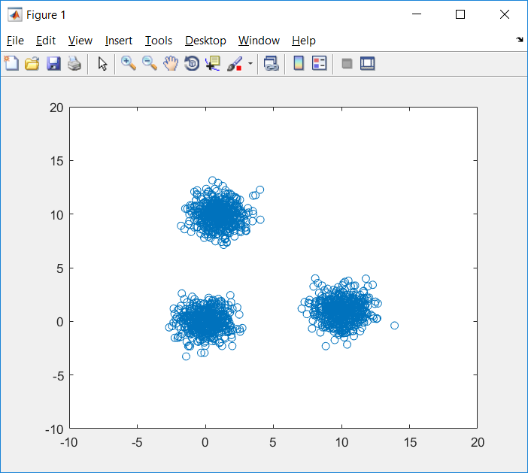
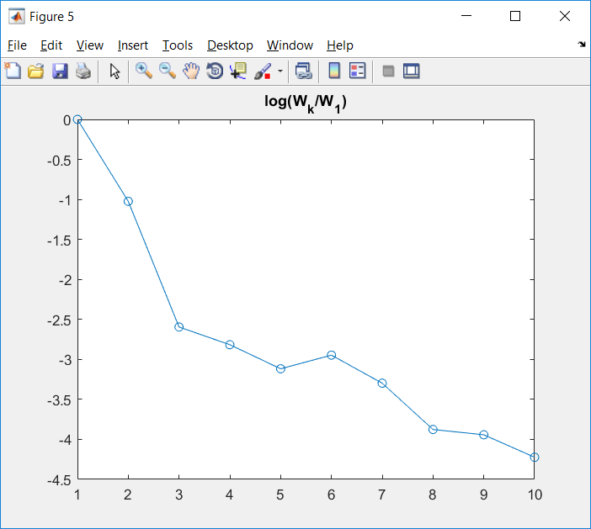
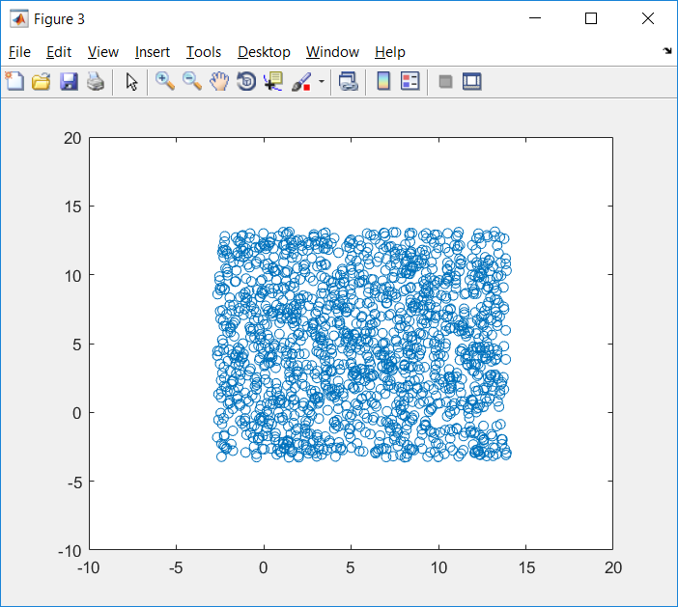
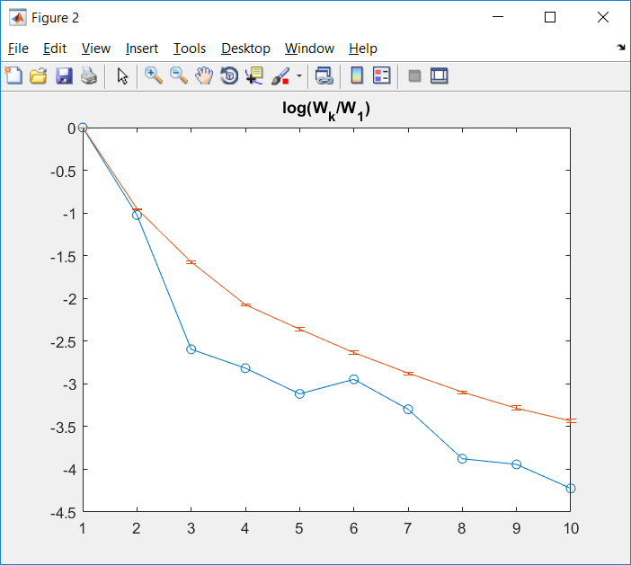
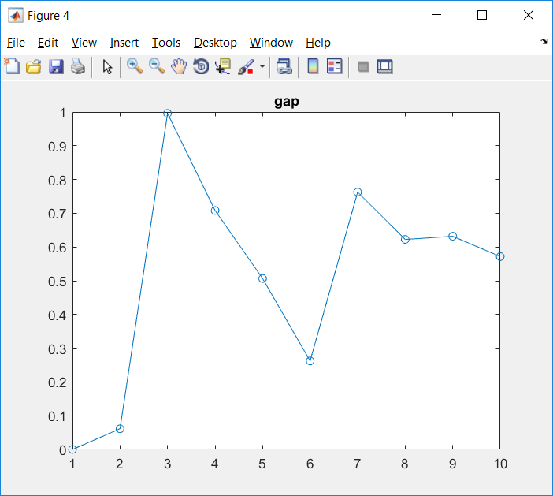
Gap statistics for k-means

Slide 15
Unsupervised clustering methods
- Hierarchical clustering
- k-means
- Spectral graph analysis
- Community finding
- Density-based clustering

Slide 16
Clustering by partitioning Graphs
Basic idea:
Construct a graph
- Each node is one sample / data point
- Each edge connects two samples, with
weights representing similarities
Cut it into smaller pieces

Slide 17

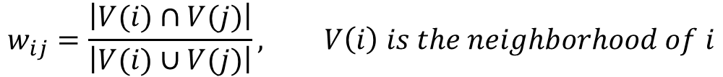
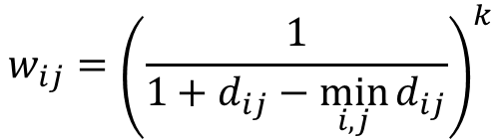
How to construct a graph?
$$w_{ij}=−d_{ij}=−\left\|x_{i}−x_{j}\right\|$$
Weight by negative of L2 distance
Weight by inverse of L2 distance
Threshold the weights to get a sparse graph
Use L2 distance to construct a kNN graph
Jaccard: kNN +
more …
$$w_{ij}={\left(\frac{1}{1+d_{ij}−\min_{i,j}{d_{ij}}}\right)}^{k}$$
$$w_{ij}=\frac{\left|V(i)∩V(j)\right|}{\left|V(i)∪V(j)\right|}, V\left(i\right) is the neighborhood of i$$

Slide 18

Spectral graph partitioning
$$L_{ij}=\left\{\begin{aligned}−w_{ij} if i≠j \\ \sum_{u}{w_{iu}} if i=j\end{aligned}\right.$$
Construct graph Laplacian (L)
Compute e-value and e-vectors of L
Assume the graph is connected:
all e-values are non-negative,
one e-value is exactly 0
In the e-vector of the 2nd smallest e-value, the +/- sign divides the graph into two pieces
Notes:
Why eigenvalue and eigenvectors?

Slide 19
Spectral graph partitioning example
A = zeros(10,10);
A(1:4,1:4) = 1; A(5:10,5:10)=1;
A(1,9)=1; A(9,1)=1;
A(1,7)=1; A(7,1)=1;
A = A-diag(diag(A));
L = diag(sum(A))-A;
[V,D] = eig(L)
6
2
1
7
5
3
4
9
10
8
A =
0 1 1 1 0 0 1 0 1 0
1 0 1 1 0 0 0 0 0 0
1 1 0 1 0 0 0 0 0 0
1 1 1 0 0 0 0 0 0 0
0 0 0 0 0 1 1 1 1 1
0 0 0 0 1 0 1 1 1 1
1 0 0 0 1 1 0 1 1 1
0 0 0 0 1 1 1 0 1 1
1 0 0 0 1 1 1 1 0 1
0 0 0 0 1 1 1 1 1 0

Slide 20
Spectral graph partitioning example
A = zeros(10,10);
A(1:4,1:4) = 1; A(5:10,5:10)=1;
A(1,9)=1; A(9,1)=1;
A(1,7)=1; A(7,1)=1;
A = A-diag(diag(A));
L = diag(sum(A))-A;
[V,D] = eig(L)
6
2
1
7
5
3
4
9
10
8
L =
5 -1 -1 -1 0 0 -1 0 -1 0
-1 3 -1 -1 0 0 0 0 0 0
-1 -1 3 -1 0 0 0 0 0 0
-1 -1 -1 3 0 0 0 0 0 0
0 0 0 0 5 -1 -1 -1 -1 -1
0 0 0 0 -1 5 -1 -1 -1 -1
-1 0 0 0 -1 -1 6 -1 -1 -1
0 0 0 0 -1 -1 -1 5 -1 -1
-1 0 0 0 -1 -1 -1 -1 6 -1
0 0 0 0 -1 -1 -1 -1 -1 5

Slide 21
Spectral graph partitioning example
A = zeros(10,10);
A(1:4,1:4) = 1; A(5:10,5:10)=1;
A(1,9)=1; A(9,1)=1;
A(1,7)=1; A(7,1)=1;
A = A-diag(diag(A));
L = diag(sum(A))-A;
[V,D] = eig(L)
6
2
1
7
5
3
4
9
10
8
V =
0.3162 -0.2025 0.0000 -0.0000 0.7628 0.0000 -0.0000 0.0000 -0.0000 -0.5265
0.3162 -0.4363 0.1245 -0.8069 -0.1907 -0.0000 0.0000 -0.0000 0.0000 0.0814
0.3162 -0.4363 0.6366 0.5113 -0.1907 -0.0000 -0.0000 -0.0000 -0.0000 0.0814
0.3162 -0.4363 -0.7611 0.2956 -0.1907 -0.0000 0.0000 -0.0000 -0.0000 0.0814
0.3162 0.2766 -0.0000 -0.0000 -0.1907 -0.5537 -0.6640 0.0508 -0.0000 -0.1927
0.3162 0.2766 0.0000 0.0000 -0.1907 0.7826 -0.2555 0.2687 0.0000 -0.1927
0.3162 0.2025 0.0000 0.0000 0.2860 -0.0000 -0.0000 -0.0000 0.7071 0.5265
0.3162 0.2766 0.0000 -0.0000 -0.1907 0.0510 0.2712 -0.8209 -0.0000 -0.1927
0.3162 0.2025 -0.0000 -0.0000 0.2860 0.0000 0.0000 -0.0000 -0.7071 0.5265
0.3162 0.2766 -0.0000 0.0000 -0.1907 -0.2799 0.6483 0.5014 -0.0000 -0.1927
diag(D)' =
-0.0000 0.5359 4.0000 4.0000 5.0000 6.0000 6.0000 6.0000 7.0000 7.4641

Slide 22
Spectral graph partitioning example
A = zeros(10,10);
A(1:4,1:4) = 1; A(5:7,5:7)=1; A(8:10,8:10)=1;
A(1,9)=1; A(9,1)=1;
A(1,7)=1; A(7,1)=1;
A = A-diag(diag(A));
L = diag(sum(A))-A;
[V,D] = eig(L)
6
2
1
7
5
3
4
9
10
8
V =
0.3162 0.0000 0.2172 -0.0000 0.0000 0.3476 0.0000 -0.0000 -0.0000 -0.8556
0.3162 0.0000 0.4277 0.0000 0.0000 -0.1549 -0.0000 0.4082 -0.7071 0.1625
0.3162 0.0000 0.4277 0.0000 -0.0000 -0.1549 -0.0000 0.4082 0.7071 0.1625
0.3162 0.0000 0.4277 0.0000 -0.0000 -0.1549 0.0000 -0.8165 -0.0000 0.1625
0.3162 0.4440 -0.2991 -0.0224 -0.7068 -0.2395 0.2299 0.0000 -0.0000 -0.0564
0.3162 0.4440 -0.2991 0.0224 0.7068 -0.2395 0.2299 0.0000 0.0000 -0.0564
0.3162 0.3251 -0.1519 -0.0000 0.0000 0.5375 -0.6280 -0.0000 0.0000 0.2967
0.3162 -0.4440 -0.2991 -0.7068 0.0224 -0.2395 -0.2299 -0.0000 0.0000 -0.0564
0.3162 -0.3251 -0.1519 -0.0000 0.0000 0.5375 0.6280 0.0000 -0.0000 0.2967
0.3162 -0.4440 -0.2991 0.7068 -0.0224 -0.2395 -0.2299 -0.0000 0 -0.0564
diag(D)' =
-0.0000 0.2679 0.4921 3.0000 3.0000 3.2444 3.7321 4.0000 4.0000 6.2635

Slide 23
Spectral graph partitioning example
A = zeros(10,10);
A(1:4,1:4) = 1; A(5:7,5:7)=1; A(8:10,8:10)=1;
A(1,7)=1; A(7,1)=1;
A = A-diag(diag(A));
L = diag(sum(A))-A;
[V,D] = eig(L)
6
2
1
7
5
3
4
9
10
8
V =
-0.3780 0 -0.2142 -0.0000 0 0 -0.3864 0.0000 -0.0000 0.8136
-0.3780 0 -0.3560 0.0000 0 0 0.1651 -0.7071 0.4082 -0.1909
-0.3780 0 -0.3560 0.0000 0 0 0.1651 0.7071 0.4082 -0.1909
-0.3780 0 -0.3560 0.0000 0 0 0.1651 0.0000 -0.8165 -0.1909
-0.3780 0 0.4929 -0.7071 0 0 0.3207 0.0000 0.0000 0.1065
-0.3780 0 0.4929 0.7071 0 0 0.3207 -0.0000 -0.0000 0.1065
-0.3780 0 0.2966 -0.0000 0 0 -0.7505 0 -0.0000 -0.4539
0 0.5774 0 0 0.7634 0.2895 0 0 0 0
0 0.5774 0 0 -0.6325 0.5164 0 0 0 0
0 0.5774 0 0 -0.1310 -0.8059 0 0 0 0
diag(D)' =
-0.0000 0.0000 0.3983 3.0000 3.0000 3.0000 3.3399 4.0000 4.0000 5.2618

Slide 24
Unsupervised clustering methods
- Hierarchical clustering
- k-means
- Spectral graph analysis
- Community finding
- Density-based clustering

Slide 25

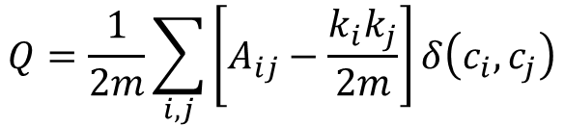




Community finding
Maximize modularity
where, is weighted adjacency
is degree of i
is cluster assignment
is total weights
Implementation: google search the following:
“google code community finding Louvain”
Key idea of the algorithm: greedy agglomerative procedure
$$Q=\frac{1}{2m}\sum_{i,j}{\left[A_{ij}−\frac{k_{i}k_{j}}{2m}\right]}δ\left(c_{i}, c_{j}\right)$$
$$A_{ij}$$
$$k_{i}$$
$$c_{i}$$
$$m$$
$m=\frac{1}{2}\sum{A_{ij}}$

Slide 26
Community finding - Examples
6
7
5
A = zeros(10,10);
A(1:4,1:4) = 1; A(5:10,5:10)=1;
A(1,9)=1; A(9,1)=1;
A(1,7)=1; A(7,1)=1;
A = A-diag(diag(A));
C = [1 1 1 1 2 2 2 2 2 2 ]
Q = sum(sum((A-sum(A)'*sum(A)/(2*sum(A(:)))).*((C'==C)-eye(size(A)))))/(2*sum(A(:)))
2
1
9
10
3
4
8
A =
0 1 1 1 0 0 1 0 1 0
1 0 1 1 0 0 0 0 0 0
1 1 0 1 0 0 0 0 0 0
1 1 1 0 0 0 0 0 0 0
0 0 0 0 0 1 1 1 1 1
0 0 0 0 1 0 1 1 1 1
1 0 0 0 1 1 0 1 1 1
0 0 0 0 1 1 1 0 1 1
1 0 0 0 1 1 1 1 0 1
0 0 0 0 1 1 1 1 1 0
C =
1 1 1 1 2 2 2 2 2 2
Q =
0.3388

Slide 27
Community finding - Examples
>> C = [1 1 1 1 1 1 2 2 2 2]
>> Q = sum(sum((A-sum(A)'*sum(A)/(2*sum(A(:)))).*((C'==C)-eye(size(A)))))/(2*sum(A(:)))
Q =
0.1838
>> C = [1 1 1 1 2 2 2 3 3 3]
>> Q = sum(sum((A-sum(A)'*sum(A)/(2*sum(A(:)))).*((C'==C)-eye(size(A)))))/(2*sum(A(:)))
Q =
0.2037
>> C = [1 1 1 1 1 1 1 1 1 1]
>> Q = sum(sum((A-sum(A)'*sum(A)/(2*sum(A(:)))).*((C'==C)-eye(size(A)))))/(2*sum(A(:)))
Q =
0.2765
>> C = [1 2 3 4 5 6 7 8 9 10]
>> Q = sum(sum((A-sum(A)'*sum(A)/(2*sum(A(:)))).*((C'==C)-eye(size(A)))))/(2*sum(A(:)))
Q =
0

Slide 28
Community finding - Examples
6
7
5
A = zeros(10,10);
A(1:4,1:4) = 1; A(5:7,5:7)=1; A(8:10,8:10)=1;
A(1,9)=1; A(9,1)=1;
A(1,7)=1; A(7,1)=1;
A = A-diag(diag(A));
C = [1 1 1 1 2 2 2 3 3 3 ]
Q = sum(sum((A-sum(A)'*sum(A)/(2*sum(A(:)))).*((C'==C)-eye(size(A)))))/(2*sum(A(:)))
2
1
9
10
3
4
8
A =
0 1 1 1 0 0 1 0 1 0
1 0 1 1 0 0 0 0 0 0
1 1 0 1 0 0 0 0 0 0
1 1 1 0 0 0 0 0 0 0
0 0 0 0 0 1 1 0 0 0
0 0 0 0 1 0 1 0 0 0
1 0 0 0 1 1 0 0 0 0
0 0 0 0 0 0 0 0 1 1
1 0 0 0 0 0 0 1 0 1
0 0 0 0 0 0 0 1 1 0
C =
1 1 1 1 2 2 2 3 3 3
Q =
0.3622

Slide 29
Community finding - Examples
>> C = [1 1 1 1 1 1 1 2 2 2]
>> Q = sum(sum((A-sum(A)'*sum(A)/(2*sum(A(:)))).*((C'==C)-eye(size(A)))))/(2*sum(A(:)))
Q =
0.3355
>> C = [1 1 1 1 2 2 2 1 1 1]
>> Q = sum(sum((A-sum(A)'*sum(A)/(2*sum(A(:)))).*((C'==C)-eye(size(A)))))/(2*sum(A(:)))
Q =
0.3355
>> C = [1 1 1 1 1 1 1 1 1 1]
>> Q = sum(sum((A-sum(A)'*sum(A)/(2*sum(A(:)))).*((C'==C)-eye(size(A)))))/(2*sum(A(:)))
Q =
0.2774
>> C = [1 2 3 4 5 6 7 8 9 10]
>> Q = sum(sum((A-sum(A)'*sum(A)/(2*sum(A(:)))).*((C'==C)-eye(size(A)))))/(2*sum(A(:)))
Q =
0

Slide 30
Unsupervised clustering methods
- Hierarchical clustering
- k-means
- Spectral graph analysis
- Community finding
- Density-based clustering

Slide 31
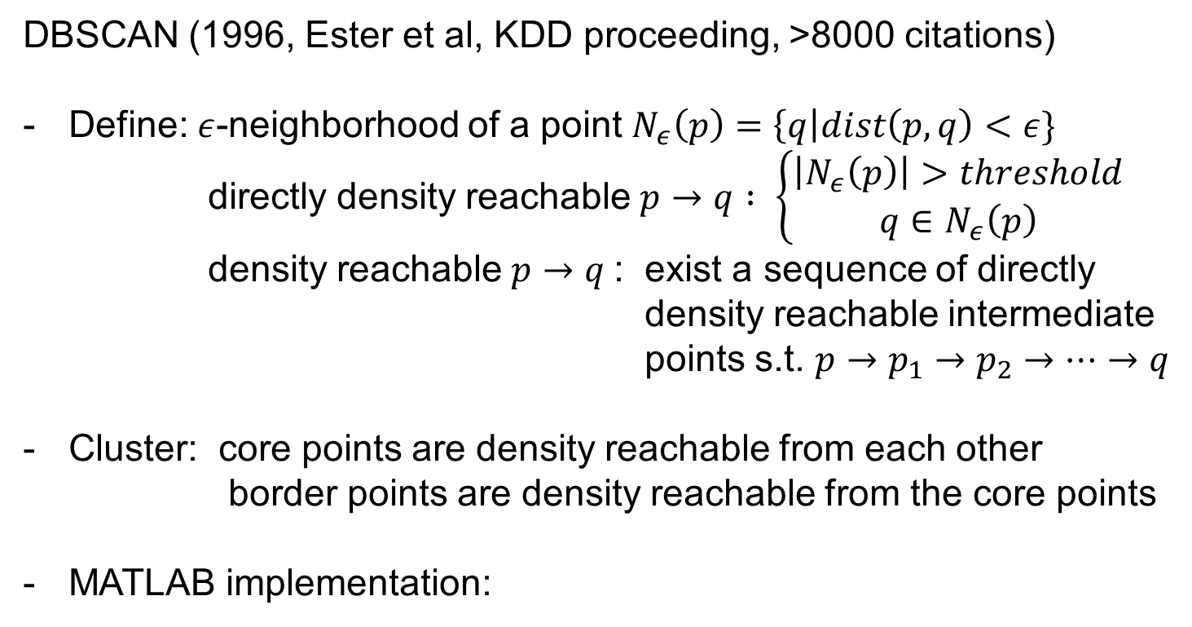
DBSCAN
DBSCAN (1996, Ester et al, KDD proceeding, >8000 citations)
Define: $ε$-neighborhood of a point $N_{ε}\left(p\right)=\left\{q\right|dist\left(p,q\right)<ε\}$
directly density reachable $p→q : \left\{\begin{aligned}\left|N_{ε}\left(p\right)\right|>threshold \\ q∈N_{ε}\left(p\right)\end{aligned}\right.$
density reachable $p→q$: exist a sequence of directly density reachable intermediate
points s.t. $p→p_{1}→p_{2}→…→q$
Cluster: core points are density reachable from each other
border points are density reachable from the core points
MATLAB implementation:
https://www.mathworks.com/help/stats/dbscan.html#d118e261580
Notes:
Why this is good? Can handle clusters with arbitrary shape

Slide 32
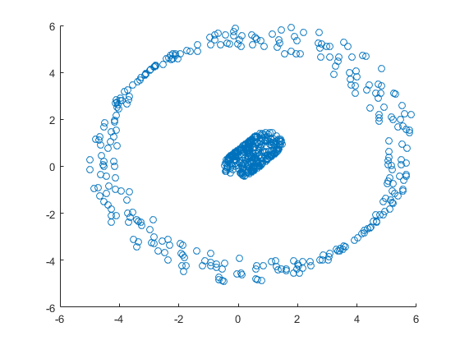
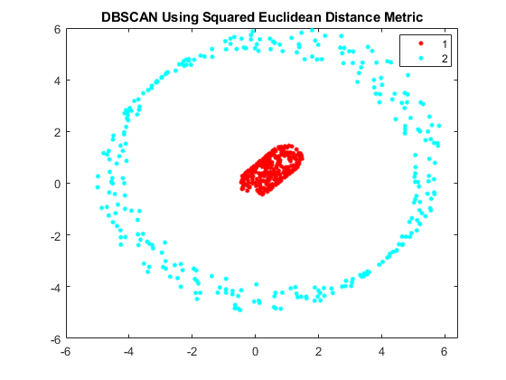
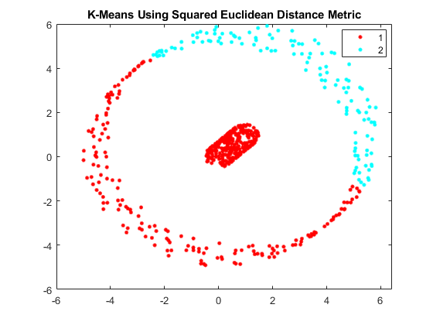
DBSCAN matlab example
Raw data (2D)
DBSCAN
kmeans
https://www.mathworks.com/help/stats/dbscan.html#d118e261580
Notes:
Why this is good? Can handle clusters with arbitrary shape

Slide 33
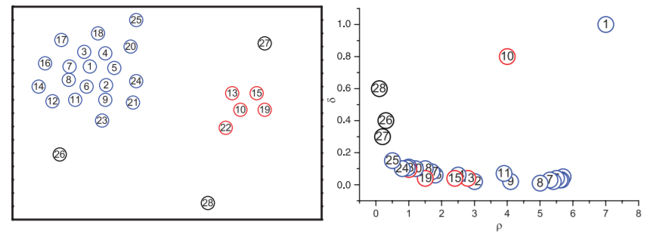
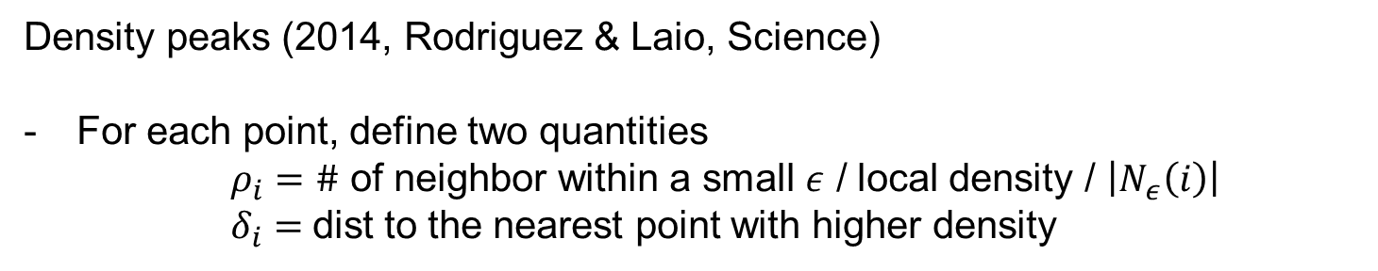
Clustering by density peaks
Density peaks (2014, Rodriguez & Laio, Science)
For each point, define two quantities
$ρ_{i}=\#$ of neighbor within a small $ε$ / local density / $\left|N_{ε}\left(i\right)\right|$
$δ_{i}=$dist to the nearest point with higher density

Slide 34
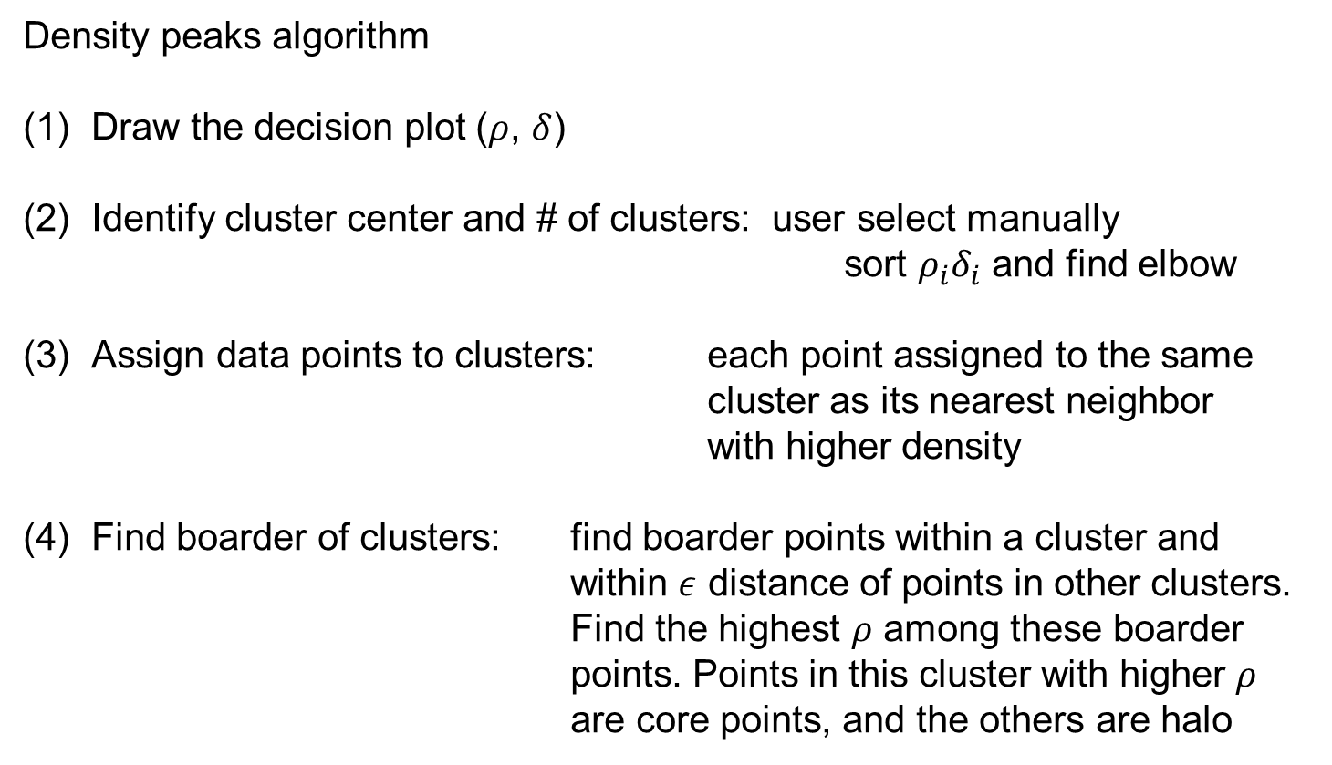
Clustering by density peaks
Density peaks algorithm
Draw the decision plot ($ρ$, $δ$)
Identify cluster center and # of clusters: user select manually
sort $ρ_{i}δ_{i}$ and find elbow
Assign data points to clusters: each point assigned to the same cluster as its nearest neighbor with higher density
Find boarder of clusters: find boarder points within a cluster and within $ε$ distance of points in other clusters. Find the highest $ρ$ among these boarder points. Points in this cluster with higher $ρ$ are core points, and the others are halo

Slide 35
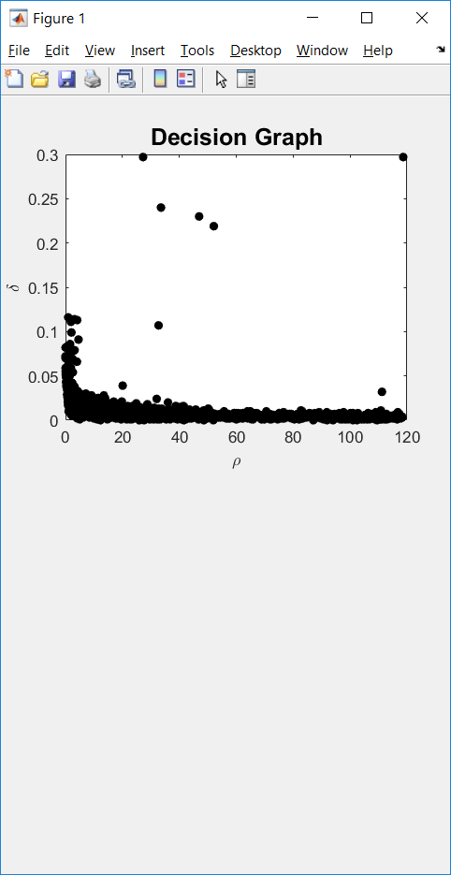
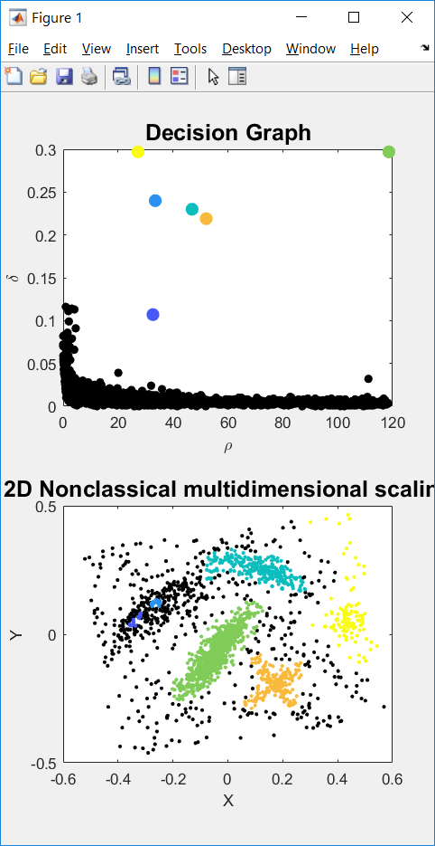
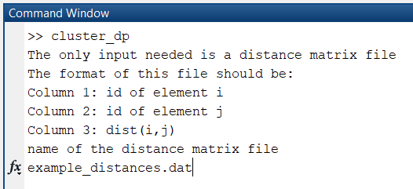
Clustering by density peaks - Implementation
https://people.sissa.it/~laio/Research/Res_clustering.php

Slide 36
Take home messages
Great tool to see patterns of genes and samples simultaneously
Often used to show signature genes
Often used to show relationship between clusters
- Hierarchical clustering
- k-means
- Spectral graph analysis
- Community finding
- Density-based clustering
Simple and extremely cheap to compute
Assume clusters to be round and of similar size
Works well if the graph is properly defined
Does not make assumptions on cluster shape/size
Able to catch rare clusters
Very popular in the literature
Works well when the dimensionality is relatively low
Does not make assumptions on cluster shape/size
Able to catch rare clusters
Also quite popular in the literature

Slide 37
Goals of Dimension Reduction
The goals of dimension reduction are:
(1) Visualization:
Reduce high-dimensional data down to
2D or 3D, so that we can see the data
(2) Preprocessing
Reduce high-dimensional data down to
low-dimensional space, so that the data become easier to analyze with other algorithms
Notes:
Visualization
Initial steps of a larger analysis pipeline

Slide 38
Dimension Reduction and Visualization
- PCA
- MDS
- Isomap
- tSNE
- UMAP

Slide 39
PCA
PCA is a linear operation
Intuition: projection that maximally preserves variance
Intuition: low rank approximation

Slide 40
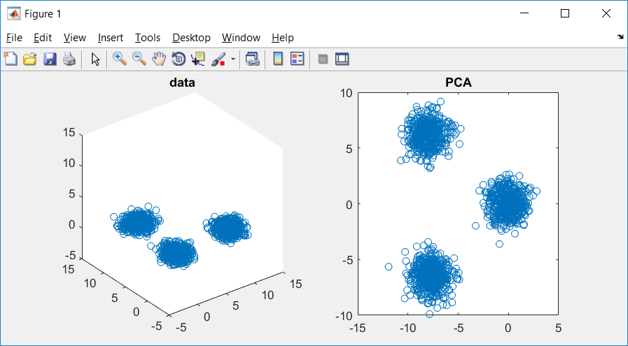
Example
data = [[randn(2,500)+[1;10], randn(2,500), randn(2,500)+[10;1]];...
rand(1,1500)*2];
figure(1); subplot(1,2,1)
plot3(data(1,:),data(2,:),data(3,:),'o'); title('data')
axis([-5,15,-5,15,-5,15])
num_PC = 2;
[U,S,V] = svds(data, num_PC); % data is M features * N samples
PCA_gene_loadings = U(:,:);
PCA_cell_embeddings = V(:,:)*S;
figure(1); subplot(1,2,2)
plot(PCA_cell_embeddings(:,1),PCA_cell_embeddings(:,2),'o');title('PCA')
PCA_gene_loadings =
-0.6996 -0.7089
-0.7032 0.7054
-0.1266 -0.0006

Slide 41
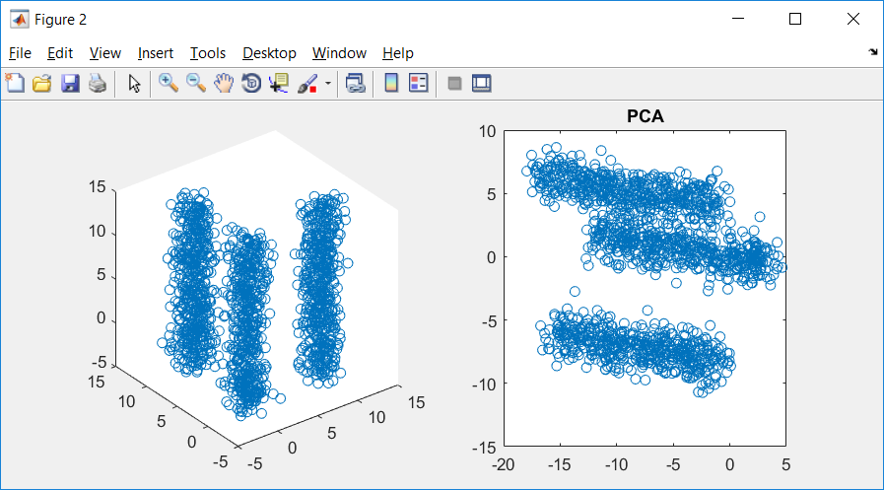
Example
data = [[randn(2,500)+[1;10], randn(2,500), randn(2,500)+[10;1]];...
rand(1,1500)*20];
figure(2); subplot(1,2,1);
plot3(data(1,:),data(2,:),data(3,:),'o'); title('data')
axis([-5,15,-5,15,-5,15])
num_PC = 2;
[U,S,V] = svds(data, num_PC); % data is M features * N samples
PCA_gene_loadings = U(:,:);
PCA_cell_embeddings = V(:,:)*S;
figure(2); subplot(1,2,2)
plot(PCA_cell_embeddings(:,1),PCA_cell_embeddings(:,2),'o');title('PCA')
PCA_gene_loadings =
-0.2934 0.7209
-0.2988 -0.6931
-0.9081 -0.0049

Slide 42
Determine the number of significant PC
- Total variance explained
- Random permutation
- Elbow of e-values
- JackStraw
- …
Notes:
High dimensional dataset, when performing PCA, need to decide the number of PC
For visualization purpose, number of PC usually is 2 or 3
For dimension reduction purpose, number of PC needs to be determined

Slide 43
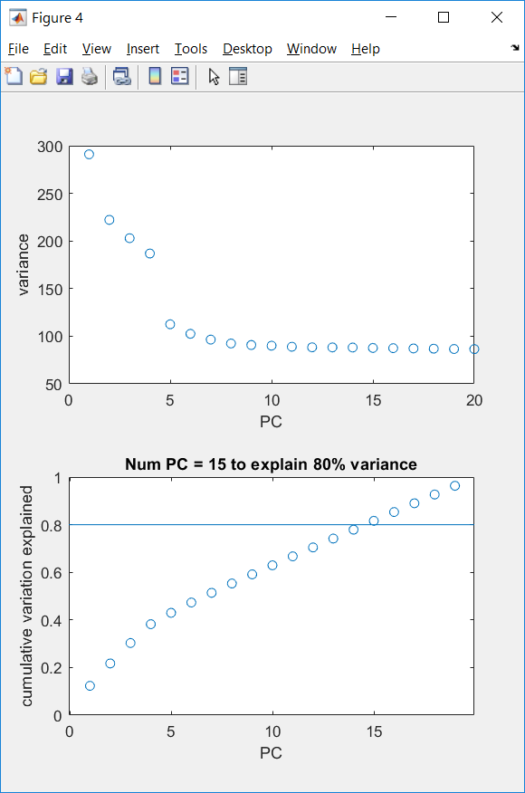
Determine the number of significant PC
- Total variance explained
- Random permutation
- Elbow of e-values
- JackStraw
- …
PBMC scRNAseq data of 2700 cells (10X Genomics)
Notes:
Number of PC = 15

Slide 44
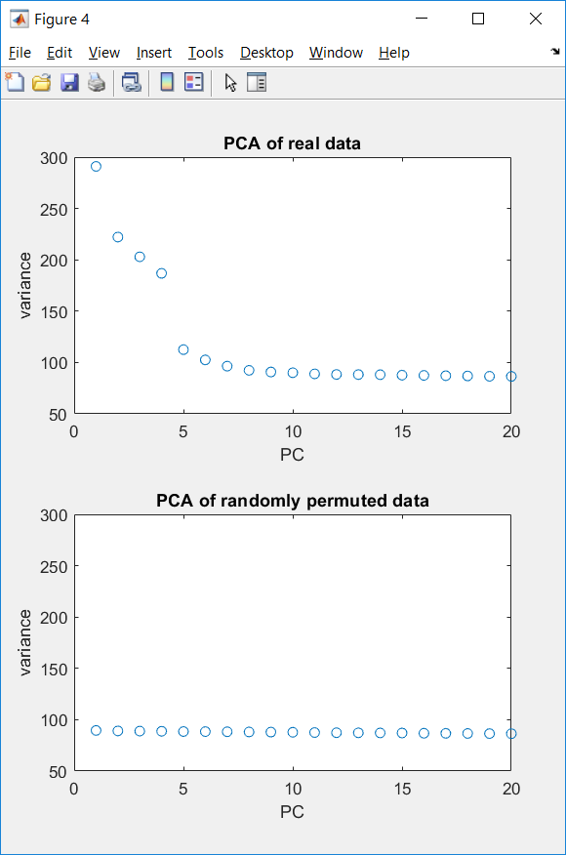
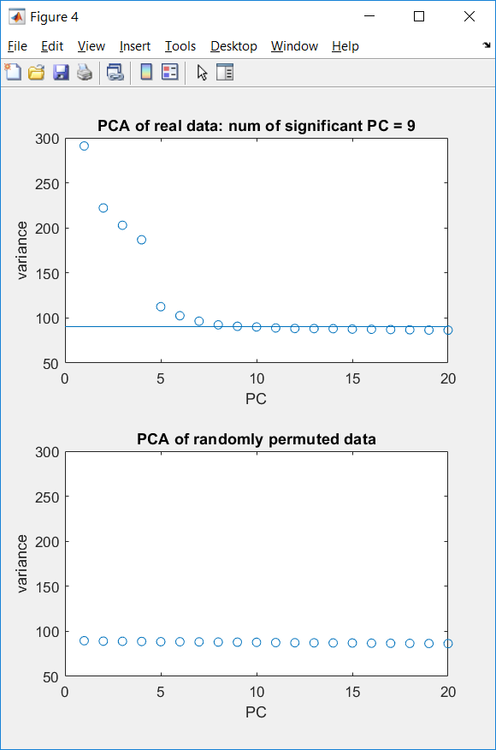
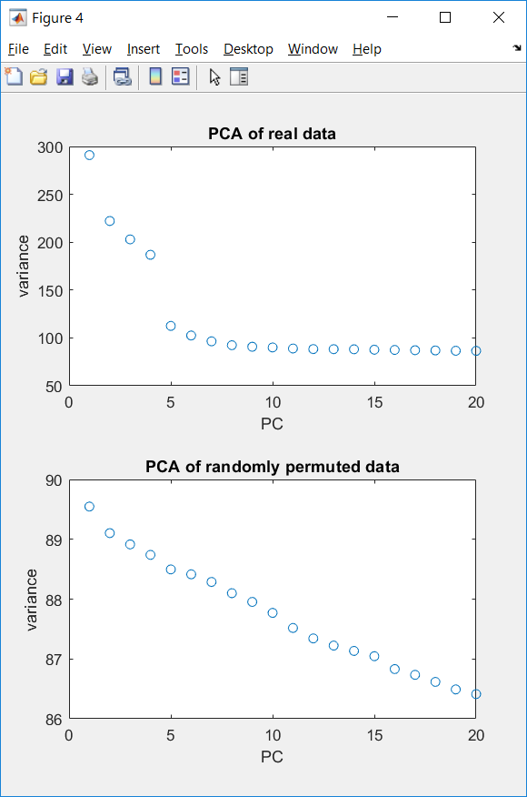
Determine the number of significant PC
- Total variance explained
- Random permutation
- Elbow of e-values
- JackStraw
- …
Highest variance from PCA of permuted data
PBMC scRNAseq data of 2700 cells (10X Genomics)
Notes:
Number of PC = 9

Slide 45
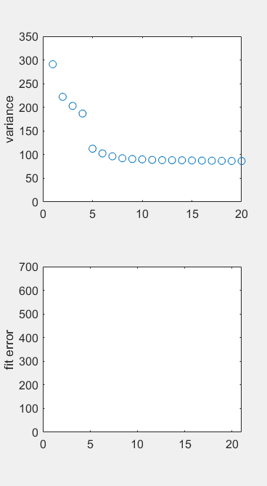
Determine the number of significant PC
- Total variance explained
- Random permutation
- Elbow of e-values
- JackStraw
- …
PBMC scRNAseq data of 2700 cells (10X Genomics)
Notes:
Number of PC = 6

Slide 46
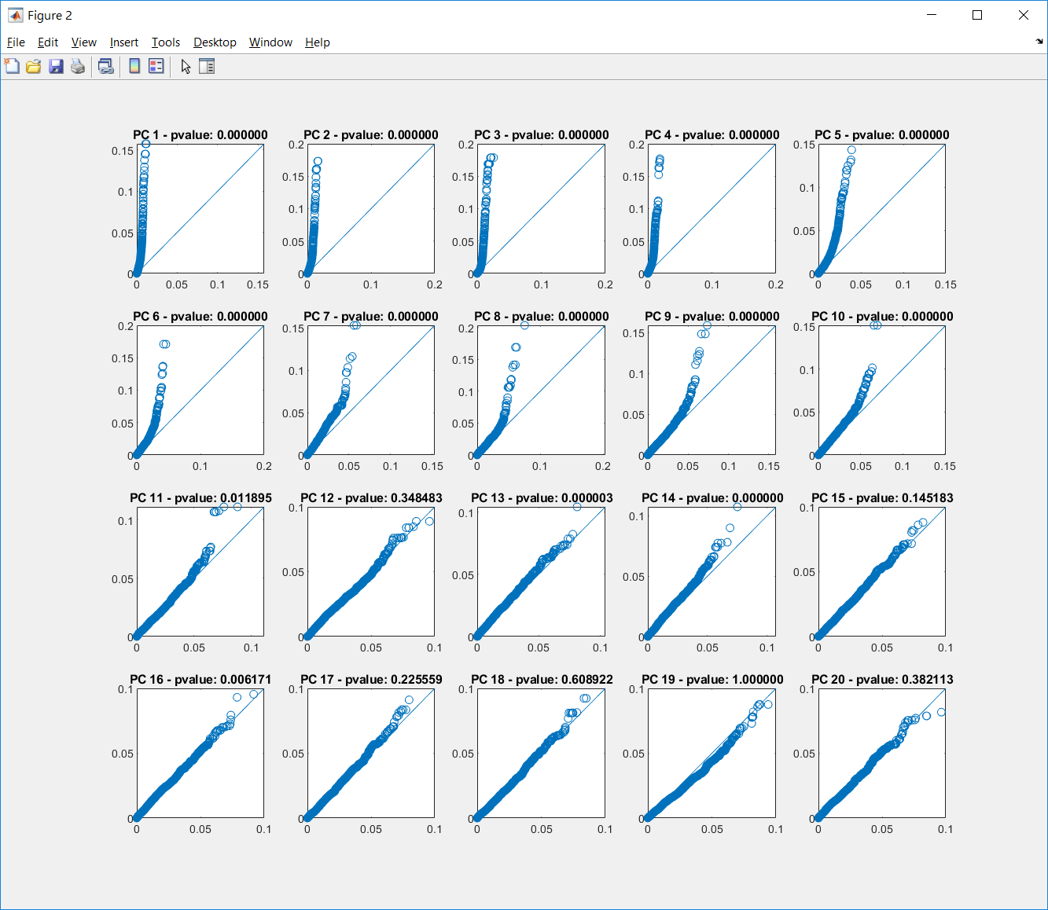
Determine the number of significant PC
- Total variance explained
- Random permutation
- Elbow of e-values
- JackStraw
- …
PBMC scRNAseq data of 2700 cells (10X Genomics)
Notes:
This approach is special because it looks at gene loadings. (Number of PC = 10 for this example)
Pseudo code of JackStraw procedure (iter = 100, percentage = 1%)
Orignial input data (genes*cells, or features*samples), perform PCA
For iterations = 1:100
Randomly pick 1% of features, permute the data only for the selected features/rows, perform PCA
Remember the gene loading for the picked features for every PC (for both original and permuted data)
For each PC
Scatter plot of the absolute values of gene loadings for original vs permutated data
ttest for pvalue significance

Slide 47
Nonlinear Techniques for Dimension Reduction
- PCA
- MDS
- Isomap
- tSNE
- UMAP

Slide 48
Nonlinear Dimension Reduction
examples
features
k*N
Reduced data in 2D visualization space
M*N
Original data in high-D data space
We would like the interpretation of the visualization to be similar to the interpretation of the original data (clusters, trajectories).

Slide 49
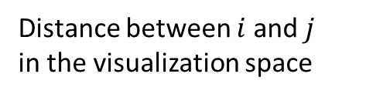

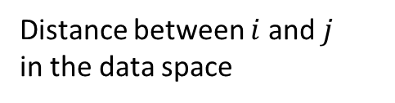



Nonlinear Dimension Reduction
$$x_{i}$$
examples
features
$$y_{i}$$
k*N
Reduced data in 2D visualization space
M*N
Original data in high-D data space
Distance between $i$ and $j$
in the data space
Distance between $i$ and $j$
in the visualization space
$$δ_{ij}^{(x)}=\left\|x_{i}−x_{j}\right\|$$
$$d_{ij}^{(y)}=\left\|y_{i}−y_{j}\right\|$$

Slide 50
Dimension Reduction and Visualization
- PCA
- MDS
- Isomap
- tSNE
- UMAP

Slide 51
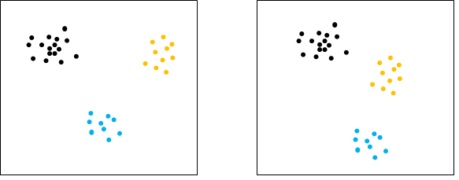
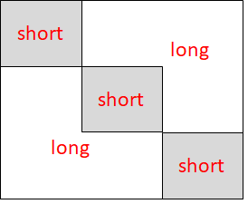
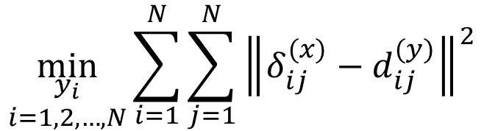
Classic MDS
Eg. four points with equal
distance to each other,
possible in 3D and higher-D,
but impossible in 2D
$$\min_{\begin{aligned}y_{i} \\ i=1,2,…,N\end{aligned}}{\sum_{i=1}^{N}{\sum_{j=1}^{N}{{\left\|δ_{ij}^{(x)}−d_{ij}^{(y)}\right\|}^{2}}}}$$
Sounds perfectly reasonable,
But not a good idea, because
(1) not always possible,
(2) emphasize too much on large
distances.
Eg. Short distances matter more for interpretation
But there are more long distances than short ones in the pairwise distance matrix

Slide 52
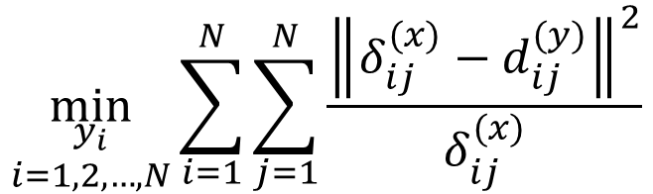
Modified MDS
$$\min_{\begin{aligned}y_{i} \\ i=1,2,…,N\end{aligned}}{\sum_{i=1}^{N}{\sum_{j=1}^{N}{\frac{{\left\|δ_{ij}^{(x)}−d_{ij}^{(y)}\right\|}^{2}}{δ_{ij}^{(x)}}}}}$$
Better, but still does not work very well.

Slide 53
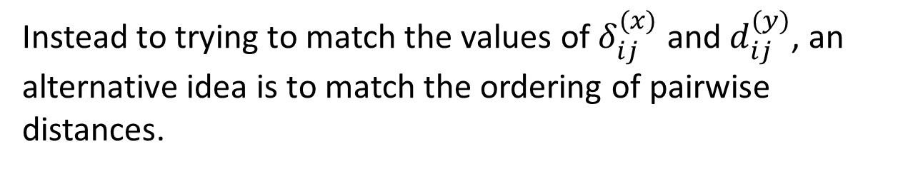
Non-metric MDS
Instead to trying to match the values of $δ_{ij}^{(x)}$ and $d_{ij}^{(y)}$, an alternative idea is to match the ordering of pairwise distances.
If $δ_{ij}^{(x)}<δ_{kl}^{(x)}$, non-metric MDS requires $d_{ij}^{(y)}<d_{kl}^{(y)}$
Again: better, but still does not work very well.
In general, MDS works well when the dimensionality of the data + distance metric is low.
Notes:
Matlab function:
mdscale

Slide 54
Dimension Reduction and Visualization
- PCA
- MDS
- Isomap
- tSNE
- UMAP

Slide 55
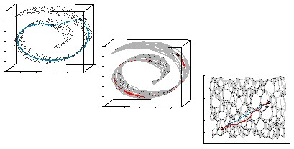
Isomap
(1) Build KNN-graph
(2) Find shortest path
(3) Compute length of shortest path
(4) Classic MDS
Tenenbaum et al, Science, 2000

Slide 56
Dimension Reduction and Visualization
- PCA
- MDS
- Isomap
- tSNE
- UMAP

Slide 57
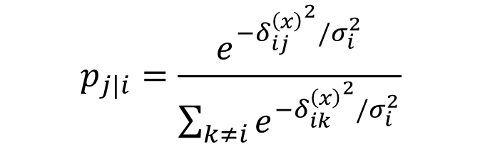

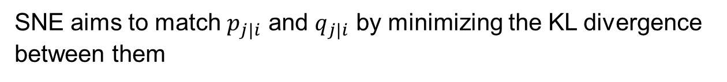
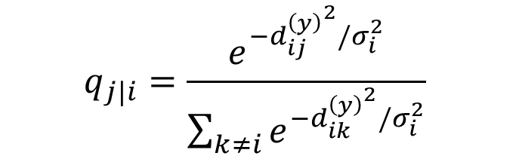
SNE
$$p_{j|i}=\frac{e^{−{δ_{ij}^{\left(x\right)}}^{2}/σ_{i}^{2}}}{\sum_{k≠i}{e^{−{δ_{ik}^{\left(x\right)}}^{2}/σ_{i}^{2}}}}$$
$$q_{j|i}=\frac{e^{−{d_{ij}^{\left(y\right)}}^{2}/σ_{i}^{2}}}{\sum_{k≠i}{e^{−{d_{ik}^{\left(y\right)}}^{2}/σ_{i}^{2}}}}$$
SNE aims to match $p_{j|i}$ and $q_{j|i}$ by minimizing the KL divergence between them
$$\min_{\begin{aligned}y_{i} \\ i=1,2,…,N\end{aligned}}{\sum_{i}{KL(P_{i}|\left|Q_{i}\right)= \sum_{i}{\sum_{j}{p_{j|i}\log{\frac{p_{j|i}}{q_{j|i}}}}}}}$$
Math here is not important.
Important messages here are: (1) great idea to focus on short distances (2) does not work very well.

Slide 58

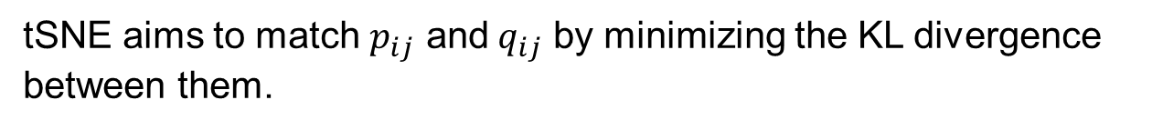

tSNE
$$q_{ij}=\frac{{(1+{d_{ij}^{\left(y\right)}}^{2})}^{−1}}{\sum_{k≠l}{{(1+{d_{kl}^{\left(y\right)}}^{2})}^{−1}}}$$
$$p_{ij}=\frac{p_{j|i}+p_{i|j}}{2N}$$
tSNE aims to match $p_{ij}$ and${ q}_{ij}$ by minimizing the KL divergence between them.
The different treatment to the original and visualization space is the key reason why tSNE is better than SNE.

Slide 59

tSNE is very good at showing clusters
(often tends to generate islands).
A potential danger is that tSNE emphasize short distance too much.
Notes:
Perplexity parameter: (similar to the k in KNN algorithm)
30~50 for large datasets with ~ 10^4 ~ 10^6 data points or more
5~10 for small datasets with ~ 100 data points

Slide 60
Dimension Reduction and Visualization
- PCA
- MDS
- Isomap
- tSNE
- UMAP

Slide 61


UMAP
(1) Build a weighted
KNN-graph
(2) Force directed graph
layout for visualization
Notes:
https://arxiv.org/pdf/1802.03426.pdf

Slide 62
Compared to tSNE, UMAP is better at preserving large scale relationships among clusters.

Slide 63
Take home messages
Distance metric
Euclidean
distance
Geodesic
distance
(manifold)
What to
preserve
Both short and
long dist
PCA
classic MDS
Isomap
Emphasize short and
Down-weight long dist
Modified MDS
Order of pairwise
distances
Non-metric MDS
Preserve only short dist
Give very low weight to
long dist
tSNE and UMAP
Preserve single-linkage
hierarchical tree
SPADE and TPE

