Slide 1
Summer Institutes of Statistical Genetics, 2020
SISG Module 6: Gene Expression Profiling
Lecture 03: Foundations of clustering
Peng Qiu and Greg Gibson
Georgia Institute of Technology

Slide 2
Supervised learning vs. Unsupervised learning
Supervised learning
Unsupervised learning
examples
examples
features
features
class labels

Slide 3
Unsupervised learning
examples
Goals of unsupervised learning are almost always:
Clustering
Trajectory finding
Dimension Reduction / visualization
features
Challenge/Issue:
What is the ground truth?
What is the right answer?
Sad Reality:
Impossible to guarantee the right answer computationally
There is no right answer
Sad Solution:
Let’s leave the decisions to downstream analysis

Slide 4
Unsupervised clustering methods
- Hierarchical clustering
- k-means
- Spectral graph analysis
- Community finding
- Density-based clustering

Slide 5
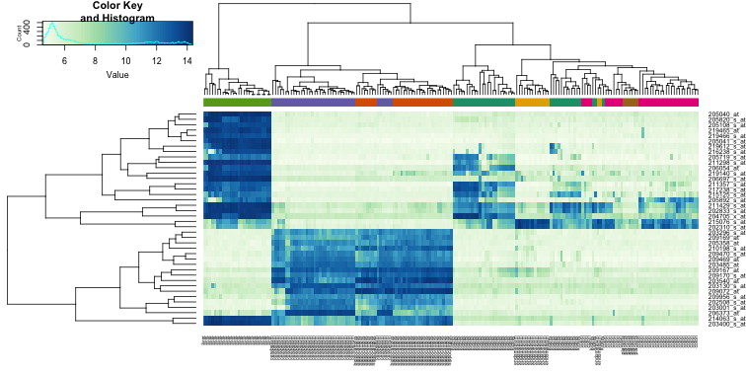
Hierarchical clustering
http://genomicsclass.github.io/book/pages/clustering_and_heatmaps.html
Notes:
Just a random hierarchical clustering heatmap found online
can cluster genes, or samples

Slide 6
Agglomerative hierarchical clustering
Basic algorithm:
(1) Start with each point in a cluster of its own
(2) Repeat the following until there is only one cluster left
  (2.1) Find the “closest” pair of “clusters”
  (2.2) Merge them
(3) Return a tree structure of the merges
Notes:
Draw a simple illustrative diagram on board

Slide 7
Distance metric and Linkage
Distance metric:
L2 distance (Euclidean)
L1 distance
Correlation distance (1-corr)

Slide 8
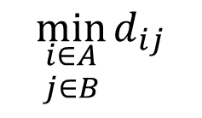
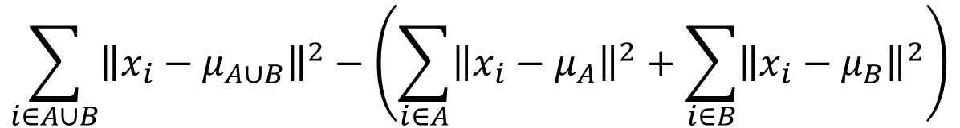

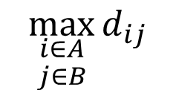
Distance metric and Linkage
Linkages:
Single linkage of two sets of points A & B:
Complete linkage
Average linkage
Ward’s linkage
$$\min_{\begin{aligned}i∈A \\ j∈B\end{aligned}}{d_{ij}}$$
$$\max_{\begin{aligned}i∈A \\ j∈B\end{aligned}}{d_{ij}}$$
$$\frac{1}{\left|A\right||B|}\sum_{i∈A}{\sum_{j∈B}{d_{ij}}}$$
$$\sum_{i∈A∪B}{{\left\|x_{i}−μ_{A∪B}\right\|}^{2}}−\left(\sum_{i∈A}{{\left\|x_{i}−μ_{A}\right\|}^{2}}+\sum_{i∈B}{{\left\|x_{i}−μ_{B}\right\|}^{2}}\right)$$
Notes:
Look at the distance b/w all nodes in A and all nodes in B, pick the smallest (MST)
Pick the largest
Pick the average
Look at the increase of variance (sum of squares) before and after merge

Slide 9
Distance metric and Linkage
Effect of choice of linkage:
If the data form compact and well-separated clusters, all the linkages are equally good choices
In real data without cluster separations
  Single linkage focus on connectedness/closeness
  Complete linkage focus on compactness
  The other two are in-between, and are popular choices
Single linkage
Complete linkage

Slide 10
Unsupervised clustering methods
- Hierarchical clustering
- k-means
- Spectral graph analysis
- Community finding
- Density-based clustering

Slide 11
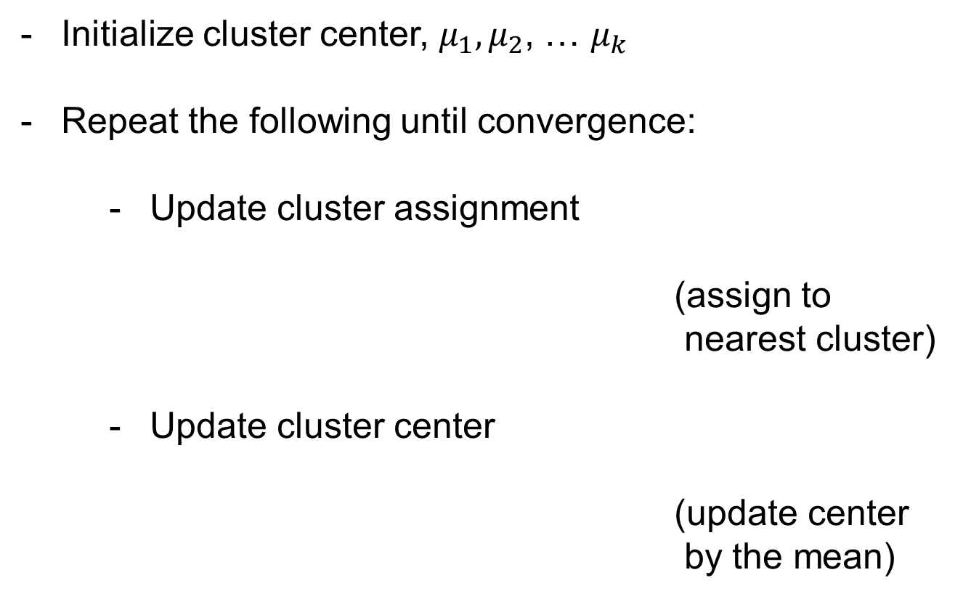

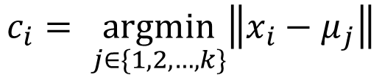
k-means
Initialize cluster center, $μ_{1},μ_{2}$, … $μ_{k}$
Repeat the following until convergence:
  Update cluster assignment
  (assign to nearest cluster)
  Update cluster center
  (update center
  by the mean)
$$c_{i}= \underset{j∈\{1,2,…,k\}}{argmin}\left\|x_{i}−μ_{j}\right\|$$
$$μ_{j}=\frac{\sum_{c_{i}=j}{x_{i}}}{\sum{{(c}_{i}=j)}}$$
Notes:
There is theoretical guarantee to converge

Slide 12
Problems/Variations of k-means
Local optimal
  run it multiple times with different initial, and find consensus
Cluster can disappear
  drop it or re-initialize
Center outside data
  K-medoids
Randomness
  Deterministic k-means
# of clusters
  Gap statistics

Slide 13
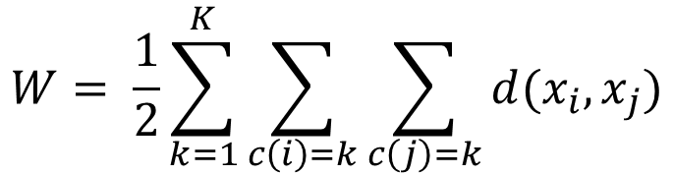

Gap statistics for k-means
Define within cluster distance as the total distances of all pairs of points in the sample cluster
Run k-means with increasing k, and plot
Randomly generate uniformly distributed data from a rectangle containing the original data, run k-means with different k
Find the largest gap
$$W= \frac{1}{2}\sum_{k=1}^{K}{\sum_{c\left(i\right)=k}{\sum_{c\left(j\right)=k}{d(x_{i}, x_{j})}}}$$
$$\log{\frac{W_{k}}{W_{1}}}$$

Slide 14
Gap statistics for k-means
data = [randn(2,500)+[1;10], randn(2,500), randn(2,500)+[10;1]];
figure(1); plot(data(1,:),data(2,:),'o')
for k=1:10
idx = kmeans(data',k,'OnlinePhase','off');
W(k) = compute_W(data, idx);
end
figure(2); plot(1:length(W), log(W/W(1)),'-o')
for i=1:100
random_data = [rand(1,size(data,2))*(max(data(1,:))-min(data(1,:)))+min(data(1,:)); ...
rand(1,size(data,2))*(max(data(2,:))-min(data(2,:)))+min(data(2,:))];
if i==1
figure(3); plot(random_data(1,:), random_data(2,:),'o'); axis([-10,20,-10,20])
end
for k=1:10
idx = kmeans(random_data',k,'OnlinePhase','off');
W_rand(i,k) = compute_W(random_data, idx);
end
end
figure(2); hold on;
errorbar(mean(log(W_rand./W_rand(:,1))), std(log(W_rand./W_rand(:,1))))
hold off; title('log(W_k/W_1)')
figure(4); plot(mean(log(W_rand./W_rand(:,1)))-log(W/W(1)),'o-'); title('gap')
Notes:
Generate real data with 3 clusters
Kmeans k=1~10, compute W_k
Generate random data
Kmeans k=1~10, compute W_k
Compare gap

Slide 15
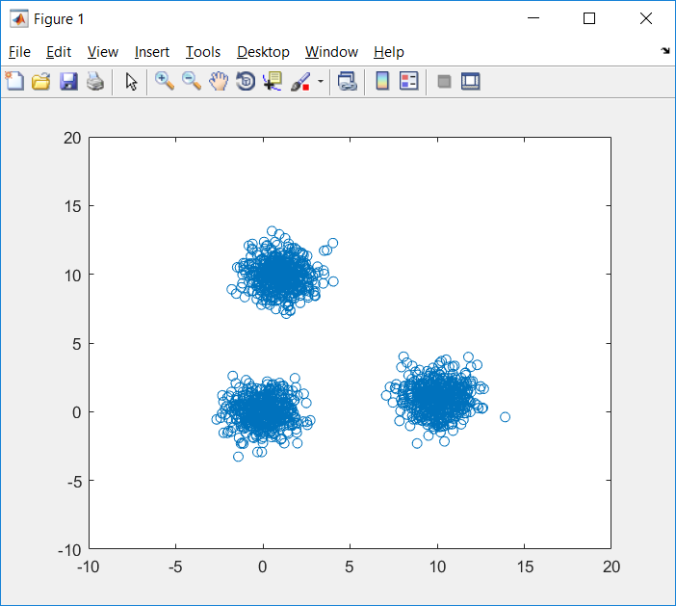
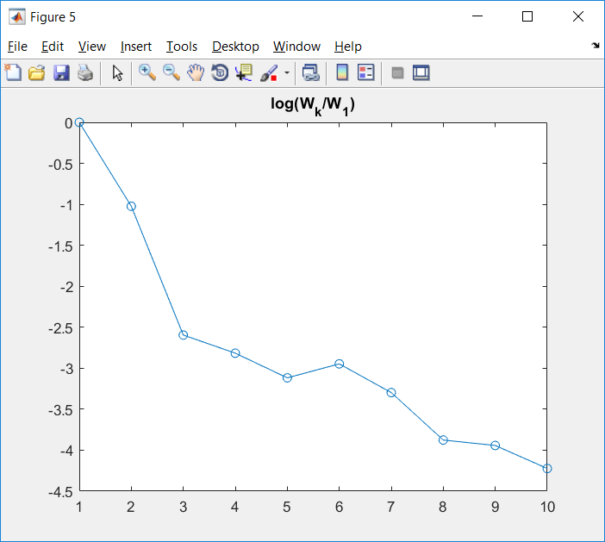
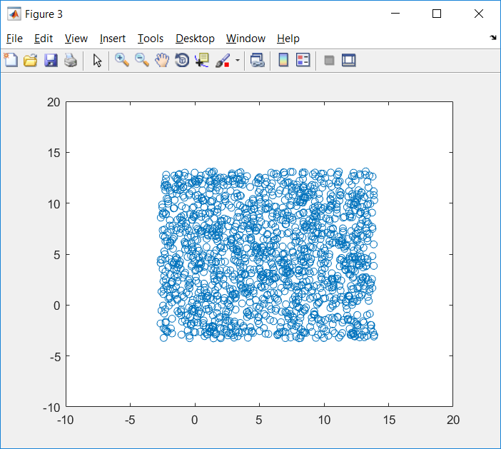
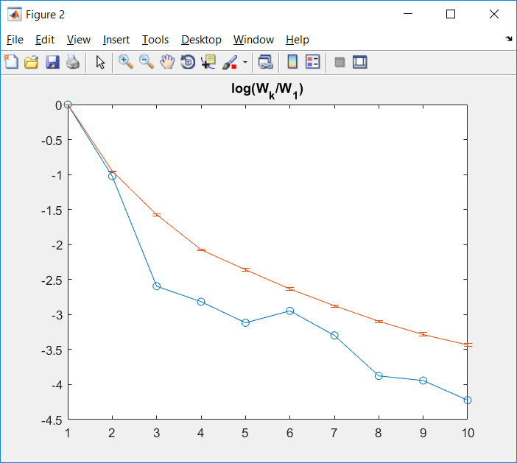
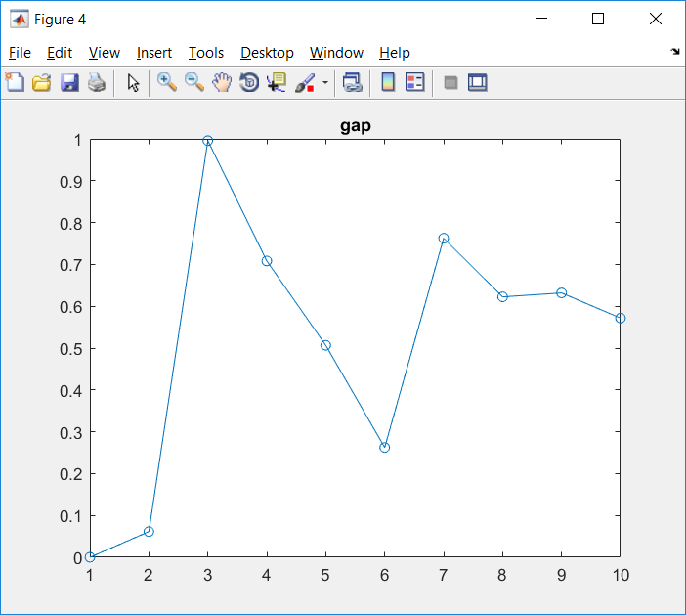
Gap statistics for k-means

Slide 16
Unsupervised clustering methods
- Hierarchical clustering
- k-means
- Spectral graph analysis
- Community finding
- Density-based clustering

Slide 17
Clustering by partitioning Graphs
Basic idea:
Construct a graph
- Each node is one sample / data point
- Each edge connects two samples, with
weights representing similarities
Cut it into smaller pieces

Slide 18

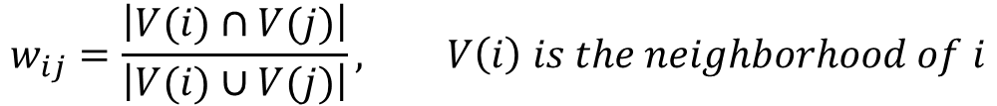
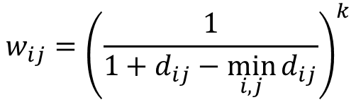
How to construct a graph?
$$w_{ij}=−d_{ij}=−\left\|x_{i}−x_{j}\right\|$$
Weight by negative of L2 distance
Weight by inverse of L2 distance
Threshold the weights to get a sparse graph
Use L2 distance to construct a kNN graph
Jaccard: kNN +
more …
$$w_{ij}={\left(\frac{1}{1+d_{ij}−\min_{i,j}{d_{ij}}}\right)}^{k}$$
$$w_{ij}=\frac{\left|V(i)∩V(j)\right|}{\left|V(i)∪V(j)\right|}, V\left(i\right) is the neighborhood of i$$

Slide 19

Spectral graph partitioning
$$L_{ij}=\left\{\begin{aligned}−w_{ij} if i≠j \\ \sum_{u}{w_{iu}} if i=j\end{aligned}\right.$$
Construct graph Laplacian (L)
Compute e-value and e-vectors of L
Assume the graph is connected:
all evalues are non-negative,
one evalue is exactly 0
In the e-vector of the 2nd smallest e-value, the +/- sign divides the graph into two pieces
Notes:
Why eigenvalue and eigenvectors?

Slide 20
Spectral graph partitioning example
A = zeros(10,10);
A(1:4,1:4) = 1; A(5:10,5:10)=1;
A(1,9)=1; A(9,1)=1;
A(1,7)=1; A(7,1)=1;
A = A-diag(diag(A));
L = diag(sum(A))-A;
[V,D] = eig(L)
6
2
1
7
5
3
4
9
10
8
A =
0 1 1 1 0 0 1 0 1 0
1 0 1 1 0 0 0 0 0 0
1 1 0 1 0 0 0 0 0 0
1 1 1 0 0 0 0 0 0 0
0 0 0 0 0 1 1 1 1 1
0 0 0 0 1 0 1 1 1 1
1 0 0 0 1 1 0 1 1 1
0 0 0 0 1 1 1 0 1 1
1 0 0 0 1 1 1 1 0 1
0 0 0 0 1 1 1 1 1 0

Slide 21
Spectral graph partitioning example
A = zeros(10,10);
A(1:4,1:4) = 1; A(5:10,5:10)=1;
A(1,9)=1; A(9,1)=1;
A(1,7)=1; A(7,1)=1;
A = A-diag(diag(A));
L = diag(sum(A))-A;
[V,D] = eig(L)
6
2
1
7
5
3
4
9
10
8
L =
5 -1 -1 -1 0 0 -1 0 -1 0
-1 3 -1 -1 0 0 0 0 0 0
-1 -1 3 -1 0 0 0 0 0 0
-1 -1 -1 3 0 0 0 0 0 0
0 0 0 0 5 -1 -1 -1 -1 -1
0 0 0 0 -1 5 -1 -1 -1 -1
-1 0 0 0 -1 -1 6 -1 -1 -1
0 0 0 0 -1 -1 -1 5 -1 -1
-1 0 0 0 -1 -1 -1 -1 6 -1
0 0 0 0 -1 -1 -1 -1 -1 5

Slide 22
Spectral graph partitioning example
A = zeros(10,10);
A(1:4,1:4) = 1; A(5:10,5:10)=1;
A(1,9)=1; A(9,1)=1;
A(1,7)=1; A(7,1)=1;
A = A-diag(diag(A));
L = diag(sum(A))-A;
[V,D] = eig(L)
6
2
1
7
5
3
4
9
10
8
V =
0.3162 -0.2025 0.0000 -0.0000 0.7628 0.0000 -0.0000 0.0000 -0.0000 -0.5265
0.3162 -0.4363 0.1245 -0.8069 -0.1907 -0.0000 0.0000 -0.0000 0.0000 0.0814
0.3162 -0.4363 0.6366 0.5113 -0.1907 -0.0000 -0.0000 -0.0000 -0.0000 0.0814
0.3162 -0.4363 -0.7611 0.2956 -0.1907 -0.0000 0.0000 -0.0000 -0.0000 0.0814
0.3162 0.2766 -0.0000 -0.0000 -0.1907 -0.5537 -0.6640 0.0508 -0.0000 -0.1927
0.3162 0.2766 0.0000 0.0000 -0.1907 0.7826 -0.2555 0.2687 0.0000 -0.1927
0.3162 0.2025 0.0000 0.0000 0.2860 -0.0000 -0.0000 -0.0000 0.7071 0.5265
0.3162 0.2766 0.0000 -0.0000 -0.1907 0.0510 0.2712 -0.8209 -0.0000 -0.1927
0.3162 0.2025 -0.0000 -0.0000 0.2860 0.0000 0.0000 -0.0000 -0.7071 0.5265
0.3162 0.2766 -0.0000 0.0000 -0.1907 -0.2799 0.6483 0.5014 -0.0000 -0.1927
diag(D)' =
-0.0000 0.5359 4.0000 4.0000 5.0000 6.0000 6.0000 6.0000 7.0000 7.4641

Slide 23
Spectral graph partitioning example
A = zeros(10,10);
A(1:4,1:4) = 1; A(5:7,5:7)=1; A(8:10,8:10)=1;
A(1,9)=1; A(9,1)=1;
A(1,7)=1; A(7,1)=1;
A = A-diag(diag(A));
L = diag(sum(A))-A;
[V,D] = eig(L)
6
2
1
7
5
3
4
9
10
8
V =
0.3162 0.0000 0.2172 -0.0000 0.0000 0.3476 0.0000 -0.0000 -0.0000 -0.8556
0.3162 0.0000 0.4277 0.0000 0.0000 -0.1549 -0.0000 0.4082 -0.7071 0.1625
0.3162 0.0000 0.4277 0.0000 -0.0000 -0.1549 -0.0000 0.4082 0.7071 0.1625
0.3162 0.0000 0.4277 0.0000 -0.0000 -0.1549 0.0000 -0.8165 -0.0000 0.1625
0.3162 0.4440 -0.2991 -0.0224 -0.7068 -0.2395 0.2299 0.0000 -0.0000 -0.0564
0.3162 0.4440 -0.2991 0.0224 0.7068 -0.2395 0.2299 0.0000 0.0000 -0.0564
0.3162 0.3251 -0.1519 -0.0000 0.0000 0.5375 -0.6280 -0.0000 0.0000 0.2967
0.3162 -0.4440 -0.2991 -0.7068 0.0224 -0.2395 -0.2299 -0.0000 0.0000 -0.0564
0.3162 -0.3251 -0.1519 -0.0000 0.0000 0.5375 0.6280 0.0000 -0.0000 0.2967
0.3162 -0.4440 -0.2991 0.7068 -0.0224 -0.2395 -0.2299 -0.0000 0 -0.0564
diag(D)' =
-0.0000 0.2679 0.4921 3.0000 3.0000 3.2444 3.7321 4.0000 4.0000 6.2635

Slide 24
Spectral graph partitioning example
A = zeros(10,10);
A(1:4,1:4) = 1; A(5:7,5:7)=1; A(8:10,8:10)=1;
A(1,7)=1; A(7,1)=1;
A = A-diag(diag(A));
L = diag(sum(A))-A;
[V,D] = eig(L)
6
2
1
7
5
3
4
9
10
8
V =
-0.3780 0 -0.2142 -0.0000 0 0 -0.3864 0.0000 -0.0000 0.8136
-0.3780 0 -0.3560 0.0000 0 0 0.1651 -0.7071 0.4082 -0.1909
-0.3780 0 -0.3560 0.0000 0 0 0.1651 0.7071 0.4082 -0.1909
-0.3780 0 -0.3560 0.0000 0 0 0.1651 0.0000 -0.8165 -0.1909
-0.3780 0 0.4929 -0.7071 0 0 0.3207 0.0000 0.0000 0.1065
-0.3780 0 0.4929 0.7071 0 0 0.3207 -0.0000 -0.0000 0.1065
-0.3780 0 0.2966 -0.0000 0 0 -0.7505 0 -0.0000 -0.4539
0 0.5774 0 0 0.7634 0.2895 0 0 0 0
0 0.5774 0 0 -0.6325 0.5164 0 0 0 0
0 0.5774 0 0 -0.1310 -0.8059 0 0 0 0
diag(D)' =
-0.0000 0.0000 0.3983 3.0000 3.0000 3.0000 3.3399 4.0000 4.0000 5.2618

Slide 25
Unsupervised clustering methods
- Hierarchical clustering
- k-means
- Spectral graph analysis
- Community finding
- Density-based clustering

Slide 26

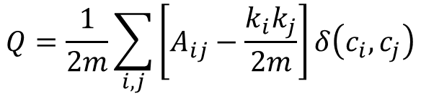




Community finding
Maximize modularity
where, is weighted adjacency
is degree of i
is cluster assignment
is total weights
Implementation: google search the following:
“google code community finding Louvain”
Key idea of the algorithm: greedy agglomerative procedure
$$Q=\frac{1}{2m}\sum_{i,j}{\left[A_{ij}−\frac{k_{i}k_{j}}{2m}\right]}δ\left(c_{i}, c_{j}\right)$$
$$A_{ij}$$
$$k_{i}$$
$$c_{i}$$
$$m$$
$m=\frac{1}{2}\sum{A_{ij}}$

Slide 27
Community finding - Examples
6
7
5
A = zeros(10,10);
A(1:4,1:4) = 1; A(5:10,5:10)=1;
A(1,9)=1; A(9,1)=1;
A(1,7)=1; A(7,1)=1;
A = A-diag(diag(A));
C = [1 1 1 1 2 2 2 2 2 2 ]
Q = sum(sum((A-sum(A)'*sum(A)/(2*sum(A(:)))).*((C'==C)-eye(size(A)))))/(2*sum(A(:)))
2
1
9
10
3
4
8
A =
0 1 1 1 0 0 1 0 1 0
1 0 1 1 0 0 0 0 0 0
1 1 0 1 0 0 0 0 0 0
1 1 1 0 0 0 0 0 0 0
0 0 0 0 0 1 1 1 1 1
0 0 0 0 1 0 1 1 1 1
1 0 0 0 1 1 0 1 1 1
0 0 0 0 1 1 1 0 1 1
1 0 0 0 1 1 1 1 0 1
0 0 0 0 1 1 1 1 1 0
C =
1 1 1 1 2 2 2 2 2 2
Q =
0.3388

Slide 28
Community finding - Examples
>> C = [1 1 1 1 1 1 2 2 2 2]
>> Q = sum(sum((A-sum(A)'*sum(A)/(2*sum(A(:)))).*((C'==C)-eye(size(A)))))/(2*sum(A(:)))
Q =
0.1838
>> C = [1 1 1 1 2 2 2 3 3 3]
>> Q = sum(sum((A-sum(A)'*sum(A)/(2*sum(A(:)))).*((C'==C)-eye(size(A)))))/(2*sum(A(:)))
Q =
0.2037
>> C = [1 1 1 1 1 1 1 1 1 1]
>> Q = sum(sum((A-sum(A)'*sum(A)/(2*sum(A(:)))).*((C'==C)-eye(size(A)))))/(2*sum(A(:)))
Q =
0.2765
>> C = [1 2 3 4 5 6 7 8 9 10]
>> Q = sum(sum((A-sum(A)'*sum(A)/(2*sum(A(:)))).*((C'==C)-eye(size(A)))))/(2*sum(A(:)))
Q =
0

Slide 29
Community finding - Examples
6
7
5
A = zeros(10,10);
A(1:4,1:4) = 1; A(5:7,5:7)=1; A(8:10,8:10)=1;
A(1,9)=1; A(9,1)=1;
A(1,7)=1; A(7,1)=1;
A = A-diag(diag(A));
C = [1 1 1 1 2 2 2 3 3 3 ]
Q = sum(sum((A-sum(A)'*sum(A)/(2*sum(A(:)))).*((C'==C)-eye(size(A)))))/(2*sum(A(:)))
2
1
9
10
3
4
8
A =
0 1 1 1 0 0 1 0 1 0
1 0 1 1 0 0 0 0 0 0
1 1 0 1 0 0 0 0 0 0
1 1 1 0 0 0 0 0 0 0
0 0 0 0 0 1 1 0 0 0
0 0 0 0 1 0 1 0 0 0
1 0 0 0 1 1 0 0 0 0
0 0 0 0 0 0 0 0 1 1
1 0 0 0 0 0 0 1 0 1
0 0 0 0 0 0 0 1 1 0
C =
1 1 1 1 2 2 2 3 3 3
Q =
0.3622

Slide 30
Community finding - Examples
>> C = [1 1 1 1 1 1 1 2 2 2]
>> Q = sum(sum((A-sum(A)'*sum(A)/(2*sum(A(:)))).*((C'==C)-eye(size(A)))))/(2*sum(A(:)))
Q =
0.3355
>> C = [1 1 1 1 2 2 2 1 1 1]
>> Q = sum(sum((A-sum(A)'*sum(A)/(2*sum(A(:)))).*((C'==C)-eye(size(A)))))/(2*sum(A(:)))
Q =
0.3355
>> C = [1 1 1 1 1 1 1 1 1 1]
>> Q = sum(sum((A-sum(A)'*sum(A)/(2*sum(A(:)))).*((C'==C)-eye(size(A)))))/(2*sum(A(:)))
Q =
0.2774
>> C = [1 2 3 4 5 6 7 8 9 10]
>> Q = sum(sum((A-sum(A)'*sum(A)/(2*sum(A(:)))).*((C'==C)-eye(size(A)))))/(2*sum(A(:)))
Q =
0

Slide 31
Unsupervised clustering methods
- Hierarchical clustering
- k-means
- Spectral graph analysis
- Community finding
- Density-based clustering

Slide 32
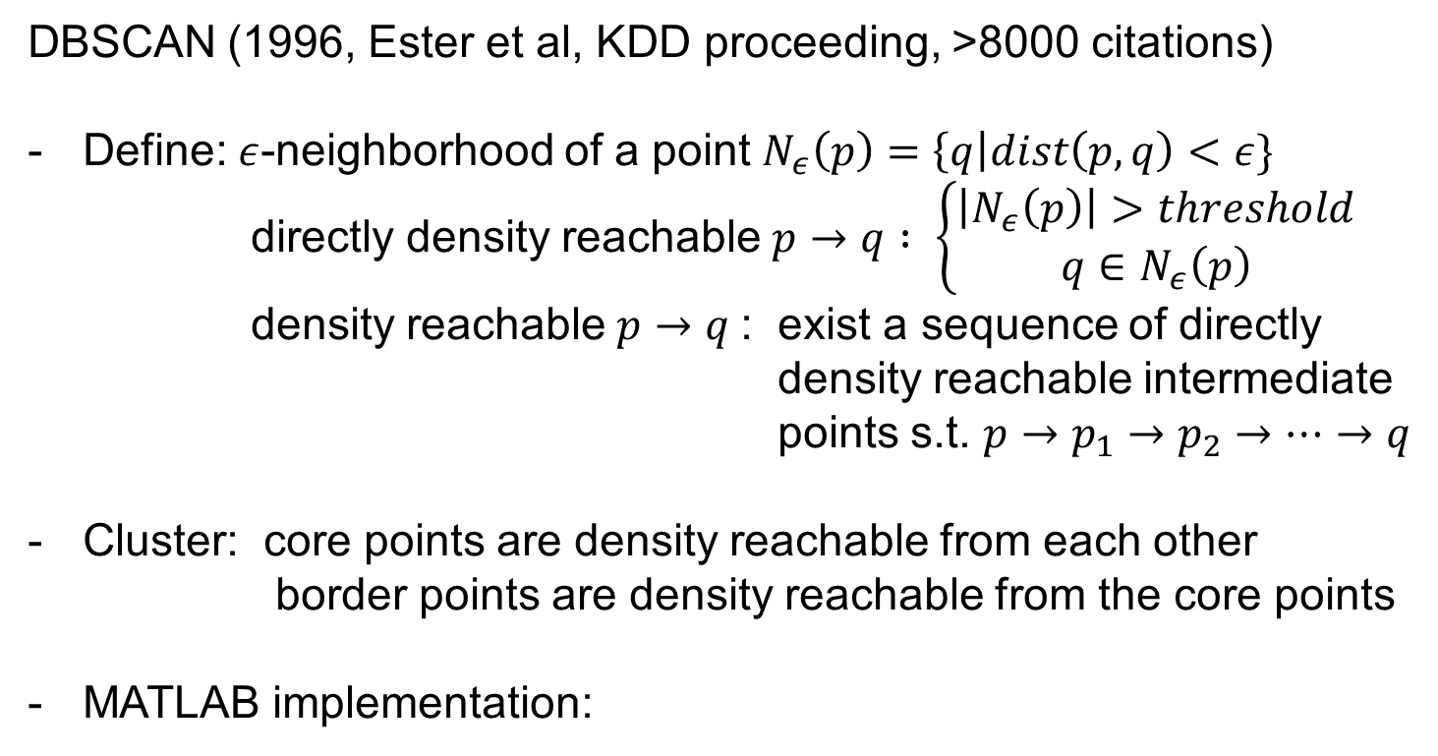
DBSCAN
DBSCAN (1996, Ester et al, KDD proceeding, >8000 citations)
Define: $ε$-neighborhood of a point $N_{ε}\left(p\right)=\left\{q\right|dist\left(p,q\right)<ε\}$
directly density reachable $p→q : \left\{\begin{aligned}\left|N_{ε}\left(p\right)\right|>threshold \\ q∈N_{ε}\left(p\right)\end{aligned}\right.$
density reachable $p→q$: exist a sequence of directly density reachable intermediate
points s.t. $p→p_{1}→p_{2}→…→q$
Cluster: core points are density reachable from each other
border points are density reachable from the core points
MATLAB implementation:
https://www.mathworks.com/help/stats/dbscan.html#d118e261580
Notes:
Why this is good? Can handle clusters with arbitrary shape

Slide 33
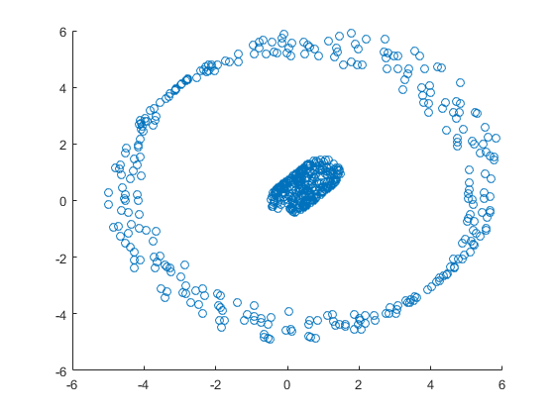
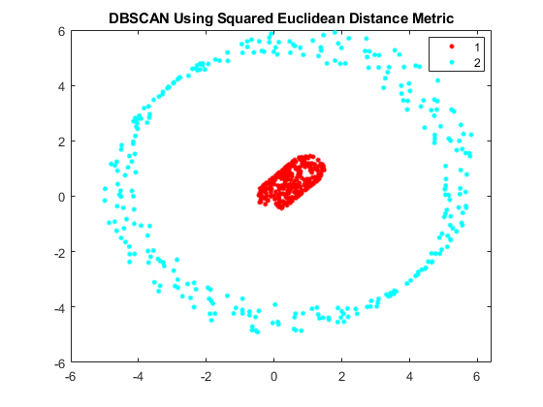
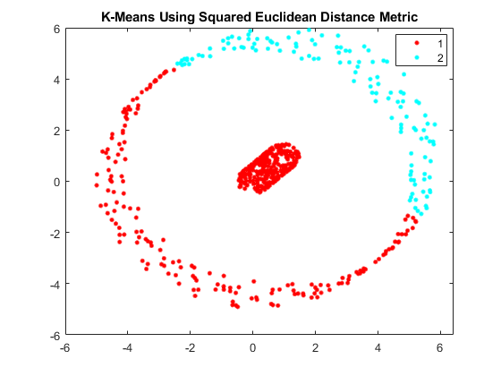
DBSCAN matlab example
Raw data (2D)
DBSCAN
kmeans
https://www.mathworks.com/help/stats/dbscan.html#d118e261580
Notes:
Why this is good? Can handle clusters with arbitrary shape

Slide 34
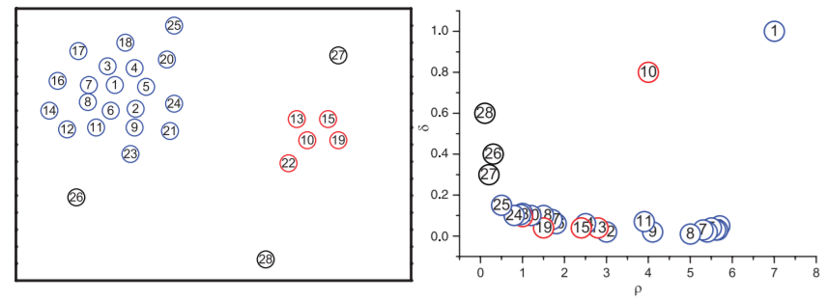
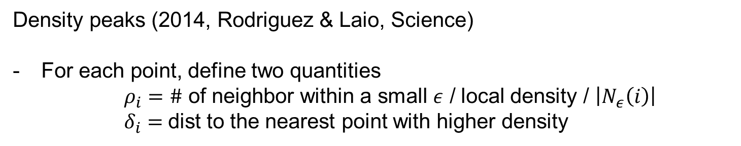
Clustering by density peaks
Density peaks (2014, Rodriguez & Laio, Science)
For each point, define two quantities
$ρ_{i}=\#$ of neighbor within a small $ε$ / local density / $\left|N_{ε}\left(i\right)\right|$
$δ_{i}=$dist to the nearest point with higher density

Slide 35
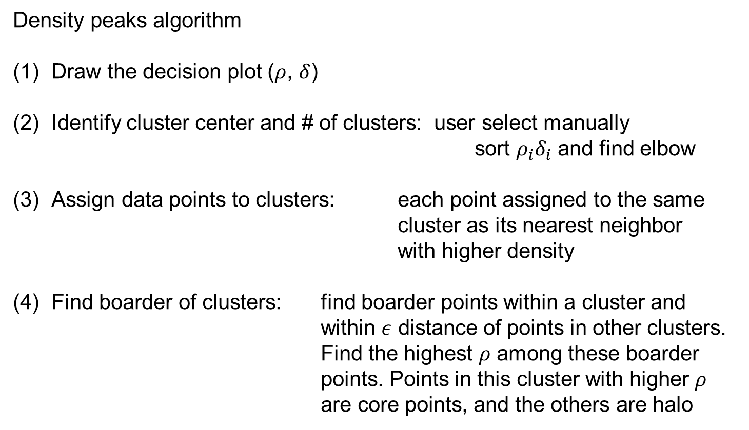
Clustering by density peaks
Density peaks algorithm
Draw the decision plot ($ρ$, $δ$)
Identify cluster center and # of clusters: user select manually
sort $ρ_{i}δ_{i}$ and find elbow
Assign data points to clusters: each point assigned to the same cluster as its nearest neighbor with higher density
Find boarder of clusters: find boarder points within a cluster and within $ε$ distance of points in other clusters. Find the highest $ρ$ among these boarder points. Points in this cluster with higher $ρ$ are core points, and the others are halo

Slide 36
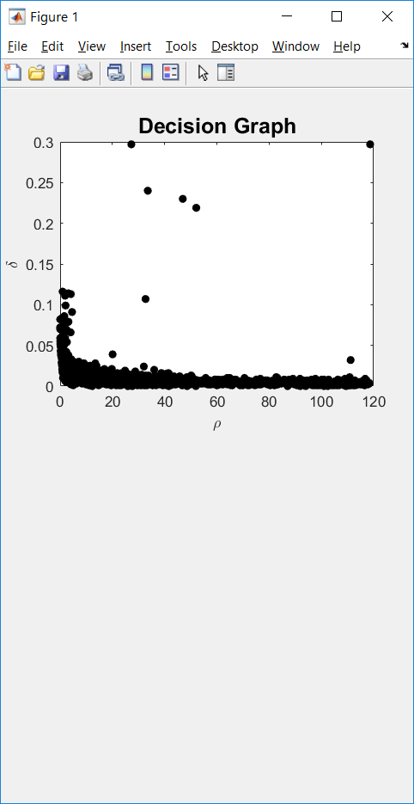
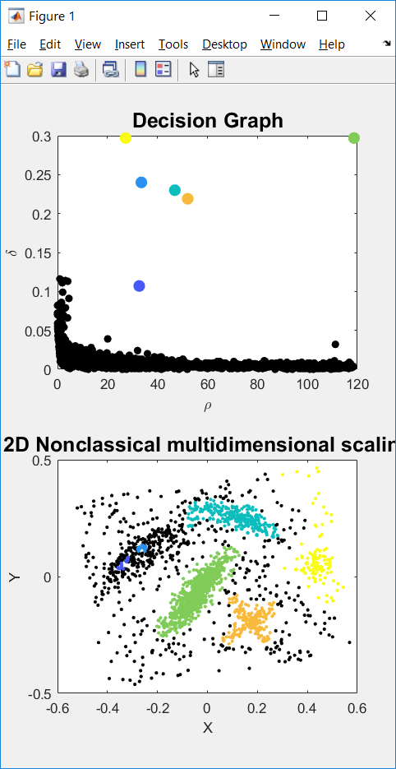
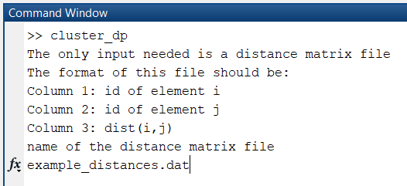
Clustering by density peaks - Implementation
https://people.sissa.it/~laio/Research/Res_clustering.php

Slide 37
Take home messages
Great tool to see patterns of genes and samples simultaneously
Often used to show signature genes
Often used to show relationship between clusters
- Hierarchical clustering
- k-means
- Spectral graph analysis
- Community finding
- Density-based clustering
Simple and extremely cheap to compute
Assume clusters to be round and of similar size
Works well if the graph is properly defined
Does not make assumptions on cluster shape/size
Able to catch rare clusters
Very popular in the literature
Works well when the dimensionality is relatively low
Does not make assumptions on cluster shape/size
Able to catch rare clusters
Also quite popular in the literature

