Slide 1
Summer Institutes of Statistical Genetics, 2021
Module 6: GENE EXPRESSION PROFILING
Greg Gibson and Peng Qiu
Georgia Institute of Technology
Lecture 4: NORMALIZATION
greg.gibson@biology.gatech.edu http://www.cig.gatech.edu

Slide 2
Why do we work on the log₂ scale ?
Log transformation makes the data more normally distributed, minimizing biases due to the common feature that a small number of genes account for over half the transcripts
Log base 2 is convenient, because in practice most differential expression is in the range of 1.2x to 8x, depending on the contrast of interest and complexity of the sample.
It is also intuitively simple to infer fold changes in a symmetrical manner:
A difference of -1 unit corresponds to half the abundance, and +1 to twice the abundance A difference of -2 units corresponds to a quarter the abundance, and +3 to 8-times the abundance
4. The log scale is insensitive to mean centering, so it is simple to just set the mean or median to 0, preserving the relative abundance above or below the sample average
5. It is generally useful to add 1 to all values before taking the log, to avoid “0” returning #NUM! (but this step is built into most code, such as edgeR)

Slide 3
Sample-specific Normalization
In the Microarray days, we generally used additive adjustment to center the mean or median
When RNAseq took over, the emphasis shifted to multiplicative scaling to total counts
Additional adjustments like TMM account for biases due to variable abundance of a small number of highly expressed transcripts, like HBB or Ribosomal or Mitochondrial components. If they account for 50% of the transcripts in one sample but 30% in another, then the CPM will all be higher on the second sample.
Also for RNAseq data, adjustment is made for the high “zero-count” (drop-out) rate for low-abundance transcripts: the data is said to be negative binomially distributed. Limma/Voom estimate the actual distribution from the data and adjust expected variance estimates accordingly.
Some analysts also adjust for GC content or gene length if they suspect a dependency of response to these.

Slide 4
Relative and Absolute Normalization
Raw data:
no effect
Variance transformed:
no effect
Mean centered:
significant effect

Slide 5
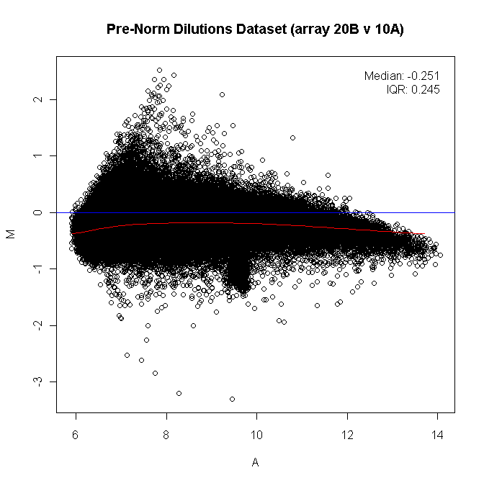
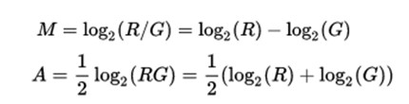
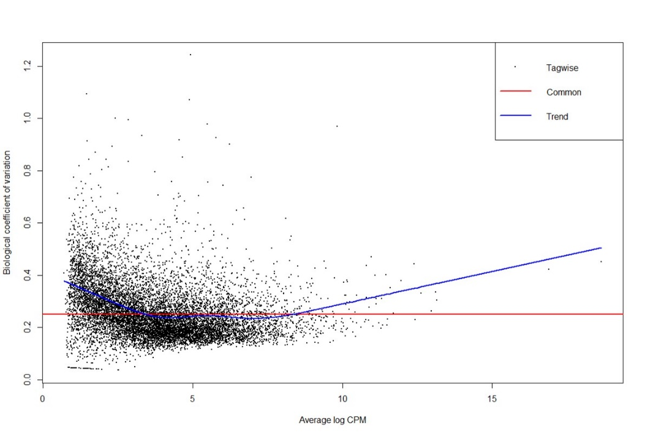
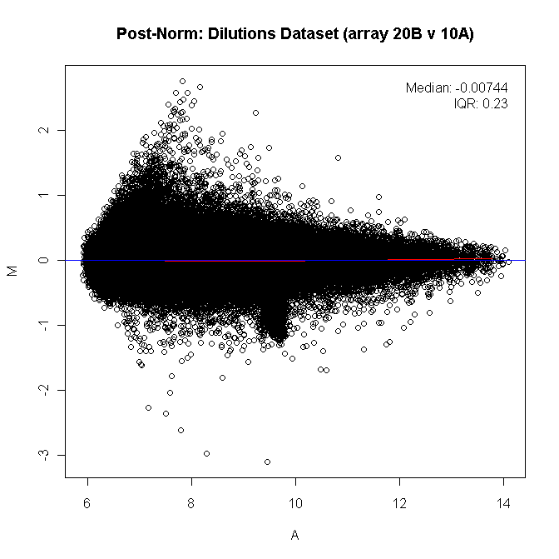
MA Plots: Magnitude vs Abundance; and Dispersion

Slide 6
Approaches to Normalization
Mean or Median transform, simply centers the distribution
  - Something like this is essential to control for overall distributional effects (eg RNA concentration)
Variance transforms, such as standardization or inter-quartile range
- Depends on whether you think the overall distributions should have similar variance
Quantile normalization
  - Transforms the ranks to the average expression value for each rank
Gene-level model fitting
  - Remove technical or biological effects before model fitting on the residuals
Supervised normalization
  - Optimally estimate the biological effect while fitting technical factors across the entire experiment

Slide 7
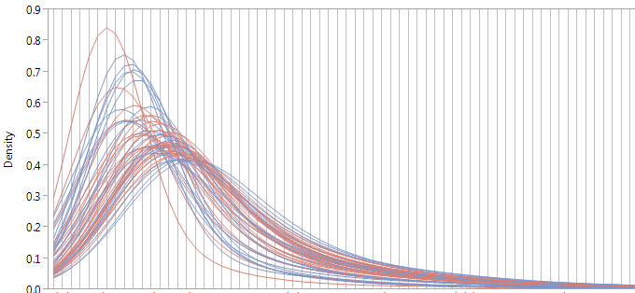
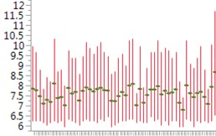
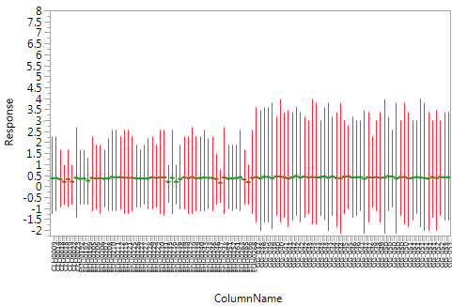
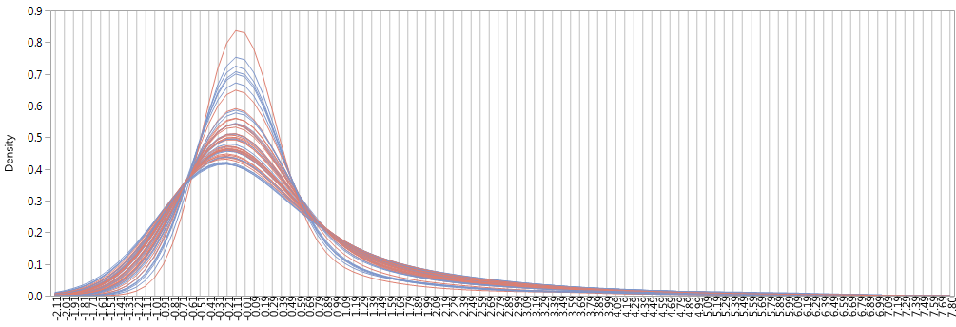
Effect of Median Centering
Raw Profiles
Density
Sample
6 7 8 9 10 11 12
Median Transform
Density
Sample
-2 -1 0 1 2 3 4
For RNASeq data, CPM essentially does this: cpm = 1,000,000 x reads/total reads

Slide 8
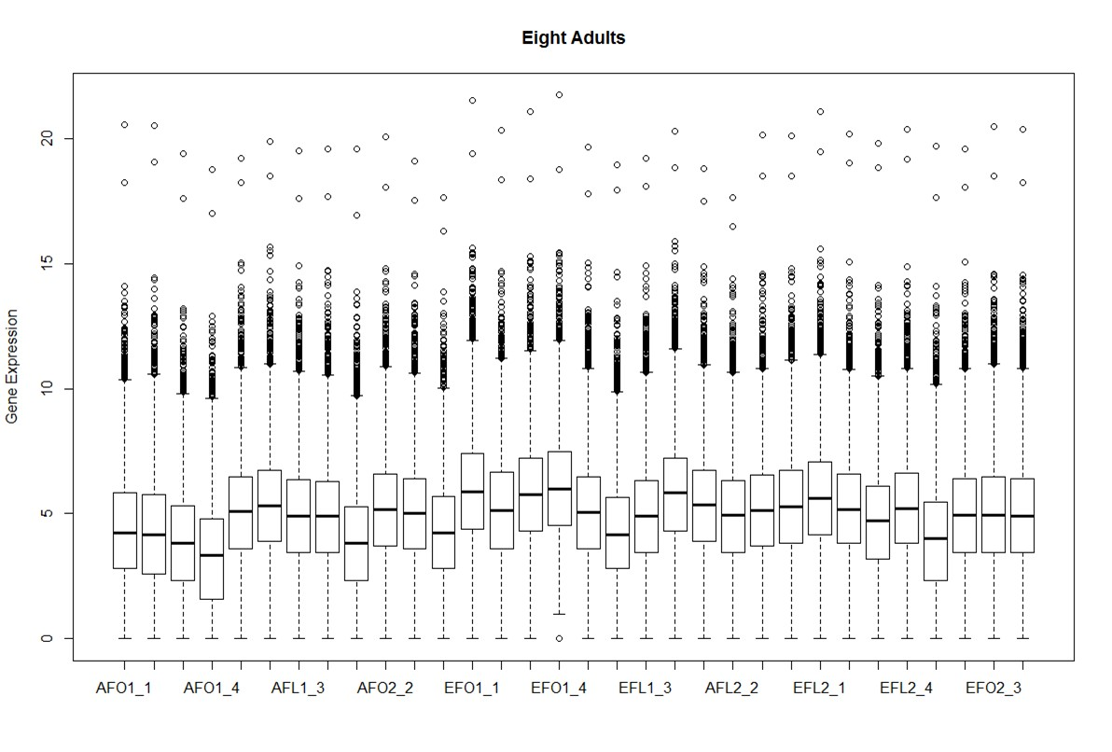
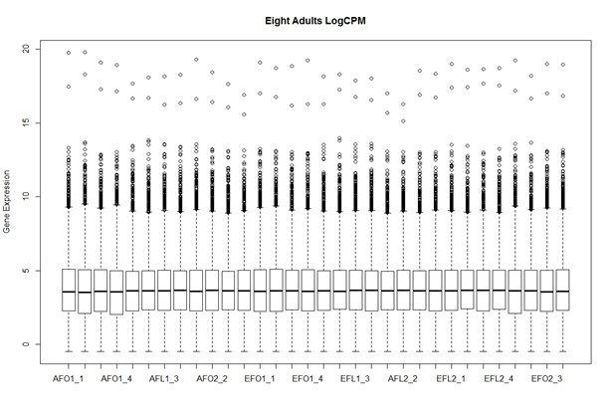
Effect of Variance Scaling

Slide 9
The Normalization Challenge

Slide 10
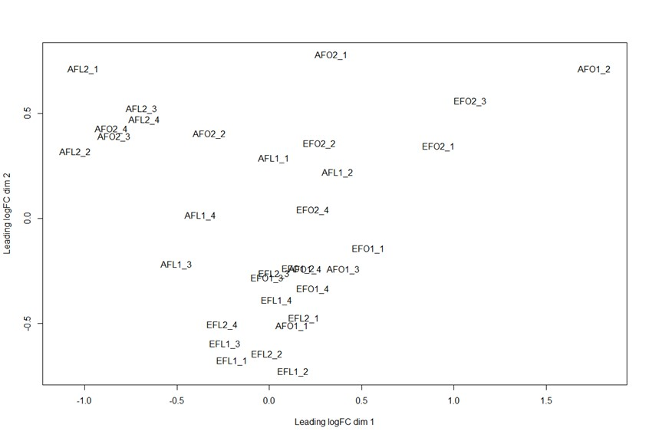
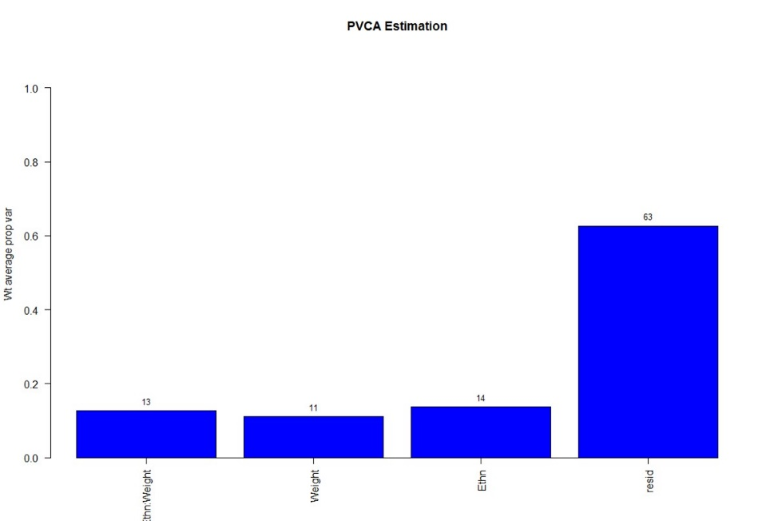
Principal Component Variance Analysis
It is always a good idea to start by asking what biological and technical factors dominate the variation in your samples.
Then you can choose which ones to adjust for in your modeling.

Slide 11
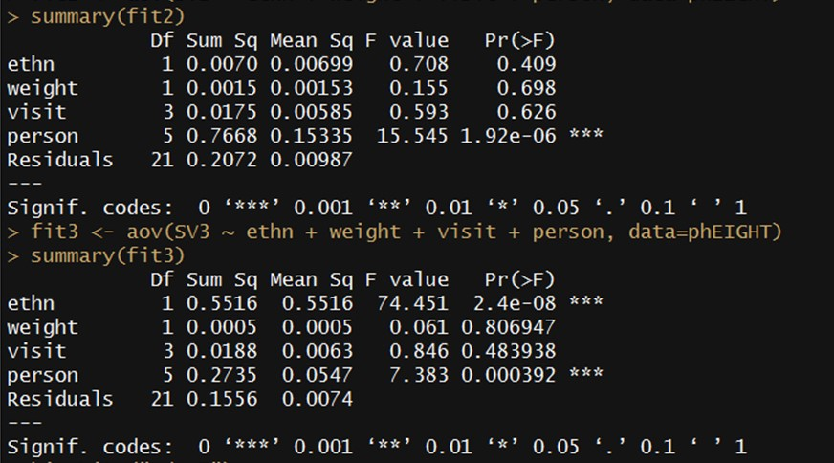
Surrogate Variable Analysis
COMBAT is a batch correction method: you remove the effects of technical confounders
PEER factor analysis is a Bayesian approach that by default automatically adjusts for latent variables
SVA (Surrogate Variable Analysis) gives you control over which variables to adjust for
SNM (Supervised Normalization of Microarrays) iteratively adjusts for biological and technical factors

Slide 12
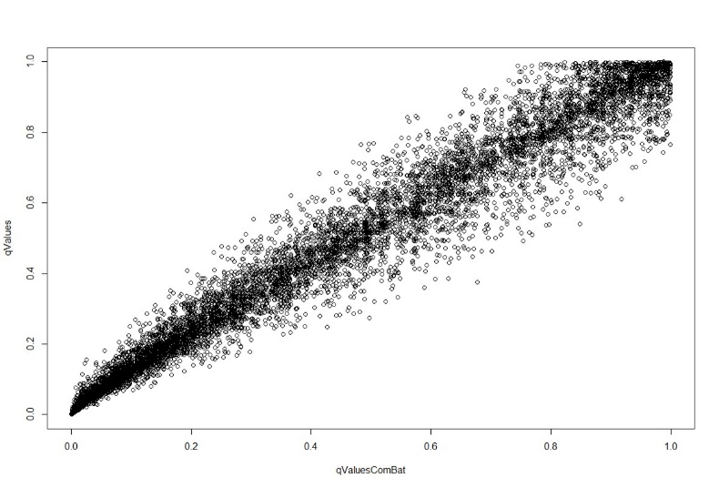
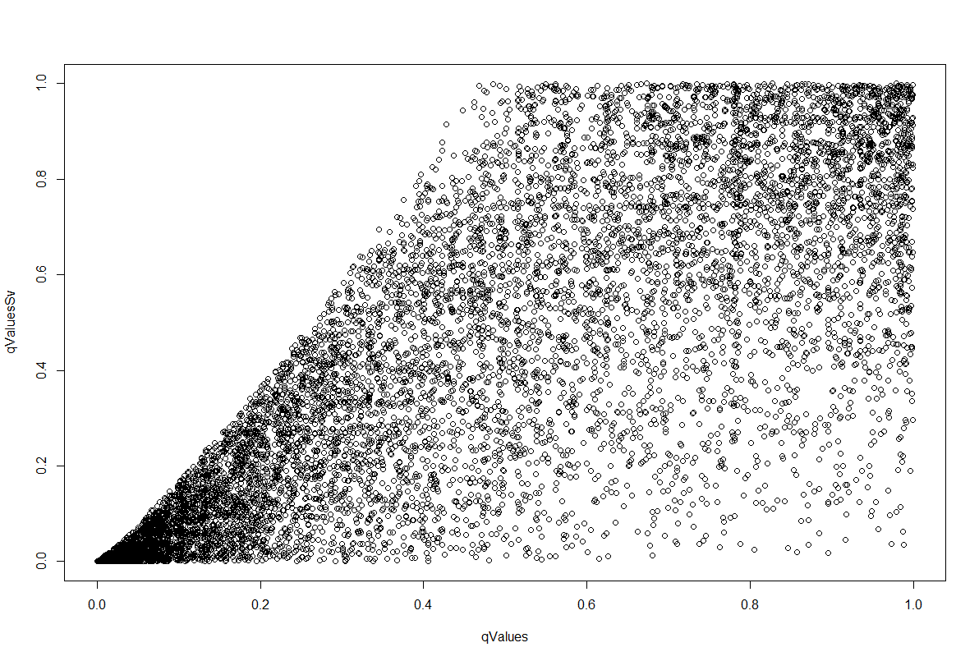
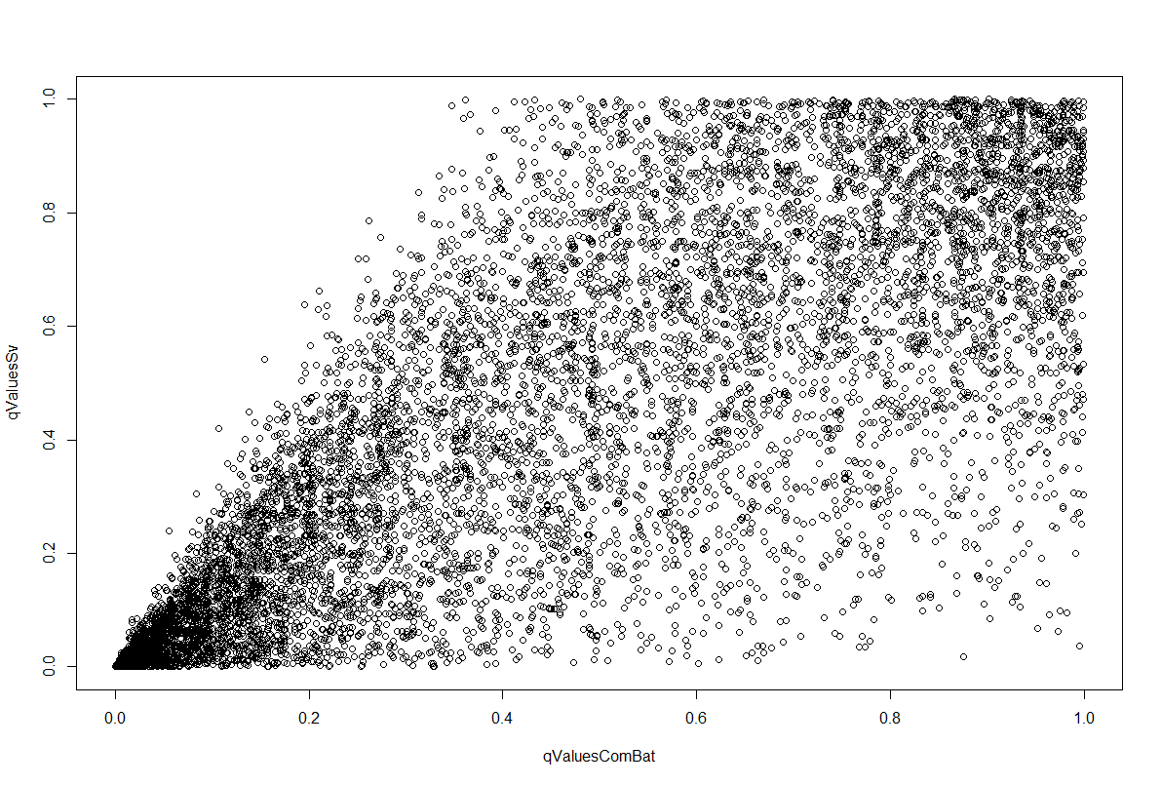
Normalization matters
Raw vs Combat
SVA vs Raw
SVA vs Combat

Slide 13
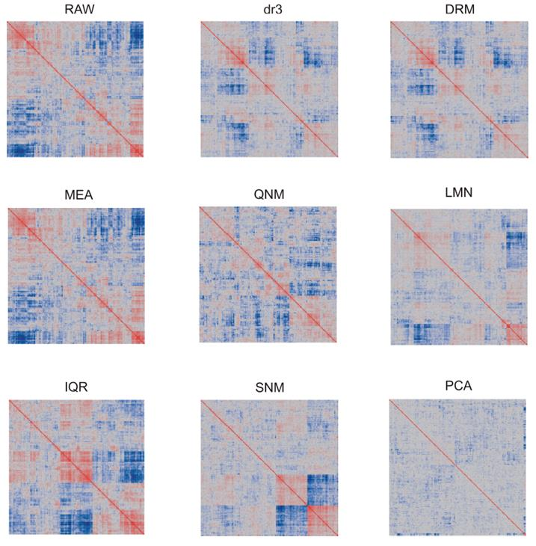
Effect of Normalization on Covariance

Slide 14
Recommended Approach
1. Normalize the samples, paying attention to the distributions of overall profiles
Extract the Principal components of gene expression, and ask whether the major PC are correlated with technical covariates such as Batch or RNA quality; or with Biological variables of interest
If they are, renormalize to remove those effects
As much as possible, analyze the dataset in several different ways to
confirm that the findings are not sensitive to your analytical choice, and
gain insight into what may cause differences, eg find confounding factors
5. Compare the final p-value distributions, and perform gene ontology analysis to evaluate which strategy is giving you biologically plausible insight.

