Slide 1
Summer Institutes of Statistical Genetics, 2020
Module 6: GENE EXPRESSION PROFILING
Greg Gibson and Peng Qiu
Georgia Institute of Technology
Lecture 5: EPIGENOMICS AND INTRO TO scRNAseq
greg.gibson@biology.gatech.edu http://www.cig.gatech.edu

Slide 2
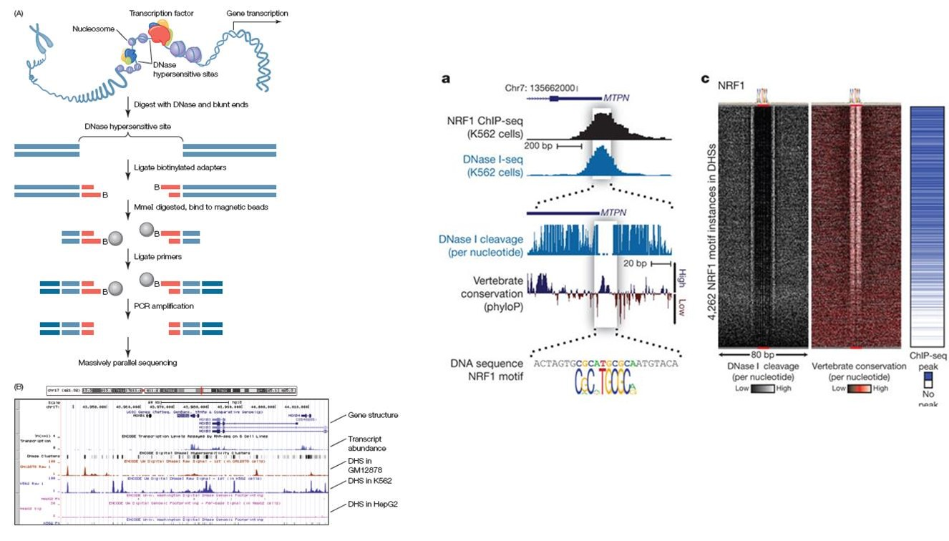
DHS and TFBS: DNAse hypersensitive sites and TF Binding

Slide 3
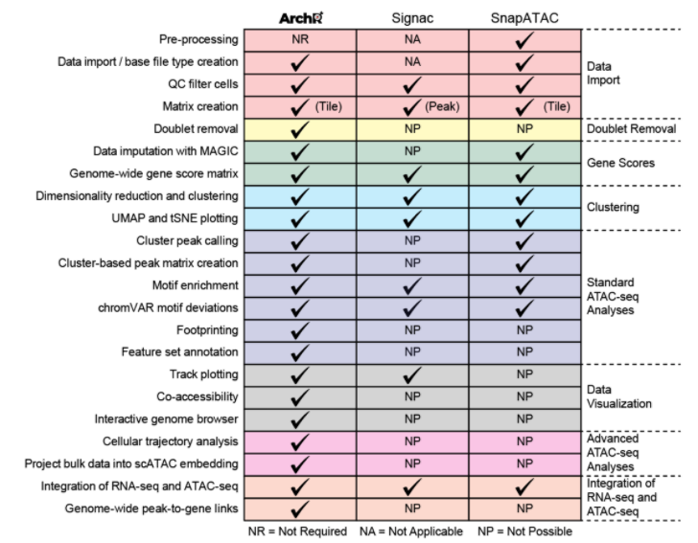
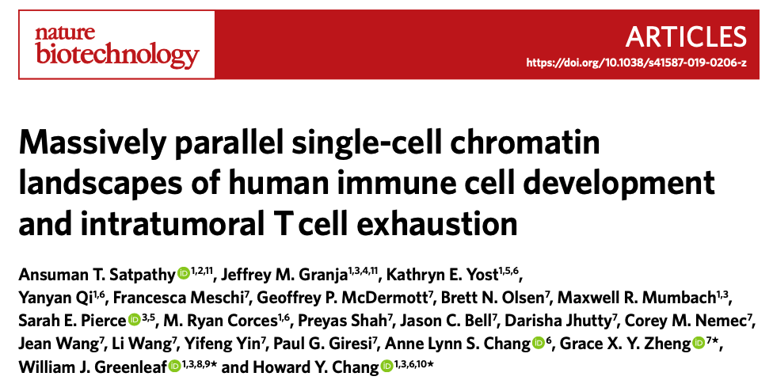
ATAC-seq and scATAC-seq
Assessment of computational methods for the analysis of single-cell ATAC-seq data
Chen, et al Genome Biology (2019) 20: 241 recommends SnapATAC for single cell analysis. Signac is the Seurat implementation.
We are finding that ArchR is easier to install and run, and meets most challenges.
Another useful review is A Hitchiker’s Guide to ATACseq analysis: Feng Yan, et al. Genome Biology (2020) 21: 22
Feng Yan, David R. Powell, David J. Curtis & Nicholas C. Wong Genome Biology 21: 22 (2020)

Slide 4
scATAC-seq Workflow
Next 4 Slides Courtesy of Maggie Brown
Dim.
Reduction
Latent Semantic Indexing
TF-IDF Transform.
SVD
Healthy
n = 1
Pre-processing & QC
Bin genome
Annotate genes
Remove ENCODE Blacklist regions
For each cell type
Merge cell types
Preliminary Analysis
TSS Enrichment
Fragment size distr.
SWM
ASCs
SWM
ASCs
Downstream Analyses
Peak calling & DARs
MACS2
Motif & Feature Enrichment
chromVAR
Footprinting
Trajectory Analysis
scRNA-seq Integration
Gene Scores vs. Gene Expression
Annotate with scRNA-seq, confirm predicted cell type labels
Assess heterogeneity
scATAC-seq data
Cluster & Label
Seurat’s Method
KNN
Louvain Alg.
Viz. on UMAP or t-SNE
Calc. Gene Scores
ID markers
Predict cluster cell types
Find contam. cells
Assess markers in tracks
scRNA-seq data
Healthy
n = 1
SWM
ASCs

Slide 5
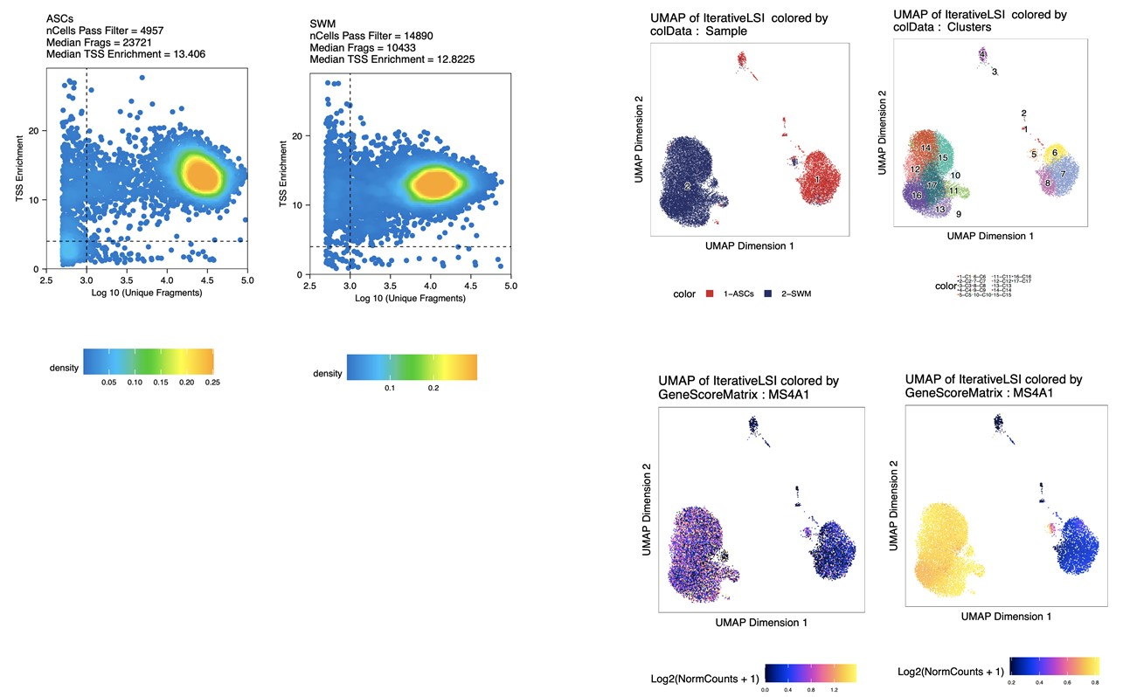
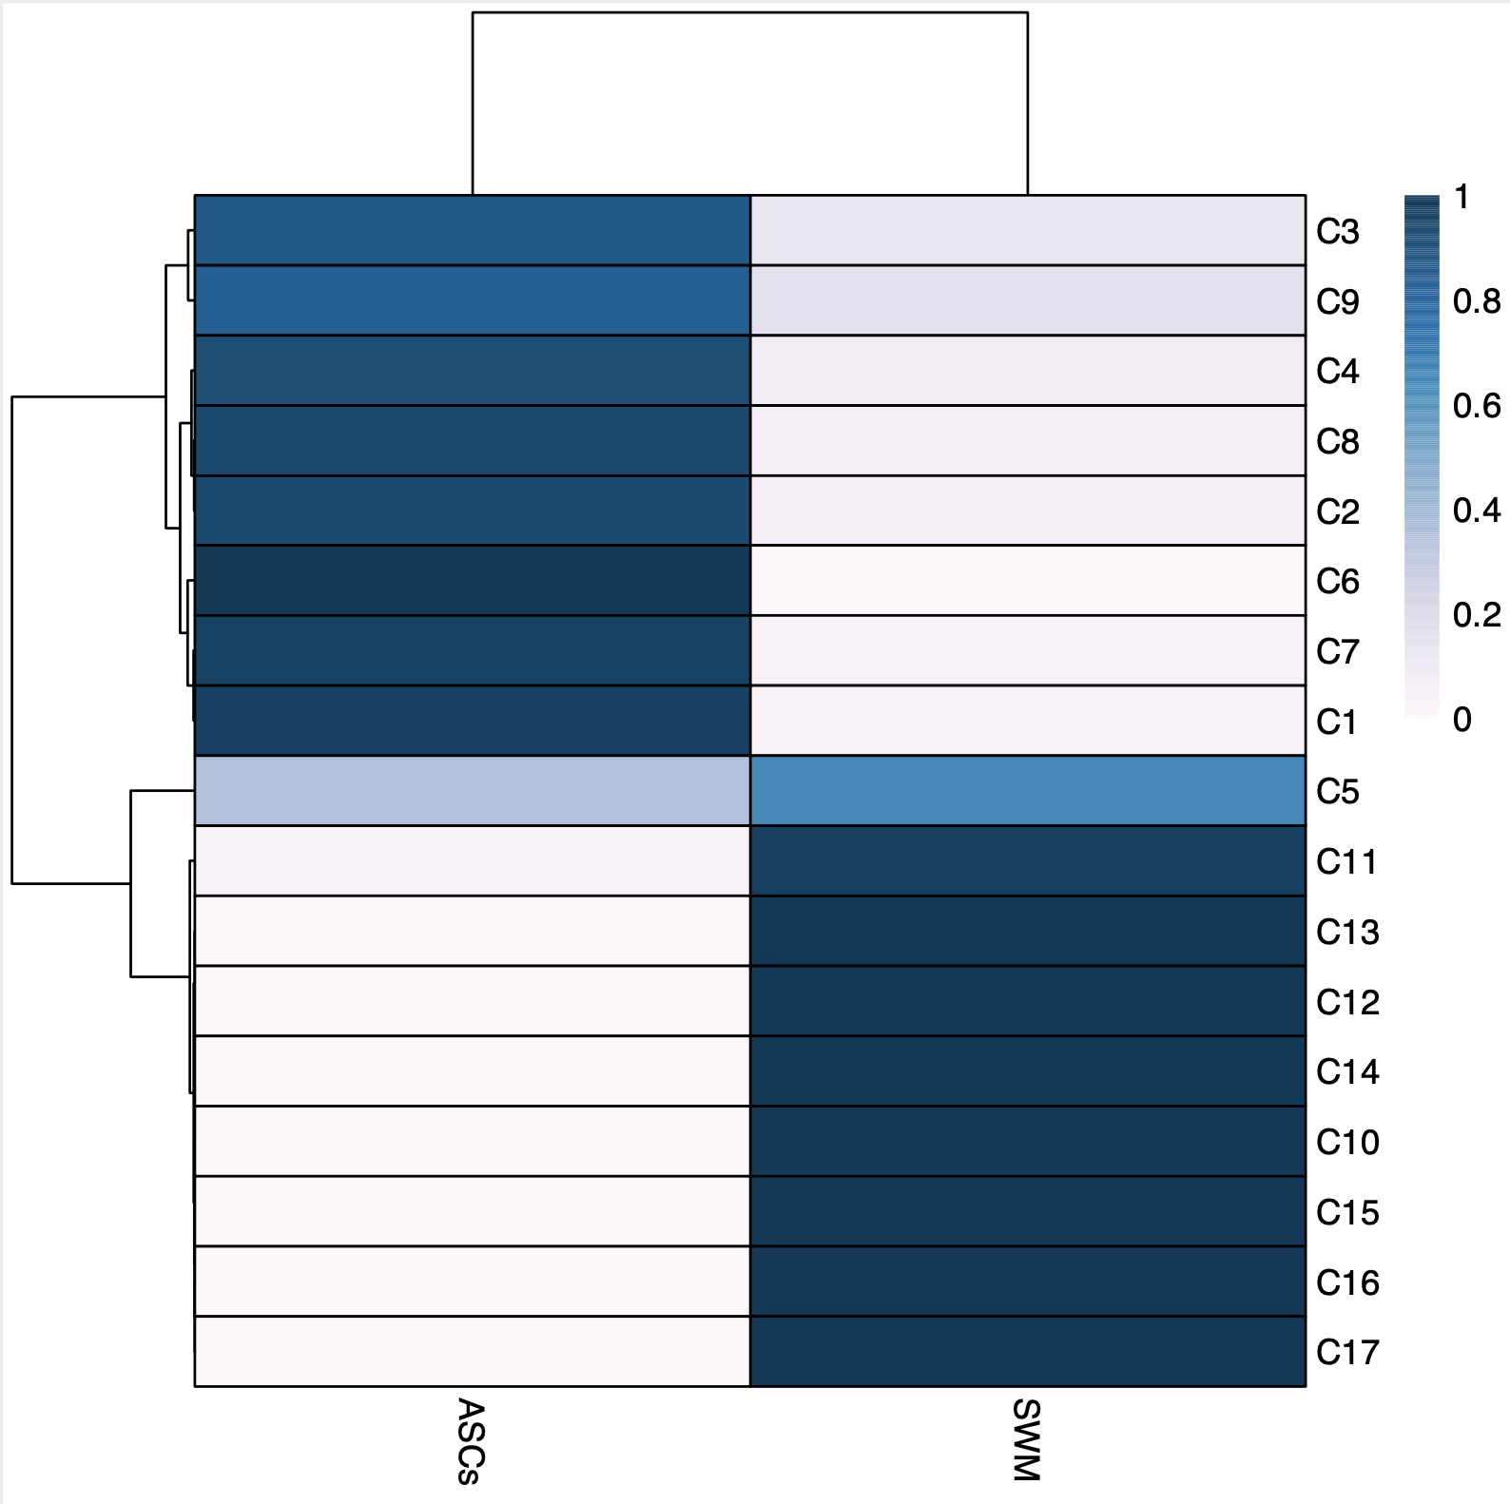
QC
4. Visualization
5. Confirm Cell Types
w/o MAGIC
with MAGIC
2. Dim Red: LSI → SVD
3. Clustering: Uses Seurat’s Clustering

Slide 6
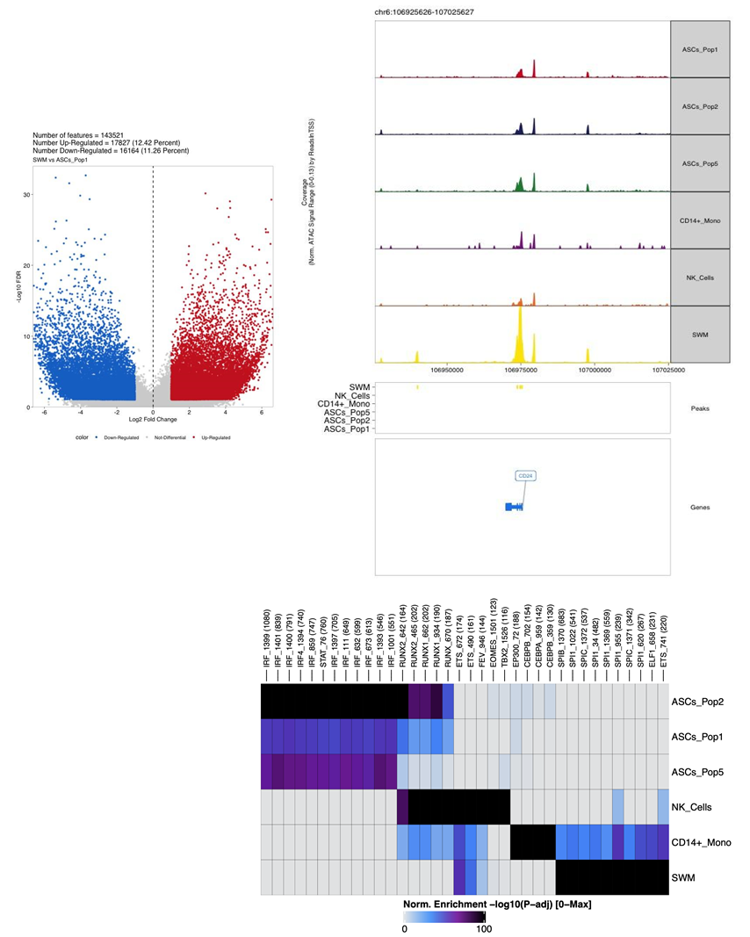
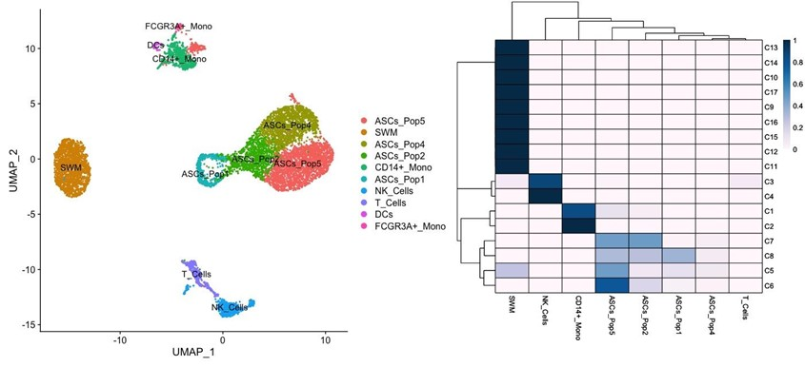
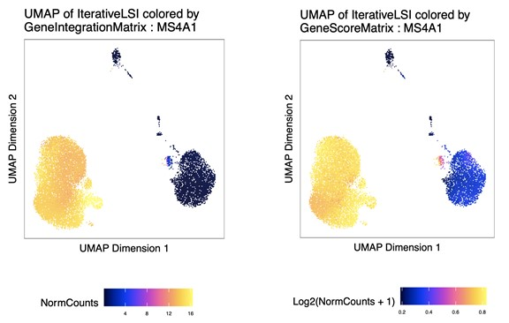
6. scRNA-seq Integration
7. Peak Calling: MACS2 & DARs
scRNA-seq Expression
Predicted Expression
8. Motif Enrichment

Slide 7
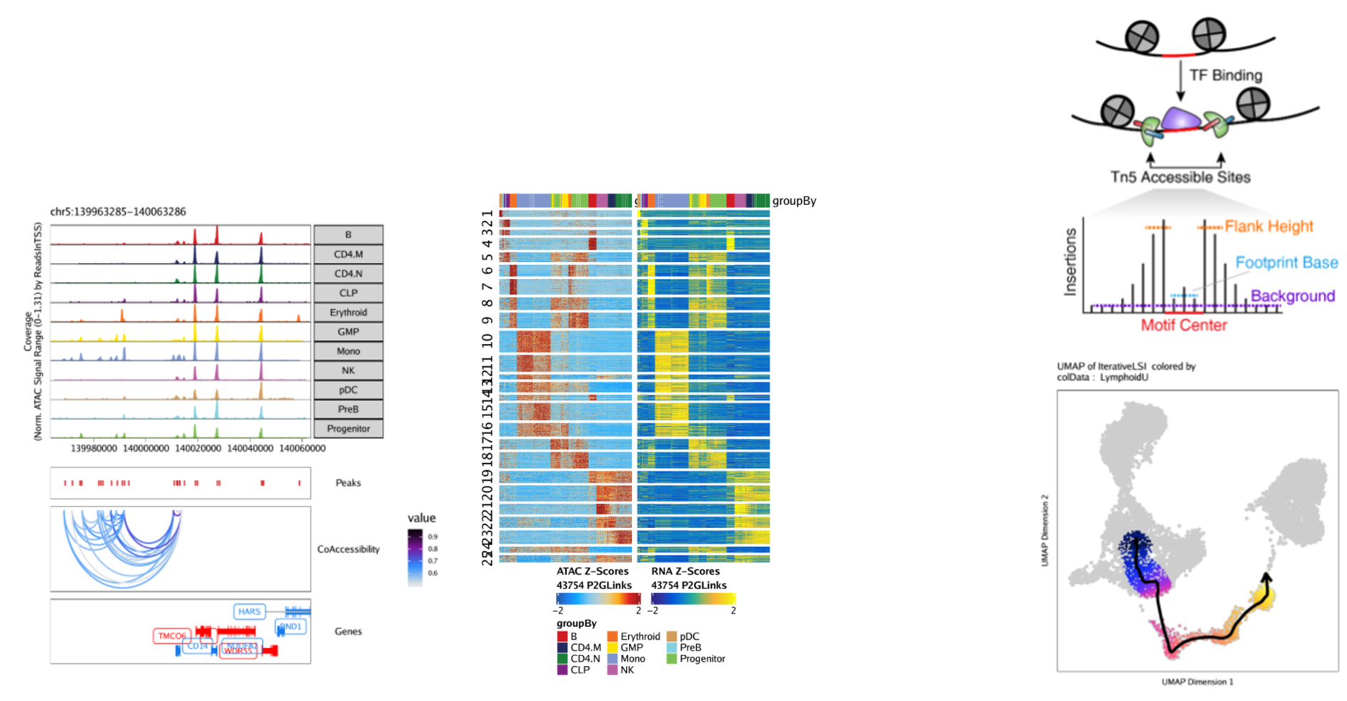
scATAC-seq Additional Downstream Analyses
Co-Accessibility
Peak-to-Gene Linkage
TF
Footprinting
Trajectory
Analysis
Images from ArchR Manual: https://www.archrproject.com/index.html
Notes:
Transcription factor (TF) footprinting allows for the prediction of the precise binding location of a TF at a particular locus. This is because the DNA bases that are directly bound by the TF are actually protected from transposition while the DNA bases immediately adjacent to TF binding are accessible.
Co-Accessbility: correlation in accessibility between two peaks across many single cells.
Peak2Gene Linkage: leverages integrated scRNA-seq data to look for correlations between peak accessibility and gene expression

Slide 8
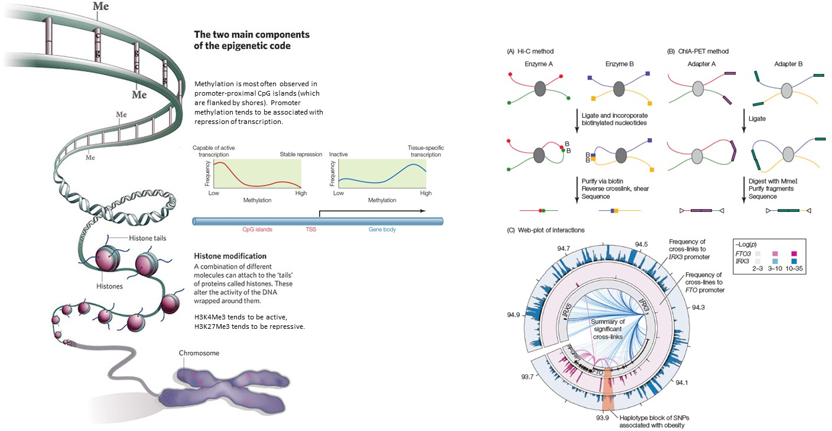
Three modes of epigenetic regulation
Chromatin conformation

Slide 9
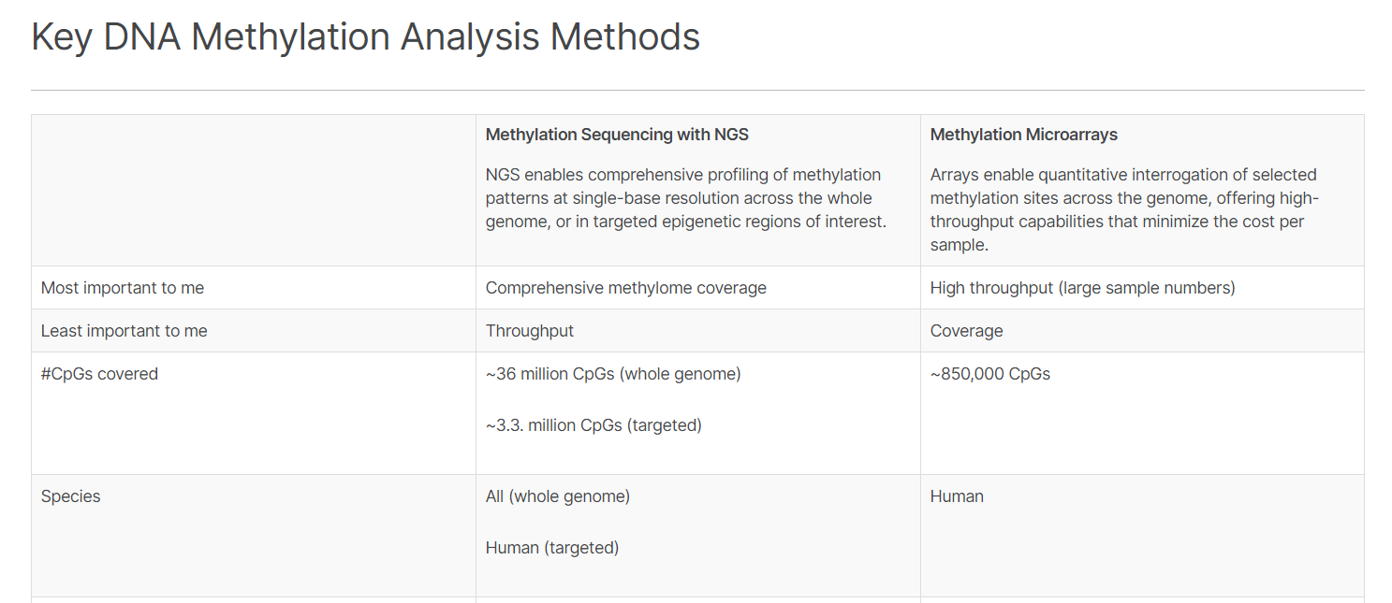
Two modes of Methylation profiling

Slide 10
Some (concise) definitions
GWAS: Genome-wide association study – search for SNPs significantly associated with a trait (eSNPs)
TWAS: Transcriptome-wide association study – search for predicted transcripts significantly associated with a trait
EpiWAS: Epigenome-wide association study – search for epigenetic marks significantly associated with a trait
(EWAS also used, but earlier used to refer to Environment-wide association study)
eQTL: a SNP which influences the abundance of a transcript. Cis-eQTL act locally (~ within ± 500kb)
eGene: a gene whose transcript abundance is regulated by a locally-acting SNP
meQTL: a genotype which is associated with the degree of methylation at a CpG site
Methyl ß: typical measure of the degree of methylation, ranging from 0 to 1 (none to complete)
hQTL: a genotype that is associated with the intensity of a histone mark (may be acetylation or methylation)
ccQTL: a genotype that influences the level of chromatin conformation / cross-linking

Slide 11
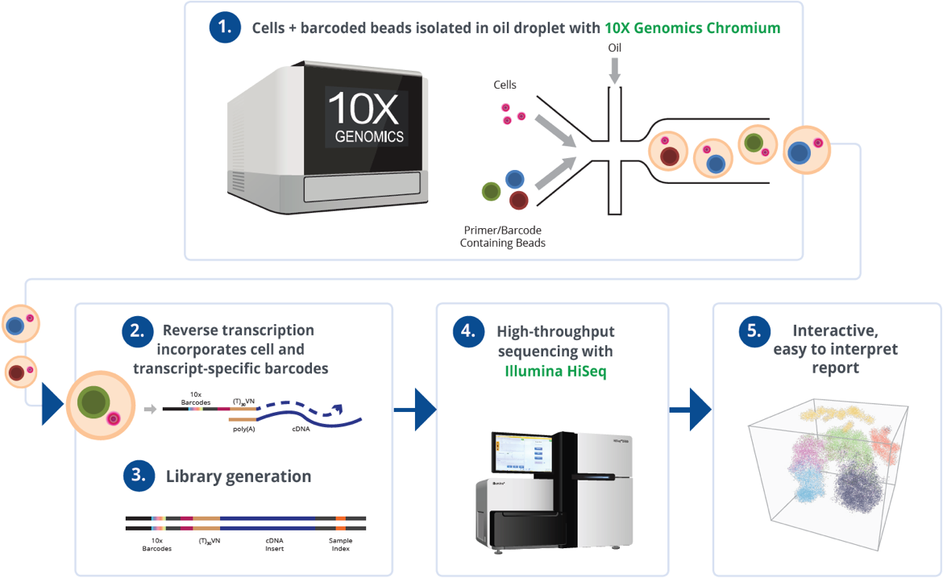
Single Cell RNA-seq: Easy as 1,2, 3, … 5

Slide 12
Types of Single Cell RNA-seq
SmartSeq2
Essentially full-length RNA-seq applied to libraries generated from single cells
Low throughput and relatively expensive, but comprehensive
Commercial option is Becton-Dickinson RhapsodyTM
2. Droplet Sequencing
Each cell is encapsulated in a droplet with enzymes and reagents for sequencing
High throughput, dollars per cell, but only detects tags for each transcript
Commercial options are 10X Genomics ChromiumTM, BioRad, and OneCellBio
3. sci-Seq
Single cell Combinatorial Indexing in microtiter plates
High throughput, very inexpensive, amenable to dual profiling with other assays
Implemented in academic labs

Slide 13
Chromium Droplet Barcodes
Sample Index is a barcode specific for the sample (individual, tissue, treatment, etc)
10X Barcode is for the cell, it tags all molecules derived from the same cell
UMI is a Unique Molecular Identifier for each actual mRNA molecule, basically controls amplification biases
Since library costs start at $1300, multiple samples can be combined in one reaction by adding a 4th type of barcode such as a BioLegend cell surface antibody, or using the person’s genotypes
In a typical cell: 50,000 reads may correspond to 10,000 UMI and 3,000 expressed genes
most transcripts may have from 1 to 5 UMI each represented by multiple reads

Slide 14
Read Depth, Cell number, and Expense
Sequencing is done on either a NextSeq or NovaSeq Illumina sequencer. Typical current options might be:
NetSeq lane = 400 Million 28x96 bp = 50,000 reads per cell for 8,000 cells, at a cost of ~$3,000 {40 c/cell}
S1 flow cell = 3 Billion 28x96 bp reads = 100,000 reads per cell for 30,000 cells, at a cost of ~$10,000 {30 c/cell}
S4 flow cell = 18 Billion PE reads = 50,000 reads per cell for 360,000 cells, at a cost of ~ $30,000 { 8 c/cell}
What read depth is required?
It depends on the cell-type: 50K is sufficient for many, but some require >100K
It depends on the application: if low abundance transcripts are key, you need more
if differential expression is key, you may need more
if defining novel cell types and states is key, you may need more

Slide 15
Typical Input and Output
Adjust for Batch Effects while preserving the Cell cluster identities
Compare the effects of the treatment on
a) The relative abundance of different types of cell
b) Gene expression within cell-types

Slide 16
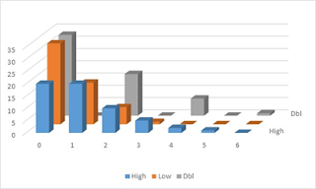
Scaling to counts per 100,000 reads
Scaling zero by any number still results in zero.
Here, the orange counts were derived by down-sampling the blue counts to half. The proportion of drop-outs increases.
Just multiplying all counts by 2 to scale back up does not restore the initial distribution – in fact, it results in a very skewed profile with no odd-numbered counts.
Some authors suggest getting around this by imputation to fill in the missing data. We think that is a dangerous strategy in general.

Slide 17
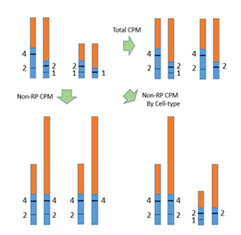
The normalization problem
Suppose we represent scRNA abundances for two cells of each of two cell types by these bars, with ribosomal proteins in orange and common transcripts in blue. Now focus on two genes represented by the horizontal bars, with counts shown next to them.
Normalizing by total cpm leads to the conclusion that there is little difference between the left and right cell types, except for the drop-out transcript, but there is high within-sample variability.
Normalizing by non-ribosomal CPM alone leads to the conclusion that all four cells are very similar.
Normalizing by cell-type and non-ribosomal CPM recovers the cell-type difference in absolute abundance.

Slide 18
Cluster Visualization
tSNE
UMAP
https://distill.pub/2016/misread-tsne/

Slide 19
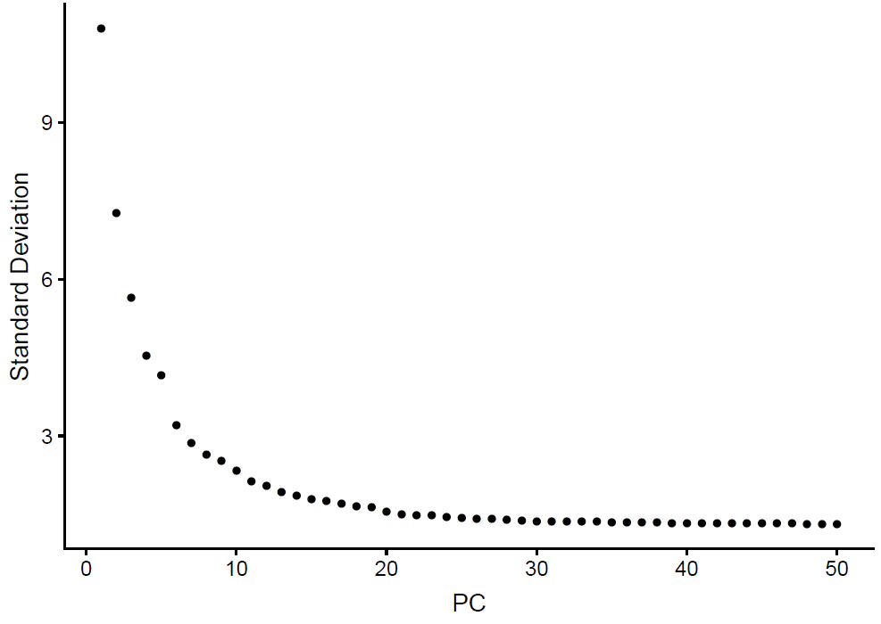
Deciding how many PC to include in CCA
https://satijalab.org/seurat/v3.0/pbmc3k_tutorial.html

Slide 20
Anchoring Cell-types by Marker genes

Slide 21
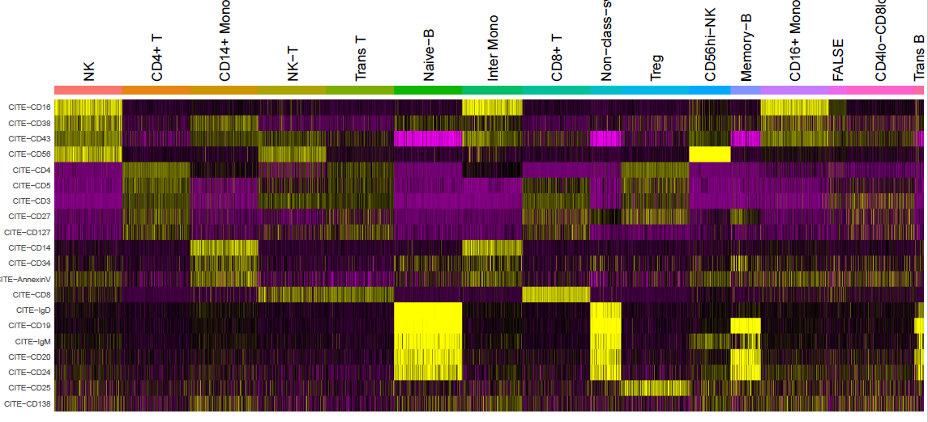
Hierarchical Clustering of Marker Genes

Slide 22
Differential Expression Analysis

Slide 23
Some extensions of Single Cell Genomics
Crop-Seq / Perturb-Seq
Microdeletion of SNPs in single cells followed by RNA-Seq
Requires co-transfection with Cas9 and lentivirus or plasmid expressing guide RNAs
Generally useful to monitor alterations of gene networks
2. CITE-Seq
Addition of oligonucleotide-conjugated Antibodies that bind cell surface receptors
Receive the same cell barcodes as the cell contents, but sequenced separately
Supports gating to homologize flow cytometry with scRNAseq
3. ATAC-Seq
Assay for Transposon-Accessible Chromatin (basically, identifying enhancers)
10X Genomics now provides kits; reports of joint scRNA and scATAC appearing
https://www.10xgenomics.com/solutions/single-cell-atac/
4. Repertoire-Seq
Sequencing of the TCR (T-cell receptors) or BCR (immunoglobulins) from single cells
Options available from 10X and OneCellBio
Data analysis requires specific expertise

