Slide 1
Summer Institutes of Statistical Genetics, 2022
SISG Module 6: Gene Expression Profiling
Lecture 06: Computational Challenges in scRNAseq Analysis
Peng Qiu and Greg Gibson
Georgia Institute of Technology

Slide 2
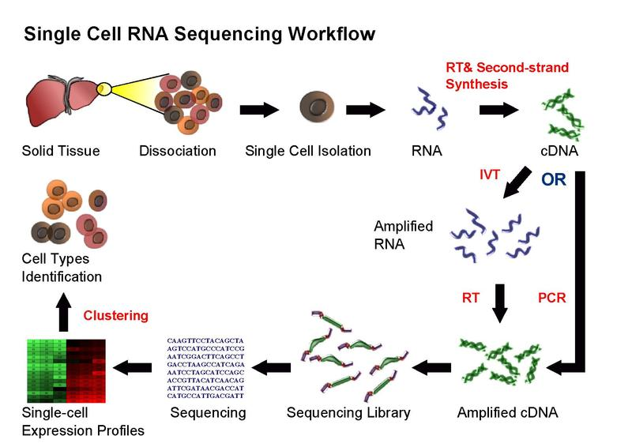
Single-cell RNA-seq

Slide 3
Single-cell RNA-seq

Slide 4
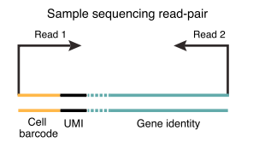
Pre-processing

Slide 5
Single-cell RNA-seq

Slide 6
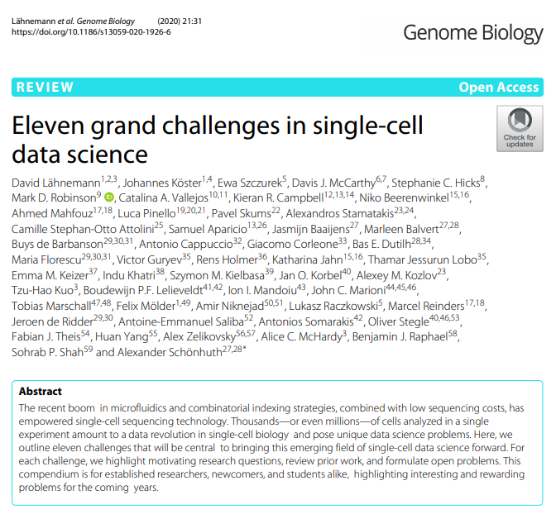

Slide 7
Computational questions in scRNA-seq analysis
Clustering
Differential expression of genes
Trajectory finding
Data integration (batch correction)
De-multiplexing
Multi-omics integration
Imputation
Spatial inference / deconvolution
Gene regulatory networks
Mapping new data to reference atlas
Benchmarking

Slide 8
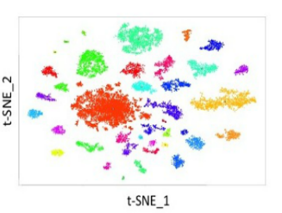
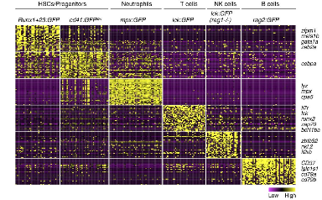
Computational questions in scRNA-seq analysis
Clustering
Differential expression of genes
Trajectory finding
Data integration (batch correction)
De-multiplexing
Multi-omics integration
Imputation
Spatial inference / deconvolution
Gene regulatory networks
Mapping new data to reference atlas
Benchmarking
Macosko, et al, Cell, 161(5):1202-1214, 2015. doi: 10.1016/j.cell.2015.05.002.

Slide 9
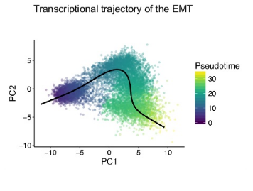
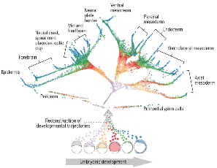
Computational questions in scRNA-seq analysis
Clustering
Differential expression of genes
Trajectory finding
Data integration (batch correction)
De-multiplexing
Multi-omics integration
Imputation
Spatial inference / deconvolution
Gene regulatory networks
Mapping new data to reference atlas
Benchmarking
David van Dijk, et al, Cell, 174(3):716-729.e27, 2018.
doi: 10.1016/j.cell.2018.05.061.
Farrell, et al, Science, 2018
https://science.sciencemag.org/content/360/6392/eaar3131

Slide 10
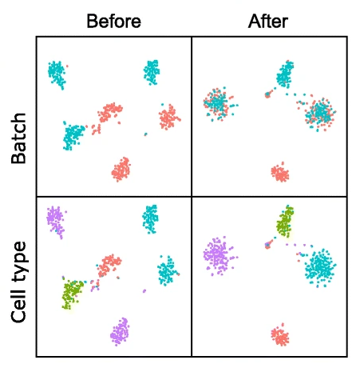
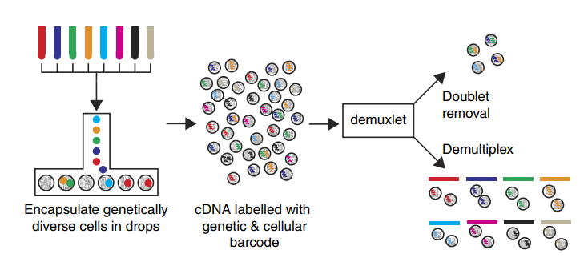
Computational questions in scRNA-seq analysis
Clustering
Differential expression of genes
Trajectory finding
Data integration (batch correction)
De-multiplexing
Multi-omics integration
Imputation
Spatial inference / deconvolution
Gene regulatory networks
Mapping new data to reference atlas
Benchmarking
Stuart T, et al. Cell, 177(7):1888-1902.e21, 2019. doi: 10.1016/j.cell.2019.05.031.
Kang, et al, Nat Biotechnol. 2018 Jan;36(1):89-94. https://doi.org/10.1038/nbt.4042
Xu, et al, Genome Biol 20, 290 (2019). https://doi.org/10.1186/s13059-019-1852-7

Slide 11
Computational questions in single-cell analysis
cells
Clustering
Differential expression of genes
Trajectory finding
Data integration (batch correction)
De-multiplexing
Multi-omics integration
Imputation
Spatial inference / deconvolution
Gene regulatory networks
Mapping new data to reference atlas
Benchmarking
genes
proteins
BCR
TCR
ATAC
methylation
Hao, et al, Cell,184(13):3573-3587.e29, 2021
doi: 10.1016/j.cell.2021.04.048.
Hoadley, et al, Cell. 158(4): 929–944, 2014
doi: 10.1016/j.cell.2014.06.049

Slide 12
Computational questions in single-cell analysis
Clustering
Differential expression of genes
Trajectory finding
Data integration (batch correction)
De-multiplexing
Multi-omics integration
Imputation
Spatial inference / deconvolution
Gene regulatory networks
Mapping new data to reference atlas
Benchmarking
Imputation strategies
cells
cells
genes
raw
data
genes
Imputed
data
Impute the data by
gene-gene similar
or cell-cell similarity
Should we try to impute at all?
Qiu P. “Embracing the dropouts in single-cell RNA-seq analysis“, Nature Communications, 11(1):1169, 2020.

Slide 13
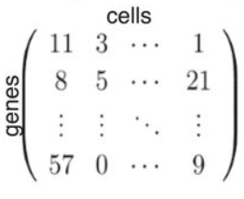
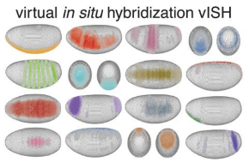
Computational questions in single-cell analysis
Clustering
Differential expression of genes
Trajectory finding
Data integration (batch correction)
De-multiplexing
Multi-omics integration
Imputation
Spatial inference / deconvolution
Gene regulatory networks
Mapping new data to reference atlas
Benchmarking
+
Satija, et al, Nat Biotechnol 33, 495–502 (2015). https://doi.org/10.1038/nbt.3192

Slide 14
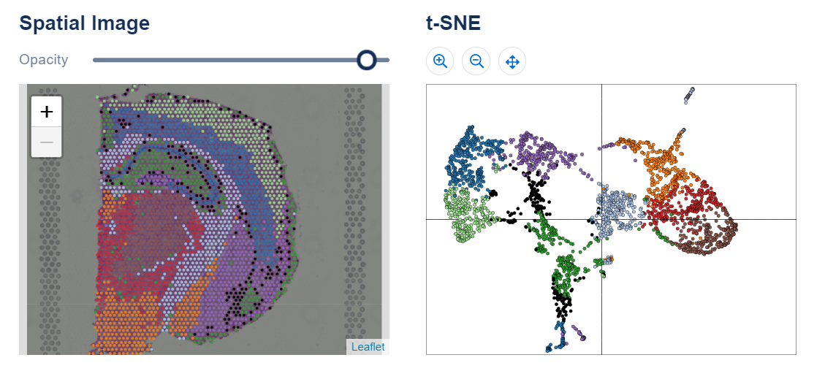
Computational questions in single-cell analysis
Clustering
Differential expression of genes
Trajectory finding
Data integration (batch correction)
De-multiplexing
Multi-omics integration
Imputation
Spatial inference / deconvolution
Gene regulatory networks
Mapping new data to reference atlas
Benchmarking
https://www.10xgenomics.com/spatial-transcriptomics

Slide 15
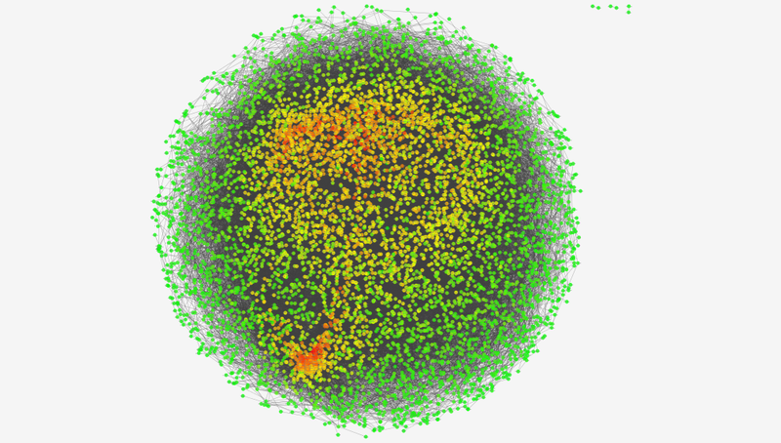
Computational questions in single-cell analysis
Clustering
Differential expression of genes
Trajectory finding
Data integration (batch correction)
De-multiplexing
Multi-omics integration
Imputation
Spatial inference / deconvolution
Gene regulatory networks
Mapping new data to reference atlas
Benchmarking
Pratapa, et al, Nat Methods, 17(2):147-154, 2020. doi: 10.1038/s41592-019-0690-6.

Slide 16
Computational questions in single-cell analysis
Clustering
Differential expression of genes
Trajectory finding
Data integration (batch correction)
De-multiplexing
Multi-omics integration
Imputation
Spatial inference / deconvolution
Gene regulatory networks
Mapping new data to reference atlas
Benchmarking
Reference atlas
New scRNAseq dataset
cells
New cells
genes
Same
genes
Annotations
B/CD4+T/CD8+T/monocytes
???????
Abdelaal, et al, Genome Biol 20, 194 (2019). https://doi.org/10.1186/s13059-019-1795-z

Slide 17
Computational questions in single-cell analysis
Clustering
Differential expression of genes
Trajectory finding
Data integration (batch correction)
De-multiplexing
Multi-omics integration
Imputation
Spatial inference / deconvolution
Gene regulatory networks
Mapping new data to reference atlas
Benchmarking

Slide 18
Take home messages
There are a lot of interesting computational questions.
The field is moving very fast, with lots of recent developments
Before diving into a specific computational question, search for benchmarking papers which may provide a good compilation of relevant literature

