Slide 1
Summer Institutes of Statistical Genetics, 2020
SISG Module 6: Gene Expression Profiling
Lecture 06: Dimension Reduction Approaches
Peng Qiu and Greg Gibson
Georgia Institute of Technology

Slide 2
Goals of Dimension Reduction
The goals of dimension reduction are:
(1) Visualization:
Reduce high-dimensional data down to
2D or 3D, so that we can see the data
(2) Preprocessing
Reduce high-dimensional data down to
low-dimensional space, so that the data become easier to analyze with other algorithms
Notes:
Visualization
Initial steps of a larger analysis pipeline

Slide 3
Dimension Reduction and Visualization
- PCA
- MDS
- Isomap
- tSNE
- UMAP

Slide 4
PCA
PCA is a linear operation
Intuition: projection that maximally preserves variance
Intuition: low rank approximation

Slide 5
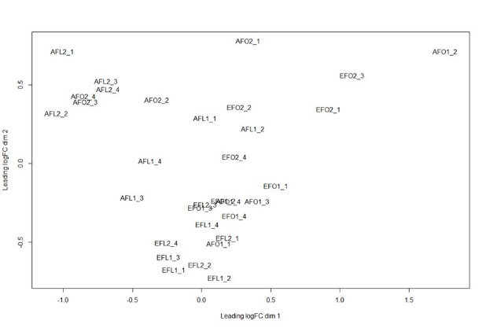

PCA
Principal components / feature loadings
examples
features
Scores / embeddings
$$≈$$
k*N
M*N
M*k
Notes:
num_PC = 5;
[U,S,V] = svds(data, num_PC); % data is M genes * N samples
PCA_gene_loadings = U(:,:);
PCA_cell_embeddings = V(:,:)*S;
[coeff, score] = pca(data’);
PCA_gene_loadings2 = coeff(:,1:num_PC);
PCA_cell_embeddings2 = score(:,1:num_PC);

Slide 6
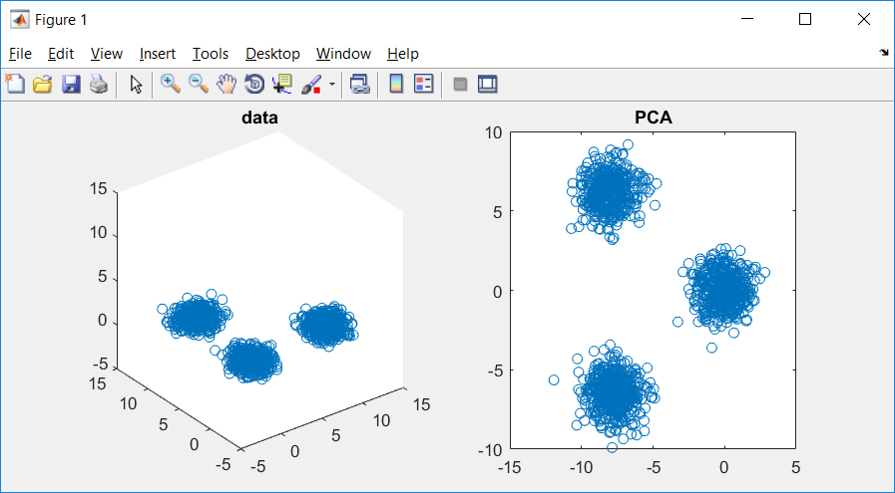
Example
data = [[randn(2,500)+[1;10], randn(2,500), randn(2,500)+[10;1]];...
rand(1,1500)*2];
figure(1); subplot(1,2,1)
plot3(data(1,:),data(2,:),data(3,:),'o'); title('data')
axis([-5,15,-5,15,-5,15])
num_PC = 2;
[U,S,V] = svds(data, num_PC); % data is M features * N samples
PCA_gene_loadings = U(:,:);
PCA_cell_embeddings = V(:,:)*S;
figure(1); subplot(1,2,2)
plot(PCA_cell_embeddings(:,1),PCA_cell_embeddings(:,2),'o');title('PCA')
PCA_gene_loadings =
-0.6996 -0.7089
-0.7032 0.7054
-0.1266 -0.0006

Slide 7
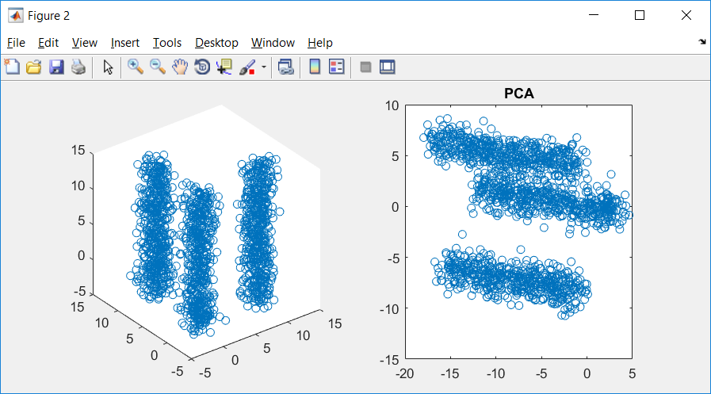
Example
data = [[randn(2,500)+[1;10], randn(2,500), randn(2,500)+[10;1]];...
rand(1,1500)*20];
figure(2); subplot(1,2,1);
plot3(data(1,:),data(2,:),data(3,:),'o'); title('data')
axis([-5,15,-5,15,-5,15])
num_PC = 2;
[U,S,V] = svds(data, num_PC); % data is M features * N samples
PCA_gene_loadings = U(:,:);
PCA_cell_embeddings = V(:,:)*S;
figure(2); subplot(1,2,2)
plot(PCA_cell_embeddings(:,1),PCA_cell_embeddings(:,2),'o');title('PCA')
PCA_gene_loadings =
-0.2934 0.7209
-0.2988 -0.6931
-0.9081 -0.0049

Slide 8
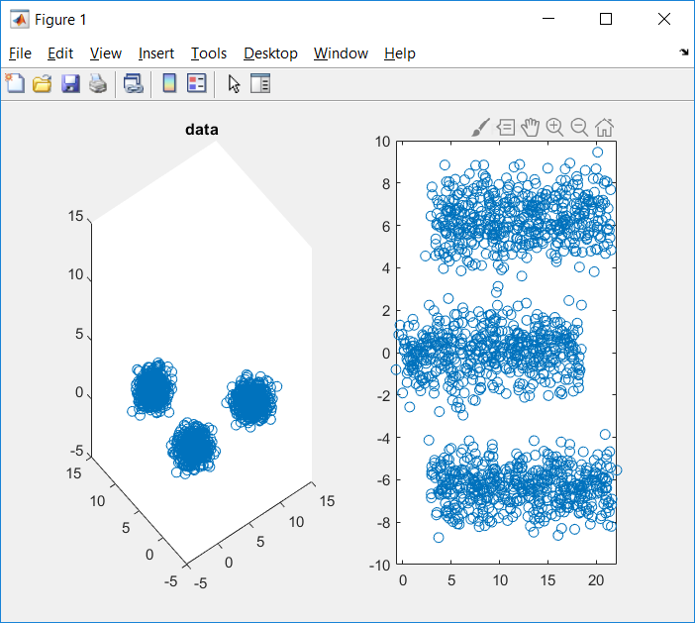
Example
data = [[randn(2,500)+[1;10], randn(2,500), randn(2,500)+[10;1]];...
rand(1,1500)*2];
figure(1); subplot(1,2,1)
plot3(data(1,:),data(2,:),data(3,:),'o'); title('data')
axis([-5,15,-5,15,-5,15])
data = [data; repmat(data(end,:),100,1)];
num_PC = 2;
[U,S,V] = svds(data, num_PC); % data is M features * N samples
PCA_gene_loadings = U(:,:);
PCA_cell_embeddings = V(:,:)*S;
figure(1); subplot(1,2,2)
plot(PCA_cell_embeddings(:,1),PCA_cell_embeddings(:,2),'o');title('PCA')
PCA_gene_loadings =
0.2859 0.6974
0.2826 -0.7166
0.0911 0.0003
0.0911 0.0003
0.0911 0.0003
0.0911 0.0003
0.0911 0.0003
0.0911 0.0003
0.0911 0.0003
0.0911 0.0003
0.0911 0.0003
0.0911 0.0003
0.0911 0.0003
0.0911 0.0003
0.0911 0.0003
0.0911 0.0003
0.0911 0.0003
0.0911 0.0003
0.0911 0.0003
0.0911 0.0003
0.0911 0.0003
0.0911 0.0003
0.0911 0.0003
0.0911 0.0003
0.0911 0.0003
0.0911 0.0003
0.0911 0.0003
0.0911 0.0003
0.0911 0.0003
0.0911 0.0003
0.0911 0.0003
0.0911 0.0003
0.0911 0.0003
0.0911 0.0003
0.0911 0.0003
0.0911 0.0003
0.0911 0.0003
0.0911 0.0003
0.0911 0.0003
0.0911 0.0003
0.0911 0.0003
0.0911 0.0003
0.0911 0.0003
0.0911 0.0003
0.0911 0.0003
0.0911 0.0003
0.0911 0.0003
0.0911 0.0003
0.0911 0.0003
0.0911 0.0003
0.0911 0.0003
0.0911 0.0003
0.0911 0.0003
0.0911 0.0003
0.0911 0.0003
0.0911 0.0003
0.0911 0.0003
0.0911 0.0003
0.0911 0.0003
0.0911 0.0003
0.0911 0.0003
0.0911 0.0003
0.0911 0.0003
0.0911 0.0003
0.0911 0.0003
0.0911 0.0003
0.0911 0.0003
0.0911 0.0003
0.0911 0.0003
0.0911 0.0003
0.0911 0.0003
0.0911 0.0003
0.0911 0.0003
0.0911 0.0003
0.0911 0.0003
0.0911 0.0003
0.0911 0.0003
0.0911 0.0003
0.0911 0.0003
0.0911 0.0003
0.0911 0.0003
0.0911 0.0003
0.0911 0.0003
0.0911 0.0003
0.0911 0.0003
0.0911 0.0003
0.0911 0.0003
0.0911 0.0003
0.0911 0.0003
0.0911 0.0003
0.0911 0.0003
0.0911 0.0003
0.0911 0.0003
0.0911 0.0003
0.0911 0.0003
0.0911 0.0003
0.0911 0.0003
0.0911 0.0003
0.0911 0.0003
0.0911 0.0003
0.0911 0.0003
0.0911 0.0003
0.0911 0.0003

Slide 9
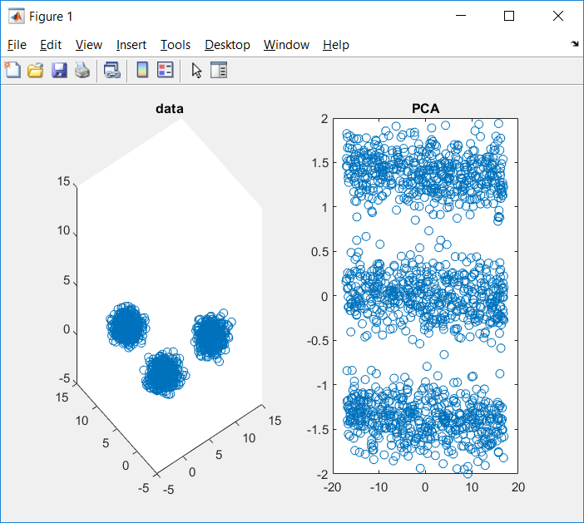
Example
data = [[randn(2,500)+[1;10], randn(2,500), randn(2,500)+[10;1]];...
rand(1,1500)*2];
figure(1); subplot(1,2,1)
plot3(data(1,:),data(2,:),data(3,:),'o'); title('data')
axis([-5,15,-5,15,-5,15])
data = [data; repmat(data(end,:),100,1)];
num_PC = 2;
[U,S,V] = svds((data-mean(data,2))./std(data,[],2), num_PC);
PCA_gene_loadings = U(:,:);
PCA_cell_embeddings = V(:,:)*S;
figure(1); subplot(1,2,2)
plot(PCA_cell_embeddings(:,1),PCA_cell_embeddings(:,2),'o');title('PCA')
PCA_gene_loadings =
0.0007 0.7087
-0.0055 -0.7055
0.0995 -0.0004
0.0995 -0.0004
0.0995 -0.0004
0.0995 -0.0004
0.0995 -0.0004
0.0995 -0.0004
0.0995 -0.0004
0.0995 -0.0004
0.0995 -0.0004
0.0995 -0.0004
0.0995 -0.0004
0.0995 -0.0004
0.0995 -0.0004
0.0995 -0.0004
0.0995 -0.0004
0.0995 -0.0004
0.0995 -0.0004
0.0995 -0.0004
0.0995 -0.0004
0.0995 -0.0004
0.0995 -0.0004
0.0995 -0.0004
0.0995 -0.0004
0.0995 -0.0004
0.0995 -0.0004
0.0995 -0.0004
0.0995 -0.0004
0.0995 -0.0004
0.0995 -0.0004
0.0995 -0.0004
0.0995 -0.0004
0.0995 -0.0004
0.0995 -0.0004
0.0995 -0.0004
0.0995 -0.0004
0.0995 -0.0004
0.0995 -0.0004
0.0995 -0.0004
0.0995 -0.0004
0.0995 -0.0004
0.0995 -0.0004
0.0995 -0.0004
0.0995 -0.0004
0.0995 -0.0004
0.0995 -0.0004
0.0995 -0.0004
0.0995 -0.0004
0.0995 -0.0004
0.0995 -0.0004
0.0995 -0.0004
0.0995 -0.0004
0.0995 -0.0004
0.0995 -0.0004
0.0995 -0.0004
0.0995 -0.0004
0.0995 -0.0004
0.0995 -0.0004
0.0995 -0.0004
0.0995 -0.0004
0.0995 -0.0004
0.0995 -0.0004
0.0995 -0.0004
0.0995 -0.0004
0.0995 -0.0004
0.0995 -0.0004
0.0995 -0.0004
0.0995 -0.0004
0.0995 -0.0004
0.0995 -0.0004
0.0995 -0.0004
0.0995 -0.0004
0.0995 -0.0004
0.0995 -0.0004
0.0995 -0.0004
0.0995 -0.0004
0.0995 -0.0004
0.0995 -0.0004
0.0995 -0.0004
0.0995 -0.0004
0.0995 -0.0004
0.0995 -0.0004
0.0995 -0.0004
0.0995 -0.0004
0.0995 -0.0004
0.0995 -0.0004
0.0995 -0.0004
0.0995 -0.0004
0.0995 -0.0004
0.0995 -0.0004
0.0995 -0.0004
0.0995 -0.0004
0.0995 -0.0004
0.0995 -0.0004
0.0995 -0.0004
0.0995 -0.0004
0.0995 -0.0004
0.0995 -0.0004
0.0995 -0.0004
0.0995 -0.0004
0.0995 -0.0004
0.0995 -0.0004

Slide 10
Determine the number of significant PC
- Total variance explained
- Random permutation
- Elbow of e-values
- JackStraw
- …
Notes:
High dimensional dataset, when performing PCA, need to decide the number of PC
For visualization purpose, number of PC usually is 2 or 3
For dimension reduction purpose, number of PC needs to be determined

Slide 11
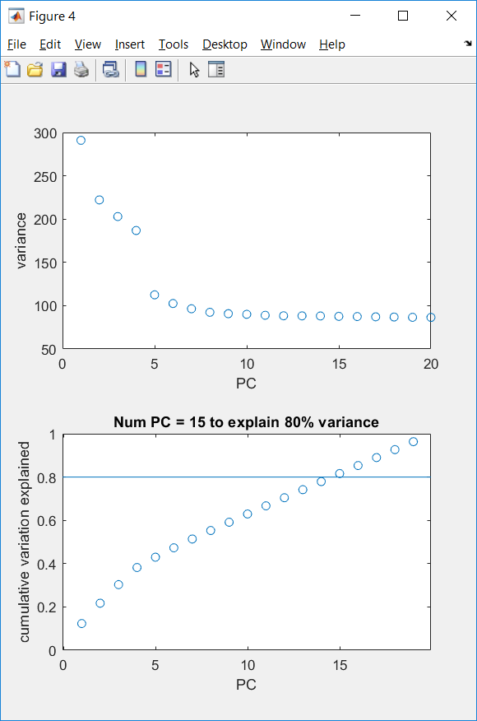
Determine the number of significant PC
- Total variance explained
- Random permutation
- Elbow of e-values
- JackStraw
- …
PBMC scRNAseq data of 2700 cells (10X Genomics)
Notes:
Number of PC = 15

Slide 12
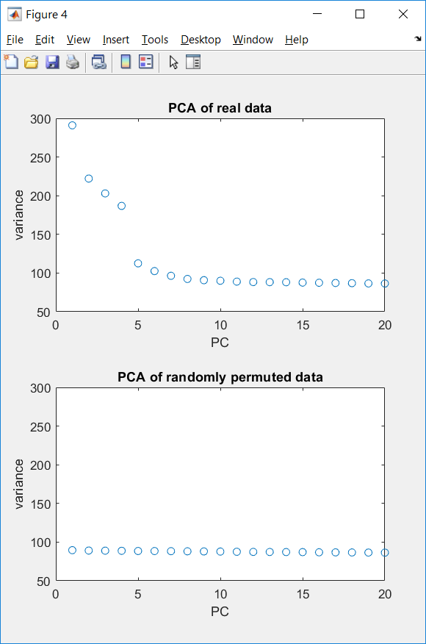
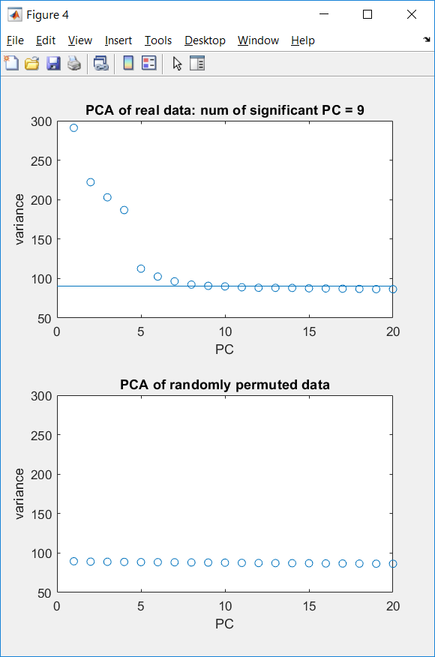
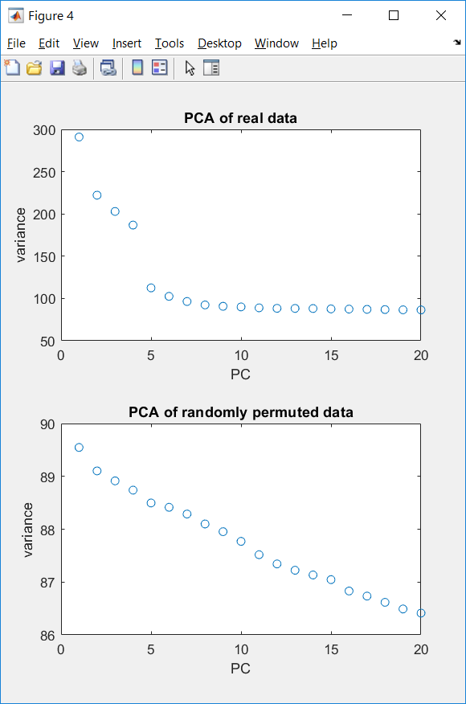
Determine the number of significant PC
- Total variance explained
- Random permutation
- Elbow of e-values
- JackStraw
- …
Highest variance from PCA of permuted data
PBMC scRNAseq data of 2700 cells (10X Genomics)
Notes:
Number of PC = 9

Slide 13
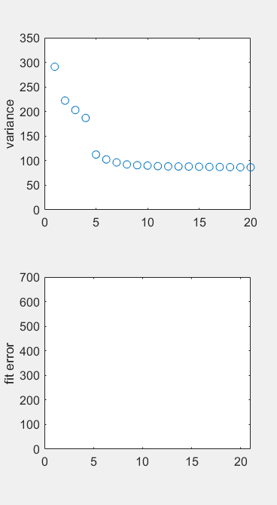
Determine the number of significant PC
- Total variance explained
- Random permutation
- Elbow of e-values
- JackStraw
- …
PBMC scRNAseq data of 2700 cells (10X Genomics)
Notes:
Number of PC = 6

Slide 14
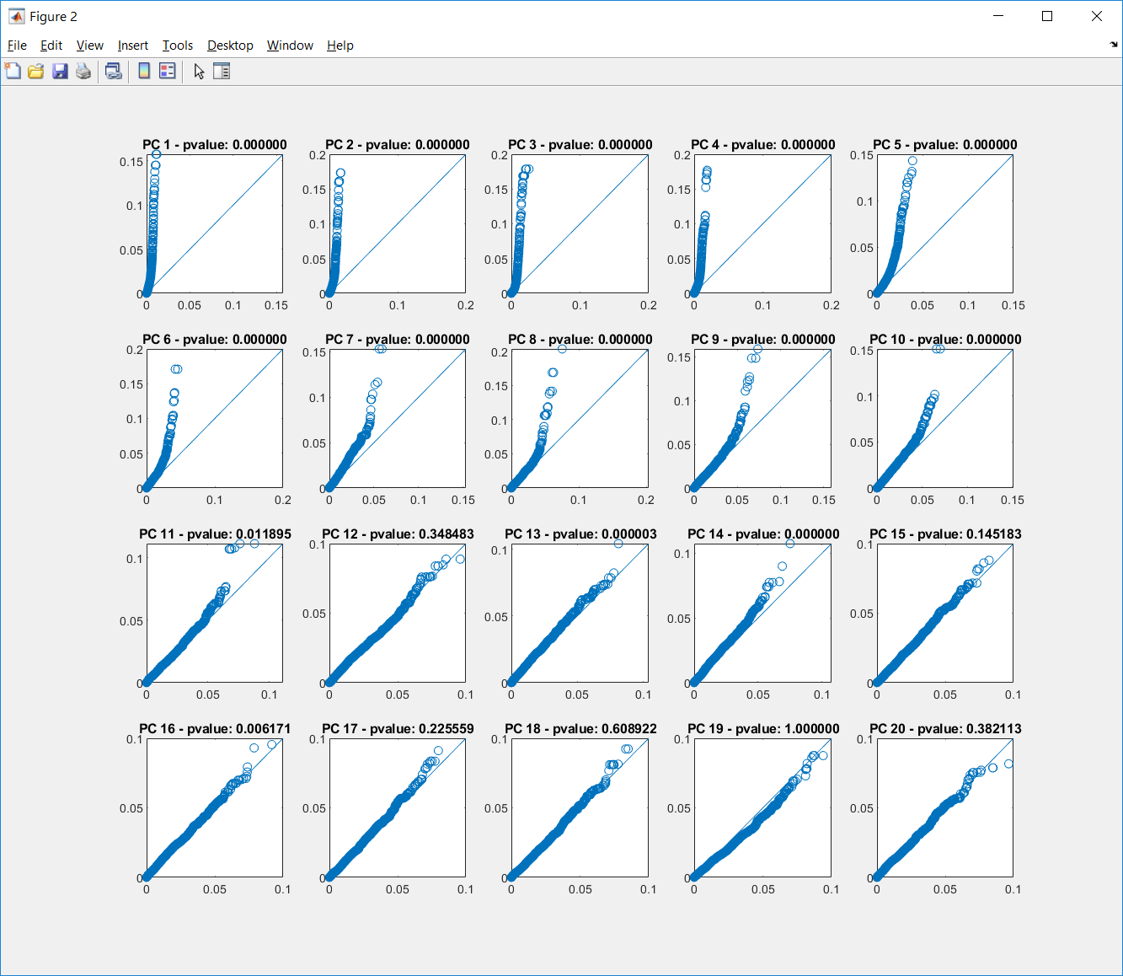
Determine the number of significant PC
- Total variance explained
- Random permutation
- Elbow of e-values
- JackStraw
- …
PBMC scRNAseq data of 2700 cells (10X Genomics)
Notes:
This approach is special because it looks at gene loadings. (Number of PC = 10 for this example)
Pseudo code of JackStraw procedure (iter = 100, percentage = 1%)
Orignial input data (genes*cells, or features*samples), perform PCA
For iterations = 1:100
Randomly pick 1% of features, permute the data only for the selected features/rows, perform PCA
Remember the gene loading for the picked features for every PC (for both original and permuted data)
For each PC
Scatter plot of the absolute values of gene loadings for original vs permutated data
ttest for pvalue significance

Slide 15
Nonlinear Techniques for Dimension Reduction
- PCA
- MDS
- Isomap
- tSNE
- UMAP

Slide 16
Nonlinear Dimension Reduction
examples
features
k*N
Reduced data in 2D visualization space
M*N
Original data in high-D data space
We would like the interpretation of the visualization to be similar to the interpretation of the original data (clusters, trajectories).

Slide 17
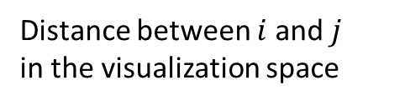

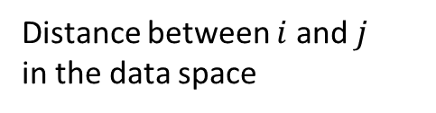



Nonlinear Dimension Reduction
$$x_{i}$$
examples
features
$$y_{i}$$
k*N
Reduced data in 2D visualization space
M*N
Original data in high-D data space
Distance between $i$ and $j$
in the data space
Distance between $i$ and $j$
in the visualization space
$$δ_{ij}^{(x)}=\left\|x_{i}−x_{j}\right\|$$
$$d_{ij}^{(y)}=\left\|y_{i}−y_{j}\right\|$$

Slide 18
Dimension Reduction and Visualization
- PCA
- MDS
- Isomap
- tSNE
- UMAP

Slide 19
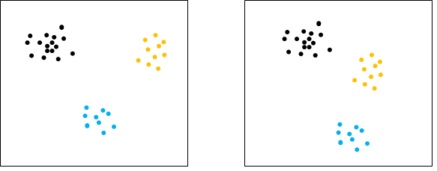
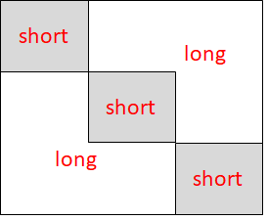
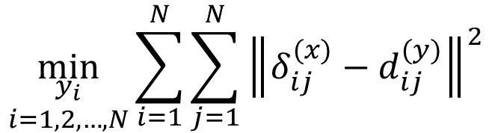
Classic MDS
Eg. four points with equal
distance to each other,
possible in 3D and higher-D,
but impossible in 2D
$$\min_{\begin{aligned}y_{i} \\ i=1,2,…,N\end{aligned}}{\sum_{i=1}^{N}{\sum_{j=1}^{N}{{\left\|δ_{ij}^{(x)}−d_{ij}^{(y)}\right\|}^{2}}}}$$
Sounds perfectly reasonable,
But not a good idea, because
(1) not always possible,
(2) emphasize too much on large
distances.
Eg. Short distances matter more for interpretation
But there are more long distances than short ones in the pairwise distance matrix

Slide 20
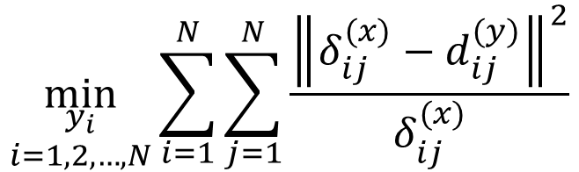
Modified MDS
$$\min_{\begin{aligned}y_{i} \\ i=1,2,…,N\end{aligned}}{\sum_{i=1}^{N}{\sum_{j=1}^{N}{\frac{{\left\|δ_{ij}^{(x)}−d_{ij}^{(y)}\right\|}^{2}}{δ_{ij}^{(x)}}}}}$$
Better, but still does not work very well.

Slide 21
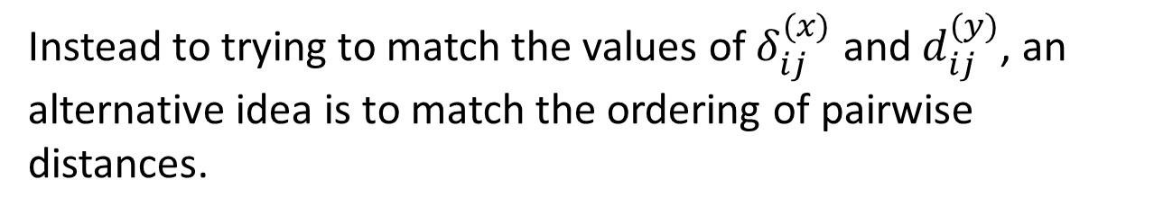
Non-metric MDS
Instead to trying to match the values of $δ_{ij}^{(x)}$ and $d_{ij}^{(y)}$, an alternative idea is to match the ordering of pairwise distances.
If $δ_{ij}^{(x)}<δ_{kl}^{(x)}$, non-metric MDS requires $d_{ij}^{(y)}<d_{kl}^{(y)}$
Again: better, but still does not work very well.
In general, MDS works well when the dimensionality of the data + distance metric is low.
Notes:
Matlab function:
mdscale

Slide 22
Dimension Reduction and Visualization
- PCA
- MDS
- Isomap
- tSNE
- UMAP

Slide 23
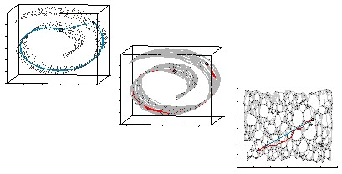
Isomap
(1) Build KNN-graph
(2) Find shortest path
(3) Compute length of shortest path
(4) Classic MDS
Tenenbaum et al, Science, 2000

Slide 24
Dimension Reduction and Visualization
- PCA
- MDS
- Isomap
- tSNE
- UMAP

Slide 25
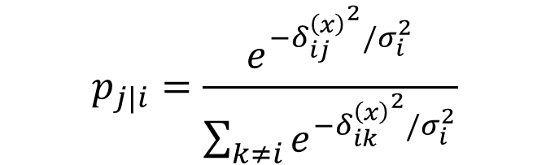


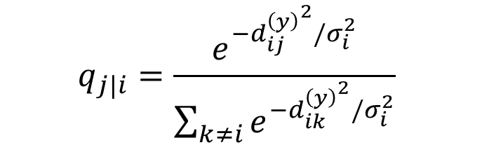
SNE
$$p_{j|i}=\frac{e^{−{δ_{ij}^{\left(x\right)}}^{2}/σ_{i}^{2}}}{\sum_{k≠i}{e^{−{δ_{ik}^{\left(x\right)}}^{2}/σ_{i}^{2}}}}$$
$$q_{j|i}=\frac{e^{−{d_{ij}^{\left(y\right)}}^{2}/σ_{i}^{2}}}{\sum_{k≠i}{e^{−{d_{ik}^{\left(y\right)}}^{2}/σ_{i}^{2}}}}$$
SNE aims to match $p_{j|i}$ and $q_{j|i}$ by minimizing the KL divergence between them
$$\min_{\begin{aligned}y_{i} \\ i=1,2,…,N\end{aligned}}{\sum_{i}{KL(P_{i}|\left|Q_{i}\right)= \sum_{i}{\sum_{j}{p_{j|i}\log{\frac{p_{j|i}}{q_{j|i}}}}}}}$$
Math here is not important.
Important messages here are: (1) great idea to focus on short distances (2) does not work very well.

Slide 26


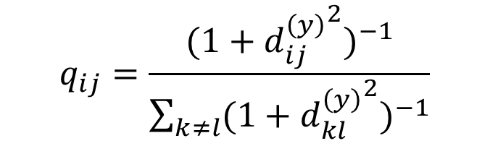
tSNE
$$q_{ij}=\frac{{(1+{d_{ij}^{\left(y\right)}}^{2})}^{−1}}{\sum_{k≠l}{{(1+{d_{kl}^{\left(y\right)}}^{2})}^{−1}}}$$
$$p_{ij}=\frac{p_{j|i}+p_{i|j}}{2N}$$
tSNE aims to match $p_{ij}$ and${ q}_{ij}$ by minimizing the KL divergence between them.
The different treatment to the original and visualization space is the key reason why tSNE is better than SNE.

Slide 27
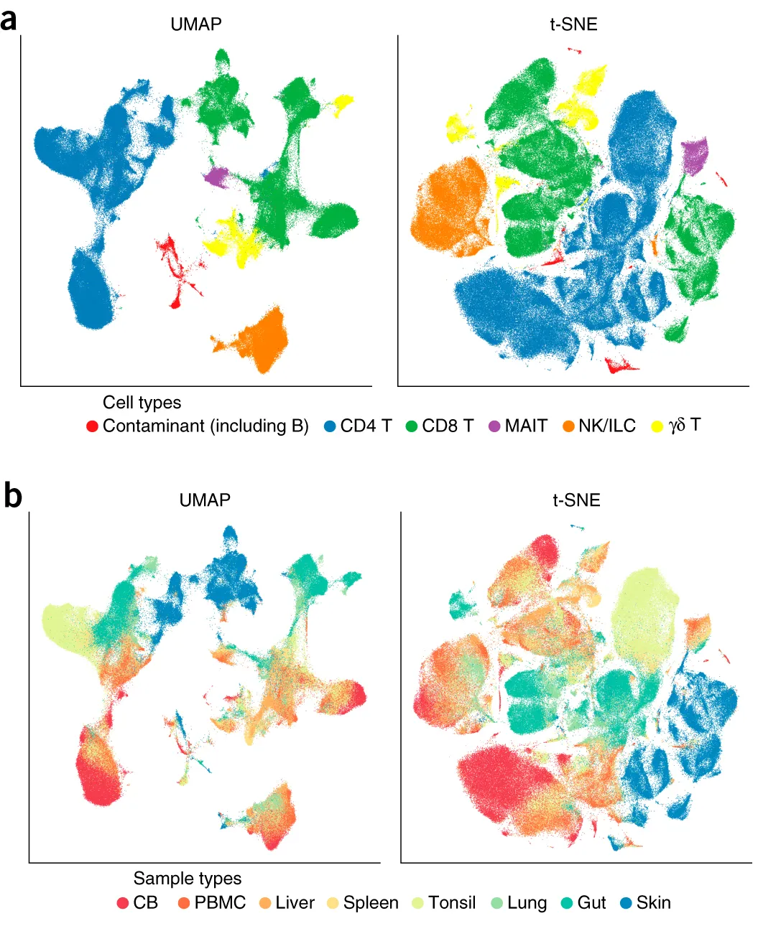
tSNE is very good at showing clusters
(often tends to generate islands).
A potential danger is that tSNE emphasize short distance too much.
Notes:
Perplexity parameter: (similar to the k in KNN algorithm)
30~50 for large datasets with ~ 10^4 ~ 10^6 data points or more
5~10 for small datasets with ~ 100 data points

Slide 28
Dimension Reduction and Visualization
- PCA
- MDS
- Isomap
- tSNE
- UMAP

Slide 29
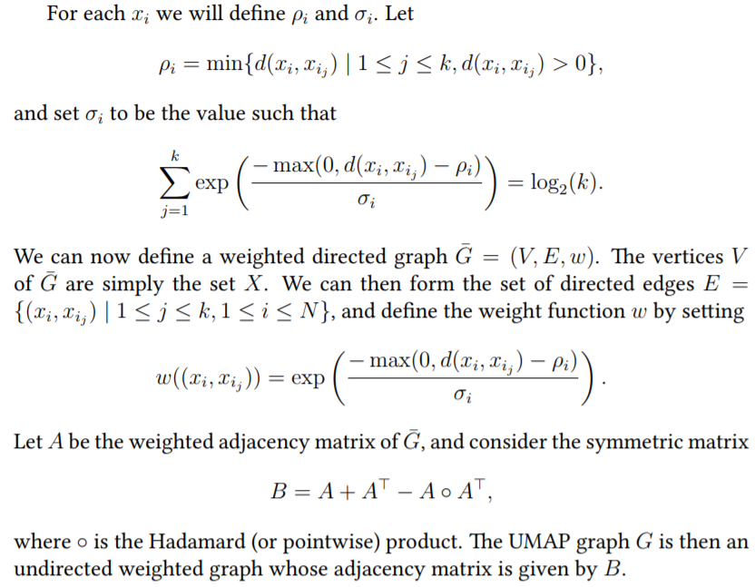
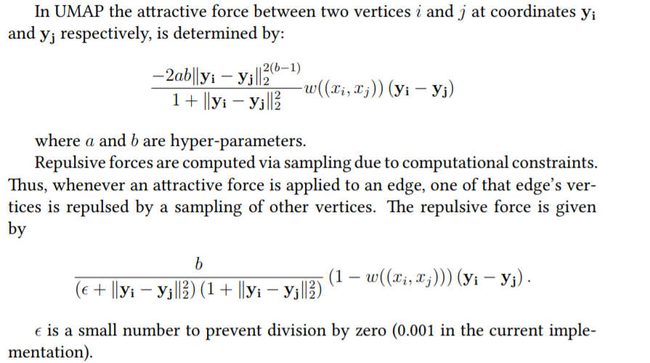
UMAP
(1) Build a weighted
KNN-graph
(2) Force directed graph
layout for visualization
Notes:
https://arxiv.org/pdf/1802.03426.pdf

Slide 30
Compared to tSNE, UMAP is better at preserving large scale relationships among clusters.

Slide 31
Take home messages
Distance metric
Euclidean
distance
Geodesic
distance
(manifold)
What to
preserve
Both short and
long dist
PCA
classic MDS
Isomap
Emphasize short and
Down-weight long dist
Modified MDS
Order of pairwise
distances
Non-metric MDS
Preserve only short dist
Give very low weight to
long dist
tSNE and UMAP
Preserve single-linkage
hierarchical tree
SPADE and TPE

