Slide 1
Summer Institutes of Statistical Genetics, 2021
SISG Module 6: Gene Expression Profiling
Lecture 07: Clustering and Trajectory Finding for scRNAseq Analysis
Peng Qiu and Greg Gibson
Georgia Institute of Technology

Slide 2
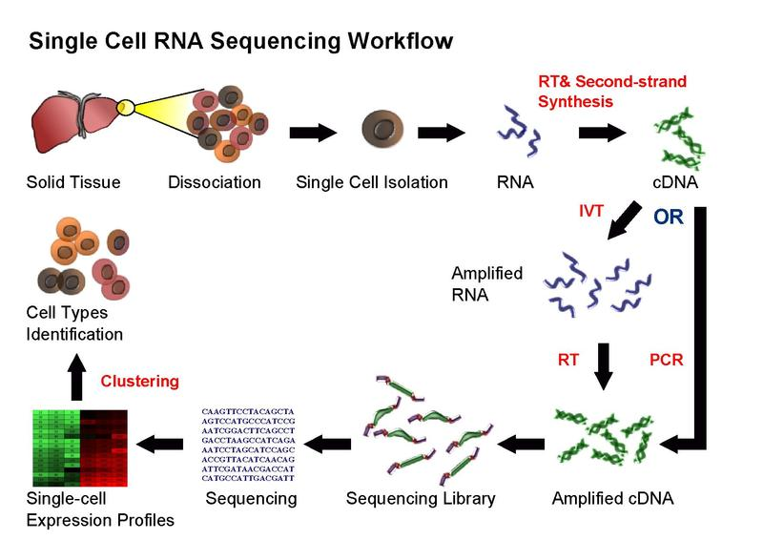
Single-cell RNA-seq

Slide 3
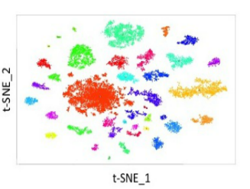
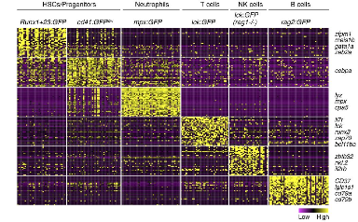
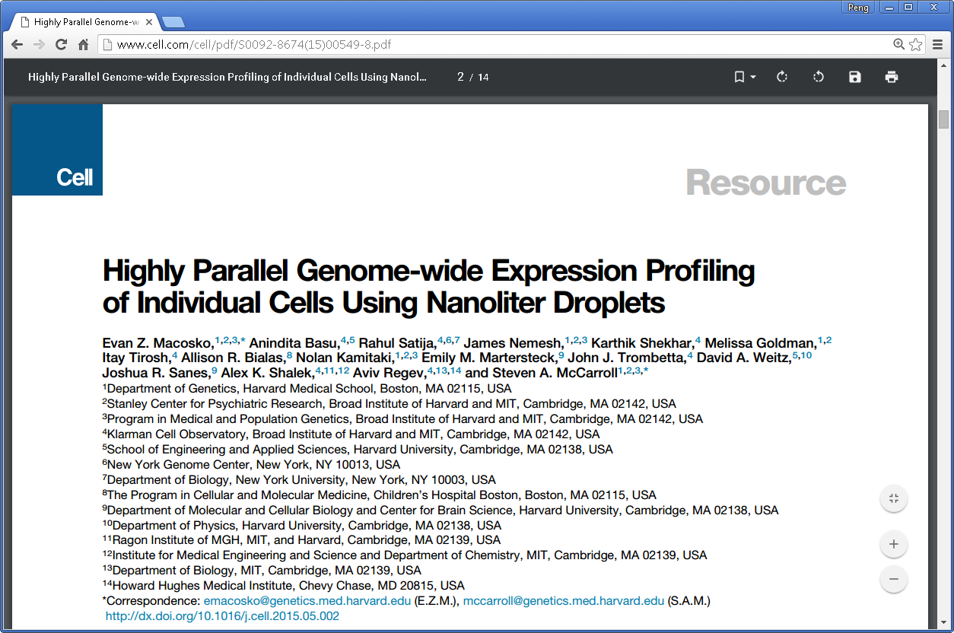

Computational questions and algorithms
Clustering
https://satijalab.org/seurat/v3.0/pbmc3k_tutorial.html

Slide 4
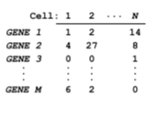
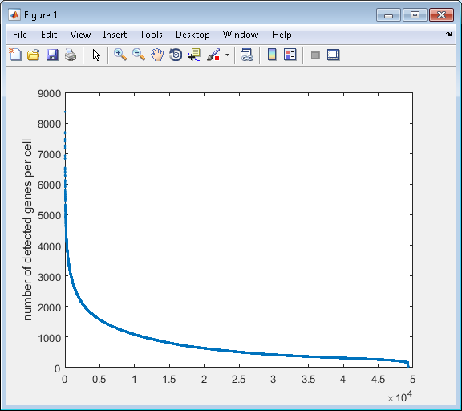
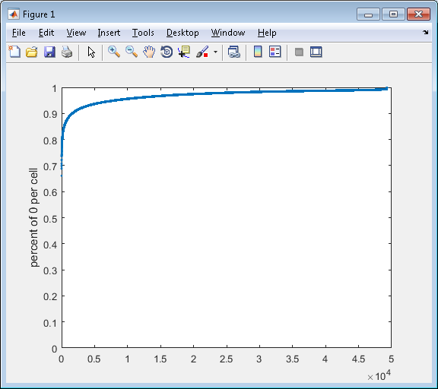
Challenge in analysis of scRNA-seq data – dropouts
97% of the data is 0

Slide 5
Starting point/input
49,300 cells
24,685
genes
(97% sparse)

Slide 6
Starting point/input
49,300 cells
49,300 cells
24,685
genes
Library size
normalization
24,685
genes
(97% sparse)
(97% sparse)
Library size normalization (per cell, divide by total UMI and multiply by 10,000)

Slide 7
Starting point/input
49,300 cells
49,300 cells
49,300 cells
24,685
genes
Library size
normalization
24,685
genes
Log transformation
24,685
genes
(97% sparse)
(97% sparse)
(97% sparse)
Log transformation - log(X+1)

Slide 8
Starting point/input
49,300 cells
49,300 cells
49,300 cells
24,685
genes
Library size
normalization
24,685
genes
Log transformation
24,685
genes
(97% sparse)
(97% sparse)
(97% sparse)
Filter cells
13,115 cells
24,685
genes
Keep cells with >900 genes detected, obtain 24,685 genes * 13,115 cells

Slide 9
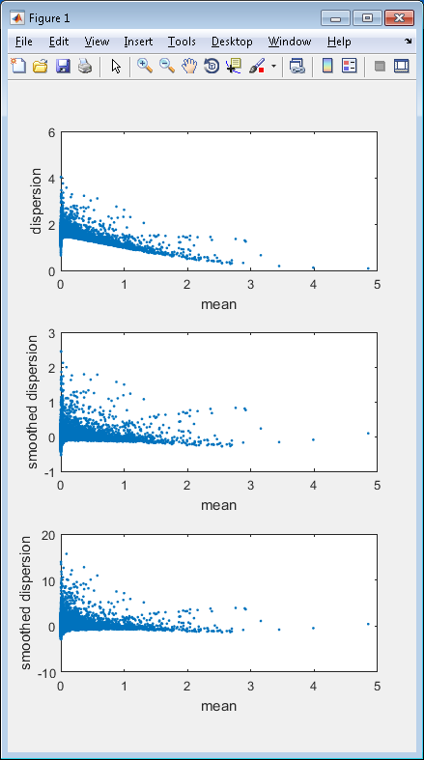
Starting point/input
49,300 cells
49,300 cells
49,300 cells
24,685
genes
Library size
normalization
24,685
genes
Log transformation
24,685
genes
(97% sparse)
(97% sparse)
(97% sparse)
Filter cells
13,115 cells
24,685
genes
13,115 cells
Filter genes
384
genes
(88% sparse)
Filter out genes with low variance, obtain 384 genes * 13,115 cells

Slide 10
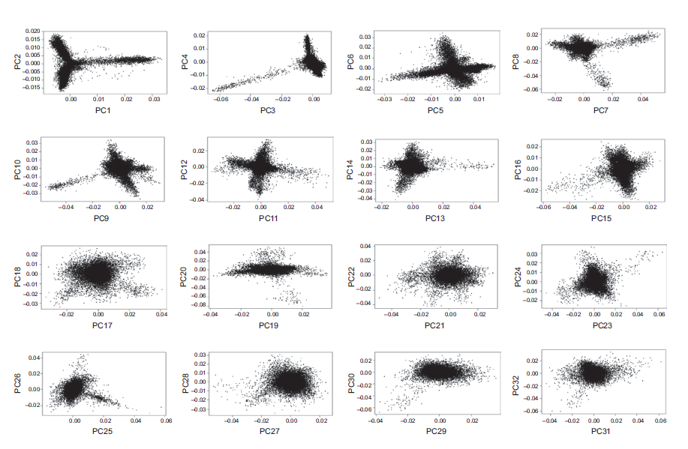
Starting point/input
49,300 cells
49,300 cells
49,300 cells
24,685
genes
Library size
normalization
24,685
genes
Log transformation
24,685
genes
(97% sparse)
(97% sparse)
(97% sparse)
Filter cells
13,115 cells
24,685
genes
13,115 cells
13,115 cells
Filter genes
384
genes
PCA
32
PCs
(88% sparse)
PCA dimension reduction to 32 dimensions
number of PC determined by JackStraw procedure

Slide 11
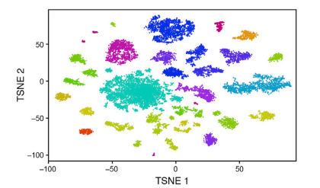
Starting point/input
49,300 cells
49,300 cells
49,300 cells
24,685
genes
Library size
normalization
24,685
genes
Log transformation
24,685
genes
(97% sparse)
(97% sparse)
(97% sparse)
Filter cells
13,115 cells
24,685
genes
13,115 cells
13,115 cells
tSNE
13,115 cells
Filter genes
384
genes
PCA
32
PCs
2D
(88% sparse)
tSNE dimension reduction to from 32 PCs to 2D

Slide 12
Starting point/input
49,300 cells
49,300 cells
49,300 cells
24,685
genes
Library size
normalization
24,685
genes
Log transformation
24,685
genes
(97% sparse)
(97% sparse)
(97% sparse)
Filter cells
13,115 cells
24,685
genes
13,115 cells
13,115 cells
tSNE
13,115 cells
Filter genes
384
genes
PCA
32
PCs
2D
(88% sparse)
Map removed
cells
49,300 cells
2D
Use a probability model same as the tSNE formulation to compute the most likely position for each new cell independently, given the already visualized 13,115 cells

Slide 13
Starting point/input
49,300 cells
49,300 cells
49,300 cells
24,685
genes
Library size
normalization
24,685
genes
Log transformation
24,685
genes
(97% sparse)
(97% sparse)
(97% sparse)
Filter cells
13,115 cells
24,685
genes
13,115 cells
13,115 cells
tSNE
13,115 cells
Filter genes
384
genes
PCA
32
PCs
2D
(88% sparse)
Map removed
cells
Heuristic merging
based on differentially
expressed genes
49,300 cells
Density based
clustering
2D
49 clusters
39 clusters
Density based clustering applied to 2D tSNE space, and find 49 clusters
Find differentially expressed genes between each pair of clusters, merge clusters with less than 10 differentially expressed genes, obtain 39 clusters

Slide 14
Starting point/input
49,300 cells
49,300 cells
49,300 cells
24,685
genes
Library size
normalization
24,685
genes
Log transformation
24,685
genes
(97% sparse)
(97% sparse)
(97% sparse)
Filter cells
13,115 cells
24,685
genes
13,115 cells
13,115 cells
tSNE
13,115 cells
Filter genes
384
genes
PCA
32
PCs
2D
(88% sparse)
Map removed
cells
Heuristic merging
based on differentially
expressed genes
Density based
clustering
Interpret the
biology
49,300 cells
2D
49 clusters
39 clusters

Slide 15
Seurat pipeline (initially published)
Start from 24,685 genes * 49,300 cells
Library size normalization (per cell, divide by total UMI and multiply by 10,000)
Log transformation - log(X+1)
Keep cells with >900 genes detected, obtain 24,685 genes * 13,115 cells
Filter out genes with low variance, obtain 384 genes * 13,115 cells (88% zero)
PCA dimension reduction to 32 dimensions, obtain 32 PC * 13,115 cells
tSNE dimension reduction to 2D, 2*13,115
Map the cells thrown away previously onto the 2D tSNE space, 2*44,808
Density based cluster on 2D tSNE space, and find 49 clusters
Find differentially expressed genes between each pair of clusters, merge clusters with less than 10 differentially expressed genes, obtain 39 clusters
Done and interpret the 39 clusters

Slide 16
Seurat pipeline (now)
Start from 24,685 genes * 49,300 cells
Library size normalization (per cell, divide by total UMI and multiply by 10,000)
Log transformation - log(X+1)
Keep cells with >900 genes detected, obtain 24,685 genes * 13,115 cells
Filter out genes with low variance, obtain 384 genes * 13,115 cells (88% zero)
PCA dimension reduction to 32 dimensions, obtain 32 PC * 13,115 cells
tSNE dimension reduction to 2D, 2*13,115
Map the cells thrown away previously onto the 2D tSNE space, 2*44,808
Clustering by community finding in PCA space (KNN->SNN in PCA space + Louvain to cluster the graph
Find differentially expressed genes between each pair of clusters, merge clusters with less than 10 differentially expressed genes, obtain 39 clusters
Done and interpret the 39 clusters

Slide 17
Starting point/input
49,300 cells
49,300 cells
49,300 cells
24,685
genes
Library size
normalization
24,685
genes
Log transformation
24,685
genes
(97% sparse)
(97% sparse)
(97% sparse)
Filter cells
13,115 cells
24,685
genes
13,115 cells
13,115 cells
tSNE
13,115 cells
Filter genes
384
genes
PCA
32
PCs
2D
(88% sparse)
Map removed
cells
Heuristic merging
based on differentially
expressed genes
Density based
clustering
Interpret the
biology
49,300 cells
2D
49 clusters
39 clusters

Slide 18
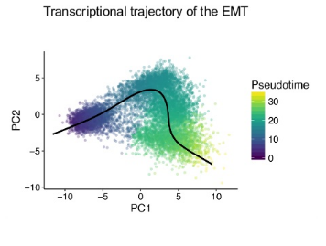
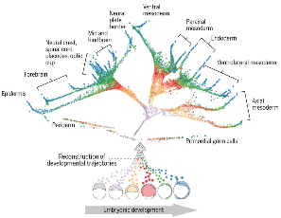
Trajectory finding (DPT)

Slide 19
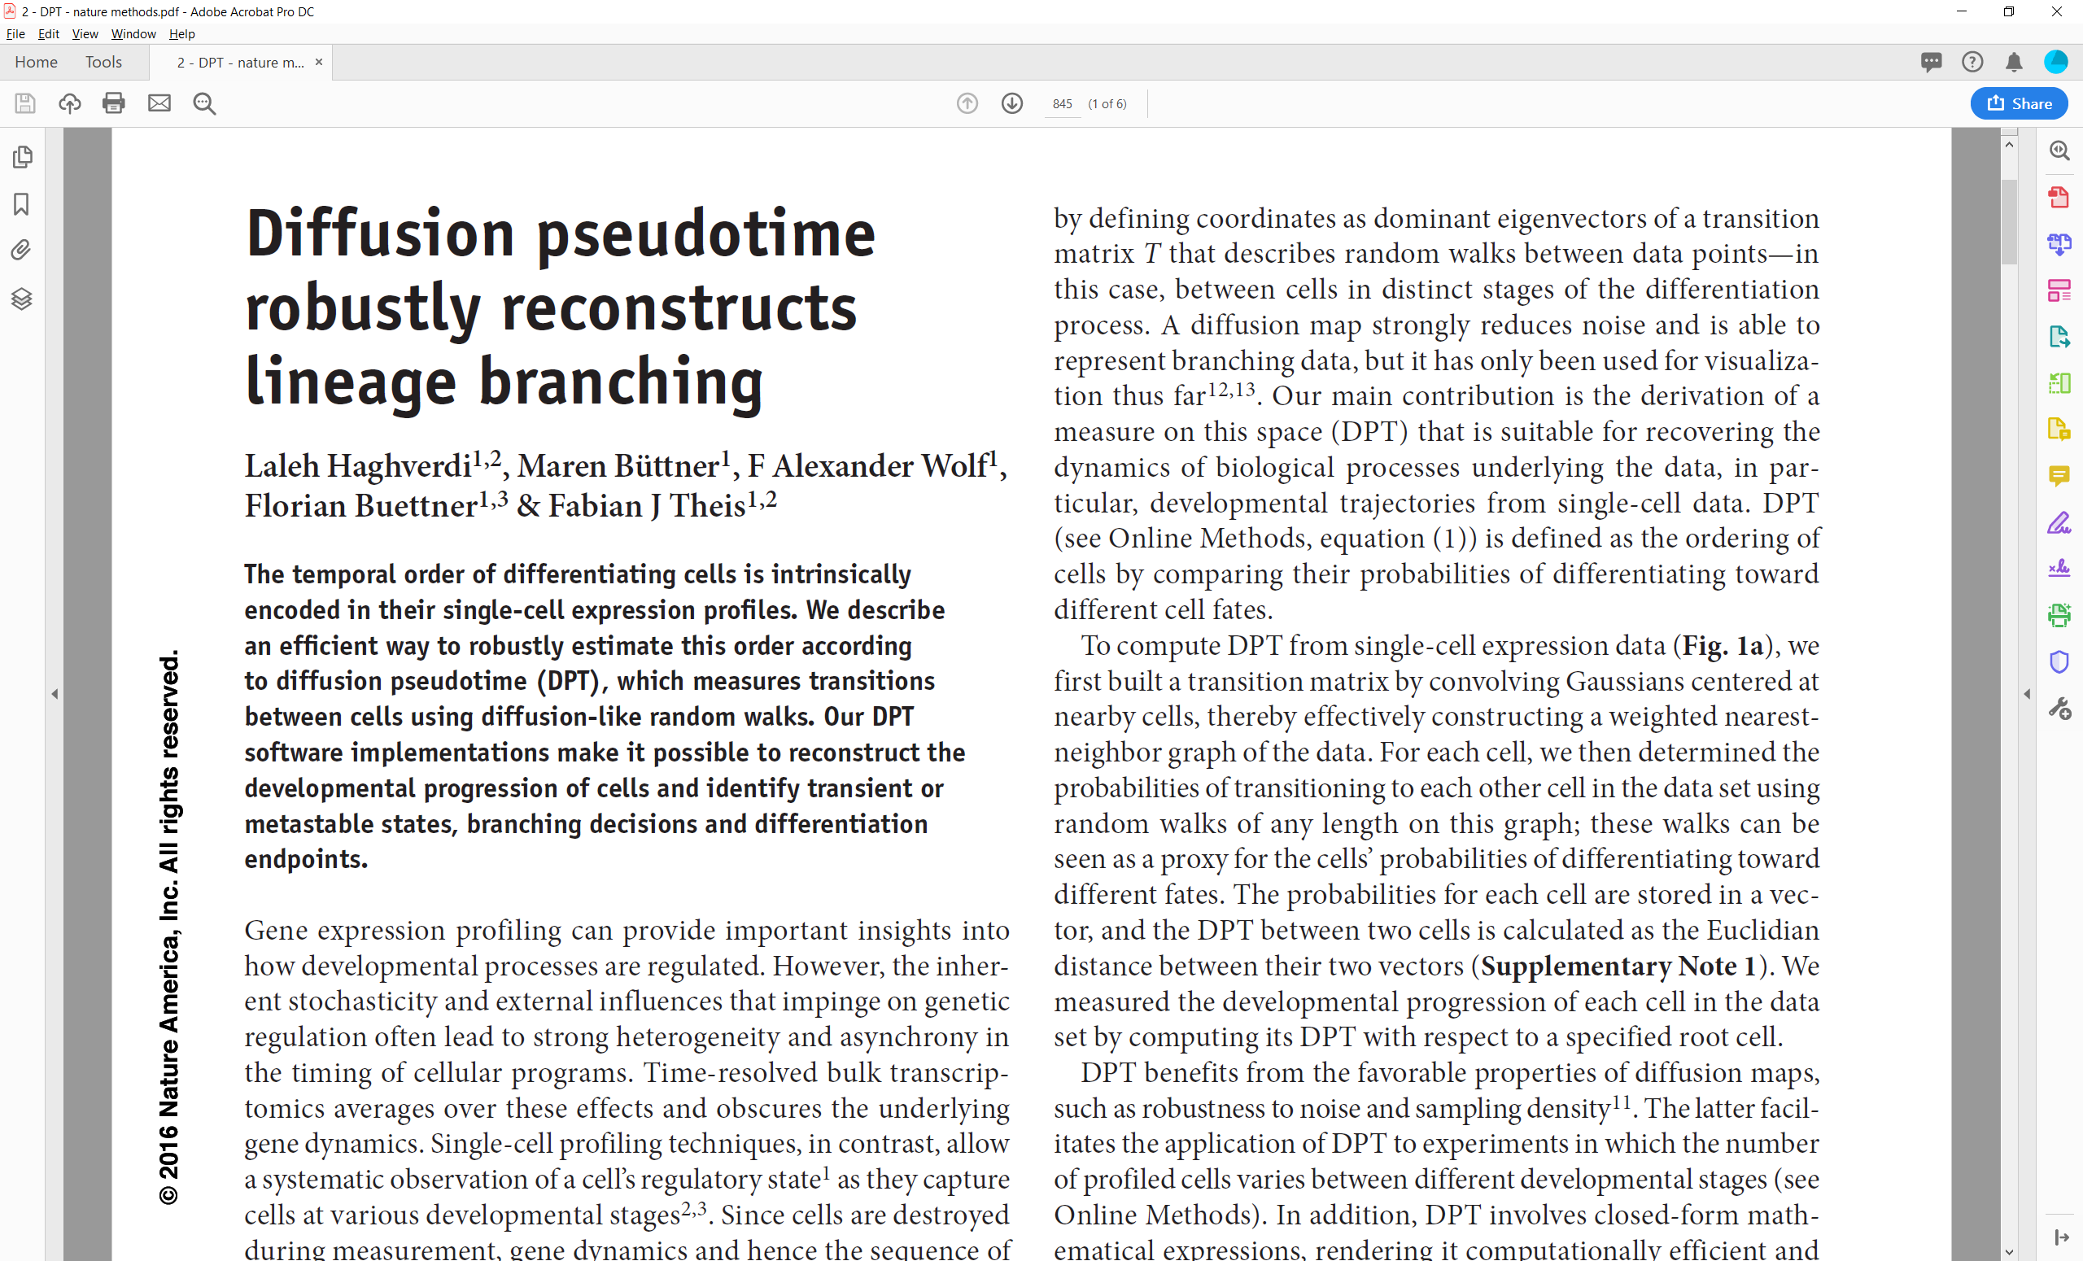

Slide 20
DPT pipeline – defining diffusion pseudo time
Starting point/input: preprocessed scRNAseq data
(Preprocessing options: library size normalization,
log transformation, cell cycle normalization)
cells
genes

Slide 21

DPT pipeline – defining diffusion pseudo time
Starting point/input: preprocessed scRNAseq data
(Preprocessing options: library size normalization,
log transformation, cell cycle normalization)
cells
cells
genes
Euclidean
distance
cells
$$d(x,y)$$

Slide 22

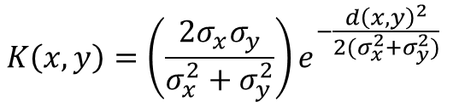
DPT pipeline – defining diffusion pseudo time
Starting point/input: preprocessed scRNAseq data
(Preprocessing options: library size normalization,
log transformation, cell cycle normalization)
cells
cells
cells
genes
Euclidean
distance
cells
Compute
affinity
cells
$$d(x,y)$$
$$K(x,y)$$
$$K\left(x,y\right)=\left(\frac{2σ_{x}σ_{y}}{σ_{x}^{2}+σ_{y}^{2}}\right)e^{−\frac{d{\left(x,y\right)}^{2}}{2(σ_{x}^{2}+σ_{y}^{2})}}$$
$σ_{x}$ is the distance between $x$ and its k^{th} nearest neighbor

Slide 23



DPT pipeline – defining diffusion pseudo time
Starting point/input: preprocessed scRNAseq data
(Preprocessing options: library size normalization,
log transformation, cell cycle normalization)
cells
cells
cells
cells
genes
Euclidean
distance
cells
Compute
affinity
cells
Normalize
by density
cells
$$d(x,y)$$
$$K(x,y)$$
$$W(x,y)$$
$$W\left(x,y\right)=\frac{K(x,y)}{Z\left(x\right)Z(y)}$$
$Z\left(x\right)$ is the row sum of $x$’s row of $K$

Slide 24
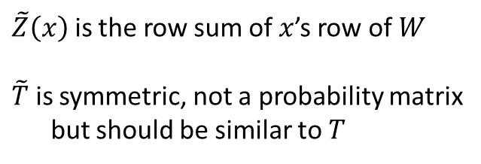
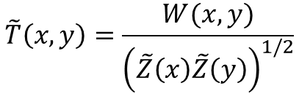

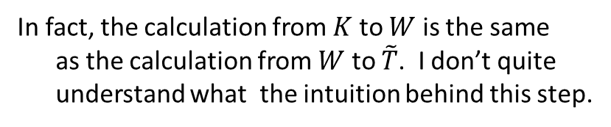
DPT pipeline – defining diffusion pseudo time
Starting point/input: preprocessed scRNAseq data
(Preprocessing options: library size normalization,
log transformation, cell cycle normalization)
cells
cells
cells
cells
genes
Euclidean
distance
cells
Compute
affinity
cells
Normalize
by density
cells
$$d(x,y)$$
$$K(x,y)$$
$$W(x,y)$$
Further normalization
cells
cells
$$\tilde{T}\left(x,y\right)=\frac{W(x,y)}{{\left(\tilde{Z}\left(x\right)\tilde{Z}\left(y\right)\right)}^{1/2}}$$
$$\tilde{T}(x,y)$$
$\tilde{Z}\left(x\right)$ is the row sum of $x$’s row of $W$
$\tilde{T}$ is symmetric, not a probability matrix
but should be similar to $T$
In fact, the calculation from $K$ to $W$ is the same
as the calculation from $W$ to $\tilde{T}$. I don’t quite
understand what the intuition behind this step.

Slide 25
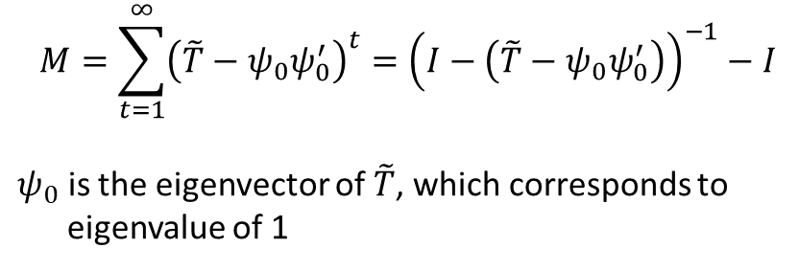

DPT pipeline – defining diffusion pseudo time
Starting point/input: preprocessed scRNAseq data
(Preprocessing options: library size normalization,
log transformation, cell cycle normalization)
cells
cells
cells
cells
genes
Euclidean
distance
cells
Compute
affinity
cells
Normalize
by density
cells
$$d(x,y)$$
$$K(x,y)$$
$$W(x,y)$$
Further normalization
cells
cells
cells
Compute
diffusion
cells
$$\tilde{T}(x,y)$$
$$M(x,y)$$
$$M=\sum_{t=1}^{∞}{{\left(\tilde{T}−ψ_{0}ψ_{0}^{′}\right)}^{t}}={\left(I−\left(\tilde{T}−ψ_{0}ψ_{0}^{′}\right)\right)}^{−1}−I$$
$ψ_{0}$ is the eigenvector of $\tilde{T}$, which corresponds to
eigenvalue of 1

Slide 26


DPT pipeline – defining diffusion pseudo time
Starting point/input: preprocessed scRNAseq data
(Preprocessing options: library size normalization,
log transformation, cell cycle normalization)
cells
cells
cells
cells
genes
Euclidean
distance
cells
Compute
affinity
cells
Normalize
by density
cells
$$d(x,y)$$
$$K(x,y)$$
$$W(x,y)$$
Further normalization
cells
cells
cells
cells
Compute
diffusion
cells
Compute
cells
$$\tilde{T}(x,y)$$
$$M(x,y)$$
$$dpt(x,y)$$
$$dpt(x,y)={\left\|M\left(x,:\right)−M(y,:)\right\|}^{2}$$

Slide 27
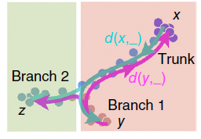
DPT pipeline – defining diffusion pseudo time
Starting point/input: preprocessed scRNAseq data
(Preprocessing options: library size normalization,
log transformation, cell cycle normalization)
cells
cells
cells
cells
genes
Euclidean
distance
cells
Compute
affinity
cells
Normalize
by density
cells
$$d(x,y)$$
$$K(x,y)$$
$$W(x,y)$$
Further normalization
cells
cells
cells
cells
Compute
diffusion
cells
Compute
cells
$$\tilde{T}(x,y)$$
$$M(x,y)$$
$$dpt(x,y)$$
A heuristic to find trajectories
Trajectory:
- Number of branches,
- Which cells belong to which branch
- Which cells represent distal end of each branch
- Which cells represent branching points
Haghverdi, L., et al, Nature Methods, 2016

Slide 28


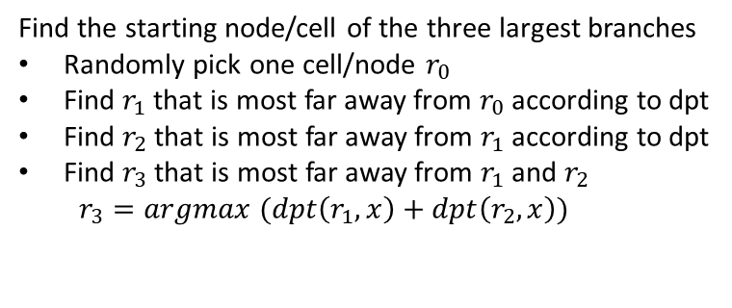


DPT pipeline – finding branching points
cells
cells
Find the starting node/cell of the three largest branches
Randomly pick one cell/node $r_{0}$
Find $r_{1}$ that is most far away from $r_{0}$ according to dpt
Find $r_{2}$ that is most far away from $r_{1}$ according to dpt
Find $r_{3}$ that is most far away from $r_{1}$ and $r_{2}$
$r_{3}=argmax (dpt\left(r_{1},x\right)+dpt\left(r_{2},x\right))$
$$dpt(i,j)$$
A heuristic
to find
trajectories
Trajectory:
- Number of branches,
- Which cells belong to which branch
- Which cells represent distal end of each branch
- Which cells represent branching points
$$r_{1}$$
$$r_{2}$$
$$r_{3}$$

Slide 29

DPT pipeline – finding branching points
cells
cells
Find the starting node/cell of the three largest branches
Randomly pick one cell/node $r_{0}$
Find $r_{1}$ that is most far away from $r_{0}$ according to dpt
Find $r_{2}$ that is most far away from $r_{1}$ according to dpt
Find $r_{3}$ that is most far away from $r_{1}$ and $r_{2}$
$r_{3}=argmax (dpt\left(r_{1},x\right)+dpt\left(r_{2},x\right))$
$$dpt(i,j)$$
A heuristic
to find
trajectories
Compute the diffusion pseudo time of all points from each of the three starting node
Trajectory:
- Number of branches,
- Which cells belong to which branch
- Which cells represent distal end of each branch
- Which cells represent branching points
$$r_{1}$$
1
2
3
15
17
18
4
13
$$r_{2}$$
5
11
6
7
8
9
10
12
14
16
$$r_{3}$$
$$O_{1}$$

Slide 30



DPT pipeline – finding branching points
cells
cells
Find the starting node/cell of the three largest branches
Randomly pick one cell/node $r_{0}$
Find $r_{1}$ that is most far away from $r_{0}$ according to dpt
Find $r_{2}$ that is most far away from $r_{1}$ according to dpt
Find $r_{3}$ that is most far away from $r_{1}$ and $r_{2}$
$r_{3}=argmax (dpt\left(r_{1},x\right)+dpt\left(r_{2},x\right))$
$$dpt(i,j)$$
A heuristic
to find
trajectories
Compute the diffusion pseudo time of all points from each of the three starting node
Trajectory:
- Number of branches,
- Which cells belong to which branch
- Which cells represent distal end of each branch
- Which cells represent branching points
$$r_{1}$$
1
2
3
15
17
18
$$r_{1}$$
18
17
2
1
$$r_{2}$$
4
13
$$r_{2}$$
16
3
5
14
4
6
11
12
5
7
9
10
6
8
8
7
10
9
12
11
14
13
16
15
$$r_{3}$$
$$r_{3}$$
$$O_{1}$$
$$O_{2}$$

Slide 31


DPT pipeline – finding branching points
cells
cells
Find the starting node/cell of the three largest branches
Randomly pick one cell/node $r_{0}$
Find $r_{1}$ that is most far away from $r_{0}$ according to dpt
Find $r_{2}$ that is most far away from $r_{1}$ according to dpt
Find $r_{3}$ that is most far away from $r_{1}$ and $r_{2}$
$r_{3}=argmax (dpt\left(r_{1},x\right)+dpt\left(r_{2},x\right))$
$$dpt(i,j)$$
A heuristic
to find
trajectories
Compute the diffusion pseudo time of all points from each of the three starting node
Trajectory:
- Number of branches,
- Which cells belong to which branch
- Which cells represent distal end of each branch
- Which cells represent branching points
$$r_{1}$$
1
2
3
15
17
18
$$r_{1}$$
18
17
2
1
$$r_{2}$$
$$r_{1}$$
18
16
15
17
4
13
$$r_{2}$$
16
3
14
13
$$r_{2}$$
5
14
4
12
11
6
11
12
5
10
7
9
10
6
8
9
8
8
6
7
7
5
10
9
4
12
11
3
14
13
2
16
15
1
$$r_{3}$$
$$r_{3}$$
$$r_{3}$$
$$O_{1}$$
$$O_{2}$$
$$O_{3}$$

Slide 32
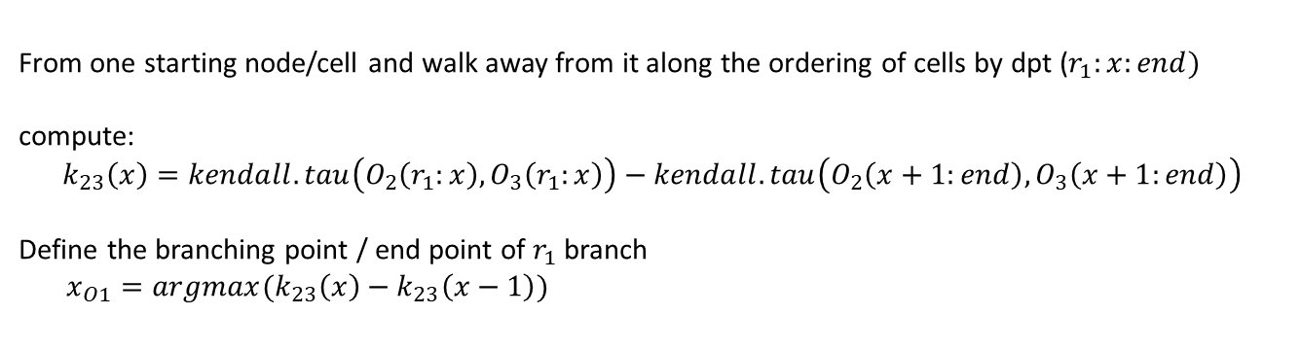
DPT pipeline – finding branching points
cells
cells
Find the starting node/cell of the three largest branches
Randomly pick one cell/node $r_{0}$
Find $r_{1}$ that is most far away from $r_{0}$ according to dpt
Find $r_{2}$ that is most far away from $r_{1}$ according to dpt
Find $r_{3}$ that is most far away from $r_{1}$ and $r_{2}$
$r_{3}=argmax (dpt\left(r_{1},x\right)+dpt\left(r_{2},x\right))$
$$dpt(i,j)$$
A heuristic
to find
trajectories
Compute the diffusion pseudo time of all points from each of the three starting node
Trajectory:
- Number of branches,
- Which cells belong to which branch
- Which cells represent distal end of each branch
- Which cells represent branching points
From one starting node/cell and walk away from it along the ordering of cells by dpt ($r_{1}:x:end)$
compute:
$$k_{23}\left(x\right)=kendall.tau\left(O_{2}\left(r_{1}:x\right),O_{3}\left(r_{1}:x\right)\right)−kendall.tau\left(O_{2}\left(x+1:end\right),O_{3}\left(x+1:end\right)\right)$$
Define the branching point / end point of $r_{1}$ branch
$x_{O1}=argmax(k_{23}\left(x\right)−k_{23}\left(x−1\right))$
$$r_{1}$$
1
2
3
15
17
18
$$r_{1}$$
18
17
2
1
$$r_{2}$$
$$r_{1}$$
18
16
15
17
4
13
$$r_{2}$$
16
3
14
13
$$r_{2}$$
5
14
4
12
11
6
11
12
5
10
7
9
10
6
8
9
8
8
6
7
7
5
10
9
4
12
11
3
14
13
2
16
15
1
$$r_{3}$$
$$r_{3}$$
$$r_{3}$$
$$O_{1}$$
$$O_{2}$$
$$O_{3}$$

Slide 33
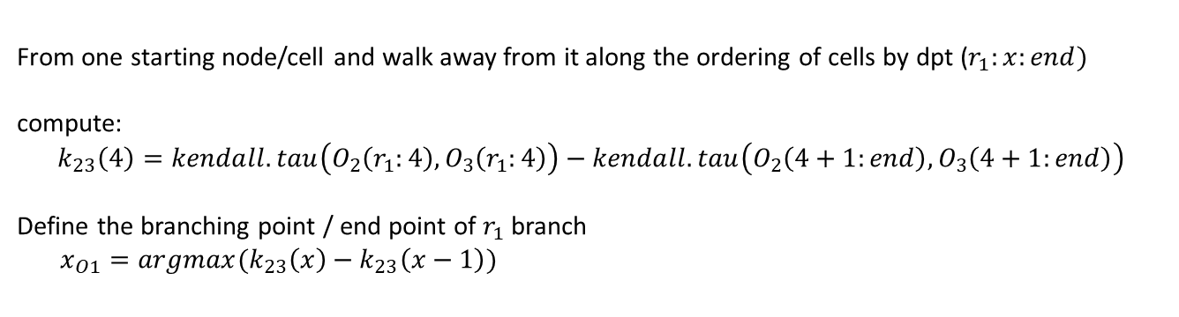
DPT pipeline – finding branching points
cells
cells
Find the starting node/cell of the three largest branches
Randomly pick one cell/node $r_{0}$
Find $r_{1}$ that is most far away from $r_{0}$ according to dpt
Find $r_{2}$ that is most far away from $r_{1}$ according to dpt
Find $r_{3}$ that is most far away from $r_{1}$ and $r_{2}$
$r_{3}=argmax (dpt\left(r_{1},x\right)+dpt\left(r_{2},x\right))$
$$dpt(i,j)$$
A heuristic
to find
trajectories
Compute the diffusion pseudo time of all points from each of the three starting node
Trajectory:
- Number of branches,
- Which cells belong to which branch
- Which cells represent distal end of each branch
- Which cells represent branching points
From one starting node/cell and walk away from it along the ordering of cells by dpt ($r_{1}:x:end)$
compute:
$$k_{23}\left(4\right)=kendall.tau\left(O_{2}\left(r_{1}:4\right),O_{3}\left(r_{1}:4\right)\right)−kendall.tau\left(O_{2}\left(4+1:end\right),O_{3}\left(4+1:end\right)\right)$$
Define the branching point / end point of $r_{1}$ branch
$x_{O1}=argmax(k_{23}\left(x\right)−k_{23}\left(x−1\right))$
18 17 16 14
18 16 14 12
12 10 8 7 6 9 5 11 4 13 3 15 2 1
10 8 6 5 7 4 9 3 11 2 13 1 15 17
$$r_{1}$$
1
2
3
15
17
18
$$r_{1}$$
18
17
2
1
$$r_{2}$$
$$r_{1}$$
18
16
15
17
4
13
$$r_{2}$$
16
3
14
13
$$r_{2}$$
5
14
4
12
11
6
11
12
5
10
7
9
10
6
8
9
8
8
6
7
7
5
10
9
4
12
11
3
14
13
2
16
15
1
$$r_{3}$$
$$r_{3}$$
$$r_{3}$$
$$O_{1}$$
$$O_{2}$$
$$O_{3}$$

Slide 34
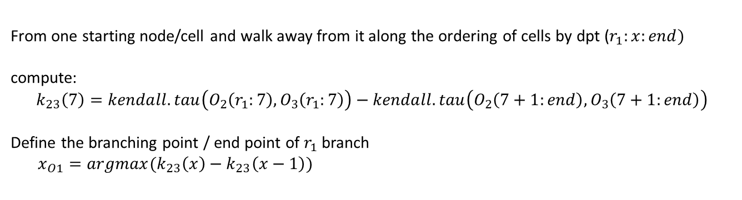
DPT pipeline – finding branching points
cells
cells
Find the starting node/cell of the three largest branches
Randomly pick one cell/node $r_{0}$
Find $r_{1}$ that is most far away from $r_{0}$ according to dpt
Find $r_{2}$ that is most far away from $r_{1}$ according to dpt
Find $r_{3}$ that is most far away from $r_{1}$ and $r_{2}$
$r_{3}=argmax (dpt\left(r_{1},x\right)+dpt\left(r_{2},x\right))$
$$dpt(i,j)$$
A heuristic
to find
trajectories
Compute the diffusion pseudo time of all points from each of the three starting node
Trajectory:
- Number of branches,
- Which cells belong to which branch
- Which cells represent distal end of each branch
- Which cells represent branching points
From one starting node/cell and walk away from it along the ordering of cells by dpt ($r_{1}:x:end)$
compute:
$$k_{23}\left(7\right)=kendall.tau\left(O_{2}\left(r_{1}:7\right),O_{3}\left(r_{1}:7\right)\right)−kendall.tau\left(O_{2}\left(7+1:end\right),O_{3}\left(7+1:end\right)\right)$$
Define the branching point / end point of $r_{1}$ branch
$x_{O1}=argmax(k_{23}\left(x\right)−k_{23}\left(x−1\right))$
18 17 16 14 12 10 8
18 16 14 12 10 8 6
7 6 9 5 11 4 13 3 15 2 1
5 7 4 9 3 11 2 13 1 15 17
$$r_{1}$$
1
2
3
15
17
18
$$r_{1}$$
18
17
2
1
$$r_{2}$$
$$r_{1}$$
18
16
15
17
4
13
$$r_{2}$$
16
3
14
13
$$r_{2}$$
5
14
4
12
11
6
11
12
5
10
7
9
10
6
8
9
8
8
6
7
7
5
10
9
4
12
11
3
14
13
2
16
15
1
$$r_{3}$$
$$r_{3}$$
$$r_{3}$$
$$O_{1}$$
$$O_{2}$$
$$O_{3}$$
Notes:
There may be unassigned nodes.

Slide 35
DPT pipeline – finding branching points
cells
cells
Find the starting node/cell of the three largest branches
Randomly pick one cell/node $r_{0}$
Find $r_{1}$ that is most far away from $r_{0}$ according to dpt
Find $r_{2}$ that is most far away from $r_{1}$ according to dpt
Find $r_{3}$ that is most far away from $r_{1}$ and $r_{2}$
$r_{3}=argmax (dpt\left(r_{1},x\right)+dpt\left(r_{2},x\right))$
$$dpt(i,j)$$
A heuristic
to find
trajectories
Compute the diffusion pseudo time of all points from each of the three starting node
Trajectory:
- Number of branches,
- Which cells belong to which branch
- Which cells represent distal end of each branch
- Which cells represent branching points
From one starting node/cell and walk away from it along the ordering of cells by dpt ($r_{1}:x:end)$
compute:
$$k_{23}\left(x\right)=kendall.tau\left(O_{2}\left(r_{1}:x\right),O_{3}\left(r_{1}:x\right)\right)−kendall.tau\left(O_{2}\left(x+1:end\right),O_{3}\left(x+1:end\right)\right)$$
Define the branching point / end point of $r_{1}$ branch
$x_{O1}=argmax(k_{23}\left(x\right)−k_{23}\left(x−1\right))$
Repeat this for each of the three starting node/cell to identify cells that belong to each of the three branch.

Slide 36
DPT pipeline – finding branching points
cells
cells
Find the starting node/cell of the three largest branches
Randomly pick one cell/node $r_{0}$
Find $r_{1}$ that is most far away from $r_{0}$ according to dpt
Find $r_{2}$ that is most far away from $r_{1}$ according to dpt
Find $r_{3}$ that is most far away from $r_{1}$ and $r_{2}$
$r_{3}=argmax (dpt\left(r_{1},x\right)+dpt\left(r_{2},x\right))$
$$dpt(i,j)$$
A heuristic
to find
trajectories
Compute the diffusion pseudo time of all points from each of the three starting node
Trajectory:
- Number of branches,
- Which cells belong to which branch
- Which cells represent distal end of each branch
- Which cells represent branching points
From one starting node/cell and walk away from it along the ordering of cells by dpt ($r_{1}:x:end)$
compute:
$$k_{23}\left(x\right)=kendall.tau\left(O_{2}\left(r_{1}:x\right),O_{3}\left(r_{1}:x\right)\right)−kendall.tau\left(O_{2}\left(x+1:end\right),O_{3}\left(x+1:end\right)\right)$$
Define the branching point / end point of $r_{1}$ branch
$x_{O1}=argmax(k_{23}\left(x\right)−k_{23}\left(x−1\right))$
Repeat this for each of the three starting node/cell to identify cells that belong to each of the three branch.
Repeat all above for cells belonging to each of the three branches separately, to identify further smaller branches within each of the three branches

Slide 37
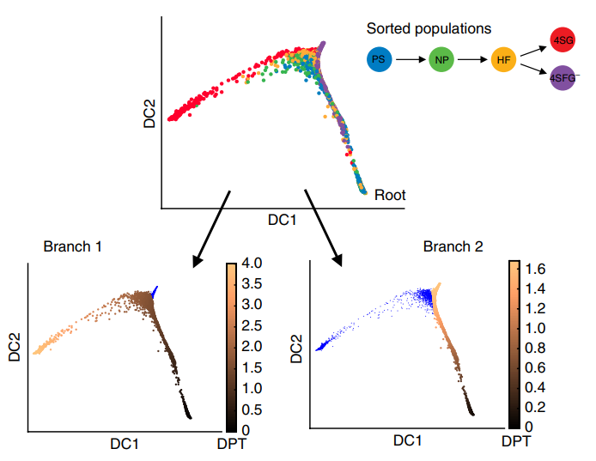
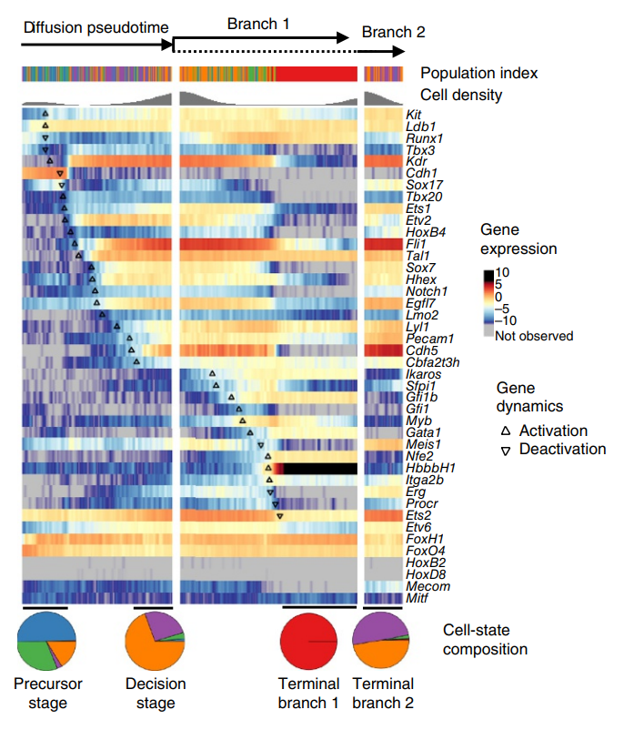
DPT pipeline

Slide 38
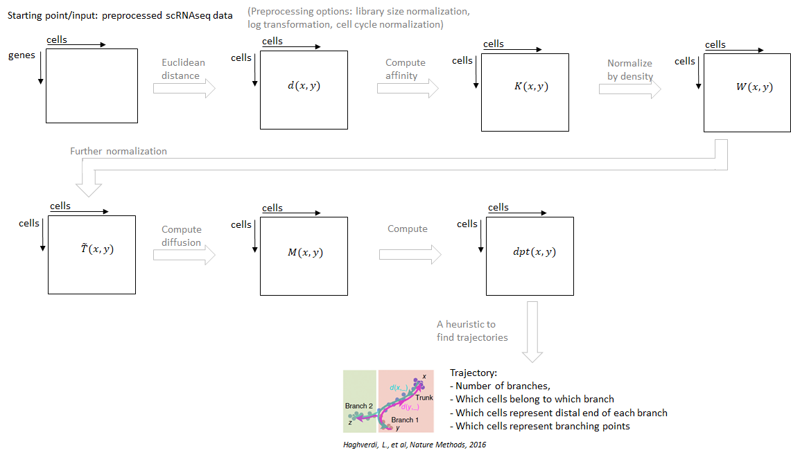
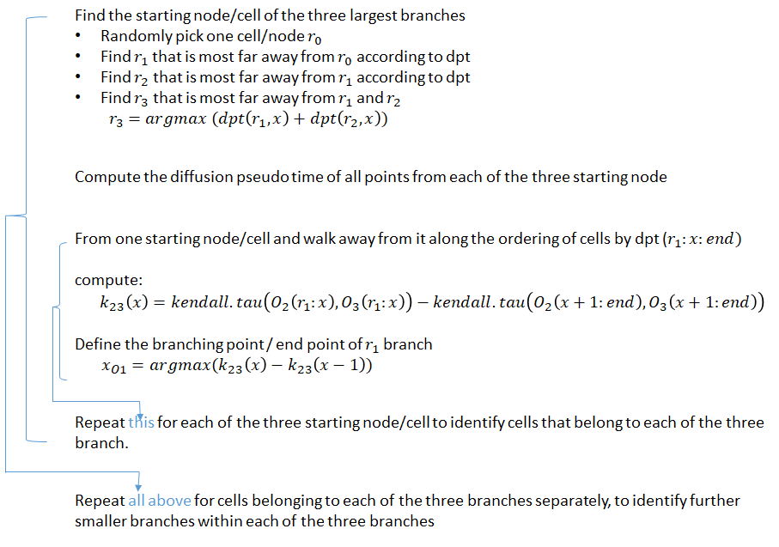
DPT pipeline

