Slide 1
Summer Institutes of Statistical Genetics, 2020
SISG Module 6: Gene Expression Profiling
Lecture 07: Clustering for scRNAseq Analysis
Peng Qiu and Greg Gibson
Georgia Institute of Technology

Slide 2
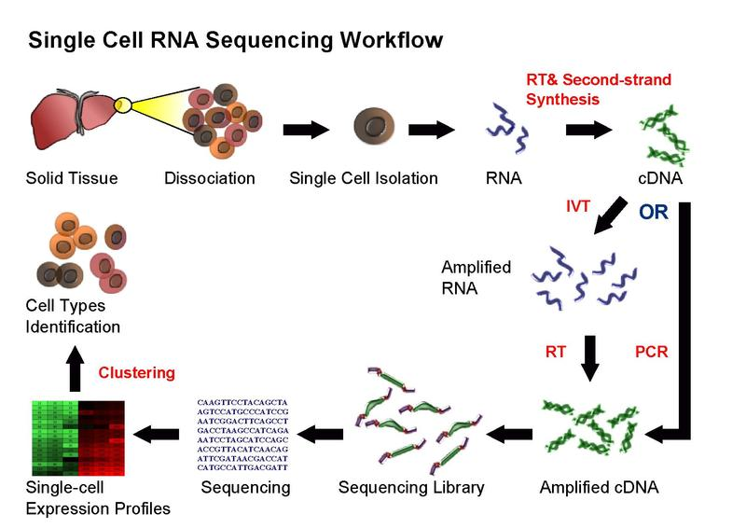
Single-cell RNA-seq

Slide 3
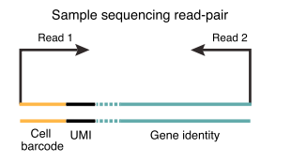
Pre-processing

Slide 4
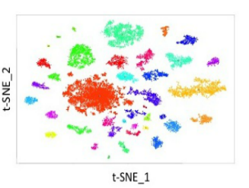
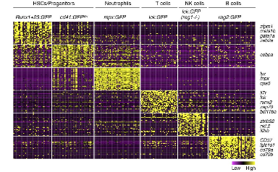
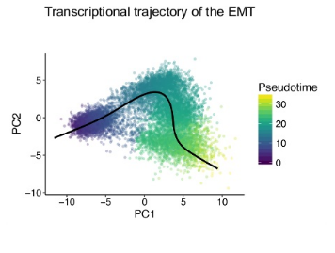
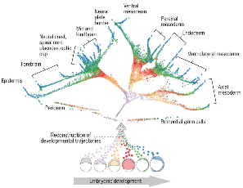
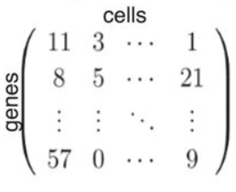
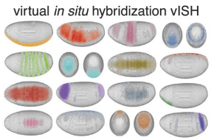
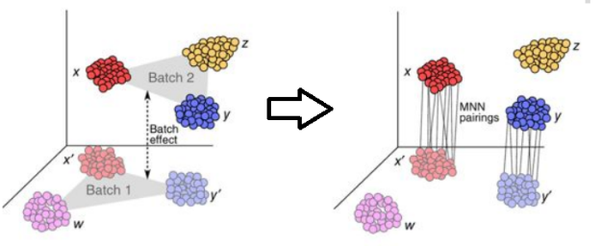
Computational questions and algorithms
Clustering
  Seurat, SC3, …
Trajectory finding
  DPT, Monocle, SLICER, STREAM, …
Spatial inference
  Seurat-2, DistMap, …
Manifold alignment
  Seurat-3, MNN batch correction, …
Gene regulatory networks
  SCENIC, SCODE, …
Imputation
  MAGIC, scImpute, SAVER, netSmooth, …
+
https://github.com/seandavi/awesome-single-cell

Slide 5
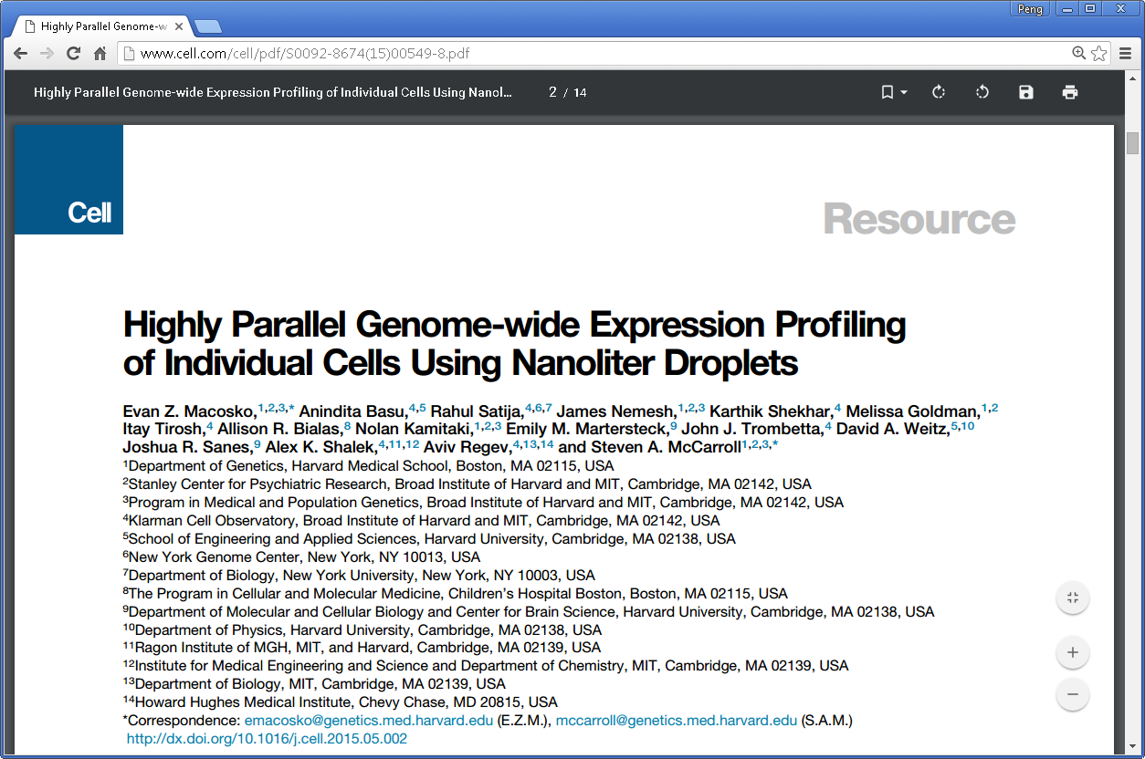
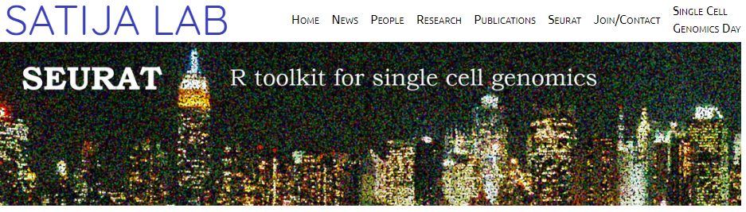
Computational questions and algorithms
Clustering
  Seurat, SC3, …
https://satijalab.org/seurat/v3.0/pbmc3k_tutorial.html

Slide 6
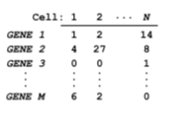
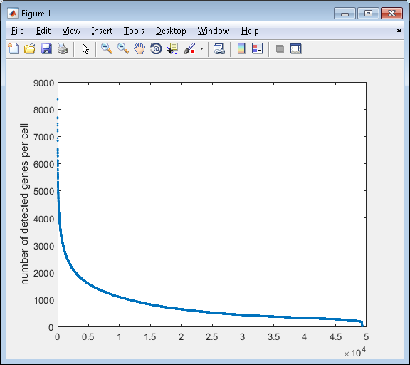
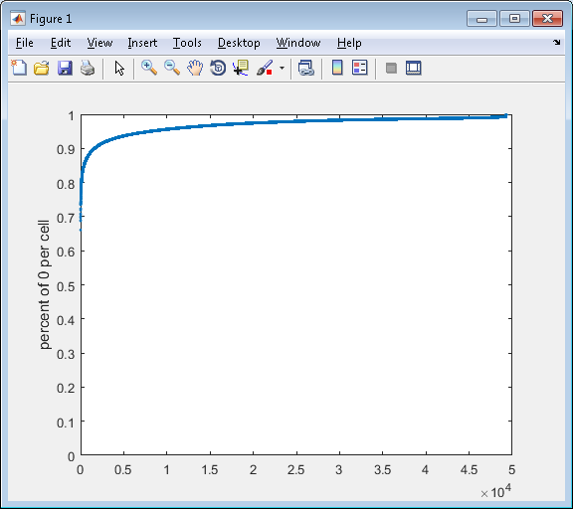
Challenge in analysis of scRNA-seq data – dropouts
97% of the data is 0

Slide 7
Starting point/input
49,300 cells
24,685
genes
(97% sparse)

Slide 8
Starting point/input
49,300 cells
49,300 cells
24,685
genes
Library size
normalization
24,685
genes
(97% sparse)
(97% sparse)
Library size normalization (per cell, divide by total UMI and multiply by 10,000)

Slide 9
Starting point/input
49,300 cells
49,300 cells
49,300 cells
24,685
genes
Library size
normalization
24,685
genes
Log transformation
24,685
genes
(97% sparse)
(97% sparse)
(97% sparse)
Log transformation - log(X+1)

Slide 10
Starting point/input
49,300 cells
49,300 cells
49,300 cells
24,685
genes
Library size
normalization
24,685
genes
Log transformation
24,685
genes
(97% sparse)
(97% sparse)
(97% sparse)
Filter cells
13,115 cells
24,685
genes
Keep cells with >900 genes detected, obtain 24,685 genes * 13,115 cells

Slide 11
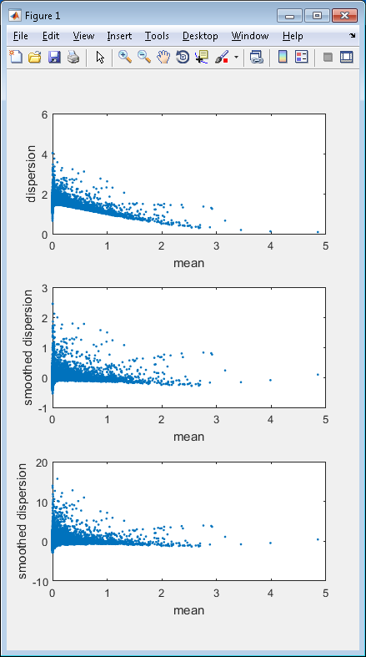
Starting point/input
49,300 cells
49,300 cells
49,300 cells
24,685
genes
Library size
normalization
24,685
genes
Log transformation
24,685
genes
(97% sparse)
(97% sparse)
(97% sparse)
Filter cells
13,115 cells
24,685
genes
13,115 cells
Filter genes
384
genes
(88% sparse)
Filter out genes with low variance, obtain 384 genes * 13,115 cells

Slide 12
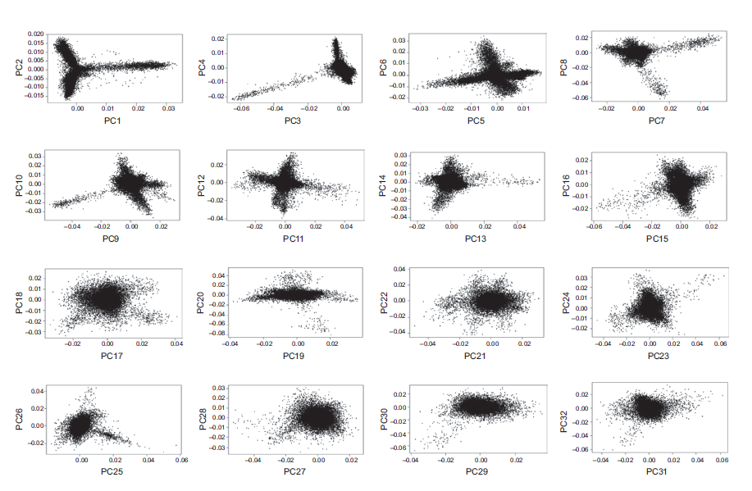
Starting point/input
49,300 cells
49,300 cells
49,300 cells
24,685
genes
Library size
normalization
24,685
genes
Log transformation
24,685
genes
(97% sparse)
(97% sparse)
(97% sparse)
Filter cells
13,115 cells
24,685
genes
13,115 cells
13,115 cells
Filter genes
384
genes
PCA
32
PCs
(88% sparse)
PCA dimension reduction to 32 dimensions
number of PC determined by JackStraw procedure

Slide 13
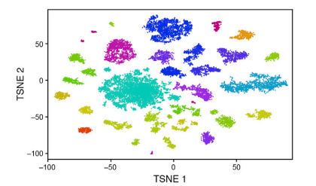
Starting point/input
49,300 cells
49,300 cells
49,300 cells
24,685
genes
Library size
normalization
24,685
genes
Log transformation
24,685
genes
(97% sparse)
(97% sparse)
(97% sparse)
Filter cells
13,115 cells
24,685
genes
13,115 cells
13,115 cells
tSNE
13,115 cells
Filter genes
384
genes
PCA
32
PCs
2D
(88% sparse)
tSNE dimension reduction to from 32 PCs to 2D

Slide 14
Starting point/input
49,300 cells
49,300 cells
49,300 cells
24,685
genes
Library size
normalization
24,685
genes
Log transformation
24,685
genes
(97% sparse)
(97% sparse)
(97% sparse)
Filter cells
13,115 cells
24,685
genes
13,115 cells
13,115 cells
tSNE
13,115 cells
Filter genes
384
genes
PCA
32
PCs
2D
(88% sparse)
Map removed
cells
49,300 cells
2D
Use a probability model same as the tSNE formulation to compute the most likely position for each new cell independently, given the already visualized 13,115 cells

Slide 15
Starting point/input
49,300 cells
49,300 cells
49,300 cells
24,685
genes
Library size
normalization
24,685
genes
Log transformation
24,685
genes
(97% sparse)
(97% sparse)
(97% sparse)
Filter cells
13,115 cells
24,685
genes
13,115 cells
13,115 cells
tSNE
13,115 cells
Filter genes
384
genes
PCA
32
PCs
2D
(88% sparse)
Map removed
cells
Heuristic merging
based on differentially
expressed genes
49,300 cells
Density based
clustering
2D
49 clusters
39 clusters
Density based clustering applied to 2D tSNE space, and find 49 clusters
Find differentially expressed genes between each pair of clusters, merge clusters with less than 10 differentially expressed genes, obtain 39 clusters

Slide 16
Starting point/input
49,300 cells
49,300 cells
49,300 cells
24,685
genes
Library size
normalization
24,685
genes
Log transformation
24,685
genes
(97% sparse)
(97% sparse)
(97% sparse)
Filter cells
13,115 cells
24,685
genes
13,115 cells
13,115 cells
tSNE
13,115 cells
Filter genes
384
genes
PCA
32
PCs
2D
(88% sparse)
Map removed
cells
Heuristic merging
based on differentially
expressed genes
Density based
clustering
Interpret the
biology
49,300 cells
2D
49 clusters
39 clusters

Slide 17
How they did it?
Start from 24,685 genes * 49,300 cells
Library size normalization (per cell, divide by total UMI and multiply by 10,000)
Log transformation - log(X+1)
Keep cells with >900 genes detected, obtain 24,685 genes * 13,115 cells
Filter out genes with low variance, obtain 384 genes * 13,115 cells (88% zero)
PCA dimension reduction to 32 dimensions, obtain 32 PC * 13,115 cells
tSNE dimension reduction to 2D, 2*13,115
Map the cells thrown away previously onto the 2D tSNE space, 2*44,808
Density based cluster on 2D, and find 49 clusters
Find differentially expressed genes between each pair of clusters, merge clusters with less than 10 differentially expressed genes, obtain 39 clusters
Done and interpret the 39 clusters

Slide 18
Seurat pipeline
Start from 24,685 genes * 49,300 cells
Library size normalization (per cell, divide by total UMI and multiply by 10,000)
Log transformation - log(X+1)
Keep cells with >900 genes detected, obtain 24,685 genes * 13,115 cells
Filter out genes with low variance, obtain 384 genes * 13,115 cells (88% zero)
PCA dimension reduction to 32 dimensions, obtain 32 PC * 13,115 cells
tSNE dimension reduction to 2D, 2*13,115
Map the cells thrown away previously onto the 2D tSNE space, 2*44,808
KNN->SNN (using the PCA embedding) + Louvain to cluster the graph
Find differentially expressed genes between each pair of clusters, merge clusters with less than 10 differentially expressed genes, obtain 39 clusters
Done and interpret the 39 clusters

Slide 19
Starting point/input
49,300 cells
49,300 cells
49,300 cells
24,685
genes
Library size
normalization
24,685
genes
Log transformation
24,685
genes
(97% sparse)
(97% sparse)
(97% sparse)
Filter cells
13,115 cells
24,685
genes
13,115 cells
13,115 cells
tSNE
13,115 cells
Filter genes
384
genes
PCA
32
PCs
2D
(88% sparse)
Map removed
cells
Heuristic merging
based on differentially
expressed genes
Density based
clustering
Interpret the
biology
49,300 cells
2D
49 clusters
39 clusters

