Slide 1
Summer Institutes of Statistical Genetics, 2023
SISG Module 6: Gene Expression Profiling
Lecture 07: Clustering, Trajectory Inference and Geometric Properties in scRNAseq
Peng Qiu and Greg Gibson
Georgia Institute of Technology

Slide 2
Topics
Clustering
Trajectory inference
Geometric property of data

Slide 3
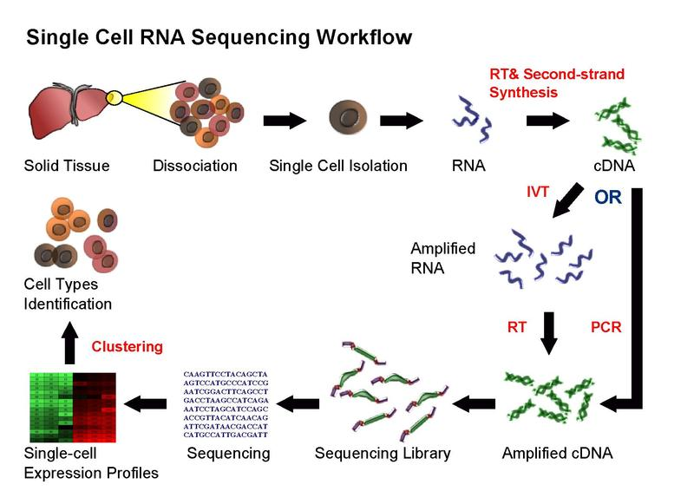
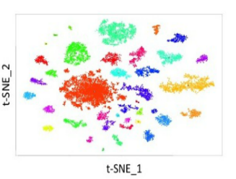
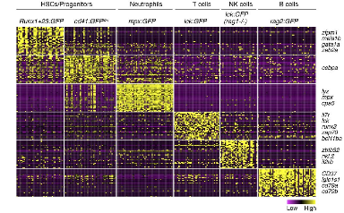
Clustering algorithm

Slide 4
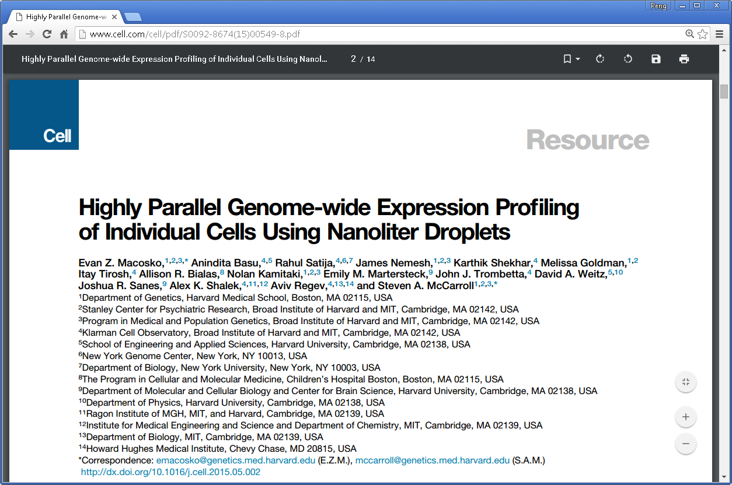

Clustering algorithm
https://satijalab.org/seurat/v3.0/pbmc3k_tutorial.html

Slide 5
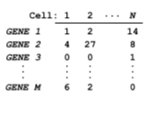
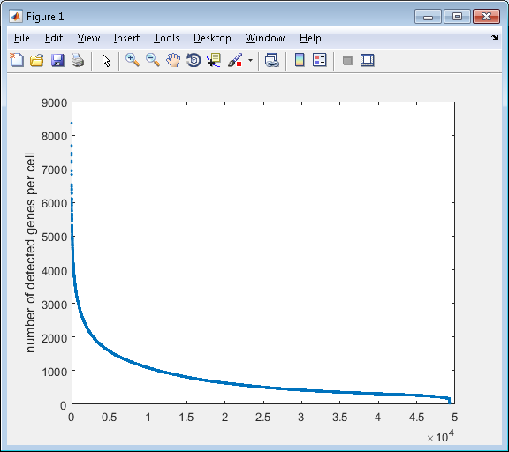
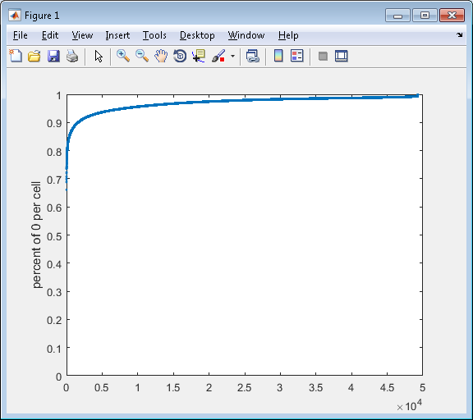
Challenge in analysis of scRNA-seq data – dropouts
97% of the data is 0

Slide 6
Starting point/input
49,300 cells
24,685
genes
(97% sparse)

Slide 7
Starting point/input
49,300 cells
49,300 cells
24,685
genes
Library size
normalization
24,685
genes
(97% sparse)
(97% sparse)
Library size normalization (per cell, divide by total UMI and multiply by 10,000)

Slide 8
Starting point/input
49,300 cells
49,300 cells
49,300 cells
24,685
genes
Library size
normalization
24,685
genes
Log transformation
24,685
genes
(97% sparse)
(97% sparse)
(97% sparse)
Log transformation - log(X+1)

Slide 9
Starting point/input
49,300 cells
49,300 cells
49,300 cells
24,685
genes
Library size
normalization
24,685
genes
Log transformation
24,685
genes
(97% sparse)
(97% sparse)
(97% sparse)
Filter cells
13,115 cells
24,685
genes
Keep cells with >900 genes detected, obtain 24,685 genes * 13,115 cells

Slide 10
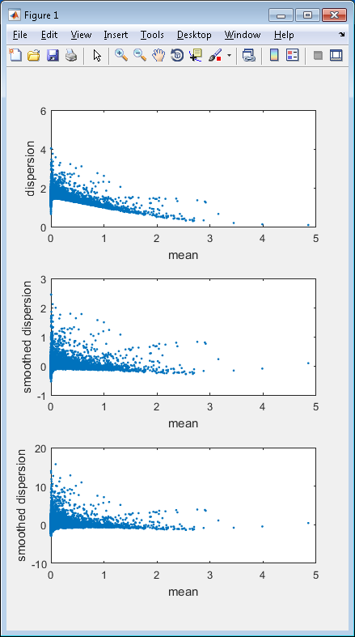
Starting point/input
49,300 cells
49,300 cells
49,300 cells
24,685
genes
Library size
normalization
24,685
genes
Log transformation
24,685
genes
(97% sparse)
(97% sparse)
(97% sparse)
Filter cells
13,115 cells
24,685
genes
Highly variable
genes
13,115 cells
384
genes
(88% sparse)
Filter out genes with low variance, obtain 384 genes * 13,115 cells

Slide 11
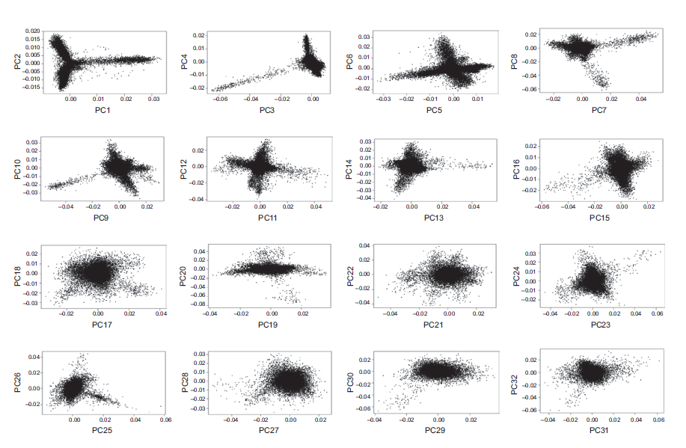
Starting point/input
49,300 cells
49,300 cells
49,300 cells
24,685
genes
Library size
normalization
24,685
genes
Log transformation
24,685
genes
(97% sparse)
(97% sparse)
(97% sparse)
Filter cells
13,115 cells
24,685
genes
Highly variable
genes
13,115 cells
13,115 cells
384
genes
PCA
32
PCs
(88% sparse)
PCA dimension reduction to 32 dimensions
number of PC determined by JackStraw procedure

Slide 12
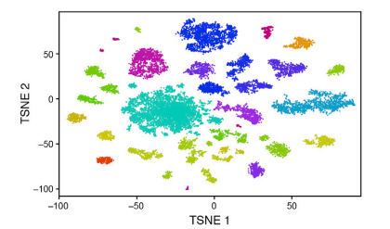
Starting point/input
49,300 cells
49,300 cells
49,300 cells
24,685
genes
Library size
normalization
24,685
genes
Log transformation
24,685
genes
(97% sparse)
(97% sparse)
(97% sparse)
Filter cells
13,115 cells
24,685
genes
Highly variable
genes
13,115 cells
13,115 cells
tSNE
13,115 cells
384
genes
PCA
32
PCs
2D
(88% sparse)
tSNE dimension reduction to from 32 PCs to 2D

Slide 13
Starting point/input
49,300 cells
49,300 cells
49,300 cells
24,685
genes
Library size
normalization
24,685
genes
Log transformation
24,685
genes
(97% sparse)
(97% sparse)
(97% sparse)
Filter cells
13,115 cells
24,685
genes
Highly variable
genes
13,115 cells
13,115 cells
tSNE
13,115 cells
384
genes
PCA
32
PCs
2D
(88% sparse)
Map removed
cells
49,300 cells
2D
Use a probability model same as the tSNE formulation to compute the most likely position for each new cell independently, given the already visualized 13,115 cells

Slide 14
Starting point/input
49,300 cells
49,300 cells
49,300 cells
24,685
genes
Library size
normalization
24,685
genes
Log transformation
24,685
genes
(97% sparse)
(97% sparse)
(97% sparse)
Filter cells
13,115 cells
24,685
genes
Highly variable
genes
13,115 cells
13,115 cells
tSNE
13,115 cells
384
genes
PCA
32
PCs
2D
(88% sparse)
Map removed
cells
Heuristic merging
based on differentially
expressed genes
49,300 cells
Density based
clustering
2D
49 clusters
39 clusters
Density based clustering applied to 2D tSNE space, and find 49 clusters
Find differentially expressed genes between each pair of clusters, merge clusters with less than 10 differentially expressed genes, obtain 39 clusters

Slide 15
Seurat today
Starting point/input
49,300 cells
49,300 cells
49,300 cells
24,685
genes
Library size
normalization
24,685
genes
Log transformation
24,685
genes
(97% sparse)
(97% sparse)
(97% sparse)
Filter cells and genes
13,115 cells
24,685
genes
Highly variable
genes
13,115 cells
13,115 cells
UMAP
13,115 cells
2000
genes
PCA
10~30
PCs
2D
Clustering by
SNN graph +
community finding
(maybe also heuristic merging)
39 clusters

Slide 16
Topics
Clustering
Trajectory inference
Geometric property of data

Slide 17
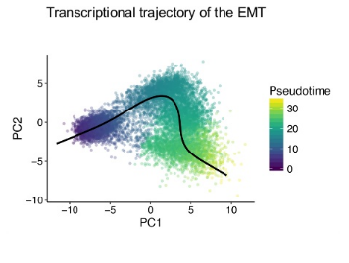
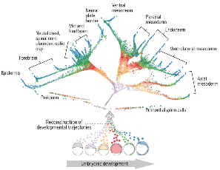
Trajectory finding (DPT)

Slide 18
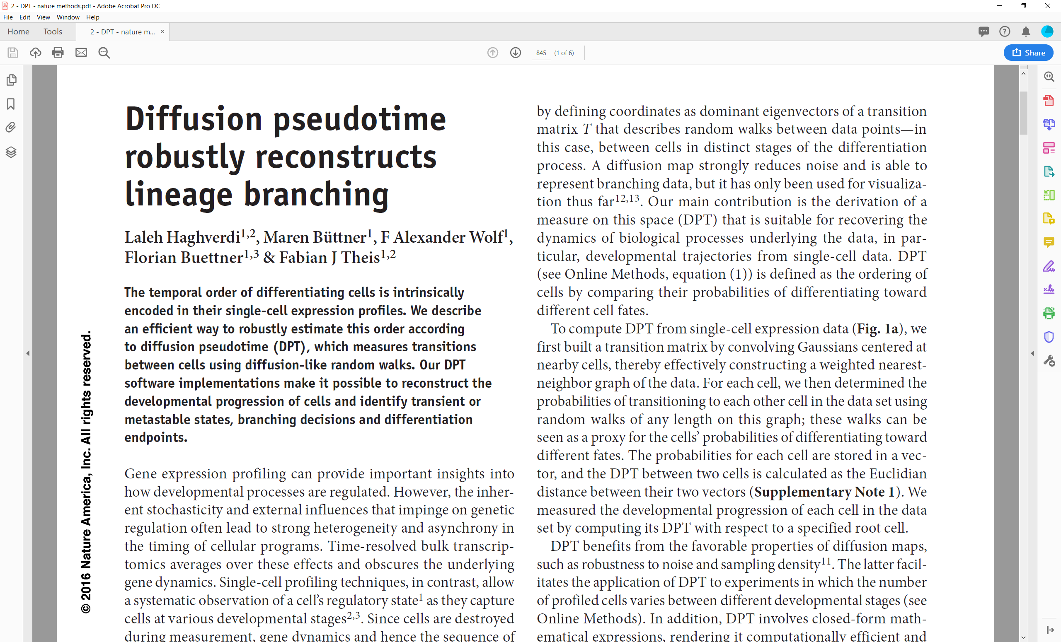

Slide 19
DPT pipeline – defining diffusion pseudo time
Starting point/input: preprocessed scRNAseq data
(Preprocessing options: library size normalization,
log transformation, cell cycle normalization)
cells
genes

Slide 20

DPT pipeline – defining diffusion pseudo time
Starting point/input: preprocessed scRNAseq data
(Preprocessing options: library size normalization,
log transformation, cell cycle normalization)
cells
cells
genes
Euclidean
distance
cells
$$d(x,y)$$

Slide 21

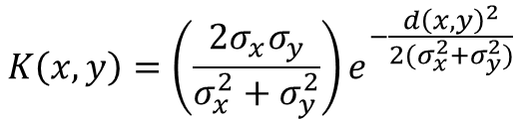
DPT pipeline – defining diffusion pseudo time
Starting point/input: preprocessed scRNAseq data
(Preprocessing options: library size normalization,
log transformation, cell cycle normalization)
cells
cells
cells
genes
Euclidean
distance
cells
Compute
affinity
cells
$$d(x,y)$$
$$K(x,y)$$
$$K\left(x,y\right)=\left(\frac{2σ_{x}σ_{y}}{σ_{x}^{2}+σ_{y}^{2}}\right)e^{−\frac{d{\left(x,y\right)}^{2}}{2(σ_{x}^{2}+σ_{y}^{2})}}$$
$σ_{x}$ is the distance between $x$ and its k^{th} nearest neighbor

Slide 22



DPT pipeline – defining diffusion pseudo time
Starting point/input: preprocessed scRNAseq data
(Preprocessing options: library size normalization,
log transformation, cell cycle normalization)
cells
cells
cells
cells
genes
Euclidean
distance
cells
Compute
affinity
cells
Normalize
by density
cells
$$d(x,y)$$
$$K(x,y)$$
$$W(x,y)$$
$$W\left(x,y\right)=\frac{K(x,y)}{Z\left(x\right)Z(y)}$$
$Z\left(x\right)$ is the row sum of $x$’s row of $K$

Slide 23
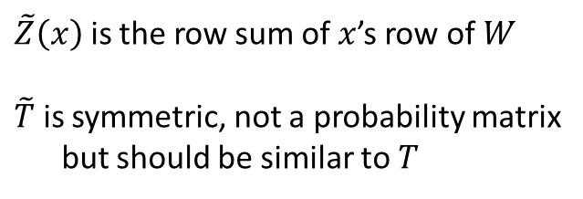
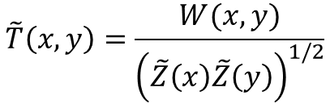

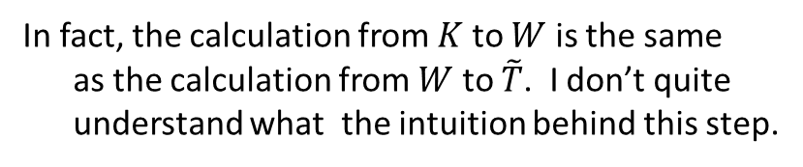
DPT pipeline – defining diffusion pseudo time
Starting point/input: preprocessed scRNAseq data
(Preprocessing options: library size normalization,
log transformation, cell cycle normalization)
cells
cells
cells
cells
genes
Euclidean
distance
cells
Compute
affinity
cells
Normalize
by density
cells
$$d(x,y)$$
$$K(x,y)$$
$$W(x,y)$$
Further normalization
cells
cells
$$\tilde{T}\left(x,y\right)=\frac{W(x,y)}{{\left(\tilde{Z}\left(x\right)\tilde{Z}\left(y\right)\right)}^{1/2}}$$
$$\tilde{T}(x,y)$$
$\tilde{Z}\left(x\right)$ is the row sum of $x$’s row of $W$
$\tilde{T}$ is symmetric, not a probability matrix
but should be similar to $T$
In fact, the calculation from $K$ to $W$ is the same
as the calculation from $W$ to $\tilde{T}$. I don’t quite
understand what the intuition behind this step.

Slide 24
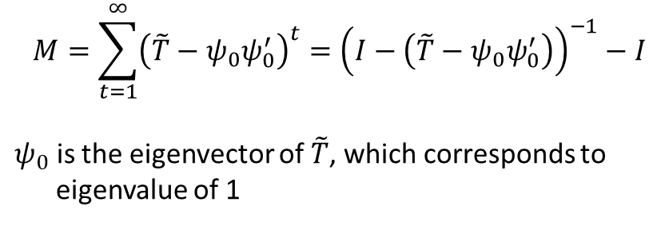

DPT pipeline – defining diffusion pseudo time
Starting point/input: preprocessed scRNAseq data
(Preprocessing options: library size normalization,
log transformation, cell cycle normalization)
cells
cells
cells
cells
genes
Euclidean
distance
cells
Compute
affinity
cells
Normalize
by density
cells
$$d(x,y)$$
$$K(x,y)$$
$$W(x,y)$$
Further normalization
cells
cells
cells
Compute
diffusion
cells
$$\tilde{T}(x,y)$$
$$M(x,y)$$
$$M=\sum_{t=1}^{∞}{{\left(\tilde{T}−ψ_{0}ψ_{0}^{′}\right)}^{t}}={\left(I−\left(\tilde{T}−ψ_{0}ψ_{0}^{′}\right)\right)}^{−1}−I$$
$ψ_{0}$ is the eigenvector of $\tilde{T}$, which corresponds to
eigenvalue of 1

Slide 25


DPT pipeline – defining diffusion pseudo time
Starting point/input: preprocessed scRNAseq data
(Preprocessing options: library size normalization,
log transformation, cell cycle normalization)
cells
cells
cells
cells
genes
Euclidean
distance
cells
Compute
affinity
cells
Normalize
by density
cells
$$d(x,y)$$
$$K(x,y)$$
$$W(x,y)$$
Further normalization
cells
cells
cells
cells
Compute
diffusion
cells
Compute
cells
$$\tilde{T}(x,y)$$
$$M(x,y)$$
$$dpt(x,y)$$
$$dpt(x,y)={\left\|M\left(x,:\right)−M(y,:)\right\|}^{2}$$

Slide 26
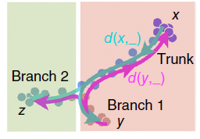
DPT pipeline – defining diffusion pseudo time
Starting point/input: preprocessed scRNAseq data
(Preprocessing options: library size normalization,
log transformation, cell cycle normalization)
cells
cells
cells
cells
genes
Euclidean
distance
cells
Compute
affinity
cells
Normalize
by density
cells
$$d(x,y)$$
$$K(x,y)$$
$$W(x,y)$$
Further normalization
cells
cells
cells
cells
Compute
diffusion
cells
Compute
cells
$$\tilde{T}(x,y)$$
$$M(x,y)$$
$$dpt(x,y)$$
A heuristic to find trajectories
Trajectory:
- Number of branches,
- Which cells belong to which branch
- Which cells represent distal end of each branch
- Which cells represent branching points
Haghverdi, L., et al, Nature Methods, 2016

Slide 27


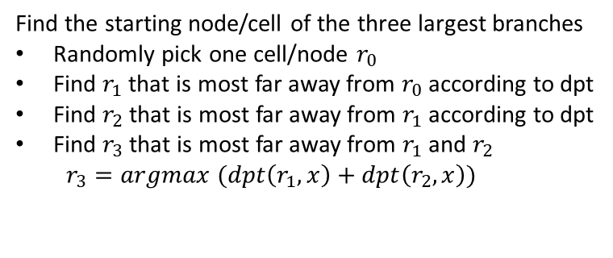


DPT pipeline – finding branching points
cells
cells
Find the starting node/cell of the three largest branches
Randomly pick one cell/node $r_{0}$
Find $r_{1}$ that is most far away from $r_{0}$ according to dpt
Find $r_{2}$ that is most far away from $r_{1}$ according to dpt
Find $r_{3}$ that is most far away from $r_{1}$ and $r_{2}$
$r_{3}=argmax (dpt\left(r_{1},x\right)+dpt\left(r_{2},x\right))$
$$dpt(i,j)$$
A heuristic
to find
trajectories
Trajectory:
- Number of branches,
- Which cells belong to which branch
- Which cells represent distal end of each branch
- Which cells represent branching points
$$r_{1}$$
$$r_{2}$$
$$r_{3}$$

Slide 28

DPT pipeline – finding branching points
cells
cells
Find the starting node/cell of the three largest branches
Randomly pick one cell/node $r_{0}$
Find $r_{1}$ that is most far away from $r_{0}$ according to dpt
Find $r_{2}$ that is most far away from $r_{1}$ according to dpt
Find $r_{3}$ that is most far away from $r_{1}$ and $r_{2}$
$r_{3}=argmax (dpt\left(r_{1},x\right)+dpt\left(r_{2},x\right))$
$$dpt(i,j)$$
A heuristic
to find
trajectories
Compute the diffusion pseudo time of all points from each of the three starting node
Trajectory:
- Number of branches,
- Which cells belong to which branch
- Which cells represent distal end of each branch
- Which cells represent branching points
$$r_{1}$$
1
2
3
15
17
18
4
13
$$r_{2}$$
5
11
6
7
8
9
10
12
14
16
$$r_{3}$$
$$O_{1}$$

Slide 29



DPT pipeline – finding branching points
cells
cells
Find the starting node/cell of the three largest branches
Randomly pick one cell/node $r_{0}$
Find $r_{1}$ that is most far away from $r_{0}$ according to dpt
Find $r_{2}$ that is most far away from $r_{1}$ according to dpt
Find $r_{3}$ that is most far away from $r_{1}$ and $r_{2}$
$r_{3}=argmax (dpt\left(r_{1},x\right)+dpt\left(r_{2},x\right))$
$$dpt(i,j)$$
A heuristic
to find
trajectories
Compute the diffusion pseudo time of all points from each of the three starting node
Trajectory:
- Number of branches,
- Which cells belong to which branch
- Which cells represent distal end of each branch
- Which cells represent branching points
$$r_{1}$$
1
2
3
15
17
18
$$r_{1}$$
18
17
2
1
$$r_{2}$$
4
13
$$r_{2}$$
16
3
5
14
4
6
11
12
5
7
9
10
6
8
8
7
10
9
12
11
14
13
16
15
$$r_{3}$$
$$r_{3}$$
$$O_{1}$$
$$O_{2}$$

Slide 30


DPT pipeline – finding branching points
cells
cells
Find the starting node/cell of the three largest branches
Randomly pick one cell/node $r_{0}$
Find $r_{1}$ that is most far away from $r_{0}$ according to dpt
Find $r_{2}$ that is most far away from $r_{1}$ according to dpt
Find $r_{3}$ that is most far away from $r_{1}$ and $r_{2}$
$r_{3}=argmax (dpt\left(r_{1},x\right)+dpt\left(r_{2},x\right))$
$$dpt(i,j)$$
A heuristic
to find
trajectories
Compute the diffusion pseudo time of all points from each of the three starting node
Trajectory:
- Number of branches,
- Which cells belong to which branch
- Which cells represent distal end of each branch
- Which cells represent branching points
$$r_{1}$$
1
2
3
15
17
18
$$r_{1}$$
18
17
2
1
$$r_{2}$$
$$r_{1}$$
18
16
15
17
4
13
$$r_{2}$$
16
3
14
13
$$r_{2}$$
5
14
4
12
11
6
11
12
5
10
7
9
10
6
8
9
8
8
6
7
7
5
10
9
4
12
11
3
14
13
2
16
15
1
$$r_{3}$$
$$r_{3}$$
$$r_{3}$$
$$O_{1}$$
$$O_{2}$$
$$O_{3}$$

Slide 31
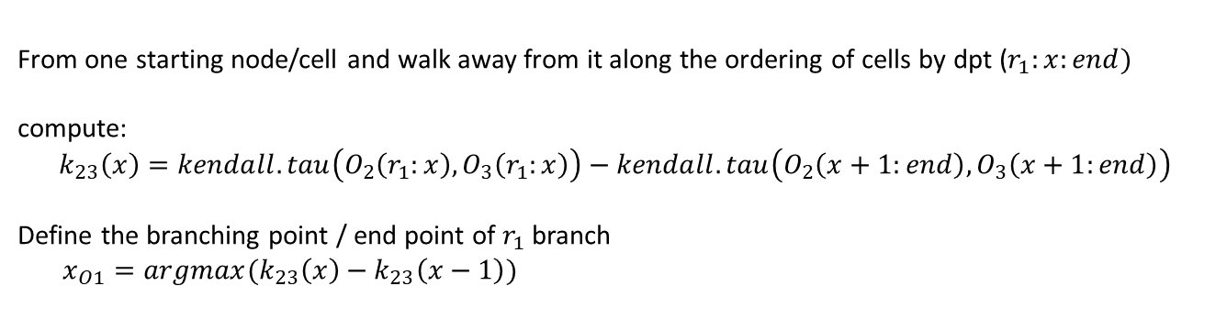
DPT pipeline – finding branching points
cells
cells
Find the starting node/cell of the three largest branches
Randomly pick one cell/node $r_{0}$
Find $r_{1}$ that is most far away from $r_{0}$ according to dpt
Find $r_{2}$ that is most far away from $r_{1}$ according to dpt
Find $r_{3}$ that is most far away from $r_{1}$ and $r_{2}$
$r_{3}=argmax (dpt\left(r_{1},x\right)+dpt\left(r_{2},x\right))$
$$dpt(i,j)$$
A heuristic
to find
trajectories
Compute the diffusion pseudo time of all points from each of the three starting node
Trajectory:
- Number of branches,
- Which cells belong to which branch
- Which cells represent distal end of each branch
- Which cells represent branching points
From one starting node/cell and walk away from it along the ordering of cells by dpt ($r_{1}:x:end)$
compute:
$$k_{23}\left(x\right)=kendall.tau\left(O_{2}\left(r_{1}:x\right),O_{3}\left(r_{1}:x\right)\right)−kendall.tau\left(O_{2}\left(x+1:end\right),O_{3}\left(x+1:end\right)\right)$$
Define the branching point / end point of $r_{1}$ branch
$x_{O1}=argmax(k_{23}\left(x\right)−k_{23}\left(x−1\right))$
$$r_{1}$$
1
2
3
15
17
18
$$r_{1}$$
18
17
2
1
$$r_{2}$$
$$r_{1}$$
18
16
15
17
4
13
$$r_{2}$$
16
3
14
13
$$r_{2}$$
5
14
4
12
11
6
11
12
5
10
7
9
10
6
8
9
8
8
6
7
7
5
10
9
4
12
11
3
14
13
2
16
15
1
$$r_{3}$$
$$r_{3}$$
$$r_{3}$$
$$O_{1}$$
$$O_{2}$$
$$O_{3}$$

Slide 32
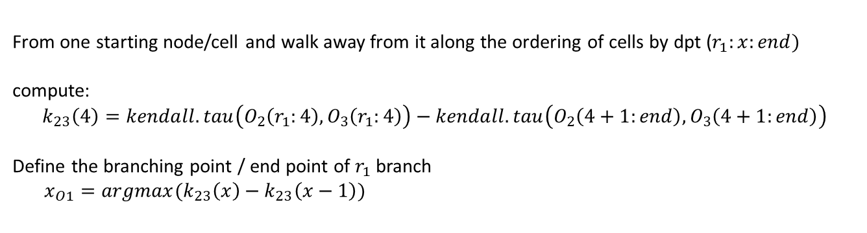
DPT pipeline – finding branching points
cells
cells
Find the starting node/cell of the three largest branches
Randomly pick one cell/node $r_{0}$
Find $r_{1}$ that is most far away from $r_{0}$ according to dpt
Find $r_{2}$ that is most far away from $r_{1}$ according to dpt
Find $r_{3}$ that is most far away from $r_{1}$ and $r_{2}$
$r_{3}=argmax (dpt\left(r_{1},x\right)+dpt\left(r_{2},x\right))$
$$dpt(i,j)$$
A heuristic
to find
trajectories
Compute the diffusion pseudo time of all points from each of the three starting node
Trajectory:
- Number of branches,
- Which cells belong to which branch
- Which cells represent distal end of each branch
- Which cells represent branching points
From one starting node/cell and walk away from it along the ordering of cells by dpt ($r_{1}:x:end)$
compute:
$$k_{23}\left(4\right)=kendall.tau\left(O_{2}\left(r_{1}:4\right),O_{3}\left(r_{1}:4\right)\right)−kendall.tau\left(O_{2}\left(4+1:end\right),O_{3}\left(4+1:end\right)\right)$$
Define the branching point / end point of $r_{1}$ branch
$x_{O1}=argmax(k_{23}\left(x\right)−k_{23}\left(x−1\right))$
18 17 16 14
18 16 14 12
12 10 8 7 6 9 5 11 4 13 3 15 2 1
10 8 6 5 7 4 9 3 11 2 13 1 15 17
$$r_{1}$$
1
2
3
15
17
18
$$r_{1}$$
18
17
2
1
$$r_{2}$$
$$r_{1}$$
18
16
15
17
4
13
$$r_{2}$$
16
3
14
13
$$r_{2}$$
5
14
4
12
11
6
11
12
5
10
7
9
10
6
8
9
8
8
6
7
7
5
10
9
4
12
11
3
14
13
2
16
15
1
$$r_{3}$$
$$r_{3}$$
$$r_{3}$$
$$O_{1}$$
$$O_{2}$$
$$O_{3}$$

Slide 33
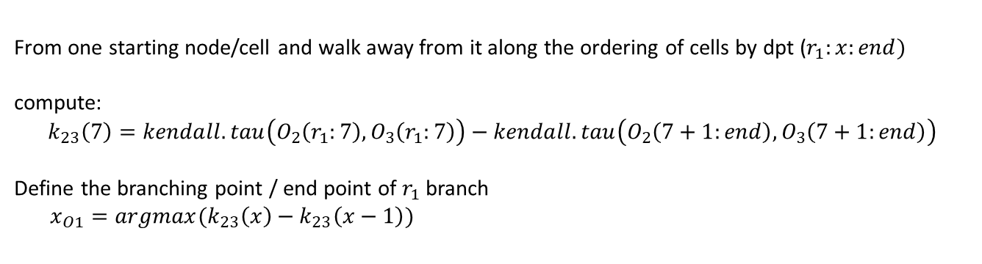
DPT pipeline – finding branching points
cells
cells
Find the starting node/cell of the three largest branches
Randomly pick one cell/node $r_{0}$
Find $r_{1}$ that is most far away from $r_{0}$ according to dpt
Find $r_{2}$ that is most far away from $r_{1}$ according to dpt
Find $r_{3}$ that is most far away from $r_{1}$ and $r_{2}$
$r_{3}=argmax (dpt\left(r_{1},x\right)+dpt\left(r_{2},x\right))$
$$dpt(i,j)$$
A heuristic
to find
trajectories
Compute the diffusion pseudo time of all points from each of the three starting node
Trajectory:
- Number of branches,
- Which cells belong to which branch
- Which cells represent distal end of each branch
- Which cells represent branching points
From one starting node/cell and walk away from it along the ordering of cells by dpt ($r_{1}:x:end)$
compute:
$$k_{23}\left(7\right)=kendall.tau\left(O_{2}\left(r_{1}:7\right),O_{3}\left(r_{1}:7\right)\right)−kendall.tau\left(O_{2}\left(7+1:end\right),O_{3}\left(7+1:end\right)\right)$$
Define the branching point / end point of $r_{1}$ branch
$x_{O1}=argmax(k_{23}\left(x\right)−k_{23}\left(x−1\right))$
18 17 16 14 12 10 8
18 16 14 12 10 8 6
7 6 9 5 11 4 13 3 15 2 1
5 7 4 9 3 11 2 13 1 15 17
$$r_{1}$$
1
2
3
15
17
18
$$r_{1}$$
18
17
2
1
$$r_{2}$$
$$r_{1}$$
18
16
15
17
4
13
$$r_{2}$$
16
3
14
13
$$r_{2}$$
5
14
4
12
11
6
11
12
5
10
7
9
10
6
8
9
8
8
6
7
7
5
10
9
4
12
11
3
14
13
2
16
15
1
$$r_{3}$$
$$r_{3}$$
$$r_{3}$$
$$O_{1}$$
$$O_{2}$$
$$O_{3}$$
Notes:
There may be unassigned nodes.

Slide 34
DPT pipeline – finding branching points
cells
cells
Find the starting node/cell of the three largest branches
Randomly pick one cell/node $r_{0}$
Find $r_{1}$ that is most far away from $r_{0}$ according to dpt
Find $r_{2}$ that is most far away from $r_{1}$ according to dpt
Find $r_{3}$ that is most far away from $r_{1}$ and $r_{2}$
$r_{3}=argmax (dpt\left(r_{1},x\right)+dpt\left(r_{2},x\right))$
$$dpt(i,j)$$
A heuristic
to find
trajectories
Compute the diffusion pseudo time of all points from each of the three starting node
Trajectory:
- Number of branches,
- Which cells belong to which branch
- Which cells represent distal end of each branch
- Which cells represent branching points
From one starting node/cell and walk away from it along the ordering of cells by dpt ($r_{1}:x:end)$
compute:
$$k_{23}\left(x\right)=kendall.tau\left(O_{2}\left(r_{1}:x\right),O_{3}\left(r_{1}:x\right)\right)−kendall.tau\left(O_{2}\left(x+1:end\right),O_{3}\left(x+1:end\right)\right)$$
Define the branching point / end point of $r_{1}$ branch
$x_{O1}=argmax(k_{23}\left(x\right)−k_{23}\left(x−1\right))$
Repeat this for each of the three starting node/cell to identify cells that belong to each of the three branch.

Slide 35
DPT pipeline – finding branching points
cells
cells
Find the starting node/cell of the three largest branches
Randomly pick one cell/node $r_{0}$
Find $r_{1}$ that is most far away from $r_{0}$ according to dpt
Find $r_{2}$ that is most far away from $r_{1}$ according to dpt
Find $r_{3}$ that is most far away from $r_{1}$ and $r_{2}$
$r_{3}=argmax (dpt\left(r_{1},x\right)+dpt\left(r_{2},x\right))$
$$dpt(i,j)$$
A heuristic
to find
trajectories
Compute the diffusion pseudo time of all points from each of the three starting node
Trajectory:
- Number of branches,
- Which cells belong to which branch
- Which cells represent distal end of each branch
- Which cells represent branching points
From one starting node/cell and walk away from it along the ordering of cells by dpt ($r_{1}:x:end)$
compute:
$$k_{23}\left(x\right)=kendall.tau\left(O_{2}\left(r_{1}:x\right),O_{3}\left(r_{1}:x\right)\right)−kendall.tau\left(O_{2}\left(x+1:end\right),O_{3}\left(x+1:end\right)\right)$$
Define the branching point / end point of $r_{1}$ branch
$x_{O1}=argmax(k_{23}\left(x\right)−k_{23}\left(x−1\right))$
Repeat this for each of the three starting node/cell to identify cells that belong to each of the three branch.
Repeat all above for cells belonging to each of the three branches separately, to identify further smaller branches within each of the three branches

Slide 36
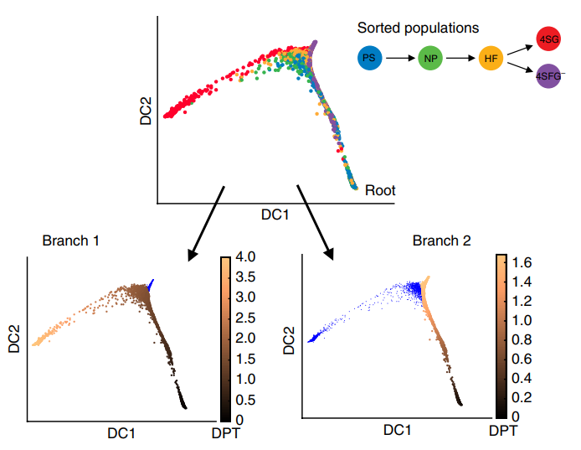
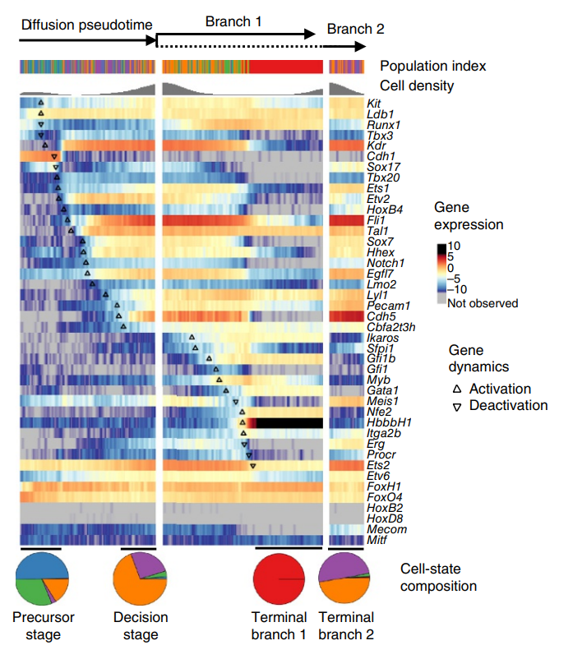
DPT pipeline

Slide 37
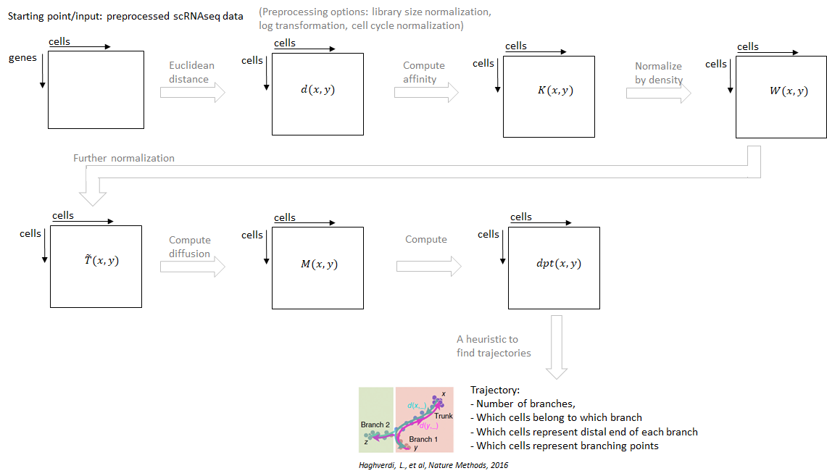
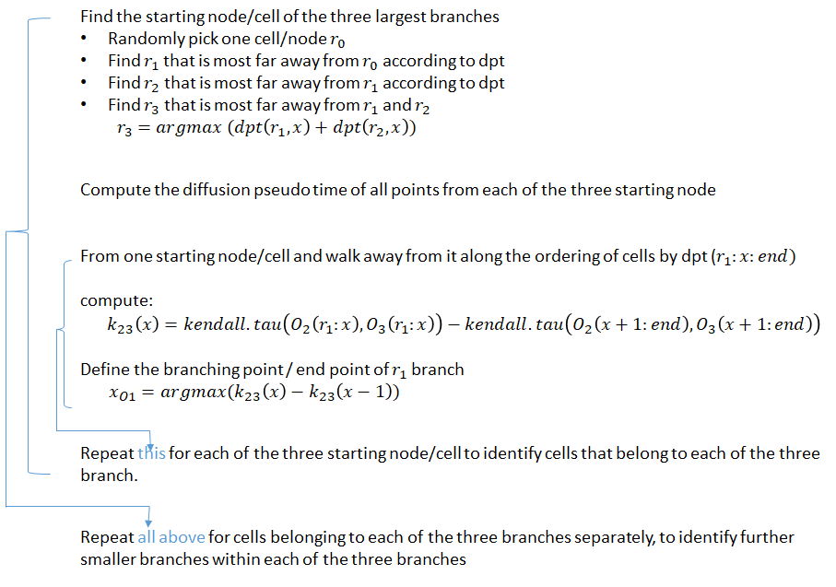
DPT pipeline

Slide 38
Topics
Clustering
Trajectory inference
Geometric property of data

Slide 39
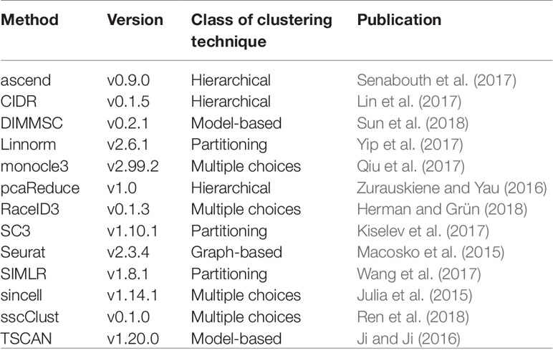
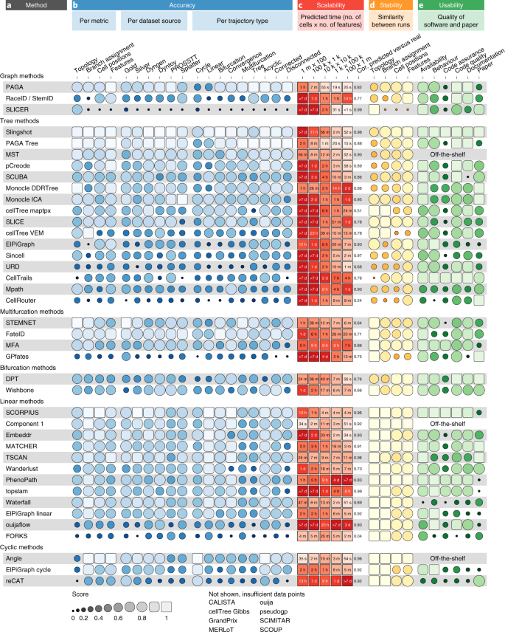
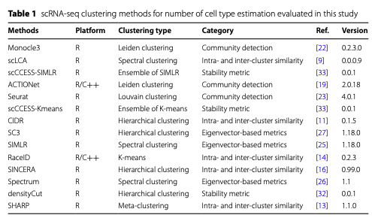
Many algorithms for clustering and trajectory inference
Krzak, Monika, et al. "Benchmark and parameter sensitivity analysis of single-cell RNA sequencing clustering methods." Frontiers in genetics 10 (2019): 1253.
Saelens, W., Cannoodt, R., Todorov, H. et al. A comparison of single-cell trajectory inference methods. Nat Biotechnol 37, 547–554 (2019). https://doi.org/10.1038/s41587-019-0071-9
Yu, L., Cao, Y., Yang, J.Y.H. et al. Benchmarking clustering algorithms on estimating the number of cell types from single-cell RNA-sequencing data. Genome Biol 23, 49.

Slide 40
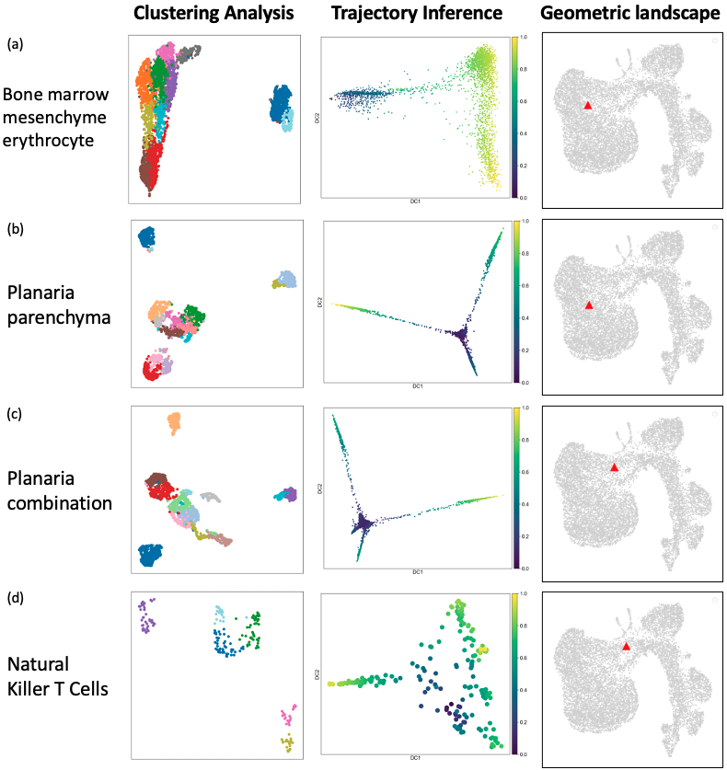
Key assumptions between clustering analysis & trajectory inference
are very different
Identify distinct cell types in heterogeneous cell population
Dataset contains clusters of cells where each cluster exhibits unique gene expression pattern different from other clusters
Minimizing intra-cluster differences while maximizing inter-cluster differences
Extracting continuum of changes representing dynamics changes of biological progressions
Dataset contains cells that represent the transitions among well-defined cellular states
Transitions are manifested as gradual changes in gene expression

Slide 41
Different type of algorithms may generate vastly different visualizations and interpretation

Slide 42
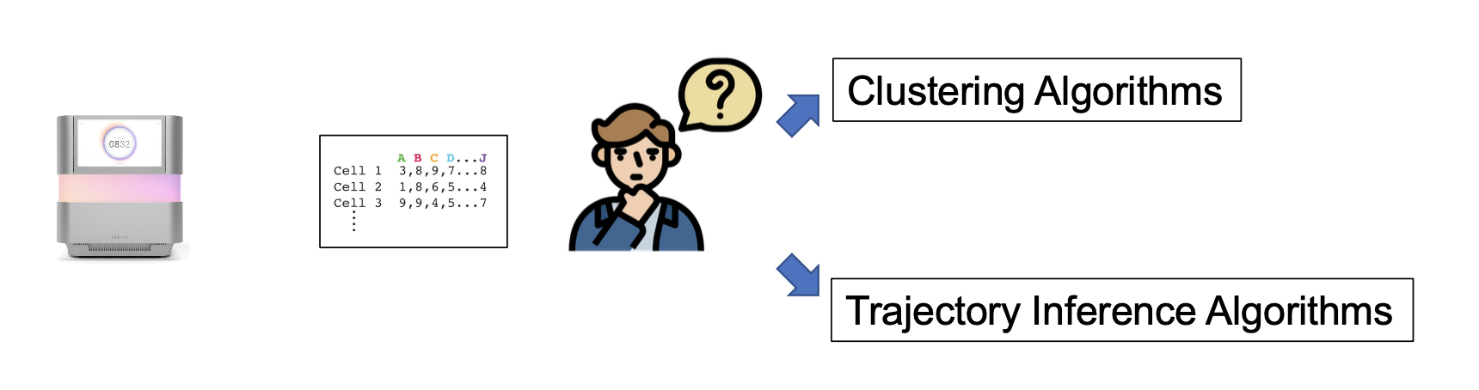
Can we quantify the geometry of a dataset,
cluster-like vs trajectory-like?
Main objective : to design multiple scores to quantify ‘clusterness’ and ‘trajectoriness’ of single-cell RNA-seq datah

Slide 43
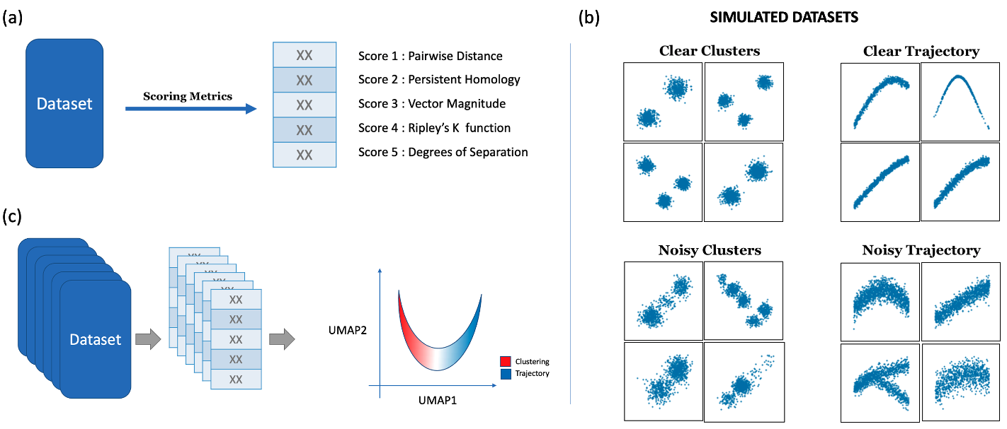
Simulate many datasets Develop scoring metrics to
of different geometry quantify geometry

Slide 44
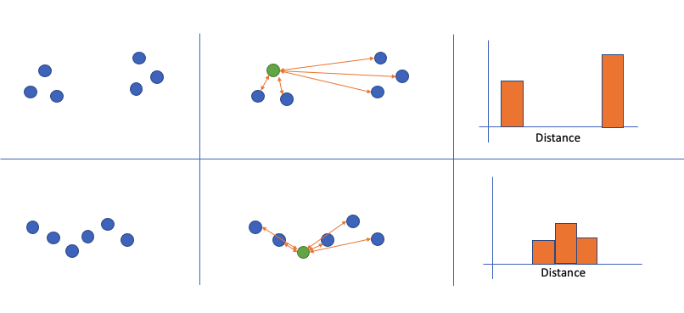
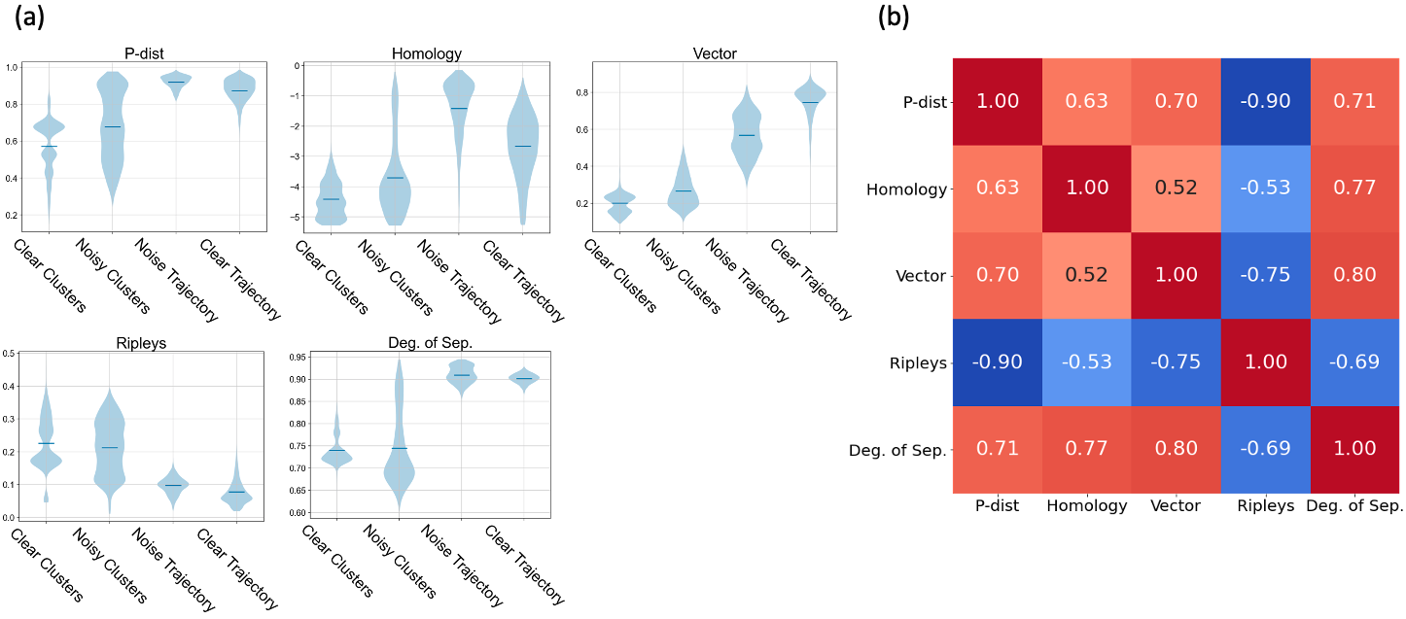
Metric 1 – distribution of pairwise distance
Distribution of cluster-like data should exhibit larger fluctuation
compared to trajectory-like data

Slide 45
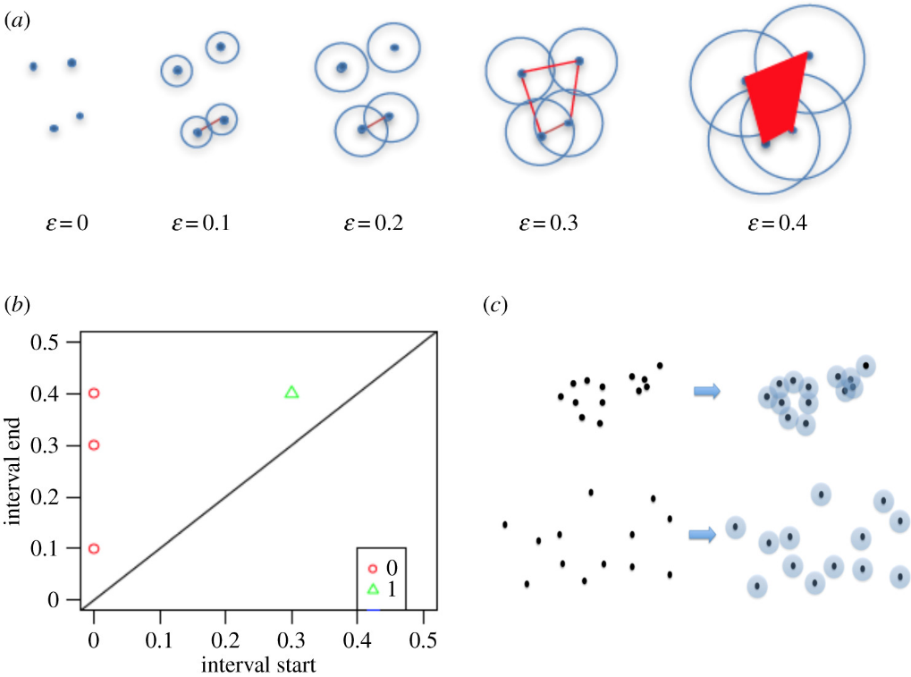
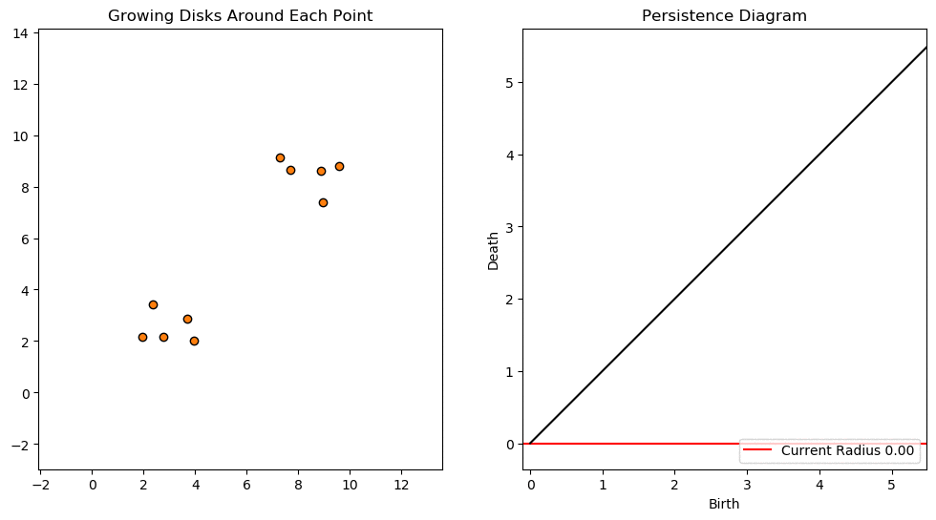
Metric 2 – persistent homology
Distribution of thresholds for the merges should be more spread out for cluster-like data, and should be uniformly distributed for trajectory-like data
https://towardsdatascience.com/persistent-homology-with-examples-1974d4b9c3d0

Slide 46
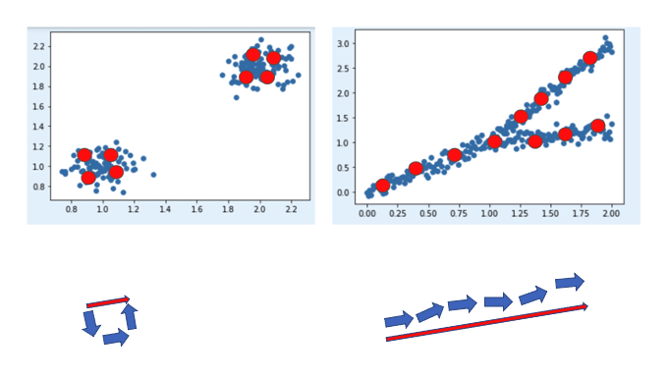
Metric 3 – vector magnitude
Trajectory-like datasets would have greater magnitude for the overall vector because trajectory-like datasets have strong directionality

Slide 47
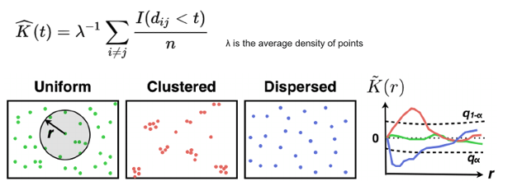
Metric 4 – Ripley’s k function
Since Ripley’s k is designed to detect the existence of clusters, area under the curve for the cluster-like datasets would be greater than the trajectory-like dataset

Slide 48
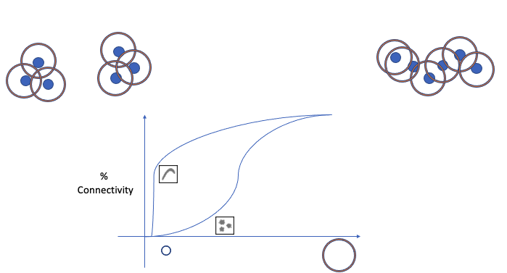
Metric 5 – degrees of separation
Cells could be potentially connected with many other cells even relatively smaller neighbor size for trajectory-like data

Slide 49
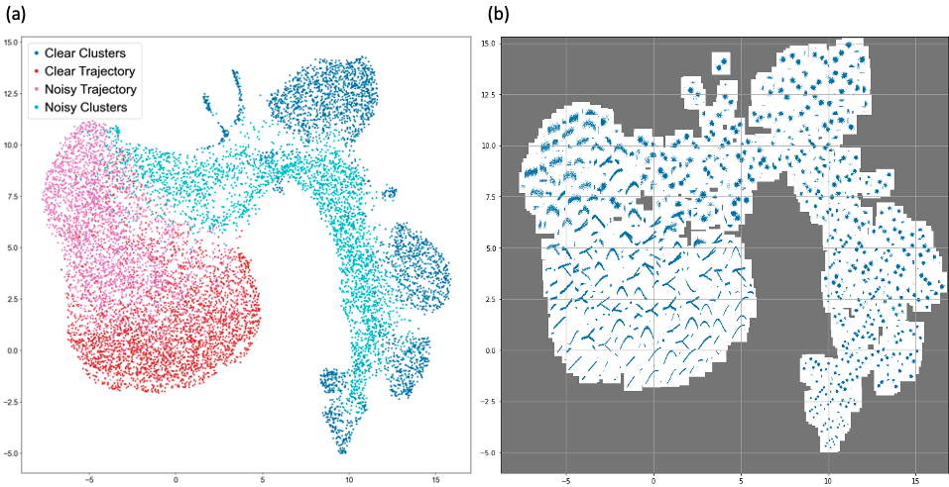
UMAP of proposed scores illustrates the landscape of geometric characteristics

Slide 50
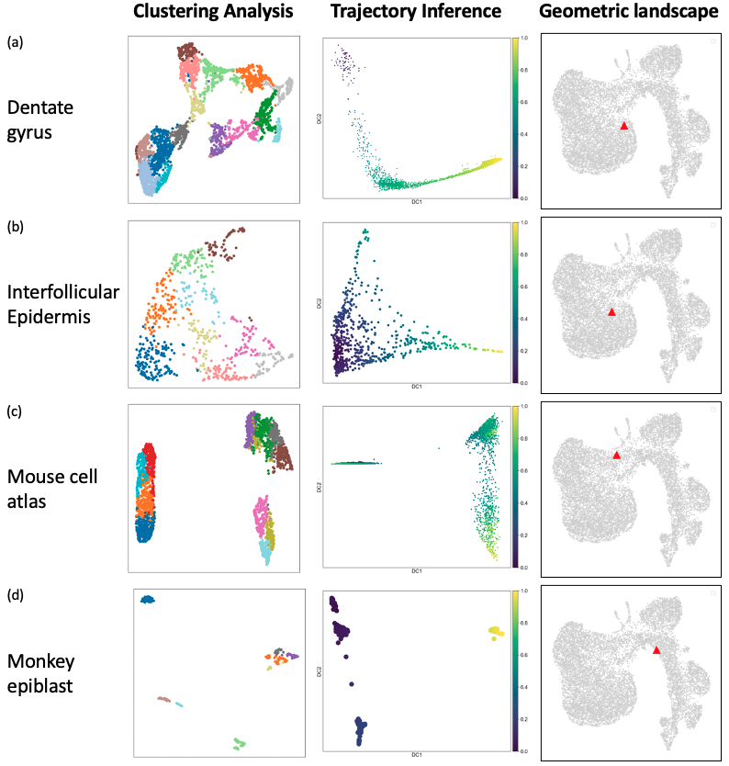
Mapping of scRNA-seq data to the geometric landscape helps understanding its characteristics

Slide 51
Mapping of scRNA-seq data to the geometric landscape helps understanding its characteristics

Slide 52
Mapping of scRNA-seq data to the geometric landscape helps understanding its characteristics

Slide 53
Mapping of scRNA-seq data to the geometric landscape helps understanding its characteristics

Slide 54
Take home messages
Choice of analysis approach (clustering and trajectory inference) can affect the interpretation of the data
In datasets where the expected geometry is known, it is good to follow your intuition
In datasets where we do not know what to expect, we want to be careful with choice of approach
It is possible to quantify the geometry of the data

