Slide 1
Summer Institutes of Statistical Genetics, 2020
SISG Module 6: Gene Expression Profiling
Lecture 08: Trajectory Finding for scRNAseq Analysis
Peng Qiu and Greg Gibson
Georgia Institute of Technology

Slide 2
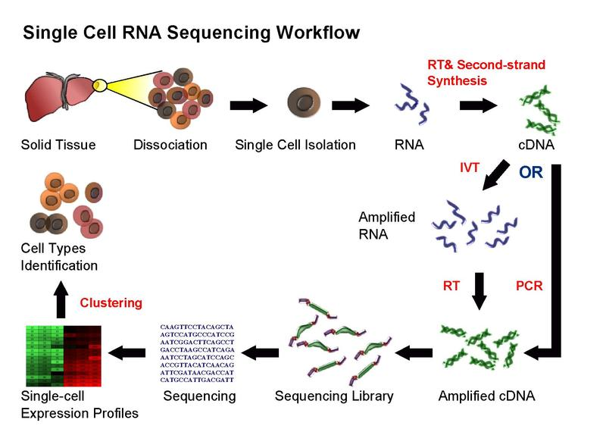
Single-cell RNA-seq

Slide 3
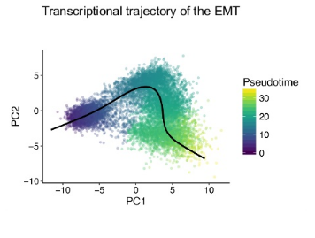
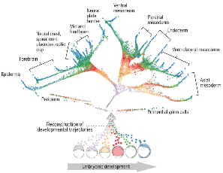
Trajectory finding (DPT)

Slide 4
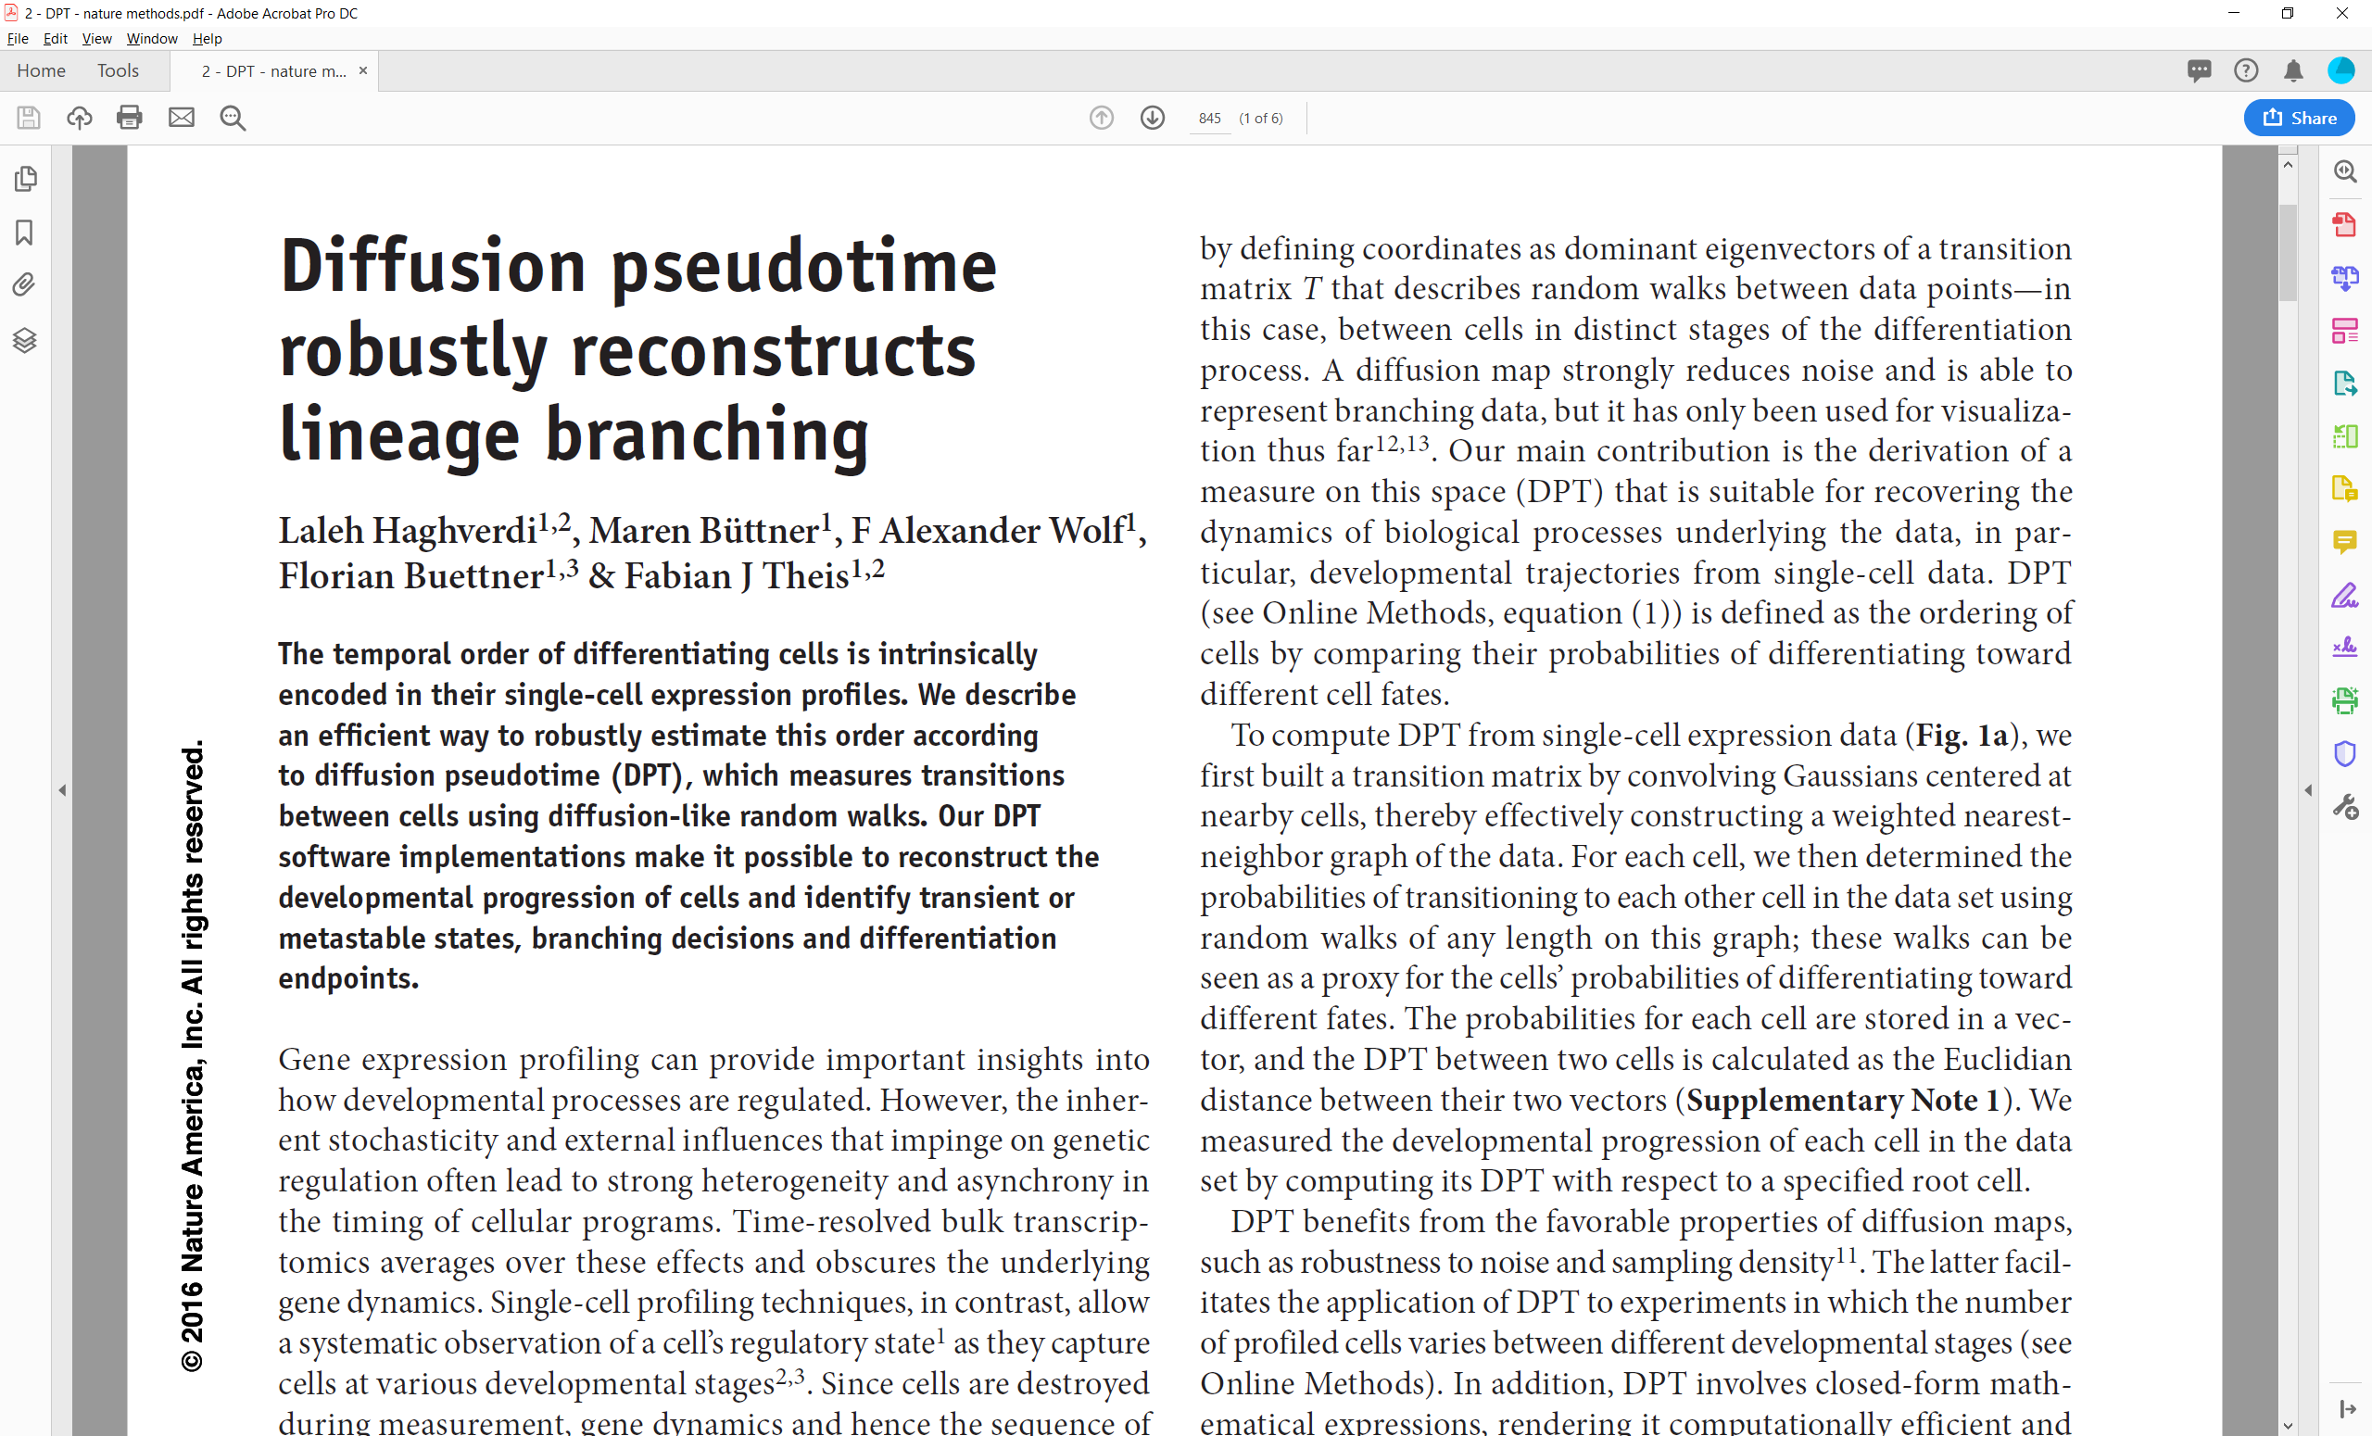

Slide 5
DPT pipeline – defining diffusion pseudo time
Starting point/input: preprocessed scRNAseq data
(Preprocessing options: library size normalization,
log transformation, cell cycle normalization)
cells
genes

Slide 6

DPT pipeline – defining diffusion pseudo time
Starting point/input: preprocessed scRNAseq data
(Preprocessing options: library size normalization,
log transformation, cell cycle normalization)
cells
cells
genes
Euclidean
distance
cells
$$d(x,y)$$

Slide 7

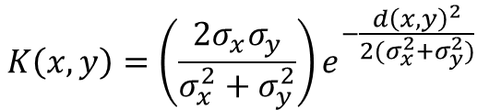
DPT pipeline – defining diffusion pseudo time
Starting point/input: preprocessed scRNAseq data
(Preprocessing options: library size normalization,
log transformation, cell cycle normalization)
cells
cells
cells
genes
Euclidean
distance
cells
Compute
affinity
cells
$$d(x,y)$$
$$K(x,y)$$
$$K\left(x,y\right)=\left(\frac{2σ_{x}σ_{y}}{σ_{x}^{2}+σ_{y}^{2}}\right)e^{−\frac{d{\left(x,y\right)}^{2}}{2(σ_{x}^{2}+σ_{y}^{2})}}$$
$σ_{x}$ is the distance between $x$ and its k^{th} nearest neighbor

Slide 8



DPT pipeline – defining diffusion pseudo time
Starting point/input: preprocessed scRNAseq data
(Preprocessing options: library size normalization,
log transformation, cell cycle normalization)
cells
cells
cells
cells
genes
Euclidean
distance
cells
Compute
affinity
cells
Normalize
by density
cells
$$d(x,y)$$
$$K(x,y)$$
$$W(x,y)$$
$$W\left(x,y\right)=\frac{K(x,y)}{Z\left(x\right)Z(y)}$$
$Z\left(x\right)$ is the row sum of $x$’s row of $K$

Slide 9
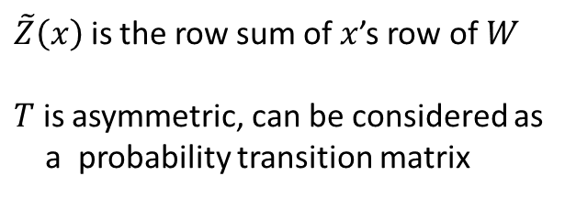


DPT pipeline – defining diffusion pseudo time
Starting point/input: preprocessed scRNAseq data
(Preprocessing options: library size normalization,
log transformation, cell cycle normalization)
cells
cells
cells
cells
genes
Euclidean
distance
cells
Compute
affinity
cells
Normalize
by density
cells
$$d(x,y)$$
$$K(x,y)$$
$$W(x,y)$$
Row normalize
$$T\left(x,y\right)=\frac{W(x,y)}{\tilde{Z}\left(x\right)}$$
cells
cells
$\tilde{Z}\left(x\right)$ is the row sum of $x$’s row of $W$
$T$ is asymmetric, can be considered as
a probability transition matrix
$$T(x,y)$$
PCA
cells
2D
Diffusion map visualization
Haghverdi, L., Buettner, F. & Theis, F.J.
Bioinformatics 31, 2989–2998 (2015).

Slide 10
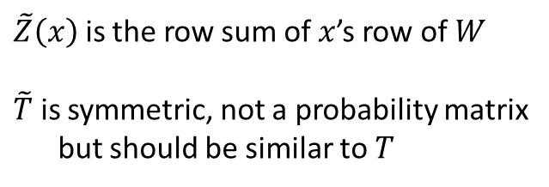
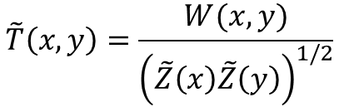

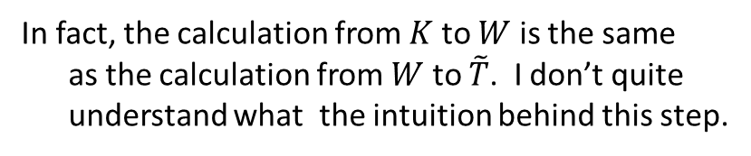
DPT pipeline – defining diffusion pseudo time
Starting point/input: preprocessed scRNAseq data
(Preprocessing options: library size normalization,
log transformation, cell cycle normalization)
cells
cells
cells
cells
genes
Euclidean
distance
cells
Compute
affinity
cells
Normalize
by density
cells
$$d(x,y)$$
$$K(x,y)$$
$$W(x,y)$$
Further normalization
Row normalize
cells
cells
cells
$$\tilde{T}\left(x,y\right)=\frac{W(x,y)}{{\left(\tilde{Z}\left(x\right)\tilde{Z}\left(y\right)\right)}^{1/2}}$$
cells
$$\tilde{T}(x,y)$$
$$T(x,y)$$
$\tilde{Z}\left(x\right)$ is the row sum of $x$’s row of $W$
$\tilde{T}$ is symmetric, not a probability matrix
but should be similar to $T$
PCA
cells
2D
Diffusion map visualization
Haghverdi, L., Buettner, F. & Theis, F.J.
Bioinformatics 31, 2989–2998 (2015).
In fact, the calculation from $K$ to $W$ is the same
as the calculation from $W$ to $\tilde{T}$. I don’t quite
understand what the intuition behind this step.

Slide 11
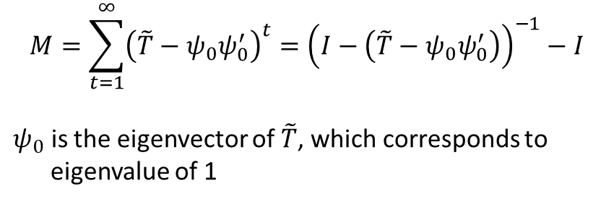

DPT pipeline – defining diffusion pseudo time
Starting point/input: preprocessed scRNAseq data
(Preprocessing options: library size normalization,
log transformation, cell cycle normalization)
cells
cells
cells
cells
genes
Euclidean
distance
cells
Compute
affinity
cells
Normalize
by density
cells
$$d(x,y)$$
$$K(x,y)$$
$$W(x,y)$$
Further normalization
Row normalize
cells
cells
cells
cells
Compute
diffusion
cells
cells
$$\tilde{T}(x,y)$$
$$M(x,y)$$
$$T(x,y)$$
PCA
$$M=\sum_{t=1}^{∞}{{\left(\tilde{T}−ψ_{0}ψ_{0}^{′}\right)}^{t}}={\left(I−\left(\tilde{T}−ψ_{0}ψ_{0}^{′}\right)\right)}^{−1}−I$$
$ψ_{0}$ is the eigenvector of $\tilde{T}$, which corresponds to
eigenvalue of 1
cells
2D
Diffusion map visualization
Haghverdi, L., Buettner, F. & Theis, F.J.
Bioinformatics 31, 2989–2998 (2015).

Slide 12


DPT pipeline – defining diffusion pseudo time
Starting point/input: preprocessed scRNAseq data
(Preprocessing options: library size normalization,
log transformation, cell cycle normalization)
cells
cells
cells
cells
genes
Euclidean
distance
cells
Compute
affinity
cells
Normalize
by density
cells
$$d(x,y)$$
$$K(x,y)$$
$$W(x,y)$$
Further normalization
Row normalize
cells
cells
cells
cells
cells
Compute
diffusion
cells
Compute
cells
cells
$$\tilde{T}(x,y)$$
$$M(x,y)$$
$$dpt(x,y)$$
$$T(x,y)$$
PCA
$$dpt(x,y)={\left\|M\left(x,:\right)−M(y,:)\right\|}^{2}$$
cells
2D
Diffusion map visualization
Haghverdi, L., Buettner, F. & Theis, F.J.
Bioinformatics 31, 2989–2998 (2015).

Slide 13
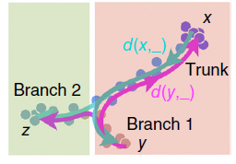
DPT pipeline – defining diffusion pseudo time
Starting point/input: preprocessed scRNAseq data
(Preprocessing options: library size normalization,
log transformation, cell cycle normalization)
cells
cells
cells
cells
genes
Euclidean
distance
cells
Compute
affinity
cells
Normalize
by density
cells
$$d(x,y)$$
$$K(x,y)$$
$$W(x,y)$$
Further normalization
Row normalize
cells
cells
cells
cells
cells
Compute
diffusion
cells
Compute
cells
cells
$$\tilde{T}(x,y)$$
$$M(x,y)$$
$$dpt(x,y)$$
$$T(x,y)$$
PCA
A heuristic to find trajectories
cells
2D
Trajectory:
- Number of branches,
- Which cells belong to which branch
- Which cells represent distal end of each branch
- Which cells represent branching points
Diffusion map visualization
Haghverdi, L., Buettner, F. & Theis, F.J.
Bioinformatics 31, 2989–2998 (2015).
Haghverdi, L., et al, Nature Methods, 2016

Slide 14


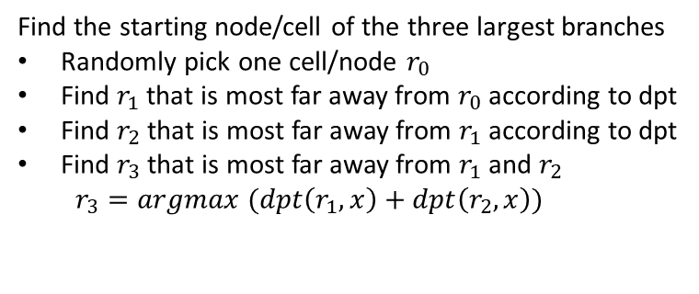


DPT pipeline – finding branching points
cells
cells
Find the starting node/cell of the three largest branches
Randomly pick one cell/node $r_{0}$
Find $r_{1}$ that is most far away from $r_{0}$ according to dpt
Find $r_{2}$ that is most far away from $r_{1}$ according to dpt
Find $r_{3}$ that is most far away from $r_{1}$ and $r_{2}$
$r_{3}=argmax (dpt\left(r_{1},x\right)+dpt\left(r_{2},x\right))$
$$dpt(i,j)$$
A heuristic
to find
trajectories
Trajectory:
- Number of branches,
- Which cells belong to which branch
- Which cells represent distal end of each branch
- Which cells represent branching points
$$r_{1}$$
$$r_{2}$$
$$r_{3}$$

Slide 15

DPT pipeline – finding branching points
cells
cells
Find the starting node/cell of the three largest branches
Randomly pick one cell/node $r_{0}$
Find $r_{1}$ that is most far away from $r_{0}$ according to dpt
Find $r_{2}$ that is most far away from $r_{1}$ according to dpt
Find $r_{3}$ that is most far away from $r_{1}$ and $r_{2}$
$r_{3}=argmax (dpt\left(r_{1},x\right)+dpt\left(r_{2},x\right))$
$$dpt(i,j)$$
A heuristic
to find
trajectories
Compute the diffusion pseudo time of all points from each of the three starting node
Trajectory:
- Number of branches,
- Which cells belong to which branch
- Which cells represent distal end of each branch
- Which cells represent branching points
$$r_{1}$$
1
2
3
15
17
18
4
13
$$r_{2}$$
5
11
6
7
8
9
10
12
14
16
$$r_{3}$$
$$O_{1}$$

Slide 16



DPT pipeline – finding branching points
cells
cells
Find the starting node/cell of the three largest branches
Randomly pick one cell/node $r_{0}$
Find $r_{1}$ that is most far away from $r_{0}$ according to dpt
Find $r_{2}$ that is most far away from $r_{1}$ according to dpt
Find $r_{3}$ that is most far away from $r_{1}$ and $r_{2}$
$r_{3}=argmax (dpt\left(r_{1},x\right)+dpt\left(r_{2},x\right))$
$$dpt(i,j)$$
A heuristic
to find
trajectories
Compute the diffusion pseudo time of all points from each of the three starting node
Trajectory:
- Number of branches,
- Which cells belong to which branch
- Which cells represent distal end of each branch
- Which cells represent branching points
$$r_{1}$$
1
2
3
15
17
18
$$r_{1}$$
18
17
2
1
$$r_{2}$$
4
13
$$r_{2}$$
16
3
5
14
4
6
11
12
5
7
9
10
6
8
8
7
10
9
12
11
14
13
16
15
$$r_{3}$$
$$r_{3}$$
$$O_{1}$$
$$O_{2}$$

Slide 17


DPT pipeline – finding branching points
cells
cells
Find the starting node/cell of the three largest branches
Randomly pick one cell/node $r_{0}$
Find $r_{1}$ that is most far away from $r_{0}$ according to dpt
Find $r_{2}$ that is most far away from $r_{1}$ according to dpt
Find $r_{3}$ that is most far away from $r_{1}$ and $r_{2}$
$r_{3}=argmax (dpt\left(r_{1},x\right)+dpt\left(r_{2},x\right))$
$$dpt(i,j)$$
A heuristic
to find
trajectories
Compute the diffusion pseudo time of all points from each of the three starting node
Trajectory:
- Number of branches,
- Which cells belong to which branch
- Which cells represent distal end of each branch
- Which cells represent branching points
$$r_{1}$$
1
2
3
15
17
18
$$r_{1}$$
18
17
2
1
$$r_{2}$$
$$r_{1}$$
18
16
15
17
4
13
$$r_{2}$$
16
3
14
13
$$r_{2}$$
5
14
4
12
11
6
11
12
5
10
7
9
10
6
8
9
8
8
6
7
7
5
10
9
4
12
11
3
14
13
2
16
15
1
$$r_{3}$$
$$r_{3}$$
$$r_{3}$$
$$O_{1}$$
$$O_{2}$$
$$O_{3}$$

Slide 18
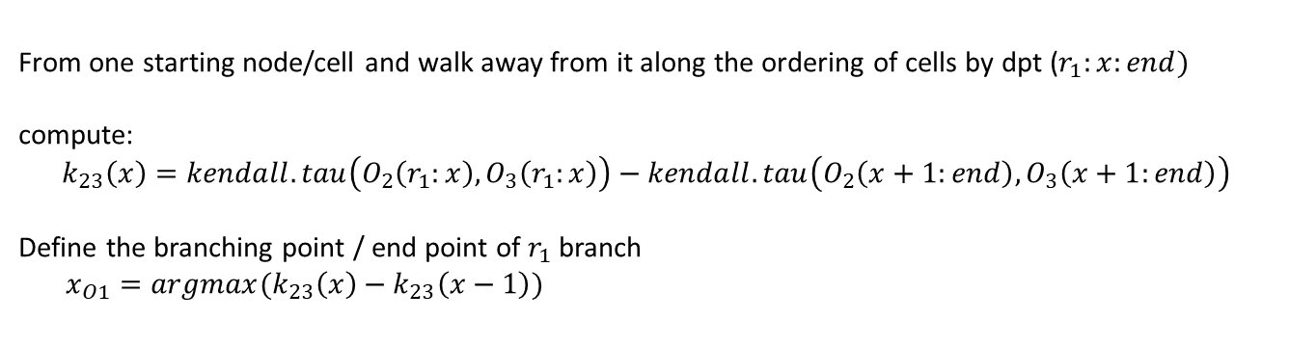
DPT pipeline – finding branching points
cells
cells
Find the starting node/cell of the three largest branches
Randomly pick one cell/node $r_{0}$
Find $r_{1}$ that is most far away from $r_{0}$ according to dpt
Find $r_{2}$ that is most far away from $r_{1}$ according to dpt
Find $r_{3}$ that is most far away from $r_{1}$ and $r_{2}$
$r_{3}=argmax (dpt\left(r_{1},x\right)+dpt\left(r_{2},x\right))$
$$dpt(i,j)$$
A heuristic
to find
trajectories
Compute the diffusion pseudo time of all points from each of the three starting node
Trajectory:
- Number of branches,
- Which cells belong to which branch
- Which cells represent distal end of each branch
- Which cells represent branching points
From one starting node/cell and walk away from it along the ordering of cells by dpt ($r_{1}:x:end)$
compute:
$$k_{23}\left(x\right)=kendall.tau\left(O_{2}\left(r_{1}:x\right),O_{3}\left(r_{1}:x\right)\right)−kendall.tau\left(O_{2}\left(x+1:end\right),O_{3}\left(x+1:end\right)\right)$$
Define the branching point / end point of $r_{1}$ branch
$x_{O1}=argmax(k_{23}\left(x\right)−k_{23}\left(x−1\right))$
$$r_{1}$$
1
2
3
15
17
18
$$r_{1}$$
18
17
2
1
$$r_{2}$$
$$r_{1}$$
18
16
15
17
4
13
$$r_{2}$$
16
3
14
13
$$r_{2}$$
5
14
4
12
11
6
11
12
5
10
7
9
10
6
8
9
8
8
6
7
7
5
10
9
4
12
11
3
14
13
2
16
15
1
$$r_{3}$$
$$r_{3}$$
$$r_{3}$$
$$O_{1}$$
$$O_{2}$$
$$O_{3}$$

Slide 19
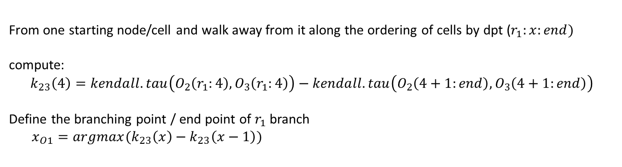
DPT pipeline – finding branching points
cells
cells
Find the starting node/cell of the three largest branches
Randomly pick one cell/node $r_{0}$
Find $r_{1}$ that is most far away from $r_{0}$ according to dpt
Find $r_{2}$ that is most far away from $r_{1}$ according to dpt
Find $r_{3}$ that is most far away from $r_{1}$ and $r_{2}$
$r_{3}=argmax (dpt\left(r_{1},x\right)+dpt\left(r_{2},x\right))$
$$dpt(i,j)$$
A heuristic
to find
trajectories
Compute the diffusion pseudo time of all points from each of the three starting node
Trajectory:
- Number of branches,
- Which cells belong to which branch
- Which cells represent distal end of each branch
- Which cells represent branching points
From one starting node/cell and walk away from it along the ordering of cells by dpt ($r_{1}:x:end)$
compute:
$$k_{23}\left(4\right)=kendall.tau\left(O_{2}\left(r_{1}:4\right),O_{3}\left(r_{1}:4\right)\right)−kendall.tau\left(O_{2}\left(4+1:end\right),O_{3}\left(4+1:end\right)\right)$$
Define the branching point / end point of $r_{1}$ branch
$x_{O1}=argmax(k_{23}\left(x\right)−k_{23}\left(x−1\right))$
18 17 16 14
18 16 14 12
12 10 8 7 6 9 5 11 4 13 3 15 2 1
10 8 6 5 7 4 9 3 11 2 13 1 15 17
$$r_{1}$$
1
2
3
15
17
18
$$r_{1}$$
18
17
2
1
$$r_{2}$$
$$r_{1}$$
18
16
15
17
4
13
$$r_{2}$$
16
3
14
13
$$r_{2}$$
5
14
4
12
11
6
11
12
5
10
7
9
10
6
8
9
8
8
6
7
7
5
10
9
4
12
11
3
14
13
2
16
15
1
$$r_{3}$$
$$r_{3}$$
$$r_{3}$$
$$O_{1}$$
$$O_{2}$$
$$O_{3}$$

Slide 20
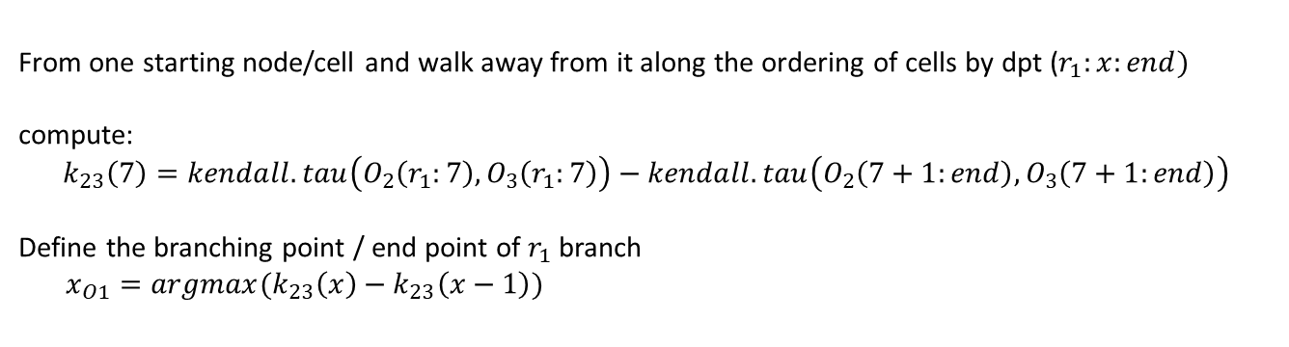
DPT pipeline – finding branching points
cells
cells
Find the starting node/cell of the three largest branches
Randomly pick one cell/node $r_{0}$
Find $r_{1}$ that is most far away from $r_{0}$ according to dpt
Find $r_{2}$ that is most far away from $r_{1}$ according to dpt
Find $r_{3}$ that is most far away from $r_{1}$ and $r_{2}$
$r_{3}=argmax (dpt\left(r_{1},x\right)+dpt\left(r_{2},x\right))$
$$dpt(i,j)$$
A heuristic
to find
trajectories
Compute the diffusion pseudo time of all points from each of the three starting node
Trajectory:
- Number of branches,
- Which cells belong to which branch
- Which cells represent distal end of each branch
- Which cells represent branching points
From one starting node/cell and walk away from it along the ordering of cells by dpt ($r_{1}:x:end)$
compute:
$$k_{23}\left(7\right)=kendall.tau\left(O_{2}\left(r_{1}:7\right),O_{3}\left(r_{1}:7\right)\right)−kendall.tau\left(O_{2}\left(7+1:end\right),O_{3}\left(7+1:end\right)\right)$$
Define the branching point / end point of $r_{1}$ branch
$x_{O1}=argmax(k_{23}\left(x\right)−k_{23}\left(x−1\right))$
18 17 16 14 12 10 8
18 16 14 12 10 8 6
7 6 9 5 11 4 13 3 15 2 1
5 7 4 9 3 11 2 13 1 15 17
$$r_{1}$$
1
2
3
15
17
18
$$r_{1}$$
18
17
2
1
$$r_{2}$$
$$r_{1}$$
18
16
15
17
4
13
$$r_{2}$$
16
3
14
13
$$r_{2}$$
5
14
4
12
11
6
11
12
5
10
7
9
10
6
8
9
8
8
6
7
7
5
10
9
4
12
11
3
14
13
2
16
15
1
$$r_{3}$$
$$r_{3}$$
$$r_{3}$$
$$O_{1}$$
$$O_{2}$$
$$O_{3}$$
Notes:
There may be unassigned nodes.

Slide 21
DPT pipeline – finding branching points
cells
cells
Find the starting node/cell of the three largest branches
Randomly pick one cell/node $r_{0}$
Find $r_{1}$ that is most far away from $r_{0}$ according to dpt
Find $r_{2}$ that is most far away from $r_{1}$ according to dpt
Find $r_{3}$ that is most far away from $r_{1}$ and $r_{2}$
$r_{3}=argmax (dpt\left(r_{1},x\right)+dpt\left(r_{2},x\right))$
$$dpt(i,j)$$
A heuristic
to find
trajectories
Compute the diffusion pseudo time of all points from each of the three starting node
Trajectory:
- Number of branches,
- Which cells belong to which branch
- Which cells represent distal end of each branch
- Which cells represent branching points
From one starting node/cell and walk away from it along the ordering of cells by dpt ($r_{1}:x:end)$
compute:
$$k_{23}\left(x\right)=kendall.tau\left(O_{2}\left(r_{1}:x\right),O_{3}\left(r_{1}:x\right)\right)−kendall.tau\left(O_{2}\left(x+1:end\right),O_{3}\left(x+1:end\right)\right)$$
Define the branching point / end point of $r_{1}$ branch
$x_{O1}=argmax(k_{23}\left(x\right)−k_{23}\left(x−1\right))$
Repeat this for each of the three starting node/cell to identify cells that belong to each of the three branch.

Slide 22
DPT pipeline – finding branching points
cells
cells
Find the starting node/cell of the three largest branches
Randomly pick one cell/node $r_{0}$
Find $r_{1}$ that is most far away from $r_{0}$ according to dpt
Find $r_{2}$ that is most far away from $r_{1}$ according to dpt
Find $r_{3}$ that is most far away from $r_{1}$ and $r_{2}$
$r_{3}=argmax (dpt\left(r_{1},x\right)+dpt\left(r_{2},x\right))$
$$dpt(i,j)$$
A heuristic
to find
trajectories
Compute the diffusion pseudo time of all points from each of the three starting node
Trajectory:
- Number of branches,
- Which cells belong to which branch
- Which cells represent distal end of each branch
- Which cells represent branching points
From one starting node/cell and walk away from it along the ordering of cells by dpt ($r_{1}:x:end)$
compute:
$$k_{23}\left(x\right)=kendall.tau\left(O_{2}\left(r_{1}:x\right),O_{3}\left(r_{1}:x\right)\right)−kendall.tau\left(O_{2}\left(x+1:end\right),O_{3}\left(x+1:end\right)\right)$$
Define the branching point / end point of $r_{1}$ branch
$x_{O1}=argmax(k_{23}\left(x\right)−k_{23}\left(x−1\right))$
Repeat this for each of the three starting node/cell to identify cells that belong to each of the three branch.
Repeat all above for cells belonging to each of the three branches separately, to identify further smaller branches within each of the three branches

Slide 23
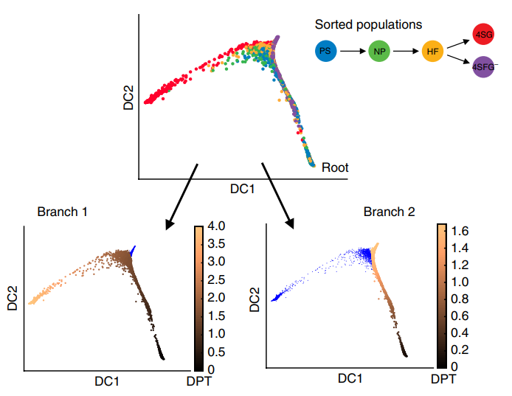
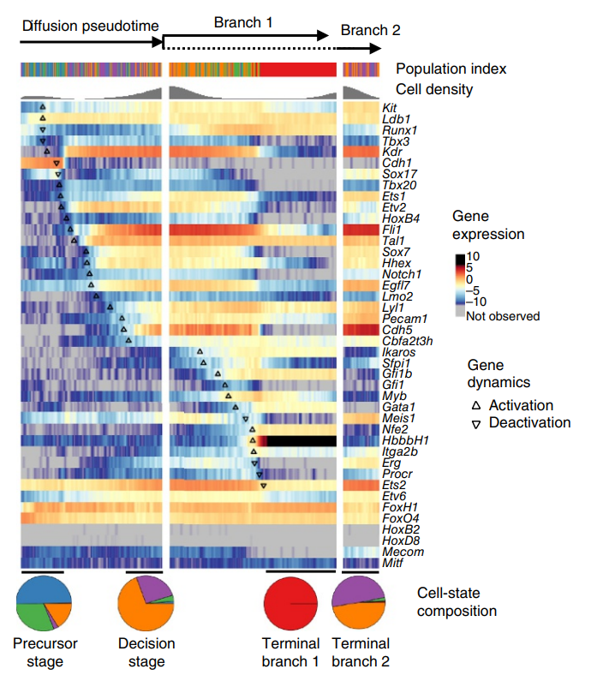
DPT pipeline

Slide 24
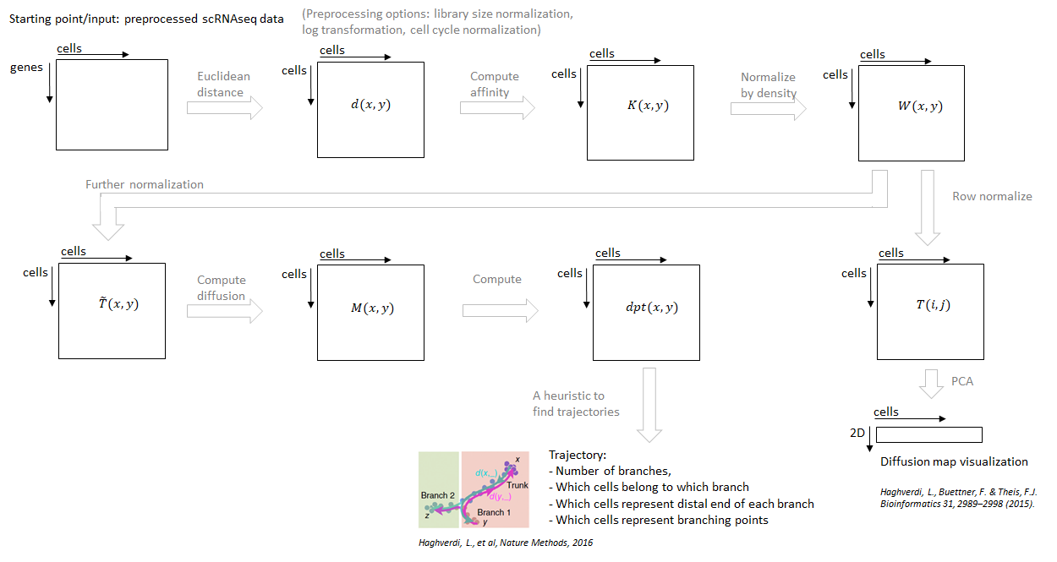
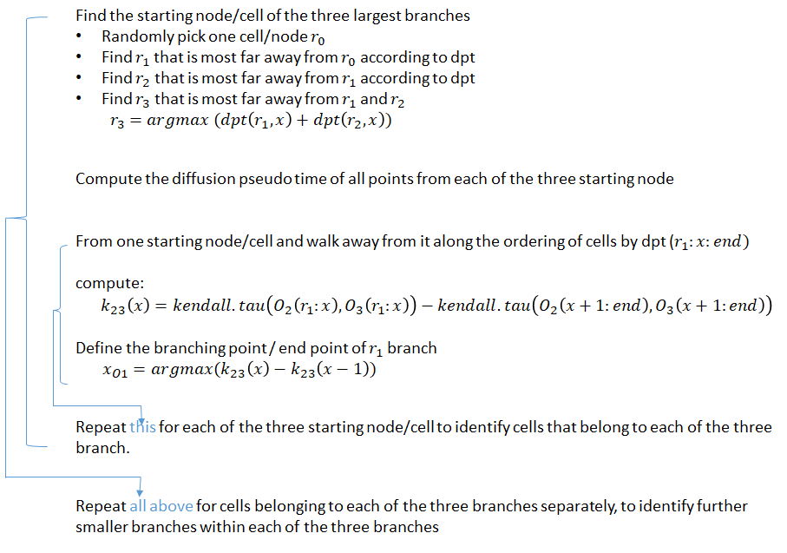
DPT pipeline

