Slide 1
Summer Institutes of Statistical Genetics, 2021
SISG Module 6: Gene Expression Profiling
Lecture 08: Handling the sparsity of scRNAseq Analysis
Peng Qiu and Greg Gibson
Georgia Institute of Technology

Slide 2
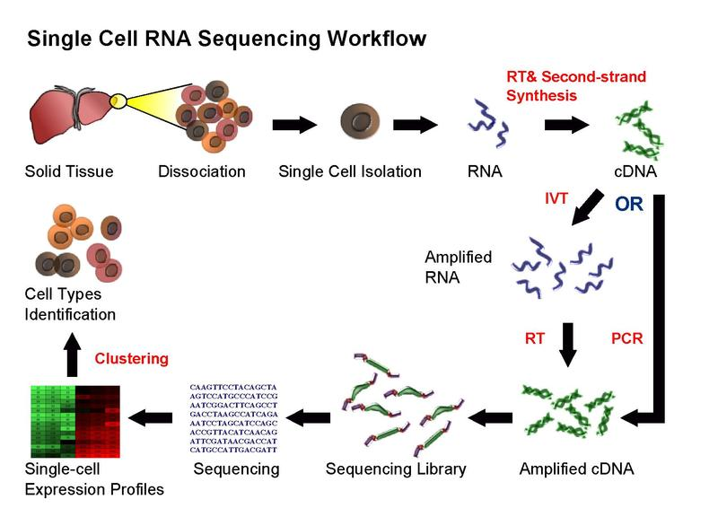
Single-cell RNA-seq

Slide 3
Dropout / sparsity
Dropout is an important phenomenon that occurs in scRNA-seq data, where a gene is observed at a moderate expression level in one cell but is not detected in another cell of the same cell type
Why dropouts occur?
  Low amounts of RNA in individual cells
  Insufficient RNA capture
  Stochasticity of gene expression
How big of a problem is it?
  droplet-based techniques, dropout rate is 90%~97%
  fcas-based techniques, dropout rate is 70~80%
How are people handling the dropouts?
  Select highly variable genes
  Perform dimension reduction (PCA, tSNE, etc)
  Imputation

Slide 4
How are people handling the dropouts / sparsity?
PCA to derive reduced features by combining genes
Select highly variable genes
which are less affected by dropouts
Subsequent analysis
cells
cells
Highly variable genes
PCs
cells
genes
raw
data
cells
genes
Imputed
data
Subsequent analysis
Impute the data based on gene-gene similar or cell-cell similarity

Slide 5
Imputation methods for addressing dropout / sparsity
Existing imputation methods: MAGIC, scImpute, SAVER, netSmooth, …
In general, there are two schools of thoughts about dropouts
  Dropout affects the observed expression counts of all the genes in all the cells. Therefore, the entire count matrix needs to be corrected.
  Only a subset of the zeros are caused by dropout, while many of the zeros in the data are supposed to be zeros. Therefore, we should only correct the zeros that are likely caused by dropout.
My opinion ???

Slide 6

MAGIC

Slide 7







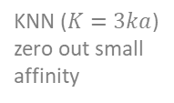


Starting point/input
PCA with # of PC to retain 70% variance, or just specify # of PC (10~20)
Library size
normalization
and log
transformation
cells
cells
cells
genes
raw
data
genes
cells
Euclidean
distance
cells
PCs
$$d(x,y)$$
Compute affinity (asymmetric): $K\left(x,y\right)=e^{−\frac{d{\left(x,y\right)}^{2}}{σ_{x}^{2}}}$, where $σ_{x}=d\left(x,NN\left(x,ka\right)\right)$, $ka$ default values 3~10
cells
KNN ($K=3ka$)
zero out small
affinity
cells
cells
Make it
Markov
probability
cells
cells
cells
Make it
symmetric
cells
cells
$$K(x,y)$$
$$A$$
$$A+A^{T}$$
$$M$$
Raise to an “appropriate” power $t$, a threshold
Difference b/w imputed data For $t$ and $t$-1
0.05
$$t$$
cells
cells
cells
cells
cells
genes
new
data
genes
raw
data
Impute data
cells
$$M^{t}$$
=
*
$$M^{t}$$
Notes:
Revisit all the parameters
Issues:
all zeros are gone, this is too much
Induces too much correlations

Slide 8
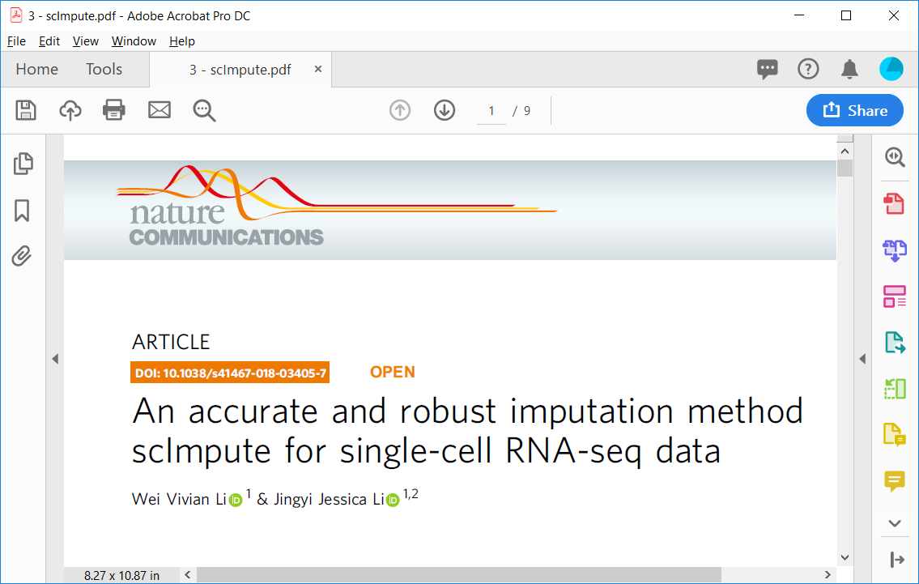
scImpute

Slide 9
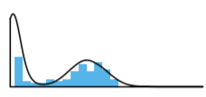





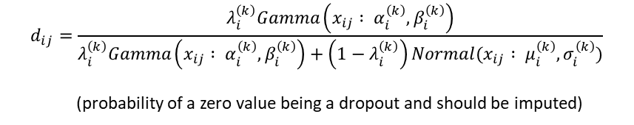






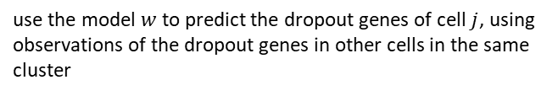







Starting point/input
Library size
normalization
and log
transformation
Spectral graph clustering
cells
cells
cells
fewer cells
genes
raw
data
genes
cells
Euclidean
distance
cells
Remove
outliers
fewer
cells
PCA
PCs
$$d(x,y)$$
K cell clusters
$$d(x,y)$$
Choose # of PC to retain 40% variance
$O=\{j:l_{j}>Q_{3}+$
$1.5(Q_{3}−Q_{1})$}
fewer cells
For each gene and each cluster of cells, model the dropouts/zeros using the following distributions
genes
$$f_{x_{i}^{(k)}}=λ_{i}^{\left(k\right)}Gamma\left(α_{i}^{\left(k\right)},β_{i}^{\left(k\right)}\right)+\left(1−λ_{i}^{\left(k\right)}\right)Normal(μ_{i}^{\left(k\right)},σ_{i}^{\left(k\right)})$$
For each gene and each cell, model the probability of the expr value should be imputed
…
$$d_{ij}=\frac{λ_{i}^{\left(k\right)}Gamma\left(x_{ij} : α_{i}^{\left(k\right)},β_{i}^{\left(k\right)}\right)}{λ_{i}^{\left(k\right)}Gamma\left(x_{ij} : α_{i}^{\left(k\right)},β_{i}^{\left(k\right)}\right)+\left(1−λ_{i}^{\left(k\right)}\right)Normal(x_{ij} : μ_{i}^{\left(k\right)},σ_{i}^{\left(k\right)})}$$
(probability of a zero value being a dropout and should be imputed)
cell clusters
Impute cell by cell (j)
cells in one cluster
For cell $j$, Define: $A_{j}=\{i :d_{ij}>t\}$, $B_{j}=\{other genes\}$,
dropout genes
for cell $j$
$$A_{j}$$
$$A_{other}$$
$$B_{j}$$
$$B_{other}$$
learn how to predict cell $j$ based on other cells in the same cluster, using non-dropout genes of cell $j$ as training instances
Learn a linear model
$$=$$
$$w$$
non-dropout genes
for cell $j$
$$B_{j}$$
$$B_{other}$$
Apply the learned model
$$A_{j}$$
$$A_{other}$$
use the model $w$to predict the dropout genes of cell $j$, using observations of the dropout genes in other cells in the same cluster
$$=$$
$$w$$
cell $j$
Notes:
Revisit all the parameters
Issues:
In the linear model, A_other and B_other contain a lot of zeros that should be imputed, using/trusting them as X may have some issues
Non-zero value are not touched (not a very big problem in my opinion)

Slide 10

MAGIC vs. scImpute vs. others
My own (biased) interpretation:
  MAGIC is probably better at dealing with trajectory like data.
  scImpute is probably better at dealing with cluster like data.
A more comprehensive evaluation:

Slide 11
Imputation methods for addressing dropout
Existing imputation methods: MAGIC, scImpute, SAVER, netSmooth, …
In general, there are two schools of thoughts about dropouts
  Dropout affects the observed expression counts of all the genes in all the cells. Therefore, the entire count matrix needs to be corrected.
  Only a subset of the zeros are caused by dropout, while many of the zeros in the data are supposed to be zeros. Therefore, we should only correct the zeros that are likely caused by dropout.
My opinion
  The first approach of imputing/updating the entire count matrix is TOO MUCH. Some of the zeros in the raw data are probably supposed to be zeros, and should be left untouched by imputation.
  The second approach of imputing/updating a subset of zeros is NOT ENOUGH. Many of the non-zero values in the raw data probably should also be updated/elevated.
  A better approach: imputing/updating all the non-zeros values and a subset of zeros ???

Slide 12
Motivation of my recent work
Everyone treats dropouts as noise/problem that needs to be fixed
I would like to explore an opposite view. Can I treat dropouts as a signal, and do something useful with it?

Slide 13
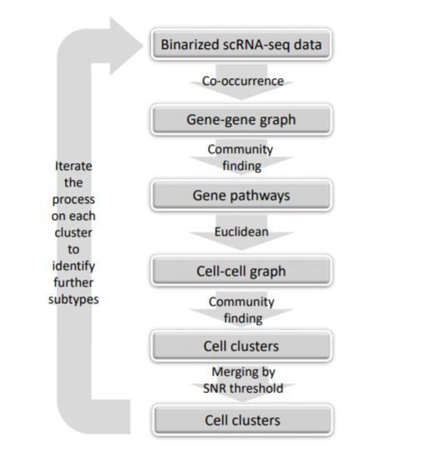
Co-occurrence clustering (unsupervised)
Qiu P. “Embracing the dropouts in single-cell RNA-seq analysis“, Nature Communications, 11(1):1169, 2020.

Slide 14
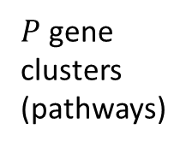
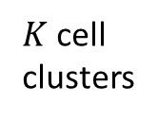

Co-occurrence clustering (unsupervised)
Starting point/input
cells
cells
genes
genes
raw
data
Binarize the data
genes
binary
data
Compute
gene-gene
similarity by
co-occurrence
genes
cooc
Community
finding
to identify
gene clusters
$P$ gene
clusters
(pathways)
Compute the activity (average detection rate) for each gene cluster
cells
Community
finding
to identify
cell clusters
cells
Euclidean
distance
cells
$K$ cell
clusters
$P$ gene
clusters
$$d(x,y)$$
Iterate and perform the same analysis for cells in each cell cluster separately
until stopping criteria are met (difference among the cell clusters too small)
Qiu P. “Embracing the dropouts in single-cell RNA-seq analysis“, Nature Communications, 11(1):1169, 2020.

Slide 15
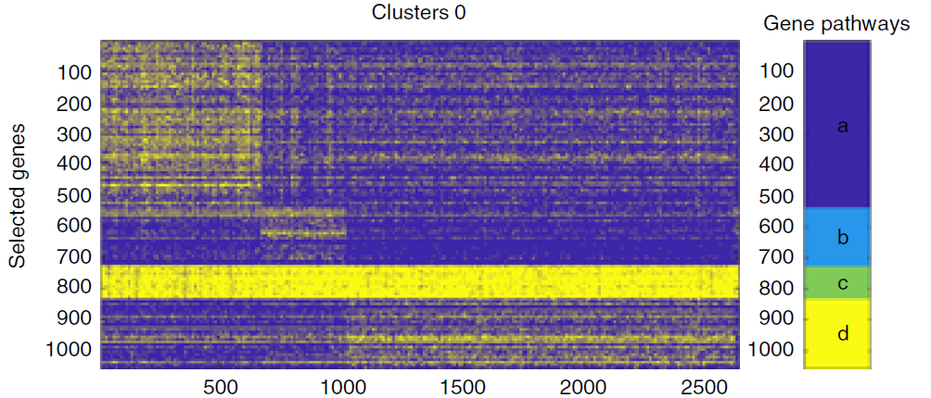
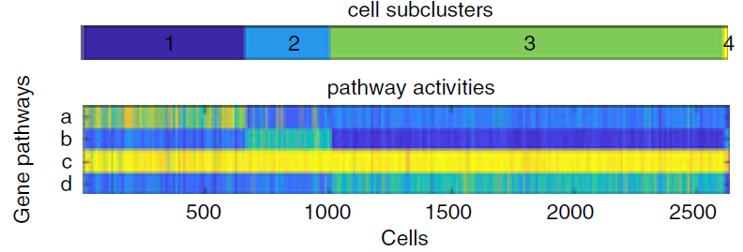
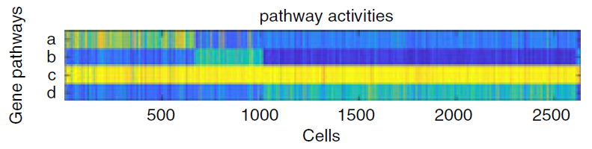
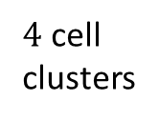
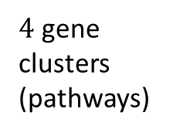
Results – Human PBMC
(profiled by 10x, 32738 genes * 2700 cells, 97% dropout)
Starting point/input
2700 cells
2700 cells
32738 genes
32738
genes
raw
data
Binarize the data
32738
genes
binary
data
Compute
gene-gene
similarity by
co-occurrence
32738
genes
cooc
Community
finding
to identify
gene clusters
$4$ gene
clusters
(pathways)
Compute the activity (average detection rate) for each gene cluster
cells
Community
finding
to identify
cell clusters
cells
Euclidean
distance
cells
$4$ cell
clusters
4 gene
clusters
$$d(x,y)$$
Iterate and perform the same analysis for cells in each cell cluster separately
until stopping criteria are met (difference among the cell clusters too small)
Qiu P. “Embracing the dropouts in single-cell RNA-seq analysis“, Nature Communications, 11(1):1169, 2020.

Slide 16
Results – Human PBMC
Data: PBMC profiled by 10x, 32738 genes * 2700 cells, 97% dropout
Result: 9 co-occurrence clusters
COOC gene clusters are highly enriched by relevant biological pathways
COOC clusters are highly consistent with
Seurat based on highly variable genes
COOC is able to identify cell clusters that Seurat misses.

Slide 17
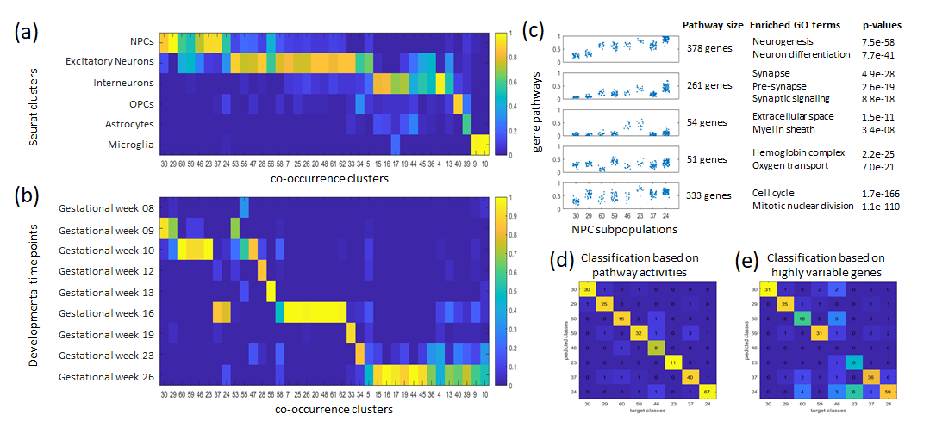
Results – Human prefrontal cortex
Data: human prefrontal cortex cells, SMARTseq2, 24153 genes * 2394 cells, 82% dropout
Result: 37 co-occurrence clusters
COOC gene clusters are highly enriched by relevant biological pathways
COOC clusters are highly consistent with known cell types.
COOC clusters are highly consistent with developmental time points.
COOC is able to identify cell clusters that Seurat misses.

Slide 18
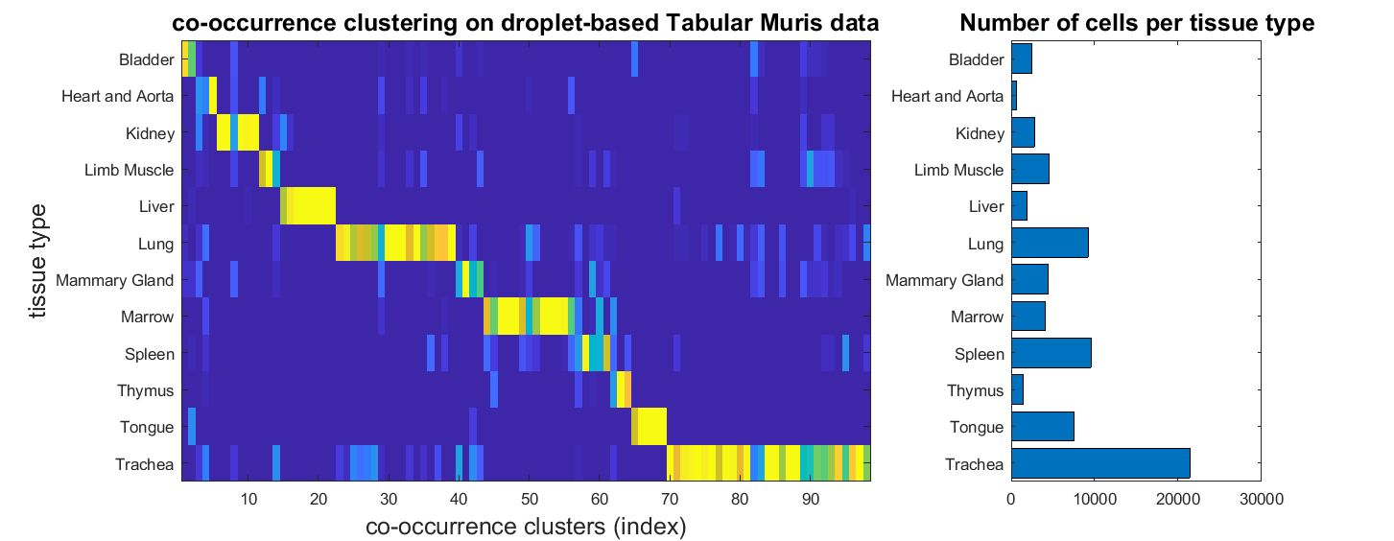
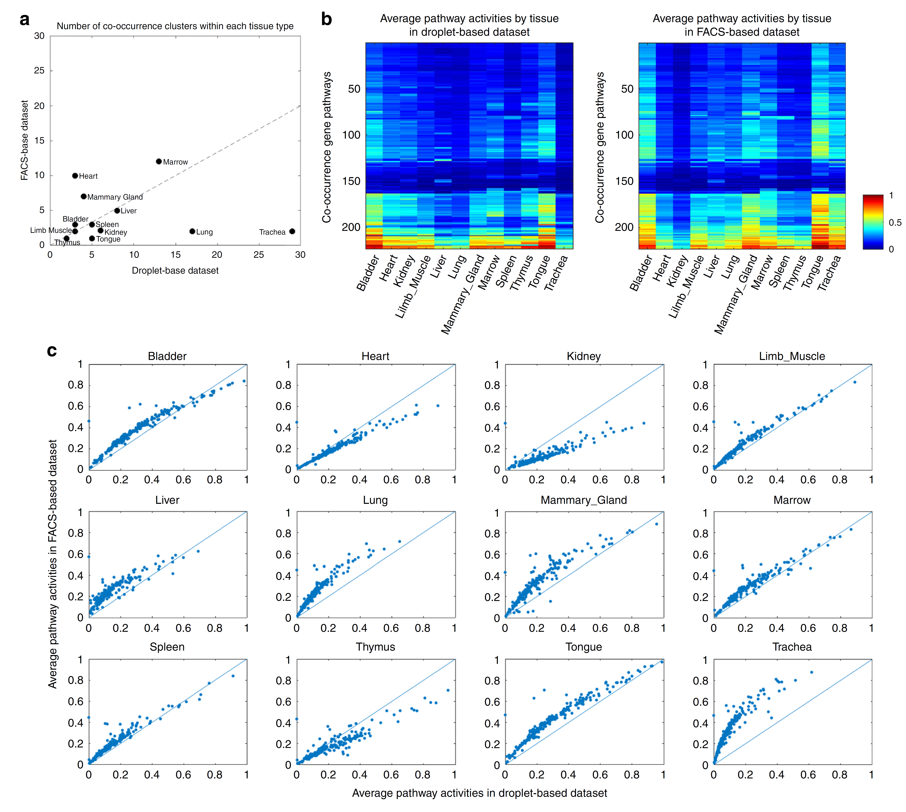
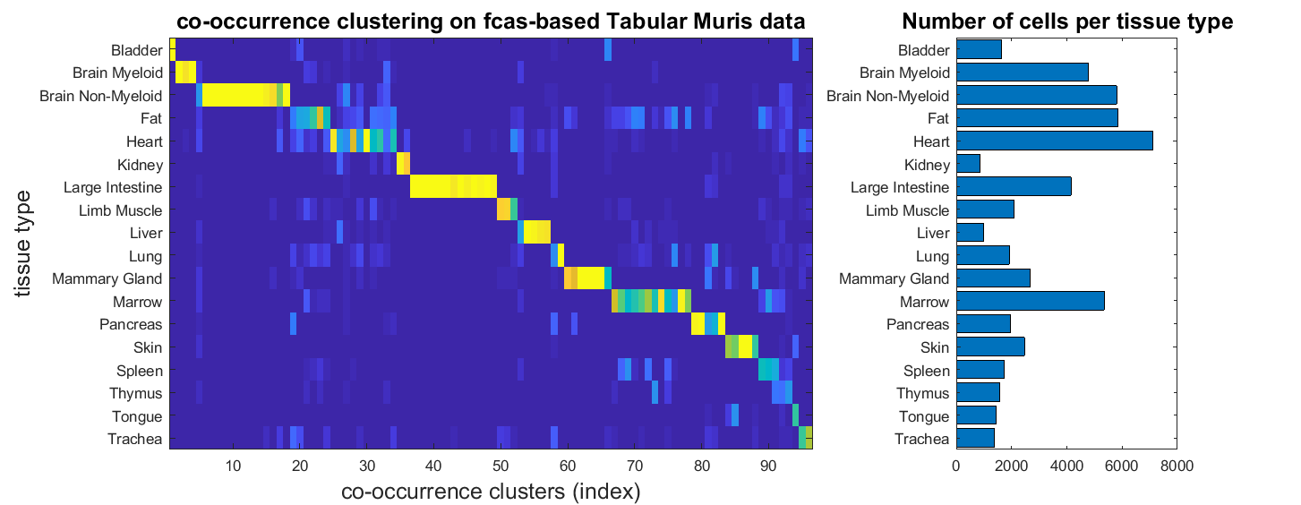
Results – Tabula Muris
Data: mouse cells from ~20 organs and tissues
profiled by 10x, 23433 genes * 70118 cells, 93% dropout
Profiled by SMARTseq2, 23433 genes * 53760 cells, 89% dropout
Result: ~100 co-occurrence clusters in each dataset
Binary signals highly consistent between two experimental protocols.
COOC clusters highly consistent with known tissue types.

Slide 19
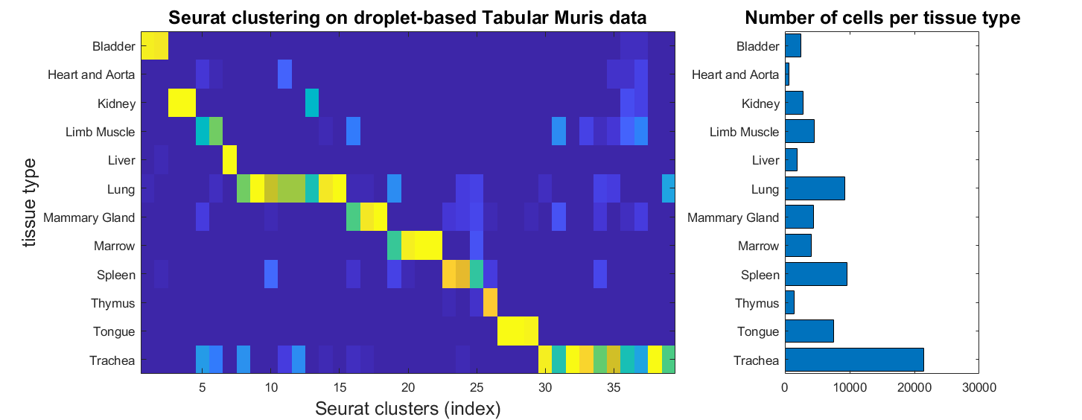
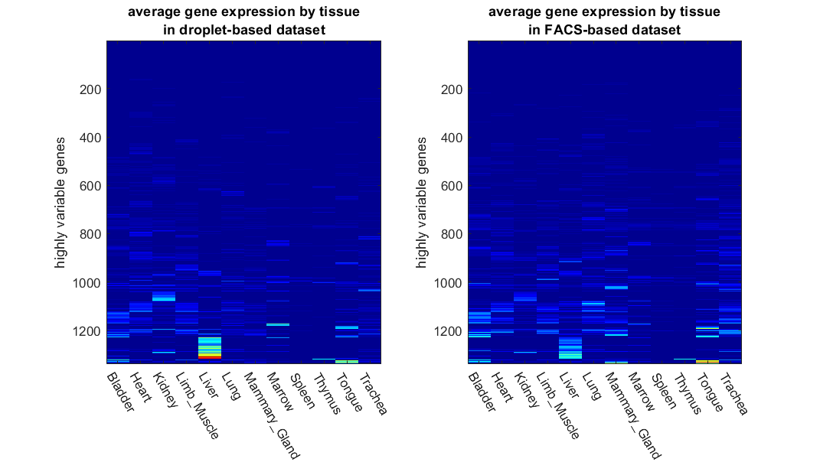
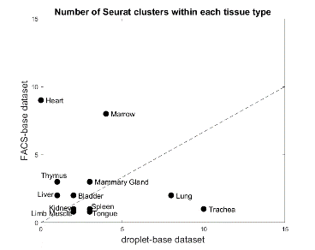
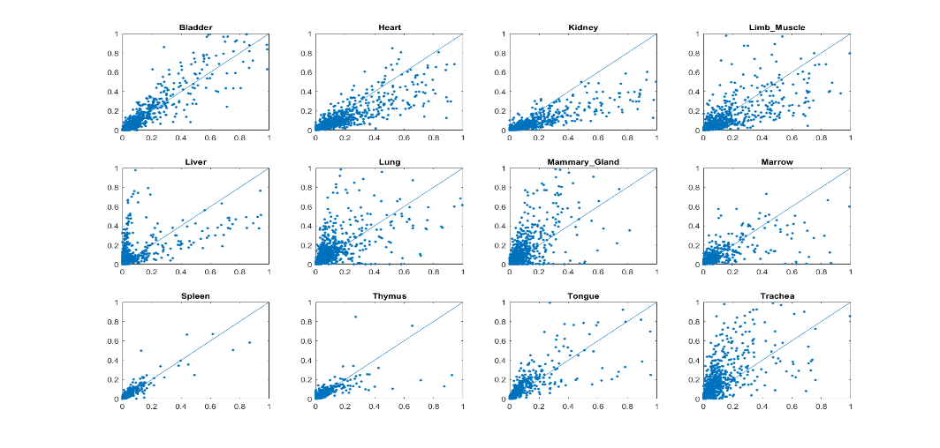
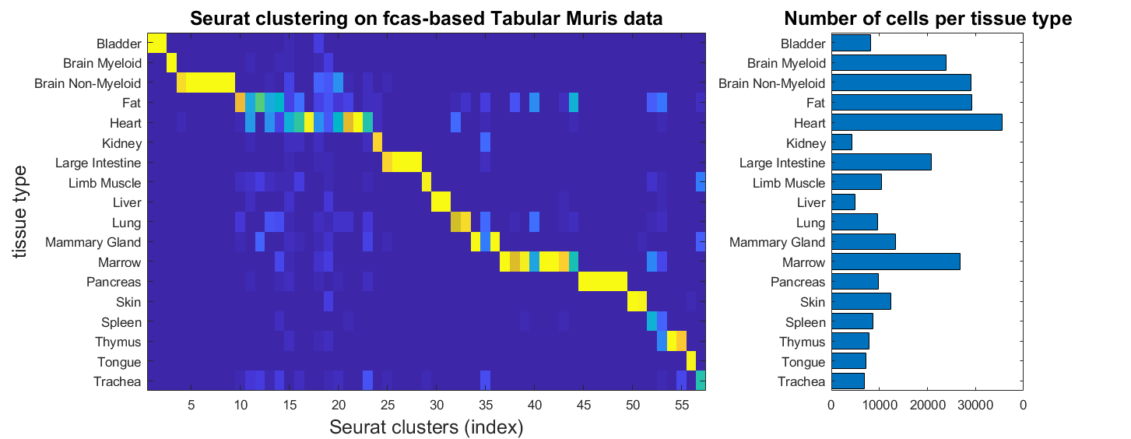
Results – Tabula Muris
Data: mouse cells from ~20 organs and tissues
profiled by 10x, 23433 genes * 70118 cells, 93% dropout
Profiled by SMARTseq2, 23433 genes * 53760 cells, 89% dropout
Result: ~100 seurat clusters in each dataset
Quantitative signals less consistent between two experimental protocols.
Seurat clusters highly consistent with known tissue types.

Slide 20
Take home messages
If we want to perform imputation to reduce the sparsity of scRNA-seq data:
  MAGIC is probably better at dealing with trajectory like data.
  scImpute is probably better at dealing with cluster like data.
Imputation may not be able to increase the performance of downstream analysis, compared to no imputation. This is likely because most scRNA-seq analysis algorithms already has components built-in to address the sparsity.
Opposite to the common view in the literature, dropout/sparsity can be a useful signal! For the purpose of clustering cells, the binary dropout pattern of all the genes is as informative as the quantitative expression data of highly variable genes.
Two other recent papers that also hinted that dropout/sparsity in scRNA-seq is useful.
Qiu P. “Embracing the dropouts in single-cell RNA-seq analysis“, Nature Communications, 11(1):1169, 2020.
Kim, et al, Demystifying "drop-outs" in single cell UMI data. Genome Biology. 21(196), 2020.
Svensson, Droplet scRNA-seq is not zero-inflated. Nature Biotechnology, 2020.

