Slide 1
Summer Institutes of Statistical Genetics, 2023
SISG Module 6: Gene Expression Profiling
Lecture 08: Practical Session for scRNA‐seq Data Analysis with Seurat
Peng Qiu and Greg Gibson
Georgia Institute of Technology

Slide 2


Installing R and R-Studio
https://posit.co/products/open-source/rstudio/
<2 minutes
<5 minutes

Slide 3
Installing R packages for scRNA-seq analysis
Open R-studio and install packages
install.packages('Seurat’)
install.packages("patchwork")
install.packages("dplyr")
install.packages("ggplot2")
install.packages('hdf5r')

Slide 4
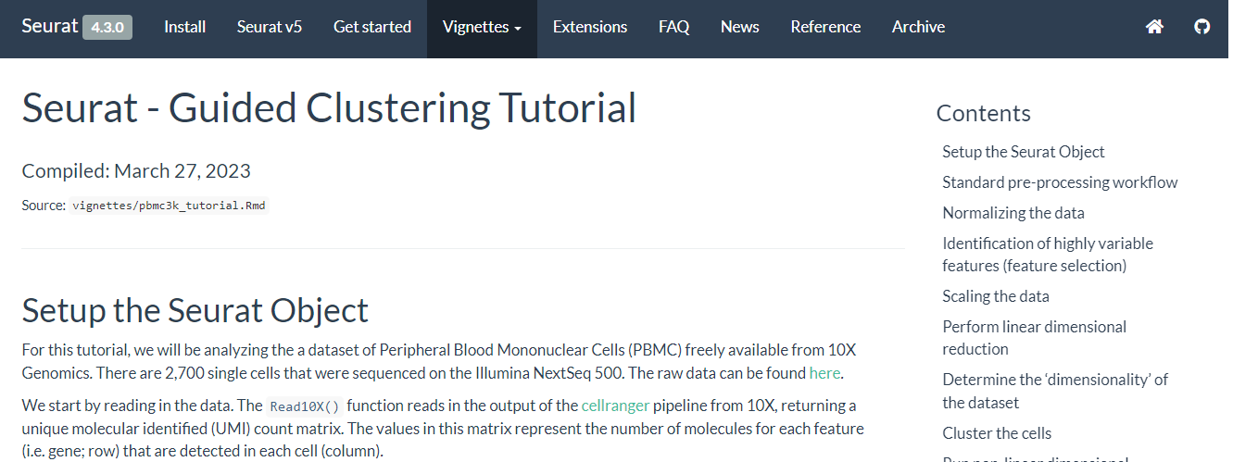
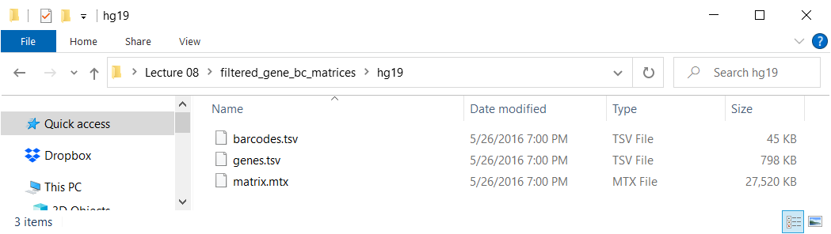
Download an example dataset
https://satijalab.org/seurat/articles/pbmc3k_tutorial.html
Download pbmc3k dataset
Unzip (untar) the downloaded
In R-studio, go to the directory of the unzipped data, and set it as working directory

Slide 5
Understand the raw data files
Open R-studio
Go to Terminal tab
Change to directory of raw files
cd Desktop/SISG/Lecture\ 08/filtered_gene_bc_matrices/hg19/
Display first few lines of each file
$ head -10 barcodes.tsv
AAACATACAACCAC-1
AAACATTGAGCTAC-1
AAACATTGATCAGC-1
AAACCGTGCTTCCG-1
AAACCGTGTATGCG-1
AAACGCACTGGTAC-1
AAACGCTGACCAGT-1
AAACGCTGGTTCTT-1
AAACGCTGTAGCCA-1
AAACGCTGTTTCTG-1
$ head -10 genes.tsv
ENSG00000243485 MIR1302-10
ENSG00000237613 FAM138A
ENSG00000186092 OR4F5
ENSG00000238009 RP11-34P13.7
ENSG00000239945 RP11-34P13.8
ENSG00000237683 AL627309.1
ENSG00000239906 RP11-34P13.14
ENSG00000241599 RP11-34P13.9
ENSG00000228463 AP006222.2
ENSG00000237094 RP4-669L17.10
$ head -10 matrix.mtx
%%MatrixMarket matrix coordinate real general
%
32738 2700 2286884
32709 1 4
32707 1 1
32706 1 10
32704 1 1
32703 1 5
32702 1 6
32700 1 10

Slide 6
Load raw data
Open R-studio, stay in Console tab
Try the following and pay attention to the numbers
setwd("C:/Users/pqiu7/Desktop/SISG/Lecture 08")
library(dplyr)
library(Seurat)
library(patchwork)
library(ggplot2)
raw_data <- Read10X(data.dir = "filtered_gene_bc_matrices/hg19/")
obj <- CreateSeuratObject(counts = raw_data, project="pbmc3k", min.cell=3, min.features=200)
raw_data[1:10, 1:5]
raw_data[1:10, 1016:1020]
dim(raw_data)
obj
sum(colSums(raw_data!=0)>=200)
sum(rowSums(raw_data!=0)>=3)

Slide 7
Seurat object
Try the following to access data in Seurat object
obj@meta.data
obj@meta.data$nFeature_RNA
obj$nFeature_RNA
obj@assays$RNA@counts[1:10,1:5]
obj@assays$RNA@counts["MS4A1",1:5]
obj@assays$RNA@counts[c("MS4A1","CD79B","CD79A"),1:5]

Slide 8
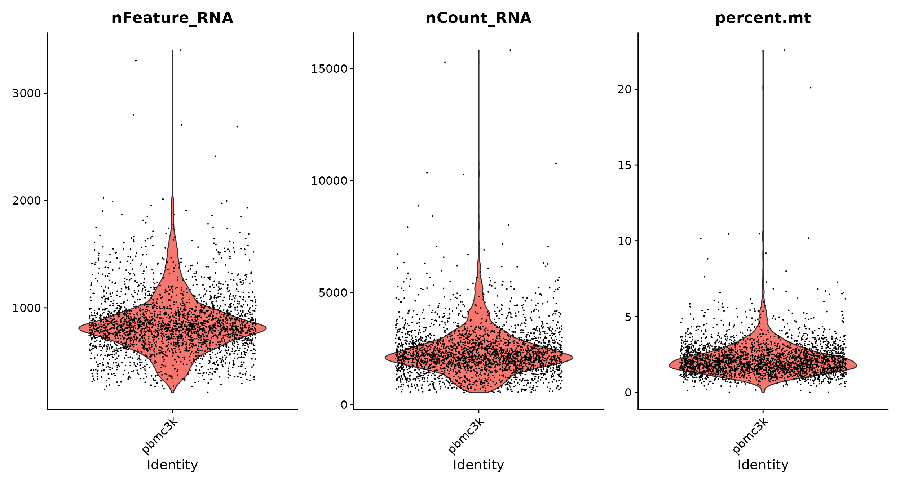
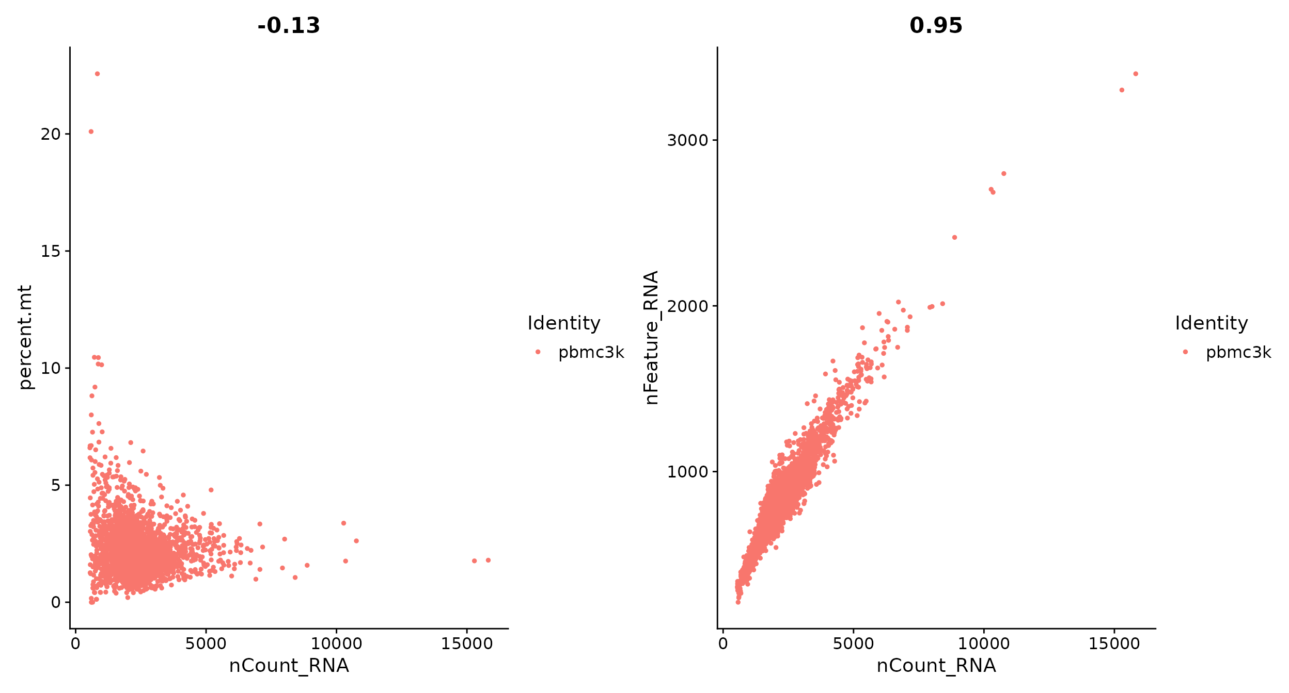
Seurat analysis pipeline
QC and select cells
obj[["percent.mt"]] <- PercentageFeatureSet(obj, pattern = "^MT-")
VlnPlot(obj, features = c("nFeature_RNA", "nCount_RNA", "percent.mt"), ncol = 3)
plot1 <- FeatureScatter(obj, feature1 = "nCount_RNA", feature2 = "percent.mt")
plot2 <- FeatureScatter(obj, feature1 = "nCount_RNA", feature2 = "nFeature_RNA")
plot1 + plot2
obj <- subset(obj, subset = nFeature_RNA > 200 & nFeature_RNA < 2500 & percent.mt < 5)
obj
(note: 62 cells are filtered out)

Slide 9
Seurat analysis pipeline
QC and select cells
Normalize data
  Library size 10000
  Log transformation
obj <- NormalizeData(obj, normalization.method = "LogNormalize", scale.factor = 10000)
obj@assays$RNA@data
colSums(exp(obj@assays$RNA@data)-1)

Slide 10
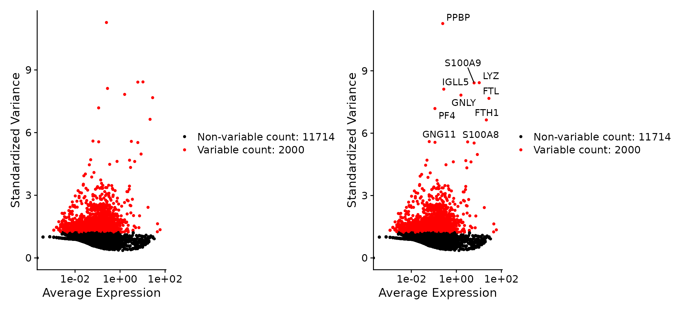
Seurat analysis pipeline
QC and select cells
Normalize data
  Library size 10000
  Log transformation
Select highly variable genes
obj <- FindVariableFeatures(obj, selection.method = "vst", nfeatures = 2000)
# Identify the 10 most highly variable genes
top10 <- head(VariableFeatures(obj), 10)
top10
# plot variable features with and without labels
plot1 <- VariableFeaturePlot(obj)
plot2 <- LabelPoints(plot = plot1, points = top10, repel = TRUE)
plot1 + plot2

Slide 11
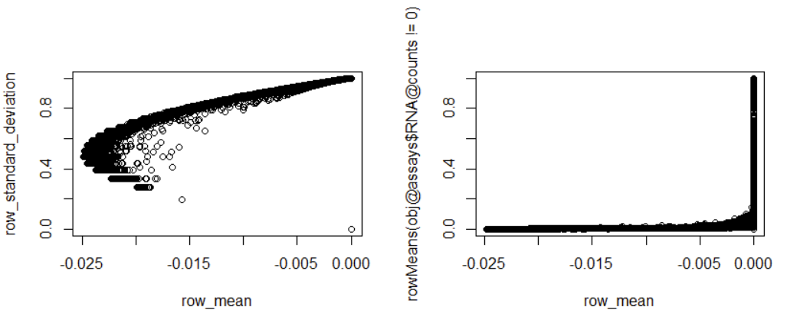
Seurat analysis pipeline
QC and select cells
Normalize data
  Library size 10000
  Log transformation
Select highly variable genes
Scale data
all.genes <- rownames(obj)
length(all.genes)
obj <- ScaleData(obj, features = all.genes)
obj@assays$RNA@scale.data
obj@assays$RNA@scale.data[1:5,1:5]
row_standard_deviation = apply(obj@assays$RNA@scale.data, 1, sd)
row_mean <- apply(obj@assays$RNA@scale.data, 1, mean)
par(mfrow=c(1,2))
plot(row_mean,row_standard_deviation)
plot(row_mean, rowMeans(obj@assays$RNA@counts!=0))

Slide 12
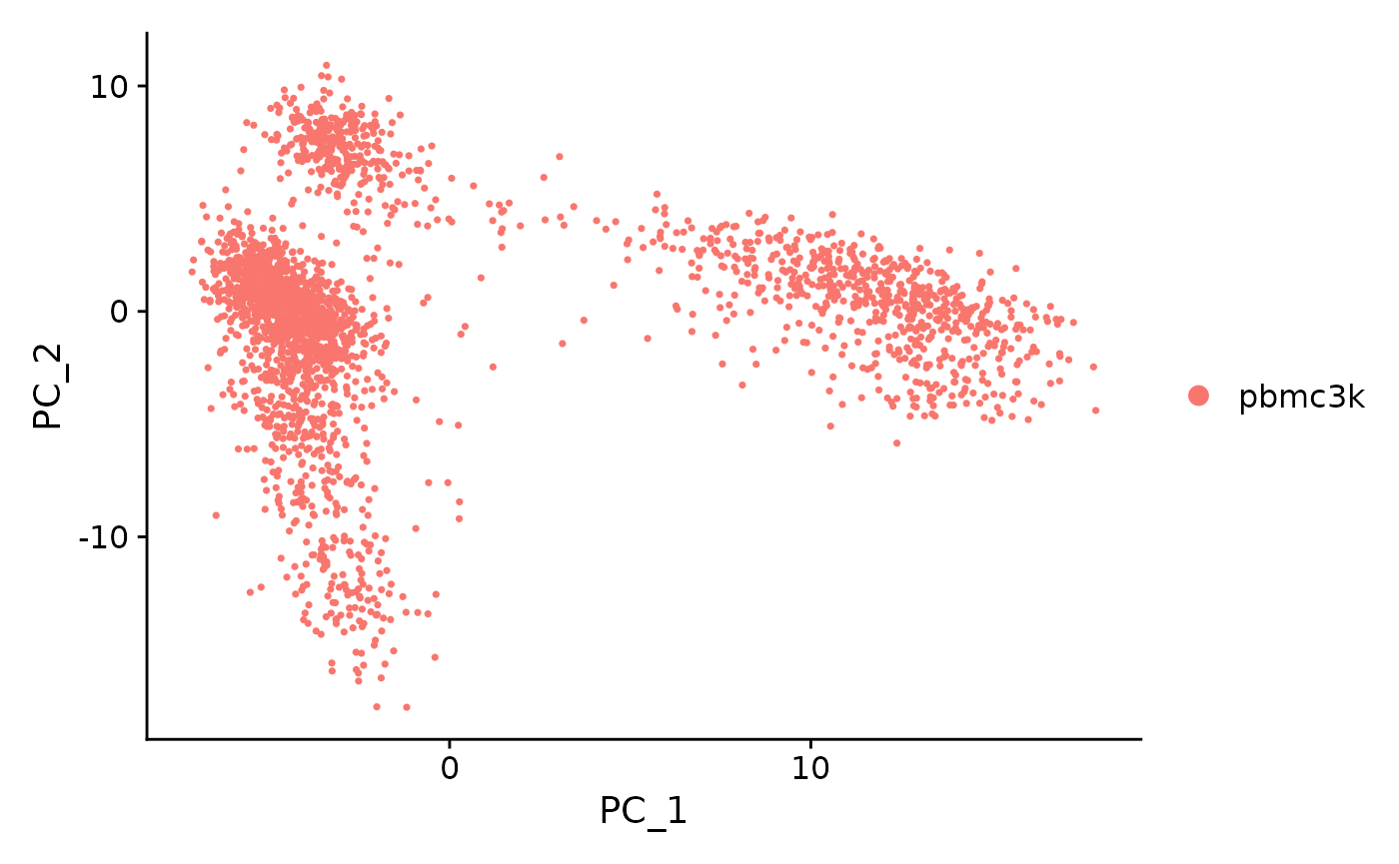
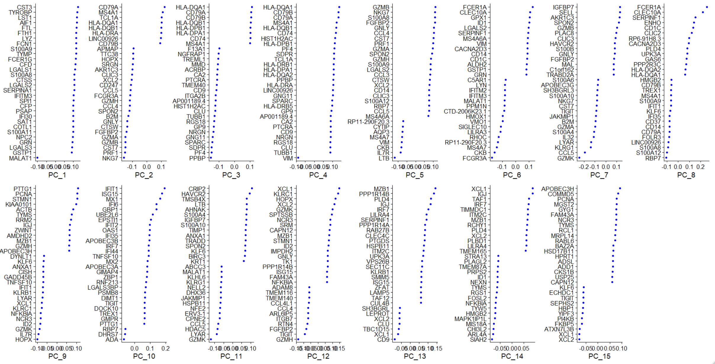
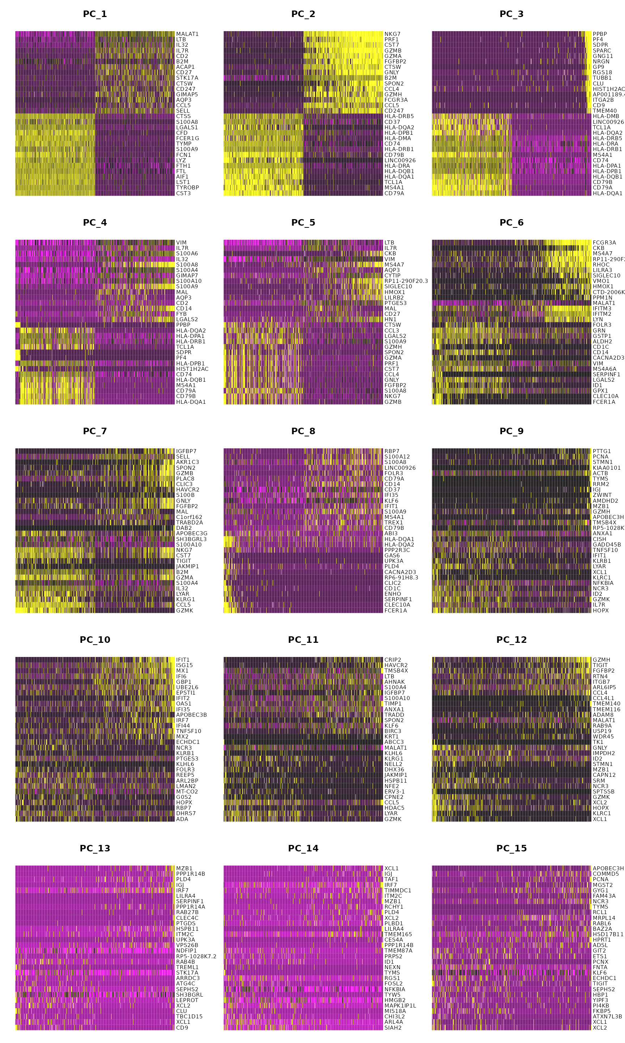
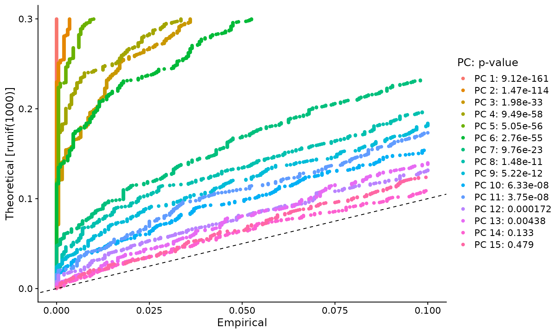
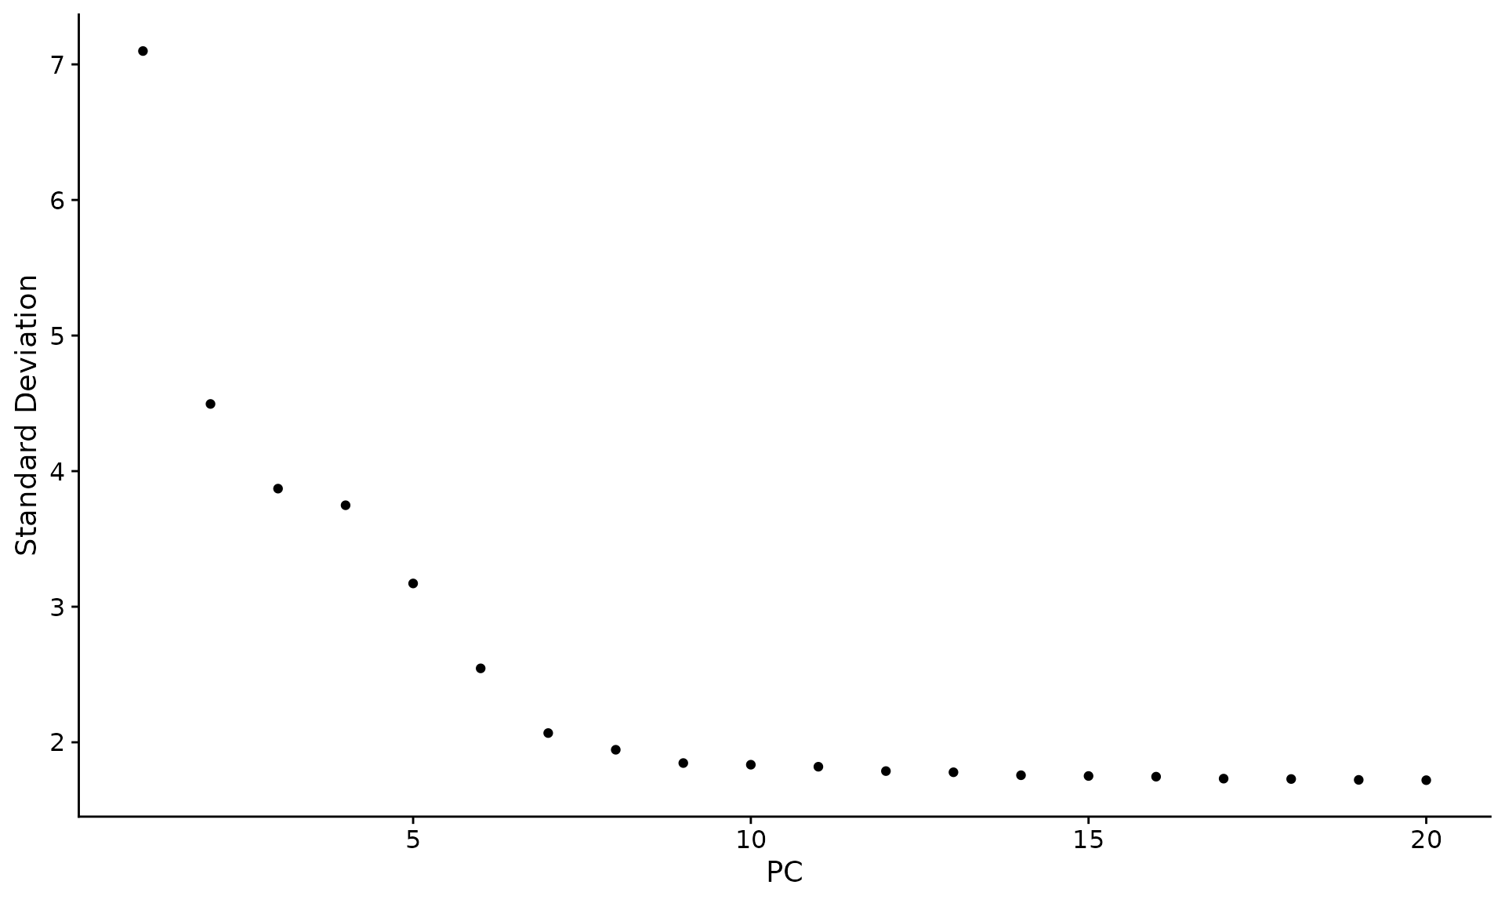
Seurat analysis pipeline
obj <- RunPCA(obj, features = VariableFeatures(object = obj))
DimPlot(obj, reduction = "pca")
# plot(obj@reductions$pca@cell.embeddings[,1], obj@reductions$pca@cell.embeddings[,2])
VizDimLoadings(obj, dims = 1:15, reduction = "pca", ncol = 3)
DimHeatmap(obj, dims = 1:15, cells = 500, balanced = TRUE)
obj <- JackStraw(obj, num.replicate = 100)
obj <- ScoreJackStraw(obj, dims = 1:20)
JackStrawPlot(obj, dims = 1:15)
ElbowPlot(obj)
QC and select cells
Normalize data
  Library size 10000
  Log transformation
Select highly variable genes
Scale data
PCA

Slide 13
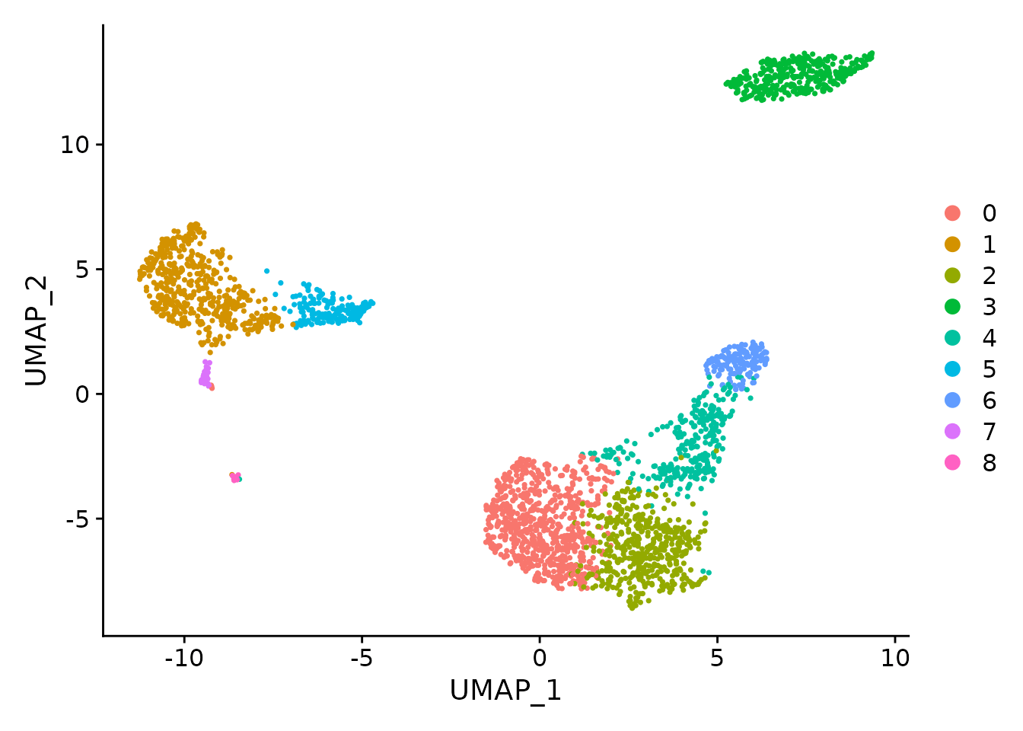
Seurat analysis pipeline
obj <- FindNeighbors(obj, dims = 1:10)
obj <- FindClusters(obj, resolution = 0.5)
obj@meta.data[1:10,]
obj <- RunUMAP(obj, dims = 1:10)
DimPlot(obj, reduction = "umap")
cluster3.markers <- FindMarkers(obj, ident.1 = 3, min.pct = 0.25)
head(cluster3.markers, n = 5)
obj.markers <- FindAllMarkers(obj, only.pos = TRUE, min.pct = 0.25, logfc.threshold = 0.25)
obj.markers %>%
group_by(cluster) %>%
slice_max(n = 2, order_by = avg_log2FC)
QC and select cells
Normalize data
  Library size 10000
  Log transformation
Select highly variable genes
Scale data
PCA
Clustering + umap
# A tibble: 18 × 7
# Groups: cluster [9]
p_val avg_log2FC pct.1 pct.2 p_val_adj cluster gene
<dbl> <dbl> <dbl> <dbl> <dbl> <fct> <chr>
1 9.57e- 88 1.36 0.447 0.108 1.31e- 83 0 CCR7
2 3.75e-112 1.09 0.912 0.592 5.14e-108 0 LDHB
3 0 5.57 0.996 0.215 0 1 S100A9
4 0 5.48 0.975 0.121 0 1 S100A8
5 1.06e- 86 1.27 0.981 0.643 1.45e- 82 2 LTB
6 2.97e- 58 1.23 0.42 0.111 4.07e- 54 2 AQP3
7 0 4.31 0.936 0.041 0 3 CD79A
8 9.48e-271 3.59 0.622 0.022 1.30e-266 3 TCL1A
9 5.61e-202 3.10 0.983 0.234 7.70e-198 4 CCL5
10 7.25e-165 3.00 0.577 0.055 9.95e-161 4 GZMK
11 3.51e-184 3.31 0.975 0.134 4.82e-180 5 FCGR3A
12 2.03e-125 3.09 1 0.315 2.78e-121 5 LST1
13 3.13e-191 5.32 0.961 0.131 4.30e-187 6 GNLY
14 7.95e-269 4.83 0.961 0.068 1.09e-264 6 GZMB
15 1.48e-220 3.87 0.812 0.011 2.03e-216 7 FCER1A
16 1.67e- 21 2.87 1 0.513 2.28e- 17 7 HLA-DPB1
17 1.92e-102 8.59 1 0.024 2.63e- 98 8 PPBP
18 9.25e-186 7.29 1 0.011 1.27e-181 8 PF4

Slide 14
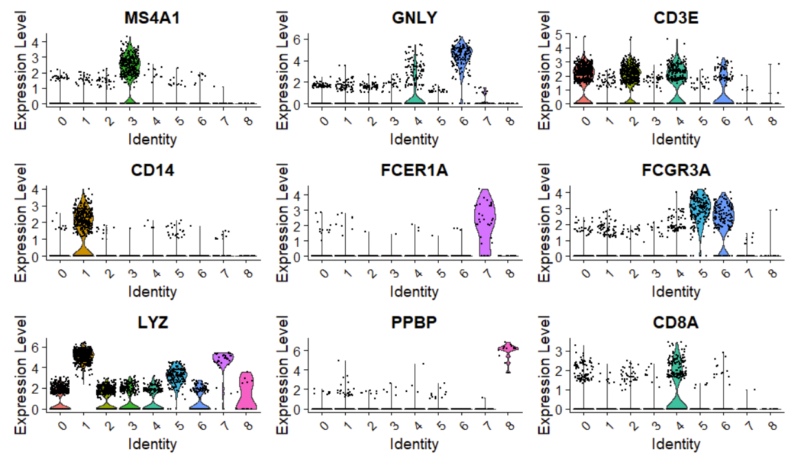
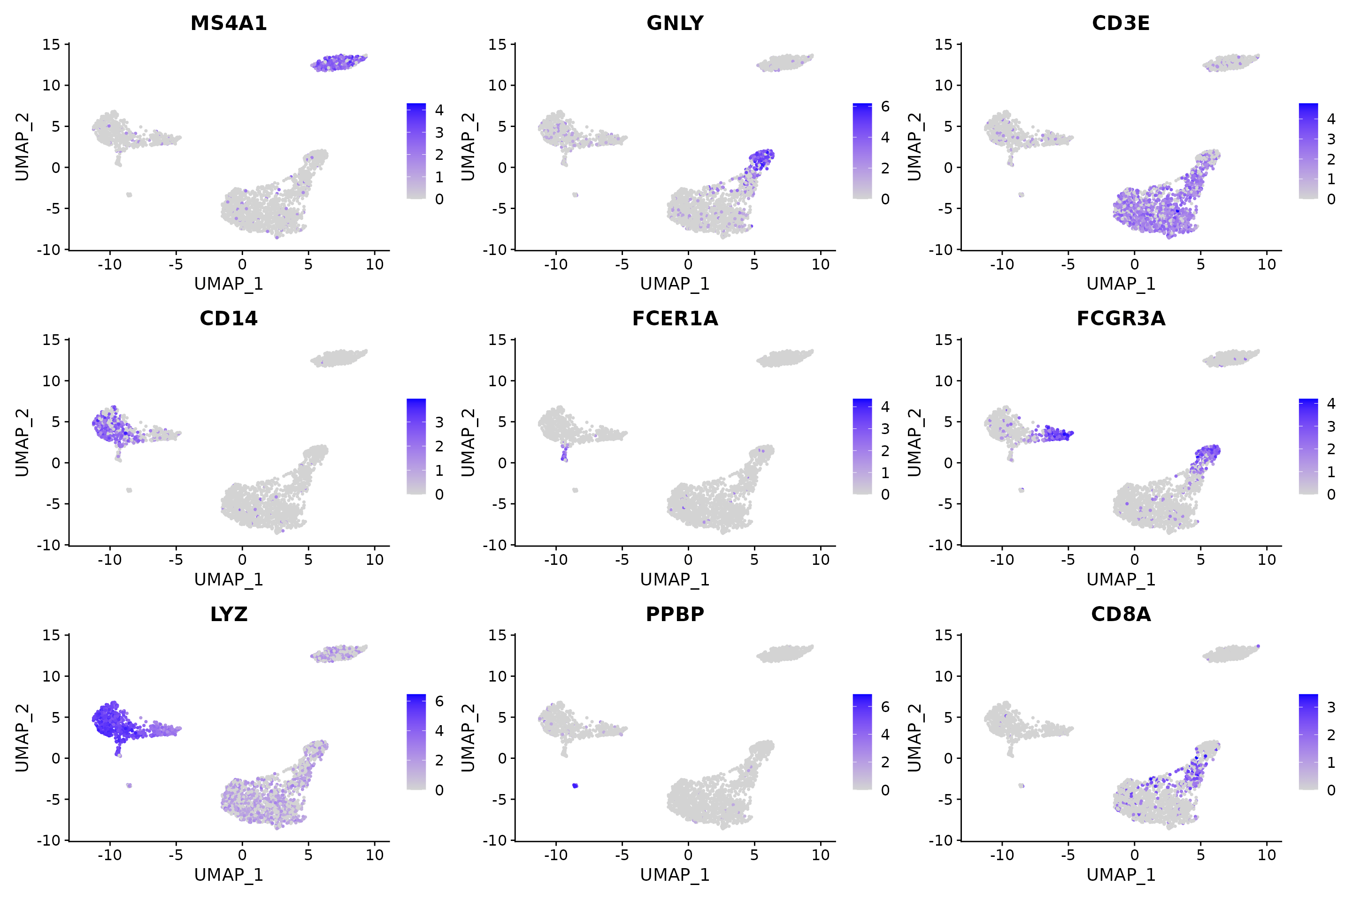
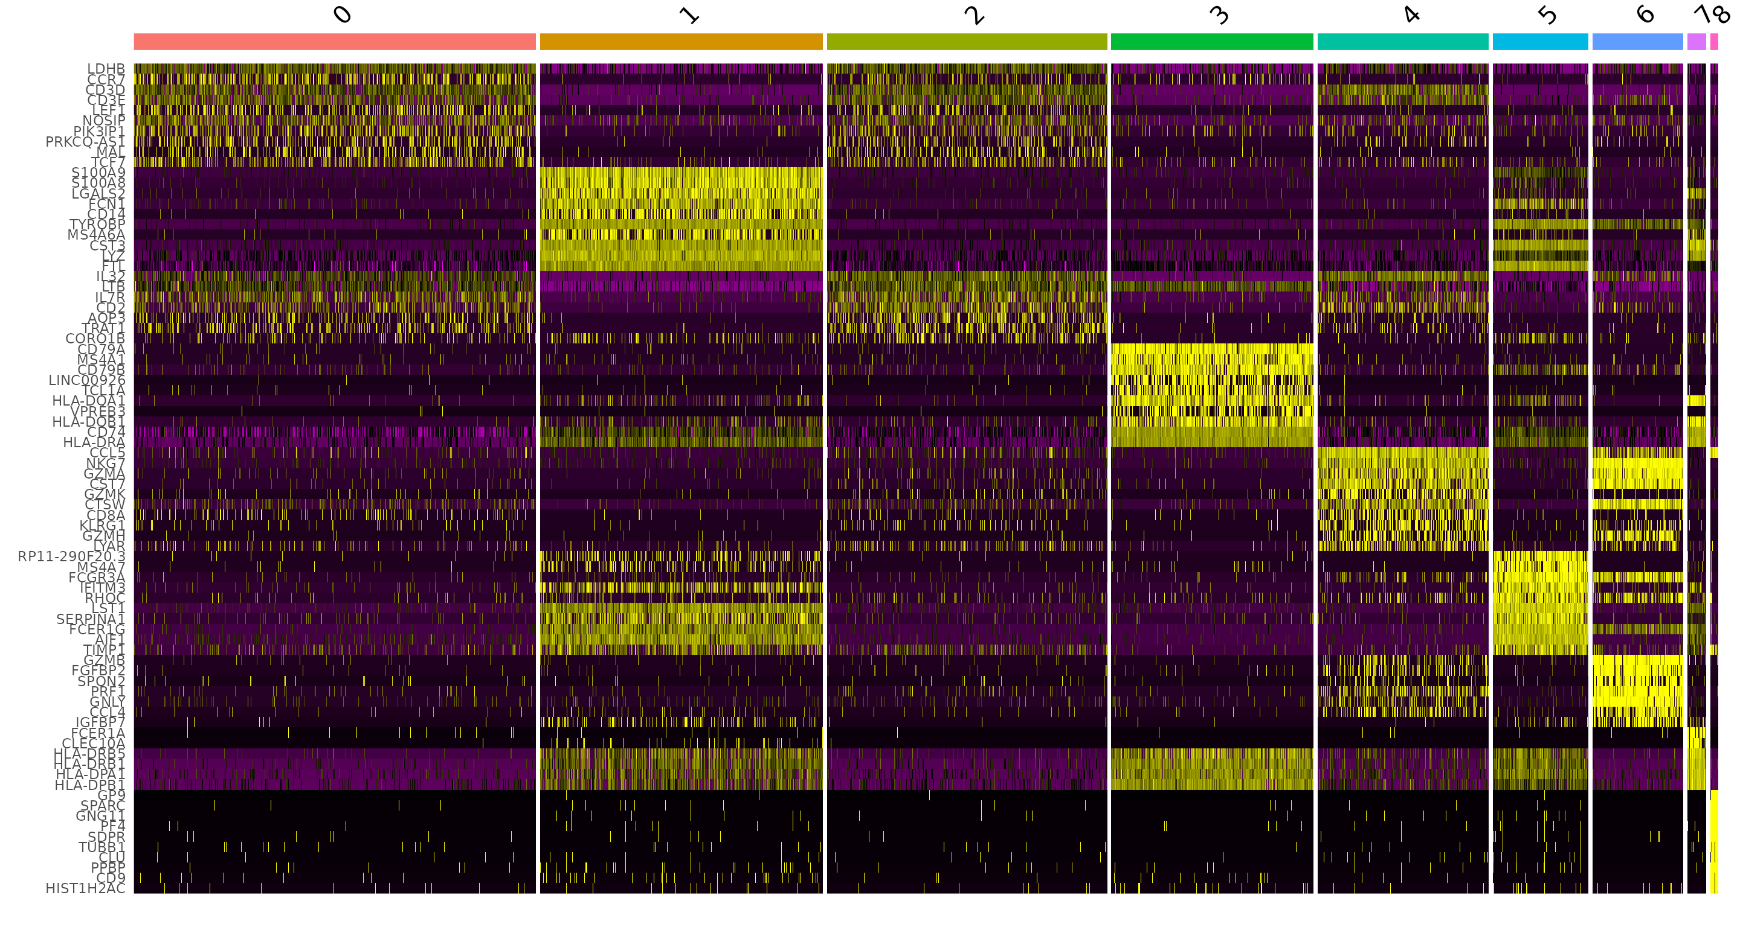
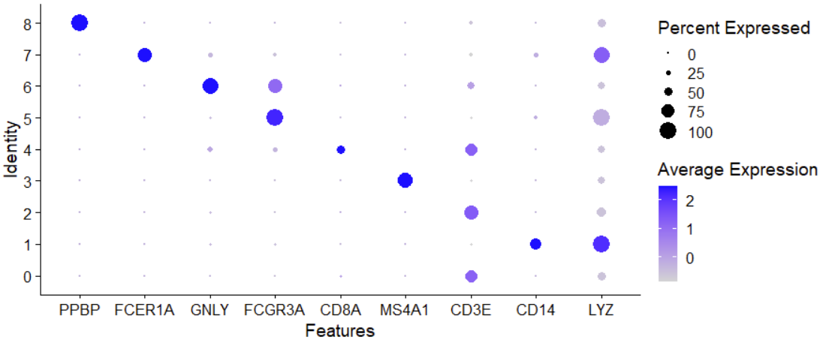
Seurat analysis pipeline
VlnPlot(obj, features = c("MS4A1", "GNLY", "CD3E", "CD14", "FCER1A", "FCGR3A", "LYZ", "PPBP", "CD8A"), group.by = "seurat_clusters", ncol = 3)
FeaturePlot(obj, features = c("MS4A1", "GNLY", "CD3E", "CD14", "FCER1A", "FCGR3A", "LYZ", "PPBP", "CD8A"))
DotPlot(obj, features = c("PPBP", "FCER1A", "GNLY", "FCGR3A", "CD8A", "MS4A1", "CD3E", "CD14", "LYZ"), group.by = "seurat_clusters")
obj.markers %>%
group_by(cluster) %>%
top_n(n = 10, wt = avg_log2FC) -> top10
DoHeatmap(obj, features = top10$gene) + NoLegend()
QC and select cells
Normalize data
  Library size 10000
  Log transformation
Select highly variable genes
Scale data
PCA
Clustering + umap
Marker genes and visualizations

Slide 15
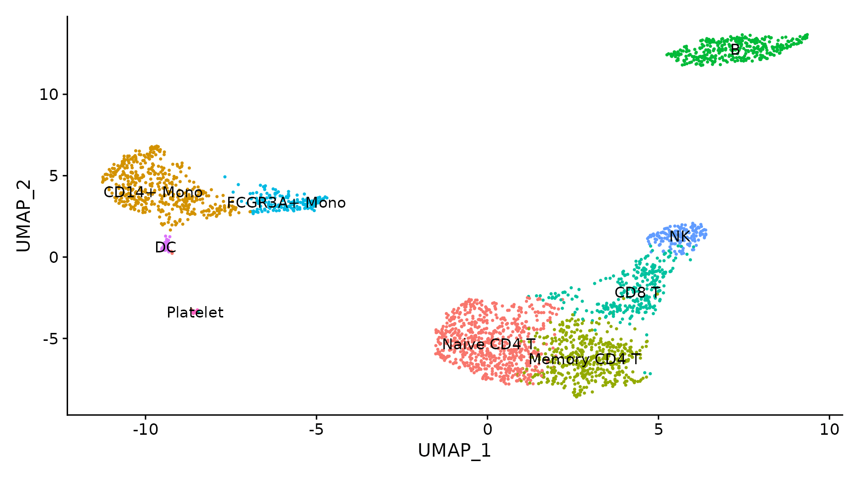
Seurat analysis pipeline
new.cluster.ids <- c("Naive CD4 T", "CD14+ Mono", "Memory CD4 T", "B", "CD8 T", "FCGR3A+ Mono",
"NK", "DC", "Platelet")
names(new.cluster.ids) <- levels(obj)
obj <- RenameIdents(obj, new.cluster.ids)
Idents(obj)
DimPlot(obj, reduction = "umap", label = TRUE, pt.size = 0.5) + NoLegend()
QC and select cells
Normalize data
  Library size 10000
  Log transformation
Select highly variable genes
Scale data
PCA
Clustering + umap
Marker genes and visualizations
Annotate clusters

Slide 16
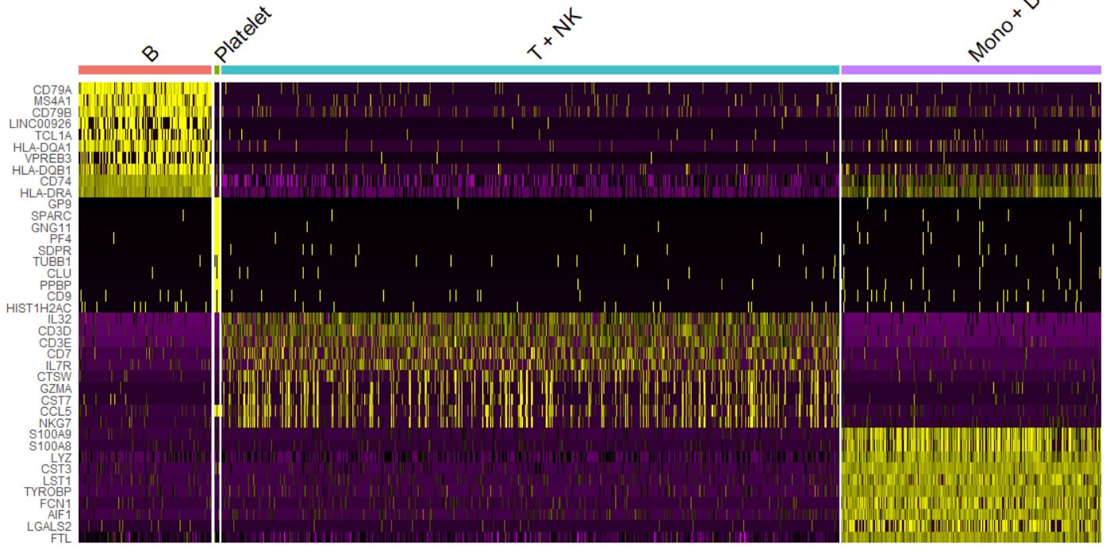
Seurat analysis pipeline
QC and select cells
Normalize data
  Library size 10000
  Log transformation
Select highly variable genes
Scale data
PCA
Clustering + umap
Marker genes and visualizations
Annotate clusters
obj2 <- obj
levels(obj2@active.ident) <- c(levels(obj2@active.ident),"T + NK")
obj2@active.ident[obj2@active.ident=='Naive CD4 T']='T + NK'
obj2@active.ident[obj2@active.ident=='Memory CD4 T']='T + NK'
obj2@active.ident[obj2@active.ident=='CD8 T']='T + NK'
obj2@active.ident[obj2@active.ident=='NK']='T + NK'
obj2@active.ident <- droplevels(obj2@active.ident)
levels(obj2@active.ident)
levels(obj2@active.ident) <- c(levels(obj2@active.ident),"Mono + DC")
obj2@active.ident[obj2@active.ident=='FCGR3A+ Mono']='Mono + DC'
obj2@active.ident[obj2@active.ident=='CD14+ Mono']='Mono + DC'
obj2@active.ident[obj2@active.ident=='DC']='Mono + DC'
obj2@active.ident <- droplevels(obj2@active.ident)
levels(obj2@active.ident)
obj2.markers <- FindAllMarkers(obj2, only.pos = TRUE, min.pct = 0.25, logfc.threshold = 0.25)
obj2.markers %>%
group_by(cluster) %>%
top_n(n = 10, wt = avg_log2FC) -> top10
DoHeatmap(obj2, features = top10$gene) + NoLegend()

Slide 17
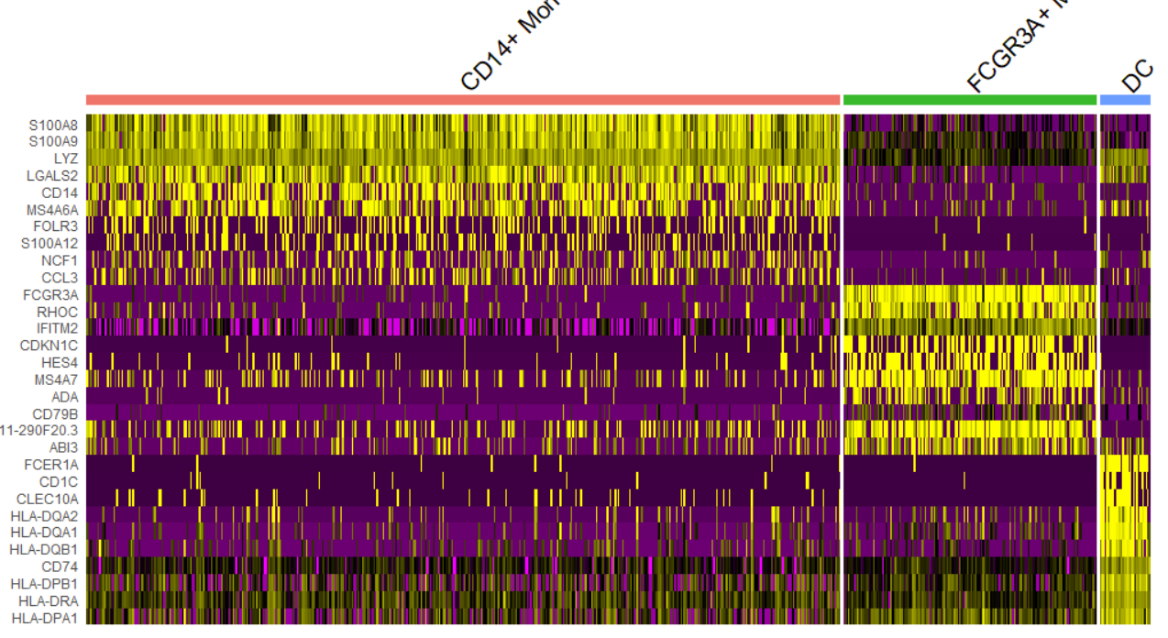
Seurat analysis pipeline
QC and select cells
Normalize data
  Library size 10000
  Log transformation
Select highly variable genes
Scale data
PCA
Clustering + umap
Marker genes and visualizations
Annotate clusters
obj3 <- subset(obj, subset = seurat_clusters==1 | seurat_clusters==5 | seurat_clusters==7 )
obj3.markers <- FindAllMarkers(obj3, only.pos = TRUE, min.pct = 0.25, logfc.threshold = 0.25)
obj3.markers %>%
group_by(cluster) %>%
top_n(n = 10, wt = avg_log2FC) -> top10
DoHeatmap(obj3, features = top10$gene) + NoLegend()

Slide 18
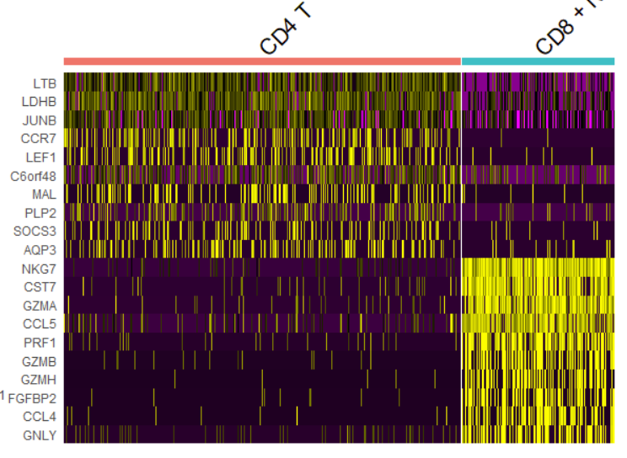
Seurat analysis pipeline
obj4 <- subset(obj, subset = seurat_clusters==0 | seurat_clusters==2 | seurat_clusters==4 | seurat_clusters==6)
levels(obj4@active.ident) <- c(levels(obj4@active.ident),"CD4 T")
obj4@active.ident[obj4@active.ident=='Naive CD4 T']='CD4 T'
obj4@active.ident[obj4@active.ident=='Memory CD4 T']='CD4 T'
levels(obj4@active.ident) <- c(levels(obj4@active.ident),"CD8 + NK")
obj4@active.ident[obj4@active.ident=='CD8 T']='CD8 + NK'
obj4@active.ident[obj4@active.ident=='NK']='CD8 + NK'
obj4@active.ident <- droplevels(obj4@active.ident)
levels(obj4@active.ident)
obj4.markers <- FindAllMarkers(obj4, only.pos = TRUE, min.pct = 0.25, logfc.threshold = 0.25)
obj4.markers %>%
group_by(cluster) %>%
top_n(n = 10, wt = avg_log2FC) -> top10
DoHeatmap(obj4, features = top10$gene) + NoLegend()
QC and select cells
Normalize data
  Library size 10000
  Log transformation
Select highly variable genes
Scale data
PCA
Clustering + umap
Marker genes and visualizations
Annotate clusters

Slide 19
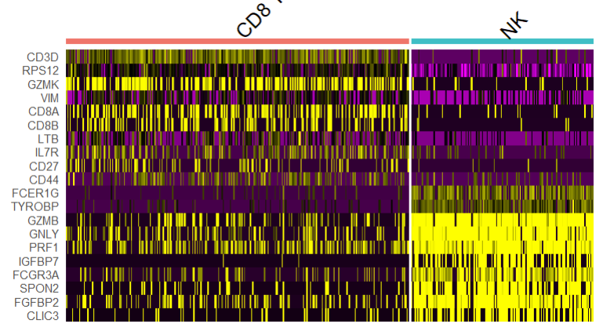
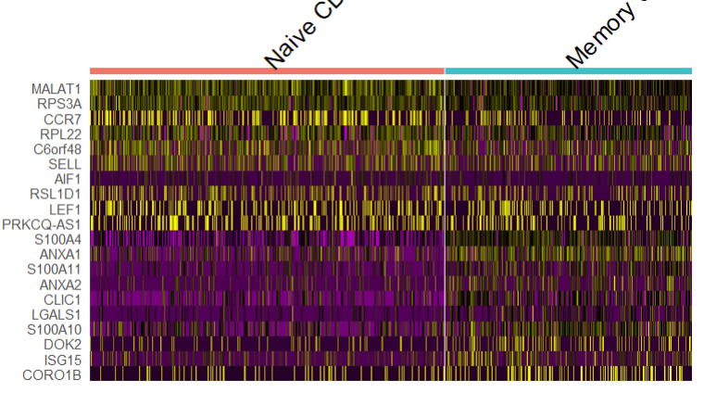
Seurat analysis pipeline
obj5 <- subset(obj, subset = seurat_clusters==4 | seurat_clusters==6)
obj5.markers <- FindAllMarkers(obj5, only.pos = TRUE, min.pct = 0.25, logfc.threshold = 0.25)
obj5.markers %>%
group_by(cluster) %>%
top_n(n = 10, wt = avg_log2FC) -> top10
DoHeatmap(obj5, features = top10$gene) + NoLegend()
obj6 <- subset(obj, subset = seurat_clusters==0 | seurat_clusters==2)
obj6.markers <- FindAllMarkers(obj6, only.pos = TRUE, min.pct = 0.25, logfc.threshold = 0.25)
obj6.markers %>%
group_by(cluster) %>%
top_n(n = 10, wt = avg_log2FC) -> top10
DoHeatmap(obj6, features = top10$gene) + NoLegend()
QC and select cells
Normalize data
  Library size 10000
  Log transformation
Select highly variable genes
Scale data
PCA
Clustering + umap
Marker genes and visualizations
Annotate clusters

