Slide 1
Summer Institutes of Statistical Genetics, 2021
Module 6: GENE EXPRESSION PROFILING
Greg Gibson and Peng Qiu
Georgia Institute of Technology
Lecture 9: eQTL ANALYSIS
greg.gibson@biology.gatech.edu http://www.cig.gatech.edu

Slide 2
Expression QTL analysis
The architecture of transcription maps genotype onto phenotype
Expression QTL (eQTL) are QTL that modulate transcript abundance in pedigrees or crosses
Expression SNP (eSNP) are SNPs that associate with transcript abundance in cohort studies
GWAS variants and eSNP “often” colocalize, but it is not that simple
At least 10% of transcripts differ in abundance between any two strains of most organisms; more than 50% across a species
Estimates of heritability of transcription also suggest that transcription often shows a higher genetic component than visible traits
One prominent eSNP may have the largest effect, but typically multiple variants at a locus will independently regulate the transcript, and overall trans-effects explain more of the variance

Slide 3
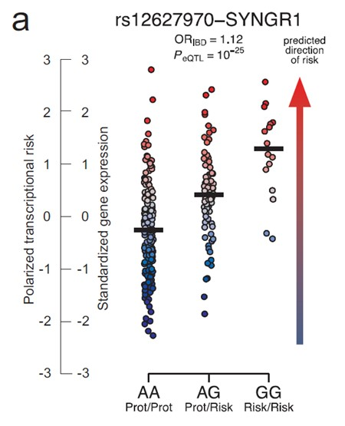
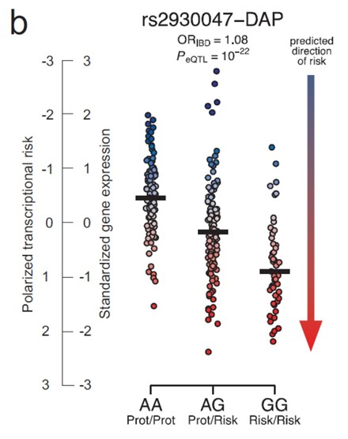
A couple of eSNPs

Slide 4
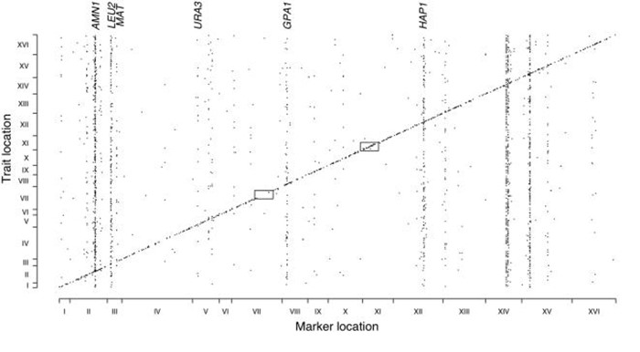
cis and trans eQTL
Strong tendency for eQTL to be in cis to the actual gene
Occasionally trans-eQTL clustered in hotspots
Ever-larger eQTL studies refine resolution and increase number of discoveries
Yeast: Ronald and Akey (2007) PLoS ONE 2: e678
Mice: Schadt, Friend et al (2003) Nature 422: 297-302

Slide 5
Meta-analysis
http://genenetwork.nl/bloodeqtlbrowser/
eQTL meta-analysis on 5,311 individuals replicated in 2,775 more
Found trans-eQTL for 233 SNPs at 103 loci many of which are also disease QTL
Also generates local cis-eSNPs for almost half the genome
Westra et al. (2013) Nature Genetics 45: 1238–1243

Slide 6
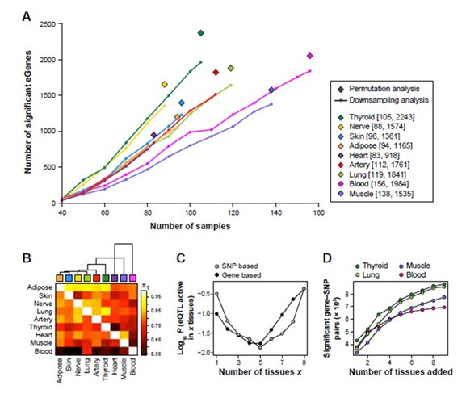
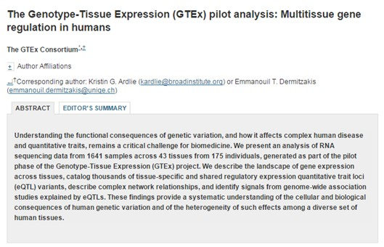
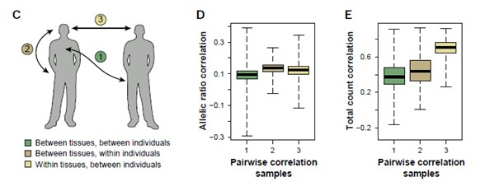
GTEx (Genotype-Tissue-Expression Project)
Science (2015) 9(5): e1003486

Slide 7
Some software
PLINK: The basic tool for GWAS
http://pngu.mgh.harvard.edu/~purcell/plink/tutorial.shtml
Matrix eQTL: Ultra-fast eQTL analysis
http://www.bios.unc.edu/research/genomic_software/Matrix_eQTL/
GEMMA: Genome-wide Efficient Mixed Model Association (GEMMA)
http://stephenslab.uchicago.edu/software.html#gemma
FMeQTL: Bayesian Joint mapping
https://github.com/xqwen/fmeqtl
DAP: Deterministic Approcimation of Posteriors (Fast Bayesian)
https://github.com/xqwen/dap
CAVIAR: Bayesian Fine Mapping
http://genetics.cs.ucla.edu/caviar/
Ventham et al (2016) Nature Communications 7: 13507

Slide 8
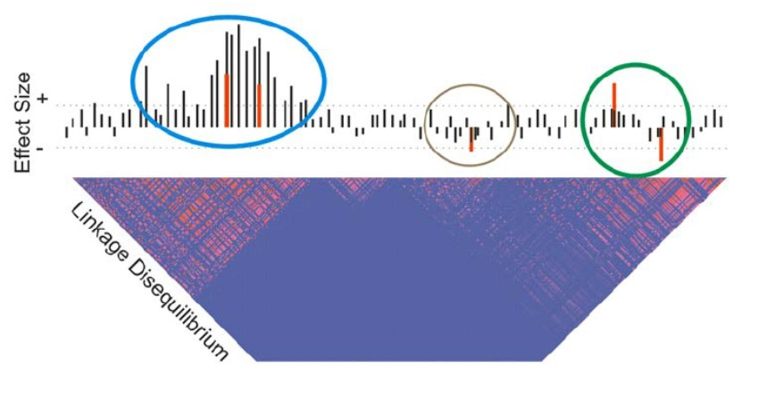
Why Colocalized Signals do not alone imply Causation
Sampling variance means that we can only map “credible intervals”
Many genes harbor multiple eSNPs, and possibly multiple trait associated SNPs
LD means that multiple sites can interfere with one another in estimation of peak locations
The nearest gene is only sometimes the one affected by a SNP!

Slide 9
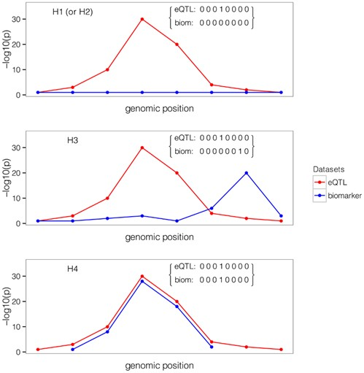
Coloc: A Bayesian test for colocalization of pairs of association signals
H1 is the hypothesis that there is only an eQTL signal at a locus
H2 is the hypothesis that there is only a GWAS signal at a locus.
H3 is the hypothesis that there are two independent eQTL and GWAS signals in linkage.
H4 is the strong hypothesis that the same SNP (not just the locus) is responsible for both the GWAS and eQTL.
Giambartolomei et al (2014) PLoS Genetics 10(5): e1004383

Slide 10
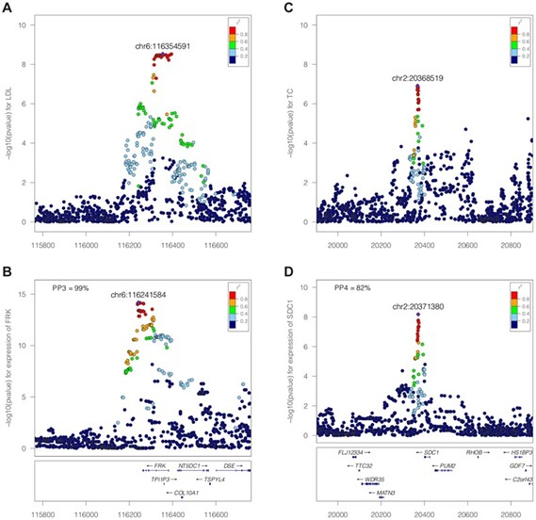
Examples of H3 and H4
On the left, the profile of association at the FRK locus with LDL (top) is very different from that with FRK expression.
H3 is the supported hypothesis.
On the right, even though there are two different peak SNPs, they are in the same strong LD region and the profiles are almost the same for Total Cholesterol and Soc1 expression.
H4 is the supported hypothesis.
Bayesian analysis evaluate each H relative to the other four and generates a confidence level for the most likely one.
Giambartolomei et al (2014) PLoS Genetics 10(5): e1004383

Slide 11
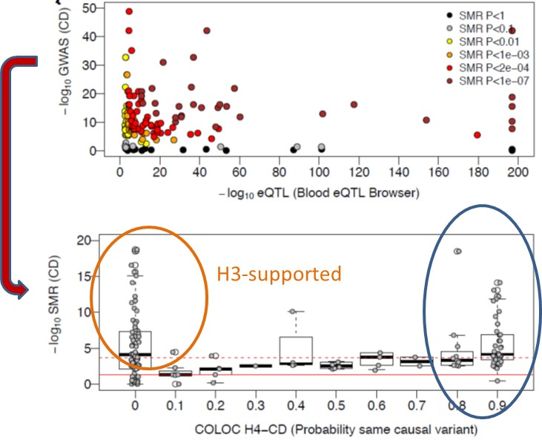
SMR and coloc are complementary
H4-supported

Slide 12
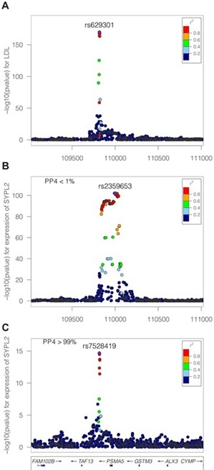
Limitations of colocalization analyses
Heavily dependent on statistical power of the contributing analyses, which is generally relatively low
Depends on high quality imputation if the SNPs are not directly typed
Assumes that the GWAS and eQTL are evaluated on the same population (there is no stratification)
A negative result may arise if the incorrect tissue is being studied for the gene expression
Assumes there is a single causal variant at each locus for each effect (which is very unlikely) although this example shows that conditional analysis has the potential to resolve joint effects
Giambartolomei et al (2014) PLoS Genetics 10(5): e1004383

Slide 13
Joint Mapping
A variety of open source methods are appearing that utilize Bayesian methods to perform joint mapping of eQTL
A statistical framework for joint eQTL analysis in multiple tissues.
Flutre T, Wen X, Pritchard J, Stephens M. PLoS Genet. 2013 9(5): e1003486.
This paper shows that combining signals across tissues increases power while also allowing assessment of whether the effect sizes are different in different cell types. Implemented in eQTLBMA software.
Cross-population joint analysis of eQTLs: Fine mapping and functional annotation.
Wen X, Luca F, Pique-Regi R. PLoS Genet. 11(4): e1005176.
This paper shows that combining signals across populations increases power while also allowing assessment of how incorporating ENCODE data improves resolution. Implemented in FM QTL software.
Efficient integrative multi-SNP association analysis via Deterministic Approximation of Posteriors
Wen X, Lee Y, Luca F, Pique-Regi R. AM J Hum. Genet. 98(6): 1114-1129.
This paper extends the framework for incorporating ENCODE data while allowing for multiple causal variants at each locus. Implemented in DAP software: http://github.com/xqwen/dap/

Slide 14
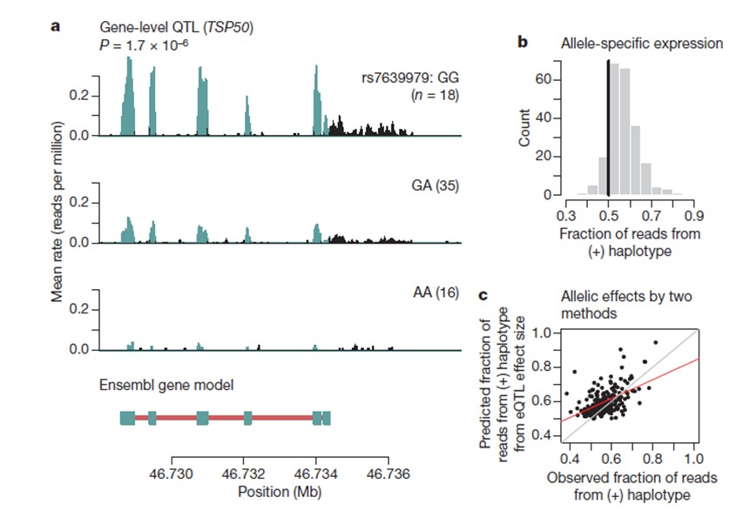
eQTL and Additivity
Pickrell et al. (2010) Nature 464: 768-772

Slide 15
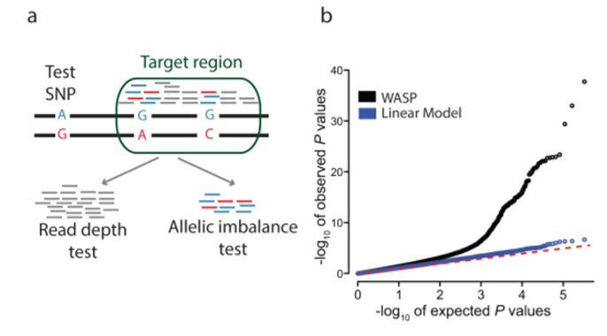
WASP
Formulates a CHT: Combined Haplotype Test
“The CHT jointly models two components: the allelic imbalance at phased heterozygous SNPs and the total read depth in the target region”
https://github.com/bmvdgeijn/WASP
Van de Geijn, et al (2015) Nature Methods 12: 1061-1063

Slide 16
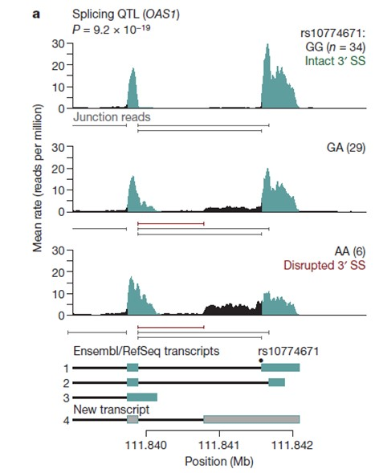
sQTL (Splicing QTL)
Pickrell et al. (2010) Nature 464: 768-772

Slide 17
MISO: Mixture of Isoforms
http://genes.mit.edu/burgelab/miso/
Estimates the Percent Spliced In (PSI, ψ) for various features:
Alternate First Exon
Mutually exclusive Exon
Excluded Exon
Included Intron
Alternate Splice Donor
Alternate Splice Acceptor
Alternate 3’ end
Katz et al. (2010) Nature Methods 7: 109–115

Slide 18
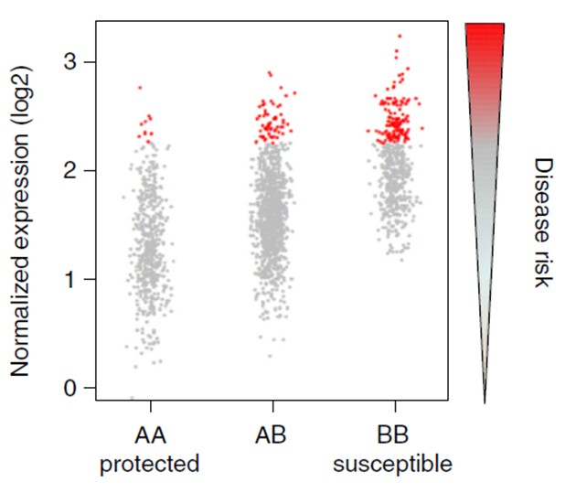
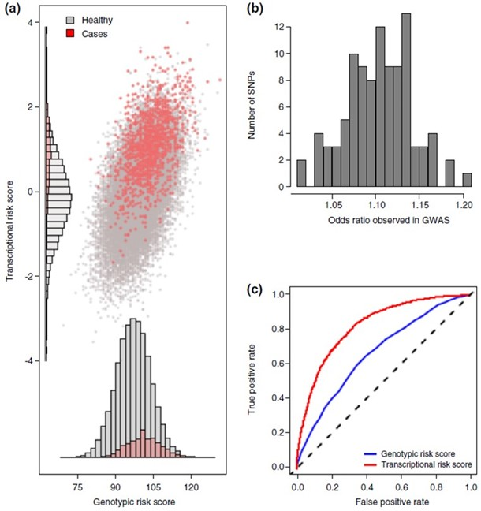
Transcriptional Risk Scores - theory
Gibson et al (2015) Genome Medicine 7: 60

Slide 19
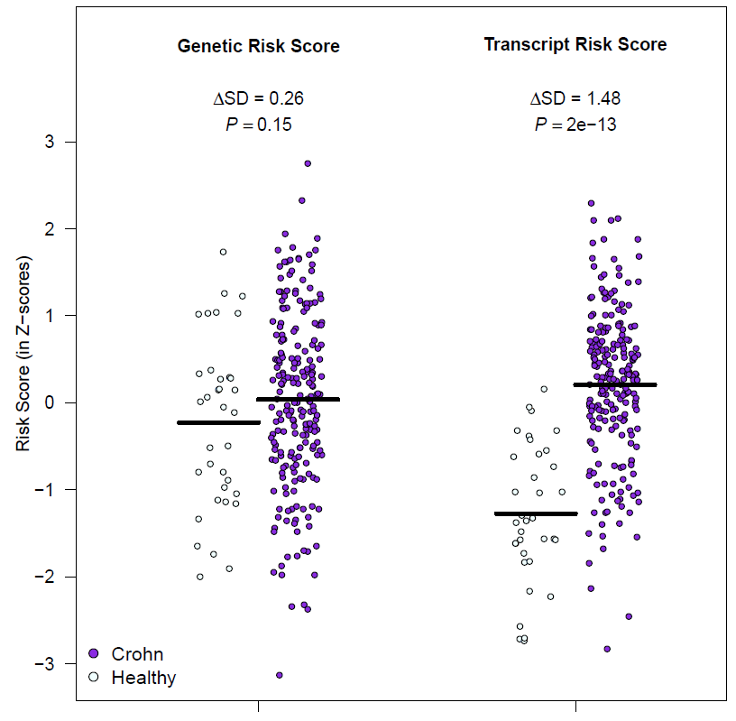
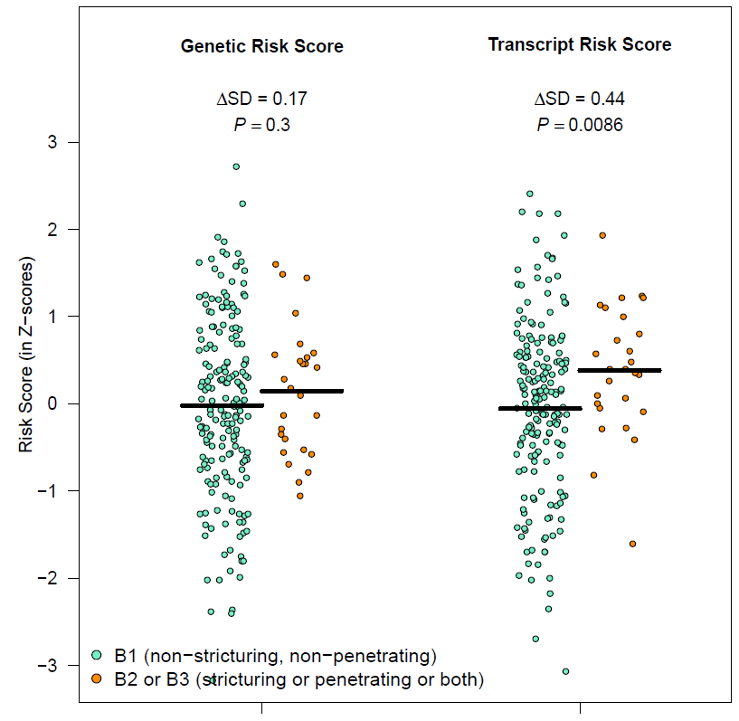
Transcriptional Risk Scores for Crohn’s Disease
Healthy-Disease
Disease Progression

