Slide 1
Summer Institutes of Statistical Genetics, 2023 SISG Module 6: Gene Expression Profiling
Lecture 09: Automated Cell Type Annotation and Interpretation
Peng Qiu and Greg Gibson
Georgia Institute of Technology

Slide 2
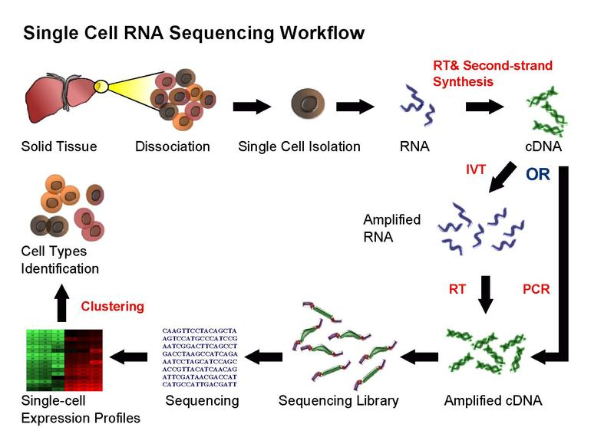
Single-cell RNA-seq

Slide 3
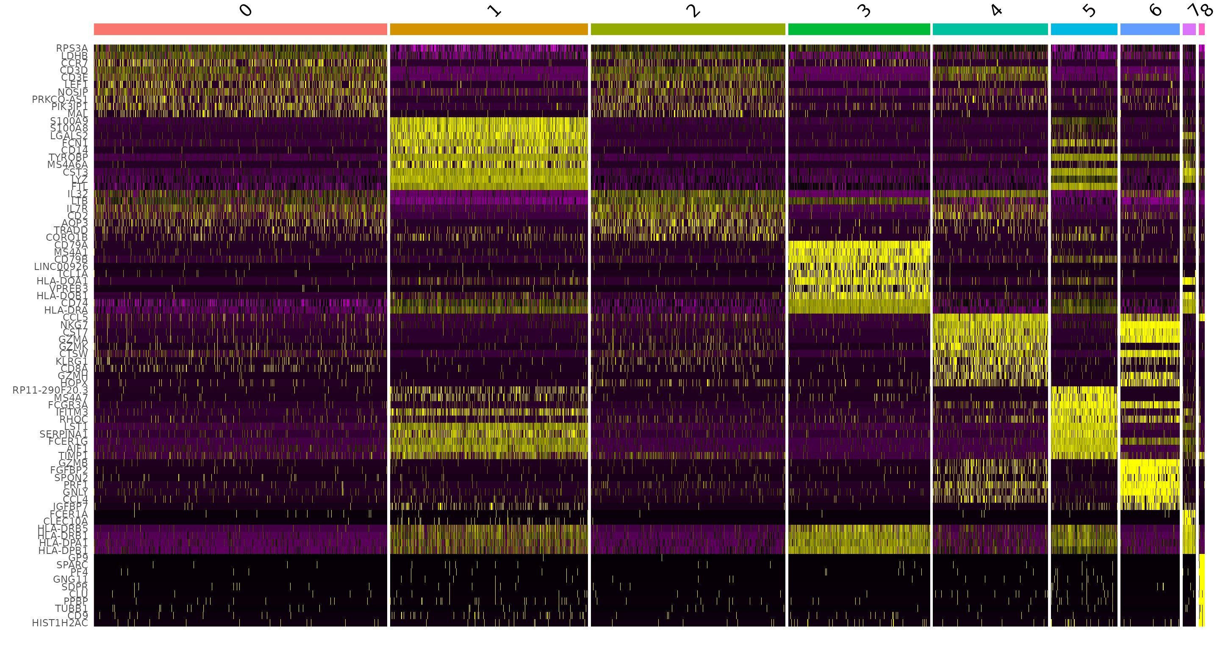
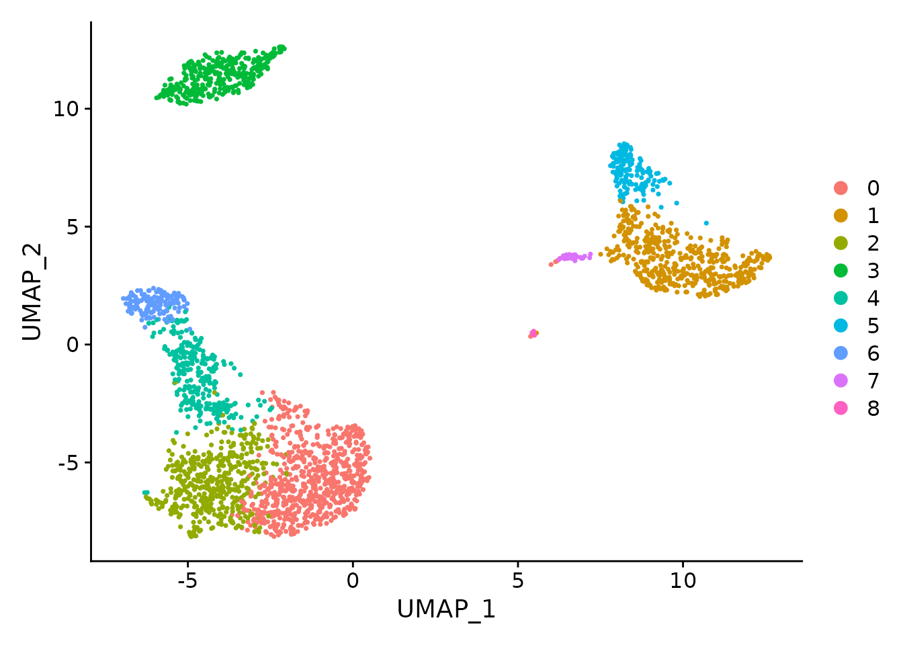
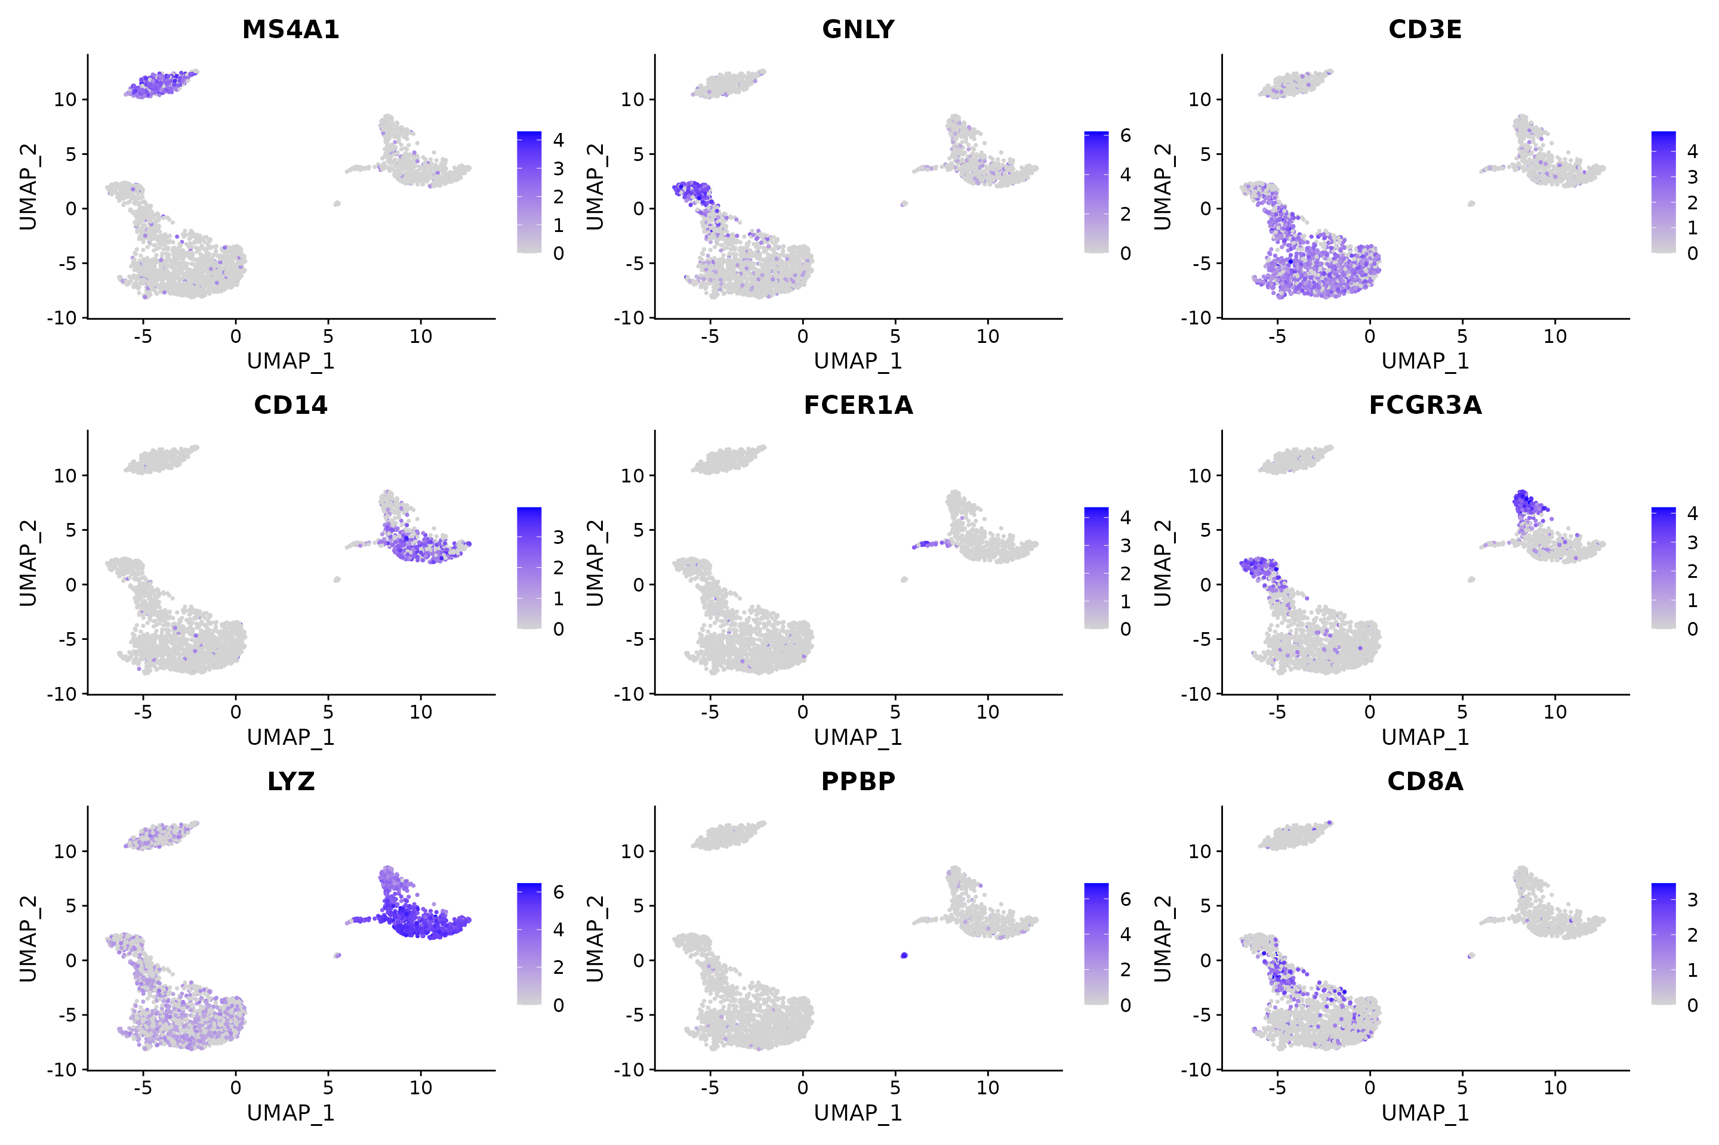
Cell type interpretation of clusters often done manually
Clustering result
Manual interpretation of clusters
This is subjective, time-consuming, and dependent on prior knowledge.
Can it be automated?

Slide 4
Mapping new data to prior database of marker genes
Prior database
New scRNAseq dataset
New cells
B cells | T cells | NK | …
CD19 | CD3 | GNLY | …
CD20 | CD4 | NKG7 | …
MS4A1 | CD8 | CD7 | …
… | … | … | …
genes
???????

Slide 5
Mapping new data to prior database of marker genes
Prior database
New scRNAseq dataset
What makes this difficult:
The numbers of established cell-type specific gene markers are often very small for many cell types.
Some cell types (subtypes) are defined by combination of marker genes (A+B+C-…), but such information is often incomplete in the literature.
New cells
B cells | T cells | NK | …
CD19 | CD3 | GNLY | …
CD20 | CD4 | NKG7 | …
MS4A1 | CD8 | CD7 | …
… | … | … | …
genes
???????

Slide 6
Mapping new data to prior database of marker genes
Prior database
New scRNAseq dataset
What makes this difficult:
The numbers of established cell-type specific gene markers are often very small for many cell types.
Some cell types (subtypes) are defined by combination of marker genes (A+B+C-…), but such information is often incomplete in the literature.
New cells
B cells | T cells | NK | …
CD19 | CD3 | GNLY | …
CD20 | CD4 | NKG7 | …
MS4A1 | CD8 | CD7 | …
… | … | … | …
genes
???????
Strategies to solve this problem:
Compute single-cell gene set enrichment score associated to each known cell type. Use the score to make predictions of cell type labels
Cluster the data and compute DE genes between clusters. Based on the overlap between the DE genes and known marker genes to make predictions (SCSA, scCATCH)
Use prior knowledge to manually define a decision tree. Use the decision to classify cells into the known cell types (Garnett)

Slide 7
Mapping new data to reference atlas
Reference atlas
New scRNAseq dataset
cells
New cells
genes
Same
genes
Annotations
B/CD4+T/CD8+T/monocytes
???????

Slide 8
Mapping new data to reference atlas
Reference atlas
New scRNAseq dataset
What makes this difficult:
The two datasets are generated by different single-cell technologies
Mismatch in terms of the biology between the two datasets
Similar cells from different tissue sources (colon vs ileum)
Reference is healthy, while new dataset is disease sample.
In the reference datasets, the difference among the annotated reference cell types are small
The scope of the reference dataset is very focused
The level of annotation is too detailed
cells
New cells
genes
Same
genes
Annotations
B/CD4+T/CD8+T/monocytes
???????

Slide 9
Mapping new data to reference atlas
Reference atlas
New query dataset
What makes this difficult:
The two datasets are generated by different single-cell technologies
Mismatch in terms of the biology between the two datasets
Similar cells from different tissue sources (colon vs ileum)
Reference is healthy, while new dataset is disease sample.
In the reference datasets, the difference among the annotated reference cell types are small
The scope of the reference dataset is very focused
The level of annotation is too detailed
cells
New cells
genes
Same
genes
Annotations
B/CD4+T/CD8+T/monocytes
???????
Strategies to solve this problem:
Remove the batch effect between reference and query, so that the classification problem become easier (e.g., Azimuth-Seurat-RPCA, MNN, …)
Find robust similarity metrics that are invariant to batch effect, so that prediction models built on those metrics are immune to the batch effect (e.g., scmap , MNN, deep learning, …)
Notes:
These two strategies are actually similar, and use similar techniques

Slide 10
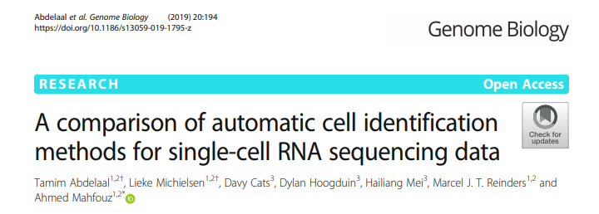
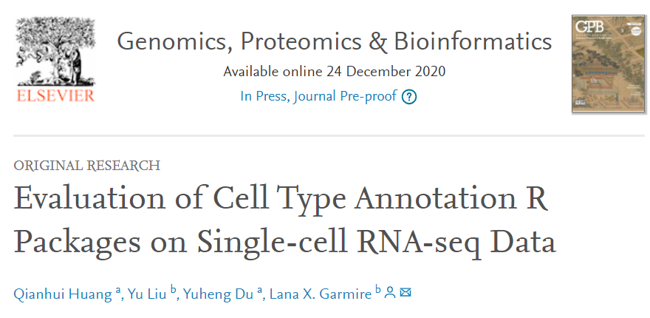
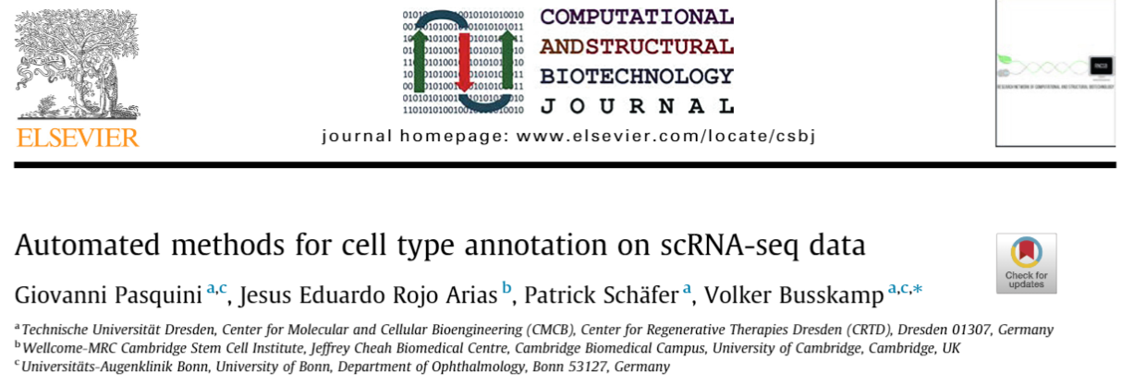
Many existing algorithms to solve this problem

Slide 11
Algorithm name | Algorithm details | Driven by data or prior knowledge | Label unknown | Label cells or clusters | Multiple ref datasets
Seurat / Azimuth | canonical correlation analysis (CCA) for data alignment, followed by a nearest neighbor classifier for prediction | Data | YES. Can be implemented by thresholding the prediction score for the most likely class. | cell
scPred | data integration by Seurat, dimension reduction by PCA, feature selection of the PCs, prediction by SVM | Data | YES. Threshold (0.9) the score for the most likely class, and label as unknown if the best score is not very high. | cell | Apply Seurat, merge to one ref
scmap-cell | Select top 500 features using M3Drop. Measure corr b/w a new cell and reference cells using cosine similarity. Perform KNN classification. | Data | YES. For a new cell, require the 2 NN have the same cell type, and the highest similarity be >0.5. If not, label as "unassigned" | cell | Separately run scmap against each ref
scmap-cluster | Select top 500 features using M3Drop. Represent each cluster by its centroid. Measure correlation b/w a new cell and the reference cluster centroids (Pearson and Spearman). | Data | YES. For a predicted assignment/label, require two correlation in agreement and one be >0.7. If not, label as "unassigned" | cell
CHETAH | Build a hierarchical tree using the reference dataset, via hierarchical clustering, unsupervised. For classification of new cell, compute corr b/w new cell and cluster average of a node in the tree, based on 200 genes with large FC between children of this node. Compare corr value against distribution of corr values of the reference cells in the node with the average of the node, use the comparison to decide which branch to follow and drill down, or label unknown | Data | YES. Compare corr value against distribution of corr for ref cells in the node, if the corr is too low, label as unknown | cell
SingleR | Take reference data of pure cell types profiled by microarray or bulk RNAseq. Identify variable genes among the reference cell types. Compute corr between a query cell and the bulk reference samples. Take the top cell types, identify variable genes again and compute corr again, which will further narrow down the top cell types. Iterate until only one top cell type remains. | Data | NO | cell
ACTINN | Simple 3-layer feedforward NN with ReLU. Straightforward training-testing framework. No special consideration for cross sample differences. Trained on Tabular Muris one platform, tested on the other platform, extremely high 99% accuracy. One interesting aspect is that they defined the class labels (cell types) themselves by running Seurat on the two datasets concatenated but not aligned. | Data | Yes. Look at the predicted probabilities for a cell, if the highest probability is <0.95, label it as "uncertain" | cell
LAmbDA | Straightforward training-testing framework. No special consideration for cross sample differences. The LAmbDA framework can be coupled with different classifiers (logistic regression, RF, NN) Strange why the algorithm has "Domain Adaption" as part of its name. | Data | NO | cell | YES. Need user to specify overlap of labels across datasets
SuperCT | Take reference count data, binarize (same as co-occurrence clustering). Take only homologous genes between human and mouse Build simple 3-layer fully connected feedforward NN Train with multiple datasets (MCA, human PBMC, etc) Apply to Tabula Muris for testing | Data | Yes Use synthetic cells/data to serve as the unknown class to train the NN model | cell
CaSTLe | Feature selection: top 100 highly expressed genes in ref and query datasets combined + top 100 genes most correlated (mutual info) with class labels in ref data. Remove highly correlated features. Discretize the data into four bins, 0 vs. 1 vs. 2~6 vs. >6 Train random forest on 80% of ref cells, and use the remaining 20% to tune RF Apply to query cells | Data | Yes. Look at the predicted probabilities | cell
SingleCellNet | Take raw count data from ref, identify genes that are differentially expressed between annotated cell types. Assume there are M genes that show DE. Perform top-pair transformation, so that M choose 2 features are obtained. Each feature is binary, and represents some form of co-occurrence of 2 genes. Surprisingly, details of how to do this is not described in the paper. Random forest train on reference, and test on query | Data | Yes. Before training RF, they used random sampling and permutation of the training data to generate an additional "rand" class. In testing, any query cell predicted to be of the "rand" class are considered as novel cell type | cell
scID | For each cell type in the reference data, identify DE genes by logFC, one list of positive/expressed genes, and one list of negative/not expressed genes (Given the algorithm, DE genes are likely defined by one cell type vs all other cell types, but has drawback compared to pairwise DE analysis). For each query cell, define expressed genes (likely binarize by zero vs non-zero). Compute precision/recall scores for the expressed genes against the positive and negative gene lists for a reference cell type. Do this for every query cell, which puts every cell as a point in the precision-recall space. Cluster the query cells in the P-R space, suggest the query cell cluster closes to [1 1] to be assigned to the cell type, and the rest to temporarily assign to "collectively others". For this cell type, based on the temporary assignment of query cells into two classes, learn LDA model (just mean and std of marker genes) based on the query data. Apply this LDA model back to all query cells, get a score for assigning each cell to this cell type. Do above for all cell types, get scores for all query cells for all cell types | Data | YES. cells that did not express any biomarker were labelled as “orphans” | cell
Cell Blast | Use neural network-based generative model to adaptively learn a nonlinear projection to a low-dimensional cell embedding space in an unsupervised manner using reference single-cell transcriptomes, with intra-reference batch effect corrected by adversarial alignment. When applied to label query data, Cell BLAST uses the pretrained model to project individual query cells into the same low-dimensional space, and then utilizes the posterior distribution in the low-dimensional space. There is some a special online-tuning mode that adaptively updates the model during querying to handle batch effect between query and reference data. (not sure exactly how this works) | Data | YES Reference cells with high similarity are returned as query hits to annotate query cells. Query cells with no significant hits are identified as unseen novel cell types. | cell
SciBet | Feature selection based on entropy. For selected genes, use ref data to compute mean and std of each cell type. For multivariate gaussian models For each query cell, evaluate the multivariate gaussian models | Data | NO | cell
scCATCH | Query -> clustering -> pairwise DE genes -> compare with marker lists from known datasets | Knowledge | NO | cluster
SCSA | Query -> clustering -> DE genes -> known databases and signatures | Knowledge | NO | cluster
DigitalCellSorter | Prior knowledge coming from a recent manually curated large database CellMarker. Method starts from custome clustering algorithm (figure out K by ARI on mini-batch kmeans, run clustering by PCA to 100D + tSNE to 2D + agglomerative clustering). For each cell cluster, compute the cluster centroid expression profile and derive some kind of z-score, and use the prior knowledge to do score the cluster against the known cell types Algorithm can be applied recursively | Knowledge | NO | cluster
Garnett | Use literature knowledge to define a hierarchy of cell types and their markers (similar to gating in flow). Identify cells with highly confident predictions (bearing markers that unambiguously identify their cell types). Train a classifier to predict the labels of the other cells (multinomial elastic-net regularized classifier). | Knowledge | YES. At each split of the hierarchy, look at the predicted probability from classifier, threshold odds ratio to call unknown | cell
CellAssign | Compile lists of marker genes for each known cell type (signature genes expressed higher in relevant cell type but no other cell types). Formulate a statistical model of the posterior probability of a cell belong to a cell type given its expression count vector and the marker gene lists and a couple of model parameters. Use EM algorithm to estimate the model parameters. Therefore, this approach is based on prior knowledge. No reference data needed. | Knowledge | YES. But almost no description available on exactly how they did this. | cell
SCINA | Prior knowledge of a group of signature genes that are characteristically highly expressed in one type of cell, compared to all other cell types (ie. Lowly expressed in other cell types). For each signature gene, assume it follows bio-modal distribution, independent from other genes (diagonal cov matrix). According to the mean and var for each marker gene and the signature genes for each cell type, build a multi-variate gaussian distribution for each cell type, and another gaussian for the novel cell type. Compute probability assignment for each cell. | Knowledge | YES. The subpopulation of cells that do not highly express the marker genes for any of the specified cell types will be designated as a novel cell type. (This method explicitly and positively call NEW) | cell
Moana | Construct reference: Start from an unlabeled scRNAseq dataset. Perform smoothing + VST + PCA + DBSCAN to define cell clusters, annotate with prior knowledge manually, build linear SVM classifier in PCA space. Repeat the process recursively to get a hierarchical clustering structure where each split is one iteration from the above (likely manual stopping criteria). Label new data: apply the hierarchy of classifiers to the new cells. (ISSUE: too many manual elements in constructing the ref classification hierarchy. As a result, it is difficult to create ref classification hierarchy for a new reference dataset or system) (NOTE: This is not just a mapping algorithm. It is almost like a full framework that aims to do clustering, in some sense similar to Seurat) | Knowledge | NO | cells
Notes:
Knowledge- vs data-driven
Explicitly label new
Label what
Handle multiple references

Slide 12
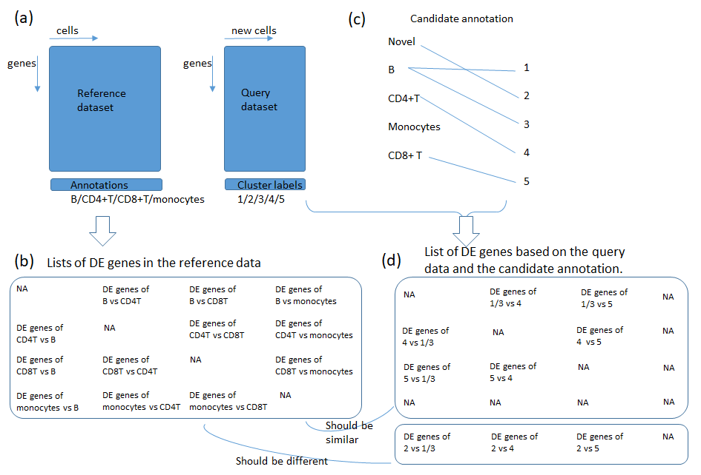
Our idea

Slide 13
Our solution
This is a combinatorial optimization problem.
Search space can be very large depending on number of cell types and cell clusters.
One heuristic recipe is: find a good candidate solution and iteratively improve upon it.

Slide 14
Our solution
This is a combinatorial optimization problem.
Search space can be very large depending on number of cell types and cell clusters.
One heuristic recipe is: find a good candidate solution and iteratively improve upon it.

Slide 15
Our solution
This is a combinatorial optimization problem.
Search space can be very large depending on number of cell types and cell clusters.
One heuristic recipe is: find a good candidate solution and iteratively improve upon it.
DE of clusters 1 vs 2
DE of cell type B vs monocyte

Slide 16
Our solution
This is a combinatorial optimization problem.
Search space can be very large depending on number of cell types and cell clusters.
One heuristic recipe is: find a good candidate solution and iteratively improve upon it.
DE of clusters 1 vs 2
DE of cell type B vs monocyte
DE of cell type B vs CD4 T
DE of cell type B vs CD8 T

Slide 17
Our solution
This is a combinatorial optimization problem.
Search space can be very large depending on number of cell types and cell clusters.
One heuristic recipe is: find a good candidate solution and iteratively improve upon it.
DE of clusters 1 vs 2
DE of cell type B vs monocyte
DE of clusters 1 vs 3
DE of cell type B vs CD4 T
DE of clusters 1 vs 4
DE of cell type B vs CD8 T
DE of clusters 1 vs 5

Slide 18
Our solution
This is a combinatorial optimization problem.
Search space can be very large depending on number of cell types and cell clusters.
One heuristic recipe is: find a good candidate solution and iteratively improve upon it.
DE of clusters 1 vs 2
DE of cell type B vs monocyte
DE of clusters 1 vs 3
Likelihood score of cluster 1 should be mapped to B cells
DE of cell type B vs CD4 T
DE of clusters 1 vs 4
DE of cell type B vs CD8 T
DE of clusters 1 vs 5

Slide 19
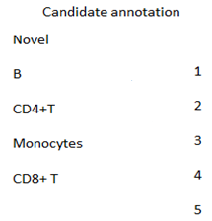
Our solution
This is a combinatorial optimization problem.
Search space can be very large depending on number of cell types and cell clusters.
One heuristic recipe is: find a good candidate solution and iteratively improve upon it.
rewire and evaluate

Slide 20
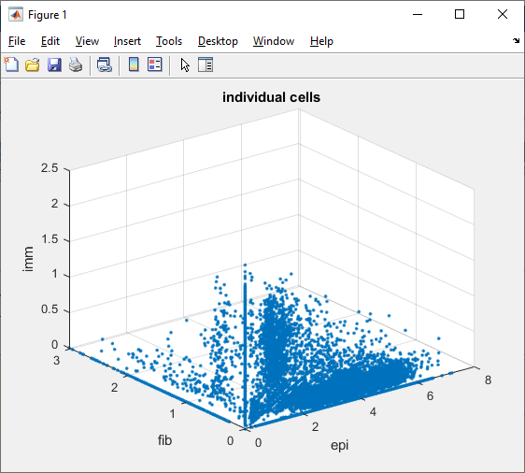
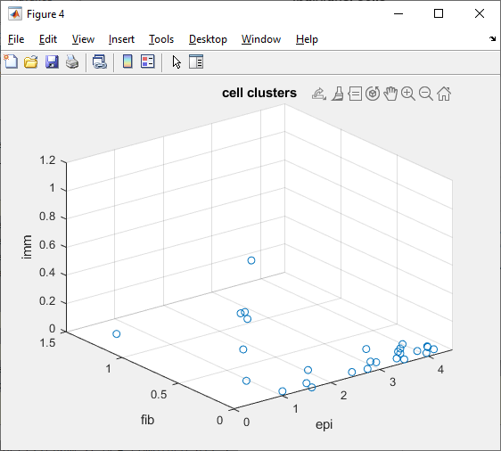
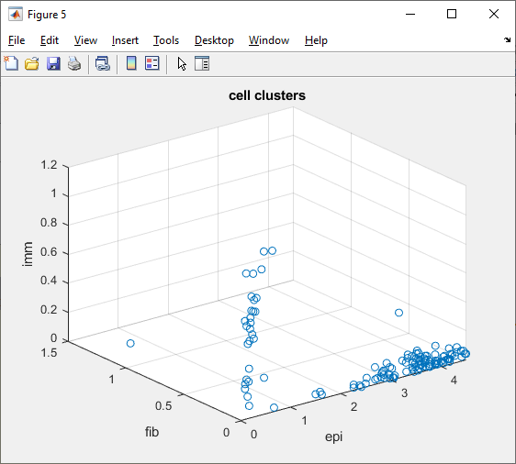
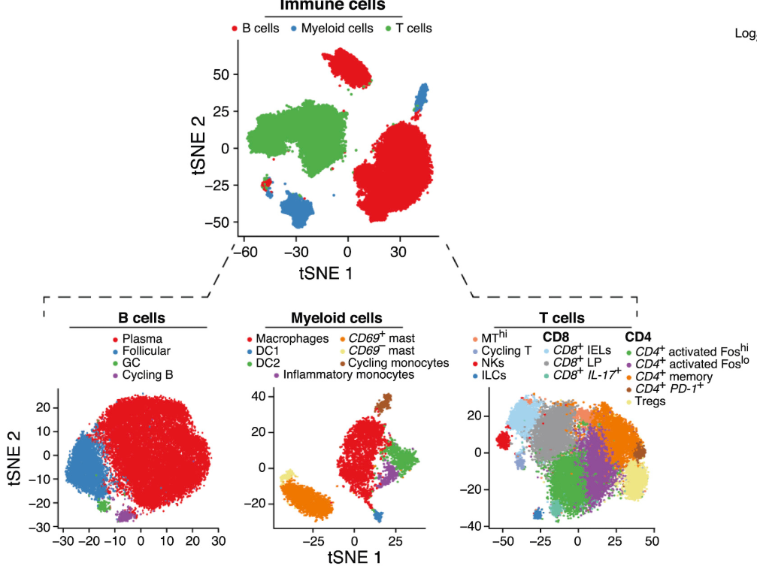
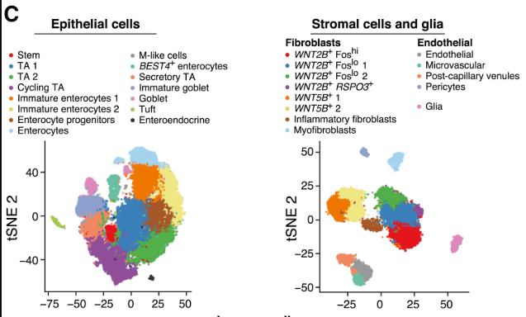
Results – our pilot data (Ileum samples from Crohn’s disease patients)
Marker genes for partitioning cells into epithelial, stromal, and immune compartments (Smillie et al)
Epithelial cells: EPCAM, KRT8, KRT18
Stromal cells: COL1A1, COL1A2, COL6A1, COL6A2, VWF, PLVAP, CDH5, S100B
Immune cells: CD52, CD2, CD3D, CD3G, CD3E, CD79A, CD79B, CD14, CD16, CD68, CD83, CSF1R, FCER1G
Good news:
We can reliably tell the tissue type of each cell cluster.
Use Smillie et al as an reference atlas (3 general cell types/compartments, or 51 more detailed cell types) to interpret clusters derived from our own data.
Notes:
Validation need ground truth

Slide 21
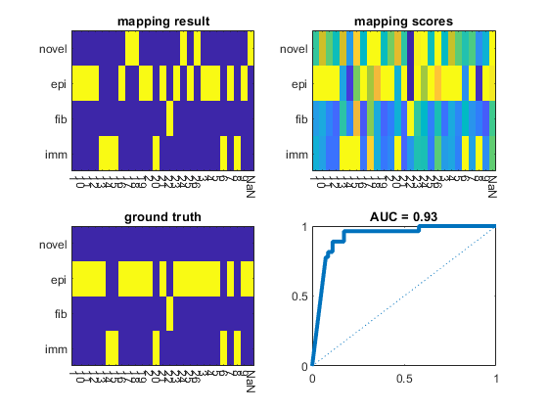
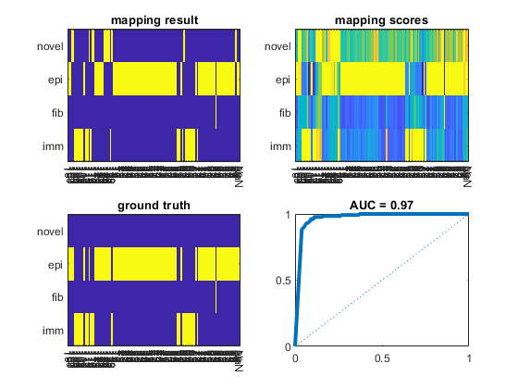
Results – our pilot data (Ileum samples from Crohn’s disease patients)
Annotate Seurat clusters derived from our data against 3 tissue compartments in Smillie
Annotate co-occurrence clusters derived from our data against 3 tissue compartments in Smillie
Cell types in ref data
Cell types in ref data
Clusters in new data
Clusters in new data
Good news:
These two mapping results to tissue compartment are almost perfect AUC. Most “errors” are annotating clusters as “novel” that do not exist in the reference.

Slide 22
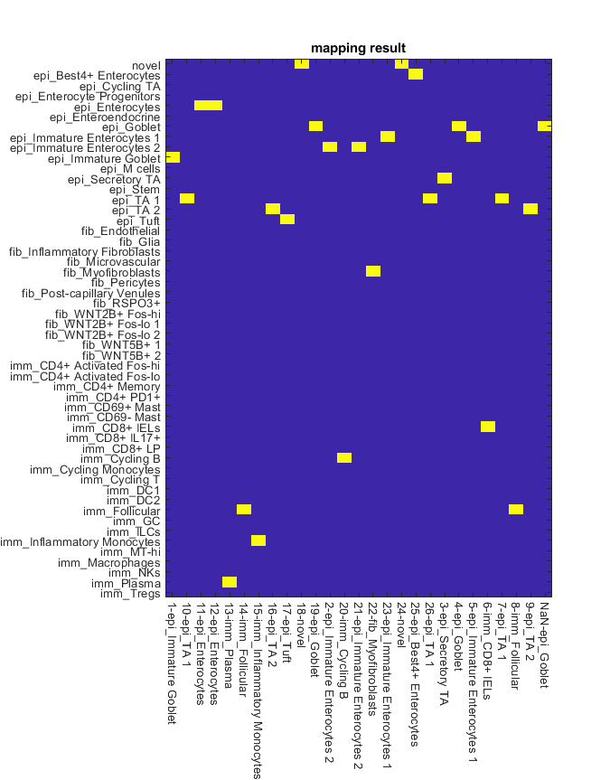
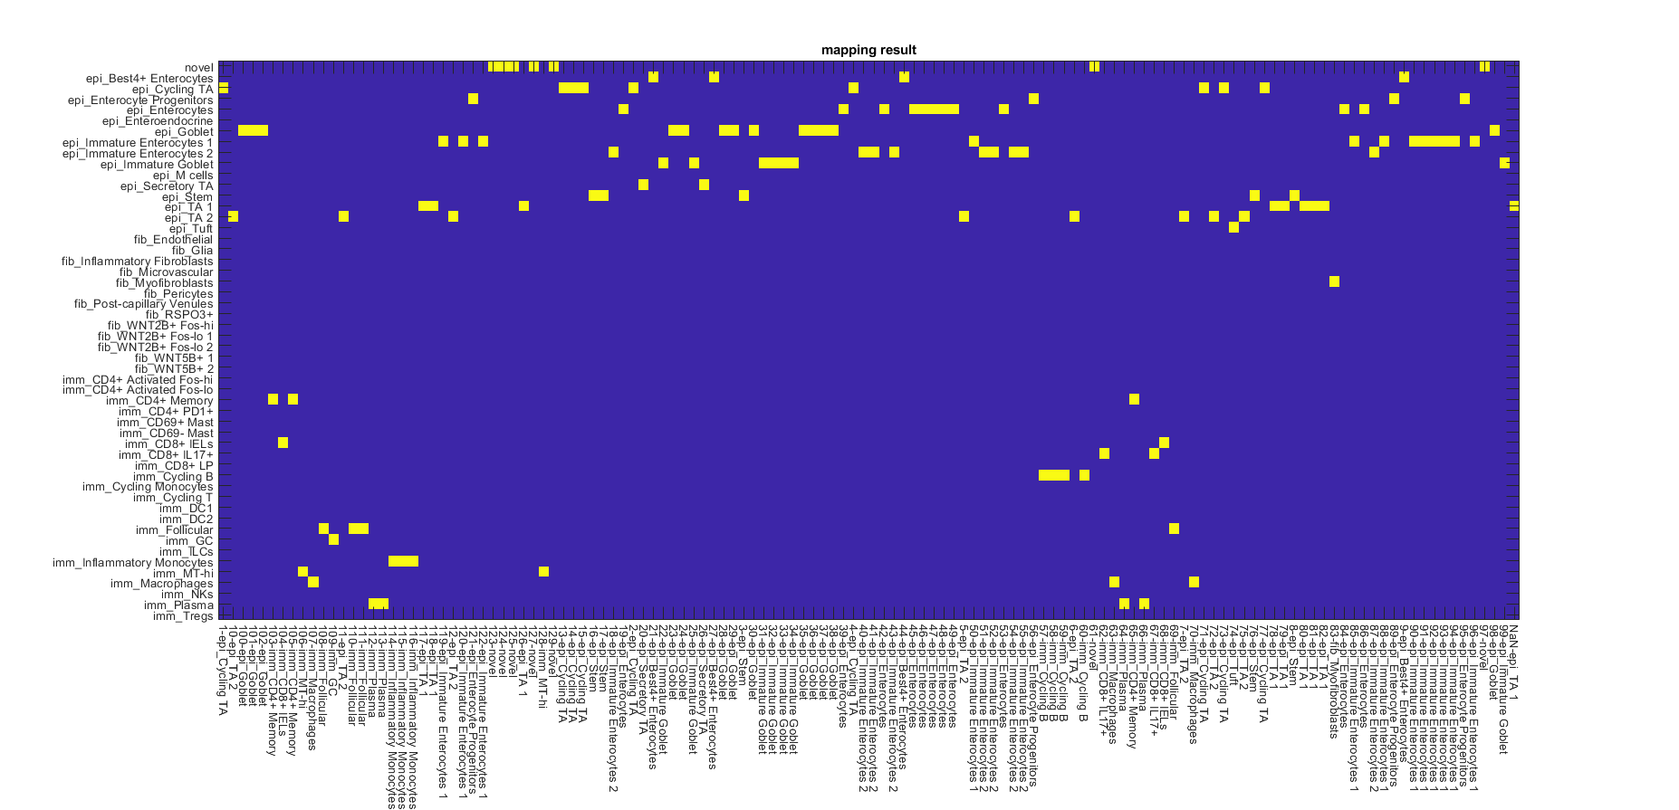
Results – our pilot data (Ileum samples from Crohn’s disease patients)
Annotate Seurat clusters derived from our data against 51 cell types in Smillie
Annotate co-occurrence clusters derived from our data against 51 cell types in Smillie
Good news:
Mapping results to detailed cell types are almost perfect in getting the correct tissue compartment:
1 or 2 epithelial cell clusters are “incorrectly” mapped as imm_Plasma and imm_MT-hi
A few cell clusters (2 or 7) are considered as novel cell types

Slide 23
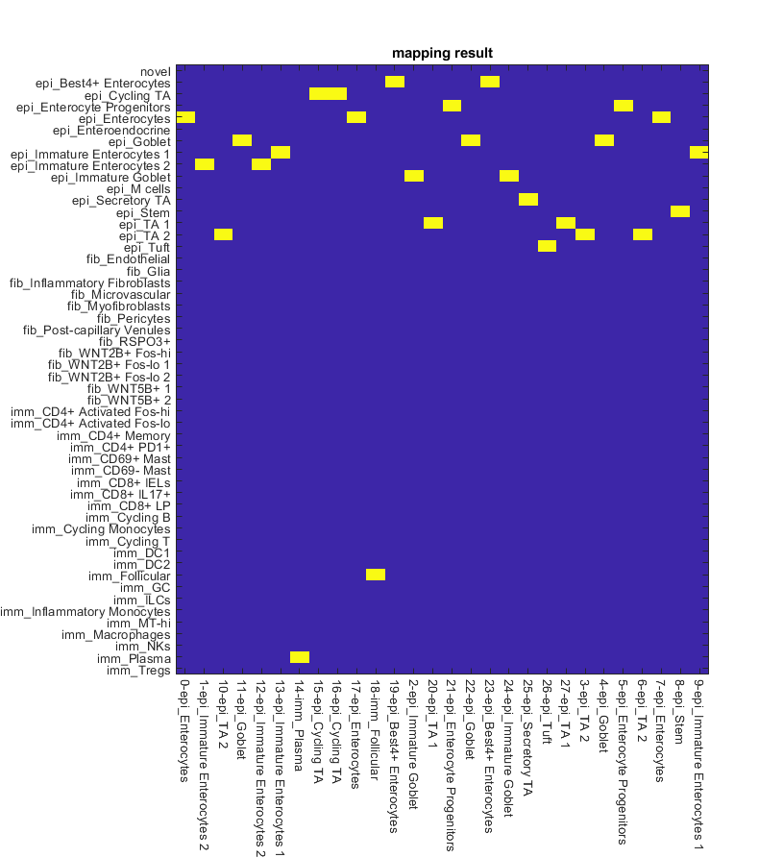
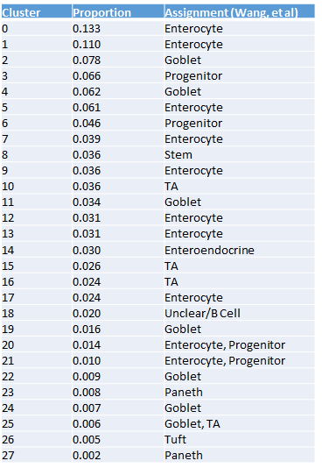
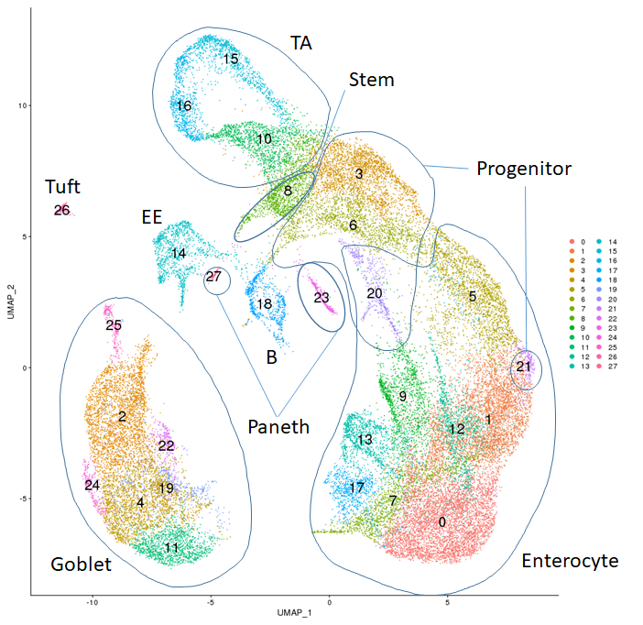
Results – our pilot data (Ileum samples from Crohn’s disease patients)
For each sample, we used signature genes to filter for epithelial cells. The samples are then integrated using Seurat, and clustered. We manually annotated the cell clusters using ~5 gene markers per cell type from the Wang et al paper.
9 - Enterocyte
8 - Stem
7 - Enterocyte
6 - Progenitor
5 - Enterocyte
4 - Goblet
3 - Progenitor
27 – Paneth
26 - Tuft
25 - Goblet, TA
24 - Goblet
23 - Paneth
22 - Goblet
21 - Enterocyte, Progenitor
20 - Enterocyte, Progenitor
2 - Goblet
19 - Goblet
18 - Unclear/B Cell
17 - Enterocyte
16 - TA
15 - TA
14 - Enteroendocrine
13 - Enterocyte
12 - Enterocyte
11 - Goblet
10 - TA
1 - Enterocyte
0 - Enterocyte
Automated annotations
Good news:
The mapping result is highly accurate compared to the manual annotation. Among the 28 automated annotations:
20 agree exactly with manual
4 (gray) close matches: progenitor vs TA subtypes
4 (red) mistakes：
2 due to insufficient reference: Paneth does not exist in ref data
2 are errors: Entroendocrine vs Plasma, Goblet vs TA1
Manual annotations

Slide 24
Take home messages
Automated cell type annotation is very useful tool to assist/expedite biological interpretation of scRNA-seq data
Many algorithms developed and benchmarked
There is still room for algorithmic innovation, such as combining data-driven and knowledge-driven ideas
Several further directions:
deal with multiple reference datasets
extend to spatial transcriptomics

