Slide 1
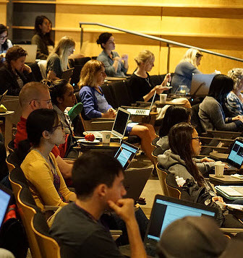
4 Online Institutes
Statistical Genetics, July 13-31
Statistics for Big Data, July 13-24
Statistics for Clinical and Epidemiological Research, July 14-31
Statistics and Modeling in Infectious Diseases, July 13-29
45+ short courses in cutting-edge ideas and approaches to statistical analysis of biological data held at the University of Washington, Seattle
630+ participants in 2019 representing colleges and universities, research labs, health organizations, non-profit organizations, private industry, and government agencies. Attendees range from graduate students/postdocs to senior level scientists in genetics, biomedical research, biostatistics, epidemiology, clinical trials, data science, and many other fields
www.biostat.washington.edu/suminst

Slide 2
Summer Institute in Statistical Genetics
Online July 13-31,2020
Short courses in:
Association Mapping: GWAS and Sequencing Data
Computational Pipeline for WGS Data
Quantitative Genetics
Gene Expression Profiling
Population Genetics…and more!
www.biostat.washington.edu/suminst/sisg
Summer Institutes are also offered in Statistics for Big Data, Statistics and Modeling in Infectious Diseases, and
Statistics for Clinical & Epidemiological Research

