Slide 1
The Independent Statistical Reporting Group:
Guiding Principles and Best Practices
Janet Wittes, PhD
SISCER
By Zoom
July 28, 2020

Slide 2
Credits
I plagiarized versions of these slides from:
  Kevin Buhr, PhD University of Wisconsin
  Matt Downs, MPH WCG Statistics Collaborative
  Janelle Rhorer, MS WCG Statistics Collaborative
  Jean Rouleau, MD Université de Montréal
Justification: Tom Lehrer’s Lobechevsky
  Plargiarize!
  Let no one else’s work evade your eyes
  Remember why the good Lord made your eyes
  So don’t shade your eyes
  But plagiarize, plagiarize, plagiarize
  Only be sure always to call it please “research”

Slide 3
Reference
.
Buhr K, Downs M, Rhorer J, Bechhofer R, Wittes J (2018).
  Reports to Independent Data Monitoring Committees:
  An Appeal for Clarity, Completeness, and Comprehensibility.
  Ther Innov Reg Science 52:459-468.

Slide 4
Outline
The role of the ISRG (aka, the SDAC)
The organizational meeting
What DMC members want to (and need to) see
How to prepare DMC reports
30 minutes break
Hard copy vs. electronic copy
Tables, graphs, and text
Approaches to specific types of data
Special (but common) problems
Summary

Slide 5
The role of the ISRG
(aka, the SDAC)

Slide 6
Four ways of reporting about a clinical trial
The primary paper
  <4000 words; 4 tables; 2 graphs
  Audience: thousands of practicing physicians, payers, etc.
Other papers
  Each one: 2000-6000 words
  Audience: people interested in the product, mechanism
The Clinical Study Report
  50,000-100,000 words; oodles of tables, figures, listings (TFLs)
  Audience: a few handfuls of regulators

Slide 7
Four ways of reporting about a clinical trial
The primary paper
  <4000 words; 4 tables; 2 graphs
Other papers
  Each one: 2000-6000 words
The Clinical Study Report
  50,000-100,000 words; oodles of tables, figures, listings (TFLs)
The ideal DMC report
  20-200 pages; lots (not oodles) of TFLs + explanatory text
  Audience: the DMC (3 to 10 people)
  Regulators, after the trial is over

Slide 8
4 summaries; 4 different purposes
The primary paper -guide for physicians’ practice
Other papers -further information about the trial
    Mechanism
    Excuses (p-value was >0.05 but the study showed benefit)
    Insights for further research
Clinical Study Report
  Summary for regulators in deciding approval and labeling
Model DMC report
  Tool for making recommendations for the ongoing trial

Slide 9
Who is on Zoom today?
Current or future members of DMCs
Sponsor staff responsible for selecting
  SDAC/ISRG
  DMC members
Member of DMC reporting center for a Phase 2b or 3 trial
  You do or will operate “independently” of
    trial sponsors
    the data and trial management CROs
  You have or will need broad experience with…
    many disease areas
    many sponsors and DMC members
    many types and sizes of trial

Slide 10
What you knew before or learned yesterday
You are aware of the purpose and importance of DMCs
  That DMCs need tools for making recommendations
  That members of DMCs are busy
You all agree that DMCs should be “independent”

Slide 11
Reminder: structure of a clinical trial
Steering Committee
Sponsor
Regulatory Agencies
Independent Data Monitoring Committee (IDMC)
Independent Statistical Reporting Group (ISRG)
Data Management Center (Sponsor or Contract Research Organization)
Central Units
(Labs, etc.)
Clinical Centers
Institutional Review Boards
Participants

Slide 12
A word about “independence”
We use the terms IDMC and ISRG
BUT, this is a fake independence
  The Sponsor pays the members and the ISRG
  So members and ISRG must act AS IF they are independent

Slide 13
The report to the DMC
The report that is reviewed during the closed session
Most important source of information for the DMC
  In understanding the progress of the trial
  In providing data for making its recommendation

Slide 14
The problem….
Many reports are
  Long, unclear, unfocussed
  Full of errors, inconsistencies, and bad statistics
Why?
  Are statisticians poorly trained?
  Is there no careful review?
  Driven by dollars and not science?
This session provides what I hope are useful tips on:
  Preparing reports
  Negotiating with sponsors to allow useful reports

Slide 15
The organizational meeting

Slide 16
Organizational meeting
Ideally before recruitment starts
Best if in person (or, in these days, Zoom-like)
Discussion and approval of charter
Review of:
  Study design
    Last opportunity for DMC to comment before ‘contaminated’ by access to unblinded data
  Model informed consent
  Interim analysis (IA) plan/report template – ISRG needs to explain IA
  CRFs & IB also often available
Discussion of potential sticking points while naïve to interim results

Slide 17
Org meeting discussion: access to efficacy
Should a DMC have access to efficacy data?
  Sometimes efficacy endpoint is also a safety endpoint
  (e.g., death, PFS, visual acuity)
  DMCs often wish to assess potential risk vs. benefit if safety signal observed
Sponsor concern
  Maintain control of information about treatment effect during trial
  Regulators may require statistical penalty for safety looks
Compromise (a little silly)
  ISRG presents efficacy only upon request – document the “look” in summary notes
  Present a variant of efficacy endpoint –proportion of deaths, but not survival curves
  Small statistical penalty (e.g., p=0.00001) assigned to each “look”
Our view- yes, the DMC should have access to efficacy data.

Slide 18
Org meeting discussion: stale data
Tension between data currency and accuracy
How to aggravate DMC: show them unacceptably ‘stale’ data
Opt for currency of data and ISRG programs defensively
One approach: have 2 tiers of data
  For read-ahead report, all data presented with a certain cut-off
  Important data (e.g., deaths & SAEs) refreshed just before report & updated at meeting
Often sponsors won’t bring this up unprompted
  Their view is to present only “clean” data

Slide 19
Org meeting discussion: masking
Semi-blinded masked labels used in report
  Group A and Group B
  Lewis and Clark for the EXPEDITION trial
Different philosophies
  DMC should know identity of treatment that corresponds to labels
  DMC should only learn identity upon request
    Rationale: To maximize objectivity, DMC should review data and form two sets of opinions – one assuming Group A one assuming Group B is active
    Sealed envelope maintained by Chair to open if needed
    Or request to learn identity from reporting statistician
    Minutes document when DMC chooses to unmask itself
Some sponsors mask ISRG (crazy!)

Slide 20
What DMC members what to
(and need to) see

Slide 21
Clinical trial sponsors have different goals
Academic institutions
National funding agencies (e.g., NIH, the VA, MHRA)
Large multinational companies
Focused biotechs

Slide 22
Reporting statistician (& report) help focus discussion
May be trial conduct (e.g., regional differences)
Emerging safety concerns
Balance of observed risk and potential benefit
May bring the DMC back to terms of reference and informed consent

Slide 23
Members do not work on the trial daily, so report should supply what members need
Trial summary (including planned total patients and events, stat section)
DMC charter
  Remind members when interim analyses are planned
  The stopping guidelines
Helpful explanations
  (eg, Is a hemorrhagic stroke both a CV & a bleeding event?)
Table summarizing past primary and secondary endpoints, and SAEs.
  May combine endpoints and specific SAEs
    Eg, Acute Coronary Syndromes and combined anticoagulants where reductions in coronary events are balanced by bleeding

Slide 24
What DMC members need to know
Is the trial integrity being preserved?
Will the primary hypothesis be tested adequately?
Are the participants “safe”?
Has the trial already shown convincing evidence of benefit?

Slide 25
Questions about trial integrity
Is the blinding adequate?
  Some sponsors use the same organization
    To capture data, prepare final report, and report to DMC
    They define “firewalled” statisticians to work with the DMC
Some trials have some in same clinical group unblinded & others blinded
Is recruitment proceeding so slowly that..
  The end may never come?
  The sponsor may remove the funding?
Is recruitment too fast in a center or country?
Do the data look credible?

Slide 26
Is adherence to intervention & protocol acceptable?
Figure should show adherence over time
Table should show major protocol deviations

Slide 27
For outcome trials
Eg: mortality, MI, progression-free survival, 3-line loss of vision
Are the event rates close enough to predicted?
If the study has an adjudication committee
  Is adjudication rapid enough for informed recommendations?
  How closely do investigator and adjudication agree?
    Does agreement and speed differ importantly
      By site?
      By severity of disease?

Slide 28
For trials with continuous outcomes
E.g., pain, visual acuity, PANSS score in schizophrenia
Are the variances close to what was expected?
Is the drop-out rate low enough for valid analysis?

Slide 29
Are the participants safe?
The ISRG must present data in an understandable form.
Rouleau: DMC should not have to look for a needle in a haystack.
  Start with SAEs, then AEs
  Maybe include drug-related SAEs and AEs
  Use color to identify potential areas of interest
  May combine related SAEs

Slide 30
Report writer should think of mechanism
Identify potential areas of adverse events related to drug’s
  Mechanism of action and structure
    Very low lipids might produce mental/neurological complications
    Interventions with viruses might cause inflammatory reactions
Take advantage of the expertise on the DMC
Remain flexible –Don’t lock report into same presentation each meeting

Slide 31
Lab values
We statisticians are interested in changes in means and medians
MDs are interested mostly in extreme values
  higher (e.g., liver enzymes)
  lower (e.g., white blood cell and platelet counts).
Use box plots but show outliers somehow
  Often the outliers are incorrect because the units are wrong
    E.g., if you have a K⁺ of 11, it’s wrong and you should delete it
    But some lab values can get very large
  Show Hy’s Law for liver toxicity

Slide 32
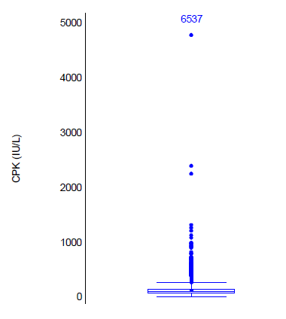
Beware of Bambi and Godzilla plots
Creatine kinase- extreme value is 4,782 IU.
ISRG should ask itself: could this number be real?

Slide 33
This number could be real
Creatine kinase- range about 20-200 international units – can go to 20,000 in a patient with rhabdomyolysis

Slide 34
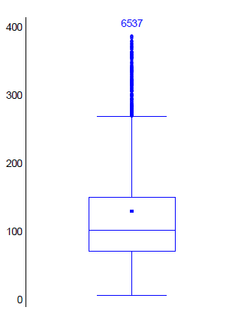
Show both plots…and interrogate the data to understand what happened to the three large outliers

Slide 35
Report may define subgroups of extra risk
If some patients developing say, renal or pulmonary complications
  Show them separately
  The DMC may want to stop entering them in the trial

Slide 36
If trial has statistical stopping guidelines
Supply DMC charter and remind members
  When interim analyses are planned
  Stopping guidelines
  Explain what the guidelines mean!
Supply a table summarizing primary and secondary endpoints
Supply Kaplan-Meier curves

Slide 37
Presenting for trials with adjudication
Present investigator reported, adjudicated, & best available data
Show cross tabs

Slide 38
How to prepare reports

Slide 39
Guiding principles for DMC reports
DMC reports are not Clinical Study Reports
Comprehensive but comprehensible
Must facilitate efficient review
  Report structure must be clear
  Analyses must be interpretable
Reports must be responsive to reasonable DMC requests
  Requests must relate to recommendations DMC may make

Slide 40
DMC reports vs. Clinical Study Reports
Audiences and purposes are very different
Use of interim vs. final, locked datasets
Flexibility (DMC) vs. pre-specification (CSR)
Statistician may have different roles
  CSR: More active before analysis starts
  DMC: Active during study and reporting process

Slide 41
DMC & CSR may need different analyses
CSR and “Topline” programs assume final, locked data
  May crash on interim data
  May exclude or misrepresent interim data
    e.g., if rule is to exclude missing dates, may miss unclean data
  DMC may need analyses irrelevant for CSR and vice versa
    DMC cares about ongoing recruitment; CSR reports total
    CSR has oodles of tables of subgroups

Slide 42
Facilitating the review: report structure
Primary goal: efficient DMC review
  Likely reading on plane for first time
    In Zoom time, may not read at all before meeting!
  E-copy vs. hardcopy
    In Zoom time, even oldies like me cope with e-copy
  Document conventions
    one PDF
    bookmarked/tabbed, page numbers
    cross references
Table of contents
Summaries for ease of review
  Executive summaries, text, appendices, protocol summary

Slide 43
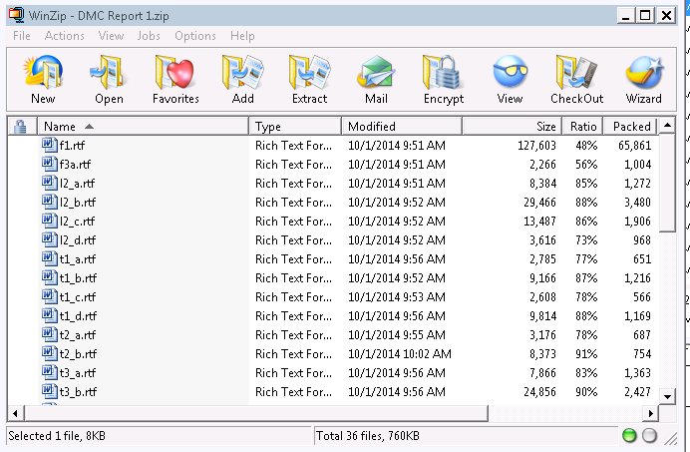
DMC reports – real examples of bad reports

Slide 44

DMC reports – stack of binders
– no table of contents

Slide 45

Binders have tabs but no labels

Slide 46
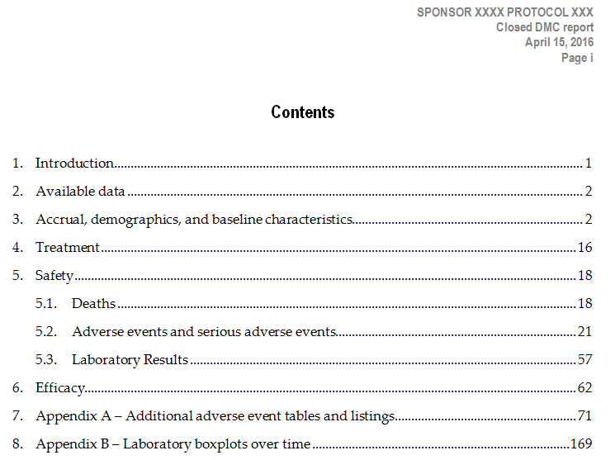
Include a table of contents & page numbers!

Slide 47
Executive summaries can be helpful
Quick summary
Bird’s eye view
  Not meant to lead/guide DMC’s review
Limited information only; not full picture
Repeated at next meeting with past meeting’s summary
  Helpful to remind committee of big picture
Some DMC members see these as leading
  If your DMC doesn’t want one, don’t do it!
Some DMC members want lots of details
  If so, give details

Slide 48
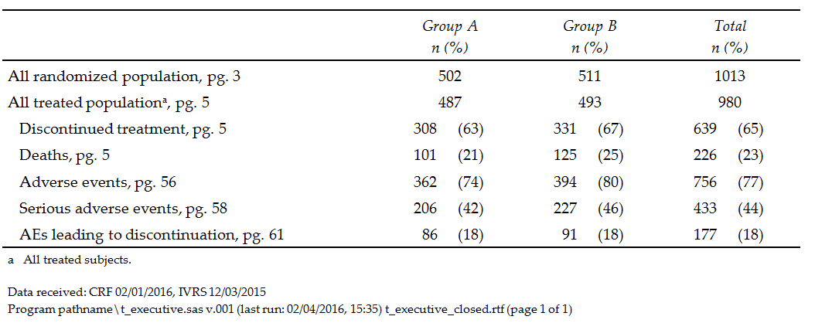
Executive summary (safety only)

Slide 49
Exec summary – other items it might include
Total patient years treated
Deaths reported as of cut-off
  Remember that deaths come from different sources
  Can confuse DMC if it’s not clear where they are from
KM estimates of deaths rates (12 month, 24 month)
Primary outcome events
  adjudicated
  unrefuted
  investigator reported

Slide 50
Facilitating the review: data presentations
Organize information efficiently
Highlight important details
  Highlight ≠ leading/guiding
  Explain where information can be found
Omit useless information
  Lots of zeros can be a distraction
Leverage similarities
  If analyses are similar, present in similar way
  Parallel structure for multiple protocols

Slide 51
Be flexible!
Display information in appropriate way
  For report of 10 patients, listings may be more informative than tables with zeros
  Transition to tables/graphs over life of project
  May need to add subsets as data accumulate
Some stat groups limited by programming “templates”
  Some presentations may not fit into company templates
  Small changes can make a difference

Slide 52
Not-so-great presentation examples
Too much information on one page
Too little information on one page
  Often distributed over lots of pages!
Difficult to follow/interpret
Too many pages (hard to follow; hard to notice trends)

Slide 53
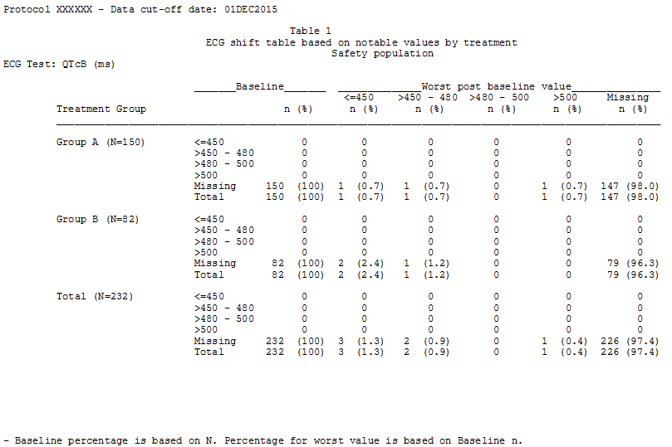
Too much (but not useful) information

Slide 54
Too much (but not useful) information
Slowly reached conclusion: all data are missing!

Slide 55
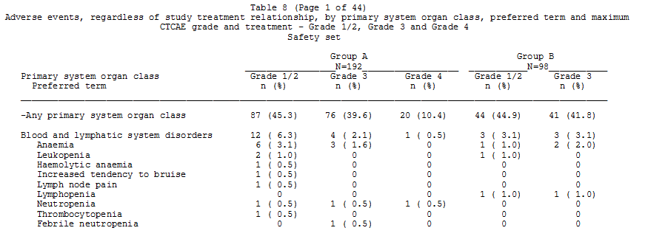
Difficult to follow
Where are
Grade 4 AEs?

Slide 56
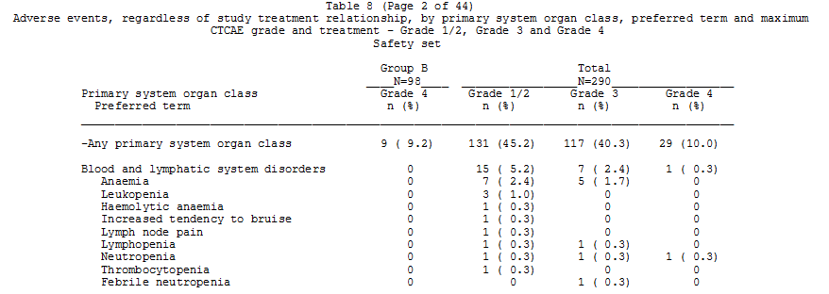
Difficult to follow
Aha! There they are – on the next page!

Slide 57
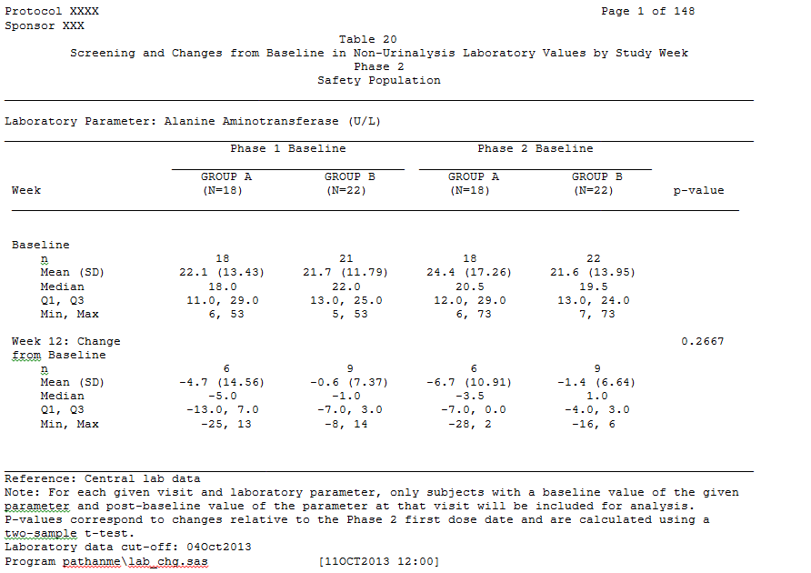
Too many pages

Slide 58
Modifying your presentations
Sometimes your macros may work, sometimes they don’t
  Be flexible in programming, when possible or most important
Small changes may help
  Shorten footnotes, column widths
  Decimal places
    (how many are really informative? You don’t need 100.00%)
  Change placement of headers/titles
  Consider different approach (figures vs. tables)

Slide 59
Difficult to follow AE table

Slide 60
Difficult to follow AE table, cont’d

Slide 61
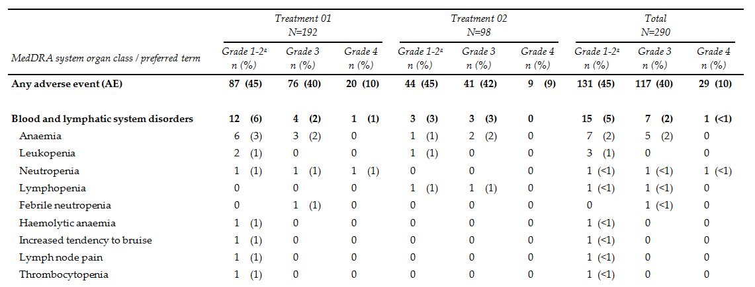
Better AE table – now all columns on one page
Preferred terms now also sorted by decreasing total frequency, then alphabetically

Slide 62
Lab table - Too many pages

Slide 63
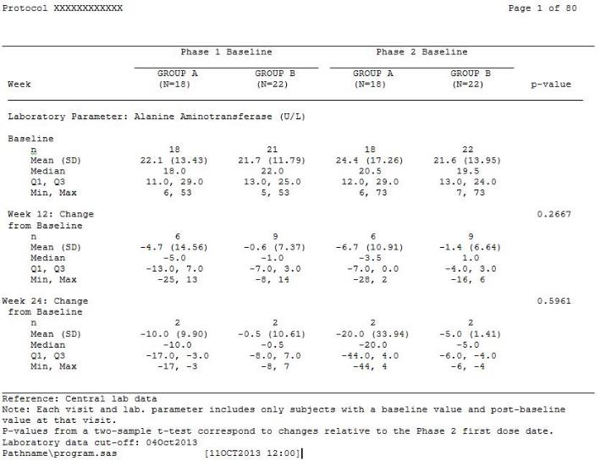
Lab table - Small changes, fewer pages
Move lab label out of title
Changing page size/automatic breaking allows more data to fit on page
Abbreviate text in footnotes

Slide 64
Hard copy vs. electronic copy
If this presentation had been given in 2019
  Remember that some people hate electronic copies
  Remember that some people hate hard copies
  So, give each members what that person wants
  Remind members: ISRG knows if you have accessed report
But in the COVID era, we need to go electronic
  Try to strike a balance between confidentiality and usability

Slide 65
Reports evolve over time
Report template presented at org meeting
  Templates are BORING
Changes because of DMC requests
  Now that tables are populated, changes requested
  Safety signal requires further exploration
  Results from related compounds prompt exploration
  DMC is contemplating recommendation to stop trial
    Subgroup analyses
    Sensitivity analyses on primary endpoint
    Conditional power calculations
  Intellectual curiosity of DMC members (not a good reason for changes)
We cannot anticipate all changes can be anticipated
  So best to get all available data as part of transfers

Slide 66
Handling DMC requests
Try to predict before meeting
  Pre-meeting with chair
  Team review of report before sending
Address at meeting
  Risky if request is even moderately complicated
Include with meeting minutes if request doesn’t require immediate action
Supplemental follow-up meeting
Build in allowance for ad hoc requests in agreement

Slide 67
At the meeting…
Who guides review of report?
  Reporting statistician
  Chair
  Assignments of topics to DMC members
  May change over course of DMC reviews
How quickly to go through report
More and more are not face to face
Pagination and presentation numbering crucial to permit all to be “on the same page”

Slide 68
Open reports
Presentations include only pooled totals
(i.e., no info by treatment group)
To inform study team about recruitment etc.
To provide a common document for discussing issues
To check accuracy of the reporting group
Dangers
  Extra expense
  Get in the way of more important activities
  Potential to unblind
  May no longer reflect what DMC is seeing in closed report

Slide 69
Open reports
Important to preserve the blind
  analyses should be presented by aggregating information across treatment groups and, usually, avoiding subject-level data (e.g., listings, etc.)
Different sponsors request different amounts of data
  Only accrual, status and baseline data
  Plus limited follow-up data (e.g., AEs)
  Or, include all or most of the closed session analysis, in aggregate form
If DMC requests specific analyses based on concern raised in closed session, don’t include in Open Report

Slide 70
Tips for open reports
Limit content of open report (e.g., baseline tables only)
Be especially wary of including listings
Limit text
Send open reports at least a day after closed reports
Make sure open presentations have distinct filenames from closed versions
If changes made to program for closed version, retain prior program version for open content
Search for group labels
  If figures are not searchable, pay special attention
Consider having one individual at Sponsor review report before larger distribution

Slide 71
Tables, graphs, and text

Slide 72
Use a sensible mixture of tables and figures
You may need to show some data both ways

Slide 73
What about text?
Many reports have no text
Some sponsors say, “why do you need text?”
My view
  I personally can’t prepare a report without writing about it
  The text should be explanatory, not interpretive
And, as always, it depends
  If the DMC meets every 6 months, members forget
  If it meets biweekly, a short report with no text is fine

Slide 74
Approaches to specific types of data

Slide 75
But first….
Challenges of working with interim data
General analysis and reporting conventions
Approaches to specific types of data

Slide 76
Data for homework assignments
Very clean, simple, complete
Purpose – to allow student to practice methods
May have problems aimed at specific methods

Slide 77
Data for final analysis
For final analysis, data are typically based on final locked database
  All data in one database (including treatment group code)
  Database structure and checks finalized
  Data won’t change out from under the analyst
  Data are complete and clean
    Queries resolved, AEs reconciled, endpoints adjudicated
    (Although that doesn’t mean statistician should trust data)

Slide 78
Challenges in programming DMC reports
Data transfer may be difficult
Quality of data may be problematic
Some data
  may not be available yet
  may be distressingly incomplete
  order of arrival may not reflect order of occurrence

Slide 79
Data transfer – multiple sources & transfers
Multiple sources
  Clinical database snapshot, randomization list
  SAEs from Safety Department,
  Lab/ECG data directly from central labs
Multiple transfers
  Data issues come and go, database structure may change

Slide 80
Procedures and systems not fully tested
ISRG may be first (or only) external group to receive data
Failed transfers, missing datasets, corrupted data
Incompatible formats
Specs incomplete, inaccurate, or unavailable

Slide 81
Advice for data transfers
Change “Trust, but verify” to “Don’t trust, and verify”
Test early and often, in as realistic a manner a possible
Specifications and documentation
  Annotated CRFs
  Adjudication committee charter
  Sponsor’s statistical analysis plan, protocol
  Investigator’s brochure
  Ask for early drafts, treat them as early drafts
  Remind Sponsor to send updates

Slide 82
Advice for data transfers
Frequent (e.g., monthly) transfers, not just before meetings
  constant stream of “test” transfers using real data
  timely identification of issues
  data “in hand” for ad hoc analysis
Specify cumulative, not incremental, transfers
Provide sufficient time between transfer and meeting
Consider relative timing of data from different sources
  all at once, SAE “update”

Slide 83
Data quality
Trade-off between quantity and quality
Uncleaned data means some will be incorrect and inconsistent
  Implausible/impossible data
    E.g., height of 10 inches
    Potassium of 11
  Inconsistencies
    Dead subjects with further follow-up
Using only “fully cleaned” data may eliminate useful information
Usually using more, dirty data is better than using less, clean data

Slide 84
Dealing with dirty data
Use simple, easily defined, and sensible approaches
Remove or convert implausible/impossible data
Use sequential/hierarchical definitions for key measures
  e.g., death date = adjudicated date if available; else date of potential death endpoint; else death date in SAE dataset; else end date for AE coded as fatal
    But if AE result says event resulted in death and the death from isn’t there, assume the person is dead
    Missing forms are more likely than plausible data

Slide 85
Dirty data lets you use your statistical prowess
Use robust analysis techniques
  Non-parametric tests
  Trimmed summary stats
  Avoid mins and maxes and drawing undue attention to outliers
    But don’t delete extreme values that represent safety issue
Explain what you have done in words that DMC can understand

Slide 86
Some specific approaches
“Same” data from multiple sources:
  e.g., SAE data from Safety Department and AEs marked “serious” in clinical database
  Use one and ignore the other; report separately clearly identifying sources; try to combine
Visit codes vs. dates:
  Windowing (typical for final analysis)
  Think of methods to reconcile multiple measurements
Impute missing or incomplete dates logically

Slide 87
Data quantity & completeness issues
Of course the follow-up is incomplete!
  Duh! the trial is in progress!
Distinguish types of missing data
  data that will always be missing
  data not yet entered
  missing data under query
Uncoded/unadjudicated data
And don’t go nuts – think about what is important

Slide 88
Advice about data quantity
Quantify data availability for DMC
  analyze what’s there, and indicate what isn’t
Summarize data availability
  in database, withdrawn, dead, expected but missing
Present uncoded/unadjudicated data in separate categories/analyses
  If nothing else, DMC can act on uncoded data by recommending it be coded!

Slide 89
General Analysis and
Reporting Conventions

Slide 90
Final vs. interim data
Final analysis is confirmatory (pre-specified)
  Sophisticated approaches to
    maximize power and efficiency
    eliminate sources of noise
  Basis for regulatory approval
  No room for “hunches” about possible signal
Interim analysis is exploratory
  DMC is looking for unanticipated safety issues
  Finding potential signal in noisy and complex data (e.g., AEs)
  DMC “hunches” and dead-ends are important

Slide 91
Best approach to exploratory analysis
Emphasis on breadth over depth of analysis
Simple, descriptive statistics
Robust techniques
Data visualization (remember audience is busy)

Slide 92
Analytical conventions
Interim analysis conventions need not (and sometimes should not) be the same as final analysis conventions
  Final analysis may assume complete, clean data
  Simple, straightforward, robust analyses may be better
    e.g., Wilcoxon tests by visit instead of linear mixed effects model w/ baseline covariate adjustment

Slide 93
Reporting conventions
Simple, descriptive statistics and analyses
What about p-values
  Some people like p-values as screening tools
  Some object strenuously
  So do what your DMC wants!
Visualization
Hierarchical organization from summary to detail

Slide 94
Approaches to Specific Types of Data

Slide 95
Categories of information
(and how are they relevant to the DMC?)
Trial conduct
  Accrual and subject disposition
  Treatment adherence
  Data availability
Baseline data
Safety data
  Adverse events
  Laboratory and ECG data
Efficacy data
  Clinical endpoint events
  Tumor response
  Continuous outcomes

Slide 96
Accrual – questions to address
How is accrual progressing compared to what was projected?
Are new countries/sites being added, or are existing sites recruiting new subjects?
Are certain sites dominating the accrual?
What is the geographic breakdown in an international trial?
Has the geographic make-up of participants changed over time?
  The special case of China – often doesn’t start recruiting until late in the study
Should the DMC intervene in any way?

Slide 97
Presentation of accrual data
In early meetings, DMC is most interested in accrual
  (and horrible SAEs)
Cumulative accrual plot, with projections if possible
Breakdown of sites by number accrued
Display of participating countries, by region
Cumulative accrual by region or country

Slide 98
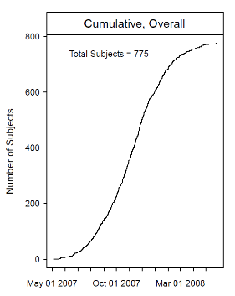
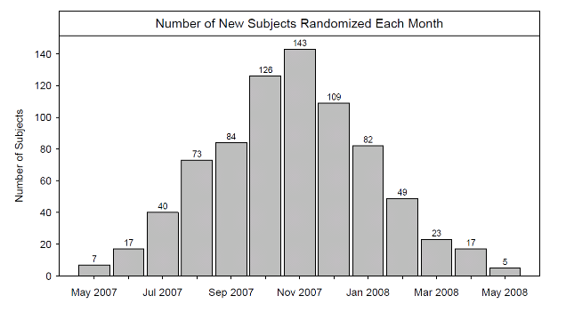
Cumulative Accrual
(with projections, if possible)

Slide 99
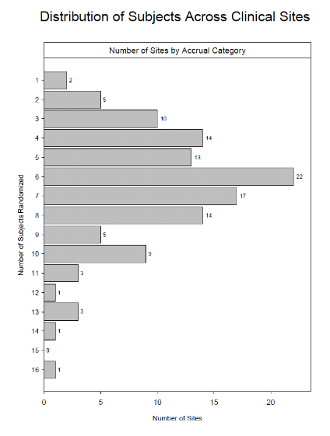
Distribution of sites by # accrued

Slide 100
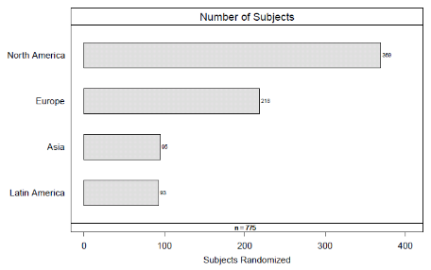
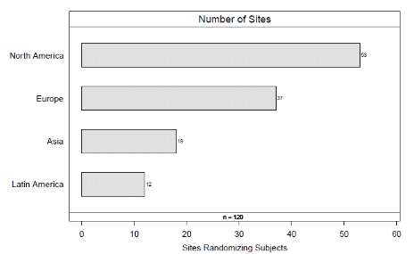
Accrual by region

Slide 101
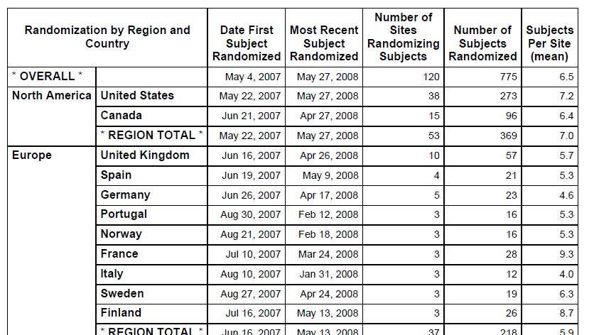
Accrual by Region and Country

Slide 102
Subject disposition
Are subjects discontinuing from treatment early?
  If so, what are the reasons?
  Do they differ by treatment group?
Are subjects who have d/c treatment continued to be followed?
What is the cumulative exposure/follow-up of subjects on study?

Slide 103
Presentation of subject disposition
Most recent subject status
Reasons for treatment and/or study discontinuation
KM plot of time to early discontinuation
  Treatment vs. study?
Plot of cumulative follow-up as a function of time on study
  Summary of patient-years of FU

Slide 104
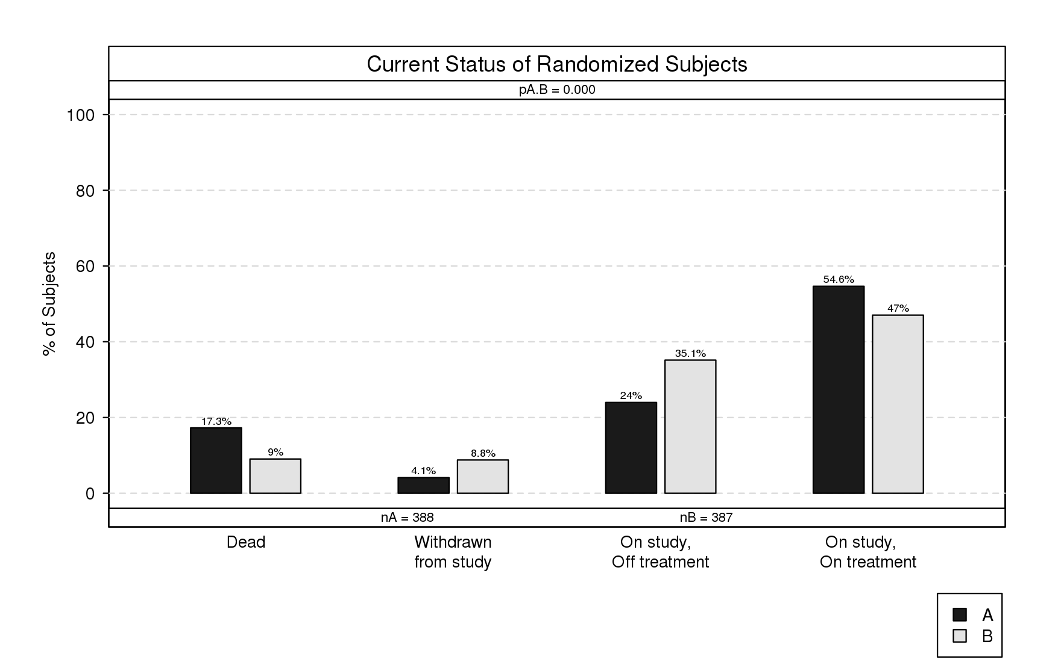
Most Recent Subject Status

Slide 105
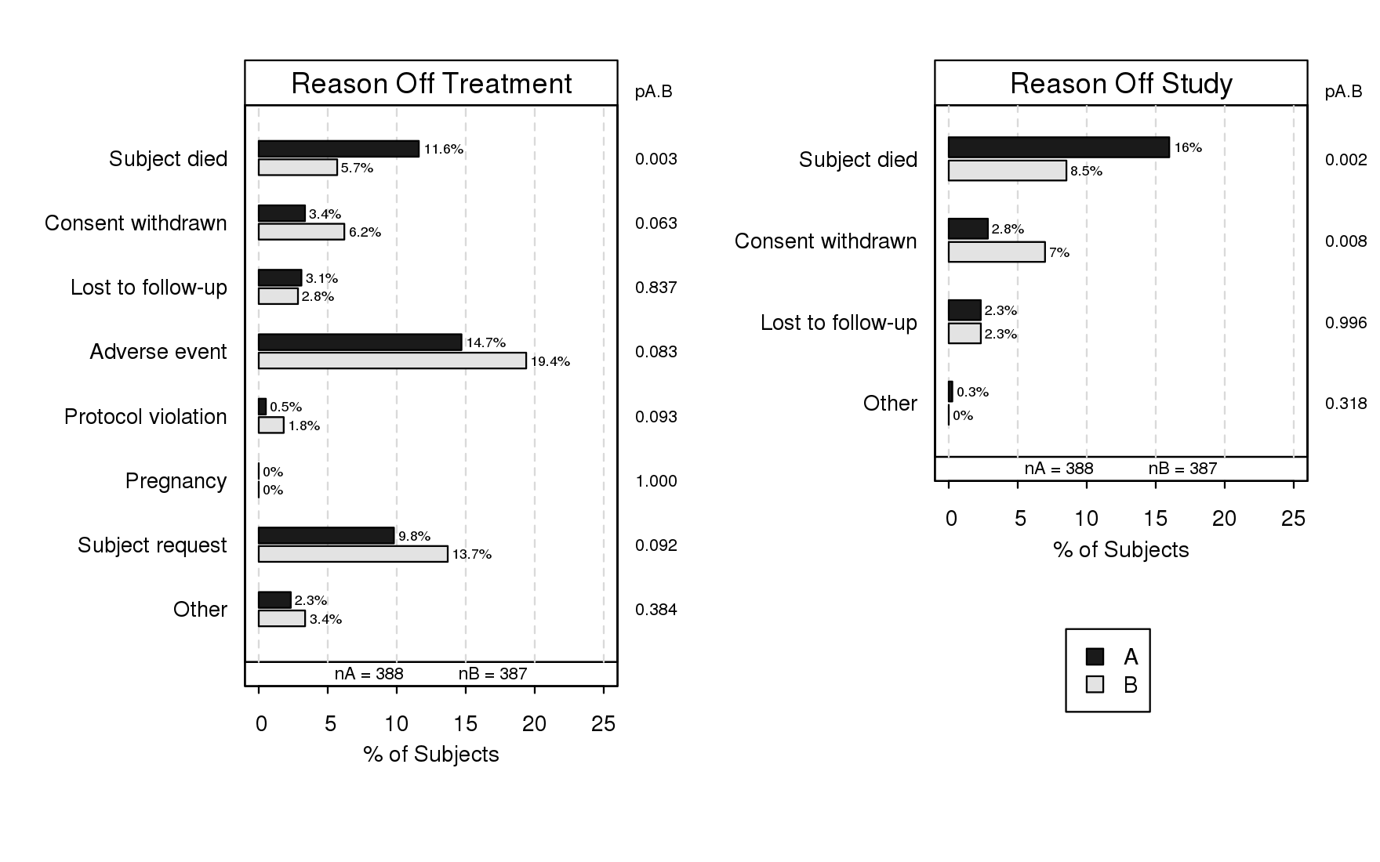
Reasons for W/D from Study or Treatment

Slide 106
CONSORT-like diagram

Slide 107
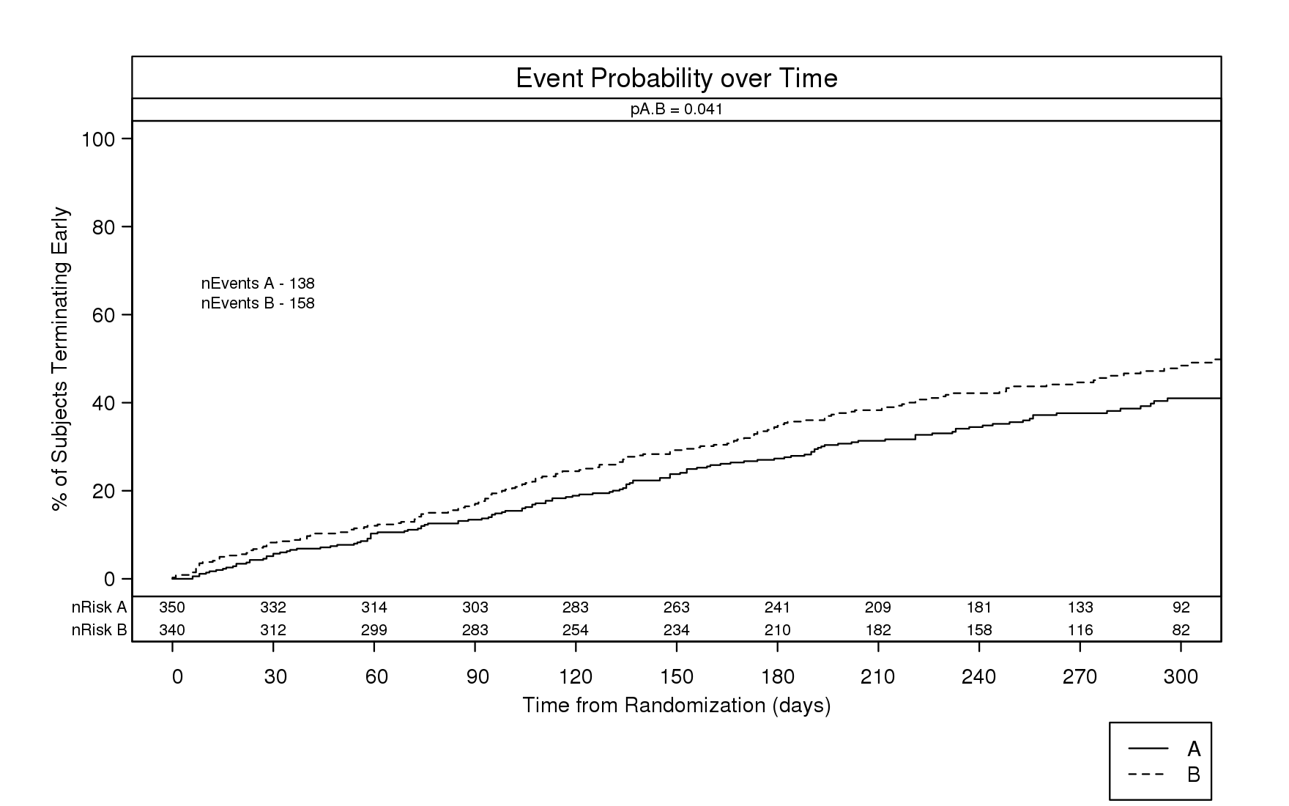
Time to Early Discontinuation

Slide 108
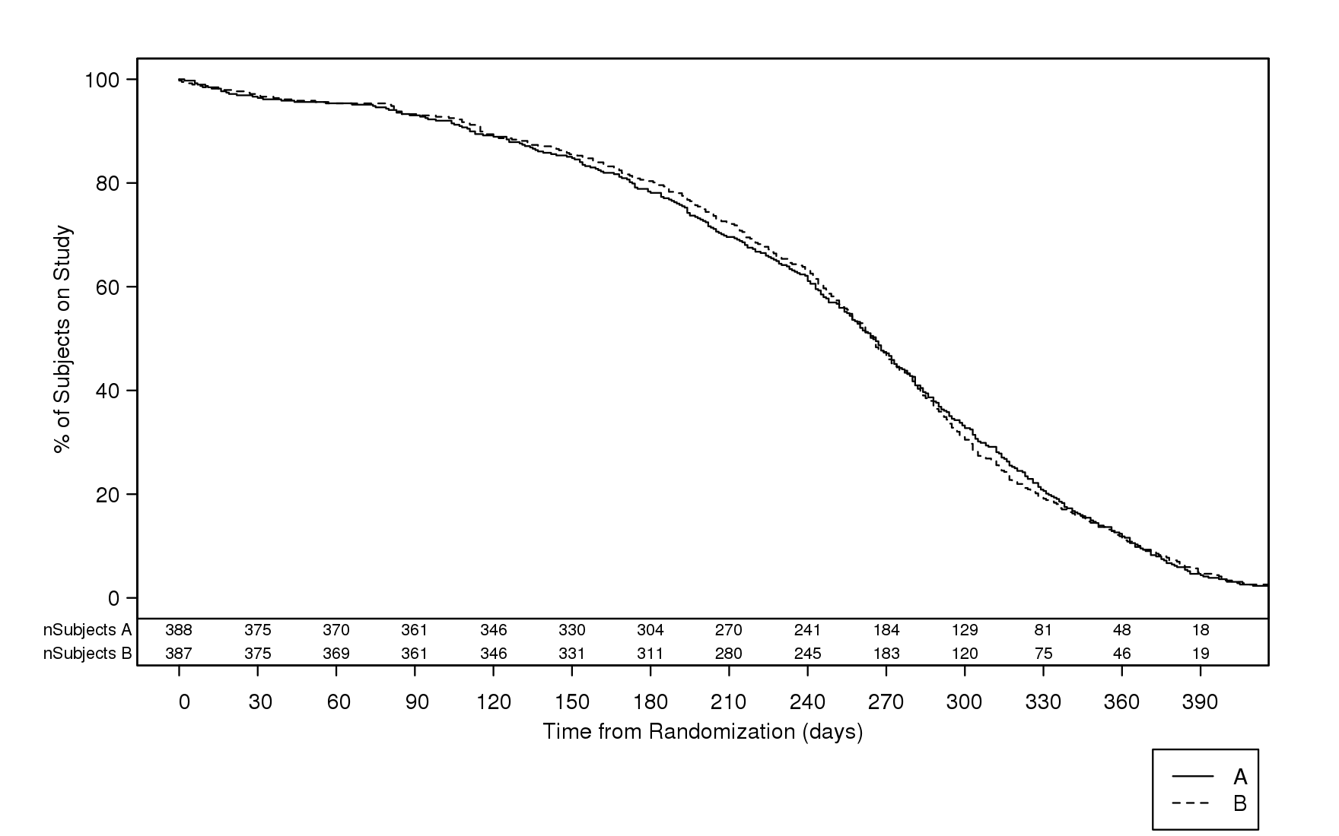
Follow-up Time

Slide 109
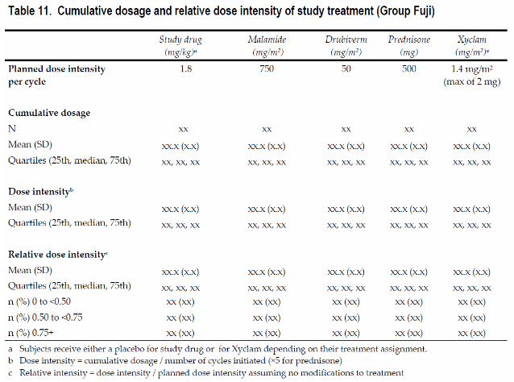
Treatment dosing

Slide 110
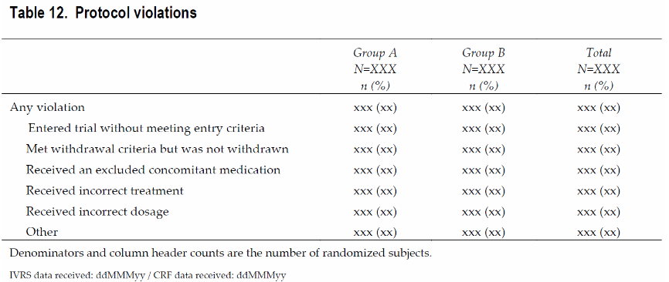
Protocol compliance

Slide 111
Data availability
How recent are the data included in the report?
How much data are available relative to what would be expected given dates of study entry and data cut-off?
If data are not available, is there a reason?
Are there more extreme lags in certain types of data?
What should DMC do about lack of availability?

Slide 112
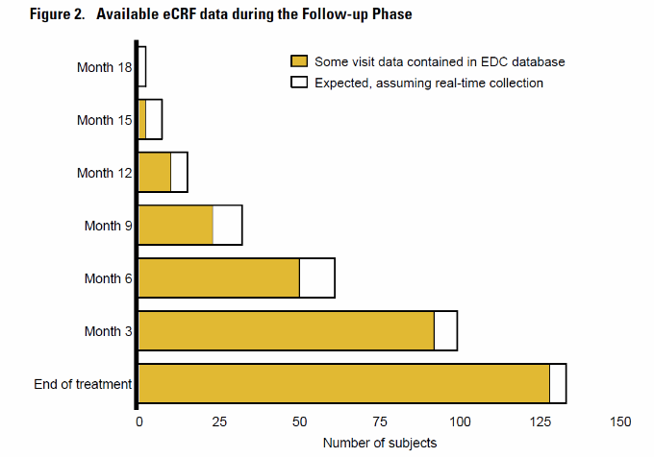
Availability of data

Slide 113
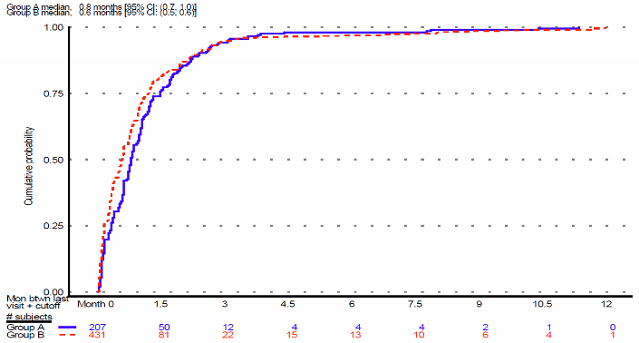
Data currency
Cumulative distribution of time from last visit in database to data cut-off date

Slide 114
Baseline data
What is the make-up of the study population?
  Have subjects met eligibility requirements?
  Is the breakdown what was expected?
    Is more effort needed to recruit certain types of participants?
What are the important baseline characteristics for understanding disease, prognosis, etc.?
Are there important imbalances by treatment group, particularly for prognostic variables?
  If so, does that suggest chance or failure of randomization?

Slide 115
Presenting baseline data
Focus on important variables
  Demographics, characteristics of disease under study
De-emphasize (or omit) reams of irrelevant info
  Medical history of unimportant conditions (overly specific)
  Physical exam by organ class (overly broad)
  Gazillion categories of prior medications
    Ask DMC if certain categories are relevant

Slide 116
Baseline data: tables vs graphs
Tables can be more compact
Visual impact of graphics may be easier to absorb
Treatment group comparisons
  Graphical presentations make it easy to compare groups
  Avoid p-values, as any differences are by chance by definition in randomized trial (but you may suspect the randomization)

Slide 117
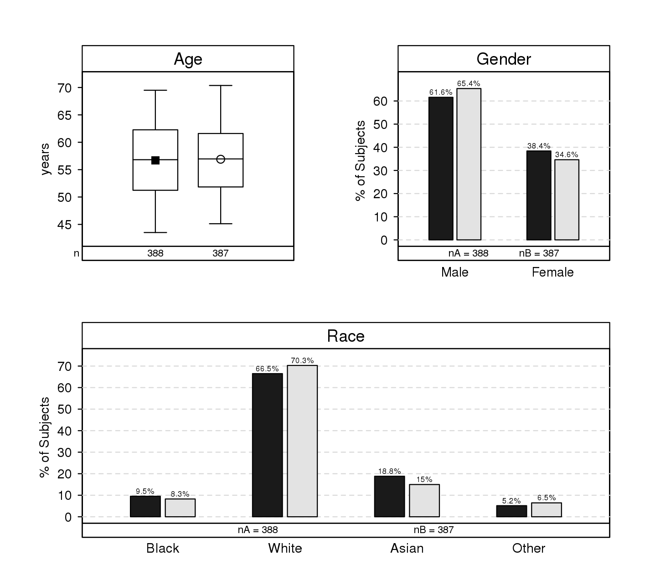
Baseline Characteristics

Slide 118
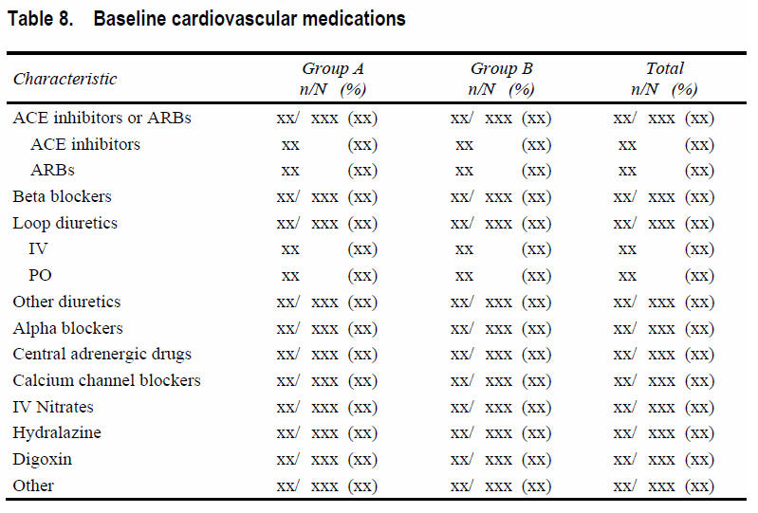
Baseline CV medication categories

Slide 119
Safety data: adverse events
Are there safety concerns for subjects participating in the trial?
What types of AEs are being experienced?
How about certain categories of events?
  Serious (SAE) events?
  Events of Grade 3 or higher?
  Events leading to alteration or termination of treatment?
  Pre-specified events of interest?
Are certain events more common in a specific treatment group?
When are events occurring?
  Early in the treatment? Are they recurrent?

Slide 120
Challenges in AE reporting
Separating signal from noise
  Important to draw attention to important issues
  But do not sacrifice completeness of reporting
Identifying appropriate categories, groupings of MedDRA terms
  Summarize by SOC, High Level Terms
  Use Standarized MedRA Queries (SMQs)
  Ask DMC if there are combinations of interest

Slide 121
Presenting adverse events
Overall summaries
  Incidence of any AEs meeting certain criteria: serious, severe, related, causing treatment modification, death
Comprehensive data
  Summaries by System Organ Class (graphics)
  Summaries by SOC, HLT, and Preferred Term (tables)
Presentation style
  Graphics: bar charts, stacked bars, dot plots
  Incidence tables: with or without p-values
  Listings: for selected categories

Slide 122
Addressing specific questions about AEs
Highlighting the most frequent adverse events
  Subset based on percent of subjects
  Present in descending order of frequency
Identifying differences between treatments
  Table of AEs (by PT, HLT) with minimum frequency and nominal treatment difference
  Volcano plot
If you see hint of difference in SAE, look at related AEs

Slide 123
AEs – Severity and timing
Examining severity of AEs
  Present bar charts for each category, stacked by max severity
  Provide subset analyses of severe or worse events
Exploring the timing of AEs
  Kaplan-Meier plots for selected events
  Examination of incidence within time intervals
  Event rates (recurrent events) based on log-rank test
But DON’T do this for every AE!

Slide 124
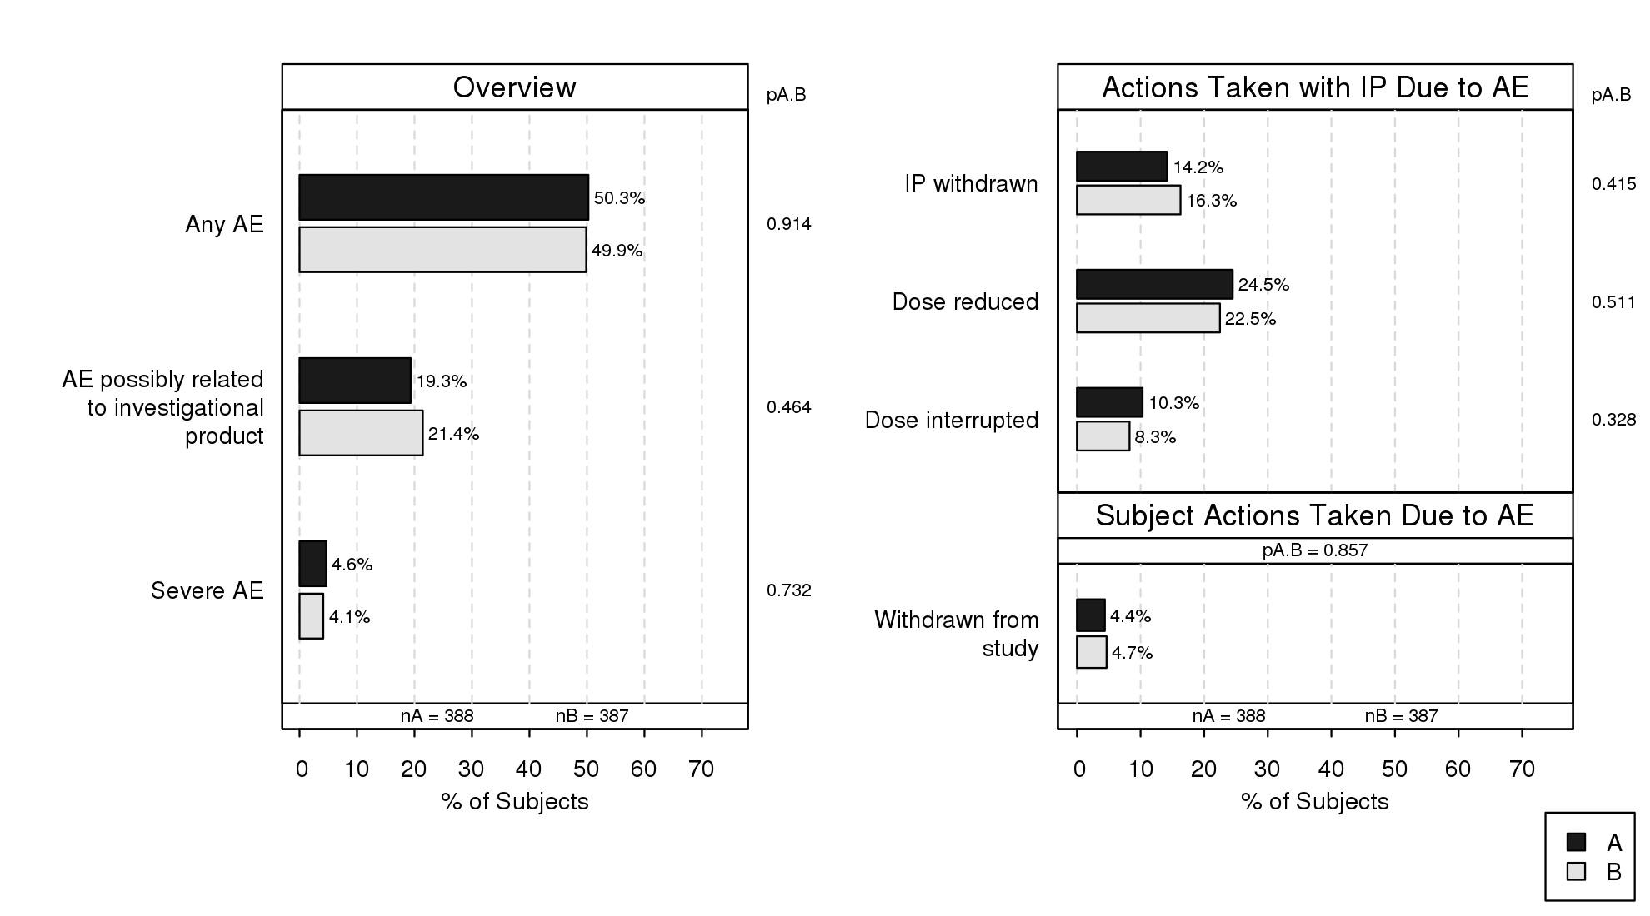
AEs: Overview

Slide 125
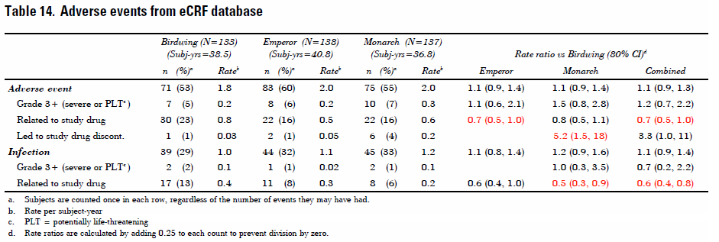
AE Overview Table

Slide 126
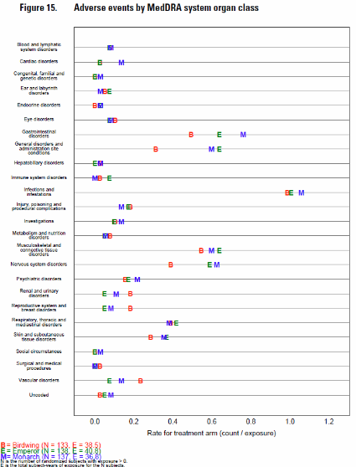
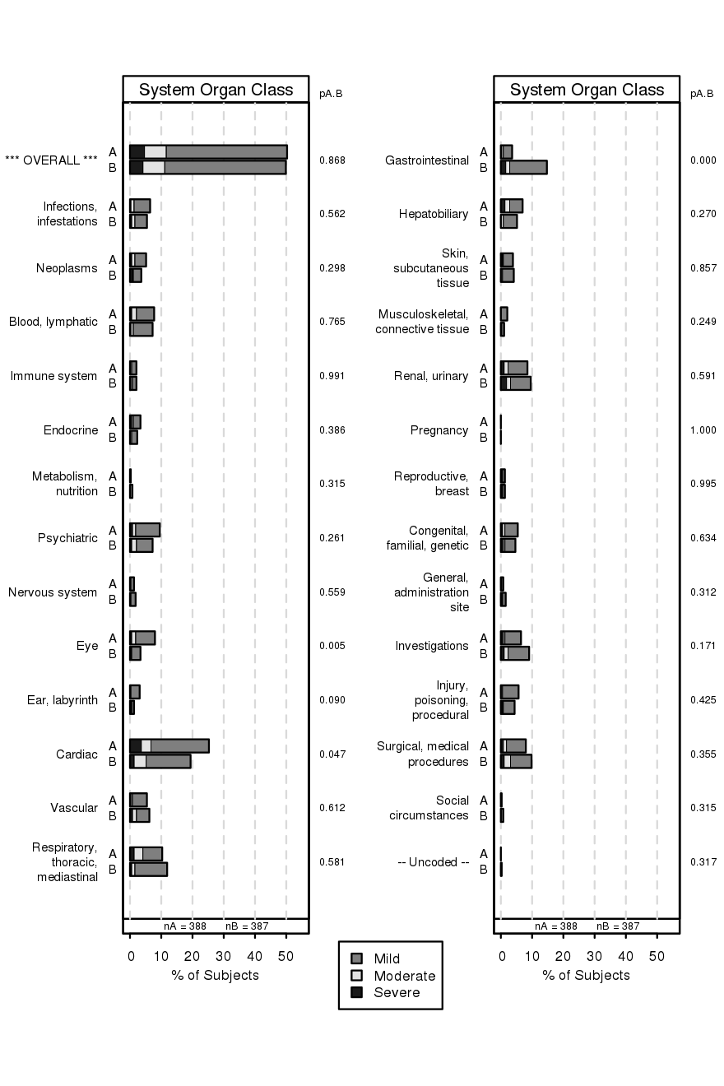
Adverse Events by SOC

Slide 127
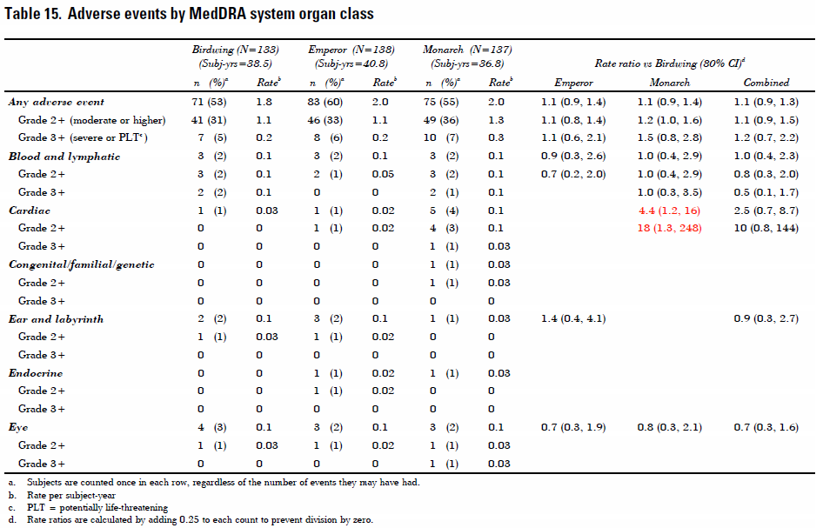
Table by SOC

Slide 128
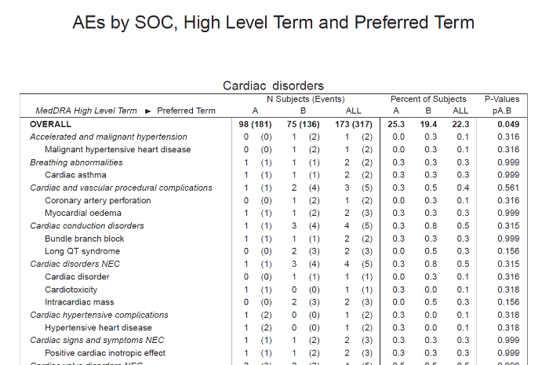
Table by SOC and Preferred Term

Slide 129
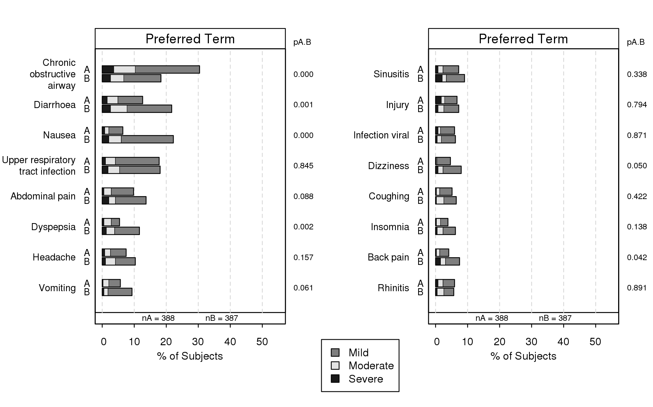
Most Common by Preferred Term

Slide 130
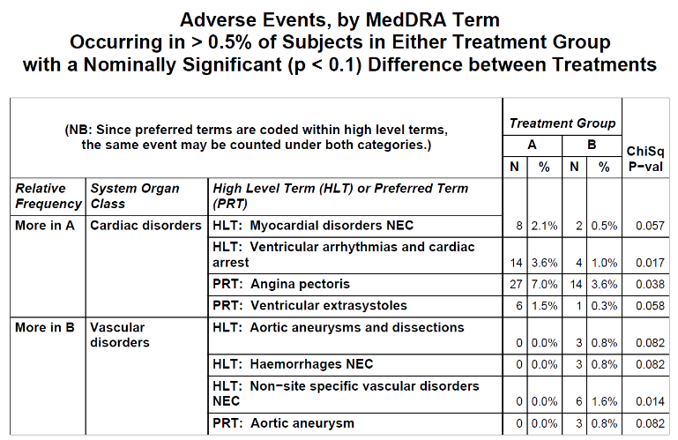
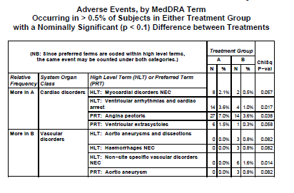
Potential Treatment Difference

Slide 131
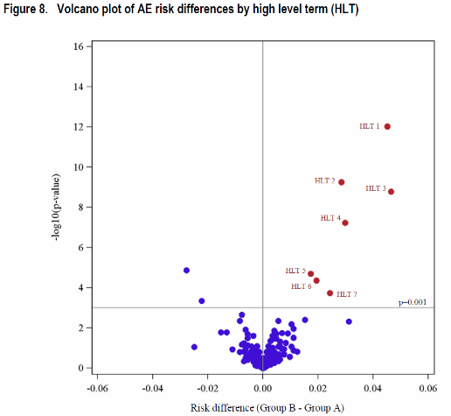
Volcano plot

Slide 132
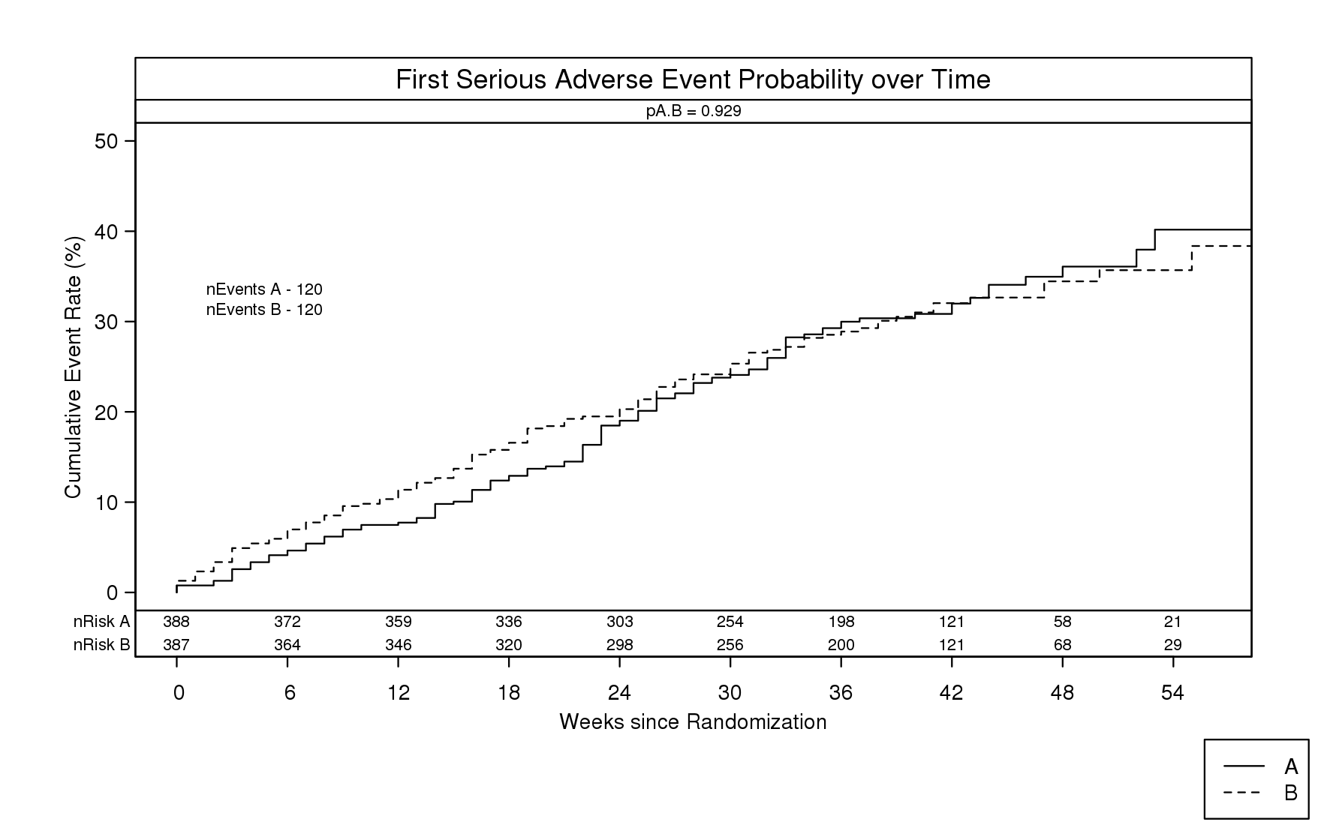
Time to first serious adverse event

Slide 133
Laboratory data
Is the treatment having the anticipated effect on targeted lab parameters? (e.g., lipids)
Are there any safety concerns as reflected in the laboratory data?
If there are treatment-related changes in lab parameters, do the differences persist over time?
Is there any evidence that subjects are experiencing drug-induced liver injury?

Slide 134
Challenges with lab data
Quantity of data
  There may be 50+ different tests performed by the laboratory
  Lab data may be collected/analyzed at many visits
How to present data without overwhelming DMC
  Identify potential abnormalities of interest
    Focus on a subset of tests/timepoints
  Ask the DMC what they care about
  Organize analytes into logical subsets (not alphabetically)
  Present data in a way that makes even large quantities of information easy to review

Slide 135
Abnormal laboratory values
Identifying abnormalities
  Percent of subjects with values above/below key thresholds
    Upper/lower limit of normal (or 3xULN)
    CTCAE lab grades
    Potentially clinically significant thresholds
      3xULN for ALT, AST
      CKD stage (<30)
    Make sure the units are correct!
  Summarizing abnormalities
    By visit
    Based on extreme values during follow-up
    Shift tables as compared to baseline category

Slide 136
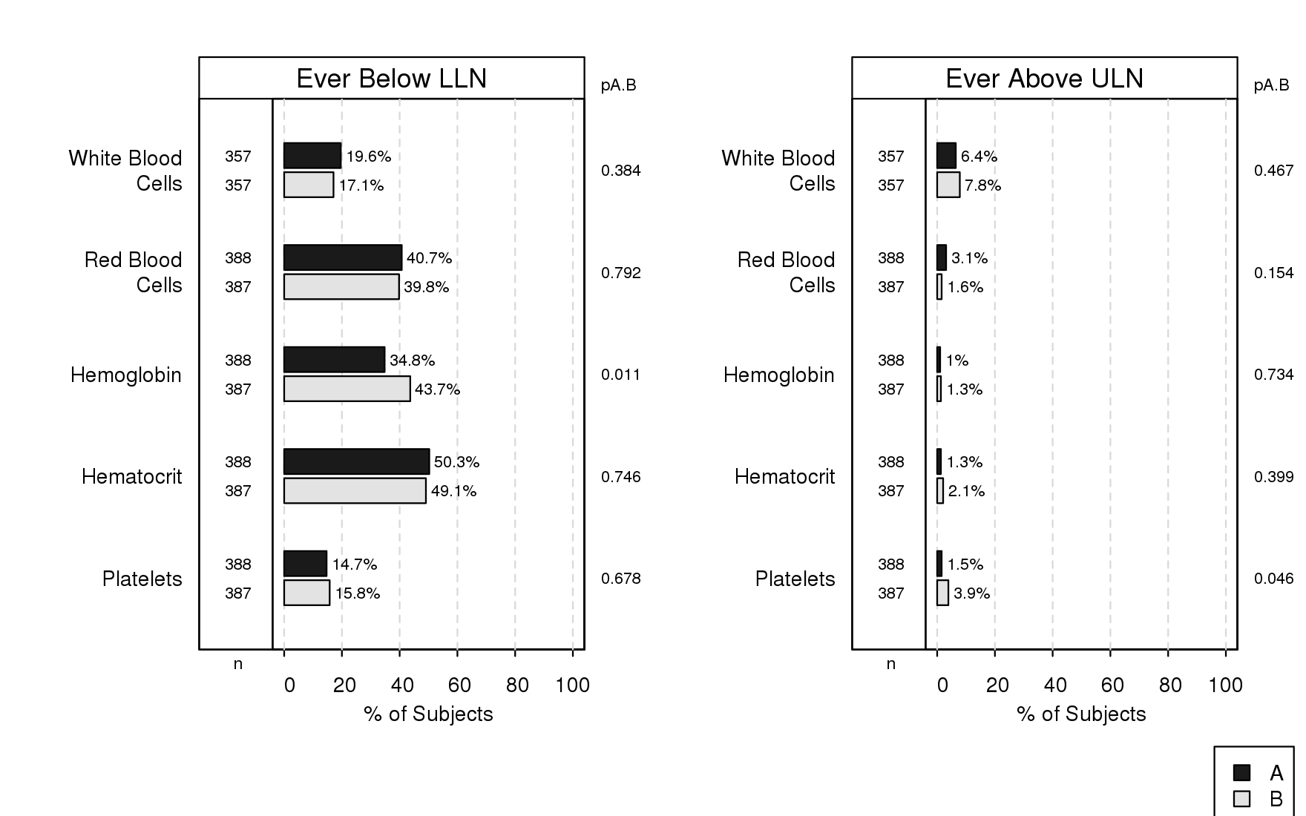
Summary for abnormal hematology

Slide 137
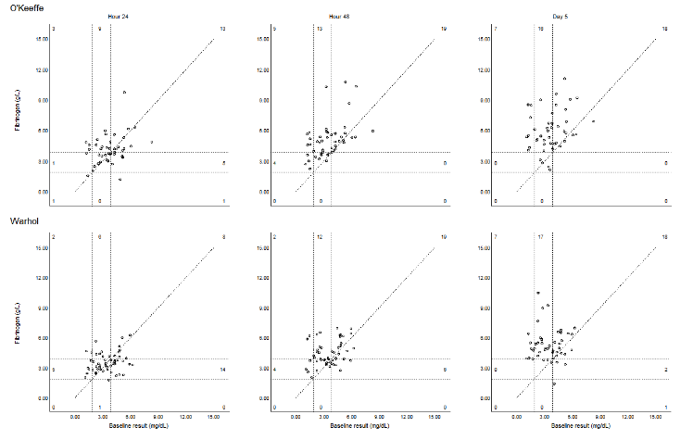
Lab shifts: graphical presentation

Slide 138
Summary page by analyte
Standard graphical lab page by visit
  Box-plots
    Presentation of data over time
    Change from baseline by visit
  Bar charts (simple or stacked)
    Abnormalities (perhaps stacked), both high and low
  Annotations
    Number of observations, (p-values)
  Visually easy to compare treatment groups and see time trends
Once DMC members are familiar with lay-out, can review a lot of data quickly

Slide 139
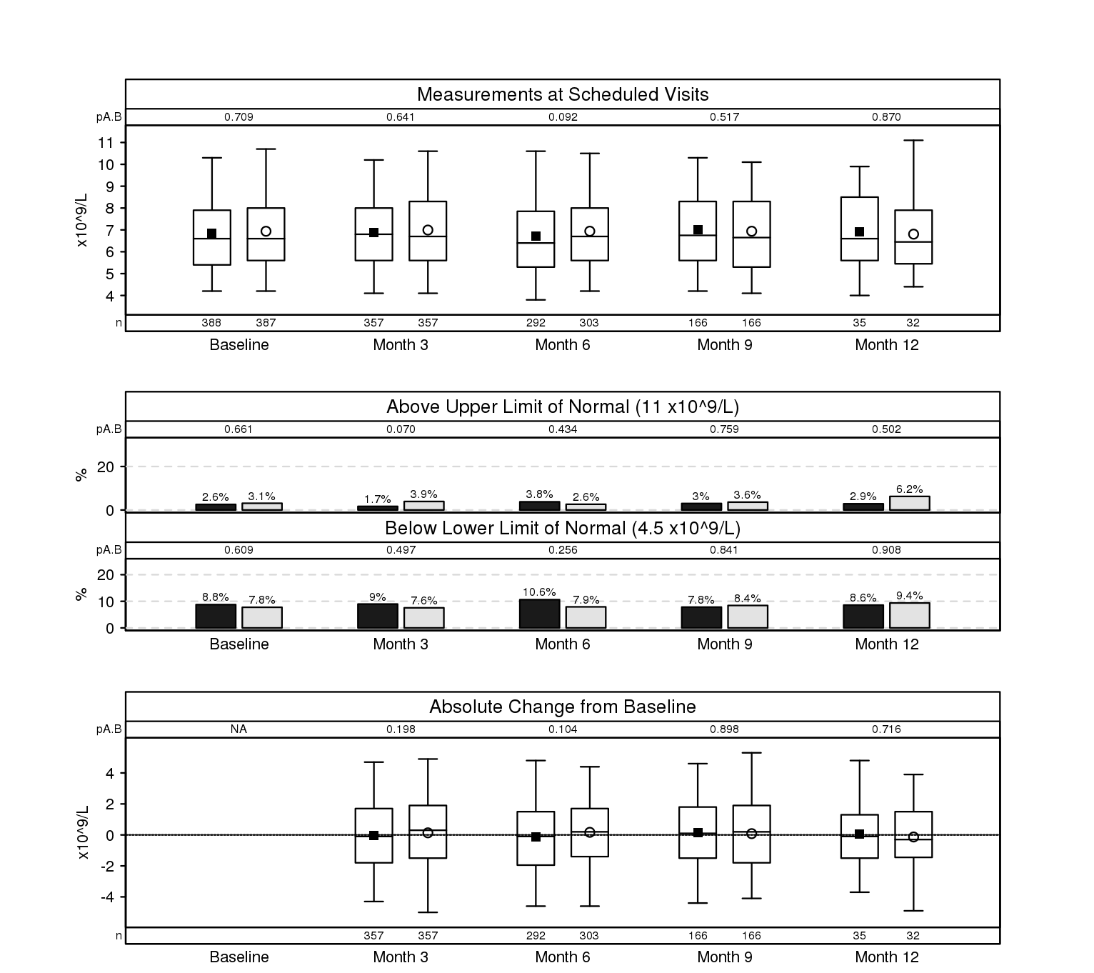
Analyte summary page

Slide 140
Specific subjects
Box-plots show shift in distribution but may mask subjects at extremes (if > 95th percentile)
Extreme cases can be examined in detail with per-subject plots or listings – e.g., subjects with LFTs > 3xULN
  Include information about treatment, dose adjustment, early discontinuation, etc.
  Adverse events, other clinical events
  Multiple lab measures displayed together

Slide 141
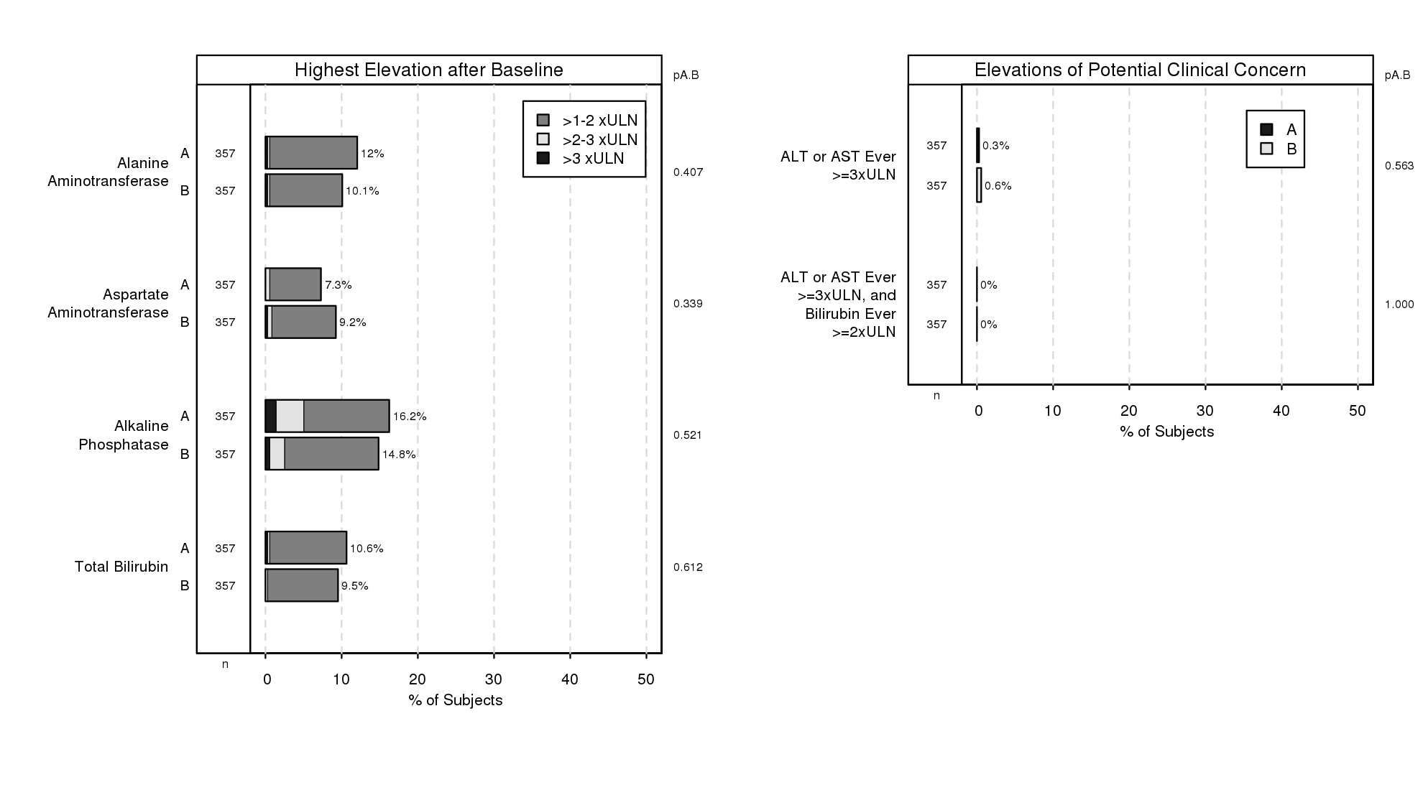
Liver Function Test Summary

Slide 142
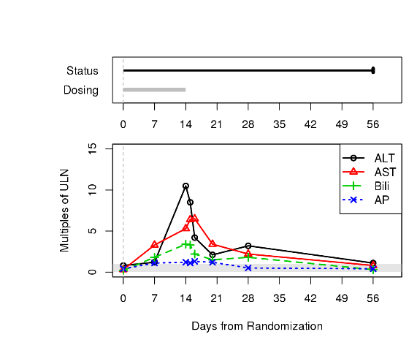
LFT Per-Patient Plot

Slide 143
Efficacy

Slide 144
Stopping for benefit
You will have prespecified guidelines for stopping
If the data meet those guidelines
  And the DMC is comfortable with the safety profile
  And the data are not likely to change
  And there is nothing in the data that is worrisome
  The DMC may recommend early stopping for benefit
The ISRG must produce lots of analyses – kick the tire hard!

Slide 145
What if treatment is MUCH better than expected?
Traditionally, effect size in trials has been less than anticipated
Some recent studies have shown dramatic benefit
  Lucentis in the first Phase 3 trials
    Went to FDA; they said: don’t stop early
  Early Phase 3 trials of nivolumab
    Stopped; FDA approved
  Dapagliflozin for HF in patients with & without T2DM
    Stopped early
    FDA approved

Slide 146
How can you stop a trial for benefit….
When the prespecified boundary has not been crossed?
Answer: very carefully
The data must be truly overwhelming
  We were the ISRG for a drug where the conditional power on null was >99% - DMC stopped; drug was approved
  For dapa, the p-values for diabetes and non-diabetes very tiny
  Nivo, p-value tiny for targeted and non-targeted subgroups
The ISRG must know how to analyze data and kick the tires hard
  Must have an excellent relationship with the DMC

Slide 147
Some horror stories… to keep you up at night
Called in the official agenda “Special (but common) problems”

Slide 148

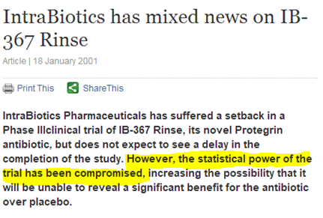

Some that saw the light of day
What's more, the phase 3 program flunked a futility analysis in March 2019, leading Biogen to pull the plug on the studies, but the company about-faced eight months later, saying the analysis was “incorrect.”

Slide 149
Accuracy in reporting
Correctness of treatment assignments
Correctness in presentations of results

Slide 150
Programming the report –who does what?
Reporting statistical group does all
  Pro: Ensures full understanding of data
  Con: Seen as duplicative with little added value
Sponsor provides analysis datasets; ISRG programs presentations
  Pro: Reporting stat can use standard presentation programming
  Con: Less familiarity with data conventions/understanding
“Press the button”
  Pro: Least expensive
  Con: Lowest quality – programming often written for final, clean database; reporting stat is least prepared to respond to DMC requests

Slide 151
A recommended model
Receive raw data and analysis files from sponsor
  May or may not be used as source for DMC reporting
    If not, used to QC ISRG’s dataset programming
    If used, “trust but verify”
  Problem: sponsor analysis files often not available in time for first DMC report

Slide 152
Double programming with sponsor
Make dummy output easy to distinguish from actual output
  Risk accidentally sending real output to sponsor or using dummy output in DMC report
  Label treatments differently
  Make filenames distinct
  ISRG should compare real & dummy versions before sending
Before comparing results with sponsor, try to identify areas of likely disagreement
  e.g., convention for handling partially missing data

Slide 153
Nightmare scenario…
The DMC is about to recommend d/c due to futility
And we’ve been unknowingly using dummy treatment codes
Potentially effective medication appears no better than control
Entire trial – and possibly drug program - compromised

Slide 154
Getting the tx codes
Receive master randomization schedule & merge tx codes using randomization number
Receive kit list & merge tx codes using kit ID
Receive incremental transfer from IVRS vendor with only used assignments
BLOCK | RANDNUM | TRT01P
1 | 10001 | A
1 | 10002 | C
1 | 10003 | B
USUBJID | RANDNUM
201-001 | 10003
201-002 | 10001
201-003 | 10001
KITNUM | TPT01A
90010 | B
90011 | B
90012 | C
90013 | A
90014 | B
USUBJID | VISIT | KITNUM
201-001 | Day 1 | 90010
201-001 | Day 7 | 90014
201-001 | Day 14 | 90011

Slide 155
Checking the tx codes
Redundancy, OCD, and paranoia are good here!
  “even paranoids have enemies” – Delmore Schwartz
Ways to check
  Programmed checks of IVRS file against master schedule
  Programmed checks of agreements between tx merge from rand schedule & kit list
  Manual check against hardcopy of schedule
  Consistency between treatment and…
    PK data
    Known toxicity profile
    Development of anti-drug antibodies
    Unmasked SAE narratives

Slide 156
Audit the randomization
ISRG can audit the randomization’s implementation
  Permuted block: ensure that next consecutive assignment used
  Dynamic algorithm: independently program algorithm to ensure agreement
Peace of mind that correct codes used in DMC reporting
Additional QC of integrity of IVRS vendor’s implementation of randomization

Slide 157
A very scary story
Three arm CV study: control, low dose, high dose (1:1:1)
ISRG and DMC noted illogical results
low and high were same dose for the first six months
but mortality was higher in the low dose than the high dose

Slide 158
The distribution was surprising
Expected | Control | Low | High
2611 | 2599 | 2709 | 2534
Chi-square = 5.99 (p = 0.05)

Slide 159
So we examined the randomization schedule
Block size of 6
90 possible ways to order C/C/L/L/H/H
3300 blocks in master schedule
3300/90 = 36.67 copies expected of each

Slide 160
Results
70
60
p<2.8×10⁻⁷⁴
50
40
36.67 expected
Frequency
30
20
10
0
C
C
C
C
C
C
C
C
C
C
C
C
C
C
C
C
C
C
C
C
C
C
C
C
C
C
C
C
C
C
L
L
L
L
L
L
L
L
L
L
L
L
L
L
L
L
L
L
L
L
L
L
L
L
L
L
L
L
L
L
H
H
H
H
H
H
H
H
H
H
H
H
H
H
H
H
H
H
H
H
H
H
H
H
H
H
H
H
H
H
C
C
C
C
C
C
L
L
L
L
L
L
L
L
L
L
L
L
H
H
H
H
H
H
H
H
H
H
H
H
C
C
C
C
C
C
C
C
C
C
C
C
L
L
L
L
L
L
H
H
H
H
H
H
H
H
H
H
H
H
C
C
C
C
C
C
C
C
C
C
C
C
L
L
L
L
L
L
L
L
L
L
L
L
H
H
H
H
H
H
L
L
L
H
H
H
C
C
C
L
L
L
H
H
H
H
H
H
C
C
C
L
L
L
L
L
L
H
H
H
C
C
C
L
L
L
H
H
H
H
H
H
C
C
C
H
H
H
C
C
C
C
C
C
L
L
L
H
H
H
C
C
C
L
L
L
L
L
L
H
H
H
C
C
C
C
C
C
L
L
L
H
H
H
C
C
C
L
L
L
L
H
H
L
L
H
L
H
H
C
H
H
C
C
L
L
H
H
L
L
H
C
C
L
L
H
H
C
L
L
L
H
H
C
H
H
C
C
L
L
H
H
C
H
H
C
C
H
C
C
L
L
H
H
C
C
H
C
C
L
L
L
H
C
C
L
L
H
H
C
L
L
C
C
L
L
H
H
C
C
H
C
C
L
C
L
L
C
C
L
H
L
H
L
H
L
H
L
H
H
C
H
L
H
C
H
C
L
L
H
L
L
H
C
H
C
L
L
C
L
H
L
H
H
C
H
L
H
C
H
C
L
H
C
H
C
H
C
L
H
C
H
C
L
C
H
C
C
L
C
L
H
L
L
H
C
H
C
L
L
C
L
L
H
C
H
C
L
C
H
C
C
L
C
L
C
L
C
L
C
H
H
L
H
L
L
H
H
L
H
H
C
H
L
H
C
L
C
H
L
L
H
L
H
C
L
C
L
L
C
H
H
L
H
H
C
H
L
H
C
L
C
H
H
C
H
C
C
H
L
H
C
L
C
H
C
C
L
C
C
H
L
L
H
L
H
C
L
C
L
L
C
H
L
H
C
L
C
H
C
C
L
C
C
L
L
C
L
C
C
Block configuration

Slide 161
My takeaway
Check randomization schedule
Most sponsors say – that is a waste

Slide 162
General DMC programming tips
Employ defensive programming
  Set obvious data errors to missing
  Identify new values in data that may not have been present when program originally coded
Request data transfer for internal dry run weeks before actual data
Triage
Validation approaches
  Code review
  Double programming
  Consistency checks btwn presentations
    Report walk-through ~ week before mailing
  Spot checks against datasets

Slide 163
Are the analyses correct?
Risk-based approach
  Demographics ≠ primary endpoint
  Time is limited in DMC reporting
Double programming – do comparisons
  Peer programmers within your organization
  Sponsor using dummy treatment codes
Supplement with code walk-through for high-stake analyses

Slide 164
When an error (or disaster) happens…
Own up to it
  If discovered before meeting, bring update
  If truly minor, just be prepared to address if brought up
But you can’t take it back once the DMC has acted on it
  Check, check, check
  Importance of triaging
  Importance of having many ‘touch’ the data
  Importance of time with data before report

Slide 165
Summary
The ISRG has a crucial role to play straddling Sponsor and DMC
The ISRG team must understand the drug and the disease
  Team members should not be bashful about asking questions
  The DMC chair is your friend!
The Sponsor and DMC both need to trust the ISRG
  More than one person at the ISRG should have access to data
The ISRG must act very carefully…
  It must have access to ALL the data
  Once a trial is stopped, it can’t restart
ISRG, DMC, and Sponsor need mutual trust and flexibility!

