Slide 1
CLINICAL TRIAL DATA MONITORING COMMITTEES: AN INTRODUCTION
Susan S. Ellenberg, Ph.D.
Perelman School of Medicine
University of Pennsylvania
Seattle Summer Institute in Statistics for Clinical and Epidemiological Research
July 27, 2020

Slide 2
PRESENTATION STRUCTURE
Introductions
Lecture Part 1
Purpose of and rationale for DMCs
History of DMCs
Basic principles and operational issues
Overview of statistical methods for interim monitoring
30 minute break
Lecture Part 2
When is a DMC needed and not needed
Rules and Regulations
Ethical issues
Feel free to interrupt at any time with questions or comments; or, enter questions and comments in the Chat box

Slide 3
INTRODUCTIONS

Slide 4
A data monitoring committee is a group of experts that reviews the ongoing conduct of a clinical trial and the emerging data to ensure continuing patient safety as well as the validity and scientific merit of the trial
DEFINITION OF A DMC

Slide 5
INDEPENDENT DMC
An “independent DMC” is one in which no member has any involvement with the trial other than serving on the DMC, and no investment in trial outcome
Most of my references to DMCs mean independent DMCs
DMCs that are not fully independent can be useful for some types of trials

Slide 6
WHY INTERIM MONITORING OF TRIAL DATA?
To identify any safety problem quickly
To identify problems with trial conduct
inadequate accrual
undesirable distribution of baseline characteristics
dropouts, noncompliance, protocol deviations
To evaluate continued feasibility of trial as presently designed
To determine if trial objectives have been met and trial may be terminated early

Slide 7
WHY DATA MONITORING COMMITTEES?
To ensure regular and systematic interim monitoring
To provide an objective assessment of the interim data by scientists with no vested interest in trial outcome
To protect confidentiality of interim treatment comparisons so that trial conduct and interim-decision-making by investigators will be unbiased

Slide 8
AN EARLY CLINICAL TRIAL
University Group Diabetes Project (UGDP): major NIH trial of 1960’s
Objective: reduce cardiovascular complications of diabetes
Several agents compared to placebo
Increased cardiovascular mortality observed early for one agent

Slide 9
INVESTIGATORS’ DILEMMA
Interim results nominally significant (p<0.05)
Investigators appreciated the “multiple looks” problem--this could be a chance finding—but no design in place to account for early stopping
Trial leadership requested assistance from outside experts with no prior involvement in trial to determine appropriate action
Concerned that they could no longer be completely objective

Slide 10
“GREENBERG REPORT”
National Heart Institute (now NHLBI) constituted a committee charged with developing recommendations regarding conduct of clinical trials
Committee chaired by Bernard Greenberg, Chair of Biostatistics at UNC
Report issued in 1967
Report included recommendations on trial monitoring
* Published in 1988 in Controlled Clinical Trials

Slide 11
GREENBERG REPORT ON TRIAL MONITORING
Accumulating data should be subject to frequent analysis, with results available to study leadership
A Policy Board, consisting of experts not otherwise involved in the trial, should be established to make recommendations and adjudicate controversies as trial progresses

Slide 12
THE CONCEPT OF A DATA MONITORING COMMITTEE
Evolved from the Policy Board as recommended in the Greenberg Report
Based on principle that optimal interim decision-making would be fostered if review included experts without involvement in trial
Over time, practice changed to exclude study leadership from access to interim data
Avoided bias in conducting/managing trial
Provided maximally objective interim review

Slide 13
EVOLUTION OF DMC USE: GOVERNMENT TRIALS
DMCs became regularly incorporated into large multicenter cardiology and pulmonary trials sponsored by the National Heart, Lung and Blood Institute
Other NIH Institutes with large multicenter clinical trials programs followed suit
National Eye Institute
National Institute of Allergy and Infectious Diseases
National Cancer Institute was a holdout

Slide 14
NATIONAL CANCER INSTITUTE
NCI supports large clinical trials groups that conducted many multicenter trials
Through the 1970s and 1980s, interim results presented to all investigators twice a year at investigator meetings
Many trials never completed successfully
Emerging positive results made investigators reluctant to have patients randomized
Emerging similarity of outcomes resulted in investigators losing interest in trial

Slide 15
NCI DID COME AROUND
Two of the groups switched to the DMC approach
Study was done comparing rates of trials that failed to accrue desired numbers of patients and did not yield conclusive findings
Results: far fewer “failed” studies in groups that showed interim data to a DMC and not to everyone*
*Green, Fleming, Emerson, Statistics in Medicine, 1987

Slide 16
DMCs IN INDUSTRY TRIALS
DMCs were uncommon in industry trials prior to the mid-1990s
Regulatory concerns about companies making changes in trial design while trial was ongoing helped move industry to use of DMCs
Now most large randomized trials sponsored by industry do have DMCs reviewing the accumulating data as the trial progresses, especially for trials assessing effects on serious outcomes

Slide 17
A NOTE ON TERMINOLOGY
Monitoring groups go by multiple names
Most common
Data Monitoring Committee (DMC)
Data and Safety Monitoring Board (DSMB)
Government-funded trials in the US tend to use DSMB
Industry-funded trials, and most trials outside the US, tend to use DMC
Other terms have been used as well
It doesn’t matter

Slide 18
GENERALLY ACCEPTED PRINCIPLES
DMCs should be multidisciplinary
A charter should describe the operations and procedures of a committee
Independent DMC members should be free of conflicts of interest
Interim data from trials expected to generate definitive data should be considered highly confidential

Slide 19
TYPES OF EXPERTISE REPRESENTED ON DMCs
Clinical medicine (appropriate specialty)
Biostatistics

Slide 20
TYPES OF EXPERTISE REPRESENTED ON DMCs
Clinical medicine (appropriate specialty)
Biostatistics
Biomedical ethics
Basic science/pharmacology
Epidemiology
Clinical trial methodology
Law
Patient advocate/community representative

Slide 21
OTHER ASPECTS OF DMC COMPOSITION
DMC members should have clinical trial experience
DMC Chair should have prior DMC experience
DMC statistician should either have prior DMC experience or experience in reporting to a DMC
Clinical members should be highly knowledgeable about the disease and treatments being studied
If a patient representative is included, that person should be knowledgeable about clinical trials
In global trials, participating regions should be represented

Slide 22
COMMITTEE SIZE
Committees vary widely in size
Minimum: 3 Maximum: ?
Principle: committees should be as small as possible while having necessary expertise
Complex study may require expertise in multiple medical areas; will require a larger committee
Committees that monitor multiple studies (e.g., trial networks) may also need to be larger
Odd number for voting purposes?
Most recommendations come to by consensus (as they should), so not critical
A DMC with an odd number of members will have an even number if one person is absent!

Slide 23
WHO APPOINTS THE DMC?
Typically appointed by sponsor (industry or government), after vetting for conflicts of interest
For some NIH trials, DMC is appointed by principal investigator of trial
For PCORI trials, DMC appointed by trial PI also
For VA trials, DMC appointed by VA analytical group in conjunction with trial PI

Slide 24
DMC CHARTER
Primary DMC responsibilities
DMC membership
Conflict of interest policy
Procedures to ensure confidentiality
Meeting structure and frequency
Process for taking, circulating and finalizing meeting minutes
Statistical monitoring plan summary
Process for issuing recommendations to sponsor

Slide 25
SCOPE OF DMC RESPONSIBILITIES
DMC responsibilities can vary with trial and sponsor
Evaluating accumulating data with regard to efficacy and toxicity
Recommending termination or continuation of study
Recommending other study modifications
Reviewing (and approving?) study protocol
Assessing study conduct
Recommending additional analyses
Reviewing (and approving?) primary study publication

Slide 26
CONFLICTS OF INTEREST
Financial involvement
With product being studied (or competing product)
With manufacturer of product being studied
Patient involvement
Entering/treating patients on study
Evaluating patient outcomes
Intellectual/emotional involvement
Involved in early product development
Strong beliefs about likely effects of product
Closely involved with competing product
Close collaborator of study chair
Regulatory involvement

Slide 27
BASIC PROBLEM
Once you know something, you can’t “un-know” it
Whatever you know can’t help but influence decision-making
Not so much when decision is obvious
A big problem in hand-wringing situations

Slide 28
VESTED INTEREST CAN INFLUENCE DECISIONS
Financial interest: obvious
Other types of interests: less obvious
Example from my own experience
Cancer trial, around 1980
Trial had been ongoing for 7 years
43 patients entered out of target of 120
No new accruals in previous 2 years
41 had died
Trial investigators asked: should we stop and report results?

Slide 30
“ZERO CONFLICTS” USUALLY NOT ATTAINABLE
Experts in a given area are likely to have had some prior involvement with sponsor (or company making a competing product) and/or with lead investigators
Insisting on complete absence of any possible conflict might be too limiting: ignorance is not preferable to independence
Distinguish between major conflicts (exclude) or minor conflicts (disclose)

Slide 31
EXAMPLE
Consider a multicenter trial of a new drug for rheumatoid arthritis
A senior rheumatologist known to be highly knowledgeable will likely have connections with one or more sponsor employees and trial investigators
May have trained some of them
May have collaborated on research projects
May have been departmental colleagues
May have served with them on committees of professional societies, NIH study sections, even FDA advisory committees
Really important not to exclude the best people from DMCs unless the conflict of interest is major

Slide 32
CONFIDENTIALITY OF INTERIM RESULTS
Interim comparative data generally considered highly confidential, because
Knowledge of interim data could affect
patient entry
patient care
patient assessment
sponsor action
When interim data potentially could influence trial conduct, interpretation of results could be muddied

Slide 33
DMC RECOMMENDATIONS
DMC recommends actions to trial sponsor
Final decisions are made by sponsor
Sponsors almost always accept a DMC recommendation
Recommendations based on comparative outcome data will require sharing of such data with sponsor to permit decision-making
In many cases, such recommendations are made to a sponsor representative not directly involved with study, to preserve confidentiality if recommendation is not followed

Slide 34
AN INDEPENDENT DMC IS ONE IN WHICH NO MEMBER HAS
Any basis for preferring the outcome to be in one or the other direction
Any ability to influence the trial conduct in a role other than that of DMC member

Slide 35
WHO IS NOT “INDEPENDENT?”
Representatives of pharmaceutical company sponsor
Anyone involved with carrying out study

Slide 36
WHO IS NOT “INDEPENDENT?”
Representatives of pharmaceutical company sponsor
Anyone involved with carrying out study
Anyone for whom the study outcome has financial implications
Anyone in the investigator’s academic department?
Anyone in the investigator’s institution?
Representative of government funding agency?
Representative of the FDA division with oversight of the treatment under study?

Slide 37
THE INDEPENDENT STATISTICIAN

Slide 38
INDEPENDENT STATISTICIAN
Although long accepted that study investigators should not participate in closed sessions of DMC meetings or view interim data comparisons, exception was traditionally made for study statistician

Slide 39
INDEPENDENT STATISTICIAN
What are the concerns?
Statistician will be only member of study team with knowledge of interim results
May sometimes be difficult to maintain confidentiality (and/or perception of confidentiality) of interim results
Particularly problematic if investigators propose changes to study protocol for which interim results would be informative

Slide 40
EXAMPLE
Partway through an ongoing study, another similar study is reported
Strong results on study 1’s secondary endpoint; no effect on study 1’s primary endpoint
Investigators in study 1 (blinded to interim results) want to consider switching primary and secondary endpoints
Statistician knows interim results—difficult to participate objectively in this decision

Slide 41
CURRENT PRACTICE
Industry has largely adopted practice of using a statistician outside company to perform interim analyses and present to DMC
Practice among government funding agencies is not uniform, although many have moved toward “independent statistician” model

Slide 42
SIMILAR ISSUE FOR DMC
Suppose investigators wish to change some aspect of the study
Primary endpoint
Approach to primary analysis
If knowledge of interim results could influence the desirability of this change, then DMC should not be asked to make any recommendation about the change
DMC will know the potential impact of the change on the final results
Will no longer be able to judge this fully objectively

Slide 43
STOPPING A TRIAL EARLY
Terminating a trial before it reaches its planned closure can be done for several reasons
Efficacy, and positive benefit-to-risk balance, clearly established
Safety concerns that would outweigh any efficacy findings
Highly unlikely that the null hypothesis posed by the trial would be rejected (futility)
External information renders the trial moot
Trial will never meet accrual goals
Basis for considering early termination must be clearly spelled out in Charter, and agreed to by the DMC
Even so, unanticipated challenges can arise
Examples to come

Slide 44
NAÏVE APPROACH TO TRIAL MONITORING
Repeated testing of data to evaluate any emerging differences between arm
Observance of “p<0.05” might lead to early termination of trial
Little attention to statistical concerns about repeated testing increasing risk of false positive error, which were being raised in the statistical literature as early as the 1950s*
*Armitage, “Sequential methods in clinical trials,” AJPH

Slide 45
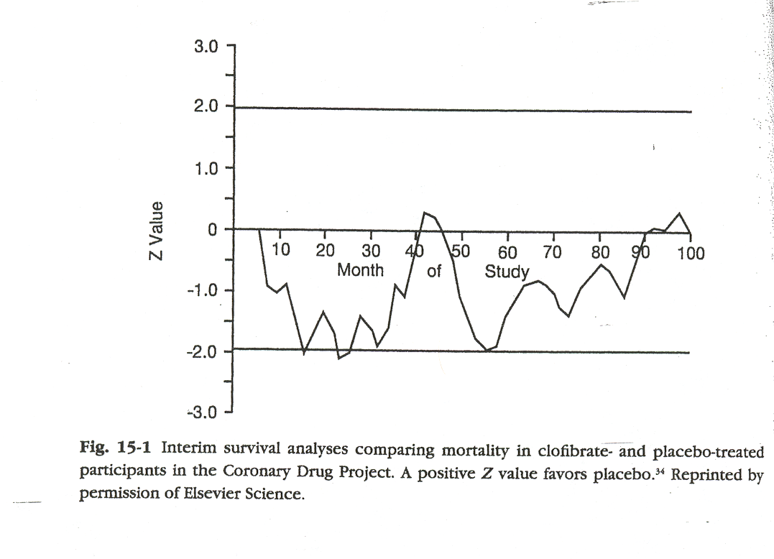
CORONARY DRUG PROJECT: INTERIM ANALYSES

Slide 46
REPEATED TESTING INFLATES TYPE I ERROR
Nominal Probability of false positive
No. of repeated tests
Significance
level (%) 1 2 3 4 5 10 200
__________________________________
1 1 1.8 2.4 2.9 3.3 4.7 12.6
5 5 8.3 10.7 12.6 14.2 19.3 42.4
McPherson K, New England Journal of Medicine; 290:501-2, 1974

Slide 47
STATISTICAL APPROACHES TO INTERIM MONITORING
Continuous testing
Group sequential tests
Triangular tests
Bayesian methods

Slide 48
STATISTICAL APPROACHES TO INTERIM MONITORING
Continuous testing
Group sequential tests
Triangular tests
Bayesian methods

Slide 49
CONTINUOUS TESTING
Initial methods (Armitage, McPherson 1969) based on continuous monitoring of paired data
“Open” procedure
evaluate cumulative data after treatment of every pair (one assigned to each treatment)
continue trial until superiority of one or the other treatment established
Overall pretty efficient—but possible that N could be very large
“Closed” procedure
Truncate plan at some fixed N

Slide 50
DEVELOPMENT OF NEW MONITORING APPROACHES
Simple monitoring at nominal significance level was gradually recognized as inadequate
Continuous monitoring of paired observations not so practical for most applications
Requires rapid evaluation of endpoint
Requires 2 subjects to present themselves at the same time
Burdensome

Slide 51
CONTINUOUS TESTING (2)
Peto and Haybittle (separately) proposed a simple and practical method in the 1970s
Evaluate data at any time; terminate only at extreme significance level (e.g., p<0.001)
Final test can be performed at usual level (0.05) because stringent stopping bound inflates error only minimally
This approach is still commonly used

Slide 52
GROUP SEQUENTIAL TESTING
By mid-1970s, large multicenter trials funded by NIH had oversight committees reviewing accumulating data on regular basis
Statisticians began to develop methods for interim monitoring in the context of regular (rather than continuous) review

Slide 53
GROUP SEQUENTIAL TESTING
Analyses performed at pre-specified intervals
Overall type I error controlled at 0.05 (or other desired value)
Simple concept: do interim tests at lower p-values, calculated to make overall error come out right

Slide 54
GROUP SEQUENTIAL APPROACHES: POCOCK (1977)
First proposed group sequential method
Specify number of interim analyses to be performed
Determine significance level that, when used for each test, results in desired overall significance level (e.g., 0.05)

Slide 55
POCOCK BOUNDS
3 Tests 5 Tests
P-value 0.0221 0.0158

Slide 56
ISSUE WITH POCOCK BOUNDARIES
Statistically valid
Implementation could be problematic
At final analysis, significance level must be much smaller than 0.05 in order to reject null hypothesis at 0.05 level
Very unsatisfying
Pocock developed this approach more as a prototype than an approach to be advocated

Slide 57
GROUP SEQUENTIAL TESTING: O’BRIEN-FLEMING (1979)
Fixed number of tests
P-values vary with time
Early tests performed at very low significance levels
Final test performed at a level close to 0.05

Slide 58
COMPARISON OF BOUNDARIES
3 Tests
POCOCK 0.0221 0.0221 0.0221
H-P 0.001 0.001 0.05
O-F 0.0006 0.0151 0.0472

Slide 59
COMPARISON OF BOUNDARIES
3 Tests
POCOCK 0.0221 0.0221 0.0221
O-F 0.0006 0.0151 0.0472
H-P 0.001 0.001 0.05
--------------------------------------------------------
5 Tests
POCOCK 0.0158 0.0158 0.0158 0.0158 0.0158
O-F 5x10⁻⁶ 0.0013 0.0085 0.0228 0.0417
H-P 0.001 0.001 0.001 0.001 0.05

Slide 60
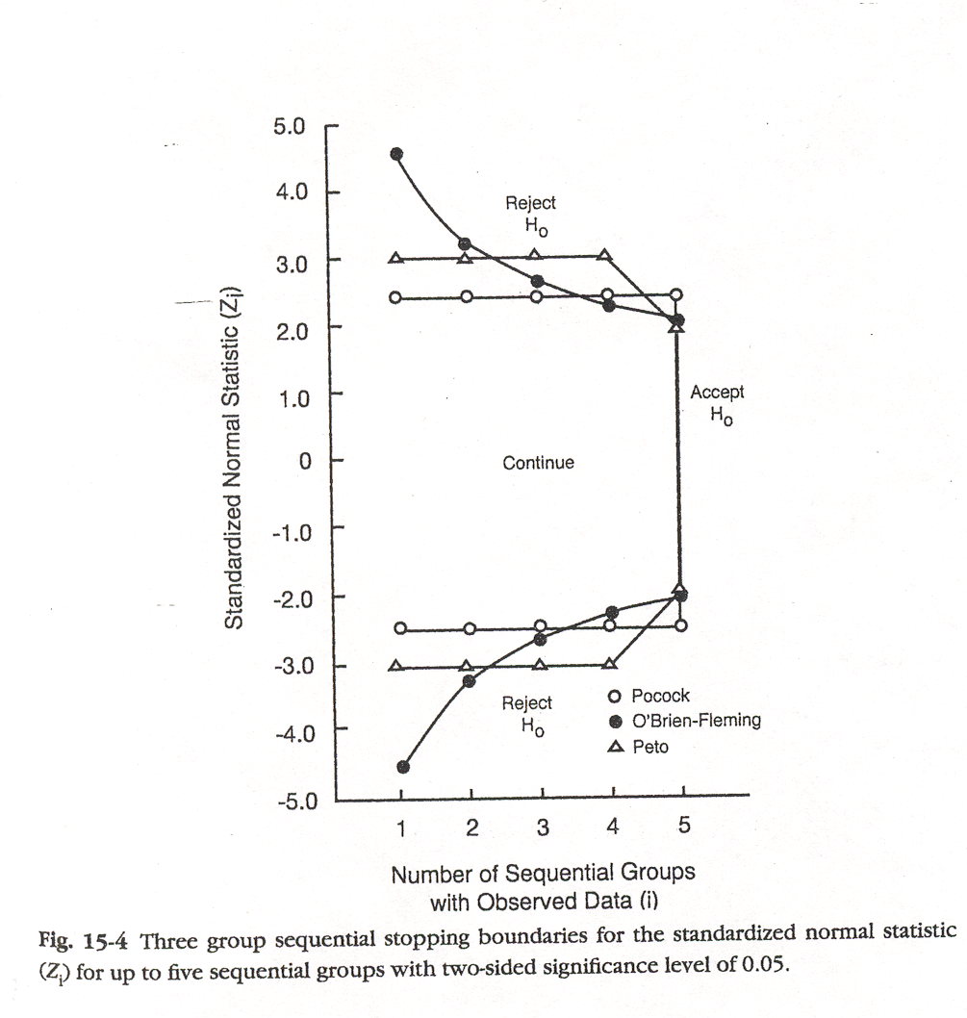

Slide 61
NEW PROBLEM
O’Brien-Fleming calculations based on fixed number of interim analyses
Suppose an unexpected concern arose at one analysis; need to review data again sooner than next specified analysis time—may increase number of interim analyses
Don’t want to inflate false positive risk, but
Safety of trial participants is first priority

Slide 62
GROUP SEQUENTIAL TESTING: LAN-DEMETS (“ALPHA-SPENDING”)
Can “spend” varying proportion of overall alpha at each interim test
Amount to spend depends on proportion of information accumulated
Permits greater flexibility in number/timing of interim analysis, but approach must be pre-specified
Because results from closely spaced interim analyses will be highly correlated, don’t need to pay too big a price for adding an analysis

Slide 63
NOT ALL TRIALS NEED TO PROVIDE EARLY TERMINATION BOUNDARIES
Trials evaluating interventions for symptom relief
Important to have as much information as possible on safety
Trial results can be very variable
Likely that multiple trials will be conducted
Trials comparing interventions in wide use
If opinion is divided about which treatment is preferable, will need substantial amount of data to affect clinical practice

Slide 64
EFFICACY VS. SAFETY
Concern about Type I error generally applies primarily to efficacy question
Definitive proof usually not required to stop a trial for safety concerns
Thus, stopping boundaries are often asymmetric
Asymmetric bounds also allow early stopping when efficacy is unlikely to be demonstrated (futility)

Slide 65
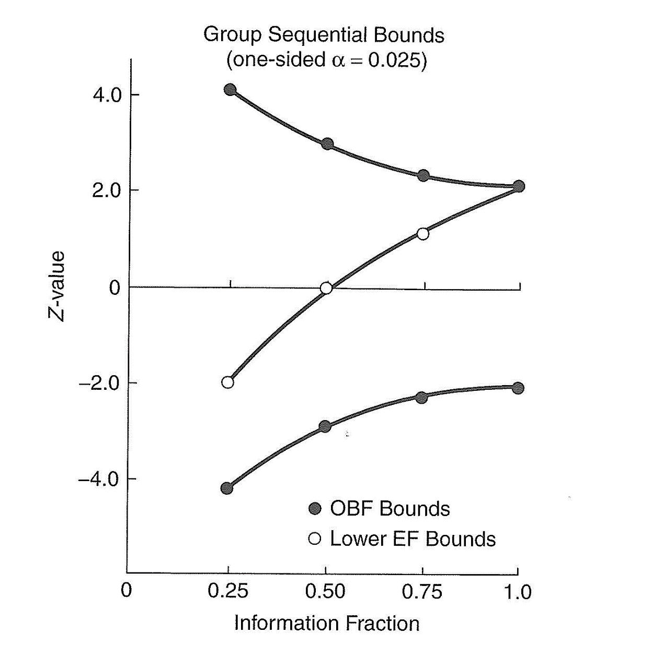

Slide 66
CURTAILED TESTING
Evaluates whether a “foregone conclusion” has been reached, either positive or negative (also called “futility” testing)
Analogy: “clinching” the pennant before the end of the season
No repeated testing issues--can evaluate on any schedule, with any frequency (no chance of Type 1 error)
Only concern is Type 2 error—not giving enough of a chance to see effect
Termination virtually impossible until most of the trial is completed

Slide 67
STOCHASTICALLY CURTAILED TESTING
Stop when “almost sure” results won’t change
Will permit stopping for futility somewhat earlier than using deterministic procedure
Generally used for negative results, concurrently with something like O-F to monitor for benefit
Still generally need at least 40-50% of planned observations in order to maintain low Type II error

Slide 68
EARLY STOPPING FOR FUTILITY
Primary motivations
Conserving resources
Limiting exposure to ineffective (or possibly harmful) treatments
Statistical criteria
Depends on trial circumstances
If prior studies suggested the treatment was effective, would want stronger evidence of futility prior to stopping
If treatment widely used, probably need more evidence of lack of effect to be persuasive

Slide 69
STATISTICAL APPROACHES
Conditional power
Probability that you will end up with a statistically significant finding, under the assumption that the true effect is what was hypothesized originally
If data are showing no benefit halfway through the trial, it will be unlikely that data yet to be accrued will be able to overcome early negative results—even if there truly is an effect

Slide 70
STATISTICAL ISSUES IN FUTILITY MONITORING
No cost in terms of significance level; no possibility of Type 1 error if stop with a declaration of “no difference”
Cost is in Type 2 error: are you giving the treatment a sufficient chance to show benefit
Maybe you had an initial run of unresponsive subjects
Maybe there is a learning curve in regard to administering treatment

Slide 71
NOT ALL TRIALS SHOULD HAVE FUTILITY STOPPING PLANS
Trials evaluating widely used treatment whose value has come under question
Need substantial evidence to change practice
Trials with important secondary objectives that may not yet be sufficiently well addressed
Trials of new treatments to relieve symptoms
Trials of effective treatments often negative
Typically need evidence from a body of trials to support approval

Slide 72
QUESTIONS/ COMMENTS

Slide 73
WHAT TRIALS NEED DMCs?

Slide 74
TRIALS THAT MIGHT BE STOPPED EARLY FOR EFFICACY
Treatment aimed at reducing mortality or morbidity
Ethical requirement to terminate a clearly inferior treatment
DMC needed to assess accumulating data so that sponsor and investigators can remain blinded

Slide 75
TRIALS REQUIRING COMPARISON OF RATES TO ASSESS SAFETY
Palliative treatments in patients at high risk of mortality or major morbidity from existing disease
Supportive care in cancer patients
Treatments to improve cognition in Alzheimer’s patients
Any treatment in elderly populations with reasonably long-term follow-up
Want to be sure that the treatment is not promoting death or other severe events

Slide 76
OTHER TRIALS RAISING SPECIAL SAFETY OR ETHICAL CONCERNS
Novel, potentially dangerous, therapies
Gene therapy
Long-term trials with implications for public health, even with low-risk interventions
Trials of new vaccines
Trials of treatment for common diseases or conditions requiring chronic use
Critical to recognize potential rare safety risks

Slide 77
WHAT TRIALS MAY NOT NEED DMCs?
Single arm trials
Phase 1/Phase 2 trials with no expected unusual safety concerns
Short-term trials of treatments to relieve common symptoms
Trials with no ethically compelling need to stop early for efficacy (and no expectation of serious adverse events)
Full data needed for benefit-to-risk assessment

Slide 78
WHY NOT?
If only one treatment group, accumulating results are known to all—confidentiality not an issue
In a low-risk and short-term randomized study, deaths or other unexpected serious events will be quickly and intensively reviewed by investigator, sponsor, IRB, FDA, etc.
Because such events are unexpected and will be infrequent, can be evaluated case by case, not by comparing rates
Monitoring efficacy generally not required

Slide 79
EXAMPLES
Trials with no ethical need to stop early for efficacy and no concern about imbalance on serious adverse events
Short term trials of treatments to relieve symptoms in otherwise healthy populations
Trials with no ethical need to stop early for efficacy, but imbalance on serious safety outcomes possible
Trial of testosterone treatment in older men

Slide 80
ARE THERE DISADVANTAGES TO HAVING A DMC?
YES!
Increases complexity of trial management
Increases costs
Lose expertise of trial sponsors and investigators
If there is no compelling scientific or ethical need to have an independent group evaluate interim data that are blinded to investigators and sponsor, other (simpler) monitoring approaches are usually acceptable

Slide 81
NIH REQUIREMENTS
Independent DMC/DSMB required for most multisite randomized intervention studies entailing potential risks to participants
Randomized phase 2 trials often excepted
DSMPs (Data and Safety Monitoring Plans) required for all clinical trials

Slide 82
REGULATORY CONSIDERATIONS

Slide 83
REGULATORY STATUS OF DMCs
Only one mention in FDA regulations: required for emergency research studies in which informed consent requirement has been waived (21 CFR § 50.24)
FDA guidance document specifically on DMCs issued March 2006

Slide 84
TOPICS IN FDA GUIDANCE
Determining need for a DMC
DMCs and other oversight committees
Establishment and operation of DMC
DMC responsibilities
DMC Charter
Independence of DMC
Record-keeping
Regulatory reporting

Slide 85
INTERNATIONAL GUIDELINES ON DMCs
European Agency for the Evaluation of Medicinal Products (EMEA), 2006
World Health Organization (WHO), 2005
Council of International Organizations of Medical Science (CIOMS), 2005
All substantially consistent with (but more concise than) FDA guidance

Slide 86
WHAT DATA SHOULD BE PRESENTED TO A DMC?

Slide 87
WHAT DOES THE DMC NEED TO KNOW?
Different DMCs take on different responsibilities, but most DMCs will want to see information on
Accrual rates
Baseline characteristics
Compliance with treatment
Study dropout
Adverse effects (all, and serious/severe)
Efficacy (primary and key secondary endpoints
DMC needs data on quality of study conduct in order to understand reliability of data on safety and efficacy

Slide 88
OTHER POSSIBLE DATA NEEDS
Subgroups of special interest
Site-specific data
Detailed narratives of certain adverse events
Use of concomitant or prior medications

Slide 89
APPROACH TO REPORT PLANNING
Reporting statistician will develop table templates for DMC to consider, prior to availability of any interim data
In studies with an independent statistician, the primary study statistician may take lead in developing templates
Clinical leadership is typically also be involved
Inevitably, once data become available, need for some changes will be perceived
Some listings may also be needed
Detailed information about deaths or other serious adverse events
Detailed information about adverse events of special interest

Slide 90
VERY IMPORTANT
Summaries of ALL data collected will be too voluminous for a report
The reporting statistician must exercise some intelligent judgment about what goes into the report
This means the statistician must
Understand the study
Understand the importance of the data to be presented
Be able to construct a text to accompany tables, plots and listings to direct the DMC members to important issues
Presentation of tables and listings designed by someone else, without interpretive text, is inadequate

Slide 91
EXAMPLE
Unexpected number of a certain type of adverse event is reported
This adverse event known to be associated with another medication that trial subjects could also be taking
Statistician preparing report should recognize that DMC would be interested in knowing how many subjects with the AE in question were taking the other medication in addition to assigned study treatment

Slide 92
EXAMPLE
Rate of primary outcome much lower than expected
Reporting statistician should recognize that one possible reason would be lack of timely reporting
Statistician should review and report distribution of time since most recent status report
Statistician might look to see if sites with greatest reporting lags are those with lowest reported event rates

Slide 93
POOR PRACTICE
Templates of DMC reports prepared by sponsoring organization
Programs to produce these reports are prepared by the sponsoring organization
Data are transferred to the independent statistician, who simply runs the programs and circulates the material produced to the DMC
No consideration given to
Data that don’t look quite right
Identifying findings of particular importance
Questions that the DMC might raise

Slide 94
NEED READILY INTERPRETABLE DATA
Adverse events are coded hierarchically
Broad categories down to highly specific events
If use only very broad categories, or the narrowest categories, may miss important trends

Slide 95
EXAMPLE: GI DISORDERS
Abdominal bloating
Abdominal discomfort
Abdominal distension
Abdominal pain
Abdominal tenderness
Acid reflux (esophageal)
Barrett s esophagus
Black stools
Bleeding gastric ulcer
Bloating
Blood in stool
Colitis
Colonic polyp
Colorectal hyperplastic polyp
Constipation
Constipation aggravated
Constipation chronic
Dental decay
Diarrhea
Dry heaves
Dry mouth
Enteritis
Epigastric pain
Esophageal pain
Esophageal reflux aggravated
External thrombosed hemorrhoids
Fecal impaction
Flatus increased
Food poisoning
GERD
Gas
Gastric dysplasia
Gastric ulcer
Gastritis
Gastritis erosive
Gastroesophageal reflux disease
Heartburn
Hemorrhoids
Hemorrhoids aggravated
Indigestion
Inguinal hernia strangulated
Intestinal obstruction
Left lower quadrant pain
Loose bowel
Mouth dry aggravated
Nausea
Nausea post chemotherapy
Pain right upper quadrant
Pain tongue
Pancreatitis
Queasy
Rectal bleeding
Sores mouth
Stomach pain
Stomach ulcer
Swallowing difficult
Swallowing painful
Tooth ache
Tooth pain
Toothache
Ulcerative colitis
Umbilical hernia
Upset stomach
Vomiting

Slide 96
SAMPLE REPORT
An excellent source for examples of high quality DMC reports can be found in the following location:
https://biostat.wiscweb.wisc.edu/wp-content/uploads/sites/1008/2019/05/Sample_Report_Closed_20160920.pdf

Slide 97
ISSUE: DMC ACCESS TO TREATMENT CODES
Controversy: should DMC see treatment codes only, or actual treatment?
Arguments made in favor of codes
more objective assessments
more protective of confidentiality
Arguments made for actual treatment
safety and efficacy are not symmetric
may be hard to blind without withholding relevant information (e.g., lab tests)
places extra burden on DMC; obstacle to optimal review, assurance of patient safety

Slide 98
MASKED MONITORING IN CLINICAL TRIALS--BLIND STUPIDITY?*
Masked monitoring denies the monitors the key information they need to perform in a competent fashion, and incompetent monitoring poses a risk to research subjects.
*Meinert, New England Journal of Medicine, 1998

Slide 99
CURRENT PRACTICES
Most experienced clinical trialists insist on DMC having unblinded access to interim data
Fundamental issue: don’t make it harder for DMC to ensure safety of trial participants
Common to print reports using codes—protects against inadvertent leaks
In some trials, the de-coding is sent to each DMC member, permitting review with knowledge of actual treatment arm
In other trials, de-coding is sent to Chair only so that de-coding can only be done at meeting, if all agree
Some trials do not permit de-coding at all
Feelings run strong on both sides of issue
Currently, most trials, both industry and NIH, provide unblinded reports to DMCs

Slide 100
FDA PERSPECTIVE
FDA guidance specifically recommends that DMCs have access to fully unblinded data
Despite this, many companies (and some NIH program officers) seem to prefer to keep DMC blinded to actual treatment
Consensus among experienced DMC members: should have access to unblinded data

Slide 101
“SAFETY ONLY” REVIEW

Slide 102
DMC CHARGE: REVIEW SAFETY
In many cases, DMC is charged to review safety only, with no access to efficacy data, with the following rationale:
No intent to stop early for efficacy
Concern that DMC access to efficacy data will result in an FDA-imposed penalty for interim looks
Desire to maintain as much blinding of interim results as possible
This can present a real problem in some circumstances

Slide 103
PROBLEM WITH REVIEW OF SAFETY ONLY
Investigational drug may be more toxic than control
Emerging toxicity may be acceptable if there is also emerging efficacy
DMC will be unable to make risk/benefit judgments if it sees only risks
Lack of efficacy data hampers DMC’s responsibility to protect study subjects

Slide 104
ONGOING CONTROVERSY: WHEN SHOULD TRIALS BE STOPPED EARLY?

Slide 105
PRELIMINARY COMMENT
Recommending early termination is the most extreme action a DMC can take
Relatively rare occurrence but when possibility emerges, very challenging for DMC

Slide 106
PERSPECTIVES ON MONITORING
Perspective 1: DMC’s primary responsibility is to patients enrolled (or to be enrolled) in trial
Implication: stop trial early if further results are unlikely to change conclusion based on interim data

Slide 107
PERSPECTIVES ON MONITORING
Perspective 2: DMC’s primary responsibility is to entire “patient horizon” (all future patients)
Implication: stop trial early only if results are sufficiently strong to lead to changes in medical practice

Slide 108
BALANCING CURRENT VS FUTURE PATIENTS
If trials are stopped too early, they may not be sufficiently persuasive, so may fail to accomplish purpose; is it ethical to enter patients in such a trial?
Is it ethical to continue to randomize to a trial long after a difference has been clearly established?

Slide 109
LONG-DEBATED CASE
International Study of Infarct Survival (ISIS)-2: evaluation of intravenous streptokinase and oral aspirin for treatment of acute MI
Enrolled 17,187 patients in late 1980’s
At study conclusion, both treatments showed significant benefit on mortality at extreme levels: p<0.00001
Nearly 2000 deaths observed
Should this trial have been stopped earlier?
Investigators argued that extremely strong data were needed to persuade physicians to use these drugs

Slide 110
DMCs AND EARLY TERMINATION
Approach to early termination considerations will not be the same in all trials
Issues for a study like the Women’s Health Initiative, evaluating a widely used treatment believed to be beneficial, are very different from those in a study of an investigational product
Critical for DMC, investigators and sponsor to be in agreement about early termination criteria
Sponsor may need to clarify regulatory expectations to DMC members
Sometimes issues are primarily ethical and can lead to DMC handwringing

Slide 111
TREATMENT OF HIV INFECTION IN NEWBORNS
NIH sponsored a study comparing treatment strategies for HIV-infected infants being treated in South Africa
Trial questions: when to start antiretroviral therapy, and how long to treat
Primary endpoint: death or failure of therapy (based on CD4 levels, clinical outcomes or treatment toxicity)
Lead investigators
Clinician: South African physician
Statistician: British (London)

Slide 112
STANDARDS OF CARE
National standard in Africa at that time was to delay treatment until clinical symptoms appeared or immune system became highly depressed
Modifying guideline to begin treatment earlier would have huge economic implications
Extremely strong findings would be required to persuade national authorities to revise guidelines because of drug costs

Slide 113
STANDARD OF CARE
DSMB included members from US, Europe, Africa
In US, guidelines at that time (2005) recommended treatment for all infected infants with symptoms or depressed CD4 counts, and recommended that treatment be considered for all others
Emerging view that all HIV-infected infants should receive treatment, regardless of symptoms or immunological/viral parameters

Slide 114
EARLY STOPPING PLAN
The study protocol specified a stringent Haybittle-Peto early stopping plan to the DSMB
Require a treatment effect significant at the 0.001 level at any interim analysis
Presentation of pooled mortality data only at reviews when formal interim analysis not scheduled
DSMB was not fully comfortable with this plan
Acknowledged need for more data to have impact on national treatment policies
Shared emerging concerns about leaving HIV-infants untreated

Slide 115
POSSIBLE ALTERNATIVE PLAN
In US, most traditional approach to early stopping is the O’Brien-Fleming design
Difficult to stop very early, but easier as more data accumulate
At any point after the first or second look, would be more permissive of early stopping
Study team argued that the more conservative stopping plan was essential
Very important to “get it right”
Strongest possible evidence would be needed to support changing guidelines

Slide 117
TRIAL INITIATED
DSMB did not insist on any change in proposed design
Accepted Haybittle-Peto monitoring plan (with some reluctance), recognizing that if results showed need for immediate treatment, they would have to be very strong to lead to change in practice
Within first year of study, and several months prior to first planned analysis, DSMB was alerted that there had been 3 deaths among children with delayed treatment, none among those starting treatment right away

Slide 118
THIRD REVIEW: ONE YEAR LATER
The 0.001 level was not yet reached for the protocol-specified primary outcomes: mortality/treatment failure in each immediate treatment arm compared to deferred treatment arm
Deferred vs 40 weeks: p=0.008
Deferred vs 92 weeks: p=0.01
Comparison of the untreated arm with the two immediate treatment arms combined (not a pre-specified analysis) yielded p<0.001

Slide 119
DSMB RECOMMENDATION
Pre-specified stopping boundary not crossed
Nevertheless, considering these data and other data available at the time, DSMB was not comfortable continuing untreated arm and recommended termination
Recommendation accepted by study team and by NIAID
Treatment guidelines changed worldwide

Slide 120
ARGUABLE POINTS
Should the DSMB have been more insistent on a less stringent stopping guideline at the beginning?
Is consideration of practical issues such as funding justified in considering early trial termination?
Was it appropriate for the DSMB to use its judgment to recommend stopping based on an outcome that was not pre-specified?

Slide 121
FINAL COMMENTS
Data Monitoring Committees are important components of many clinical trials
There is a fair amount of consensus regarding optimal operational procedures
Unexpected findings during ongoing trials can present major challenges
Need for knowledgeable and experienced people to serve on DMCs
Judgments made in difficult cases will inevitably be second-guessed

